Slide 1










Collaboration Opportunities with Scientific Professional Societies
JUNE 2015
NETWORK-WIDE MEETING
NISENET.ORG
Notes:
Society of Hispanic Professional Engineers
Many of these are Diversity Serving Professional Societies

Slide 2
Collaboration Opportunities with Scientific Professional Societies
Lizzie Hager-Barnard and Darrell Porcello, Lawrence Hall of Science
Darcy Gentleman, American Chemical Society (ACS)
Richard Souza, Materials Research Society
JUNE 2015
NETWORK-WIDE MEETING
NISENET.ORG

Slide 3
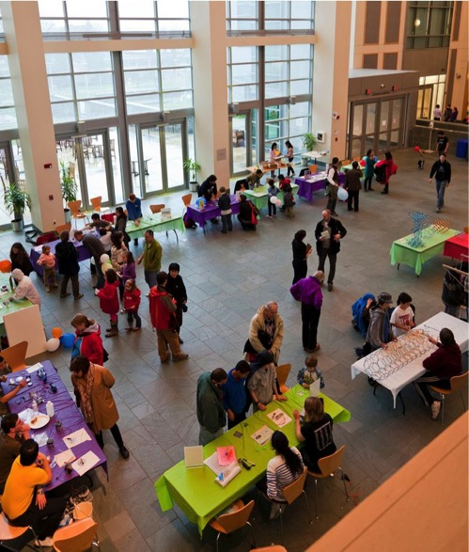


Why Collaborate with a Scientific Society?
Your visitors want to meet scientists
You need more volunteers
You’d like to learn about new research

Slide 4

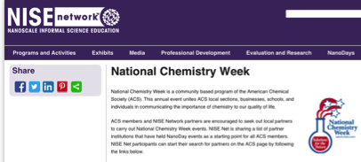
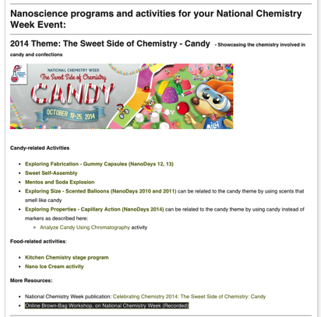
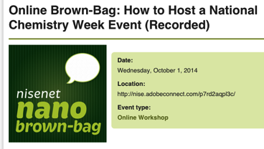
American Chemical Society
Cross-listed and cross-promoted resources

Slide 5

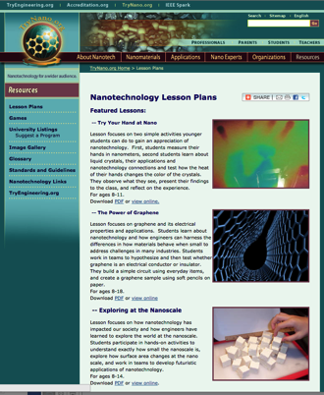
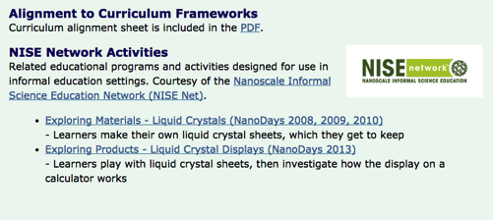
IEEE
Cross-listed and cross-promoted resources
TryNano.org

Slide 6
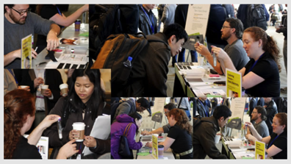
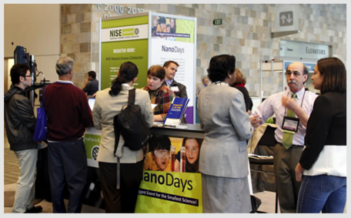
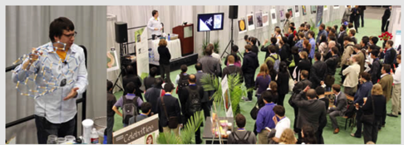
Materials Research Society (MRS)
http://www.mrs.org/meeting-scene-archives-2012/

Slide 7

Resources
Engaging the Public in Nano Key Concepts
Science Café Guide
Online Brown-Bag: Nano 101: How to Introduce the Smallest Science

