Slide 1
NanoMedicine - A View from the Trenches
Mauro Ferrari, Ph.D.
Ernest Cockrell Jr Presidential Distinguished Chair
President and CEO, Houston Methodist Research Institute
Director, Institute for Academic Medicine
Executive Vice President, Houston Methodist Hospital
Senior Associate Dean and Professor of Medicine
Weill Cornell Medical College, New York
NISENetwork Meeting, June 2015, MN

Slide 2
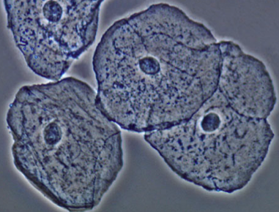
Frontier of Nanomedicine and Nanotechnology:
Integrating “nanos” into “smart micros”
This is how biology obtains truly superior “emerging properties”
Biological cells are “smart microbags” that integrate the functions of nanoscale components (proteins, nucleic acids…)
We are using this design to try to control the drug concentration in a patient’s body
http://www.microscopyu.com/galleries/dicphasecontrast/images/cheekcellspc.jpg

Slide 3
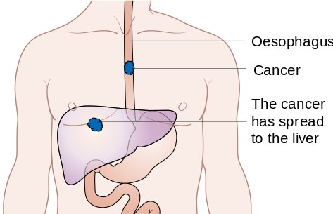
Background: Why is this needed?
Most cancer deaths and morbidity are caused by metastases (lungs, liver, brain, bones)
Cure rates for metastatic cancer have essentially not improved – remain about 0 though survival has increased somewhat
We have very effective drugs, we just can’t get them to go preferentially to the cancer, and that is why they cause adverse side effects
http://en.wikipedia.org/wiki/Esophageal_cancer

Slide 4
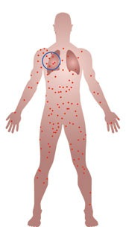
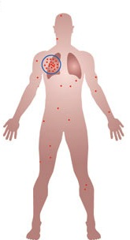
Solution strategies
Biological targeting of drugs and their carriers by molecular recognition
Developing drug carriers (nanoparticles) that can cross the biological barriers that protect the cancers
Combinations of the above
Additional problem: targeted drugs and nanoparticles have greater difficulty crossing biological barriers
http://www.nature.com/nnano/journal/v7/n8/fig_tab/nnano.2012.132_F1.html

Slide 5
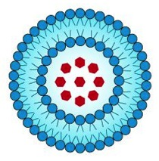
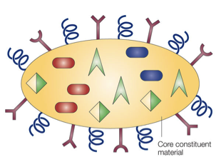
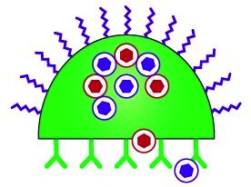
Current Nanomedicines
Liposomes
Abraxane
Colloids
Iron Oxide
First Generation: Passive targeting, in clinic (10% of mkt)
Second Generation: Biomolecular targeting, in pipeline
Third Generation: Higher functions, combinatorial nanotech, sequential actions, biobarrier focus
Dendrimers
Nanoshells
Nanocells Nanoshuttles
MultiStage Systems

Slide 6
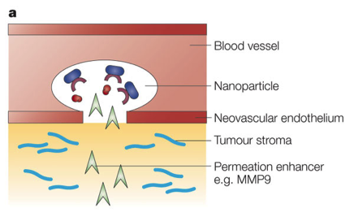
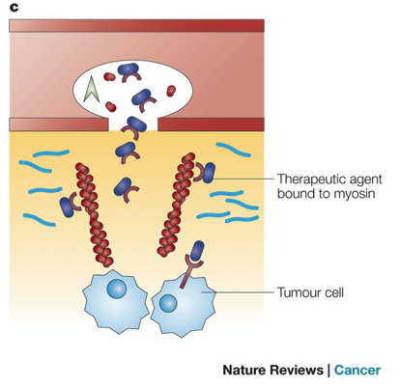
Cancer Biobarriers
Endothelial barriers
Tumor-Associated Osmotic Pressure
And many others!

Slide 7
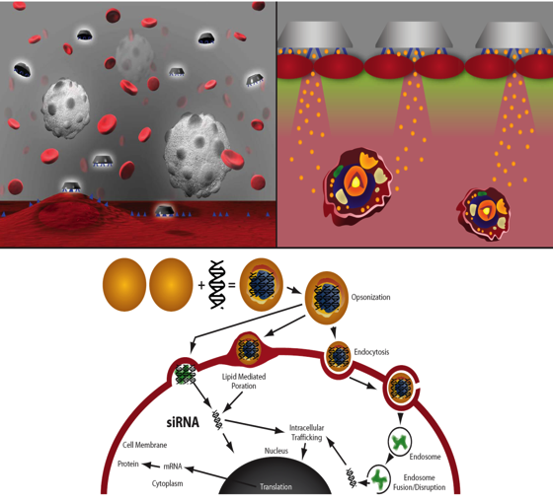
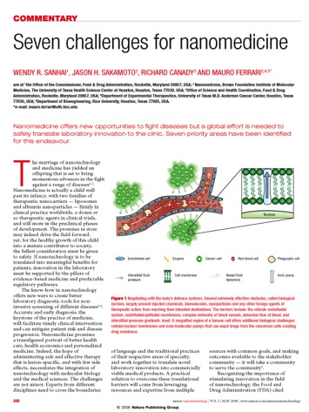
Nano-in-Micro Multi-Stage Vectors

Slide 8
Multi-Stage Vectors Design

Slide 9
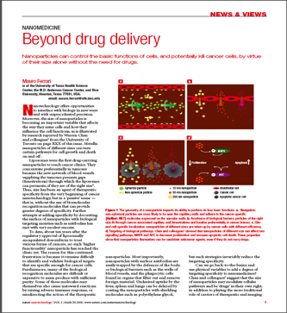
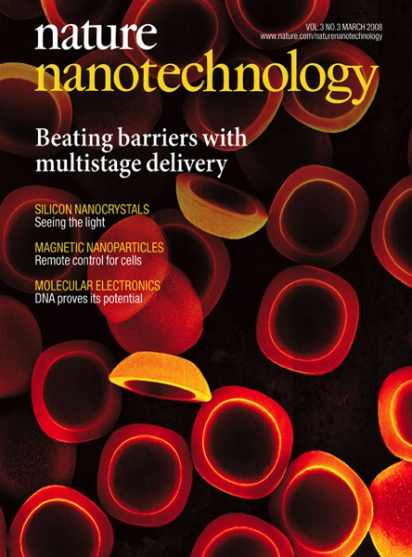
The Debut of MultiStage (Nature Nanotech 2008)
Back Side
Front Side
Cross Section
200 nm
1 µm
1 µm
1 m
200 nm
Pores
Nucleation Layer
Cross Section
20 nm
20 nm
20 nm

Slide 10
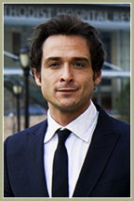
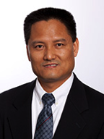
Two examples of MSV
An MSV “cloaked” by a biological cell membrane for increased biological barrier penetration (with Ennio Tasciotti)
MSV-pDox: A nanoparticle generator for the therapy of otherwise incurable lungs metastases from breast cancer (with Haifa Shen)

Slide 11
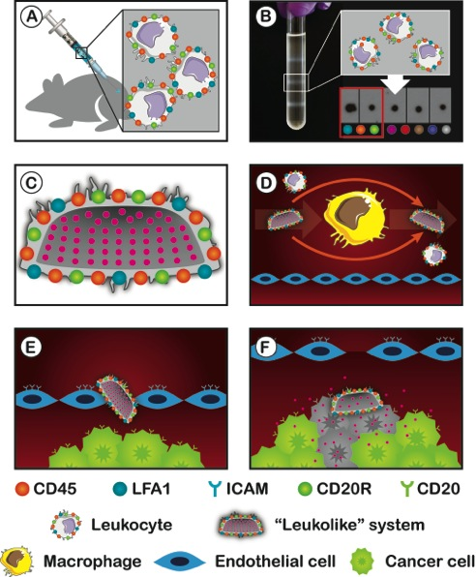
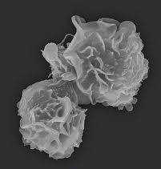
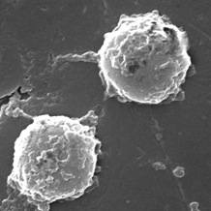
“Leukolike” MSVs (Nature Nano January 2013)
Increased circulation time
Prevention of RES uptake
Decreased immune response
Prevention of NP release
Accumulation at tumor site
Leukocyte
Leukolike

Slide 12
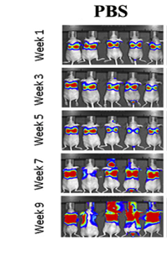
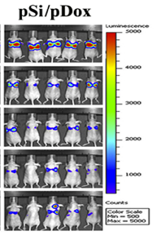
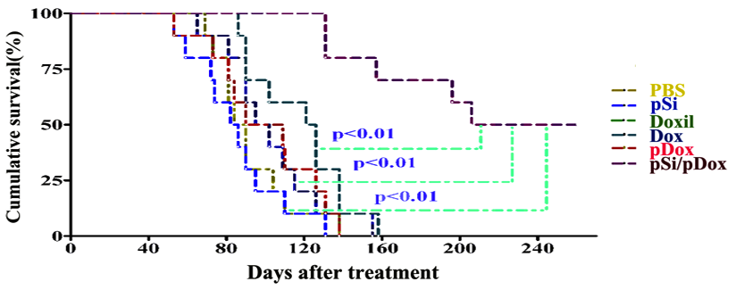
MSV pDox Treatment - cGMP
Metastatic MDA-MB-231tumor (Haifa Shen)
Survival rates
 | 120 days | 200 days
Control | ~10% | 0%
pSi/pDox | 100% | ~60%

Slide 13
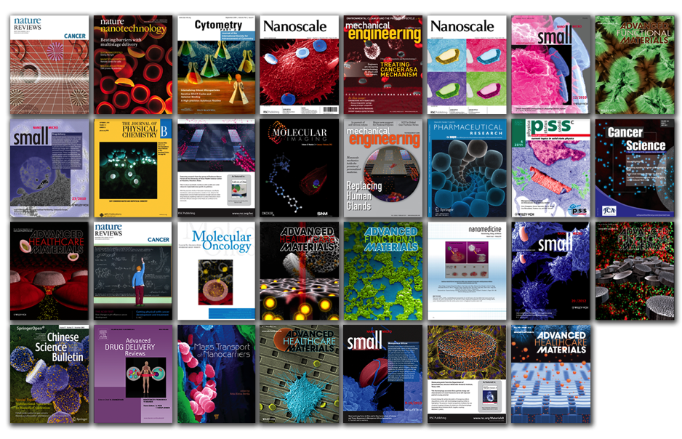
Multidisciplinary !!!!!

Slide 14
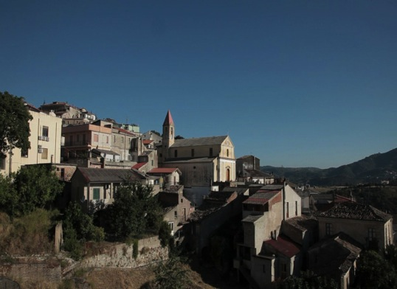
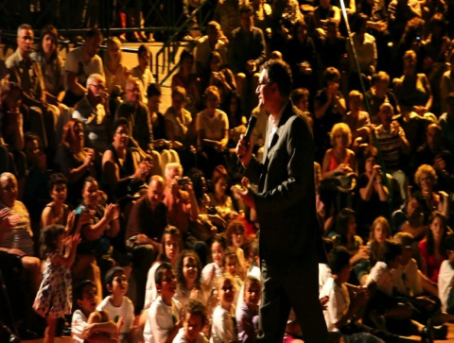
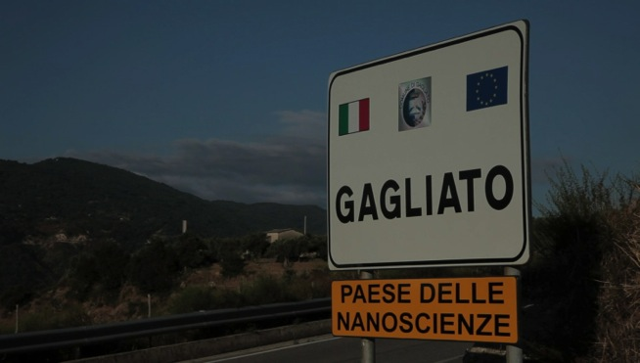

Slide 15
Thanks!
mferrari@tmhs.org

