Slide 1
Nanomaterials:
The Best Weapon in the War Against Corrosion
Emily M. Hunt, Ph.D.
West Texas A&M University

Slide 2

Notes:
There’s a war happening, and you’ve probably never thought about. It is good vs. evil, but it’s not against a super villain—it’s against corrosion.

Slide 3

Notes:
What’s corrosion? Corrosion is the slow destruction of a material, and it’s usually due to a chemical reaction.
This may not sound important, but if you don’t like crumbling bridges, leaky pipelines, and dirty water, this war is important to you.
Winning this war won’t be easy, and not even Batman can save us. But there is a hero in this story, and I’m here to convince you that the hero is anti-corrosive nanomaterials.

Slide 4
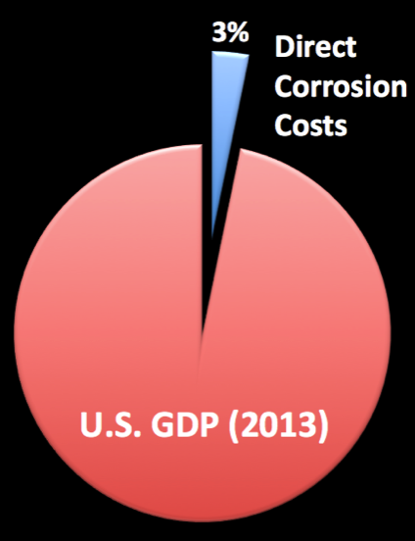
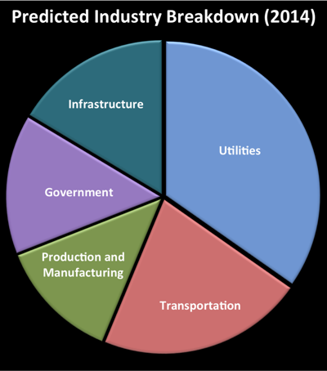
Sources: Corrosion Costs and Preventative Strategies in the United States, 2002 and http://www.g2mtlabs.com/corrosion/cost-of-corrosion/
Notes:
This war has already cost us all dearly. We may not know it, we may not see it, but we have felt it financially. We pay for the casualties of this war every day. From taxes to a tank of gas, these costs are passed on to you and me.
Corrosion is all around us and is costing us dearly. The cost of corrosion in the US was estimated at $276 billion ANNUALLY in 1998 and rose to over $1 trillion in the middle of 2013. Corrosion affects our society on a daily basis, causing damage to household appliances, automobiles, airplanes, bridges, energy production and distribution systems, clean water systems, pipelines, and much more. Corrosion is one of the largest single expenses in the US economy.
Are you convinced that we are at war yet? Are you seeing how much this war is costing us annually? The costs associated with this naturally occurring phenomenon and the damage it causes are substantial and are passed directly to you and me. The estimated cost in 2013 was $2000 per person per year. With five kiddos in my household, that is a hefty bill for my family!
[Note from Lizzie: We liked the photo of your family, but your kids are so cute that it was kind of distracting!]

Slide 5
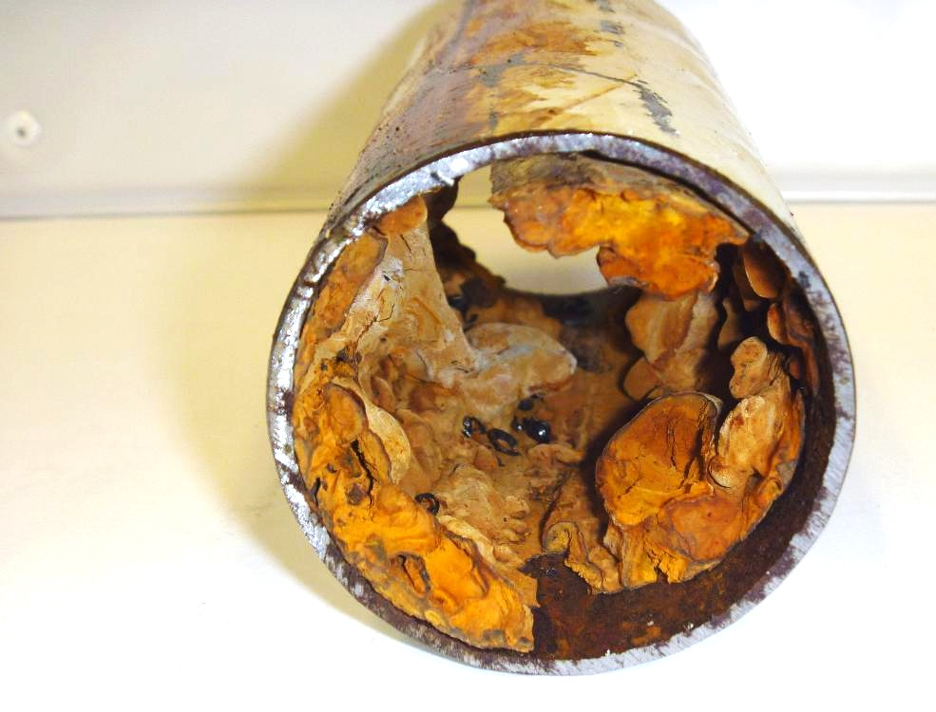
Notes:
You might think this war is new, but it’s not!
The war has been going on for thousands of years and the enemy is unseen to the naked eye. For centuries, mankind has stood by and accepted these attacks as “just a part of life.”
We’ve stood by as this enemy destroys our fire sprinkler systems, our bridges, our pipelines, and our ships.
[Photo caption: Damage in a fire sprinkler system pipe caused by MIC]

Slide 6
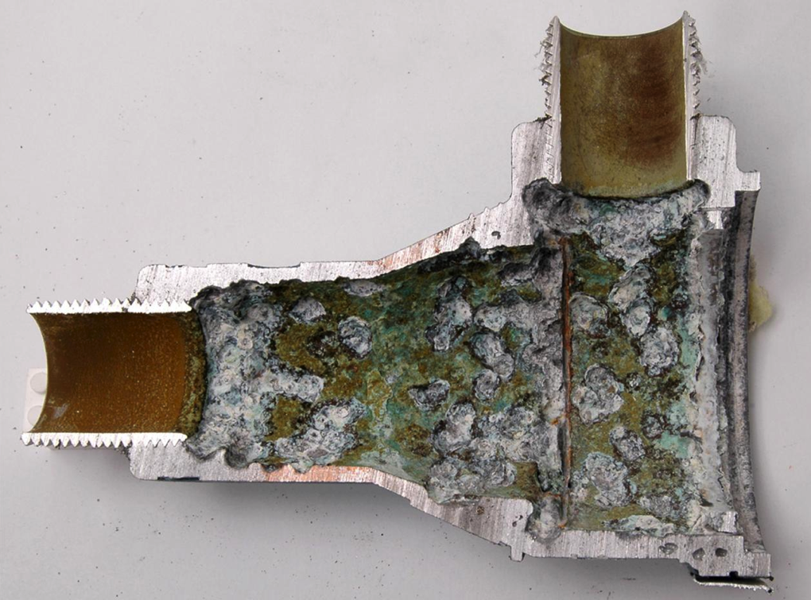
Notes:
But enough is enough! Our enemy impacts our way of life every single day, and so it must be stopped. And finally we have the technology to win this war.
[Photo caption: Failure analysis of a valve due to MIC (microbial influenced corrosion)]

Slide 7
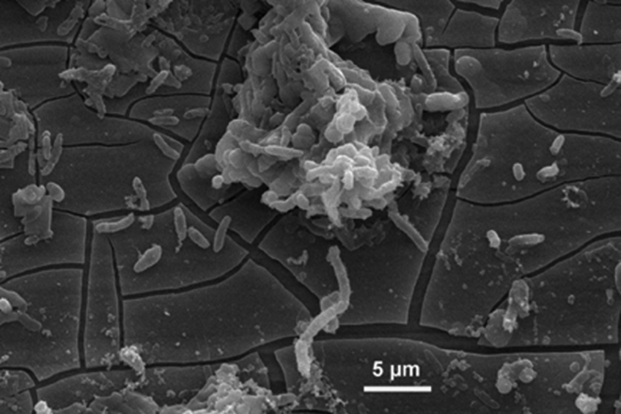
http://www.corrodys.com/laboratoire-corrosion-biocorrosion/equipement/corrosion-microbiologie/
Notes:
In any war, you first have to understand your enemy. And in this case one of our main enemies is Microbiologically Induced Corrosion (or MIC or microbial corrosion). An estimated 40% of all internal pipeline corrosion and 65% of the corrosion in the shipping industry can be attributed to microbial corrosion.
MIC is the deterioration of a metal due to the growth of microbes on the surface. These microbes eat away at the metal and ultimately cause structural failure.
[Do you have a higher-resolution photo you could use?]

Slide 8
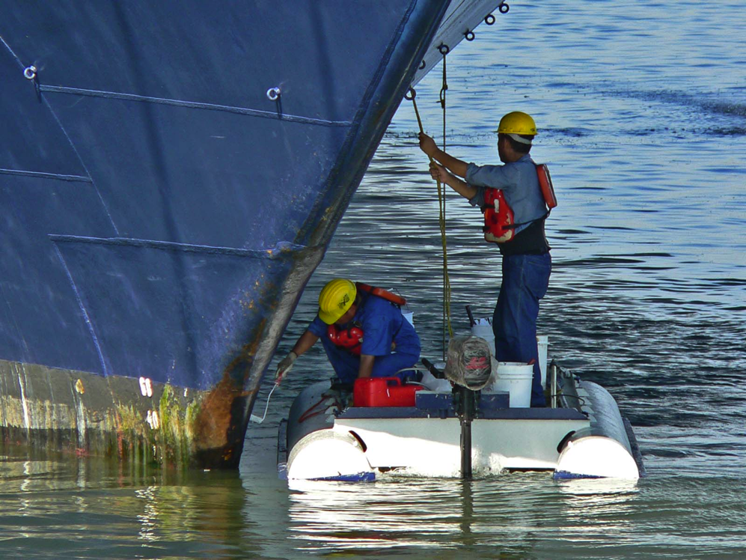
Notes:
We waste so much time and money fighting this enemy. So how are we going to fight this war? How can we get to a world where we are not just cleaning up and repairing our enemy’s destruction, but actually preventing it?
I have found a way and I am making this world a reality. My team and I have discovered and developed a way to fight back! What is our newest weapon?

Slide 9
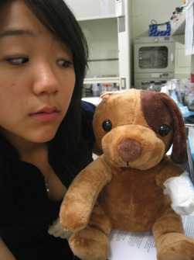
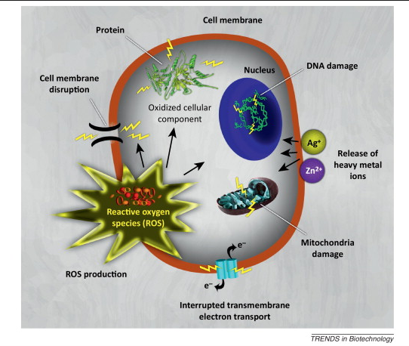
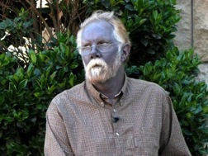
Notes:
Nanotechnology.
For thousands of years, materials scientists have been limited in the fight against corrosion by the availability of metals, techniques, and coatings. And we have given it a good fight!
Now, though, we have the ability to build a material from the ground up—to engineer a material for a specific application, in this case, corrosion-fighting, using thermal, physical, and biological properties found only at the nano scale.
Nanomaterials have a natural protective mechanism that can fight and destroy the bacteria that causes corrosion.

Slide 10
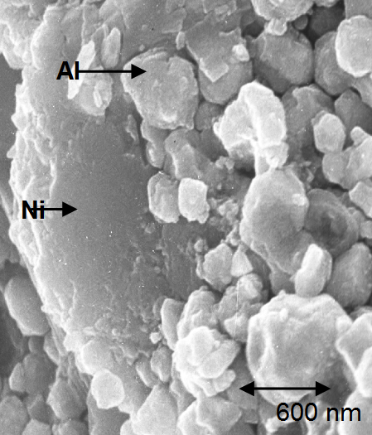
Notes:
We start with particles at the nanoscale and then combine them to form a new alloy. This nano alloy is then used to create a material or coating that is strong, resistant to chemicals and high temperatures, and most importantly, can fight bacteria.

Slide 11
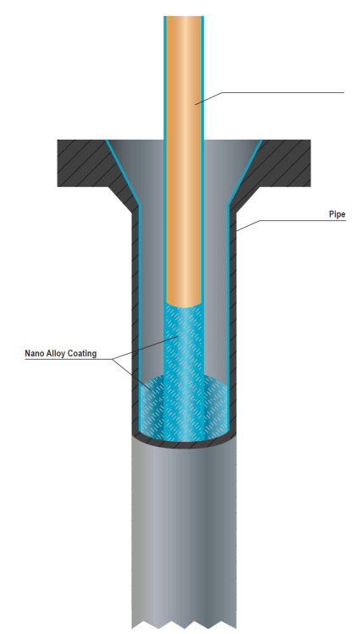
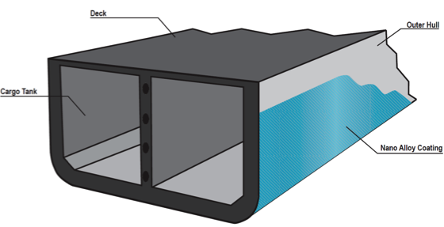
Notes:
We have applied this new nano-scale alloy to internal pipelines for use in the oil field and to ship ballasts to prevent a biofilm build-up in shipping.

Slide 12
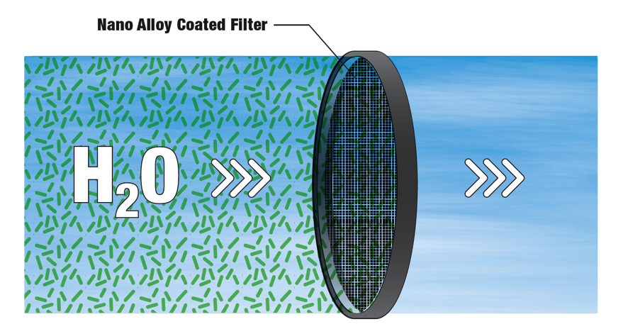
Notes:
In 5-10 years, we will be utilizing this technology to clean water both in traditional and desalination plants. This will be unique in that it protects water from internal threats such as bacteria that cause biofilm and corrosion on filter materials, and also external threats such as bioterrorism (I’m sure you guys want to soften this statement somehow so please do!)

Slide 13

Notes:
The opportunities for innovation have now become limitless. Nanomaterials is the newborn baby of materials science. And like new parents, materials scientists (including myself) are mentally and emotionally overcome with the potential for growth and transformation in our beautiful new field. . .still in its infancy and advancing the world unparalleled in pace and promise.
The road ahead sure looks bright when it is no longer corroding under our feet.

Slide 14
Photo Credits
Slide 2: http://thedarkknight.warnerbros.com/
Slide 3: http://en.wikipedia.org/wiki/I-5_Skagit_River_Bridge_collapse#/media/File:05-23-13_Skagit_Bridge_Collapse.jpg
Slide 5: http://www.allied-fire.com/files/4798/605834.jpg
Slide 6: http://www.imrtest.com/failure-analysis
Slide 8: http://www.giantmicrobes.com/
Slide 9: http://upload.wikimedia.org/wikipedia/commons/2/29/Cleaning_the_hull_3.jpg
Slide 12:
Woman with stuffed animal: https://howardhughes.trinity.duke.edu/blogs/2009/06/21/week-1-of-howard-hughes-embarking
-on-a-new-journey-in-biology
Photo of Paul Karason: http://abcnews.go.com/Health/internet-sensation-papa-smurf-dies-blue-people-live/story?id=20368758
Slide 14: https://flic.kr/p/9ADJqf

