Slide 1
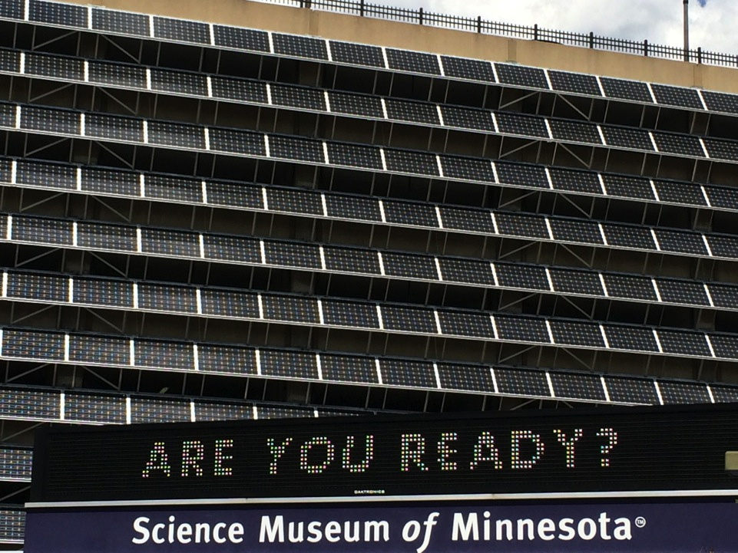

Slide 2
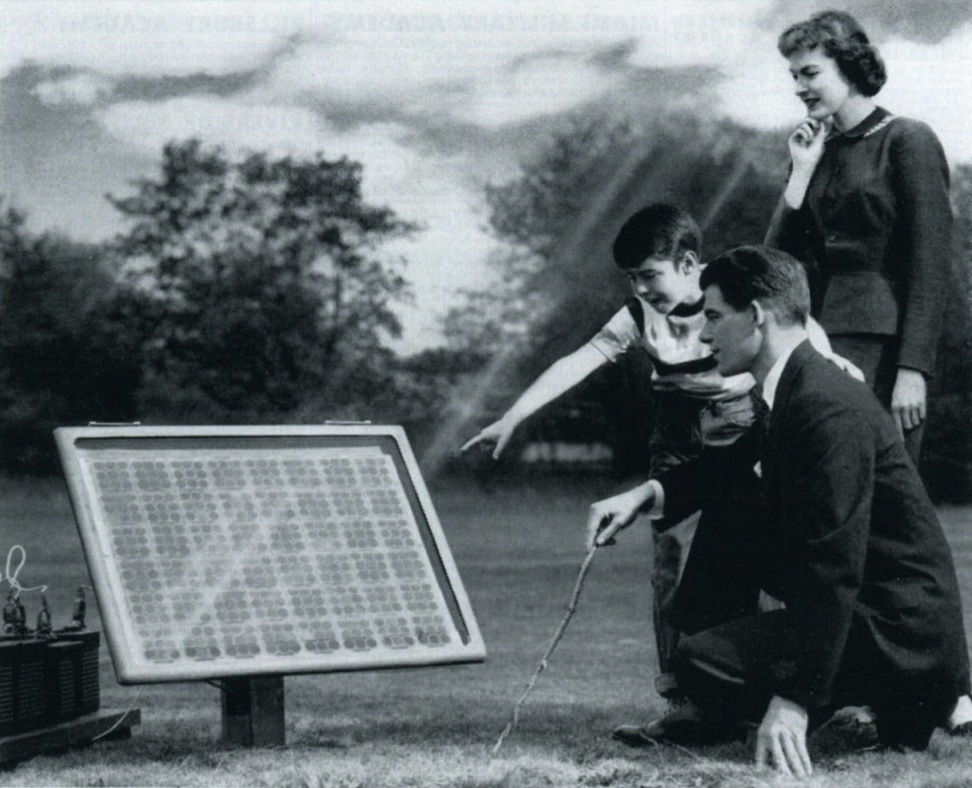
Yesterday’s Vision (1954)

Slide 3
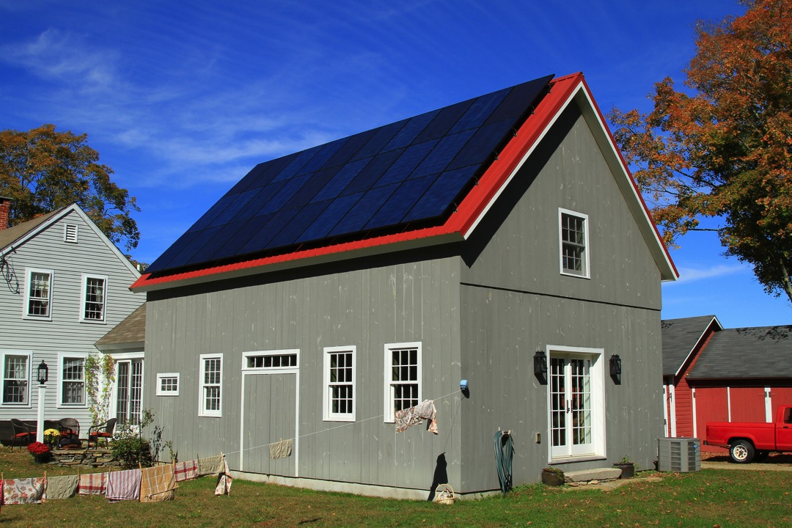
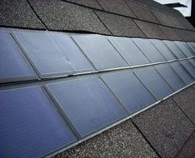
Today’s Reality (2015)

Slide 4

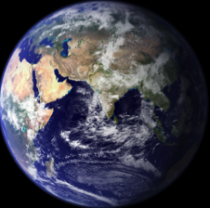
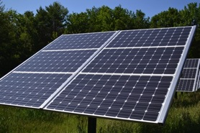
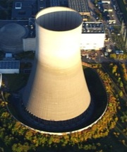
10-100 W
2,000,000,000,000 W = 2 TW
150 W (per m²)
1,000,000,000 W = 1 GW

Slide 5
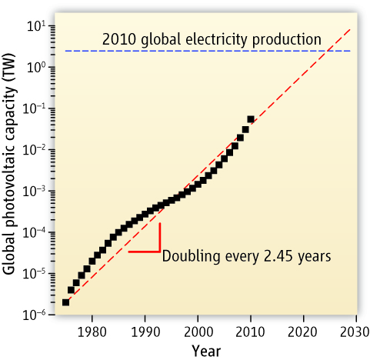

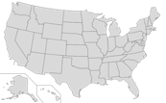

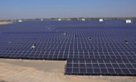
Norris & Aydil, Science 338, 625 (2012).

Slide 6


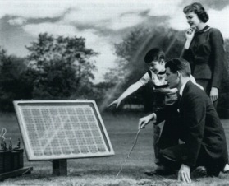

Slide 7


Love it!
Efficiency
Cost / Area

Slide 8


Efficiency
Future
Solar Cells Now
Cost / Area

Slide 9
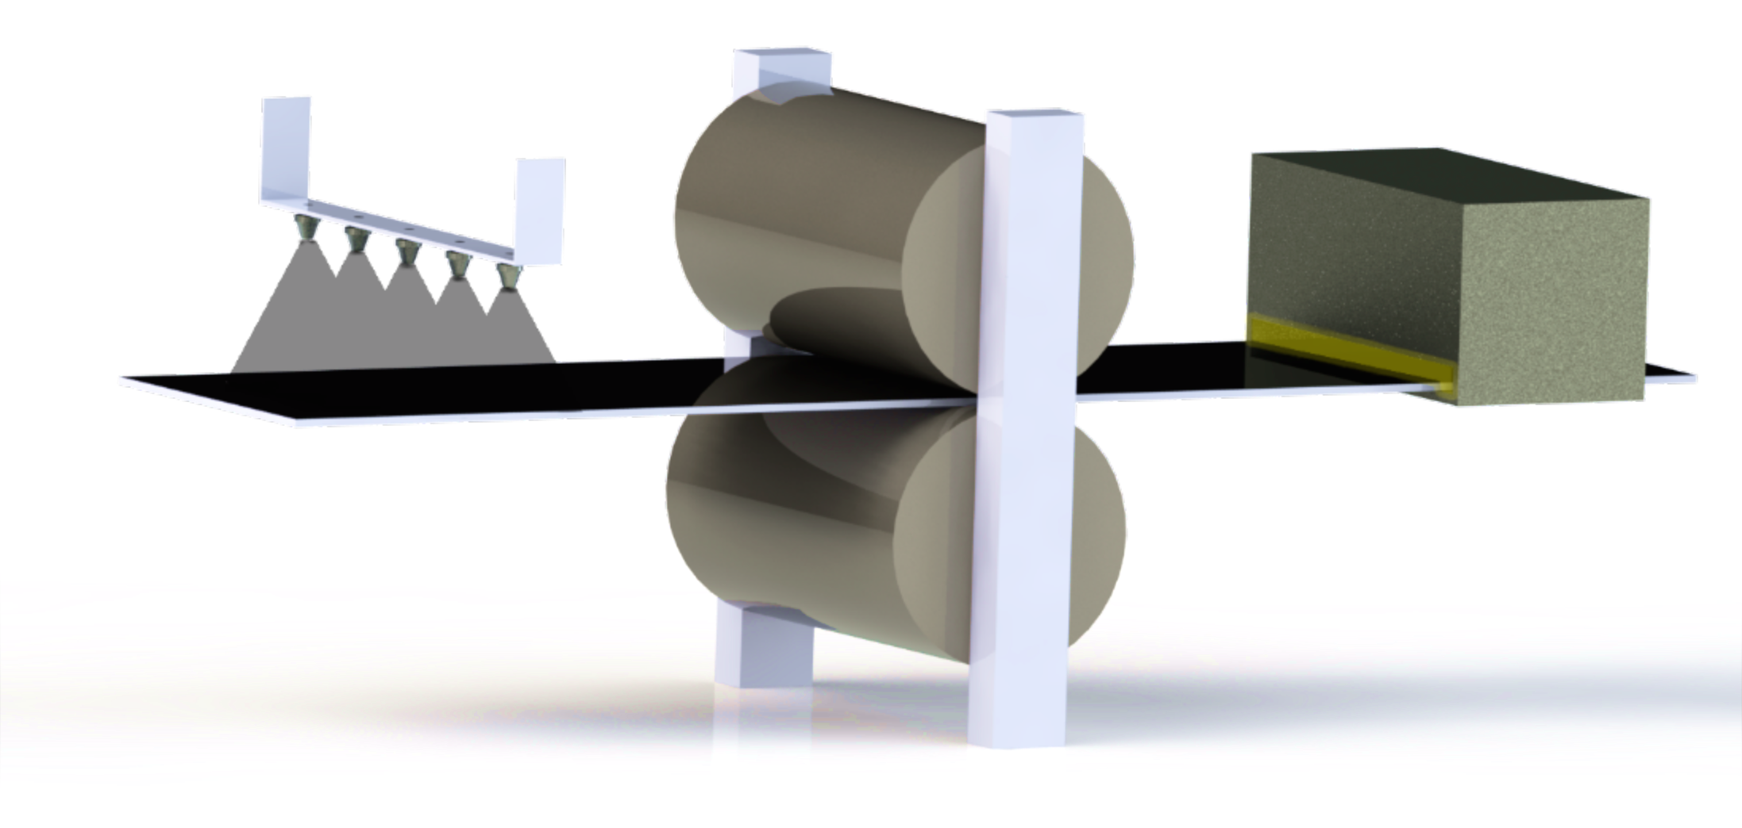
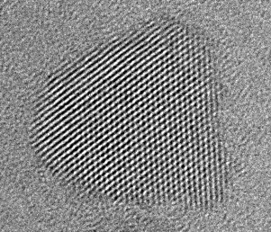
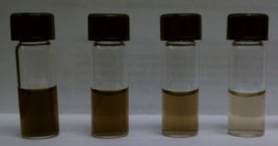
Solar Nanoinks
5 nm

Slide 10


68%
Future
Efficiency
34%
Solar Cells Now
Cost / Area

Slide 11
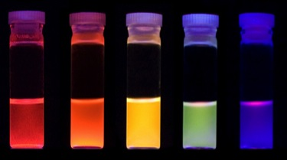
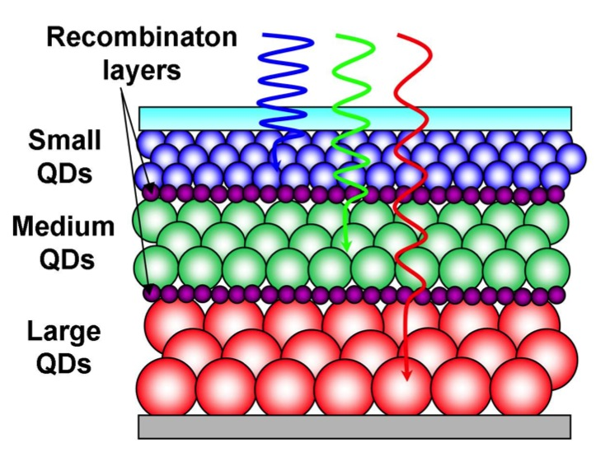
Campbell, Kortshagen, et al. Nanotechnology (2008)

Slide 12
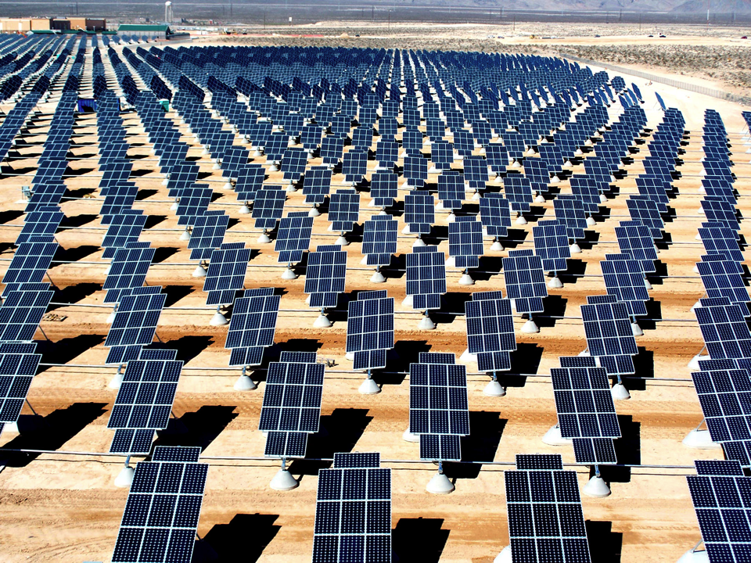
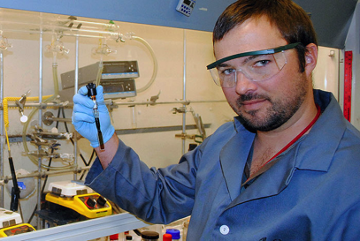

Slide 13
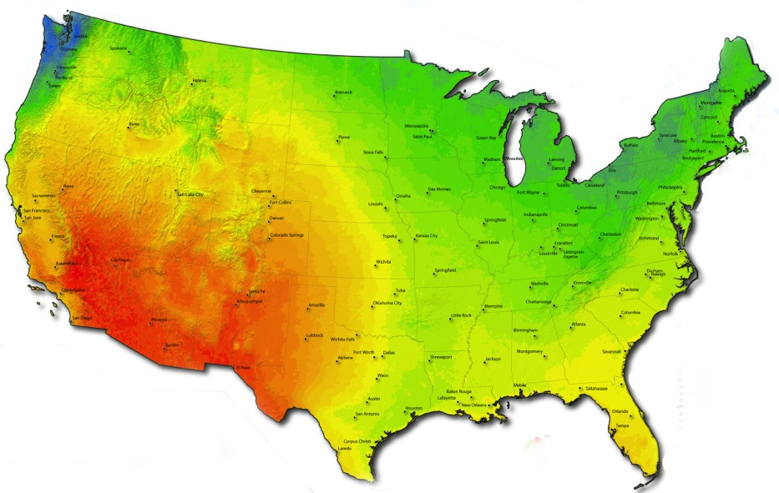



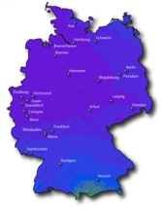

U.S. (0.3%)
Germany (5%)

Slide 14
Photo credits
Solar Cell ad (slides 2, 6): https://www.flickr.com/photos/91591049@N00/15378408886/
Slides 3 and 6:
  House (slides 3 and 6): https://flic.kr/p/oSNPqX
  Solar cells (slides 3 and 6): https://flic.kr/p/3AxBF6
  Future sign (slide 6): http://www.solarfeeds.com/the-future-of-solar-2/
Slides 4 and 5:
  Light bulb: https://commons.wikimedia.org/wiki/Incandescent_light_bulb#/media/File:Bombeta_de_Llum.JPG
  Solar panel: https://upload.wikimedia.org/wikipedia/commons/2/2c/Fixed_Tilt_Solar_panel_at_Canterbury_Municipal_Building_Canterbury_New_Hampshire.jpg
  Nuclear power plant: https://upload.wikimedia.org/wikipedia/commons/2/28/M%C3%BClheim-K%C3%A4rlich-007.JPG
  Earth: http://commons.wikimedia.org/wiki/Earth#/media/File:Earth_Eastern_Hemisphere.jpg
  U.S. map: http://commons.wikimedia.org/wiki/File:Blank_US_Map.svg
  Minnesota: http://digital-vector-maps.com/state-maps-detail/1127/Minnesota-Outline-Blank-Map-Adobe-Illustrator.htm
  Solar plant: https://commons.wikimedia.org/wiki/File:Astonfield_11.5MW_Solar_Plant_Gujarat.jpg
Slides 7 and 10:
  Like button: http://www.clker.com/clipart-178288.html
  Speed limit sign: http://www.educationworld.com/tools_templates/speedlimit_sign.gif
Slide 8
  Pizza: http://www.clipartbest.co/pizza-food-clip-art/
  Stack of newspapers: https://flic.kr/p/WezqD
Slide 12:
  LANL researcher: http://farm6.staticflickr.com/5529/11298844263_275a922071_b.jpg
  Photovoltaic array: http://upload.wikimedia.org/wikipedia/commons/4/45/Giant_photovoltaic_array.jpg

