Slide 1

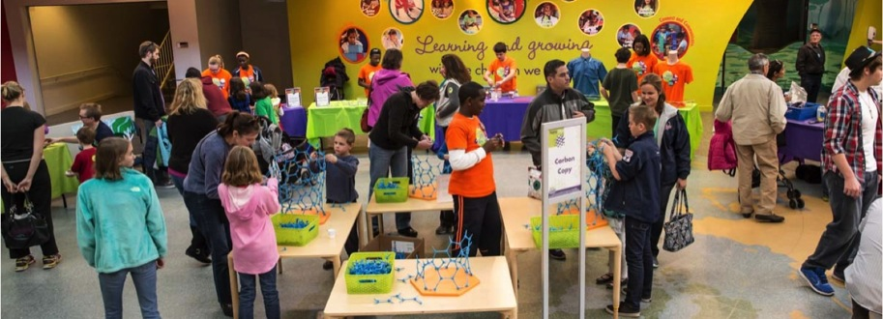

June 2015
Network-Wide Meeting
Welcome
www.nisenet.org
Notes:
WEDNESDAY MORNING, 9AM
LARRY: Welcome to the meeting
PAUL: Welcome to Minnesota, SMM is so pleased to be hosting

Slide 2


Morning plenary
Meeting overview
NISE Network impact
Ongoing and future work
New opportunities
Logistics
Notes:
LARRY

Slide 3
Meeting goals
1
2
3
4
Participants will deepen relationships with each other in order to sustain partnerships and explore future collaborations for public engagement in science, technology, engineering, and math (STEM).
Participants will learn about educational products and professional development resources they can use to increase their capacity to sustain public engagement in nano and other current science topics.
Participants will have opportunities to share their experiences with public engagement in nanoscale science, engineering, and technology and be inspired by the experiences of other partners.
Participants will learn about new current science content and opportunities for collaboration and public engagement, including the synthetic biology project.
Notes:
LARRY

Slide 4
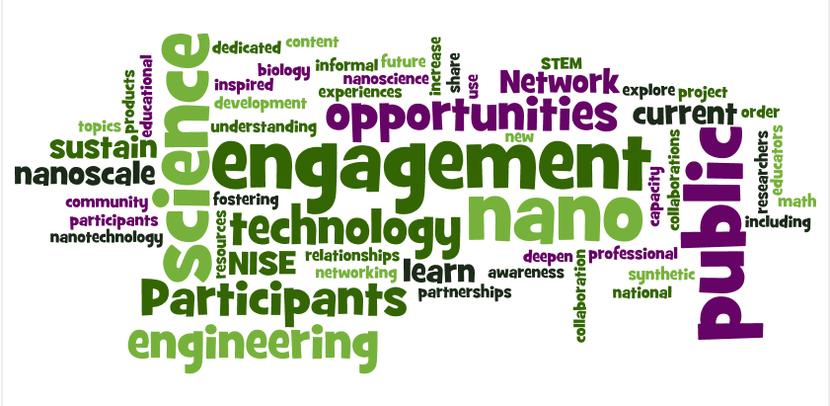
In other words…
Notes:
LARRY

Slide 5
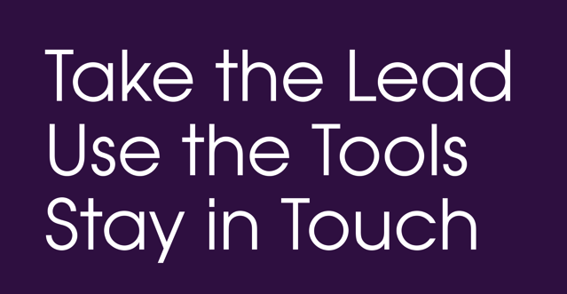
Your charge
Notes:
PAUL: This is your charge for the meeting. As you go through the meeting, please think about the questions on page 25 of your program.

Slide 6
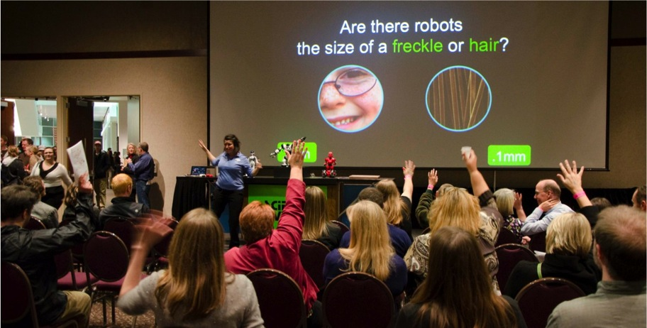
Who is here?
Notes:
PAUL
Please Stand Up - Who has been involved since the original proposal?
Who has ever hosted or collaborated on a NanoDays event?
Who is joining us for the first time? <welcome!>
Who has (or will have) a copy of the Nano mini-exhibition?
WhO has ever had a NISE Network mini-grant?
Who has collaborated with new partners as a result of this project?
Who uses nano particle sunscreen?
Who is wearing nano pants right now?

Slide 7
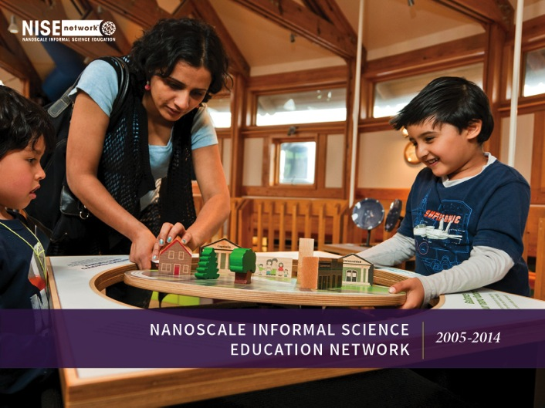
NISE Network impact
Notes:
LARRY
Report to partners, 2005-2014

Slide 8
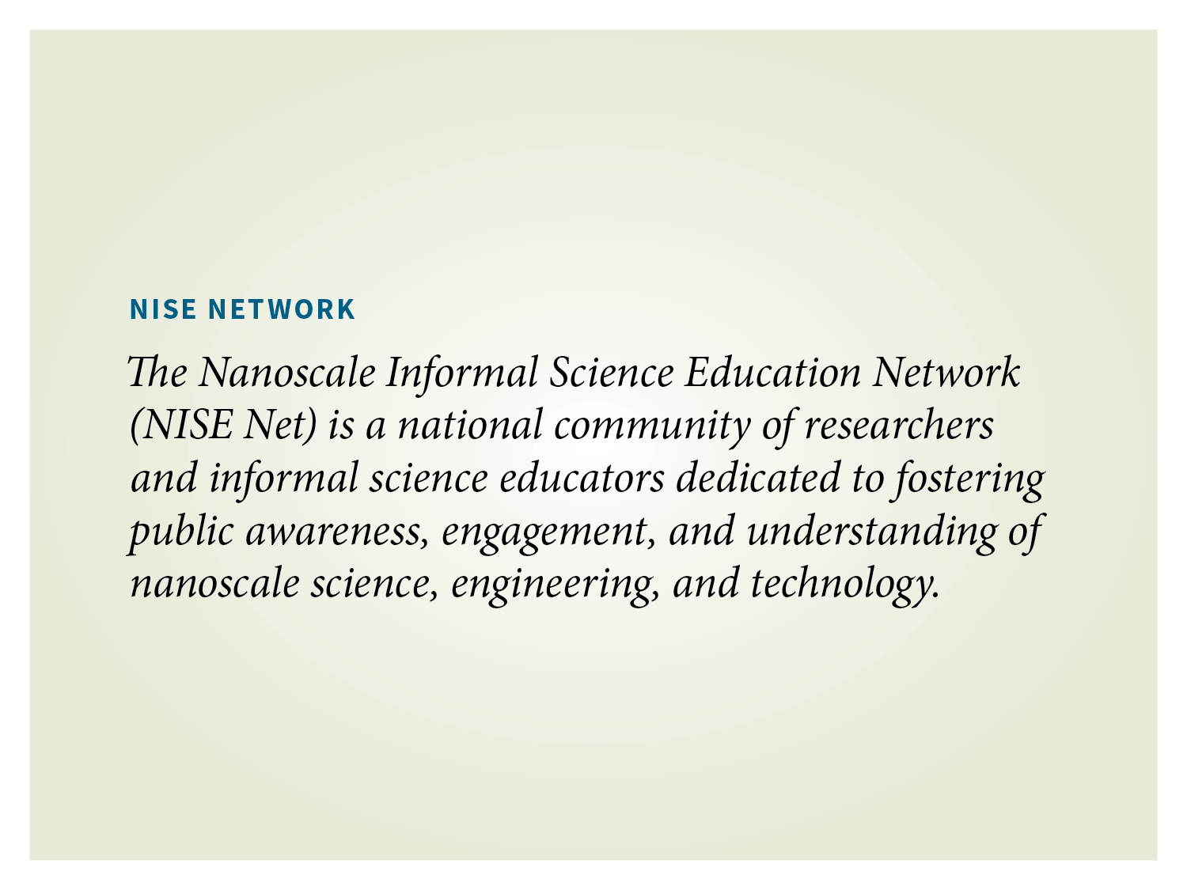
Notes:
LARRY

Slide 9
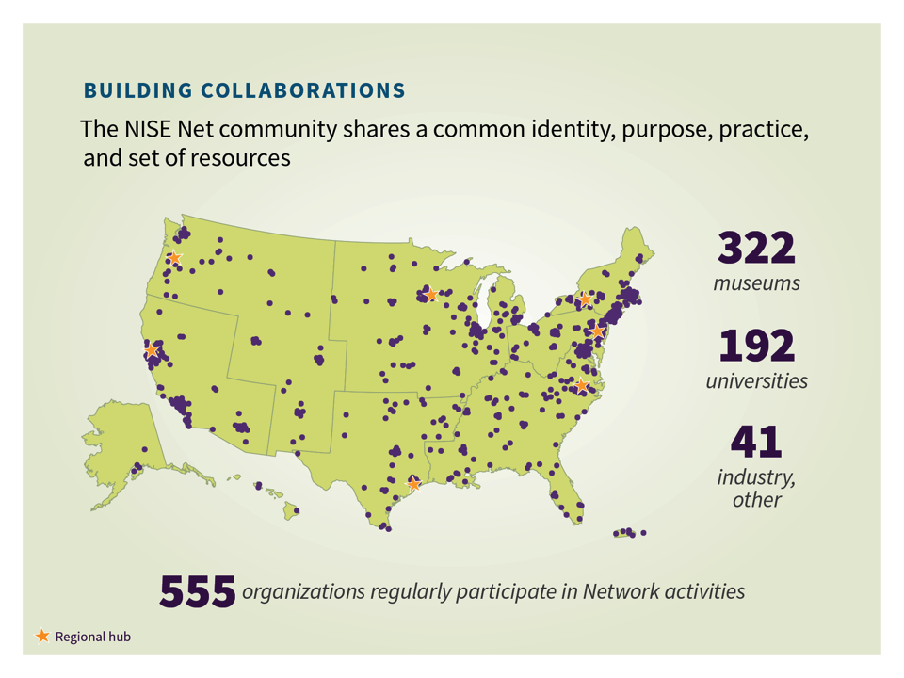
Notes:
LARRY

Slide 10
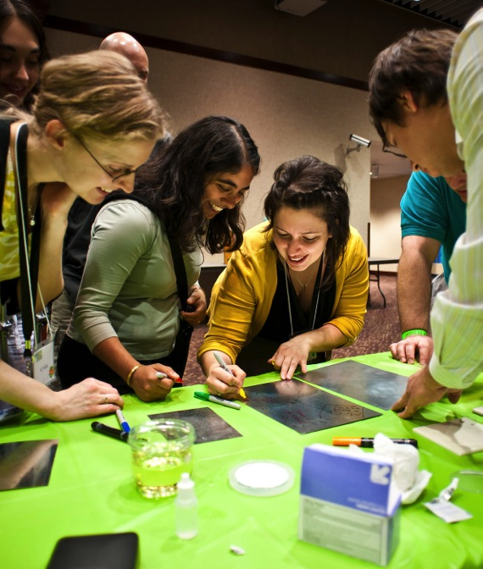
BUILDING
COLLABORATIONS
Years 1-5:
“Building the Network by doing work together”
Years 6-10:
“Using the Network to engage the public”
Notes:
LARRY
YEARS 1-5: “Building the Network by doing work together”
--informal educators at museums and universities: Expertise on engaging public (developing and delivering educational experiences; evaluating and researching learning)
--researchers: Content expertise (defining the field, its accomplishments, future directions, and potential impact)
--together: Rationale for professionals/organizations to engage the public; Relevance, interest, enjoyment for public audiences; Models for what does (and doesn’t) work on a nationwide scale with broad public audiences
YEARS 6-10: “Using the Network to engage the public”

Slide 11
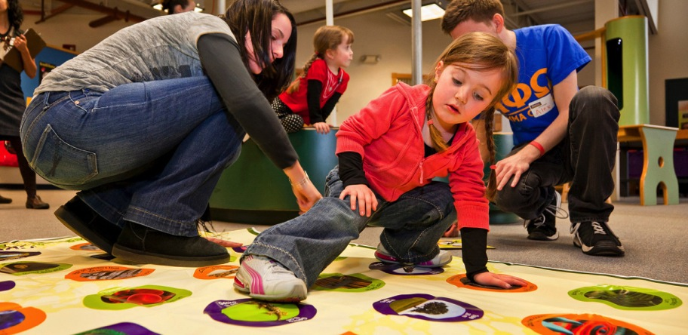
ENGAGING THE PUBLIC
NISE Net’s educational materials are designed to engage a wide range of audiences in learning about complex scientific content—in ways that are fun and easy to understand.
Notes:
LARRY

Slide 12
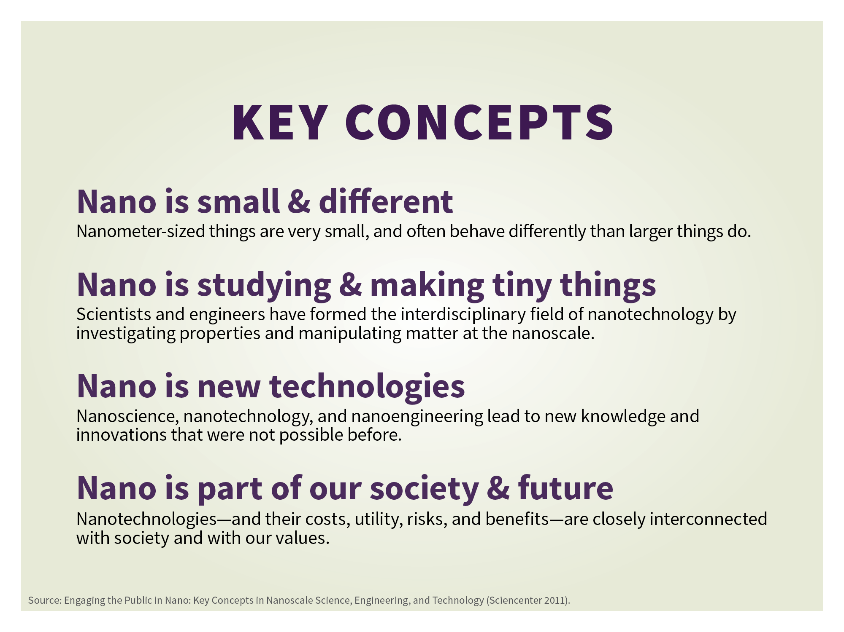
Notes:
LARRY
Nano is a new interdisciplinary field of research. NISE Net developed a content map that identifies these four key concepts to introduce the public to nanotechnology.
The great potential of nano comes from its tiny size. Nano research and development happens at the scale of atoms and molecules. Many things have different properties at the nanoscale, which allows scientists and engineers to create new materials and devices. Some experts think that nanotechnology may transform our lives, similar to the way that the automobile and personal computer changed the way we live and work.

Slide 13
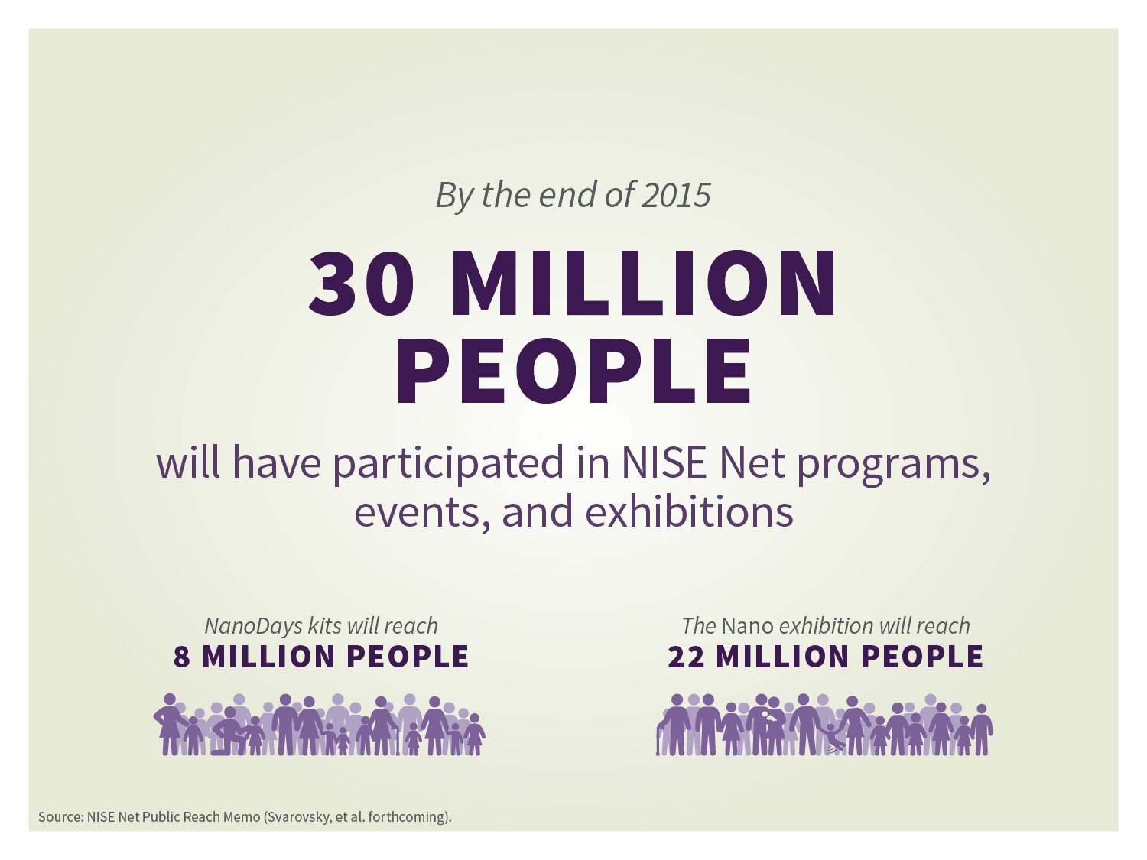
Notes:
LARRY

Slide 14
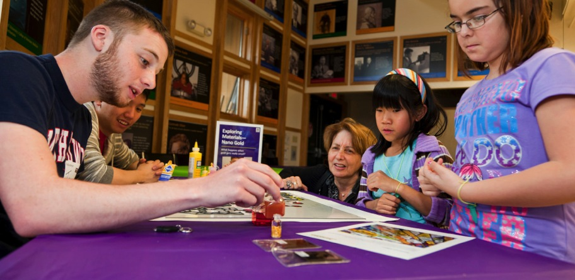
NANODAYS
NanoDays is the Network’s signature event—an annual celebration of nanoscale science, engineering and technology.
Notes:
LARRY

Slide 15


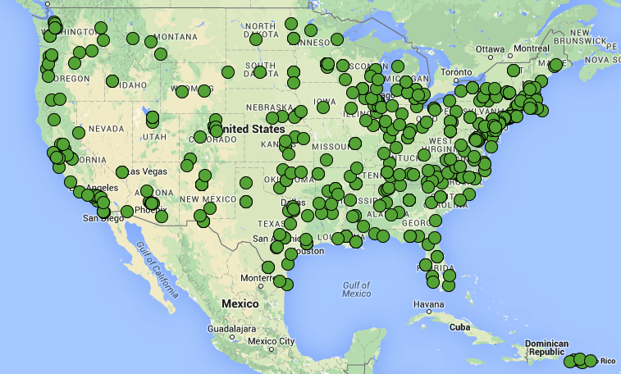
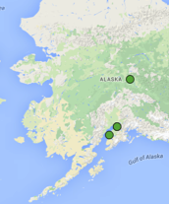
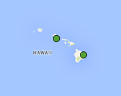
Nanodays 2008-2015
Total: 1650
Unique: 468
Notes:
LARRY
NanoDays has been successful at helping the Network achieve all three of its goals: Building collaborations, engaging the public, and increasing capacity in the field:
--initially, ND provided a tangible opportunity to partner: low risk and low barrier
--eventually, many partnerships developed further
--initially, the idea was that event itself was the public engagement activities
--soon, the resources also provided building blocks for many other programs and had much greater use and impact
--initially, the event built confidence, skills, motivation for both educators and researchers to engage the public in nano
--eventually, vehicle for sharing new practices across the field
The map shows all the sites that have done NanoDays, 2008-2015. Total: 1650. Unique: 468

Slide 16
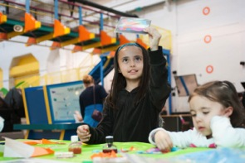
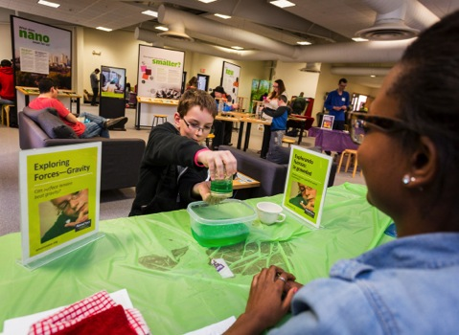
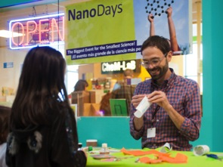
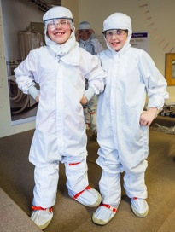
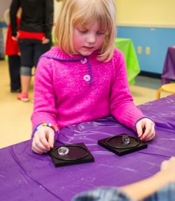
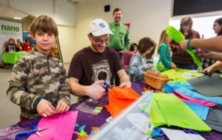
OMSI, portland OR | Sciencenter, ithaca ny
Notes:
LARRY
Photos from NanoDays across the country, 2015:
Two top left: OMSI, Portland OR
Remaining: Sciencenter, Ithaca NY in partnership with Cornell University

Slide 17
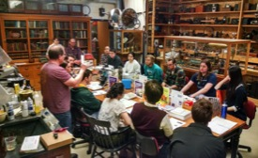
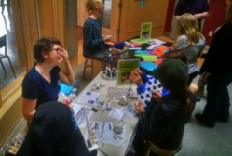
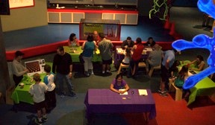
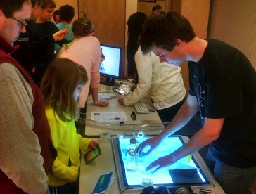
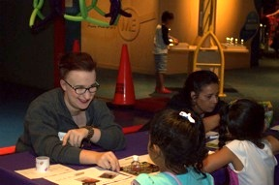
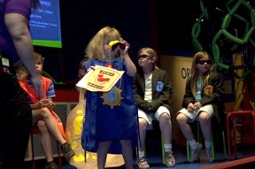
Echo, burlington VT | Arizona Science center, phoenix AZ
Notes:
LARRY
Left and center: ECHO Lake Aquarium and Science Center, Burlington VT, in partnership with University of Vermont
Right: Arizona Science Center, Phoenix AZ, in partnership with Arizona State University

Slide 18
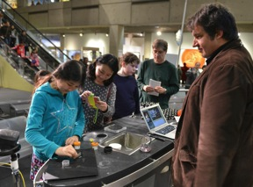
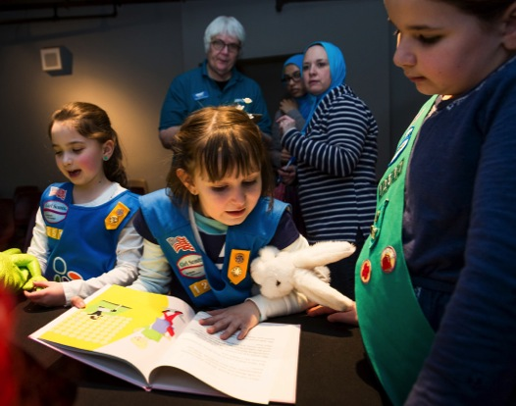
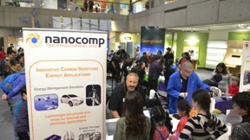
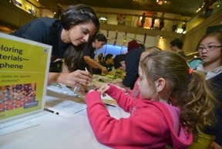
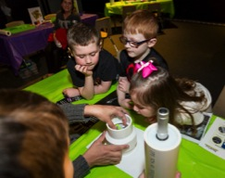
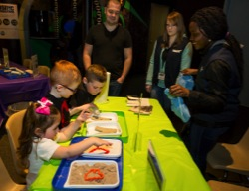
Museum of science, boston ma | most, syracuse ny
Notes:
LARRY
Left: Museum of Science, Boston, in partnership with Nanocomp and multiple universities/research centers: Northeastern, U Mass Lowell, Harvard, MIT, and Howard:
Northeastern and U Mass Lowell: Center for High-Rate Nanomanufacturing
Harvard, MIT, and Howard: Center for Integrated Quantum Mechanics
MIT: Center for Excitonics
Northeastern: Macromolecular Innovations in Nano-Materials Utilizing Systems Laboratory
Right: Museum of Science & Technology, Syracuse, in partnership with Syracuse University and SUNY Environmental Science & Forestry

Slide 19
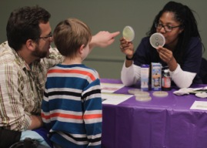
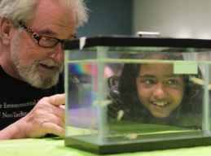
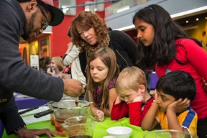
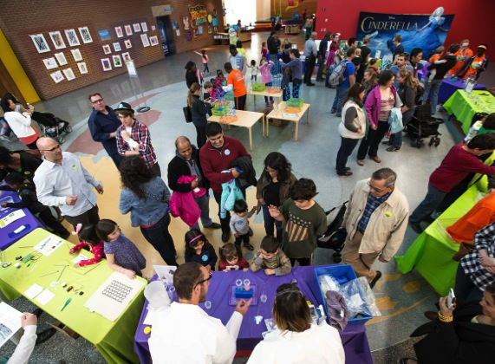
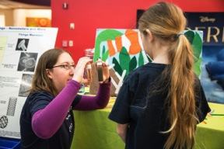
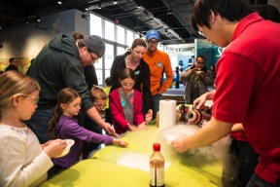
Museum of life + science, Durham | marbles kids museum, raleigh NC
Notes:
LARRY
Top left and top center: Museum of Life + Science, Durham NC
Large image and right hand column: Marbles Kids Museum, Raleigh NC
MLS and Marbles collaborate on NanoDays held at both orgs. Other partners that participate in both NanoDays are: Duke, NC State, UNC Chapel Hill and NC Central U.
Special note: Marbles STEM Play Corps present activities (20 middle school students)—grant funded project among Marbles, CEINT at Duke and NC State’s Nanotechnology Education program

Slide 20
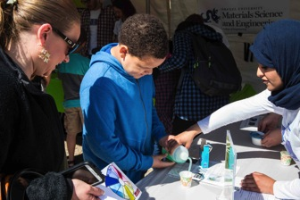
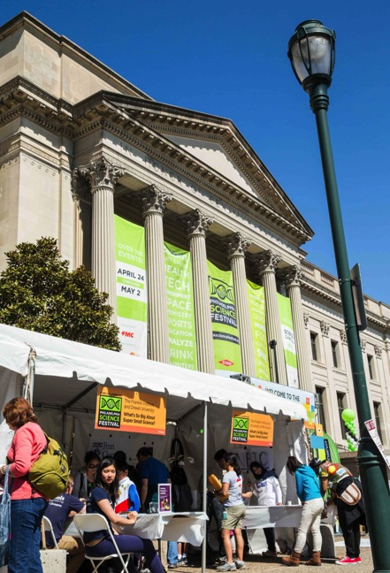
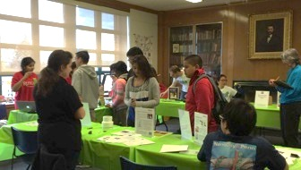
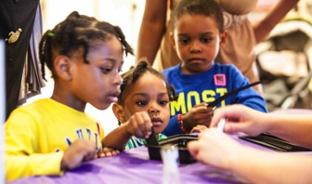
the franklin institute, philadelphia pa
Notes:
LARRY
Franklin Institute and multiple partners: Drexel U, U of Penn, and Free Library of Philadelphia
Events held at Franklin Institute (Target Community Night, TFI and Drexel), Philly Science Festival (TFI, Drexel, and Penn), and Bushrod Library (TFI, Penn, and Free Library of Phila)

Slide 21
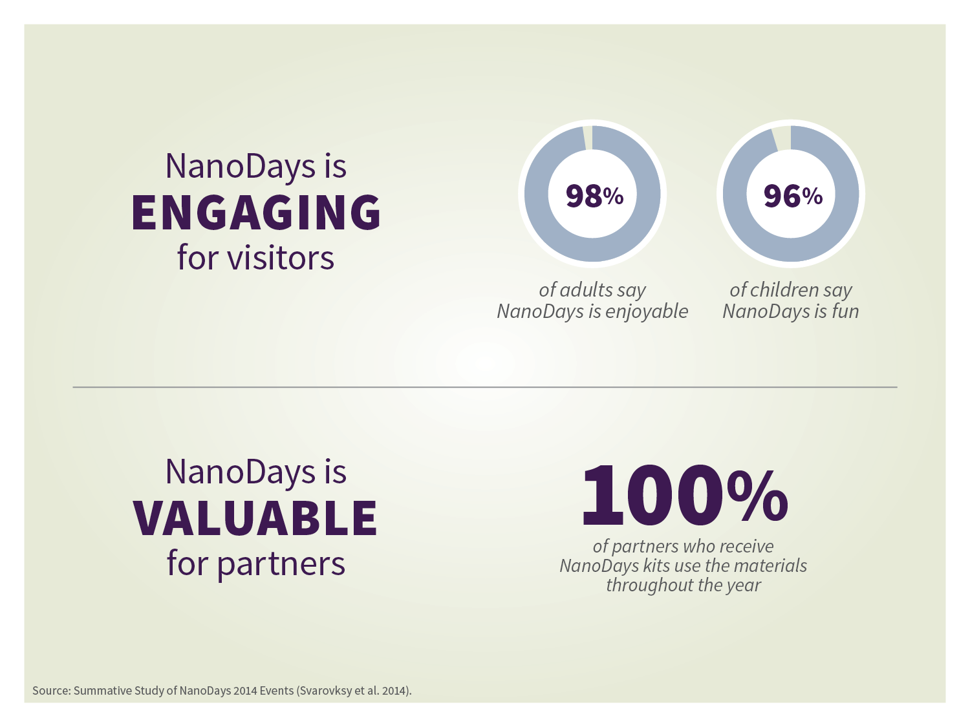
Notes:
LARRY

Slide 22
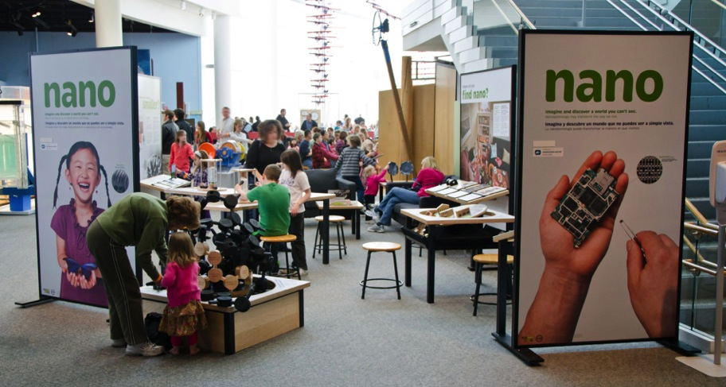
NANO EXHIBITION
Nano has a small footprint and a big impact!
Notes:
PAUL

Slide 23
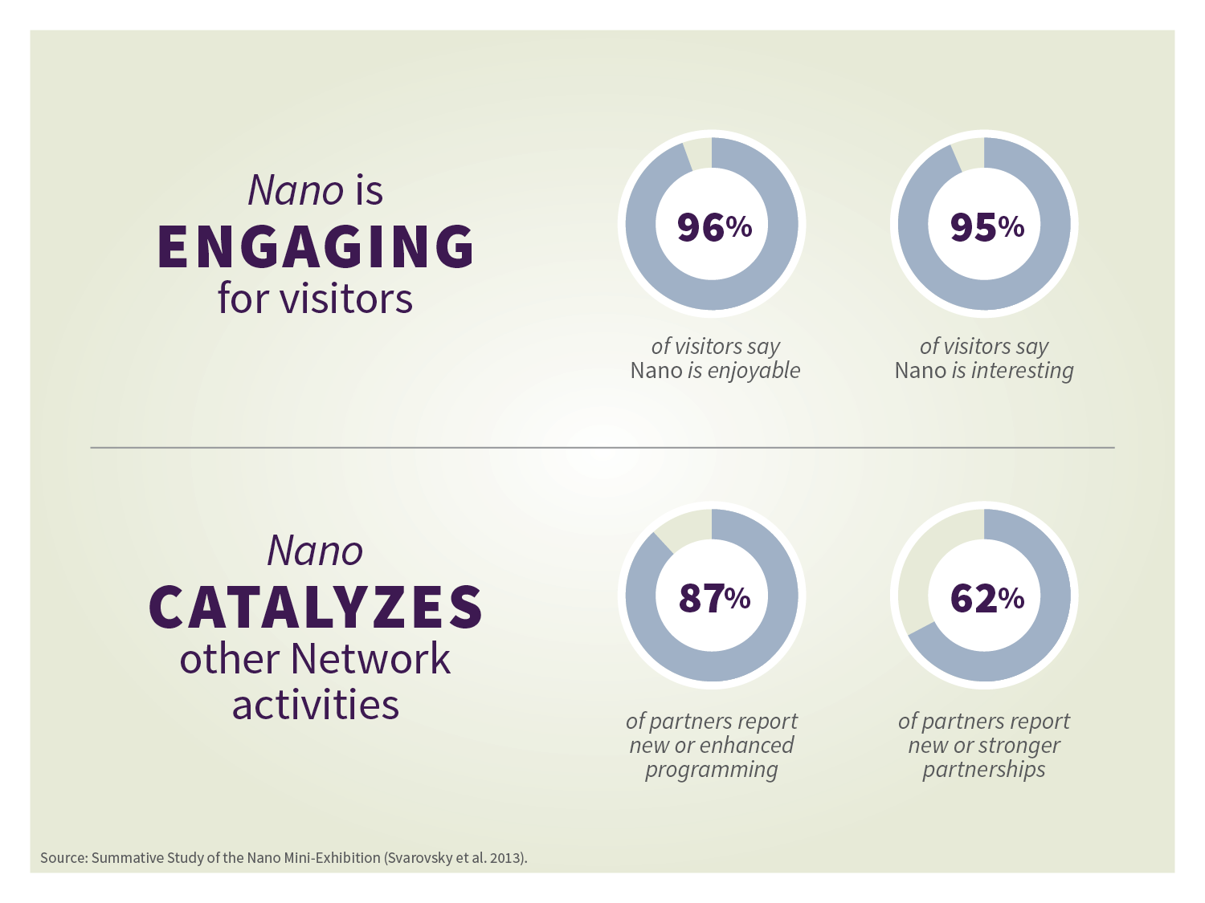
Notes:
PAUL
More information:
ENGAGING FOR VISITORS:
Both adults and children learn nano concepts
Almost all adults say they would come to NanoDays again
VALUABLE FOR PARTNERS:
Event volunteers learn nano concepts
Student volunteers become more interested in STEM careers

Slide 24

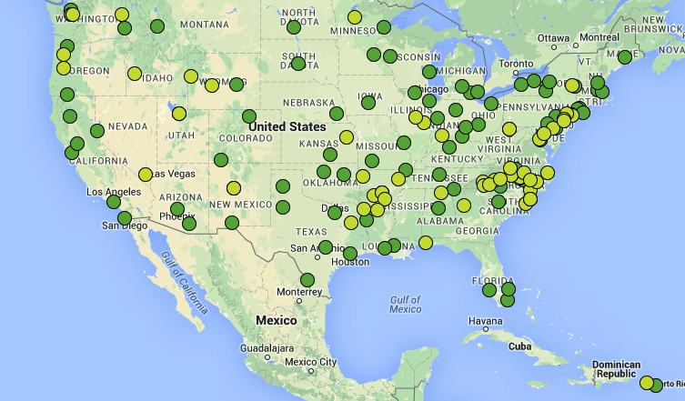
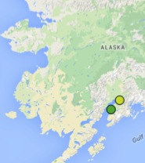
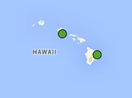
Nano exhibition
• Owning = 93
• Sharing = 56
Total = 149
Notes:
PAUL
Nano exhibition was all three Network goals + NEW GOAL: Sustaining the benefits of the Network beyond the funded period
--Exhibits are durable and have a long lifespan
--They don’t require staffing, so they can engage people all the time and achieve greater reach
--They can provide an opportunity to embed nano more deeply and broadly in an organization (more programming, more staff involved, more opportunities for partnerships across organizations)

Slide 25
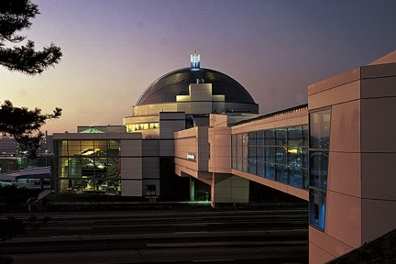


SAINT LOUIS SCIENCE CENTER, SAINT LOUIS MO
“Visitors have indicated that the Nano mini-exhibition was the highlight of their experience at the science center.”
Paul Freiling
Director of Engineering and Technology Educator
Notes:
PAUL
Large science museum that is hosting the mini-exhibition. Despite the small footprint of the exhibit, it has made a big impression on visitors. In the museum’s quarterly visitor survey, visitors have identified Nano as one the highlight of their experience.

Slide 26



DA VINCI SCIENCE CENTER, allentown PA
“I have seen families talking about nano and how the new technologies might impact them. It has sparked conversations
between guests and our staff.”
Karen Knecht
Director of Education and Exhibits
Notes:
PAUL
The Da Vinci Science Center in Pennsylvania is a medium-sized museum. Here too, the mini-exhibition has become a visitor favorite. The staff have noted the kinds of social interactions and conversations that the exhibition was designed to encourage.
“The Nano Mini Exhibition has immediately become one of our visitor favorites in visitor surveys.…I have seen families … talking about nano and how the new technologies might impact them. It has sparked conversations between guests and our staff.”

Slide 27



Natural history museum of utah, university of utah, salt lake city ut
“Visitors have active, prolonged engagement with the exhibit, especially the hands-on activities.”
Tim Lee
Exhibits Manager and Senior Exhibit Designer
Notes:
PAUL
Mini-exhibition at a university museum. Staff have noticed extended visitor engagement.
The mini-exhibition summative evaluation identified a long dwell time for exhibition, particularly notable given its small size. Visitors spend a long time in the mini-exhibition—around four times longer than a typical exhibition. [Measured by the Sweep Rate Index (SRI). (Over 6 minutes average dwell time; 4 minutes median dwell time.)

Slide 28



COSI, columbus OH
“The Nano exhibition brings science content to life.”
Joshua Sarver
Senior Director of Experience Design and Production
Notes:
PAUL
Staff at COSI have found that the presence of the mini-exhibition has encouraged them to incorporate nano into programming efforts across the museum.
Context for quote: “The impact of the Nano mini-exhibition at COSI has been quite extensive, from COSI Guests to COSI’s Team Members….COSI Team Members across the institution have seized the opportunity to mainstream nanotechnology into their programs.”

Slide 29




Princeton public library, princeton NJ &
new jersey state museum, trenton nj
“The exhibit gives us a daily presence in two different communities in need of science education support, and increases our ability to reach out to diverse audiences.”
Daniel Steinberg
Education and Outreach Director
Princeton Center for Complex Materials
Notes:
PAUL
Princeton University is partnering with two other community organizations to host the mini-exhibition: the public library and the NJ State Museum. Princeton has found that the mini-exhibition is valuable both for developing partnerships with those organizations, which in turn provides them with better opportunities for reaching underserved and underrepresented audiences.
The two photos on the right-hand side of the slide show a school group receiving a tour of the nanofabrication facilities at Princeton (top left). The students then walked from campus to the library—still wearing their cleanroom suits—and used the miniexhibition at the public library. (In the bottom slide you can see that one boy put his school uniform jackets on top of his bunny suit).

Slide 30



Port discovery children’s museum, baltimore mD
“It’s been our platform for STEM.”
Nora Moynihan
Port Discovery Children’s Museum
Notes:
PAUL
Port Discovery was one of the first sites to host the mini-exhibition.
The photo on the top left shows an additional component built by the MRSEC at the University of Maryland, in partnership with Port Discovery. This partnership began with NanoDays and has expanded into other initiatives.
About the partnesrhip, Nora Moynihan says:
“They helped us design a whole exhibit piece to add onto our mini exhibit.…[W]hen we added onto the exhibition, it's given us a platform for bringing in new partners from industry, partners from universities. It has given us a platform to really take this as far as we can. Now we're looking at traveling it to libraries, to make it accessible for kids in disadvantaged neighborhoods.” Nora Moynihan, Port Discovery Children’s Museum
Donna Hammer, MRSEC Associate Director at Maryland, says:
“Our partnership is built on common goals, mutual respect, realistic expectations, flexibility, and open communication. From these qualities, we have built trust, which has blossomed into a synergy between the two institutions that has seeded a long and fruitful partnership.”

Slide 31

INCREASING CAPACITY
NISE Net has provided the rationale, resources, and support to
transform informal STEM learning in museums.
Notes:
PAUL

Slide 32

Notes:
PAUL

Slide 33

Mini grantS
New efforts to integrate nano into existing programming
New efforts to reach new audiences with nano programming, including traditionally underserved or underrepresented audiences
New partnerships between museums and nano researchers, community-based organizations, or diversity-serving organizations
Notes:
PAUL:
Each minigrant addressed at least one of these criteria:
New efforts to integrate nano into existing programming
New efforts to reach new audiences with nano programming, including traditionally underserved or underrepresented audiences
New partnerships between museums and nano researchers, community-based organizations, or diversity-serving organizations

Slide 34



Mini grantS
Year 6: 27
Year 7: 42
Year 8: 42
Year 9: 41
Year 10: 41
Total: 193
Notes:
PAUL
You’ll hear about a lot of these projects throughout the meeting.

Slide 35
Video
Notes:
PAUL
The NISE Network Impacts - Partners Testimonials video provides perspectives from individuals across the Network on what we have accomplished as a group and what the Network has meant to them.
This video is part of a NISE Network Report to Partners resource package. The Report includes three related products: a printed report, a set of presentation slides, and 2 videos video. Together, these resources allow NISE Net partners to learn about the impact of the Network and share it with others.

Slide 36
Ongoing and future work
Building collaborations
Engaging the public
Increasing capacity
Sustaining the Network
Notes:
LARRY

Slide 37


Building collaborations
Ongoing relationships among professionals and organizations
Notes:
LARRY

Slide 38


Engaging the public
Ongoing use of NanoDays kits and other educational products
Notes:
LARRY
NanoDays dates are scheduled into the future

Slide 39


Engaging the public
Tens of millions of people interacting with Nano exhibitions nationwide
Notes:
LARRY
Remaining copies of the exhibition will be shipped this year
New supplies of some materials for existing exhibitions

Slide 40






Engaging the public
Maintenance of whatisnano.org, our public website
Continuing downloads of our DIY nano iOS app
Notes:
LARRY

Slide 41


Increasing capacity
New resources
Notes:
LARRY
Many new resources are under development, which document the products and learnings of the Network over the years.
These include a compilation of NanoDays and DIY nano activities, which anyone who has received a physical NanoDays kit will receive.
We’re creating a series of new guides: the Nano exhibition guide has been completed, and we’re working on additional guides on Network Community, Network administration, Evaluation, Program development, and NanoDays development. These will be available on nisenet.org.

Slide 42

Increasing capacity
Completion of research studies, evaluation reports, and Team-Based Inquiry (TBI) projects
Notes:
Increasing capacity and knowledge
In addition to formative and summative evaluation, we have a number of research studies:
Museum-scientist partnerships
Organizational change
Public learning and decision making
Tracking NISE Net’s real world impact
Updates on the research and evaluation studies throughout the meeting in various sessions

Slide 43


Sustaining the Network
Maintenance of nisenet.org, our website for educators
Notes:
New content can be added through Feb 2017
Accessed for some tieme beyond that

Slide 44
New opportunities
Museum and Community Partnerships
Building with Biology
Sustainability and Science Museums
Small footprint exhibitions
Notes:
LARRY

Slide 45


Museum and
Community Partnerships
PROJECT GOALS:
Engage local communities more broadly in STEM learning, focusing on nanoscale science, engineering, and technology
Develop local partnerships between museums and community-based organizations, helping museums reach new audiences and helping community organizations provide high-quality STEM learning experiences for their audiences
Identify, develop, and share successful practices and models for reaching new audiences and developing successful collaborations among local organizations
Representatives from Afterschool Alliance, Boys & Girls Clubs of America, National Girls Collaborative Project, and 4H are attending the meeting
Notes:
LARRY
See flyer in your packet
To be eligible, existing NISE Network partners must collaborate with a community partner such as
a local community group, afterschool program, library, or
a local chapter of a national youth-serving group such as PTA, 4H YWCA, YMCA, Boys & Girls Clubs, Boy Scouts, Girl Scouts
You can learn more about this project at the showcase on Wednesday

Slide 46
Museum and
Community Partnerships
KIT
Includes hands-on activities to engage underserved audiences in nano
Includes professional resources to support partnerships and training materials to support program implementation
100 kits nationwide
TIMELINE
Application due Fall 2015 for a free kit
Kits delivered Winter 2016
Present the programs in Spring or Summer 2016
Report on activities Summer 2016
Notes:
LARRY

Slide 47

Building with Biology
PROJECT GOAL: To create conversations in museums among scientists and public audiences about the emerging field of synthetic biology and its implications for society
Many partners from this project are attending the meeting
Notes:
LARRY
See flyer in your packet
You’ll hear more at the showcase on Thursday and lunch on Thursday

Slide 48
Building with Biology
KIT
Includes hands-on activities and programs to stimulate conversations
Includes professional development and collaboration materials
200 kits nationwide
TIMELINE
Application due early 2016 for a free kit
Kits delivered Summer 2016
Host a “Building with Biology” event Summer 2016
Report on activities Fall 2016
Notes:
LARRY

Slide 49


Sustainability and
Science Museums
PROJECT GOAL: To engage the public in sustainability through the educational power of science centers and museums.
Partners from this project are attending the meeting
Notes:
PAUL
See flyer in your packet
You can learn more about this project at the Wednesday showcase

Slide 50
Sustainability and
Science Museums
KIT
Includes hands-on activities and programs to stimulate conversations
Includes professional development and collaboration materials
50+ kits nationwide for two years (100+ total)
TIMELINE
Application due Fall 2016 and 2017 for a free kit
Kits delivered Winter 2017 and 2018
Host a Sustainability Festival event in February
Report on activities in the Summer
Notes:
PAUL

Slide 51

Small footprint exhibitions
On the model of the Nano exhibition
We want your feedback—join us for Concurrent session #4
Thursday at 3pm, Room 7
Notes:
PAUL

Slide 52

Other opportunities…
Notes:
PAUL

Slide 53

Logistics
Restrooms
Concurrent sessions are across the hall
Showcases are in hallways around this room
We will go over evening logistics at 4pm
Sticky note wall
Change to program
Notes:
PAUL
Change to program: David Ucko speaking this afternoon, rather than tomorrow…

Slide 54
Logistics
Taxis
Taxi shares listing by departure time by the registration area
See page 4 for taxi phone #s
Cleanup of showcase materials
and shipping boxes:
Cart for ready-to-ship labeled boxes will be near the registration table Thursday afternoon
We will have packing tape, scissors, and Fed Ex forms
(you need your ownFedEx #)
Notes:
PAUL
We need to clean everything out of this building tomorrow evening – so just wanted to mention this in advance

Slide 55

Connecting
Wifi:
RC_Freewifi
no password needed
Social media: #nisenet
Notes:
PAUL

Slide 56

Improv activity
  Incorporating improv exercises into staff and volunteer training helps create a supportive and upbeat environment for educators to practice and strengthen essential skills.
Notes:
STEPH AND HEATHER
Incorporating improv exercises into staff and volunteer training helps create a supportive and upbeat environment for educators to practice and strengthen essential skills:
Warm up skills required for interacting with visitors
Encourage conversations: with visitors (rather than reciting scripts)
Be better listeners: think on your feet and respond in the moment
Be responsive: better tailor content to visitors responses and integrate visitor feedback
Be positioned as equals with visitors not “the expert”
Foster teamwork & creativity: create a fun, supportive, positive work environment to practice skills

Slide 57



Thank you
Cynthia Needham, ICAN Productions
This presentation is based on work supported by the National Science Foundation under Grant No. 0940143. Any opinions, findings, and conclusions or recommendations expressed in this presentation are those of the authors and do not necessarily reflect the views of the Foundation.
Notes:
PAUL

Slide 58


Notes:
WEDNESDAY MORNING, 9AM

Slide 59
Notes:
Blank siide – break between plenary sections

Slide 60




Future of Nanoscale Science, Engineering, and Technology
Darrell Porcello Eray Aydil Mauro Ferrari Emily Hunt
Notes:
WEDNESDAY MORNING, 10:15AM
LARRY
Introduce Darrell; he will introduce speakers
(New slide deck

Slide 61

Lunch with your region
Northeast, Room 1/2: NY, VT, NH, ME, RI, CT, and MA
Mid-Atlantic, Room 3: PA, NJ, MD, Washington DC, DE, OH, and WV
Southeast, Room 4: VA, NC, SC, KY, TN, LA, MS, AL, GA, FL, and PR
West, Room 5: AK, WA, OR, ID, MT, WY, CO, UT, and NM
South, Room 6: TX, AR, and OK
Southwest, Room 7: CA, NV, AZ, and HI.
Midwest, Room 8/9: ND, SD, NE, KS, MN, IA, MO, WI, IL, MI, and IN
Notes:
LARRY
Regions are listed in your program on page 24
Note Washington DC is with Mid-Atlantic

Slide 62

Showcase A
ODD numbered posters and tables will be staffed
Wednesday, 1:30pm-2:45pm
Museum and Community Partnerships +
National youth serving organizations
#69-77
Sustainability and Science Museums
#55
Notes:
Showcase in hallways outside this room
please see list in your packet
Includes a group of national youth serving organizations (Afterschool Alliance, National Girls Collaborative Project, Boys & Girls Clubs, 4H,

Slide 63
Notes:
Blank siide – break between plenary sections

Slide 64

June 2015
Network-Wide Meeting
Wednesday wrap-up
www.nisenet.org
Notes:
WEDNESDAY AFTERNOON, 4:30PM
PAUL

Slide 65

Plenary remarks
David Ucko
Notes:
PAUL:
Dave Ucko has been a leader in the science museum community since 1979 in Chicago, Los Angeles, Kansas City, and Washington, DC. In 2003 he began a 7 ½ year stint at the National Science Foundation, where he served as the Head of the Informal Science Education program and the Deputy Director and Acting Director of the Division of Research on Learning in Formal and Informal Settings. Despite these and other distinguished appointments, we know him best as the NSF program officer for the initial NISE Net award ten years ago.

Slide 66
Video
Notes:
PAUL
The NISE Network Impacts: Museum-Scientist Partnerships NanoDays and Beyond video highlights a partnership between the Marbles Kids Museum, Duke University, and NC State University called STEM Play Corps. This video provides perspectives about this project from individuals in this partnership and shows the impact that the NISE Network has had in assisting partners with developing and sustaining their own local collaborations.
This video is part of a NISE Network Report to Partners resource package. The Report includes three related products: a printed report, a set of presentation slides, and 2 videos video. Together, these resources allow NISE Net partners to learn about the impact of the Network and share it with others.

Slide 67

Wednesday night
Bring your map (purple top)
Wear your badge
Schedule 5:30pm Begin walking to Padelford boat dock from hotels
  5:45pm sharp Shuttle departs from both hotels to Padelford boat dock
  6:00pm Boarding begins
  6:30pm sharp Boat leaves the dock (the boat will not wait)
  6:30pm Nano demonstrations on the boat
  7:15pm Dinner served
  9:30pm Boat returns to dock; shuttles return to hotels
Notes:
PAUL
Information is in program
Important to emphasize out loud

Slide 68

Thank you
Cynthia Needham, ICAN Productions
This presentation is based on work supported by the National Science Foundation under Grant No. 0940143. Any opinions, findings, and conclusions or recommendations expressed in this presentation are those of the authors and do not necessarily reflect the views of the Foundation.
Notes:
PAUL

Slide 69


Slide 71



Building with Biology
Larry Bell David Sittenfeld Megan Palmer
Notes:
THURSDAY LUNCH, 12PM
LARRY
Larry makes transition from NISE Net to Building with Biology and introduces David
David describes BwB project and introduces Megan
Megan talks about syn bio

Slide 72

New opportunities
Notes:
LARRY

Slide 73
Building with Biology
Larry Bell David Sittenfeld Megan Palmer
Notes:
THURSDAY LUNCH, 12PM
LARRY
Larry makes transition from NISE Net to Building with Biology and introduces David
David describes BwB project and introduces Megan
Megan talks about syn bio

Slide 74

Showcase B
EVEN numbered posters and tables will be staffed
Thursday, 1:30pm-2:45pm
Building with Biology
#4 - #34
Notes:
LARRY
Showcase in hallways outside this room
please see list in your packet
Includes a group of national youth serving organizations (Afterschool Alliance, National Girls Collaborative Project, Boys & Girls Clubs, 4H,

Slide 75

Thank you
Cynthia Needham, ICAN Productions
This presentation is based on work supported by the National Science Foundation under Grant No. 0940143. Any opinions, findings, and conclusions or recommendations expressed in this presentation are those of the authors and do not necessarily reflect the views of the Foundation.
Notes:
LARRY

Slide 76


