Slide 1
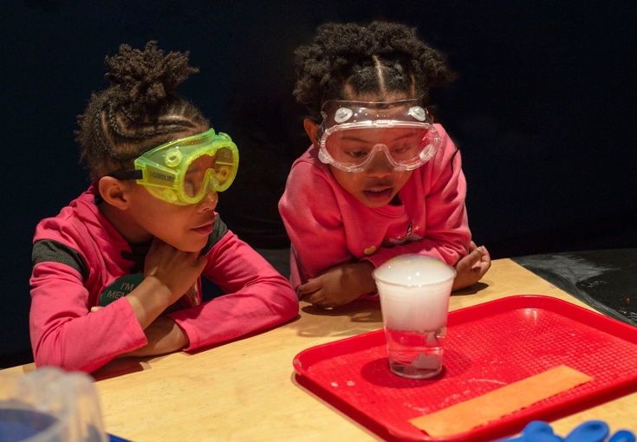
Fear Less! Bringing Chemists and Chemistry Experiments into Your Museum
Association of Children’s Museums – Interactivity Conference
Denver, CO May 2019
Science Museum of Minnesota

Slide 2
Presenters
Catherine McCarthy, Science Museum of Minnesota, Saint Paul, MN
Frank Kusiak, Lawrence Hall of Science, Berkeley, CA
Gini Philipp, WOW! Children’s Museum, Lafayette, CO
Barb McMillan, The Children’s Museum in Oak Lawn, IL

Slide 3
Session Agenda
Catherine McCarthy
Activity (Gum, & Chocolate)
Gini Philipp
Barb McMillan
Frank Kusiak
Q/A Discussion

Slide 4
Catherine McCarthy
Science Museum of Minnesota
Saint Paul, MN

Slide 5
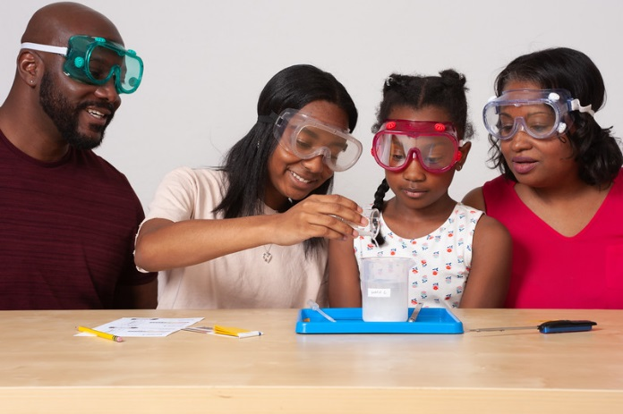
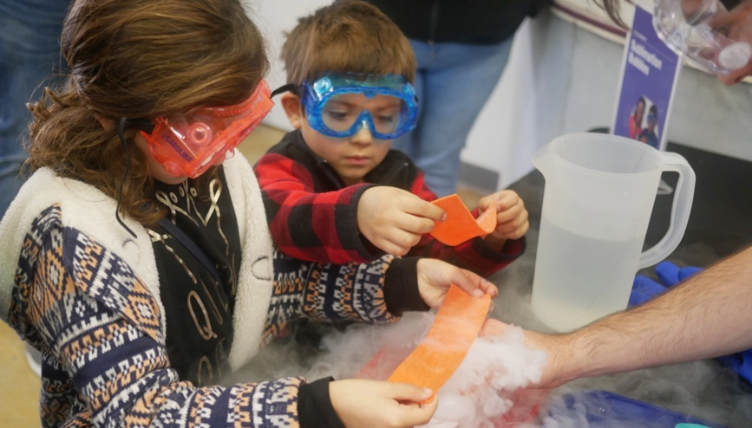
Project Overview Explore Science: Let’s Do Chemistry
Children’s Creativity Museum, San Francisco
Catherine McCarthy
Science Museum of Minnesota
cmccarthy@smm.org May 2019
Association of Children’s Museums - Interactivity

Slide 6
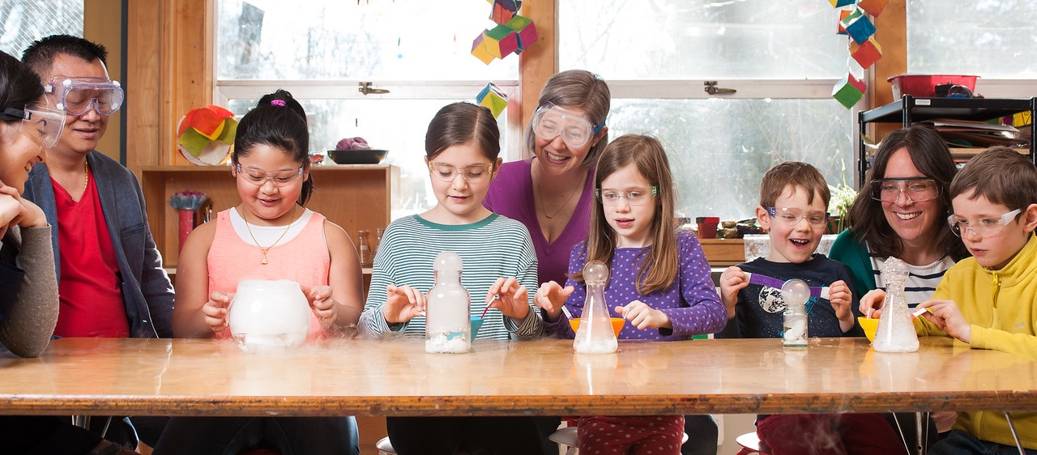
Project Goals Putting research into practice Hands-on activities that increase:
1. Interest,
2. Relevance
3. Self-efficacy
Notes:
This project came out of a need that we saw in the National Academies of Science report about Effective Chemistry Communication
In looking at this report and other literature about public perceptions of chemistry, the project team came to feel that it would be useful to create educational products that focus on changing the public’s attitudes towards chemistry
More particularly, our goals were to create hands-on activities that increase people’s
Interest in chemistry
Understanding of the relevance of chemistry to their lives, and
Feelings of self-efficacy towards chemistry

Slide 7
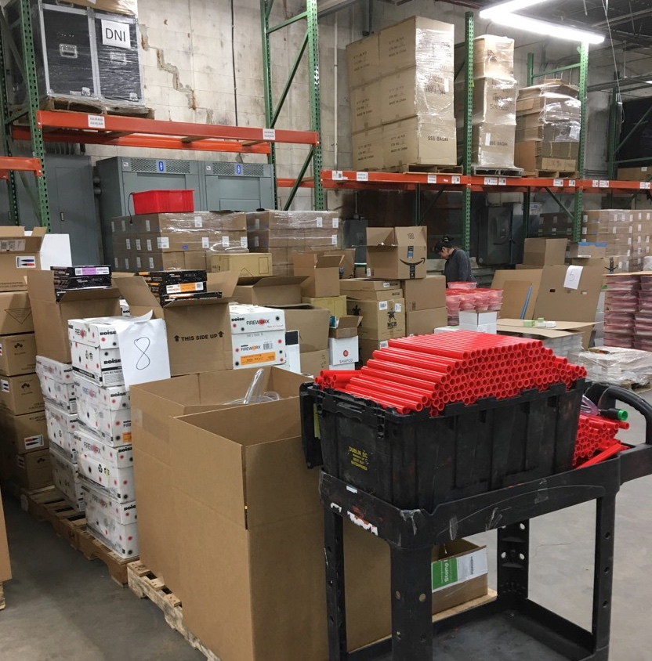
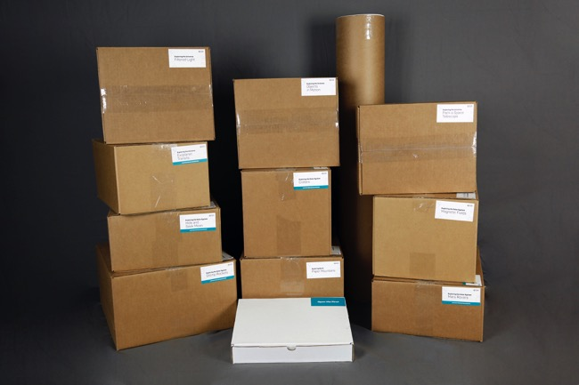
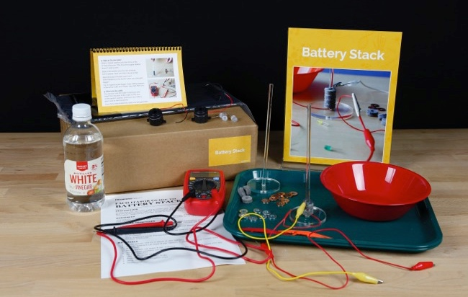
Explore Science: Let’s Do Chemistry kit contents

Slide 8
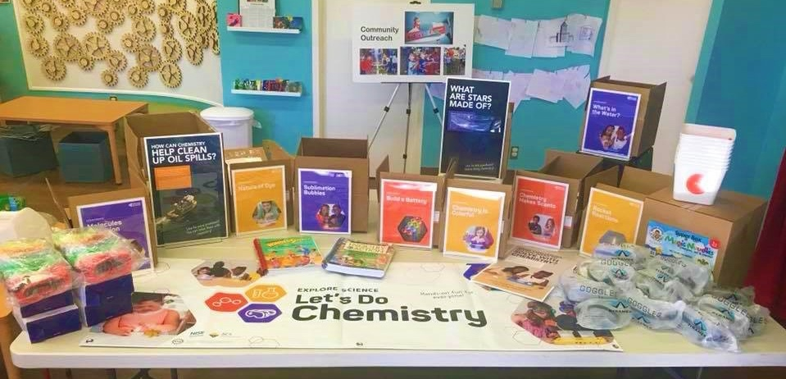
Explore Science: Let’s Do Chemistry kit contents
KidSTREAM
Science Museum of Minnesota
Sciencenter
Museum of Science

Slide 9
Activity Guides
KidSTREAM
Science Museum of Minnesota
Sciencenter
Museum of Science

Slide 10
Training Guides
KidSTREAM
Science Museum of Minnesota
Sciencenter
Museum of Science

Slide 11
Event Planning an Partnerships Guide
Event Planning and Partnership Guide This guide contains everything you will need to begin planning and promoting your Let's Do Chemistry event. Guide covers
Planning timeline
National Chemistry Week
Collaborations and finding local experts
Training staff and volunteers
Additional resources
Evaluating your event
Promotional and marketing materials
Notes:
Explore Science: Let’s Do Chemistry Event Planning and Promotion Guide
http://nisenet.org/catalog/explore-science-lets-do-chemistry-event-planning-and-promotion-guide

Slide 12
Safety Guide
Safety Guide Use this guide as you plan your Let’s Do Chemistry event and as a resource before training, demonstrating, or facilitating the activities. Guide covers
Let’s Do Chemistry kit safety practices and protocols
General chemistry safety guidelines, protocols, and precautions
Additional safety tips
Chemistry materials and supplies
Additional resources
Notes:
Explore Science: Let’s Do Chemistry Safety Guide
http://nisenet.org/catalog/explore-science-lets-do-chemistry-safety-guide

Slide 13
Framework and Strategies
Framework and
Strategies Research to Practice Guide This guide will help you and your facilitators run a fun, successful Let's Do Chemistry event and to encourage positive attitudes toward learning chemistry. Within the guide Guide covers
Let’s Do Chemistry project overview
Learning chemistry in museums
Creating the framework
Understanding the framework
Using the framework
Notes:
Let’s Do Chemistry: A Framework and Strategies to Encourage Positive Attitudes Toward Learning Chemistry in Museums and Informal Settings Guide
http://nisenet.org/catalog/explore-science-lets-do-chemistry-professional-development-and-training-materials-framework

Slide 14
Professional Development Videos
Training videos
Training videos for each hands-on activity intended for staff and volunteer educators
Facilitation video
Chem-Attitudes with Dr. Braxton Hazelby facilitation training video This funny video will help you and your facilitators run activities in a way that encourages participation and positive attitudes towards learning about chemistry.
Notes:
Explore Science: Let’s Do Chemistry Training videos
https://vimeopro.com/nisenet/explore-science-lets-do-chemistry-training-films

Slide 15
Digital Materials
Physical kits
Include USB drive
Digital Download
www.nisenet.org/chemistry-kit

Slide 16
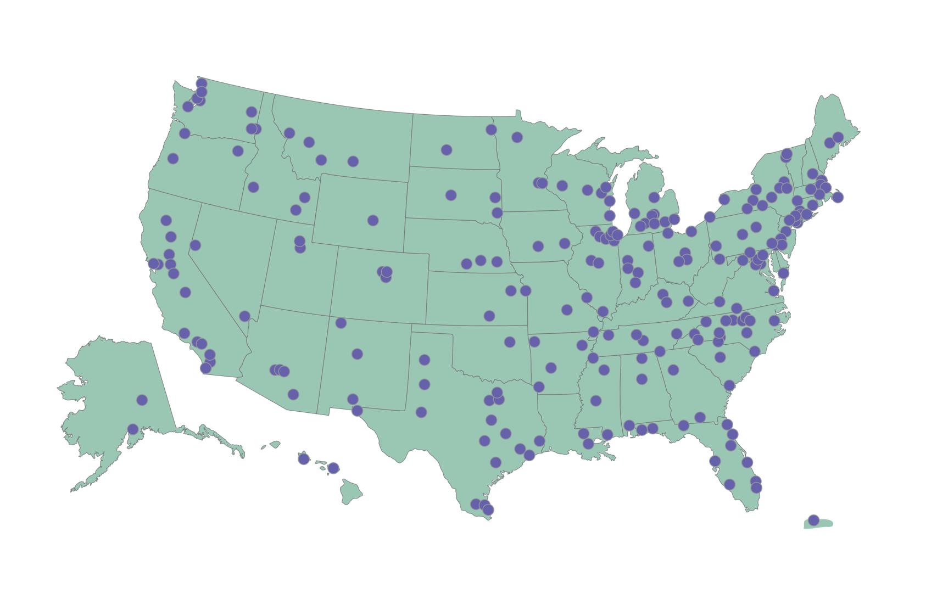
Explore Science: Let’s Do Chemistry kits
250 physical kits distributed across the US
museums, universities, ACS Local Sections & Student Chapters
Notes:
Last year, 250 Explore Science: Let’s Do Chemistry physical kits were developed and distributed to NISE Network partners such as museums, universities, ACS sections and chapters, and chemists all across the country to host a hands-on chemistry public event between October and December. Partners were encouraged to collaborate with their local museum or ACS section/chapter to host these activities during National Chemistry Week, which ran from October 21st-27th.
List:
http://www.nisenet.org/explore-science-lets-do-chemistry-kit-recipients

Slide 17
Who hosted Let’s Do Chemistry events?

Slide 18
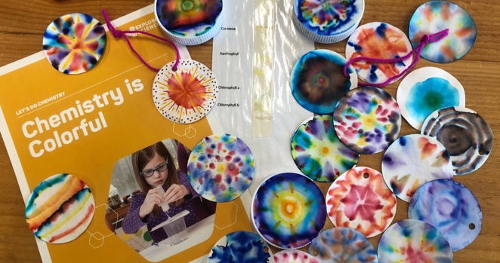
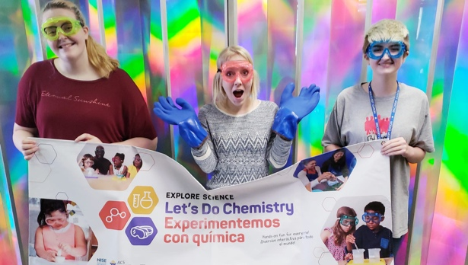
Public audiences reached through chemistry events
Shared by ECHO, Leahy Center for Lake Champlain, VT
210,526 people reached through October-November 2018 Let’s Do Chemistry events across the US
6,121 volunteers participated in and facilitated hands-on activities
Many partners using in other ways
Museum of Science
Discovery Station
Shared by Discovery Station, Hagerstown, Maryland

Slide 19
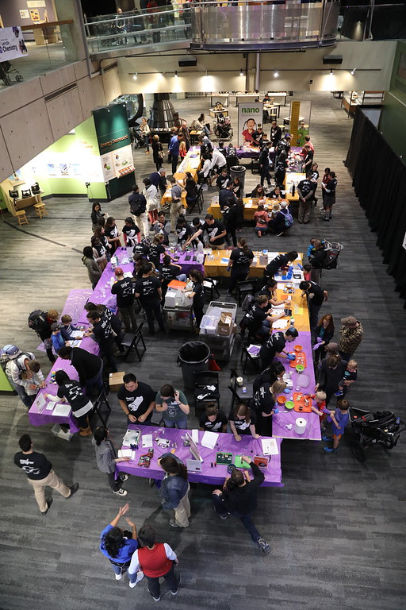
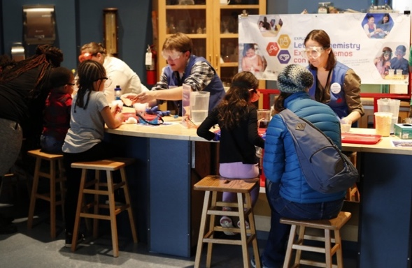
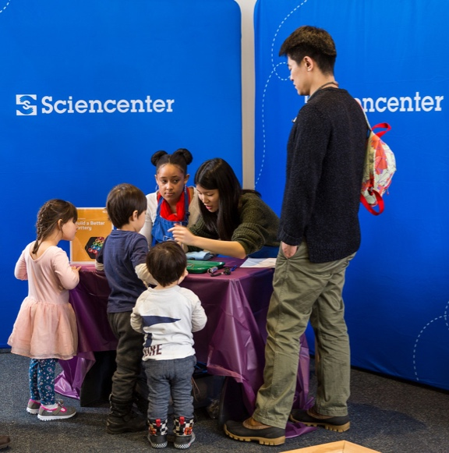
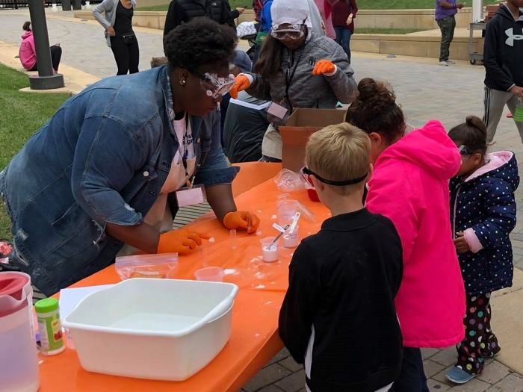
Events across the United States
Science Museum of Minnesota
Shared by Sciencenter
Shared by Discovery Station
Shared by Museum of Science
Notes:
44 ACS groups and 206 NISE Net members were awarded a physical kit that provided training resources and activities for hosting hands-on Let’s Do Chemistry events, which are all unique in location, format, and the audiences they reach. Here are just a few partner event examples.

Slide 20
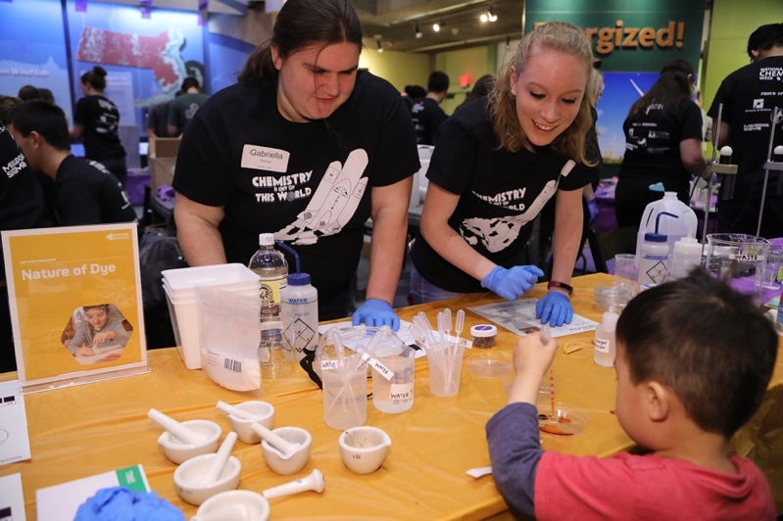
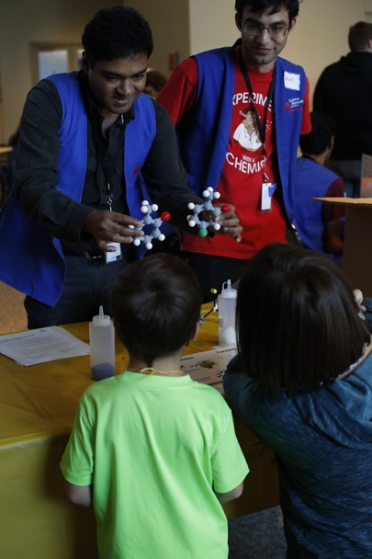
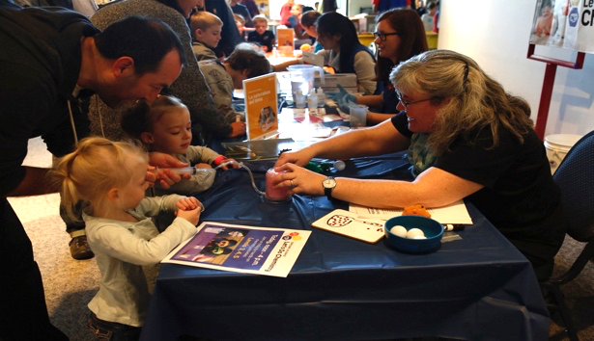
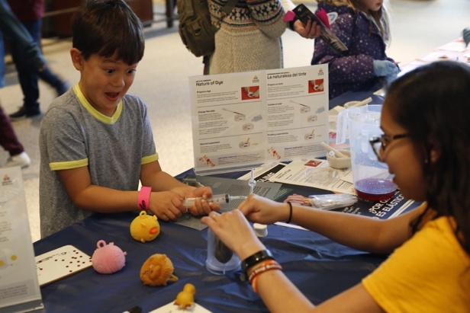
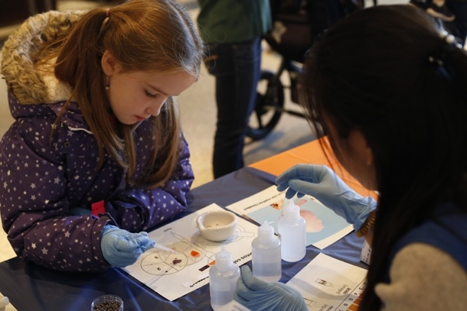
Science Museum of Minnesota, Saint Paul, MN
Events across the United States
Shared by Museum of Science
Museum of Science, Boston, MA

Slide 21
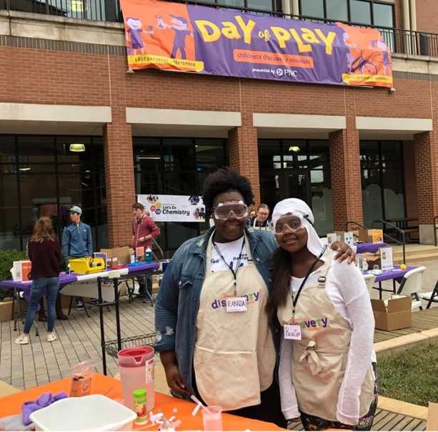
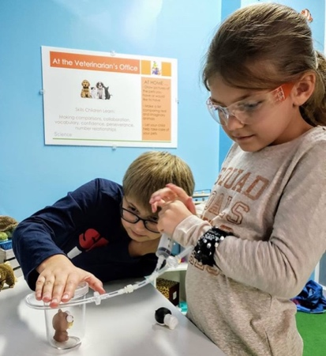
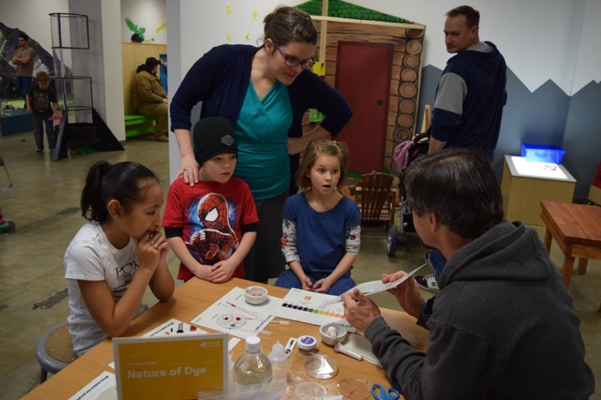
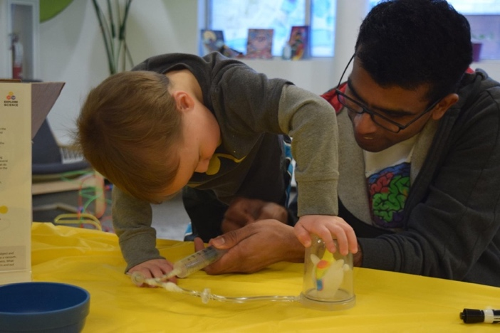
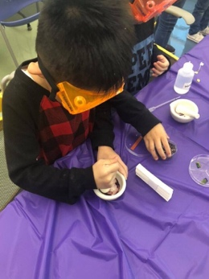
Children's Discovery Museum, Normal, Illinois
Events across the United States
Children's Discovery Museum, Normal, Illinois
Discovery Station, Hagerstown, Maryland
University of Arkansas Center for Mathematics and Science Education
Fairbanks Children’s Museum, Alaska
Fairbanks Children’s Museum

Slide 22
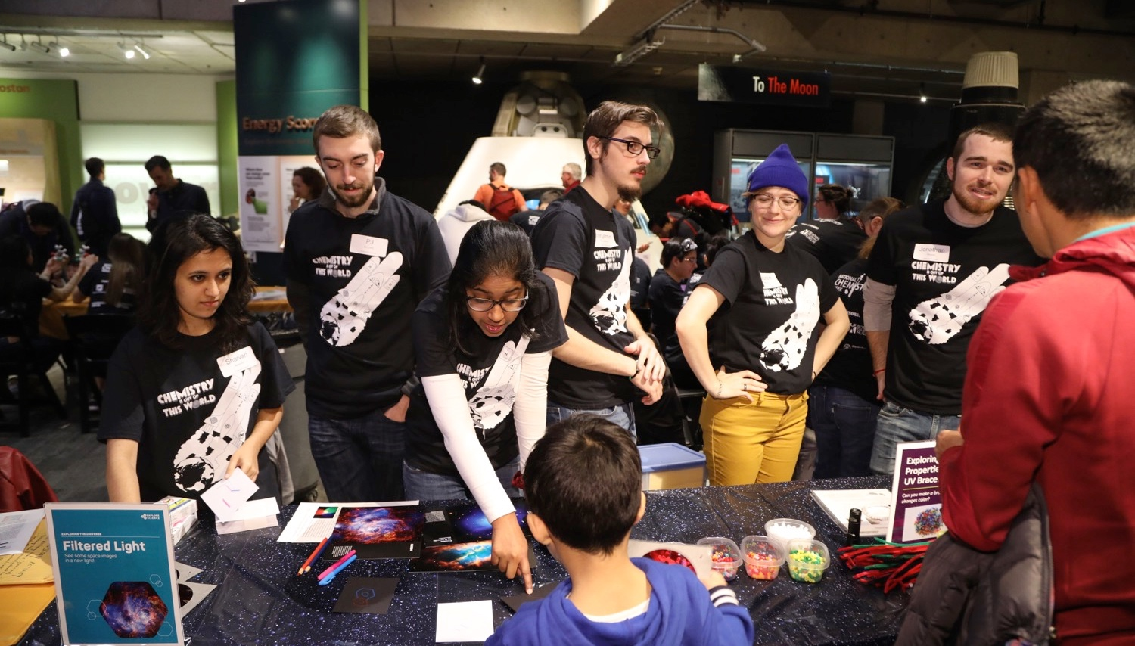
Shared by Museum of Science, Boston
Thank you to museum and chemist partners for hosting Explore Science: Let’s Do Chemistry events!

Slide 23
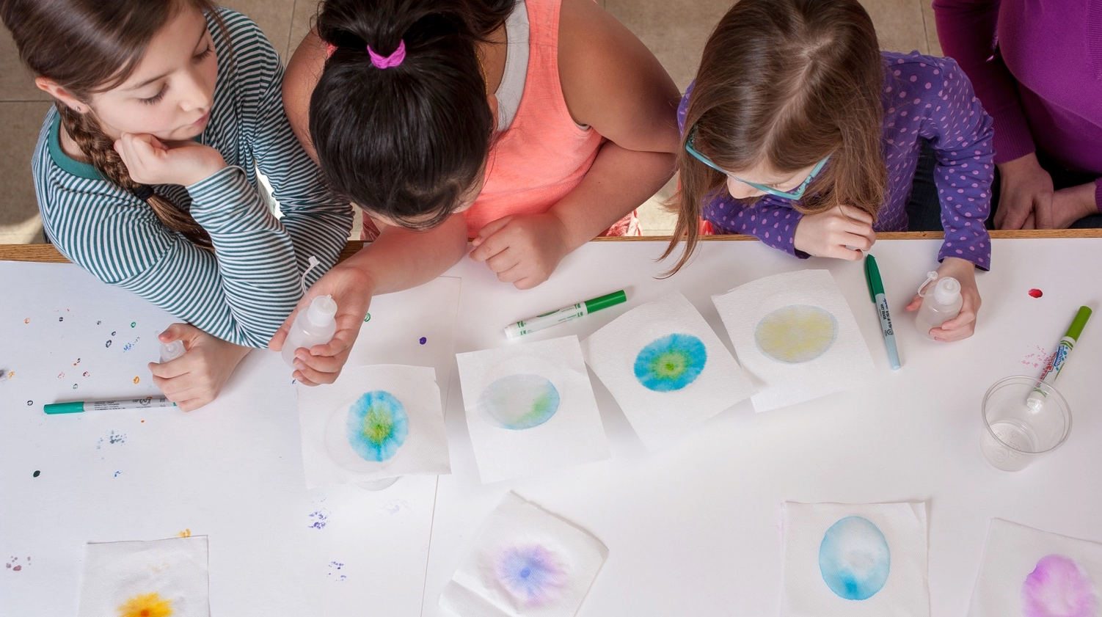
This work is supported by the National Science Foundation under award number 1612482.
Any opinions, findings, and conclusions or recommendations expressed in this presentation are those of the authors and do not necessarily reflect the views of the Foundation.

Slide 24
Gum &
Chocolate

Slide 25
Gini Philipp
WOW! Children’s Museum
Lafayette, CO

Slide 26
Gini Philipp, Director of Early Childhood Education
Lafayette, CO

Slide 27
Let's do Chemistry with Little Learners

Slide 28
Chemistry with toddlers?!
Notes:
At WOW! Children's Museum, our main demographic of children is 0-5, so when we offer activities to these friends, we are sure to make them age appropriate. I know your first reaction might be surprise when you hear chemistry with toddlers. But chemistry can be accessible for children very young if you know how to do it. Chemistry is the science of composition, structure, and properties of matter. Safety and education first! On the museum side, we are sure to have adequate space and supervision for exploring chemistry with small children. Then comes parent education, we provide easily understandable instructions and background on the project and what it all means, how it relates to chemistry, the Let's Do Chemistry kits offer a great background on each of their kits and how it applies to chemistry.

Slide 29
Molecules in Motion
Notes:
When practicing chemistry with children, it is important to offer the space and time for many different iterations and trials with materials. Molecules in Motion is a great example of this: it's a simple project, done with adult support, that toddlers and young children love! They want to do it many times with all the animals they can. Introduce words like molecule, vacuum, suction. This activity provides opportunities for gross and fine motor skill building.
One thing to be mindful of here: the eyeballs sometimes pop off and are choking hazards, so keep close eyes on this project.
Moon sand is another interesting tool for chemistry with toddlers! It is an exploration in states of matter. Though your young child may not yet understand the concept of solids and liquids, this is a great starter activity to introduce those vocabulary words.

Slide 30
Loose Parts: Chemistry
Notes:
Some of you may or may not be familiar with loose parts. For those of you unfamiliar, loose parts are open ended provocations, designed for little hands. Things like wooden spools, tree cookies, ribbon, kitchen utensils, etc.
Instead of expecting infants and toddlers to complete a chemistry experiment, I instead offered them the opportunity to tinker with the materials with our Let's Do Chemistry set! By removing the expectation of "how to engage" with the chemistry sets, I opened the possibility of learning for our little chemists. This activity can be used as a launch for learners to spend time with gain familiarity with specific materials at the earliest stages of inquiry.

Slide 31
Let's Do Tinkering!

Slide 33
Barb McMillan The Children’s Museum in Oak Lawn
Oak Lawn, IL

Slide 34
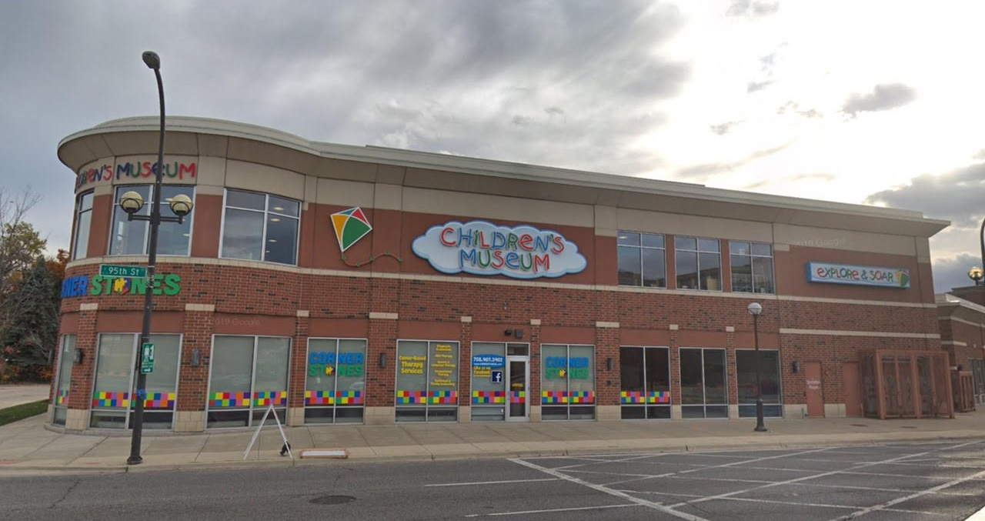
Children’s Museum in Oak Lawn
KidSTREAM
Science Museum of Minnesota
Sciencenter
Museum of Science

Slide 35
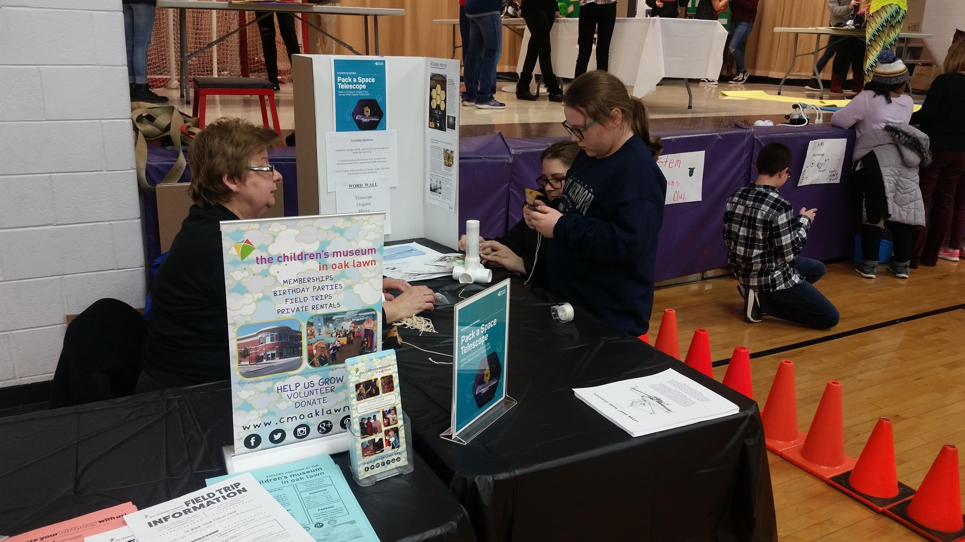
Children’s Museum in Oak Lawn
KidSTREAM
Science Museum of Minnesota
Sciencenter
Museum of Science

Slide 36
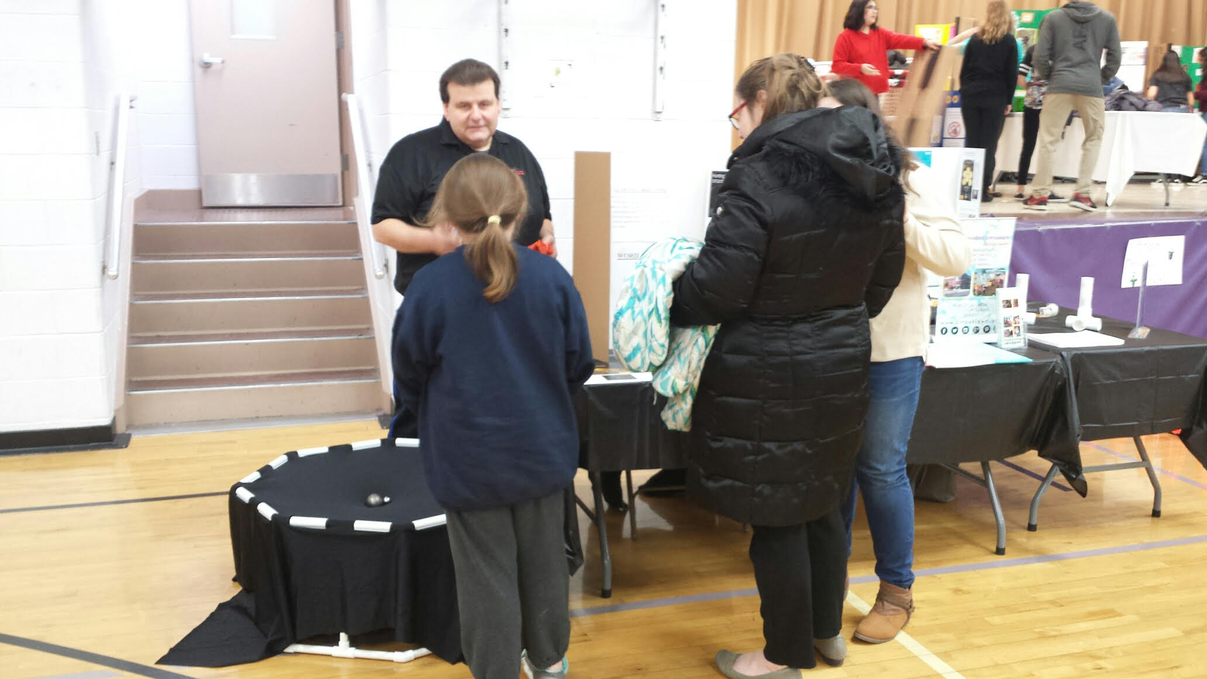
Children’s Museum in Oak Lawn
KidSTREAM
Science Museum of Minnesota
Sciencenter
Museum of Science

Slide 37
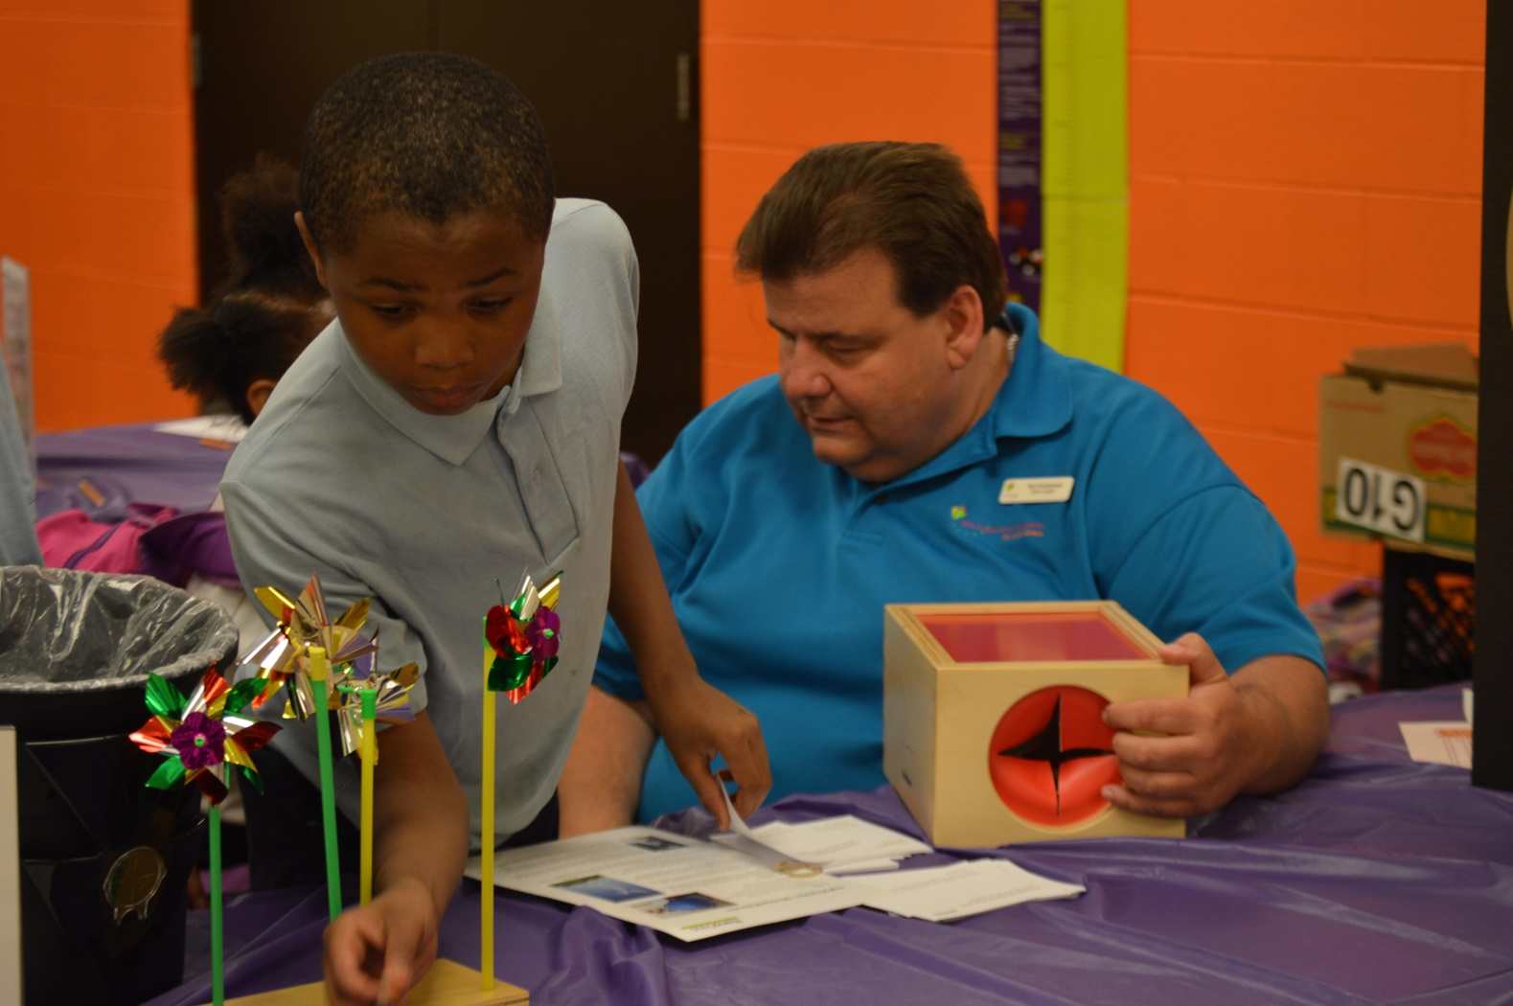
Children’s Museum in Oak Lawn
KidSTREAM
Science Museum of Minnesota
Sciencenter
Museum of Science

Slide 38
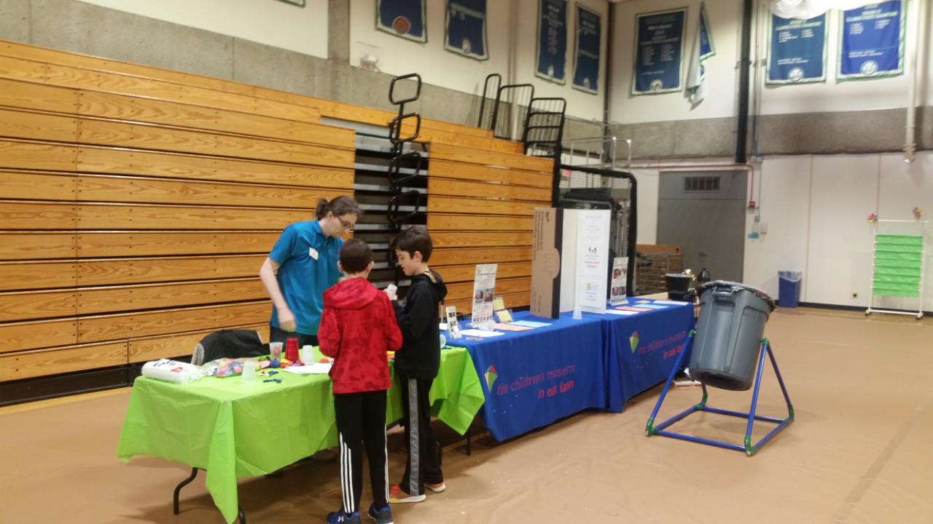
Children’s Museum in Oak Lawn
KidSTREAM
Science Museum of Minnesota
Sciencenter
Museum of Science

Slide 39
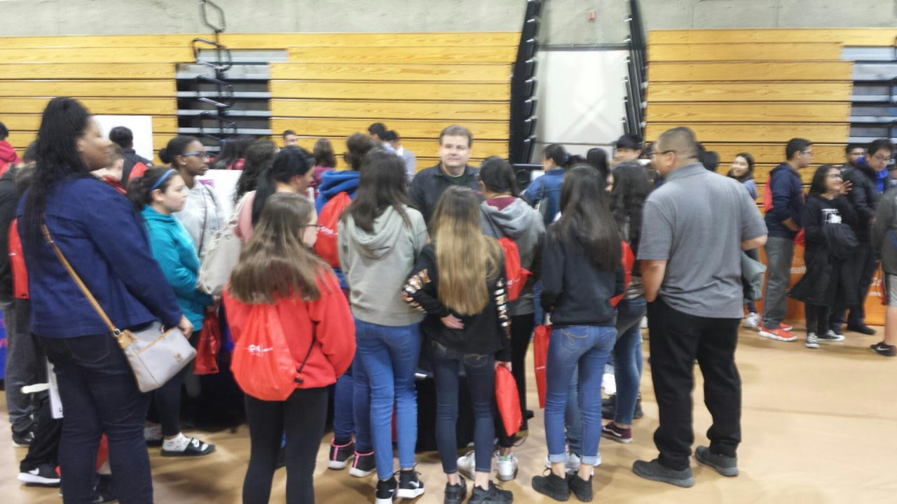
Children’s Museum in Oak Lawn
KidSTREAM
Science Museum of Minnesota
Sciencenter
Museum of Science

Slide 40
Frank Kusiak Lawrence Hall of Science,
Berkeley, CA

Slide 41
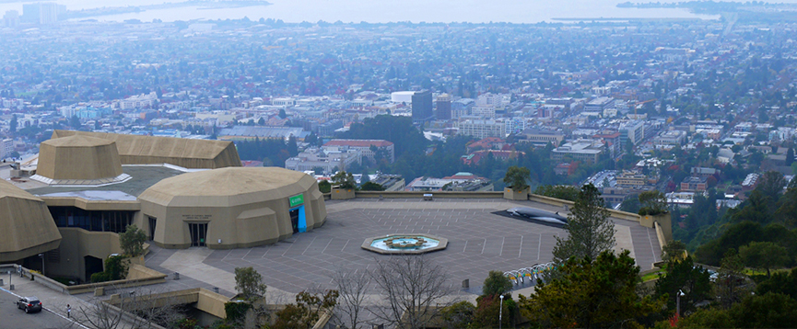
Getting Chemistry Event Help
Frank Kusiak
frank_kusiak@berkeley.edu
May 9, 2019

Slide 42
Chemistry Peeps
Public Science Center for UC Berkeley
170,000+ total visitors per year
60,000 school-aged children (mostly preK - 6)

Slide 43
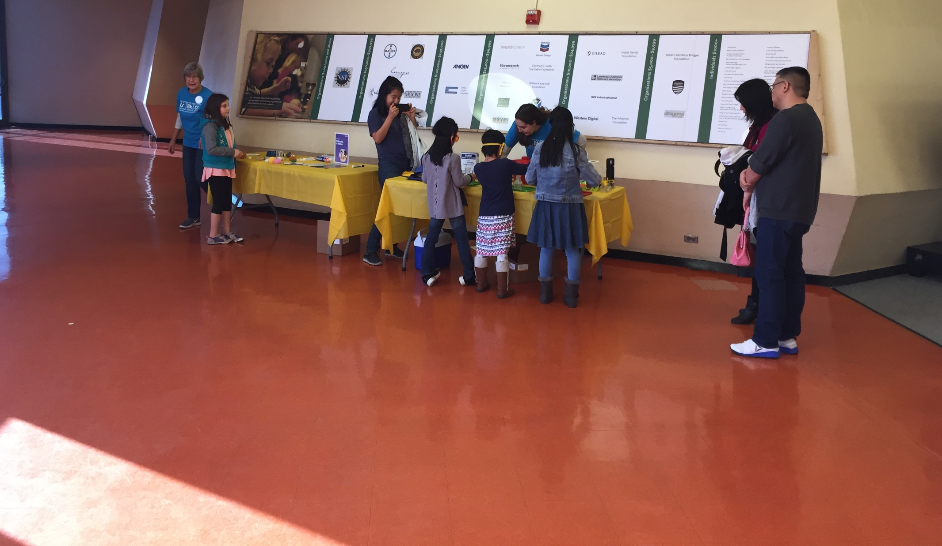
www.nisenet.org

Slide 44
Reaching Out to
Subject Matter Experts
American Chemical Society
National Chemistry Week (Last full week of October)
2019 Theme: Marvelous Metals
National Chemistry Week Coordinator Look Up: http://bit.ly/acs-coordinators
ACS Student Chapters: http://bit.ly/acs-student-chapters

Slide 45
Alternative SME’s
Chemistry Departments/Research Center
Major universities chemistry/research departments have an outreach coordinator(s)
Find the “Contact Us” webpage and call them.
Chemistry Honor Societies
Gamma Sigma Epsilon
Phi Lambda Upsilon
Local High School/Middle School
http://bit.ly/acs-chemclub
Local industry

Slide 46
What do you say?
Be clear who you are and what your museum is.
Have a date and time frame in mind, but make sure it’s 3-4 months in advance.
For a college/university, be mindful of when your event is and how it fits in the academic calendar. Be flexible if your event is far enough out.
Be open to who will be willing to help:
it may be the outreach coordinator, faculty, or a student chapter!
Do you want just one person to help your staff understand concepts or do you want many volunteers?
Do you want to pair your volunteers with those coming from the university/club?
Don’t make their commitment onerous (NISE materials help!)

Slide 47
So You Got An SME!
Prepare them by being very clear what’s expected and what they will expect.
For NISE materials:
we provide materials digitally: send them the activity and facilitation guides in advance.
We also have activity training videos which are probably better than the guides for onboarding.
We also have training videos for SME’s!
http://bit.ly/nise-training-videos
Be prepared to maintain this relationship because there’s a lot of turnover on both sides!

Slide 48
This work is supported by the National Science Foundation under award number 1612482.
Any opinions, findings, and conclusions or recommendations expressed in this presentation are those of the authors and do not necessarily reflect the views of the Foundation.

Slide 49
This work is supported by the National Science Foundation under award number 1612482.
Any opinions, findings, and conclusions or recommendations expressed in this presentation are those of the authors and do not necessarily reflect the views of the Foundation.

Slide 50
Discussion
Sub headline here
Notes:
RAE

