Slide 1
Creating fun and guiding learning!
Techniques for excellent facilitation
ACM Interactivity 2019
Thursday, May 9, 12:45pm-2:00pm

Slide 2
Session overview
Introductions
Science activity facilitation
Making + tinkering activity facilitation
Discussion and resources

Slide 3


Presenters
Rae Ostman, Arizona State University
Brad Herring, Museum of Life and Science
Ali Jackson, Sciencenter
Chip Lindsey, Children’s Museum of Pittsburgh

Slide 4

Please stand up!

Slide 5
How much experience do you have in children’s museums?
A LITTLE SOME A LOT

Slide 6
How much experience do you have delivering programs?
A LITTLE SOME A LOT

Slide 7
How much experience do you have with science activities?
A LITTLE SOME A LOT

Slide 8
How much experience do you have with making + tinkering activities?
A LITTLE SOME A LOT

Slide 9
How much experience do you have training others?
A LITTLE SOME A LOT

Slide 10
Welcome!
We’re glad to have you.

Slide 11
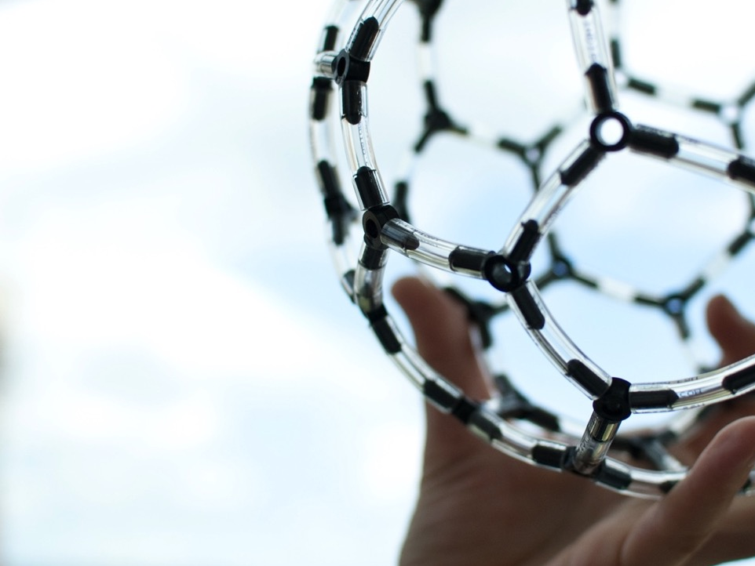
HANDS-ON
SCIENCE

Slide 12
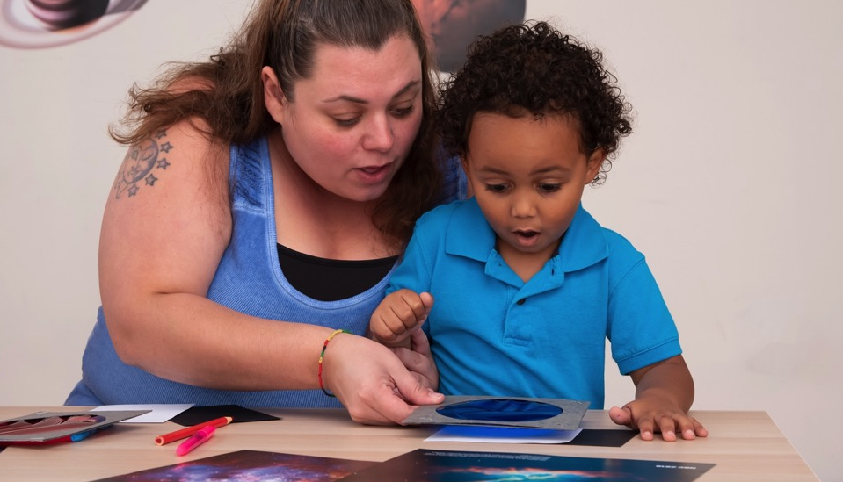
The National Informal STEM Education Network (NISE Net) is a community of informal educators and scientists dedicated to supporting STEM learning.

Slide 13
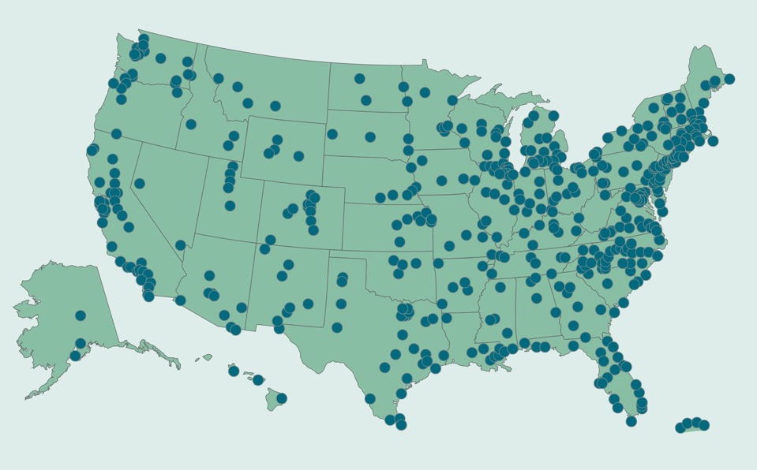
Hundreds of organizations participate in the NISE Network.

Slide 14
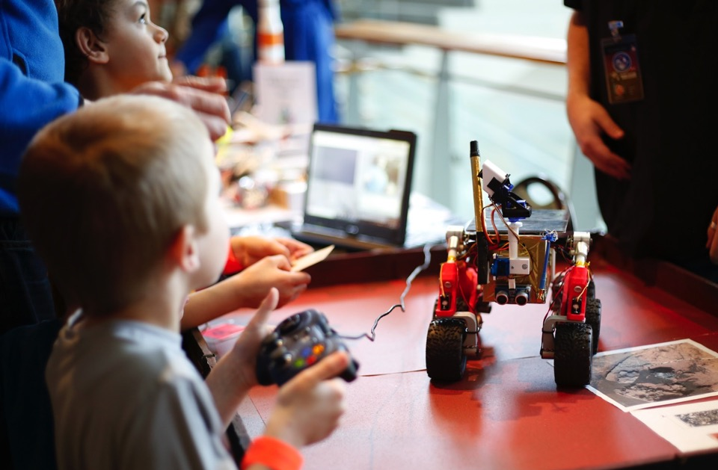
Together we reach millions of people a year!

Slide 15
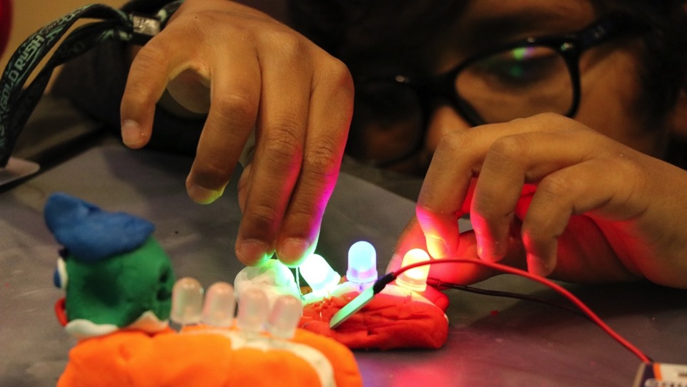
We have projects and resources for many different STEM topics
(Science, Technology, Engineering, Math)

Slide 16

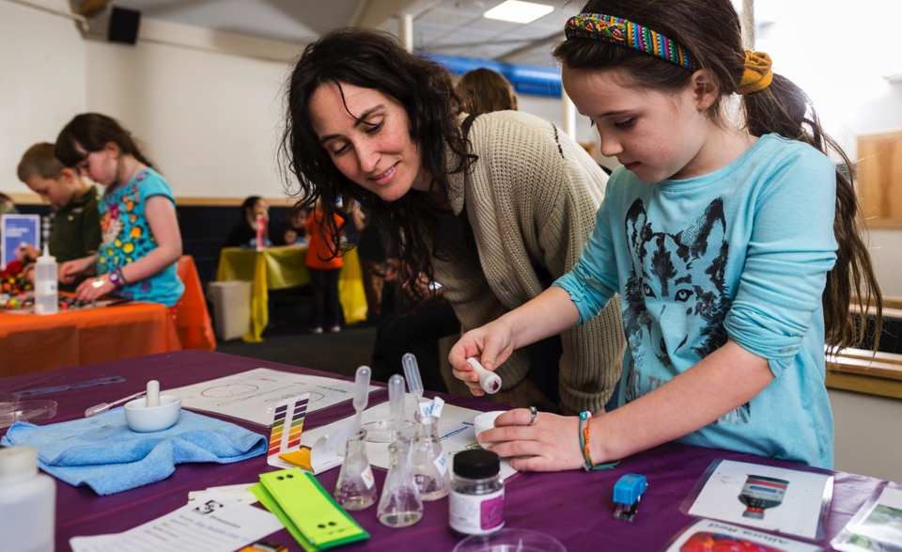
Explore Science: Let’s Do Chemistry
NISE Network and American Chemical Society

Slide 17
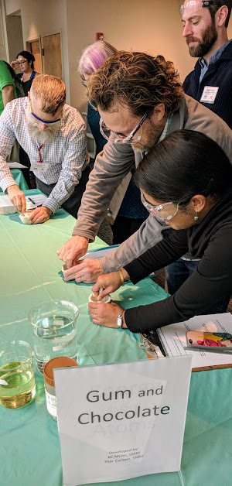
Design-based RESEARCH on ways to increase positive attitudes:
interest
relevance
self-efficacy
Resources to support professional PRACTICES:
activity design
activity facilitation
staff training

Slide 18
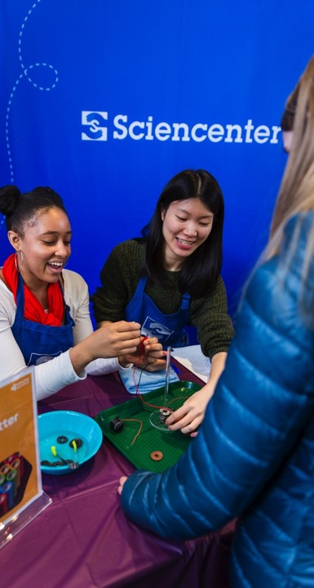
FINDINGS
Good facilitation practices support chemistry engagement and learning generally
Practices that are important for chemistry also apply to other areas of STEM

Slide 19
ROLE OF THE FACILITATOR
To encourage positive attitudes, focus on: | And don’t worry as much about:
Fostering a fun experience Building confidence Sharing excitement Finding concrete connections Exploring with someone Offering guidance and suggestions Asking questions | Getting across a lot of facts Developing deep knowledge Writing equations Mastering abstract ideas Explaining to someone Showing the “right” way Providing answers
Notes:
The most important role of the facilitator of Let’s Do Chemistry activities is to create a positive learning environment, which helps participants develop positive attitudes toward learning chemistry.

Slide 20
FACILITATION STRATEGIES
15%
58%
22%
Invite participation | Support exploration | Deepen understanding
Greet participants Model what to do Engage the whole group Have fun! | Let participants do the activity Be flexible and attentive Ask guiding questions Be a good listener Use simple, clear language Offer positive feedback Support learners through challenges | Ask discussion questions Make connections Share what you know Acknowledge what you don’t know Wrap up
Self-efficacy
Relevance
Notes:
6% other
Positive relationships between strategies that support exploration and learners increasing their sense of self-efficacy
And strategies that deepen understanding and learners increasing their sense of relevance of chemistry

Slide 21
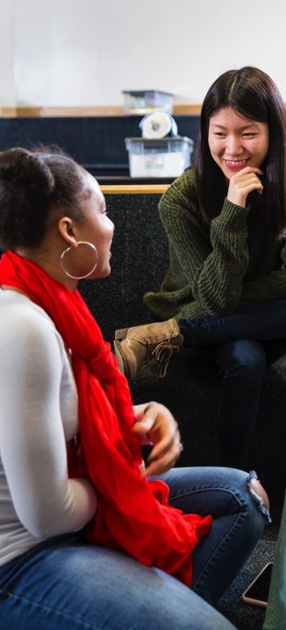
TRAINING
Improv exercises
Hands-on activities and games
(Guides, slides, and videos)

Slide 22
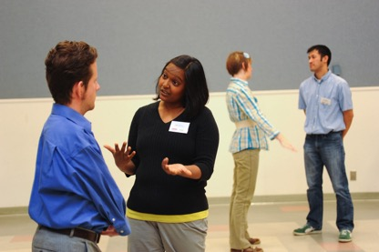
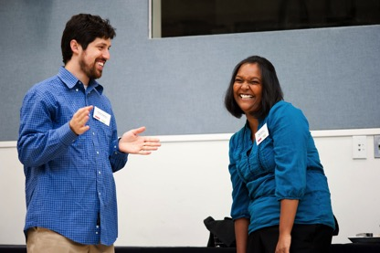
What’s in the Box?
Improv Exercise
Everyone find a buddy.
Person A walks up to person B holding a mimed box.
Person B steps forward and asks, “What’s in the box?
Person B opens the box and announces the content, with whatever they imagine.
Person A gives a specific reason for giving the gift to Person B. The reason should explain how the gift meets one of their partner’s needs.
Person B accepts the reason given by their partner and adds information to help support it.

Slide 23
What’s in the Box?
Debrief
Debrief questions
How did you know what was in the box? What did you do to figure out what was inside?
Who was surprised by what was in the box they were carrying?
How would you describe your experience in this exercise? What helped us be successful?
What techniques did you use to come up with a specific reason that the gifts were great?
How could you apply these techniques to engaging with guests? What is a specific example from your experience?

Slide 24
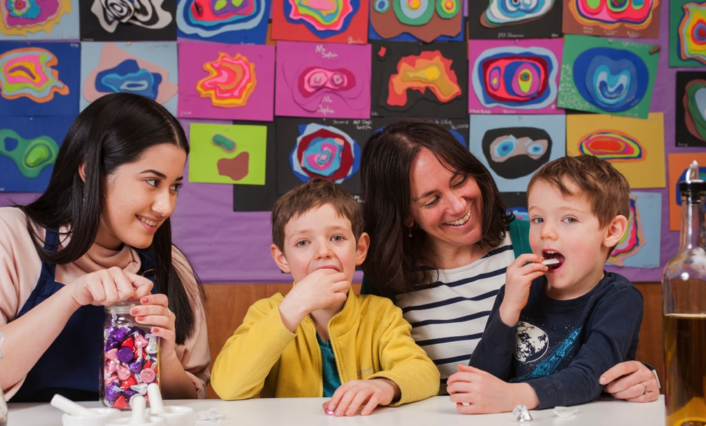
GUM & CHOCOLATE
Notes:
First, let’s start by experiencing some chemistry in action! Together, we’re going to do a hands-on (mouths-on!) chemistry activity. This activity requires eating gum and chocolate, so please let me know now if you have any food sensitivities or allergies.
Refer to the training guide included in the Let’s Do Chemistry kit for instructions and tips. If a participant is unable to complete this activity due to food allergies or sensitivities to gum or chocolate, invite them to partner up with another participant to share observations.
***You can also share this activity with public audiences, but please remember to specifically be aware of food sensitivities and allergies. The gum and chocolate in this activity also present a choking hazard to children under 3.***

Slide 25




Online digital library:
nisenet.org
Monthly newsletter
nisenet.org/newsletter
Social networking: nisenet.org/social

Slide 26


THANK YOU
The Nanoscale Informal Science Education Network was supported by the National Science Foundation under award numbers 0532536 and 0940143. Multi-Site Public Engagement in Science is supported by the National Science Foundation under award number 1421179. Increasing Learning and Efficacy is supported by the National Science Foundation under award number 1516684. ChemAttitudes is supported by the National Science Foundation under award number 1612482. Any opinions, findings, and conclusions or recommendations expressed in this presentation are those of the authors and do not necessarily reflect the views of the Foundation.
Space and Earth Informal STEM Education is supported by NASA under cooperative agreement number NNX16AC67A and 80NSSC18M0061. Moon and Beyond is supported by NASA under grant number 80NSSC18K1219. Any opinions, findings, and conclusions or recommendations expressed in this material are those of the author(s) and do not necessarily reflect the view of the National Aeronautics and Space Administration (NASA).

Slide 27
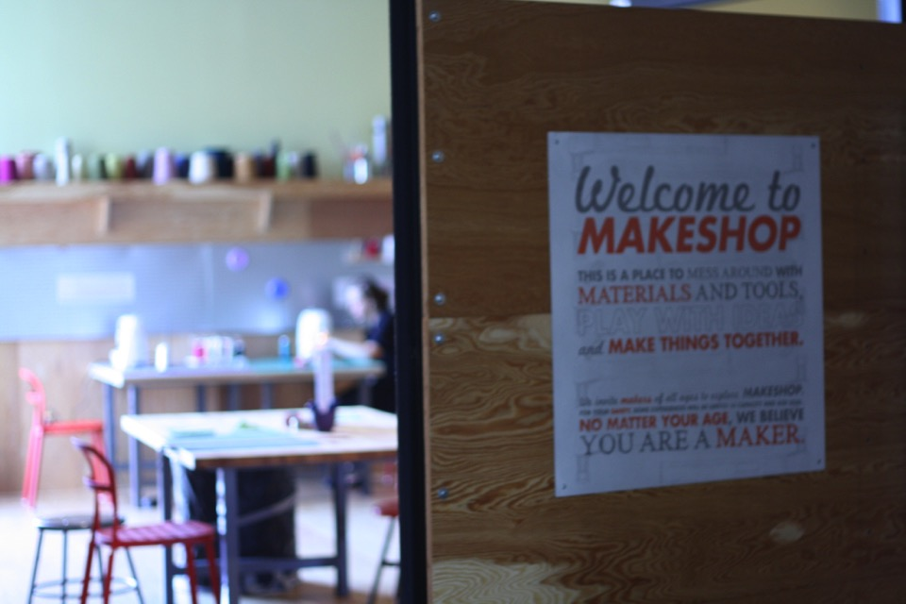

Making Connections: Learning Through Making

Slide 28
Facilitation of Making
Maker Educators play an essential role in supporting learning through facilitation:
Questioning & Discussion
Collaborative Engagement
Design of Space & Interpretive Materials
Modeling
Notes:
Facilitation might mean hands on co-learning between an educator and visitors. It might mean an interactive discussion with learners while they are engaged. It might even mean creating and strategically displaying signs or resources in the space to further learners’ creative process. Ultimately, facilitation means using an awareness of the maker-program’s goals to facilitate learners toward a particular learning objective.

Slide 29
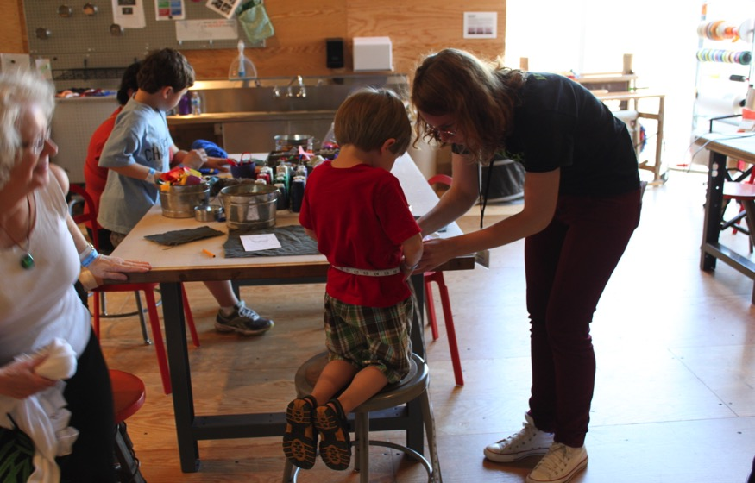
Facilitation of Making
Key component to maker-based learning experiences
Learned skill of maker educators
Need for both professional learning and theory-building
Notes:
“Staff over Stuff”
We view Making in the Museum as a Designed Activity
Design of Space, Activity and Facilitation
Need for both professional learning for educators to build skill, shared language and a reflective practice around facilitation and for theory building about what constitutes good maker-based facilitation and why.

Slide 30
Making Connections
Using an awareness of the maker-program’s goals to facilitate learners toward a particular learning objective
Making Connections
Learner Types
Learning Practices
Facilitation Strategies

Slide 31


Learning Practices of Making
Inquire
Tinker
Seek and Share Resources
Simplifiy to Complexify
Express Intent
Develop Fluency
Hack and Repurpose
Notes:
The Learning Practices of Making is an empirically identified framework that describes observable behaviors of learners in MAKESHOP. These practices represent the learning objectives that we value and design to support in MAKESHOP, and were identified through a comparative research study funded by the Institute of Museum and Library Services to identify, describe and support family learning in museum-based makerspaces.
We use a practice-based approach to identify and describe learning (e.g. Brown, Collins & Daguid, 1989; Lave & Wenger, 1991). In this way, we are focusing on the behaviors—the actions and interactions of learners as they engage in making as a learning process.
By focusing on learning practices, we have built a framework that serves as a conceptual tool for describing, identifying and ultimately designing for making as a learning process.
Using an iterative design-based improvement model, research-practice teams focus on the behaviors—the actions and interactions of learners as they engage in learning processes, rather than on the end results of their experience. Viewing learning in this way, the learner and the learning experience are at the center of design.
By identifying definitional practices, as learning objectives, we have developed a common language around making as a learning process among our educators that is practice-based. This common language guides ongoing discussions about design—of space, activity and facilitation--that support learning.
It enables us to make empirical claims about learning through making based on the actions, interactions and work of making as it is being carried out in context.
We include these Learning Practices as an example of “learning objectives” for this game. It is recognized that these Learning Practices may not reflect the learning objectives of every program or organization; rather they represent one empirical lens of consideration, and can be used for further reflection and identification of learning goals relevant to diverse contexts of practice.

Slide 32


Facilitation Strategies
Simple Interactions
Research-Practice Partnership with the Akiva Lab at the University of Pittsburgh
Strategy identification by engaging educators in reflective practice by watching videos of their own interactions with visitors
Not a “one size fits all” approach to facilitating successful maker-based learning experiences
Notes:
Facilitation Strategies: Educators use an assortment of techniques to facilitate different types of learners’ engagement in a maker-based learning experience, towards a particular learning objective. These cards include a variety of these strategies.
The strategies included in the game were derived through a partnership between the research-practice team of MAKESHOP and Simple Interactions, a project of the Akiva Lab at the University of Pittsburgh. Simple Interactions (simpleinteractions.org) is a process of engaging facilitators in reflective practice by watching videos of their own interactions with visitors and using the Simple Interactions model to identify and describe strategies used in supporting interactions with individuals and groups as opportunities for learning. This model recognizes that there is not a “one size fits all” approach to facilitating successful maker-based learning experiences, and therefore includes a range of possible strategies that a maker educator might apply while facilitating.

Slide 33
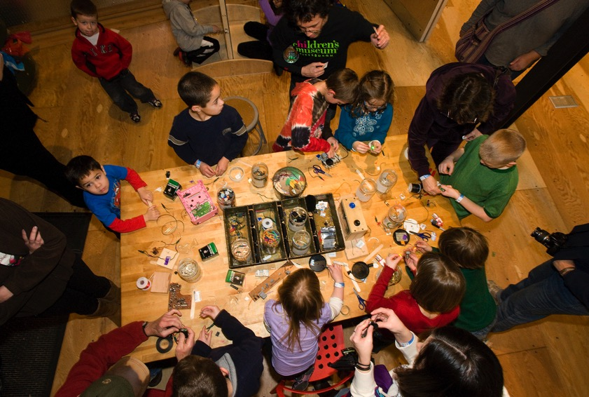
Learner Types
The Novice
The Observer
The Hesitator
The Template-Bound
The Lone Wolf
The Window Shopper
The Lifeguard
The Scout
Notes:
Learners approach a making experience with many different motivations, interests, questions and ways of being. These cards identify a range of archetypes, or examples of the kinds of leaners who may engage in making.
These types were identified through a partnership study between the Children’s Museum and the Entertainment Technology Center at Carnegie Mellon University (ETC). ETC provided a design team of master’s students to work with the museum. The design team conducted observations of facilitated interactions between learners and educators in MAKESHOP. Through their observations, and ongoing discussion with the research-practice team at MAKESHOP, they derived a learner behavior model that enabled the identification of the eight learner types included in the game.

Slide 34
How to Play the Game
Divide into groups of 5-6 players
Distribute 5-10 Facilitation Strategy Cards to each player randomly
Place one Leaner Type card and one Learning Practice card face up on the table as a pair
Each player chooses one Facilitation Strategy from their hand that they feel could be used to best facilitate the selected Learner Type’s engagement in the selected Learning Practice, and places this card on the table
After each player has played their cards, the group discusses the reasoning and approach of each presented strategy
Repeat using different combinations of Learner Types and Learning Practices.

Slide 35
thank you
www.makinginmuseums.org
www.makeshoppgh.org
www.pittsburghkids.org

