Slide 1
Working together toward better co-creation
Leigh Ann Mesiti Caulfield
Mad*Pow
Elizabeth Kunz Kollmann
Museum of Science, Boston
Claire Quimby
Rockman et al Cooperative
Notes:
Hello, and welcome to our session, “Working together toward better co-creation”
I know there have been a lot of sessions about co-creation over the course of the conference, so thank you so much for joining us.
Our goals for today’s session are:
To help you think about co-creation as a process that can play out in a number of different ways
To invite you to discuss the nuances of co-creation projects and how specific attributes may be stronger or weaker in different projects
To help you think about how you might be able to move the co-creation needle a little further in your projects
Session Goals
To help audience see that co-creation is a process rather than a destination
To invite discussion about the nuances of co-created projects and how specific co-creation attributes may be stronger or weaker in certain projects
To help audience think about how they might move the co-creation needle a little further in their projects while having realistic expectations for their teams and partners

Slide 2
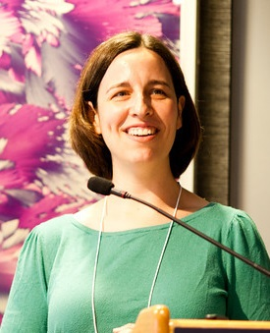
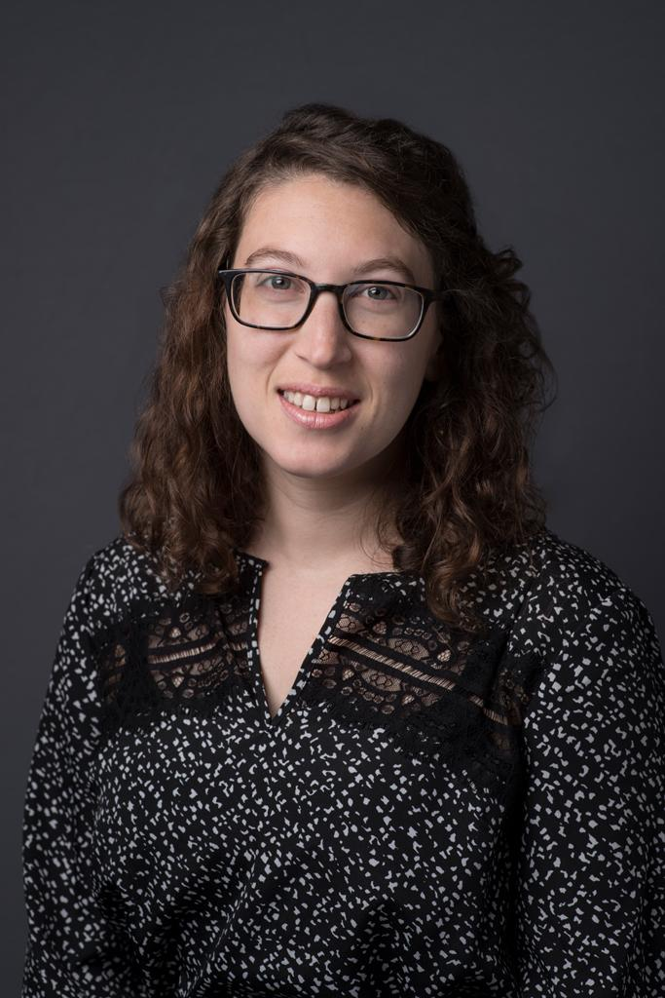
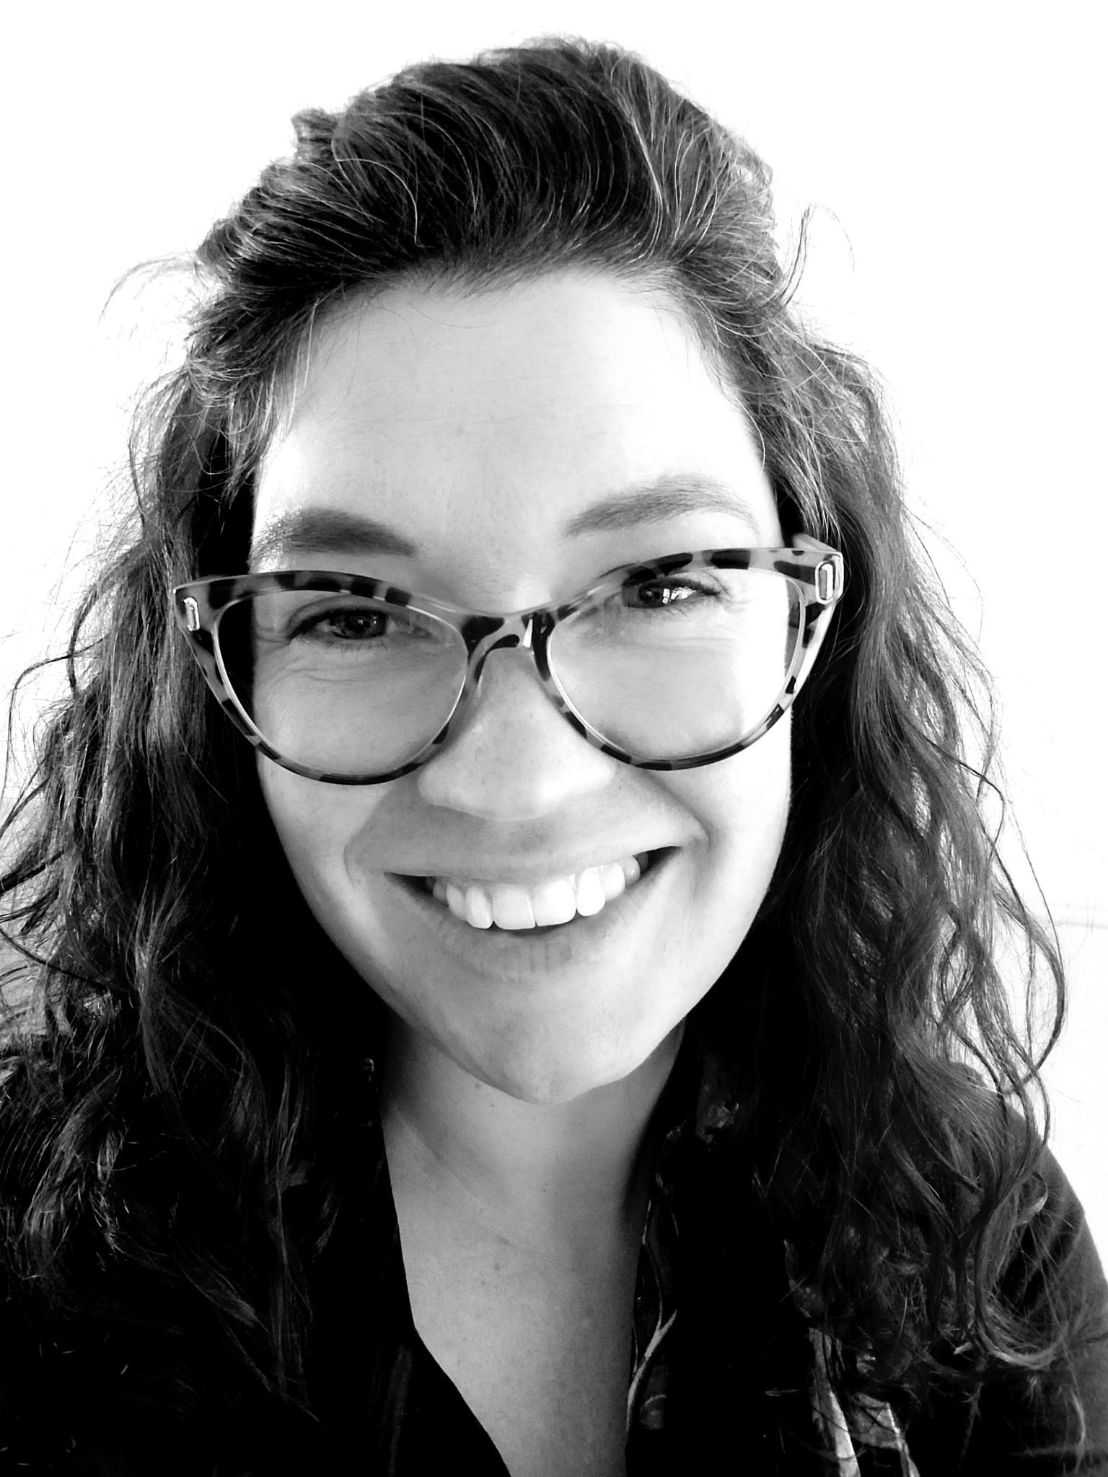
Who we are
Liz Kollmann
Director, Research and Evaluation
Museum of Science, Boston
Leigh Ann Mesiti Caulfield
Senior Experience Researcher
Mad*Pow
Claire Quimby
Senior Research Associate
Rockman et al Cooperative
Notes:
Hopefully, we will do all of this while also providing a slightly different perspective on co-creation.
All of us are researchers and evaluators who have a been a part of projects that used co-creation
This allowed us to think about what the goals for co-creation are and how they can be achieved (or not) in projects
My name is Liz Kollmann, and I am the Director of Research and Evaluation at the Museum of Science, Boston
I am also the co-PI of a project called Co-Created Public Engagement with Science that you will hear a little more about later
Leigh Ann
Claire

Slide 3
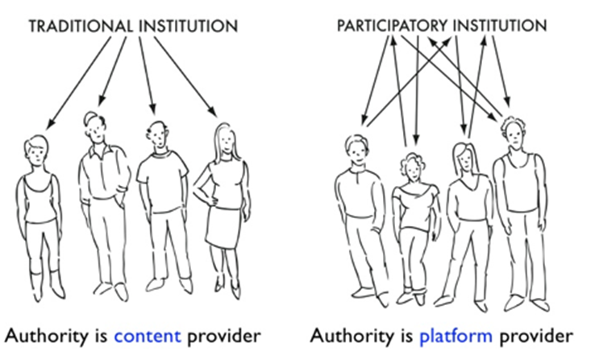
What is co-creation?
“In co-creative projects, community members work together with institutional staff members from the beginning to define the project’s goals and to generate the program or exhibit based on community interests.”
Simon, N., & Atkins, J. R. (2011). The Participatory Museum. Santa Cruz: Museum 2.0.
Notes:
So what is co-creation
One definition from the book The Participatory Museum is that
“In co-creative projects, community members work together with institutional staff members from the beginning to define the project’s goals and to generate the program or exhibit based on community interests.”

Slide 4
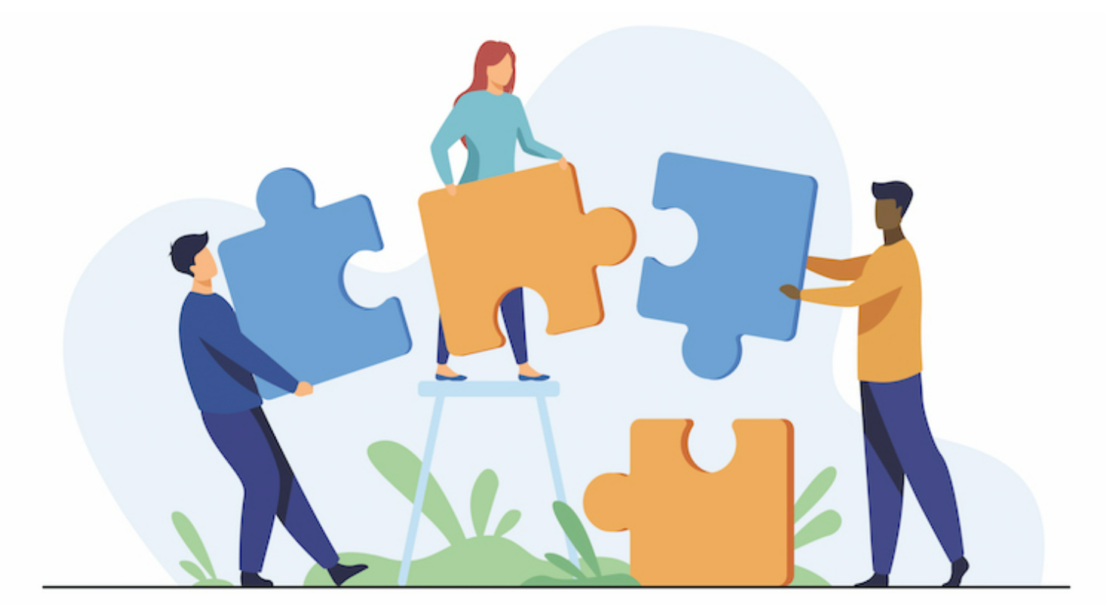
What makes a project “co-creation”?
What are the values or attributes of “co-creation”?
Go to slido.com and enter code: #cocreateastc
Notes:
When you hear this definition and think about your own experiences, what is makes a project co-creation to you? What are the values or attributes of co-creation?
Please go to slido.com and put in the hashtag #cocreateastc
We’ll give you a few minutes to input your answers to these questions
Bring up some of the responses as they come in
These responses show the diversity within co-creation and that it can be defined and operationalized in many different ways
Now, I’ll turn it over to Claire to talk about a co-creation project that she evaluated
https://app.sli.do/event/4Gv4eDTeyund9N3et6RmkE
Talk through what we see as it populates.
Co-creation means a lot of different things to different people. Defined in many ways. Operationalized in many different ways.

Slide 5
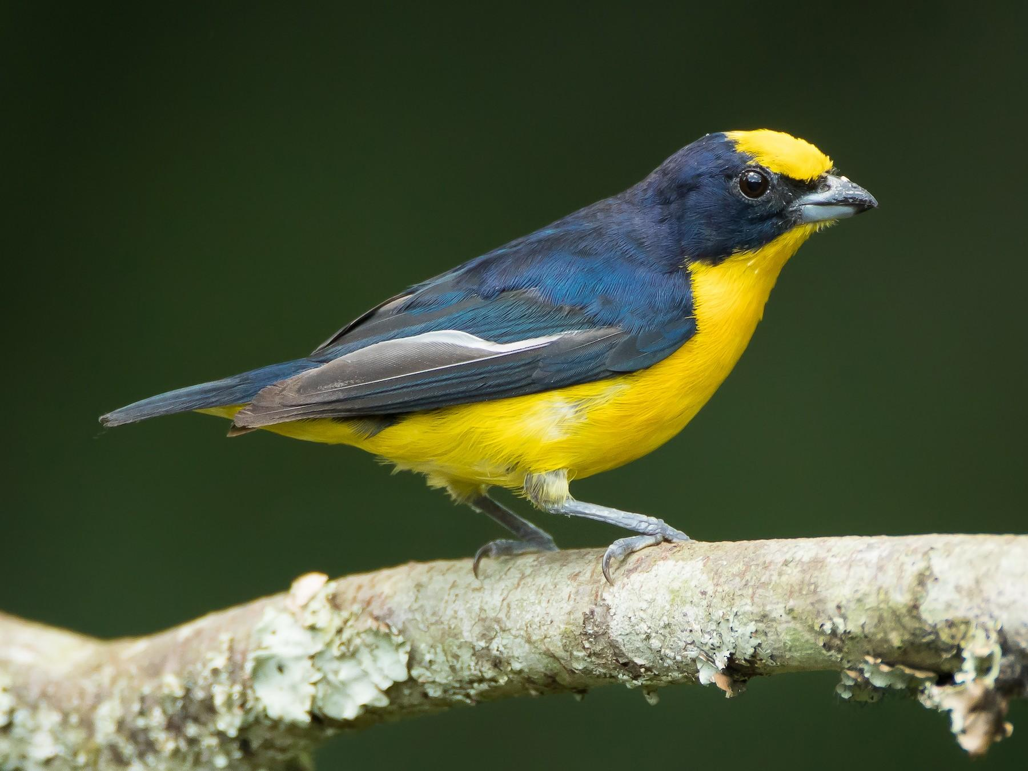
Bird Cams Lab
Cornell Lab of Ornithology
Image credit: Dorian Anderson/Macaulay Library
Notes:
The first co-creation project we’d like to share with you is Bird Cams Lab. I had the pleasure of serving on the evaluation team for this project which wrapped up a little over a year ago.
Bird Cams Lab was an initiative led by the Cornell Lab of Ornithology. It was essentially a citizen science project, but in this project the team wanted participants to become invested in stages of research that are usually reserved for experts and for those public participants to bring their own perspectives and experiences to the table. In this way, Bird Cams Lab was envisioned as a co-creation project.

Slide 6
WHY: CO-CREATION RATIONALE
Previous work suggests that “co-created” research projects, designed by scientists and communities working together throughout the scientific process, offer more robust learning outcomes than “contributory” projects that focus just on data collection (Bonney et al. 2009).
[from original grant proposal]
Notes:
The driving rationale behind this project was the idea that if public participants took part in more stages of the research process they would have better learning outcomes that your typical citizen science project where the public just helps to collect the data. They would have a better understanding of the content subject matter (in this case, bird species and bird behaviors), they would have a better understanding of how scientific research works, and they would maybe even have a better understanding of how to interpret data (reading charts, etc).

Slide 7
WHO: PARTICIPANTS
Over 15,000 individuals, 5000 of which responded to our surveys
Mostly:
Engaged, dedicated bird enthusiasts
Drop-in style participation
White
89%
Female
75%
Age 55+
67%
Notes:
The Cornell Lab of Ornithology is fortunate to have a really large captive audience in their existing cam watchers. Also since this project was conducted entirely online, people could participate from anywhere. The team also advertised their project through Zooniverse, which is a citizen science website where people can go to find projects that they can contribute to. So this was a very engaged audience - people who generally already cared a lot about birds or who liked contributing to citizen science projects. The project team wanted to cast as wide a net as possible for this project, so they kept the project pretty wide open for people to participate at any juncture, as much or as little as they wanted.

Slide 8
WHAT: THE CO-CREATION PROCESS
QUESTION DESIGN
DATA COLLECTION
DATA EXPLORATION
REVIEW FINDINGS
Notes:
So what did participants actually do? The Bird Cams Lab team used webinars, message boards, web surveys, and emails to walk participants through these steps of the scientific process and invite their feedback.
The first step was Question Design, choosing a research question for the investigation. There was usually a webinar led by an expert to discuss possibilities, then people could generate ideas via a message board and vote on their favorites.
Data Collection - They would watch the bird cams and collect data through an online tagging system
Data Exploration - Using the data the participant collected, the Cornell team would create charts and figures, sometimes with cool interactive elements, and invite comments via the message boards and during webinars
Review Findings - A member of the Cornell team would draft a report presenting the findings, and this also open for comments/feedback/review

Slide 9
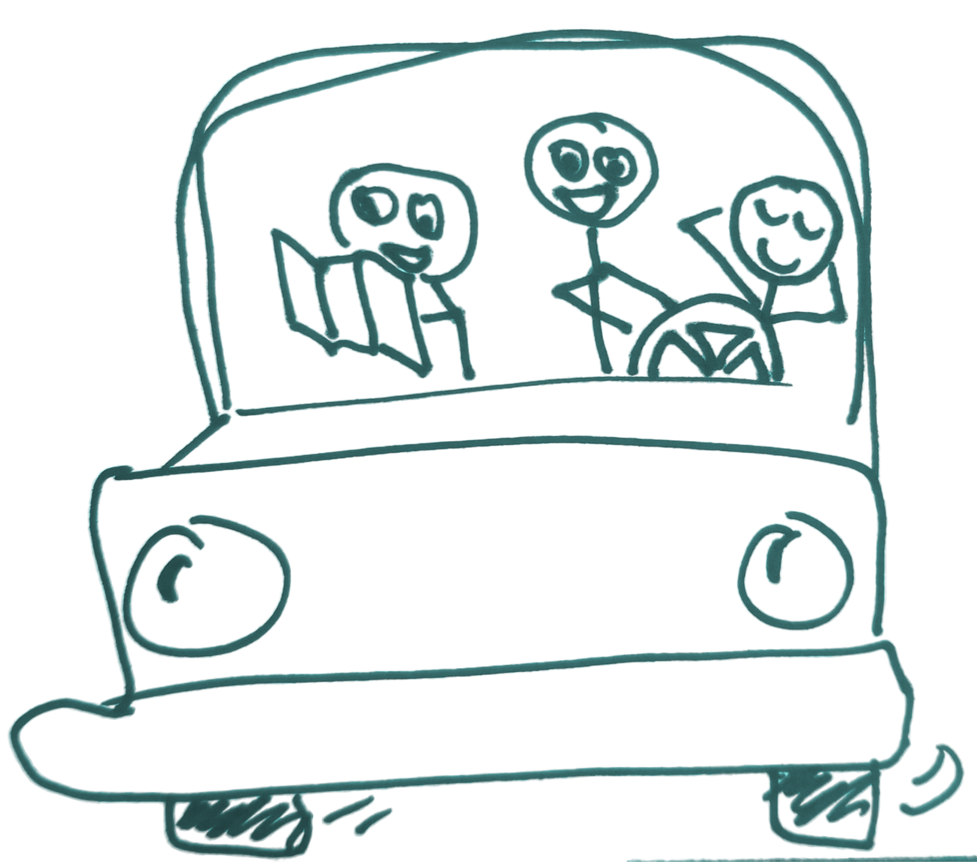
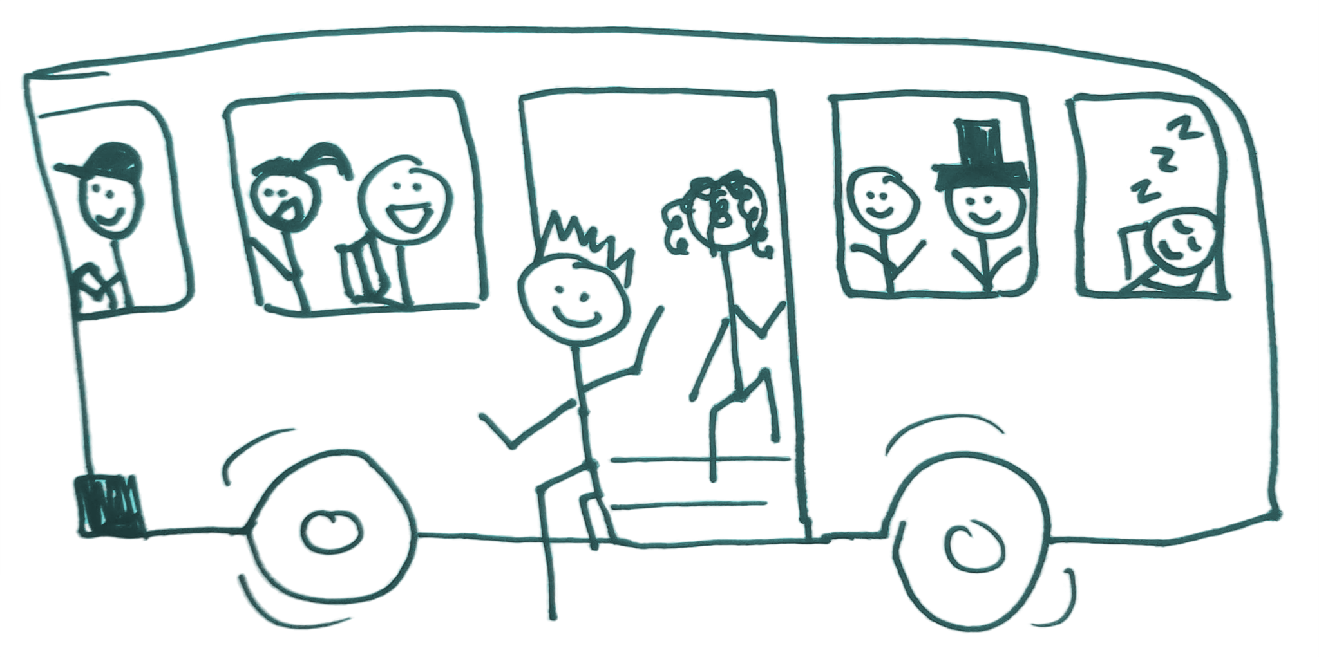
GOAL
REALITY
Share the driver’s seat on a scientific investigation roadtrip
Drove a science investigation transportation service
Notes:
In setting up this project, the Bird Cams Lab team was hoping to share the driver’s seat with their audience and share ownership of that scientific research process. They envisioned some people - maybe not everyone, but a good number - taking part in each step of project and feeling real agency from their involvement.
In reality, people would come and go as their interest and availability dictated, and most didn’t develop that sense of ownership. Some people said they didn’t feel qualified, and some just weren’t interested in being co-creators. There were a few highly engaged participants, but most people saw themselves more as contributors and less as co-creators.
This led to a lot of reflective discussion on the team about the nature of co-creation and how to think about the project’s impacts on its audience.
Now I’ll hand it over to Leigh Ann to talk about another project.
(From report: 60% of participants felt that the Bird Cams Lab investigations were led by scientists with the support of public participants. ~20% described the relationship as a more equal partnership. And only 2% thought that public participants led the projects with the support of scientists.)

Slide 10
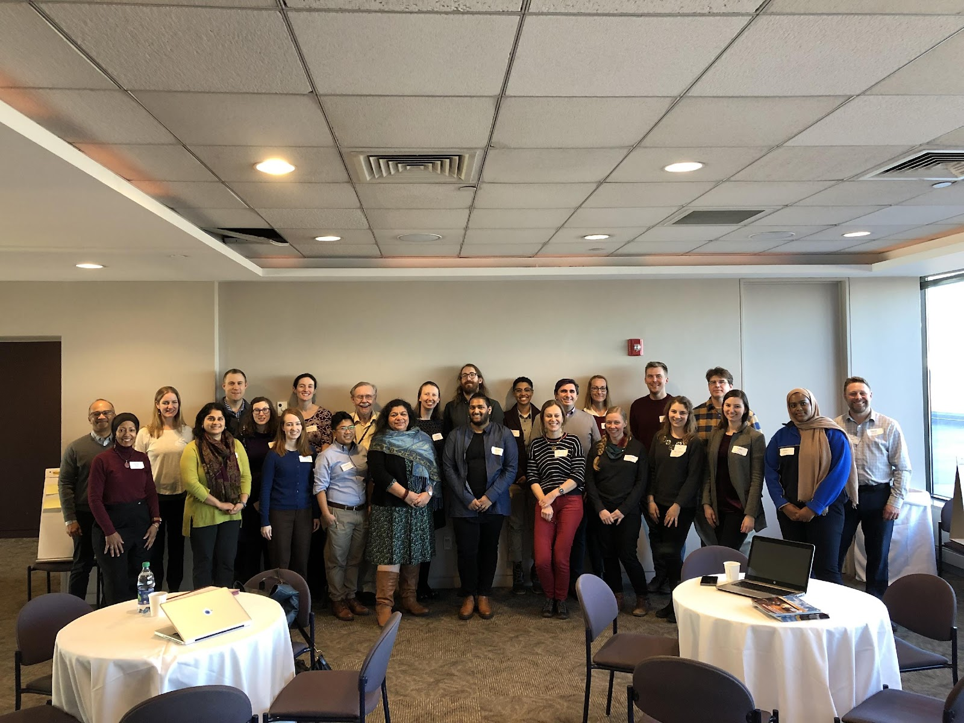
Co-Created Public Engagement with Science
Museum of Science, Boston
Notes:
The Co-created Public engagement with Science project (CCPES), led by the Museum of Science, Boston, aimed to create a roadmap for developing and implementing community forums that encourage public engagement with science.

Slide 11
WHY: CO-CREATION RATIONALE
[Co-creation in] CC-PES will raise the capacity of ISE institutions to facilitate dialogues of particular relevance to local community, civic, and scientific stakeholders to reduce polarization and connect scientists, civic institutions, and publics with one another, thereby addressing barriers that threaten societal decision-making on crucial socio-scientific issues.
[from original grant proposal]
Notes:
Through co-creation, this project hoped to deepen public conversations around science topics that are interesting, relevant, and impactful to society, particularly the communities engaged in the project, so that this work could influence local policy debates and decision-making.
This project focused on creating and testing a model for co-creation that hoped to raise the capacity of ISE institutions to
-be a community convener and facilitate dialogues on topics of interest to local communities
- reduce the polarization around who can meaningfully have conversations about socio-scientific issues.

Slide 12
How: Project Model & Event Roadmap
Process
AGENDA SETTING
DECISION MAKING
POLICY FORMING
Form Partnership
Welcome Event
Topic Selection Workshop
Forum
Policy Forming
Notes:
The project set forth the following model for events and workshops that would build to a forum and policy forming step.
First, the project brings together three distinct types of organizations into a partnership – civic orgs, community orgs, and an ISE.
During Agenda setting & Topic Selection – Teams come together with members of the community and figure out what socio-scientific topic should be addressed.
In Decision making – Teams hold a forum to discuss their topic, collect opinions from participants, and generate recommendations based on their audiences’ ideas.
Lastly, in Policy forming – There’s a discussion outcomes of the forum, formulate action plans, and disseminate their findings.
These steps were seen as a guide or milestones to be accomplished through the project. The 3 project cohorts interpreted these steps in a range of different ways.

Slide 13
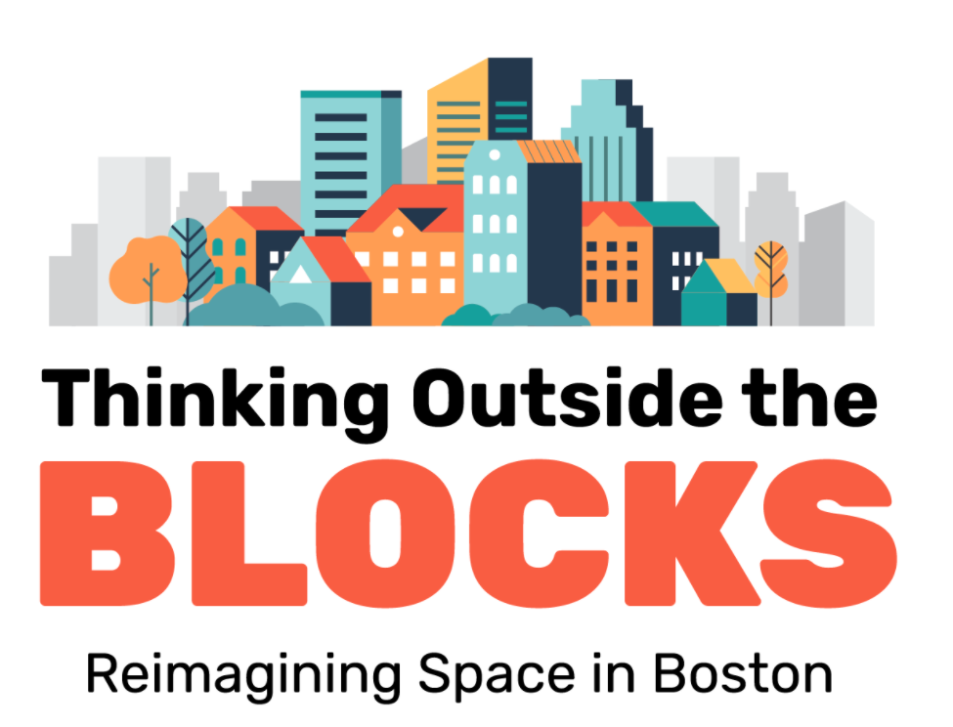
Phase 1 Recap
BOSTON
Virtual Policy Event
Team
Topics Considered
Async Platform + Virtual Forum
Urban College of Boston
Housing
Economy
Education
Mayor’s Office of New Urban Mechanics
Museum of Science
Policy discussion re: Accessory Dwelling Units (ADUs
Connected team with the Housing Innovation Lab
Notes:
Here is what the model looked like for the Boston team.
Team
●Museum of Science, Boston - science center partner
●Urban College of Boston – Serves predominantly non-traditional students, working parents, mostly non-white, many who speak language beyond English
●Mayor’s Office of New Urban Mechanics – civic org using innovation to tackle issues
Public Audience = Students at the Urban College of Boston
Topics that arose during their welcome event and topic selection workshop were housing, economy, and education.
From here the team designed a forum where participants considered the development of a hypothetical open lot in Boston from the perspectives of different stakeholders. The team was ready to present this forum in-person when the pandemic hit, but it ended up being a collection of virtual activities.
Their final policy event invited staff from Boston’s Housing Innovation Lab to talk with participants about how housing policies are decided in Boston and then invited discussion about a policies related to accessory dwelling units, which are an important issue for community members in Boston

Slide 14
Phase 1 Recap
PORTLAND
Virtual Youth-led Forum
Virtual Policy Event
Team
Topics
Considered
Momentum Alliance
Education
Climate Change
Metro
Oregon Museum of Science and Industry
Climate change & corporate responsibility
Climate Stories workshop
＜
Youth Advisory Council
Notes:
Team:
Momentum Alliance – Non-profit dedicating to helping youth become social justice advocates and leaders
Metro – A council of elected members from the Portland area that works on issues related to land use, infrastructure, and preserving nature
OMSI
Public Audience – focus on youth, wanted to pay special attention to equity issues in whatever topic they pursued
After talking about education and climate change during their welcome event and topic select workshop, the team decided to create a forum focused on climate change and corporate responsibility
They formed a Youth Advisory Council to guide the development of the forum and make sure they were designing well for their intended audience. Members of this council also served as facilitators at their forum.
Forum was a live virtual event, with a few different components, included guest speakers who talked about equity and city planning and climate change. And they held small group discussions about climate policies through the lens of corporate stakeholders. Youth also did a Q&A with the Metro Council Deputy president.
The policy event concluded with a Climate Stories Workshop that supported individuals be storytellers of their own climate experiences and reflections.

Slide 15
Phase 2 in Process
DURHAM
Team
Topics
Considered
+
Listening Sessions
In-person Forum
Urban Green Spaces
Affordable Housing
Public Safety
Education
Families Moving Forward
Durham Neighborhood Improvement Services
Policy Event
Museum of Life and Science
Notes:
For the final cohort, this team is still in progress. This cohort includes:
Families Moving Forward – Organization that helps families experiencing homelessness find stable housing
Museum of Life and Science – With FMF started building their relationship well in advance of their CC-PES events by developing programs together for the families served by FMF
Durham Neighborhood Improvement Services – Has joined recently in the process
Public Audience = families experiencing homelessness
Tod-date, they have held listening sessions in addition to the prescribed events of the CC-PES model, as a way to make sure they have been hearing what the community has to say.
Currently in the process of designing their forum about Affordable Housing. What are the directions around affordable housing (fixing old, creating new, restrictions)

Slide 16
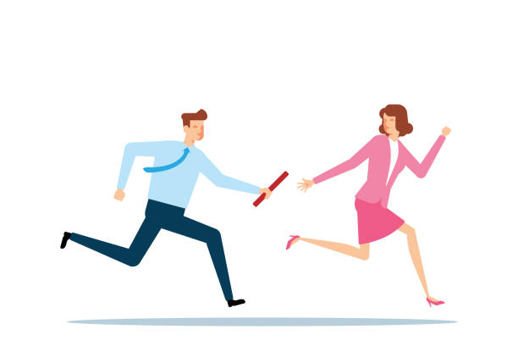
Key CCPES Takeaways
Cohort leadership ebbed and flowed throughout project phases
Project activities did not smoothly build into a
final action step
Goal
Goal
AGENDA SETTING
DECISION MAKING
POLICY FORMING
Reality
Reality
AGENDA SETTING
DECISION MAKING
POLICY FORMING
Notes:
Balancing science center, community, and civic roles was challenging throughout the project. The co-creation project perhaps envisioned each institution carrying equal weight throughout the project and making all decisions along the way together. In reality, different organizations more or less took the lead at different points of the project (almost like a baton pass off) based on their individual expertise, capacity to support the project during COVID, and competing priorities. Also, the project perhaps expected the public to play a more leading role in topic selection, whereas the community org was in some ways a proxy for the public or they experienced greater development in the project.
In theory, all of the project activities built toward a culminating policy forming step that completed the model for public engagement with science. In reality, the public-facing events took different forms in the different cohorts and the forum discussions did not necessarily produce a product that could be neatly transitioned into a policy or action step. For two of the cohorts, the policy forming step was more free-form and felt like an add-on to the model rather than a natural progression.

Slide 17
Shared takeaways and challenges of co-creation
No single model
New roles for public engagement with science
Process product
Equitable equal participation
?? Audience as experts ??
>
Notes:
These projects experimented with different models of co-creation and redefined the roles that organizations can play in public engagement with science projects.
Co-creation is messy - it’s more about the way you frame your project and build relationships, rather than the end deliverable. Co-creation is the process, not the product.
A common goal of co-creation is creating a more equitable project, that is developed in a more equitable way, but that may not mean equal participation at every phase.
Asking public participants to serve as experts in co-creation projects may not always work as intended. Projects may need to rethink why we are pursuing this model and what is a reasonable expectation from public participation.

Slide 18
Brainstorm
The co-creation spectrum
Notes:
Now that we’ve shared some of our experiences, we want to do an exercise with you all where we think of co-creation as a spectrum. This is not a new idea - Rick Bonney from the Cornell Lab of Ornithology and Kathleen McLean both used this metaphor for describing co-creation. Projects on the left side of the spectrum might involve members of the public as contributors to a project, and the level of participants involvement increases toward the right end of the spectrum.
Many different projects embrace co-creation values, but they play out in really different ways. Together, we’re going to generate some examples of how different key elements of co-creation might look at different places along the spectrum.

Slide 19
How would you answer these questions for different points along the co-creation spectrum?
How are the project scope, format, and goals developed for a co-creation project?
How is the project being managed and driven forward? How is momentum maintained?
Who represents the community, and what are some different ways for incorporating community voices?
Who are the experts in a co-creation project? What expertise are they lending and what decisions are they making?
Notes:
Here are our four questions about different parts of a co-creation project. Each group is going to focus on just one of these questions, and think about how you would answer it for different points along the co-creation spectrum. If it helps you can focus on one of the projects we’ve talked about today or a project from your own experience, and use that as an example for thinking about your question.

Slide 20
Report
Out
After doing this activity:
What surprised you about co-creation?
What stood out to you most about co-creation?
How did your perspective on co-creation change?

Slide 21
Contact us
Liz Kollmann
ekollmann@mos.org
Leigh Ann Mesiti Caulfield
lcaulfield@madpow.net
Claire Quimby
claire@rockman.com
This presentation is based on work supported by the National Science Foundation under Grant No. DRL-1811118. Any opinions, findings, and conclusions or recommendations expressed in this presentation are those of the authors and do not necessarily reflect the views of the Foundation.

