Slide 1
NISE Network Tools to Support Diversity, Equity, Accessibility, and Inclusion in Public Engagement
Notes:
https://www.nisenet.org/Audiences

Slide 3
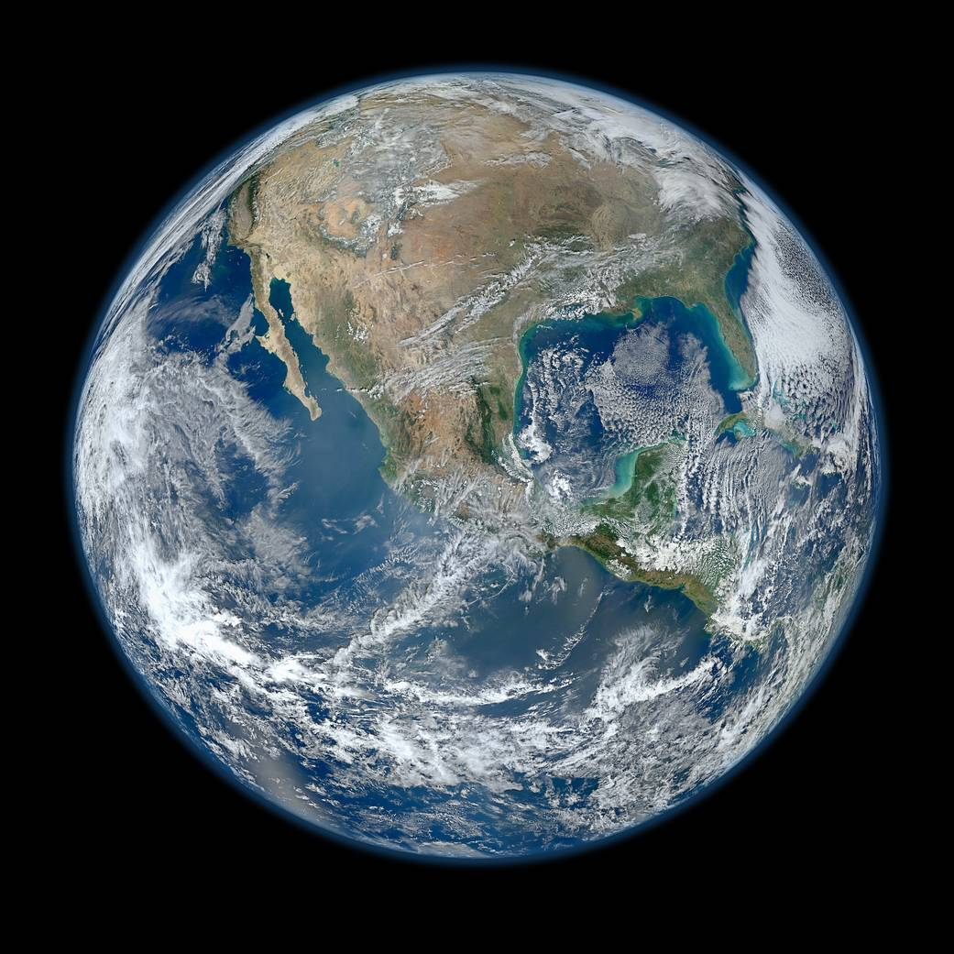
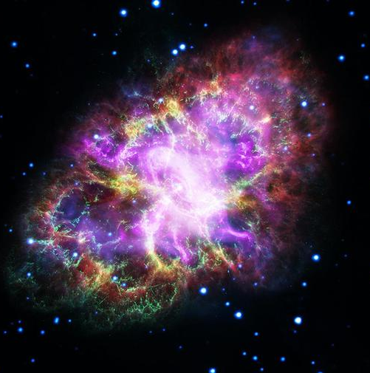
NISE Network’s Earth & Space
Project-Based
Professional Learning Community
Focused on increasing the capacity of museums to make Earth & Space science more relevant and inclusive for local communities.
Ali Jackson, Sciencenter
ajackson@sciencenter.org
Notes:
(Ali)

Slide 4
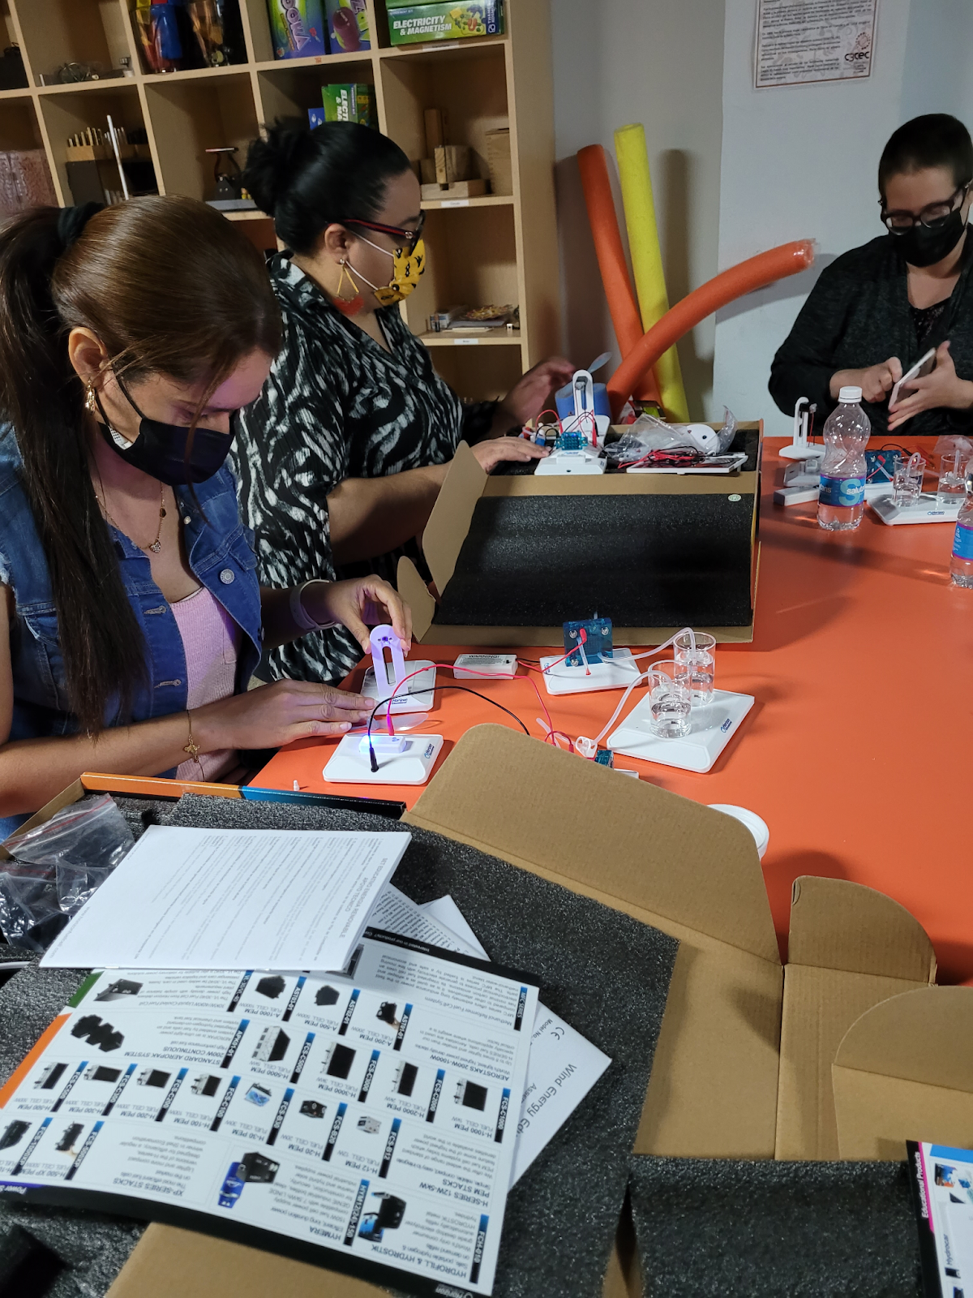
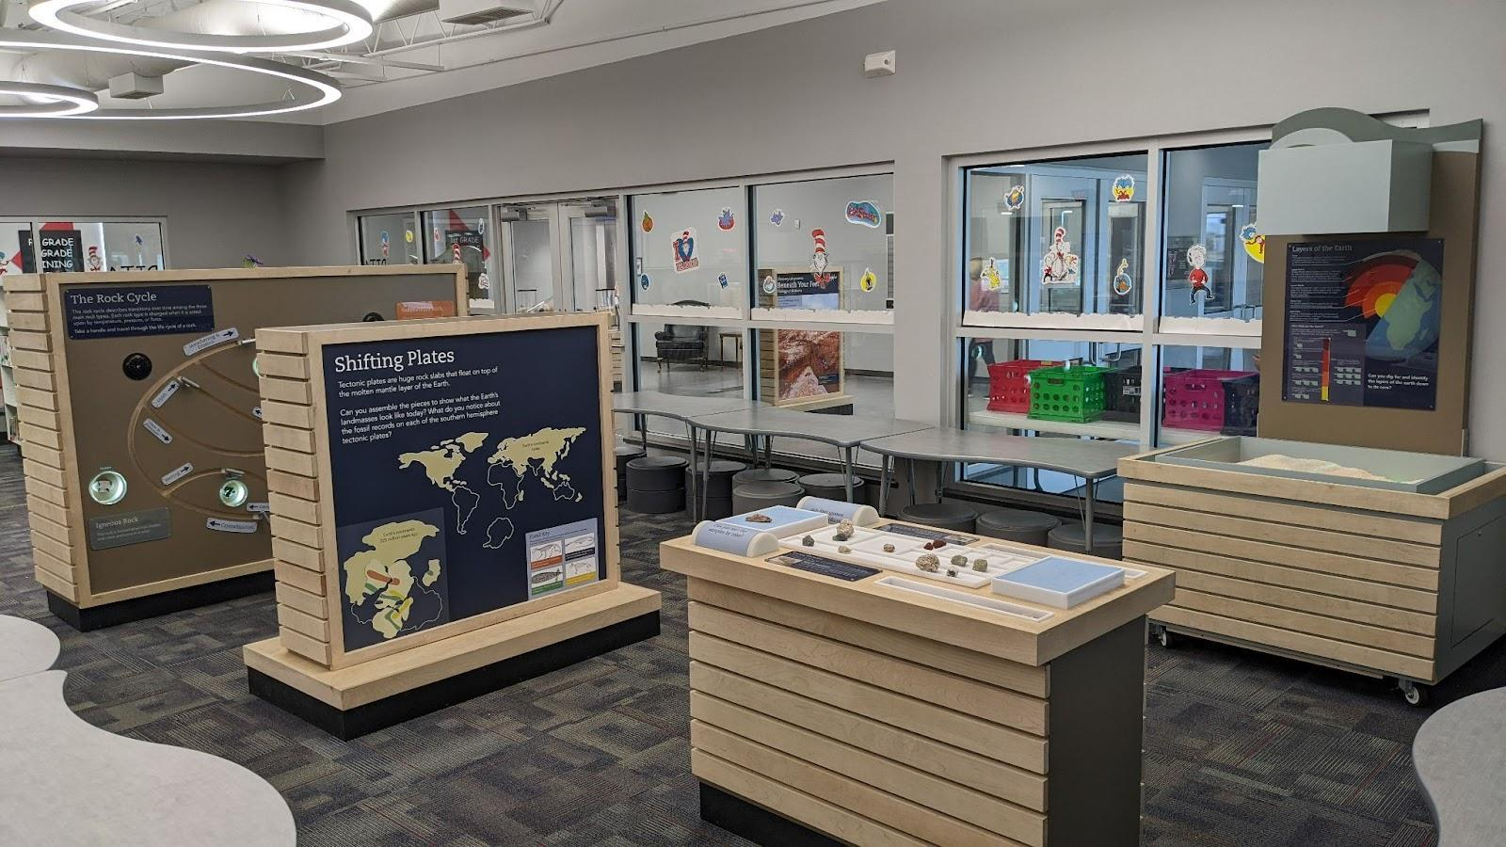
National Community and Conversion, Local Impact
Pauls Valley, Oklahoma
Discovery Lab, Tulsa, OK
Arecibo Observatory, Arecibo, PR
Explora, Albuquerque, NM

Slide 5
Examples of Project Inclusive and Relevance Themes
Collaborating with experts
Collaborating with community organizations
Intentionally working with specific audiences
Incorporating Indigenous ways of knowing & expertise
Deaf/Hard of Hearing communities
Blind/ Low Vision communities
Schools / Teachers/ @ home learning
Co-creation with minoritized and rural communities
Non-English speaking communities
And more!

Slide 6
Notes:
https://www.nisenet.org/DEAI-tools

Slide 7
Diversity, Equity, Accessibility, and Inclusion (DEAI) Tools & Practices
Defining Diversity, Equity, Accessibility, & Inclusion in Your Project
Social Identity & Perspective
Building Inclusive Teams
Equity & Inclusion in Community Engagement
Partnership Approaches & Strategies
Culturally Responsive Programs
Collaborative Content Development
Multilingual Engagement
Working with Indigenous Communities
Inclusive Design

Slide 8
Diversity, Equity, Accessibility, and Inclusion (DEAI) Tools
Tools include:
Overview
Let’s Try This Activities
Case Studies
Discussion and Reflection Questions
Curated Resource Lists
Process approach
There is no one “right” answer

Slide 9
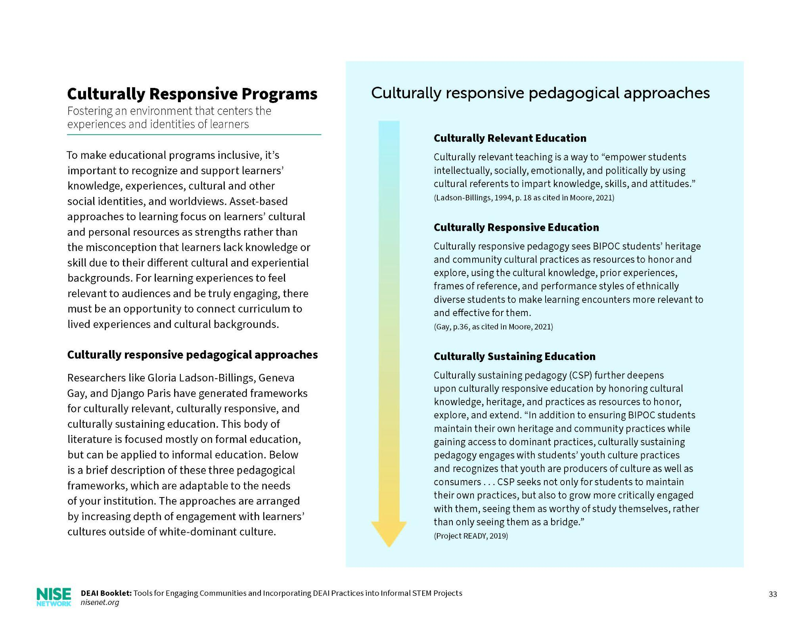
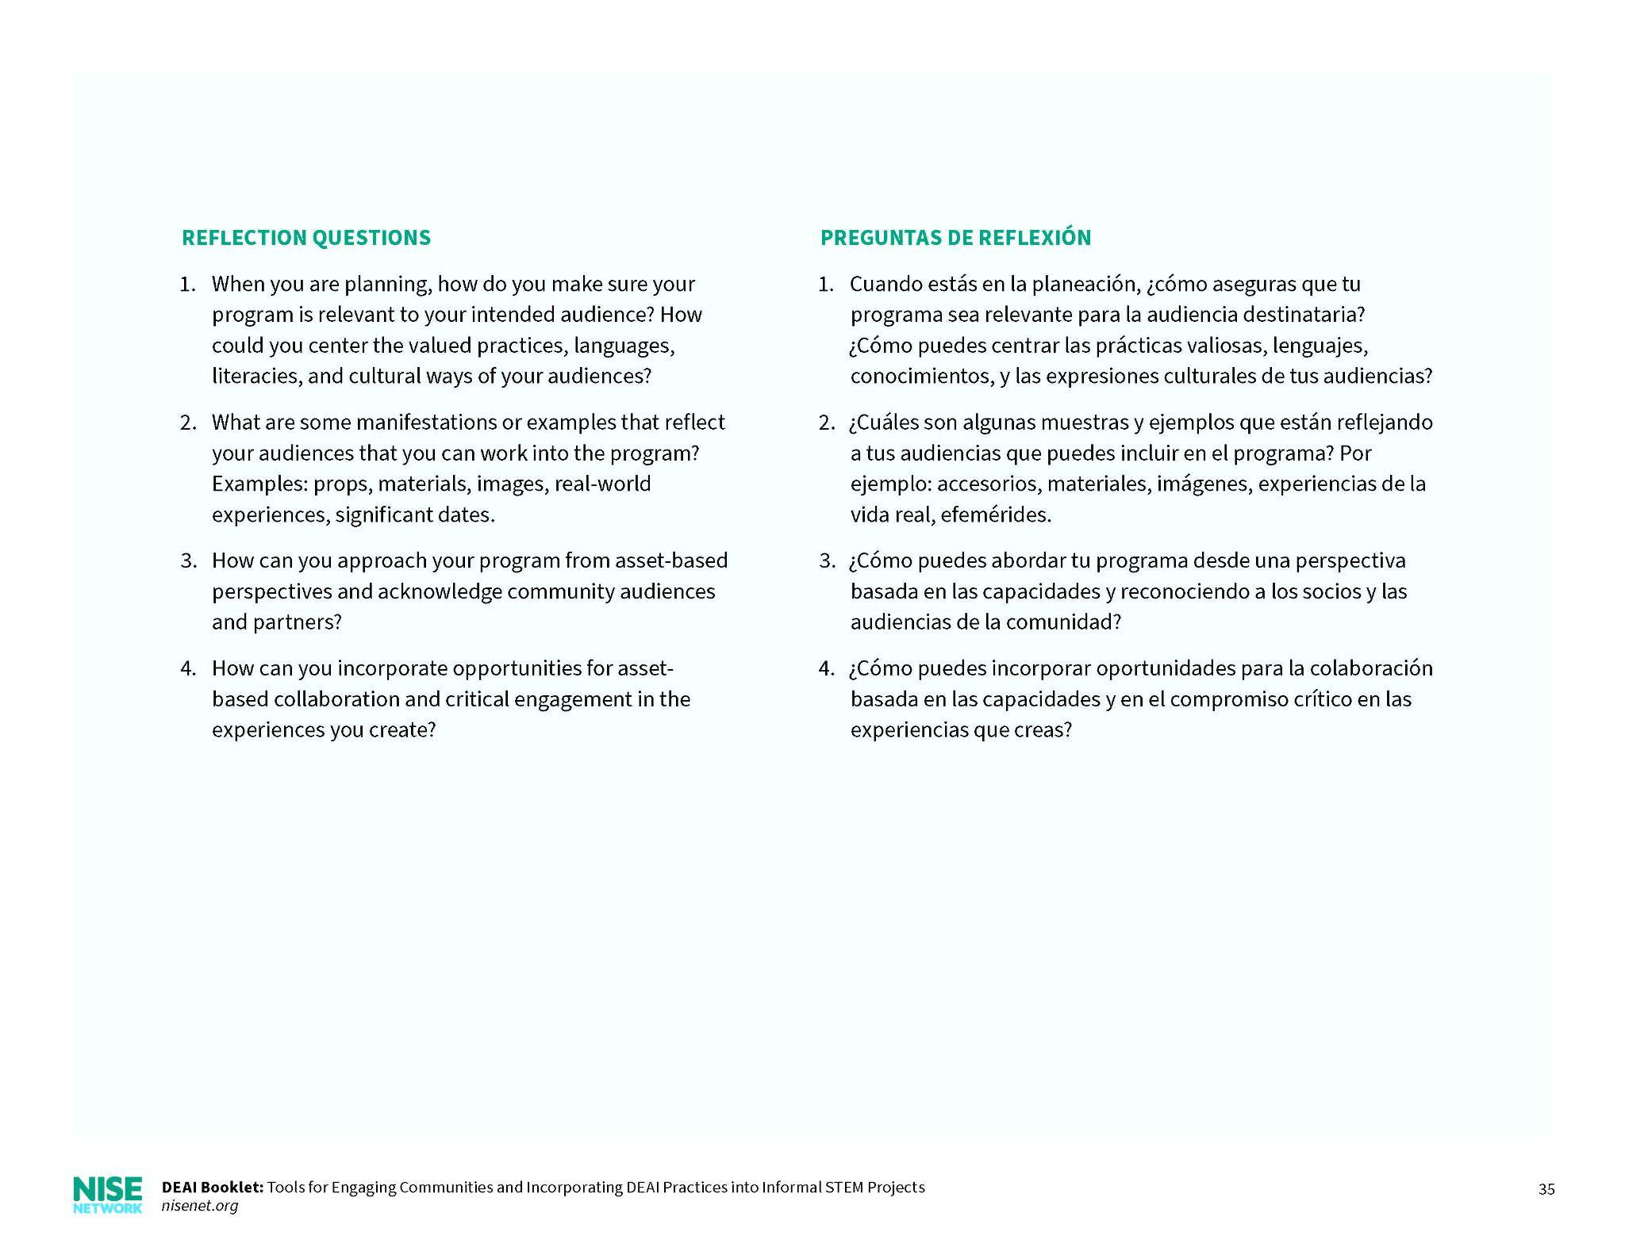
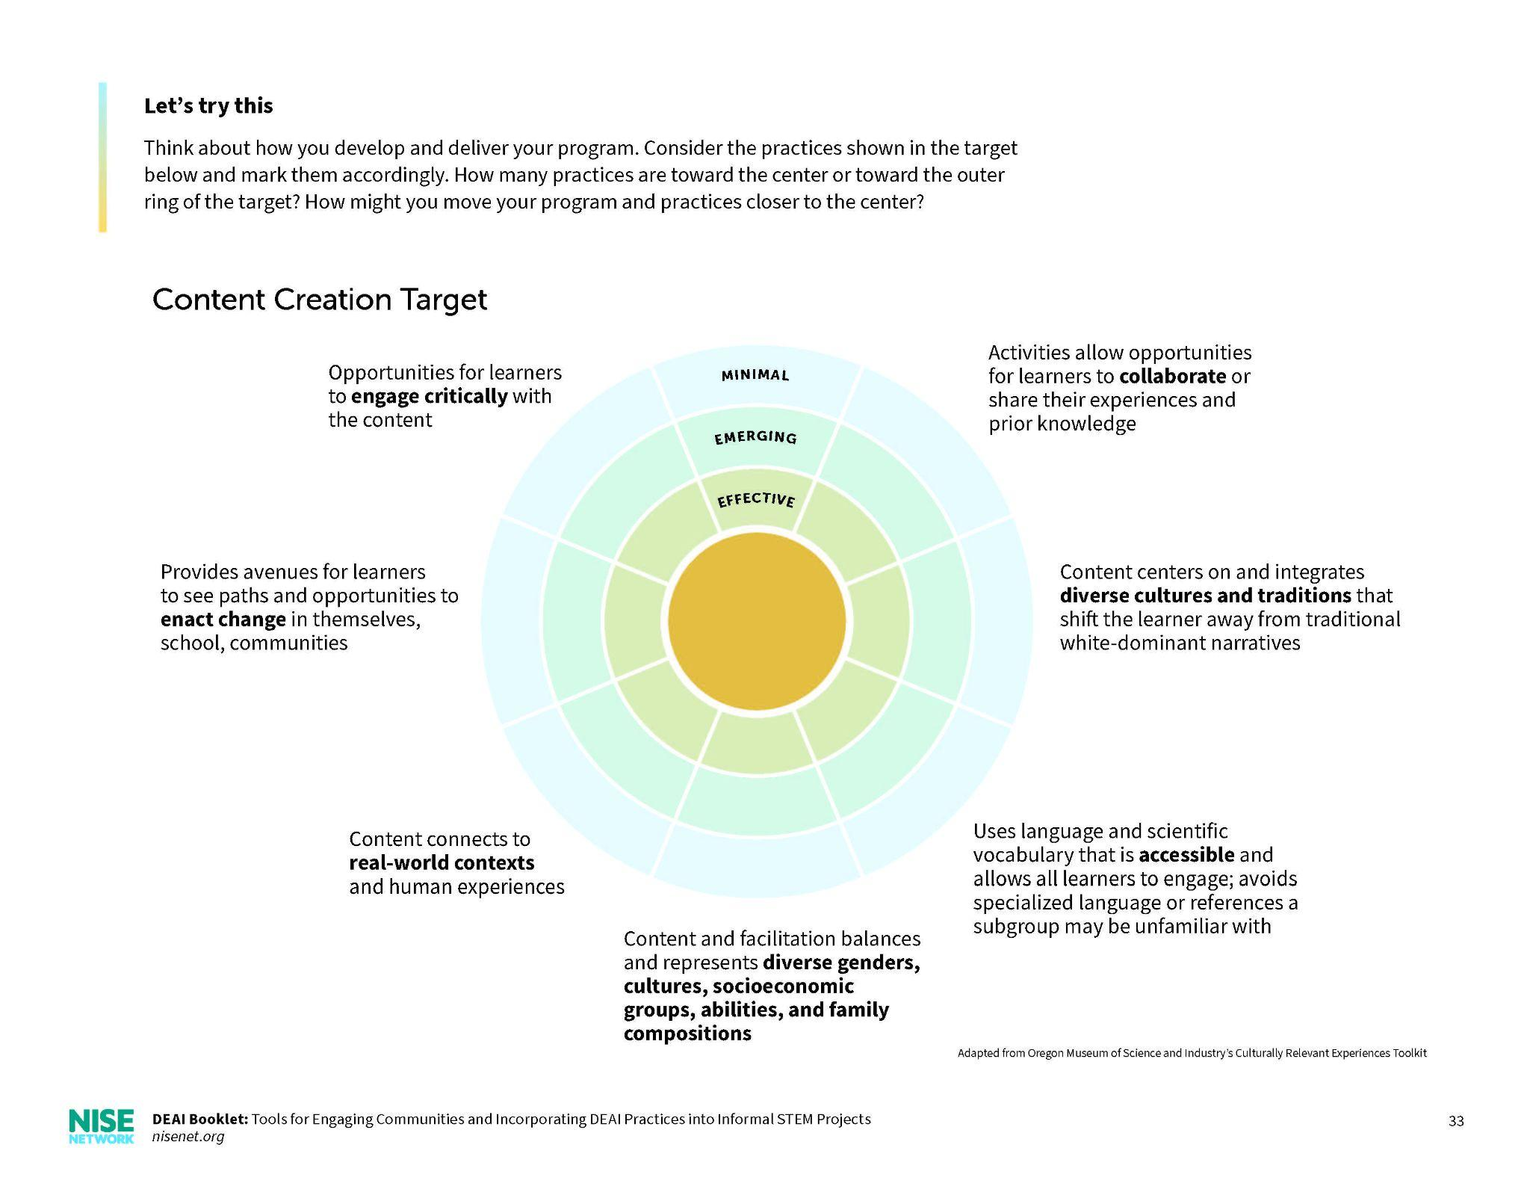
Example Tool: Culturally Responsive Programs
Reflection Questions
Resources
Overview
Let’s Try This

Slide 10
Equity & Inclusion in Community Engagement
Building trust, deepening relationships, and creating sustainable change
Example DEAI Tool:
Notes:
Swap for different tool to highlight

Slide 11
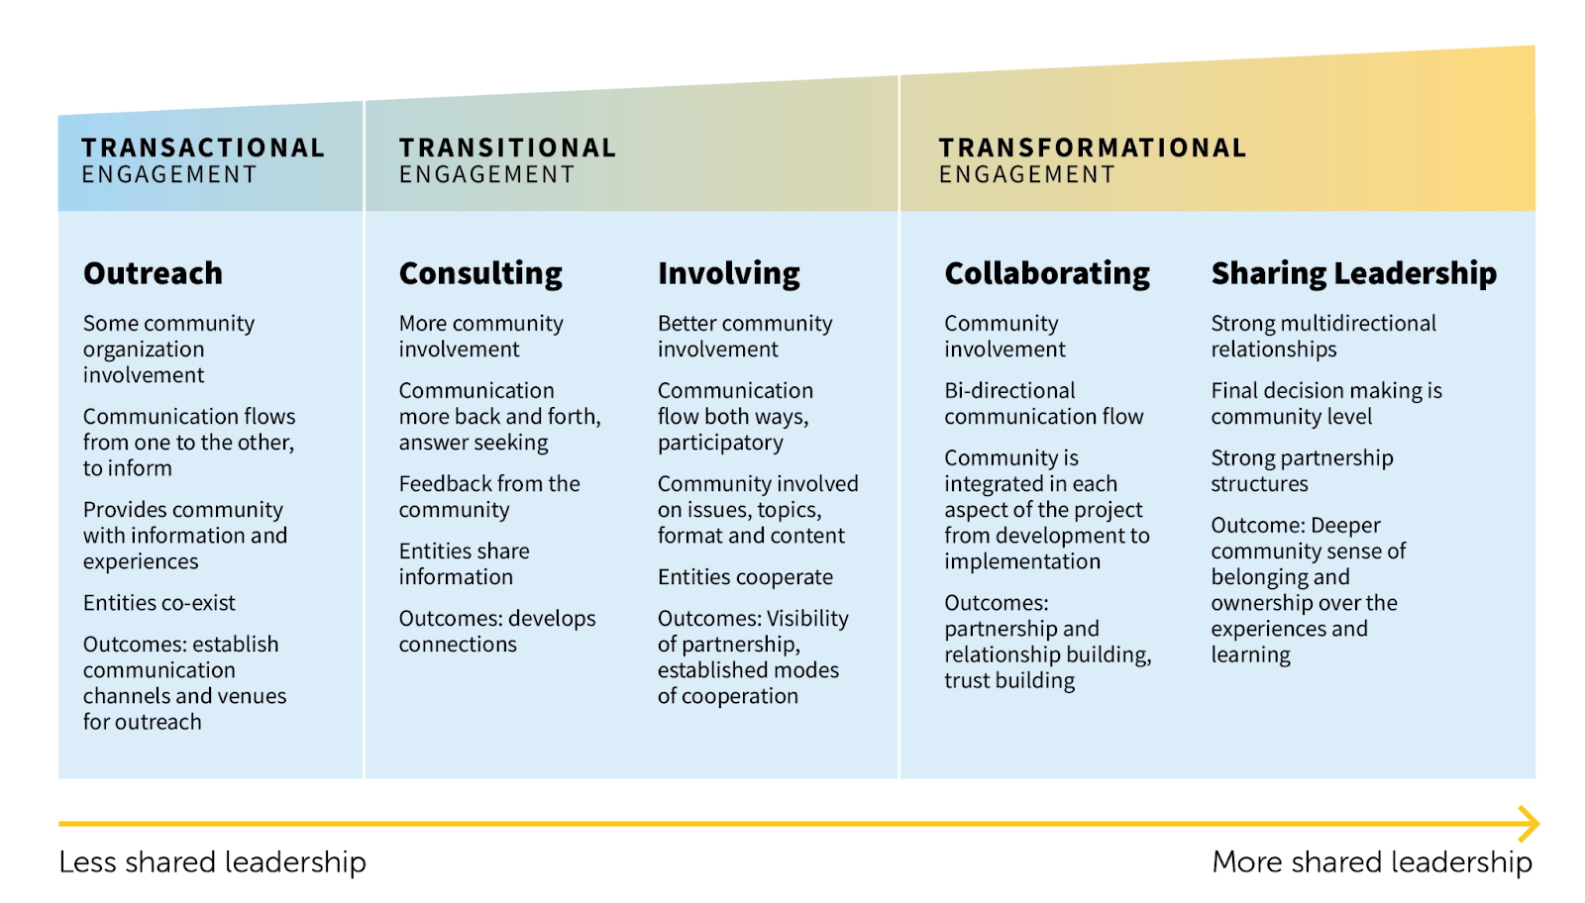
Equity & Inclusion in Community Engagement
Increasing Level of Community-Driven Involvement
*Adapted from the International Association for Public Participation
Notes:
Swap for different tool to highlight

Slide 12
Equity & Inclusion in Community Engagement
Examples of Community Engagement Work Activity
Think about where you most often fall on this spectrum and think about examples in your work and how this affects your DEAI practice.
Outreach Example: Family Science Events at Local Schools | Consulting Example: Getting student input on traveling exhibits | Involving Example: Prototyping with visitors and the community | Collaborating Example: Development team creating shared goals and funding with partner organizations | Sharing Leadership Example: Museum & Head Start Partnership: teacher training and family engagement events
Notes:
Swap for different tool to highlight

Slide 13
Equity & Inclusion in Community Engagement
Reflection Questions
How can you authentically involve community participants in planning, implementing, and sustaining the program?
What does your end product look like, and what strategies do you have in mind to make visible the voices of the community and program participants?
How would you make sure that the exchange between individuals and organizations are and feel fair and just?
How are you building trust with your partners and community members?
Notes:
Swap for different tool to highlight

Slide 14
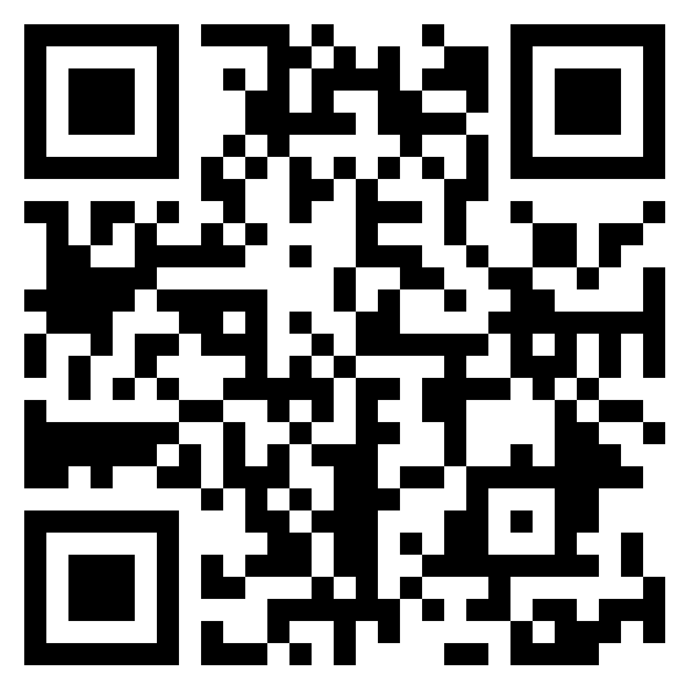
Padlet Resources
https://padlet.com/ACM22DEAISession/
Notes:
Reshare? Reuse?

Slide 15
Get Involved
Learn more and access the
NISE Network’s online digital resources
nisenet.org
Subscribe to the monthly newsletter
nisenet.org/newsletter
Follow NISE Net on social networking
nisenet.org/social
Notes:
https://www.nisenet.org/newsletter
https://www.nisenet.org/social

Slide 16
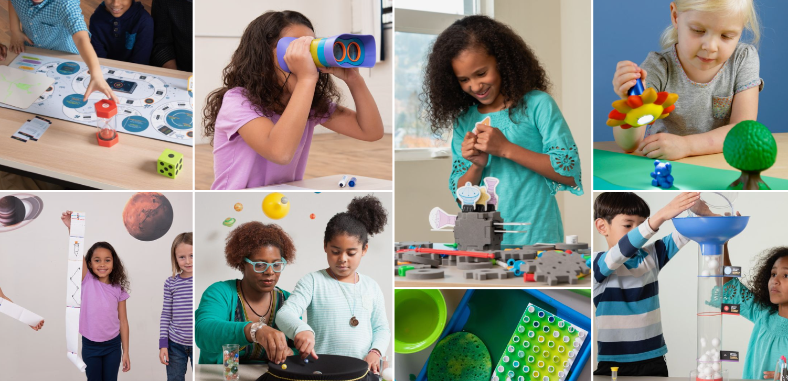
Thank You
This material is based upon work supported by NASA under cooperative agreement award numbers NNX16AC67A and 80NSSC18M0061. Any opinions, findings, and conclusions or recommendations expressed in this material are those of the author(s) and do not necessarily reflect the view of the National Aeronautics and Space Administration (NASA).

Slide 17
Notes:
Where are you on this journey: https://jamboard.google.com/d/1y-U9qWemL_idK2RXI69y0G9QE7PSWACQu7lWWkOT-SU/viewer?f=0
Core element of the NISE Net DEAI Booklet is interrogating current practices and reflecting together.

Slide 18
Ivan Coyote, “Imagine A Pair of Boots”, from their collection of short stories entitled, A Slow Fix.
Notes:
Ali
Short story by Ivan Coyote, “Imagine a Pair of Boots” from their collection entitled, The Slow Fix.

Slide 19
Ivan Coyote, “Imagine A Pair of Boots”, from their collection of short stories entitled, A Slow Fix.
Notes:
Ali
Short story by Ivan Coyote, “Imagine a Pair of Boots” from their collection entitled, The Slow Fix.

Slide 20
Conversational Prompts
What parts of this story resonate with your own personal or professional experiences?
Does this story remind you of anything?
How can storytelling support the DEAI work you’re engaged in with your team and community?
Notes:
Breakout Rooms (5-6 people per room) for 10 minutes

Slide 21
Small Group Share Outs
Notes:
in chat or emojis

Slide 22
Conversational Prompts
What parts of this story resonate with your own personal or professional experiences?
Does this story remind you of anything?
How can storytelling support the DEAI work you’re engaged in with your team and community?

Slide 23
Q&A

