Slide 1
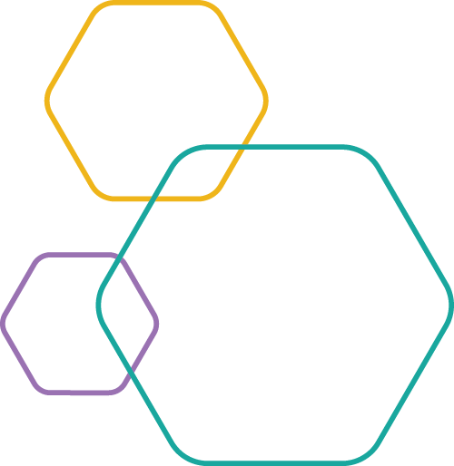
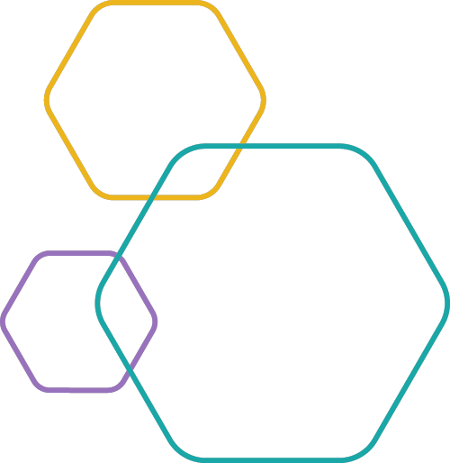
MOONSHOTS IN THE MUSEUM:
Creative ways to engage museum audiences in big challenges
ASTC 2019

Slide 2
Presenters
Darrell Porcello, Children’s Creativity Museum
Jayatri Das, The Franklin Institute
Jeannie Colton, Arizona State University
Paul Martin, Arizona State University
Rae Ostman, Arizona State University
Sari Custer, Arizona Science Center

Slide 3
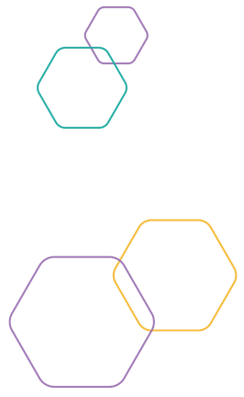
Overview
Welcome and introductions (5 min)
Project presentations (30 min total)
Jeannie and Sari: Earth and space
Paul and Rae: Sustainable futures
Darrell and Jayatri: Brain science
Rapid prototyping activity (35 min)
Wrap up (5 min)
GOAL: Develop and share a set of concepts for “moonshot” projects.

Slide 4
PRESENTATIONS

Slide 5
Exploring Earth and Space
Sari Custer
Jeannie Colton
Notes:
If it hasn’t already been asked, find out who in the room has received a SEISE toolkit and who applied for the 2020 kit.

Slide 6
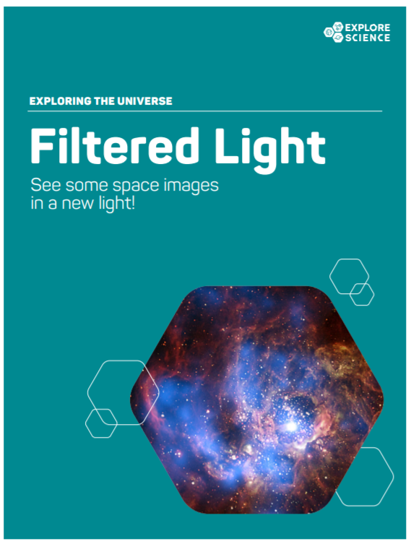
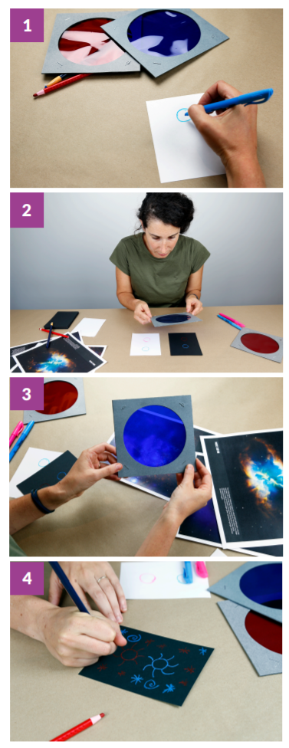
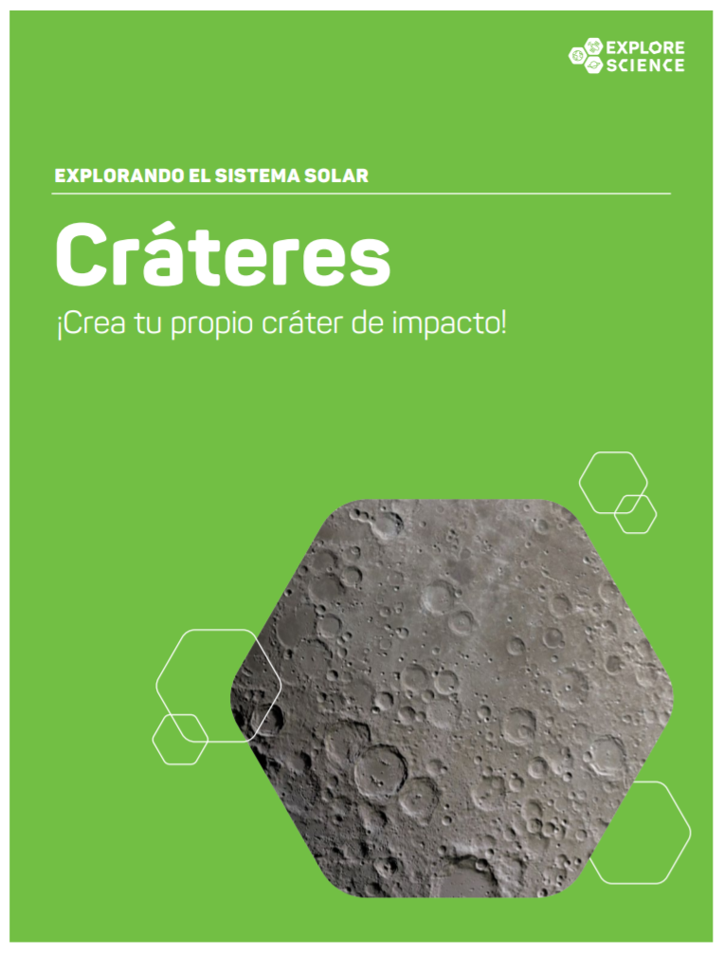
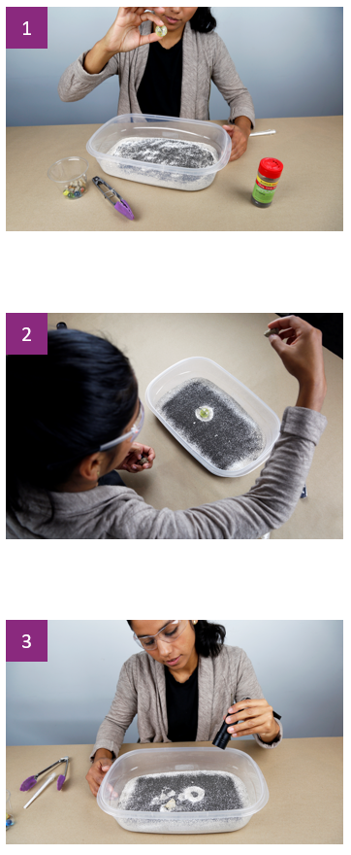
Apollo 11 50th Anniversary Celebration
NISE Net shares a variety of programming ideas, activities, and resources: https://www.nisenet.org/moon50
Notes:
NISE net shares a ton of resources to explore Earth and Space science. We used so many for Apollo and/or moon related content: stomp rockets and impact craters to filtered light and static electricity. What were one or two of your favorite activities? Topics in Earth and Space science range from space travel to instrumentation, to light, to rocketry. All to understand how we study space and in particular the moon and what we know about it. But what about the Future…?

Slide 7

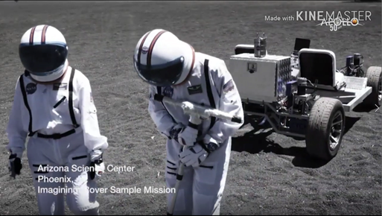
ARTEMIS
First woman and next man on the Moon by 2024
Sustainable presence on the Moon by 2028
Notes:
What about the future? 50th anniversary - driver and framework for celebrating and learning from the past to shape future exploration. Artemis - first woman and next man on the moon by 2024, sustainable presence by 2028. That’s FAST! What would it truly take to live on the moon and how can this help us better understand living on Earth and become better stewards of Earth?

Slide 8
Moon and Beyond:
An Immersive Game for STEM Learning in Museums and Planetariums
AKA Moon Adventure Game
A STEM educational game that immerses players in a scenario related to NASA lunar missions.
The primary learning objectives for participants are related to STEM processes and STEM identity. Learners will:
  work together in groups to accomplish goals and solve problems
  identify as someone who can learn about and sometimes participate in Earth and space exploration
Notes:
Next Giant leap = focus on Moon and Beyond; Moon and Beyond is one of three projects selected in 2018 through NASA’s Teams Engaging Affiliated Museums and Informal Institutions (TEAM II) initiative. TEAM II grant to produce a game to help the public explore space exploration beyond low Earth orbit. Those who receive the 2020 kit will not only receive the game but will receive a few traditional tabletop activities that are related to science behind the moon. Go over the big ideas and learning objectives.

Slide 9
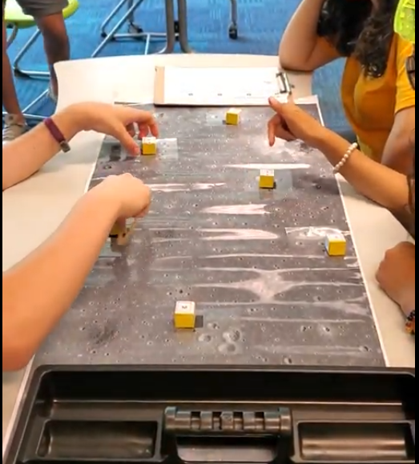
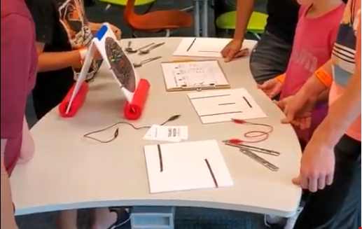
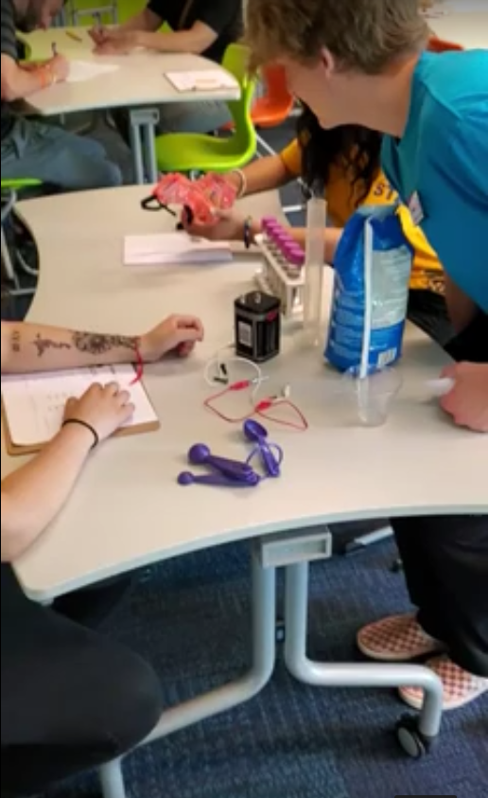
Challenges
Game play time
Physical space
Materials
Notes:
As many of you are familiar with the previous kits we have developed, this is a new type of offering that we haven’t done before. We realized right away we could not design this game for typical museum floor use. It needs a separate space, even its own room. It works best with 4-6 players.

Slide 10

Looking Ahead...

Slide 11

This work is supported by NASA under grant number 80NSSC18K1219. Any opinions, findings, and conclusions or recommendations expressed in this material are those of the author(s) and do not necessarily reflect the view of the National Aeronautics and Space Administration (NASA).

Slide 12


Rae Ostman and Paul Martin

Slide 13
Purpose: Support museums and similar cultural organizations in their efforts to integrate sustainability into their program and operations.
Approach: Provide professional development and programmatic resources that share and develop sustainability science and practice.
Strategic outcome: Leverage the power of museums around the world to help millions of people understand the social, environmental, and economic impact of human behavior on the planet’s future.

Slide 14
“meets the needs of the present without compromising the ability of future generations to meet their own needs.”
Sustainability
United Nations. Our common future, Brundtland Report, (1987).
Society
Economy
Society
Environment
Economy
Environment

Slide 15
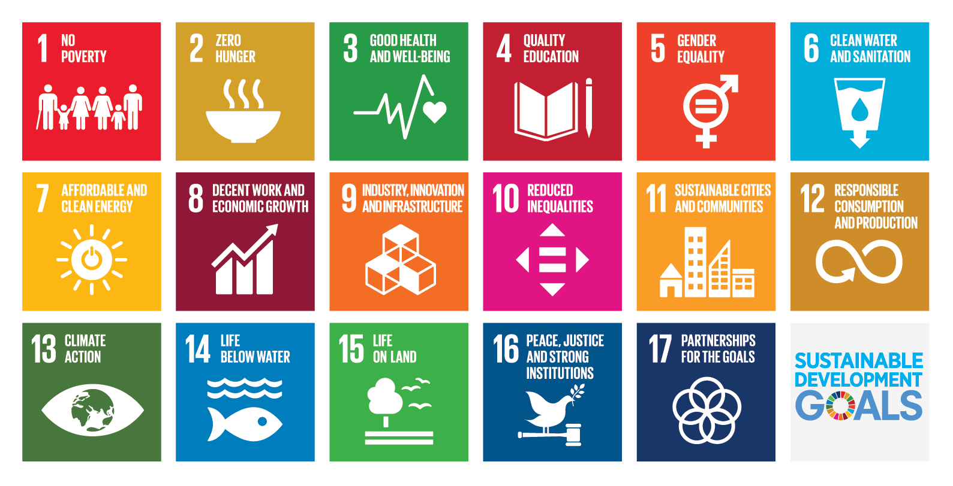
United Nations
Sustainable Development Goals

Slide 16
Project examples
Projects by participants in the Sustainability Fellowship program
Projects include public engagement, professional development, museum operations, community partnerships, and other efforts
Projects address different elements of the UN Sustainable Development Goals

Slide 17


Children Science Center, Kenya
Sustainable Agriculture Garden
Notes:
Project Description: Forty high school students were engaged in a one day workshop at the Centre to familiarize them with sustainability and Agriculture. The children’s garden was established with the guidance of science centre team and professionals. The garden comprised of a compost pit and various garden beds of indigenous vegetables. A rain water harvesting principal was used to maintain the farm in order to achieve sustainability. The student were challenged on the various indigenous vegetables consumed by different tribes their name and nutritional values.

Slide 18

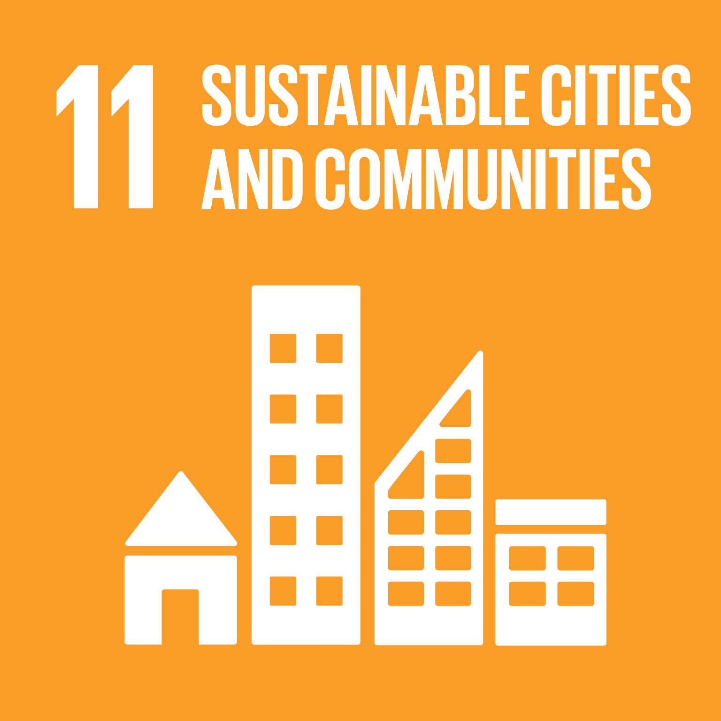
Parque Explora, Colombia
Community science
Notes:
Project Description: The event called "Open Data for a cleaner air in Medellin" brought together around 40 people from different sectors of society to trace the citizens path to the open data that would help proposing solutions to the current air quality crisis the city is facing. We haven't had yet the final project. We hope there will be an artistic intervention with the data that the participants are collecting.

Slide 19


Science Museum of Western Virginia, USA
Universal design
Notes:
Project Description: I was inspired by the UN goals for sustainable development. With accessibility in mind, I reexamined the education departments programming. We explored Universal Design for Learning (an educational framework designed for accommodating learning differences) and applied many of these concepts to our plan for a specific program. We also began to include accessibility as a topic discussed within regular education meetings. I think we were successful in changing the culture of the education department to be one that is more cognizant of different abilities and needs of our learners. My lead educator and I worked together to create a guideline of things we felt we could actually accomplish and a wishlist of things on which we are still working and a list of goals.

Slide 20


TELUS Spark Science Centre, Canada
Energy transitions
Notes:
Project Description: This project was focused on the implementation of an internal working group to support our organization's Energy Transitions initiative. The overarching initiative has the goal to: Help define our City and Province as leaders in energy system innovation in Canada, by partnering with others to engage key audiences in ways which visibly reduce the polarity in public dialogue and measurably advance energy sustainability. Our particular challenge is to build a visitor experience road map that will help TELUS Spark achieve this goal.

Slide 21

Espace des Sciences Pierre-Gilles de Gennes,
France
Training on digital fabrication
Notes:
Project Description: The project focuses on my E-FABRIK program for NEET (Not in Education, Employment or Training). It's a 5-month intensive training on digital fabrication for people with disability. E-FABRIK is a program that embraces social and digital inclusion and empowerment of young people and people with disabilities. My main target audience was the 15 young adults. Most of them are from a migrant background. By using the digital resources of their area, they develop, create and build concrete solutions that are answers to a difficulty expressed by the disabled person in the group.

Slide 22
Ontario Science Center, Canada
Community partnerships
Notes:
Project Description: Video about First Nations youth from Toronto, Ontario. Created a video about indigenous people in Canada and their connection to nature that will be played throughout the year as the Ontario Science Centre celebrates the Country's 150th year. The process, rather than product, of this project is most important; it’s a way of building trust with Indigenous communities.

Slide 23
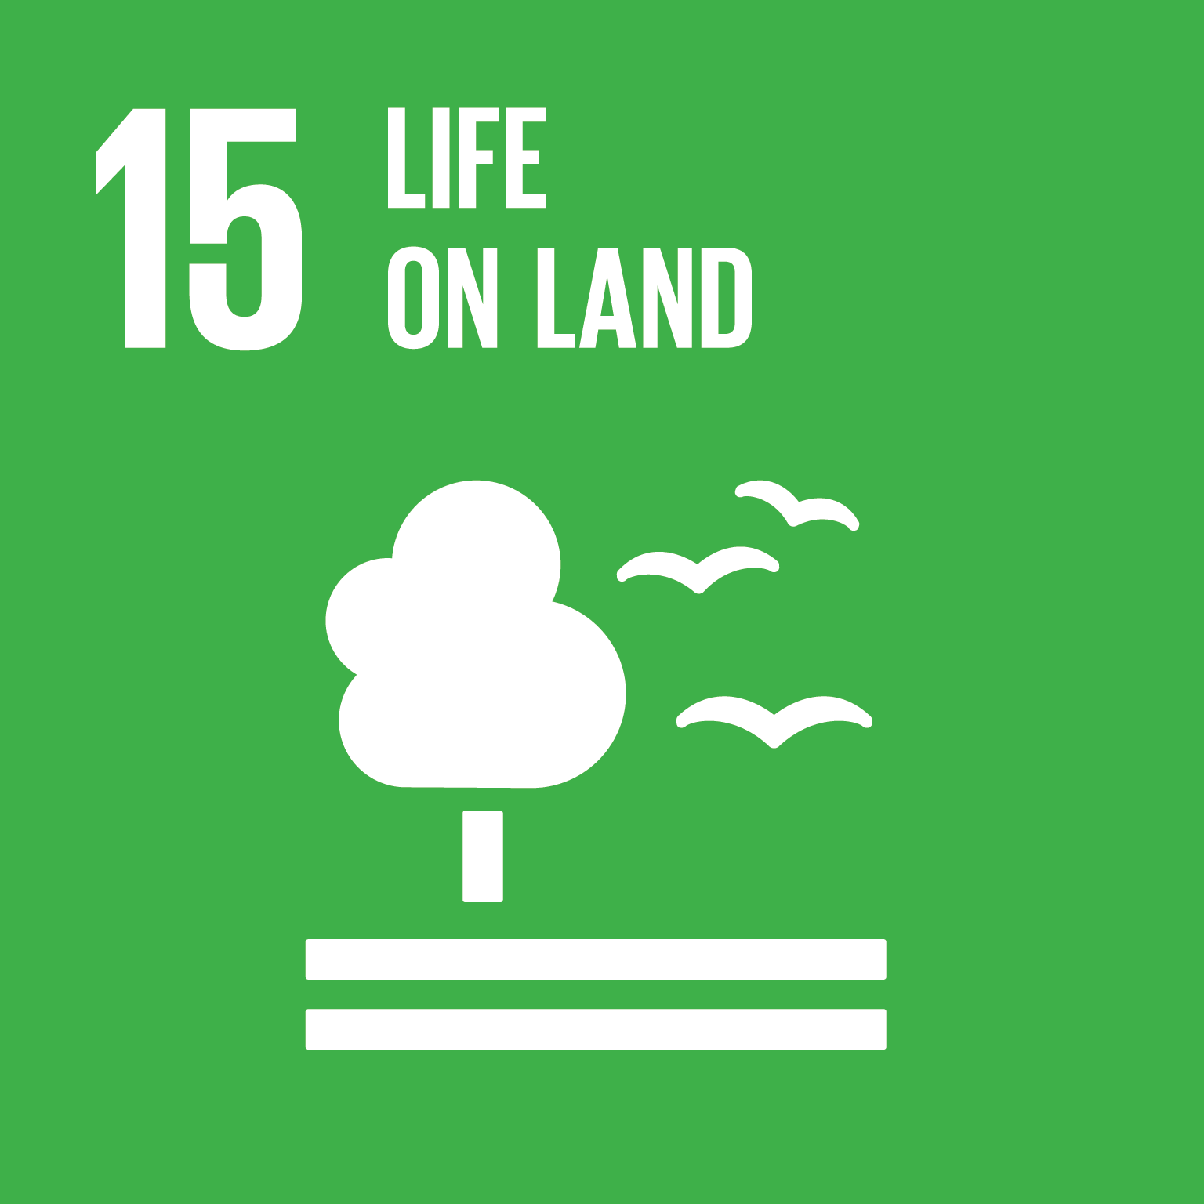
Museo Nacional de Historia Natural, Chile
Ecosystem research and education
Notes:
Project Description: Teachers from the coastal area participate in a workshop at the museum with curators that specialize in different groups of organisms that inhabit the humid temperate forest, focusing on a trail recently established for ecotourism. The project wants to change the vision that local people have about their environment. Rather than thinking of the forest as an assorted set of exploitable resources, they will have a systemic understanding of the ecosystem, where even small plants and animals are important and valuable for general ecosystem well-being and his sustainable use through the time.

Slide 24

Long Island Children’s Museum, USA
Citizen science
Notes:
Project Description: The Monarch Larva Monitoring Project is a citizen science initiative through the University of Minnesota that collects data on milkweed species in order to better understand monarch populations. Museum created a milkweed garden and families were invited to learn about monarch butterflies and the plants that they use for their habitat. Then they measured the amount of rain that had fallen over the past week using a rain gauge, the height of the milkweed plants, the number of monarchs found (and what stage they were in), and the presence or absence of aphids on the plants.

Slide 25
Challenge
Help us brainstorm new ideas for public programs that address the SDGs and can be implemented broadly.
Public learning objectives:
Understanding of big ideas related to sustainability
Awareness of the relevance of sustainability
Sense of self-efficacy related to sustainability

Slide 26
Acknowledgements
The Rob and Melani Walton Sustainability in Science and Technology Museums program is supported through funding from The Rob and Melani Walton Foundation.

Slide 27



Global challenges in neuroscience public engagement
Jayatri Das, Ph.D. & Darrell Porcello, Ph.D.
National Informal STEM Education Network

Slide 28
Stand Up
Sit Down

Slide 29
Stand for any types of neuroscience public engagement have you participated in.
Structured discussion through a deliberative dialogue or citizen jury
Interactive exhibits at a museum or in the public space of a research center
Inspirational art like an art exhibition or a film
Expert-driven presentation or panel discussion in front of public audiences
Patient collaboration, advocacy group meeting, or outreach event
Blog, website, or other online forum

Slide 30
Are you still you? Sit down when you aren’t sure.
You are fitted with a prosthetic arm with fine control through nerve impulses.
You are implanted deep brain stimulation system that stop tremors but also causes a personality change.
You used a neuroenhancement device that dramatically boosts their memory well beyond human capacity.
You are in a coma on life support and can only only communicate through a neuroimaging device that interprets live data through a population-level dataset.
Your tissue is used to grow a human brain organoid that to be implanted in a host animal for long-term observation.

Slide 31
Advanced facial recognition technology is installed in your local grocery store. Sit down when the application feels uncomfortable.
When you enter, the daily count of return visitors goes up by 1.
As you walk by products you have bought in the past, a text message alerts you to a discount.
If you look confused, an employee is sent to your location to ask if you require assistance.
The camera assesses you are happy and nearby video screens play fun ads for sweets and fancy food products.
The camera assesses you are sad and you get a text message asking if you are ok and would like suggestions on products to pick up your mood.

Slide 32
Stand up for nonhuman primate research you support.
Testing the safety of future human brain-computer interface products.
Creating models of psychiatric disorders that may cause suffering.
Cognitive enhancements for nonhuman primates to better understand human brain development.
Causing movement disorders to examine new pharmacologic treatments.
Human tissue integrated into nonhuman primate brains.

Slide 33
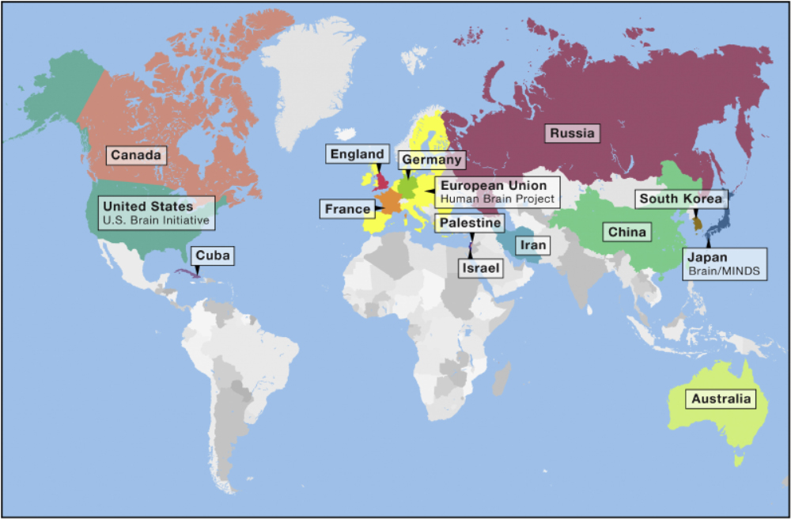


Slide 34
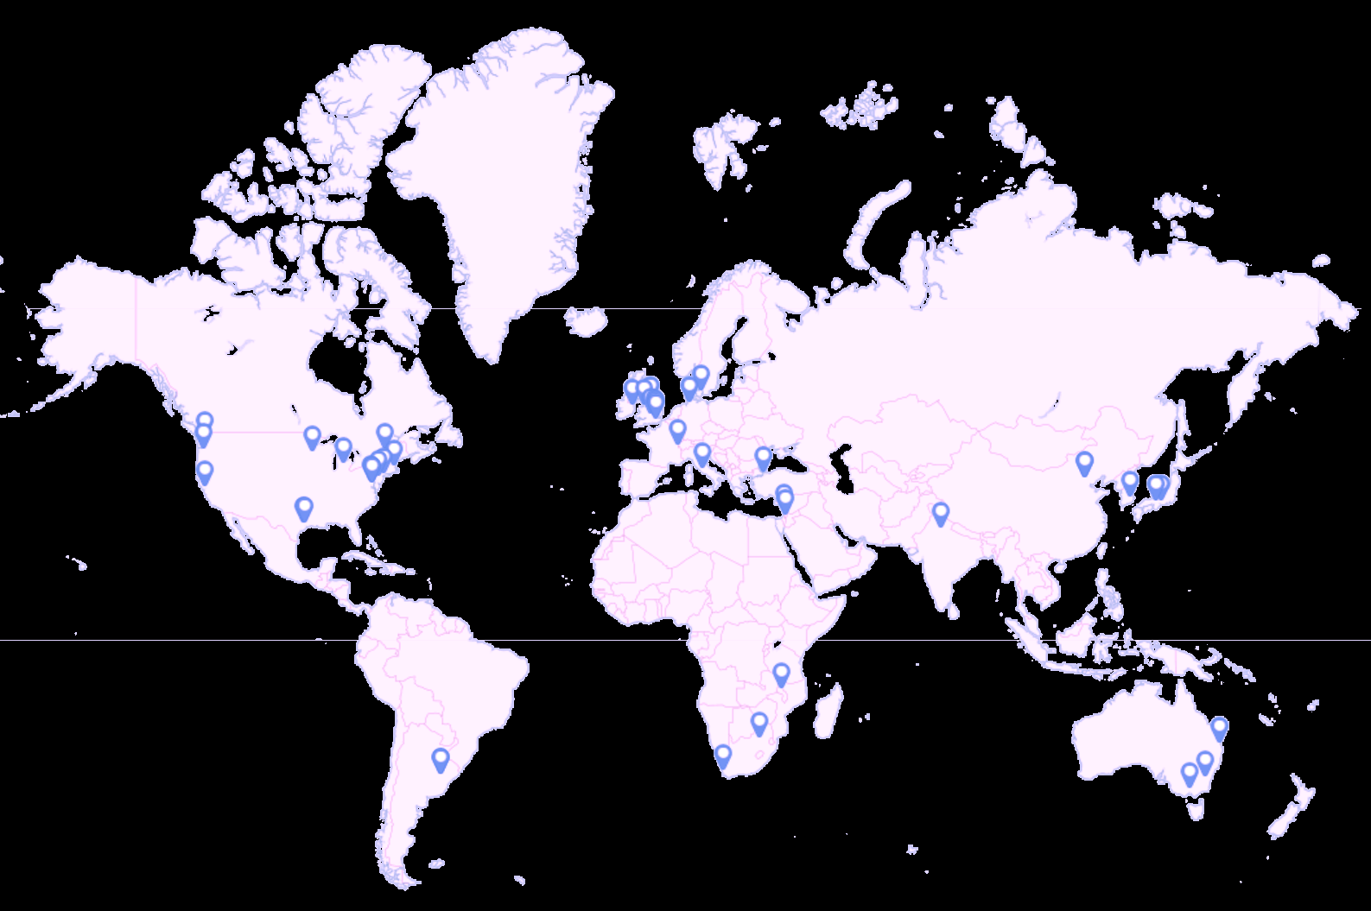
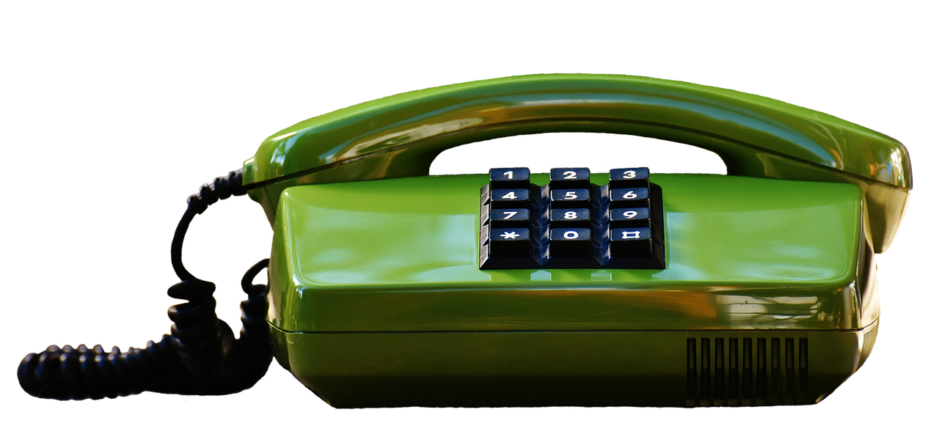
Let’s talk...about neuroscience public engagement
Academic Neuroethicists
Informal STEM Education
Patient Advocacy
Program
Administration
Academic Neuroscientists

Slide 35
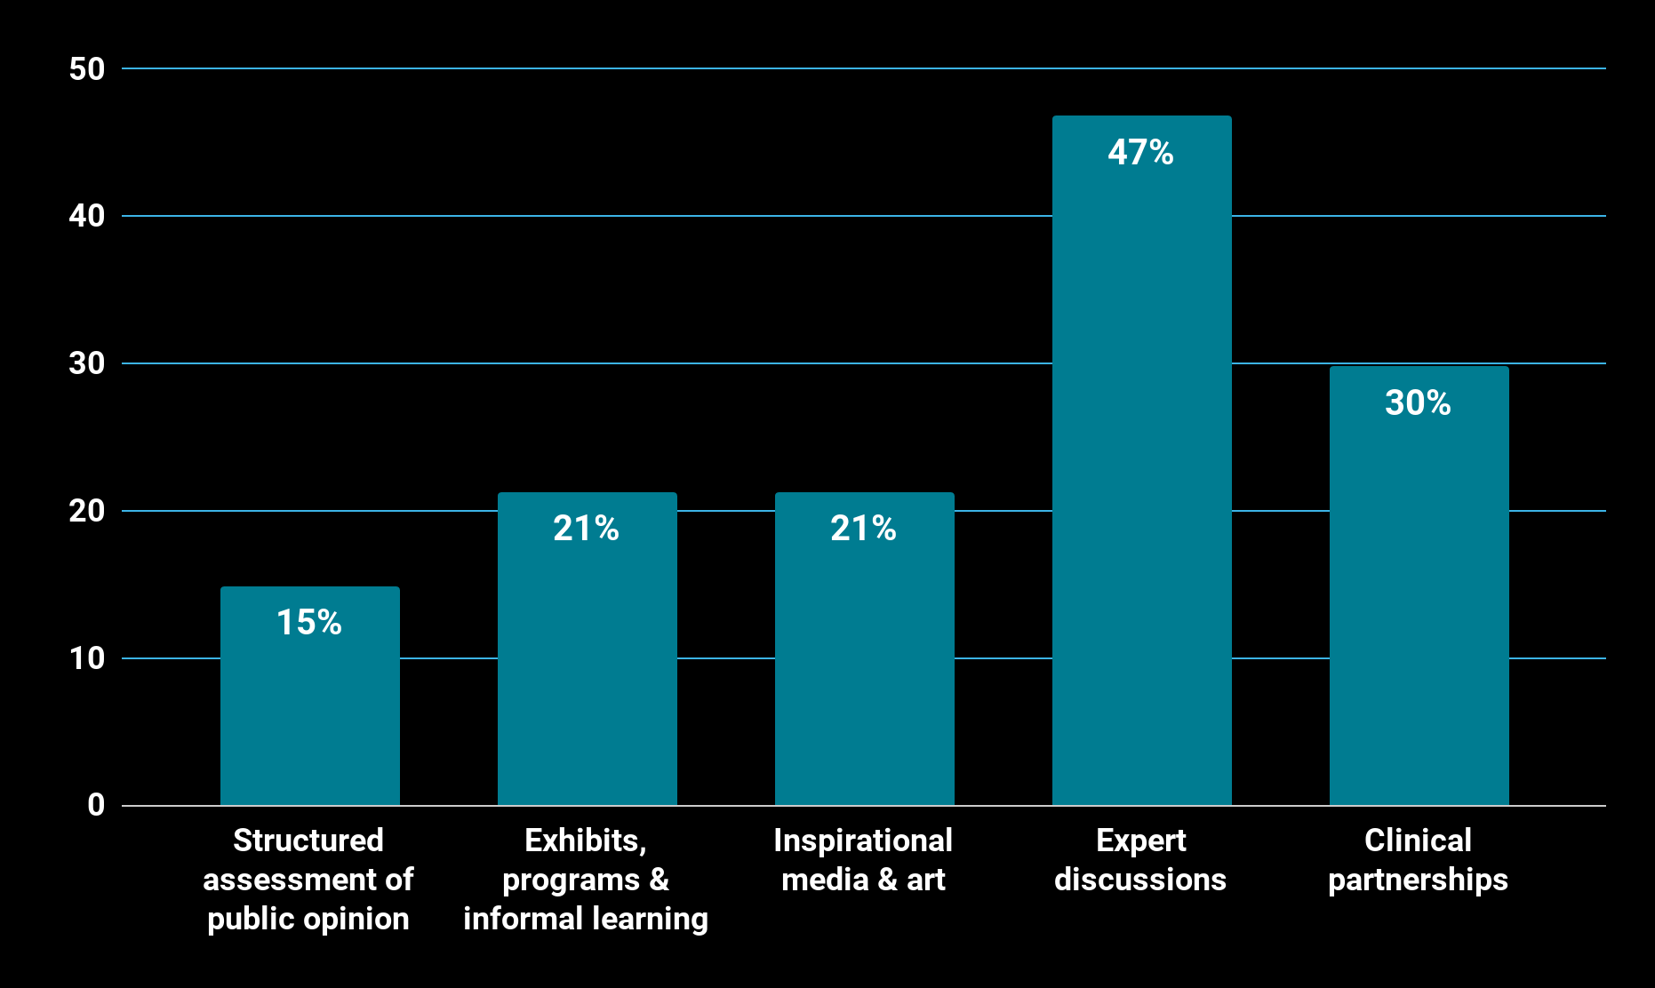

Emerging trends in neuroscience public engagement
Structured assessment of public opinions & attitudes
Interactive exhibits, public programs & informal STEM learning
Inspirational media through partnerships with artists
Expert discussions for public audiences
Partnerships for clinical applications

Slide 36

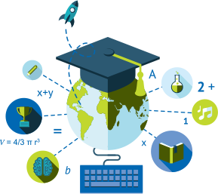
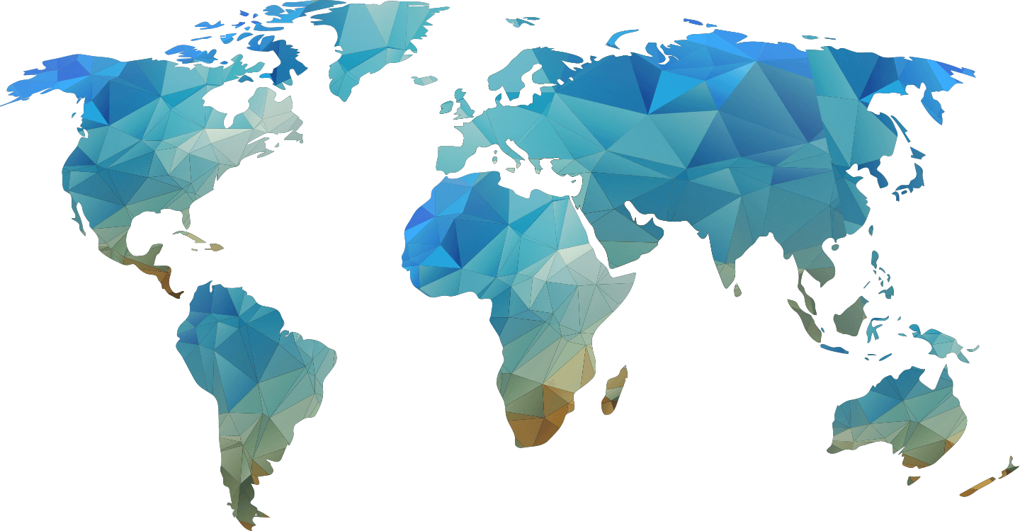
Common Challenges
Pockets of innovation in public engagement are inconsistent
Academic culture is not optimally aligned to support public engagement
NeQNs are not prioritized equally by public engagement practitioners

Slide 37




Opportunities for Global Public Engagement
Foster collaborations between scientists, ethicists, and experts in other fields
Expand training resources, especially for early career professionals
Support local networks with community perspectives
Create shared resources for facilitating dialogue and mutual learning

Slide 38

Look for reports and resources at https://www.nisenet.org/brain

Slide 39

Thank you
International Brain Initiative
Global Neuroethics Working Group

Slide 40
RAPID PROTOTYPING

Slide 41
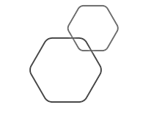
Develop a “moonshot” idea
Work in small groups to develop a concept for a “moonshot” museum experience related to:
MARS EXPLORATION
SUSTAINABLE FUTURES
NEUROSCIENCE
At 4:20, we will interview 2-3 future visitors to your experience. Our correspondent from the future will ask:
What did you just participate in? What was it called and what did you do?
What did you like best?
What did you learn?

Slide 42
THANK YOU!

