Slide 1

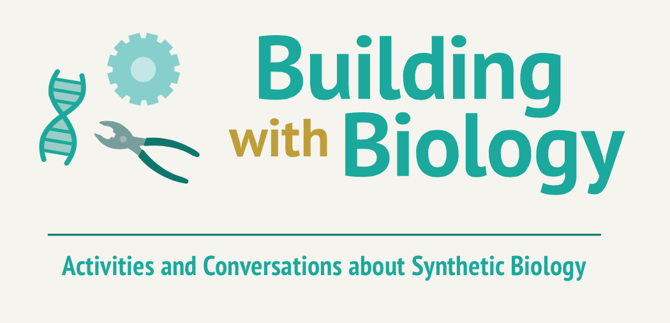
Event Orientation
Notes:
Welcome everyone – thank you for volunteering your time to attend this orientation session for the Building with Biology event
We could not have this event without you!
Note: This project and PowerPoint presentation use the free Google font Lato. To correctly use and view this presentation you will need to download the font and install it on your computer. Lato: https://www.google.com/fonts/specimen/Lato. You can download from here: https://www.google.com/fonts#UsePlace:use/Collection:Lato The more common fonts Calibri or Ariel are fine substitutions.

Slide 2
Presentation Overview
Introduction to Building with Biology:
About the project
What is synthetic biology?
Conversations with visitors
Our Building with Biology Event
Hands-on activities
Logistics
Notes:
Here is our agenda for the orientation today.
We’ll start out with a project overview and then spend most of our time going over the hands-on activities.

Slide 3
Presentation Overview
Introduction to Building with Biology:
About the project
What is synthetic biology?
Conversations with visitors
Our Building with Biology Event:
Hands-on activities
Logistics
Notes:
We’ll start by discussing the project.

Slide 4
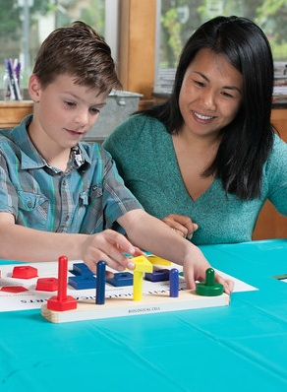
Public Engagement
Project Goals:
Multi-directional conversations between scientists and the public
Target Audiences:
Scientists and informal science educators, and the public
Notes:
One of the primary goals of this NSF-funded project is to encourage back-and-forth conversation and dialogue between scientists and public audiences.
The activities and programs we’re doing during our event are designed to share some basic scientific information, and to solicit people’s own ideas. Public audiences will benefit from knowing about this field of research and researchers will benefit from hearing public perspectives directly from event participants.
You, scientists and volunteers, are an important target audience for this project! By participating in this event, and in this kind of outreach experience, we hope that you will learn through your conversations with the public and share what you learn back with your colleagues in the field. The field, as a whole, benefits from many voices including scientific and public.

Slide 5
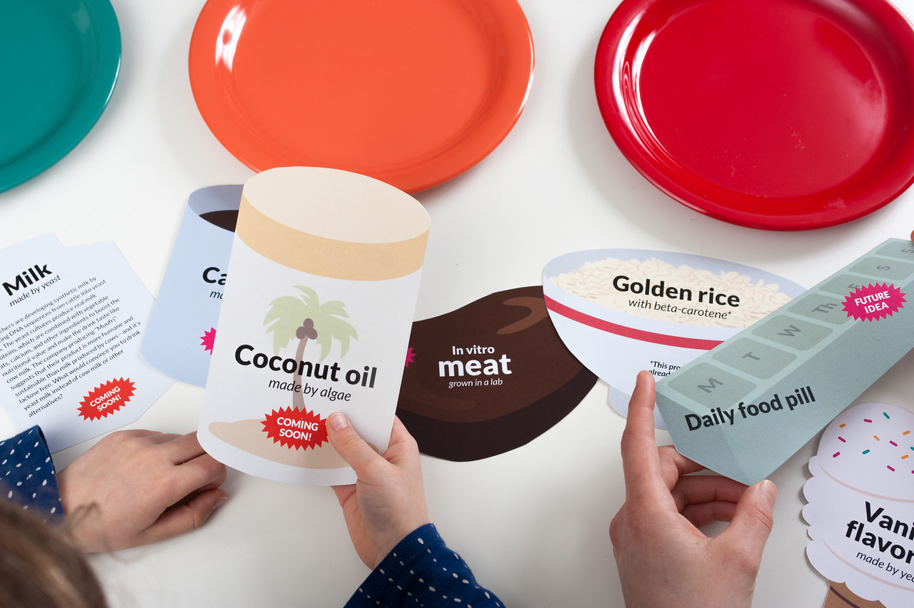
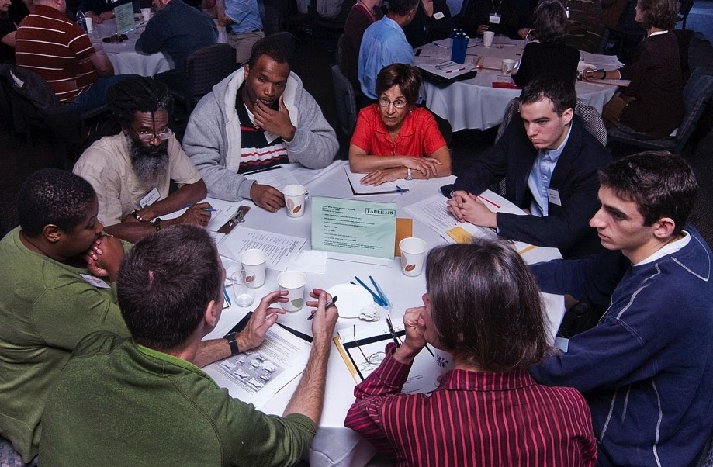
Hands-on activities
Forums
Facilitated
Shorter experiences + back-and- forth discussions
Longer conversations
Focus on societal and ethical issues
Science content + personal experiences and values
Notes:
In order to encourage multi-directional conversations between scientists and the public, the Building with Biology project team has created 1) hands-on activities and 2) longer conversational forums.

Slide 6
Partners
The Multi-Site Public Engagement with Science – Synthetic Biology project is led by the Museum of Science, Boston in collaboration with:
  American Association for the Advancement of Science (AAAS): www.aaas.org
  BioBuilder Educational Foundation: www.biobuilder.org
  National Informal STEM Education Network: www.nisenet.org
  Science Museum of Minnesota: www.smm.org
  Sciencenter (Ithaca, NY): www.sciencenter.org
  Synthetic Biology Engineering Research Center (Synberc): www.synberc.org
Notes:
“Building with Biology” is the public facing event of the MultiSite Public Engagement with Science-Synbio project, led by Museum of Science, Boston in collaboration with a number of scientist and informal learning partners.

Slide 7
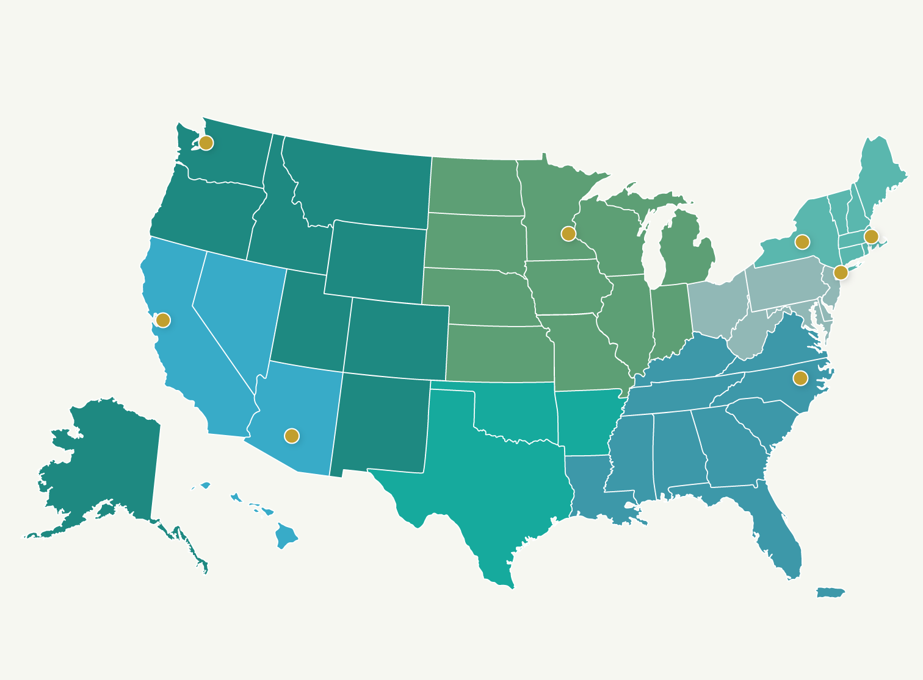
Pilot Events – Summer 2015
Science Museum of Minnesota &
University of Minnesota
Pacific Science Center &
University of Washington
Museum of Science &
MIT
Sciencenter &
Cornell
Chabot Space &
Science Center &
UC Berkeley
New York
Hall of Science &
GenSpace
Museum of
Life and Science &
North Carolina
State University
Arizona Science Center &
Arizona State University
Notes:
The Building with Biology pilot events in the Summer of 2015 brought scientists and members of the public together at 8 science centers and museums across the U.S. to have conversations about synthetic biology.
The materials and activities for Building with Biology have been developed by both informal science educators (the event host sites and the regional hubs) and scientists. In the summer and early fall of 2016, these conversations will take place at about 200 sites around the nation.

Slide 8
Evaluation Findings from Pilot Year
During the pilot events, we conducted surveys and found that:
Visitors enjoyed the events
Participating in events increased visitors’ interest in synthetic biology
Volunteers increased their skills in engaging the public in science
Notes:
In the pilot year of the project, we conducted evaluation.
97% of visitors who filled out surveys “agreed” or “strongly agreed” that they enjoyed their participation
85% of visitors who filled out surveys said that the event increased their interest in learning about how synthetic biology is connected to their daily lives “somewhat” or “a great deal”
95% of volunteers “agreed” or “strongly agreed” that participating in Building with Biology increased their skills in engaging the public in science

Slide 9
Presentation Overview
Introduction to Building with Biology:
About the project
What is synthetic biology?
Conversations with visitors
Our Building with Biology Event:
Hands-on activities
Logistics
Notes:
Now we’re going to move onto sharing some very quick and basic information about the emerging field of synthetic biology.

Slide 10
Synthetic Biology
Biologists study life, specifically organisms and their relationship to their environment.
Engineers solve problems using science and math. They use an engineering design process, which is a series of steps towards solving a problem.
Notes:
First, a very quick introduction to synthetic biology… Many visitors may be more familiar with the fields of biology and engineering. Biologists study life, specifically organisms and their relationship to their environment. Engineers solve problems using science and math. They use an engineering design process, which is a series of steps towards solving a problem.

Slide 11
Synthetic Biology
Synthetic biologists solve problems by applying engineering principles to biology.
Notes:
Synthetic biologists solve problems by applying engineering principles to biology.

Slide 12
Synthetic Biology
Researchers in this emerging field redesign existing organisms and make new ones.
Synthetic biology may provide solutions to problems in areas such as food security, healthcare, energy, and the environment.
Notes:
Many visitors may find the new and emerging applications from this field most accessible and interesting. Researchers in this emerging field redesign existing organisms and make new ones. Synthetic biology may provide solutions to problems in areas such as food security, healthcare, energy, and the environment.

Slide 13
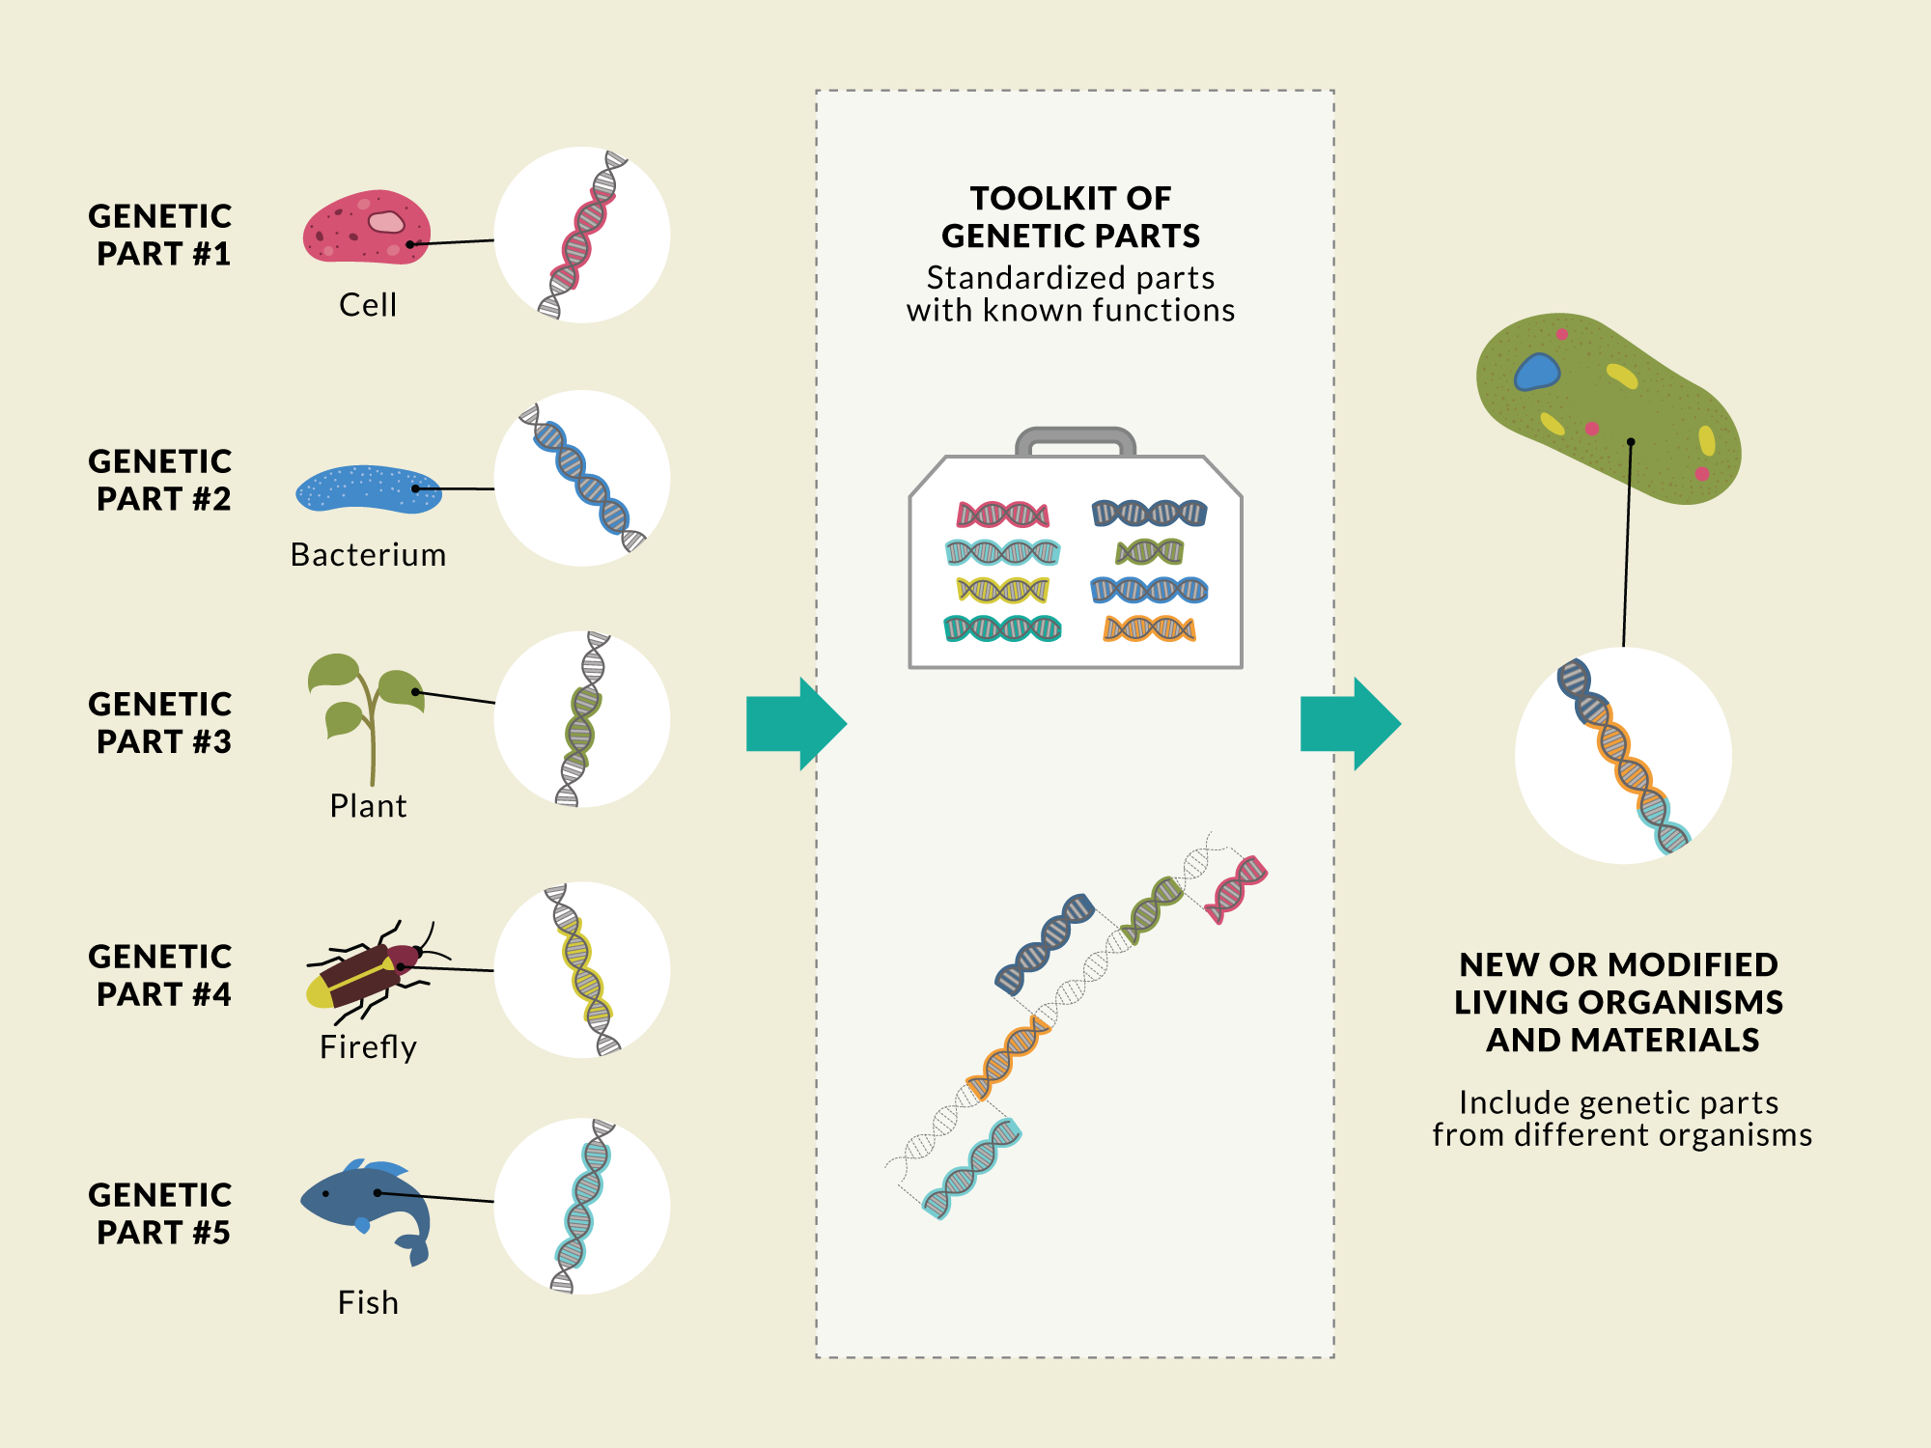
Synthetic Biology
Notes:
Using tools from genetics and biology, scientists and engineers mix and match pieces of DNA to make modified or new living systems. They design, build, and test these new systems in an iterative cycle (engineering design process).
Synthetic biologists are developing a library of standard biological parts. These genetic parts act like instructions that can be put together in different combinations to do and make new things.

Slide 14
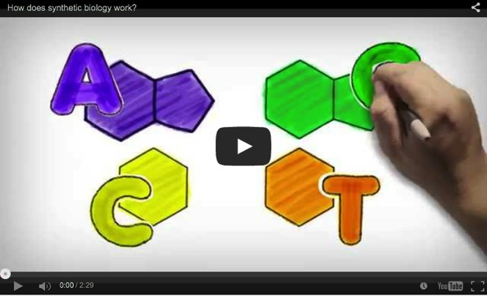
Notes:
We’d like to show you 3 short videos designed for public audiences to help you think about ways to share information about synthetic biology and have a conversation with visitors.
First:
How does synthetic biology work?
~2 minutes, http://youtu.be/ZTBl5NJaqNg
created by MindfFuel Canada
Note: to play the video, you will need to use the file on the USB drive or go to YouTube (The video is not embedded in the slide show)

Slide 15
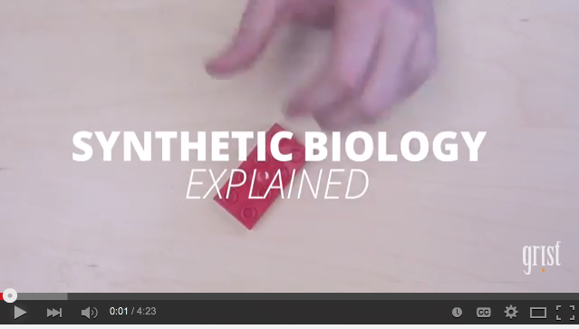
Notes:
Second:
Synthetic Biology Explained
~4 minutes
https://www.youtube.com/watch?v=mlOFE9-3CN0
created by Grist
Note: to play the video, you will need to use the file on the USB drive or go to YouTube (The video is not embedded in the slide show)

Slide 16
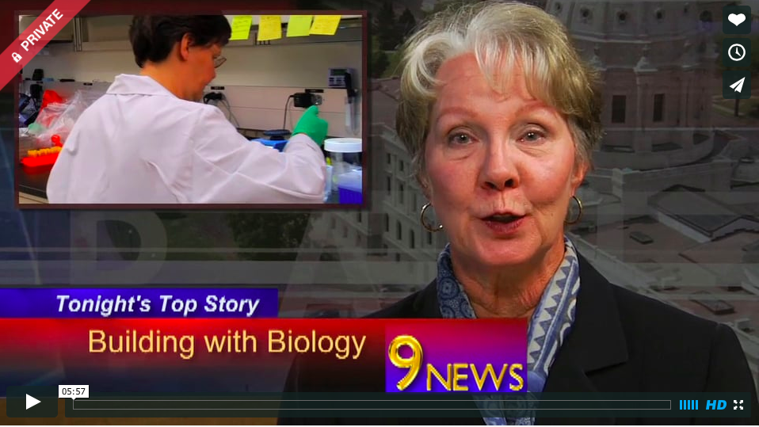
Notes:
Now, we’d like to show you a short video designed for public audiences. This video focuses on the ways that synthetic biology is interconnected with society, and shares some specific examples examples of how to talk about this complex content with our guests.
English Version:
https://vimeo.com/160802115
https://vimeopro.com/nisenet/buildingwithbiology/video/160802115
Spanish Version:
https://vimeo.com/160802114
https://vimeopro.com/nisenet/buildingwithbiology/video/160802114
Note: to play the video, you will need to use the file on the USB drive or go to Vimeo (The video is not embedded in the slide show)

Slide 17
Presentation Overview
Introduction to Building with Biology:
About the project
What is synthetic biology?
Conversations with visitors
Our Building with Biology Event:
Hands-on activities
Logistics
Notes:
Now we’re going to move onto a brief overview of public engagement with science and conversations about synthetic biology.

Slide 18
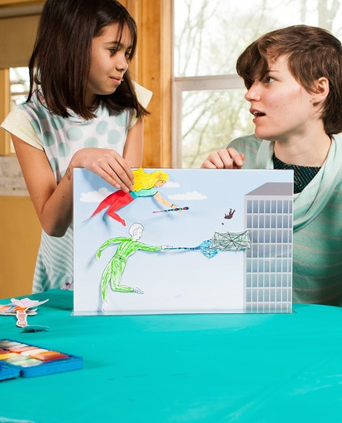
Conversations with Visitors
The focus of this project is to encourage scientists and volunteers to engage in conversations with visitors.
Notes:
In these activities, we take a neutral position on synthetic biology. We are not “selling” it – and we are also not trying to discourage it.
We are creating a space for museum visitors to ask questions, share their ideas, and explore this emerging technology as it applies to their lives. We want scientists to have a conversation with the public.

Slide 19
Public understanding
Public engagement
Demonstration
Scientist/educator has knowledge and expertise to share
Visitors discover phenomena and laws of nature
The facilitator communicates facts
Visitors ask questions and receive answers
Conversation
Everyone has their own values and perspective to share
Visitors form opinions and explore ideas
The group considers facts and values
Facilitators and visitors ask questions and receive responses
Notes:
This project is focused on increasing opportunities for public engagement with synthetic biology rather than public understanding. With the hands-on activities and the forum this engagement comes from having back-and-forth conversations between scientists and volunteers and the public.
READ NOTES FROM SLIDE
Note: Additional resources about Public Engagement with Science, specifically about synthetic biology, have been created for this project by AAAS. Links to resources and archived webinars can be found online at buildingwithbiology.org/orientations

Slide 20
Making the Content Accessible
You can use analogies and examples to help make synthetic biology concepts accessible.
Notes:
We have a few suggested strategies for having conversations with the public that involve using different analogies and concrete examples.

Slide 21
Using Analogies
Making cells into factories . . . to make new things
Medicine
Foods
Energy
Materials
Notes:
Analogy: Cells are like tiny factories.
With synthetic biology, modified bacteria, algae, and yeast cells can be programmed to become tiny “factories” that produce new materials. Synthetic biology may provide solutions to problems in areas such as food security, healthcare, energy, and the environment.

Slide 22
Using Analogies
Synthetic biology is like mixing and matching interchangeable parts and pieces.
Each part has a different biological function.
Notes:
Analogy: Pieces of genes can be assembled like blocks.
Genetic engineering has traditionally focused on swapping out single genes at a time. Rather than cut-and-paste, synthetic biologists hope to create entirely new genetic code assembled from an open-source repository of snippets of working genes called "BioBricks." Assembling them like blocks, the new sets of custom genetic code can then be re-inserted into bacteria or other organisms, modifying their fundamental behaviors and life cycles. This opens the door for scientists to engineer entirely new living organisms.

Slide 23
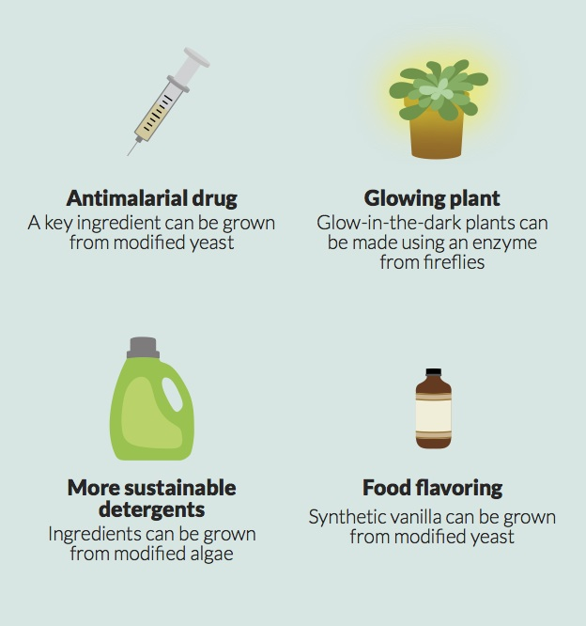
Using Examples
Notes:
Having concrete examples of synthetic biology products is another good way to talk about synthetic biology. All of the hands-on activity boxes include a reference with a few examples. This can be is a good way to prompt visitors when discussing ways in which these technologies are interconnected with society.
Examples:
Medical applications are interesting and important to many visitors
Consumer products help connect synthetic biology to their everyday lives
Surprising inventions can spark their curiosity

Slide 24
Presentation Overview
Introduction to Building with Biology:
About the project
What is synthetic biology?
Conversations with visitors
Our Building with Biology Event:
Hands-on activities
Logistics
Notes:
We’ll give you an opportunity to try out the hands-on activities, but, first, here’s an overview of all the activities.

Slide 25
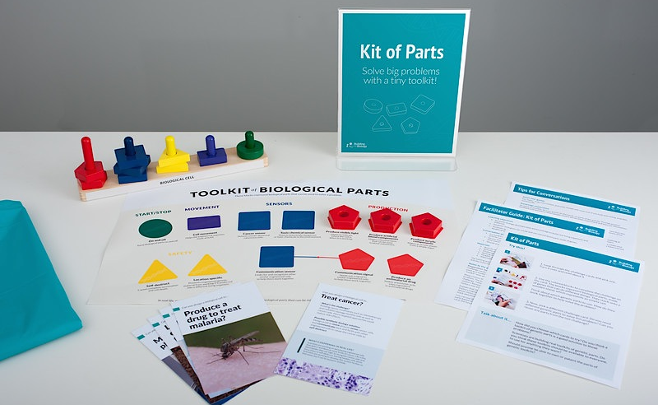
Hands-on Activities
Notes:
In every hands-on activity box:
Activity guide - with language to help you interact with visitors
Facilitator guide – with learning objectives and suggestions for conversation starters
Background reference sheets with information about the science behind your activity.
All the hands-on activity materials you’ll need to run the activity, including a sign stand and colorful table cloth.

Slide 26
Big Ideas
Synthetic biology
builds biological
systems
Synthetic biology generates new tools
and knowledge
Synthetic biology
benefits from
many voices
Synthetic biology
is interconnected
with society
Notes:
This project has 4 “big ideas” that we use to talk to the public about the emerging field of synthetic biology. The activities in the kit are meant to provide opportunities for conversations about synthetic biology and these ideas.

Slide 27
Hands-on Activities
Synthetic biology
builds biological
systems
Synthetic biologists apply engineering principles to the life sciences to solve problems.
Notes:
The activities: “Bio Bistro” and “VirEx Delivery” focus on the idea that “Synthetic biology builds biological systems”

Slide 28
Hands-on Activities
Synthetic biology generates new tools
and knowledge
Using tools from genetics and biology, scientists and engineers are mixing and matching pieces of DNA to program living systems, in a way that is like computer programming.
Notes:
The activity “Kit of Parts” focuses on the idea that “Synthetic biology generates new tools and knowledge”

Slide 29
Hands-on Activities
Synthetic biology
benefits from
many voices
Synthetic biology is an interdisciplinary field. People from many different fields
participate. The work can take place in university labs, companies, and DIY maker spaces.
Notes:
The activity “See DNA” introduces visitors to this essential biological material, and explores the idea that many people can participate in synthetic biology.

Slide 30
Hands-on Activities
Synthetic biology
is interconnected
with society
Technologies and societies are interconnected. People’s values determine which new technologies are developed and used. Synthetic biology scientists are doing research that might affect all of us.
Notes:
The activities “SuperOrganism” and “Tech Tokens” explore how synthetic biology and society are interrelated.

Slide 31
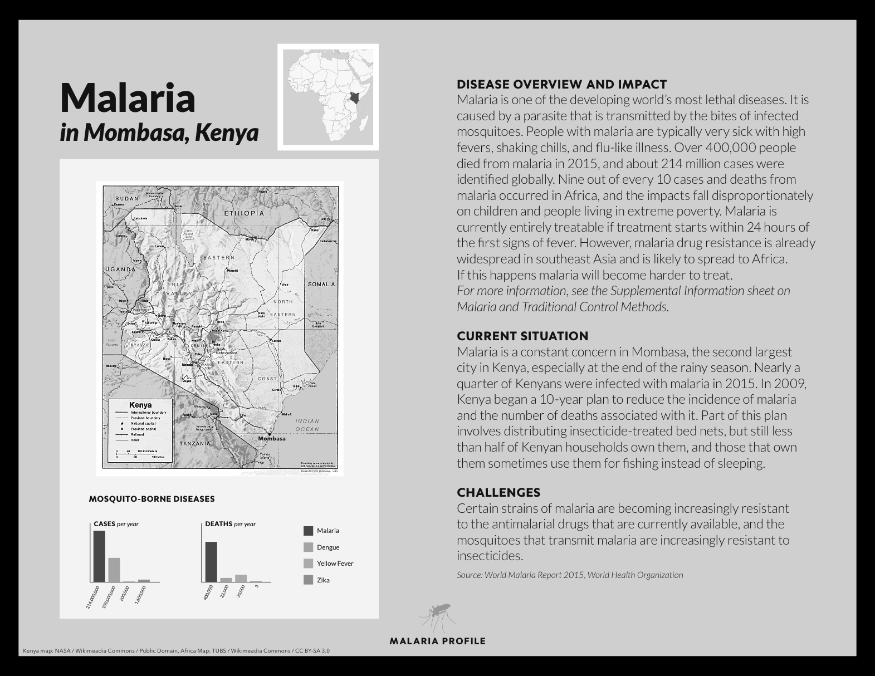
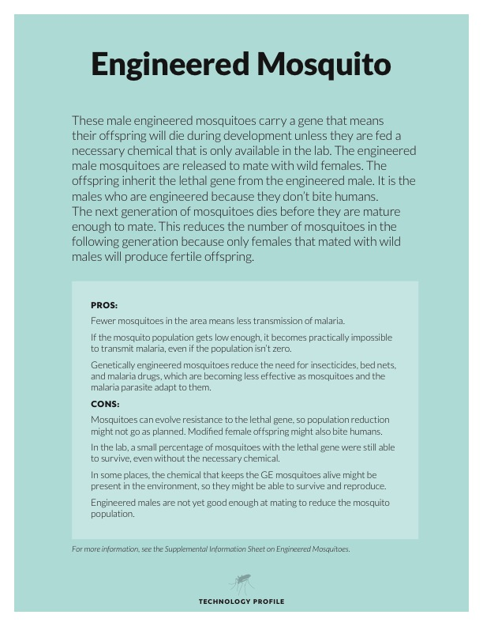
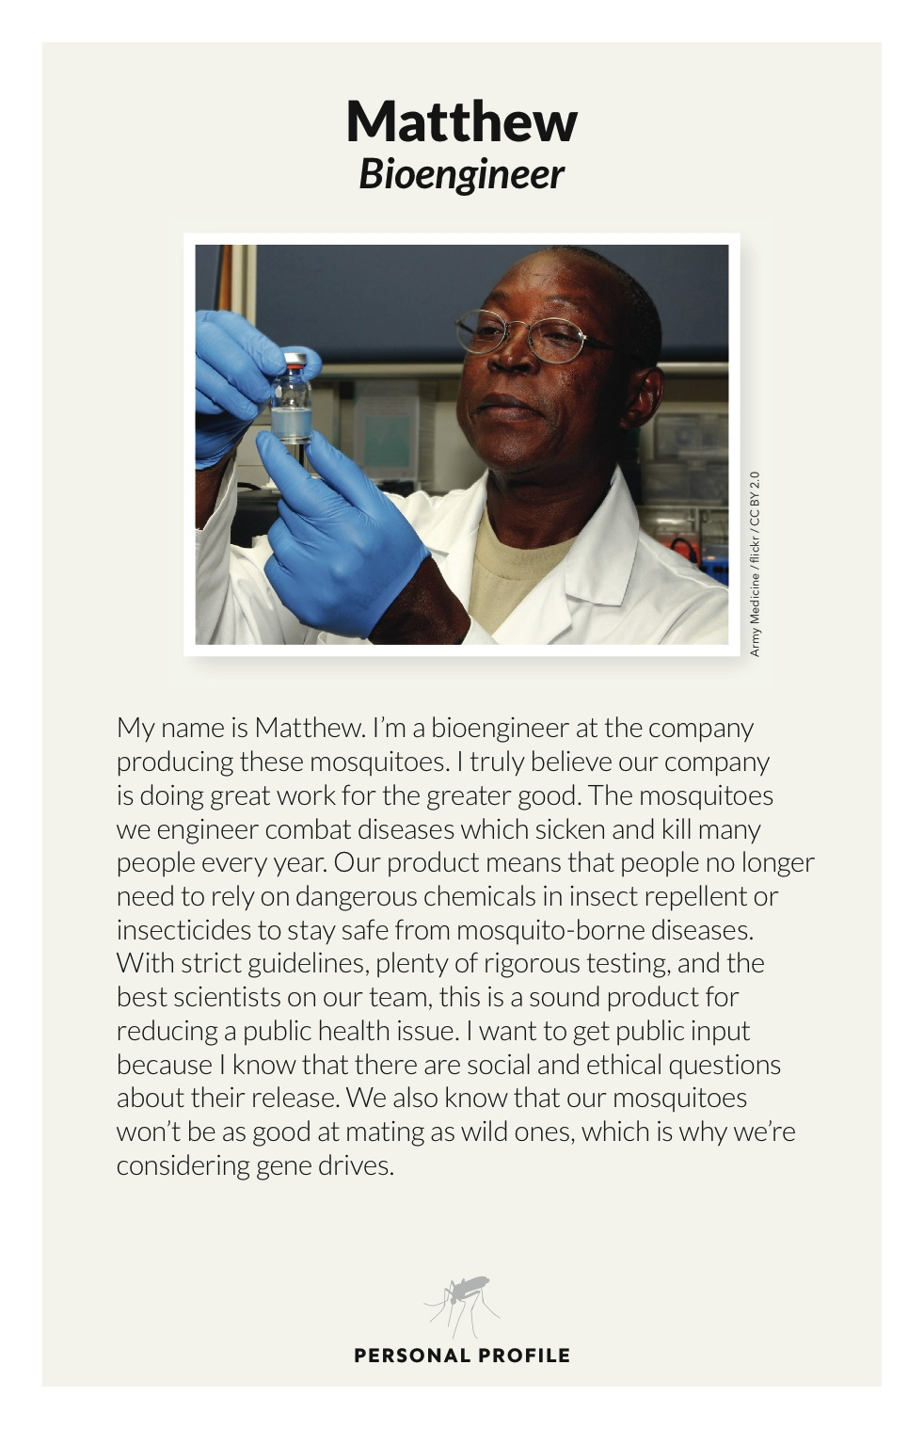
Forums
Notes:
The forum touches on all four of the big ideas, and encourages thoughtful and deliberative conversation between scientists and the public about ways synthetic biology and these new technologies are interconnected with society.
Note: In the forum box, you will find a detailed manual on how to host a forum-style program. Additional forum programs and resources can be found online at Buildingwithbiology.org.

Slide 32

Passports
Each facilitator will need to be prepared to stamp visitors’ passports if guests ask them a question and/ or share what they think about synthetic biology.
Facilitators who are scientists should wear “I’m a scientist” stickers at the event and should be ready to stamp passports if guests talk to them.
The person at the graffiti board will need to stamp passports if a guest adds a post-it note to the graffiti board about how they think synthetic biology will change our lives in the future.
Notes:
Each staff or volunteer will need to be prepared to stamp visitors’ passports if:
Guests ask the facilitator a question
Guests share what they think about synthetic biology
Facilitators who are scientists should wear “I’m a scientist” stickers at the event and should be ready to stamp passports if:
Visitors talk to the scientist facilitator
The person at the graffiti board will need to stamp passports if:
Visitors add a post-it note to the graffiti board about how they think synthetic biology will change our lives in the future
Note: You may or may not choose to use the Building with Biology passports at your event, and that’s fine. They physical kit include 100 copies (in English and in Spanish) but you are free to print more of your own from the digital file. Every activity box include a marker stamp for facilitators to use.

Slide 33
Presentation Overview
Introduction to Building with Biology:
About the project
What is synthetic biology?
Conversations with visitors
Our Building with Biology Event:
Hands-on activities
Logistics
Notes:
We’d like to go over a few logistics for today’s event.

Slide 34
Event Logistics
  Event schedule
  What else is going on
  Location of bathrooms
  Emergency procedures
Notes:
Note: Here are some common logistical points you’ll probably want to cover. You can add any logistics that you would like to share for your institution.

Slide 35
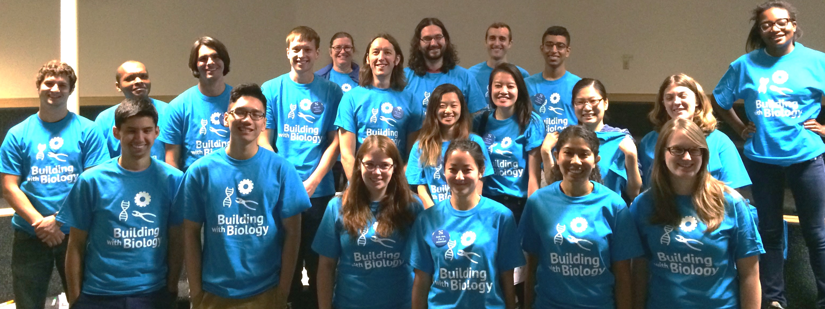

Thanks for volunteering!
We couldn’t do this without you!
This presentation was created as a collaboration of the ￼￼￼Multi-Site Public Engagement with Science—Synthetic Biology project. This project was supported by the National Science Foundation under Award Number 1421179. Any opinions, findings, and conclusions or recommendations expressed in this program are those of the authors and do not necessarily reflect the views of the Foundation.

