Slide 1
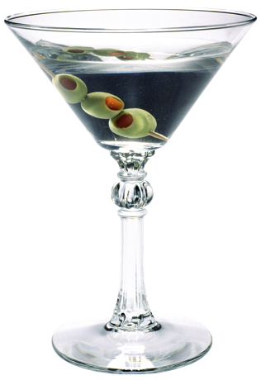
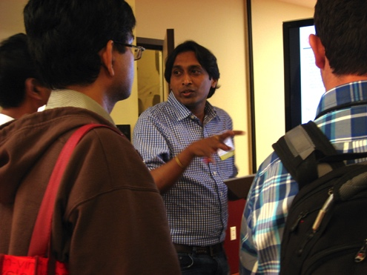
Welcome! We’re warming up with professional-style introductions.
Sharing Science Workshop & Practicum
(Pretend you’re at a
science conference
networking session)
Don’t forget to… breathe, smile,
make eye-contact, provide the motivation
for your work, show interest in others.
Notes:
Slide 1: [Have this slide up on the screen in the meeting room when the workshop participants arrive… It’s nice to have a little background music as well. Switch to the next slide when you’re ready to call the meeting to order.]

Slide 2
SHARING SCIENCE Workshop & Practicum [Date]
[Provider Name(s)]
[Sponsoring Organization]
Notes:
Slide 2: Leader Intro:
Hello, my name is ________ and we’re delighted to be hosting you here today at [this institution].
[How many of you have come [to the Museum] previously? Welcome back. How many of you have never been here before? Welcome! Please feel free to stay and explore the museum after the Workshop has ended. We’ve included a Museum map and schedule in your packets.]
[Optional: Introduce other workshop facilitators. Give brief background – this can include a briefing on the university-museum partnership, its aspirations and joint activities.]
Today, we’d like to engage you as our partners in developing a more science literate society, and in inspiring and empowering young people to focus on learning science, engineering, and math, perhaps following in your footsteps and preparing for careers in research, science, and technology. Indeed, some of the children you will interact with during the Practicum part of this Workshop may end up being your graduate students and lab technicians when you are tenured leaders in your field or CEOs of start-up companies.
We think you’re going to find the experience extremely rewarding. Can any of you remember a visit to a science museum that inspired you to think about going into science as a career? Was there an adult – perhaps a teacher or a family member who introduced you to science or engineering in a way you’d never before experienced? Did you have some experience actually doing something scientific with someone in research, and catch the bug that way? During your life, you are going to have plenty of opportunities to inspire young people and open their eyes to new possibilities. There’s not a better feeling in the world.
Now, many of you noted in your pre-Workshop survey that you have more confidence speaking about your research to other scientists than you do to non-scientists. Which is perfect, because that is the topic we’re going to be focused on here today. [Option to quote from survey responses that many attendees will find mirror their own thoughts – but please do so without revealing the authors.]
Once you have mastered the ability to engage young people and even adults without much science background; once you have learned how to capture their imaginations and lead them into a new way of seeing things, you will find you also have new tools to communicate with other people important to your work - potential collaborators in other fields, funders, perhaps investors. And, you may finally be able to explain to your elderly grandparents what your work is all about.
So we urge you to really engage today. Give it your all. Successful science communication skills are important to a career in science – especially these days –where research teams include specialists in many diverse areas, all using different jargon, different tools, different units of measurements, and different acronyms.
Today, we only have a few hours together, and we’re going to concentrate on just a few key aspects of communication, education & outreach. First we’re going to focus first on Sharing Science with Words - introducing yourself, who you are and what you do - and then on Sharing Science with Hands-on Demos - using hands-on demonstrations to engage students and other folks in interesting conversations about science.
And, if you like doing this, we’re going to give you some opportunities in the future to come back to the Museum and continue to work with us to develop your skills as science educators.

Slide 3
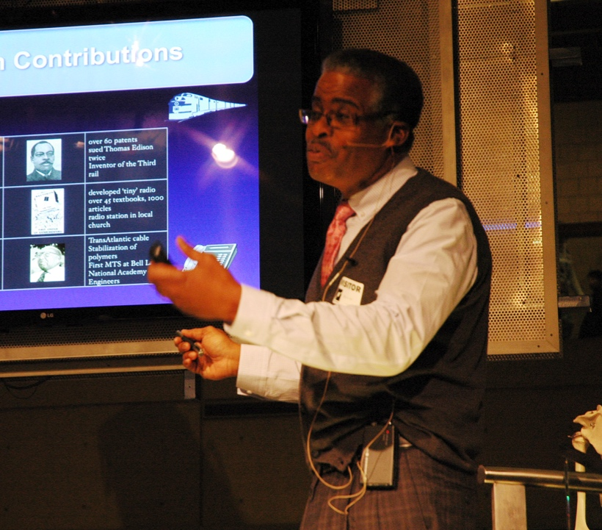
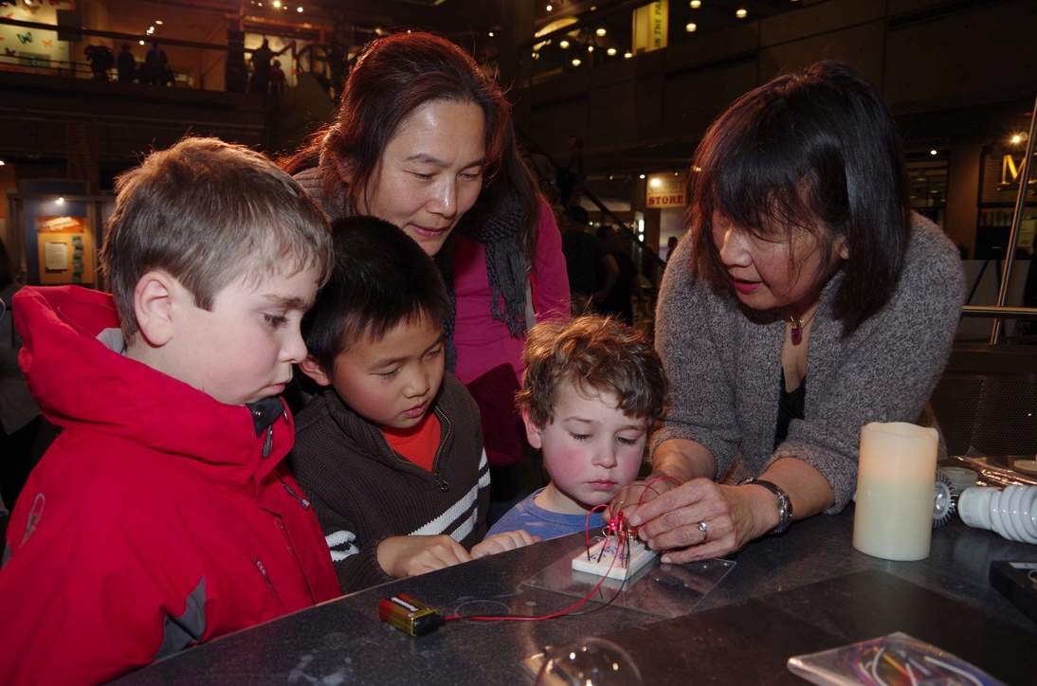
What’s different about sharing science with broader audiences?
Sharing Science Workshop & Practicum
Nothing.
You have to meet any audience where they are.
Notes:
[Slide 3] So, what’s different about sharing science with broader audiences? Nothing really. Because no matter what the audience, your strategy should be meet that audience where they already are. And then carefully guide them to where you want to take them.
So, the first thing you need to do when you are preparing to speak to a person or a group of people, is to figure out who they are.

Slide 4
Consider Your Audience:
Who are they?
What prior experience do they have?
Why should they care?
How can you “hook” them?
What do they want to know?
How much time do they have?
Notes:
[Slide 4]
In considering any audience, you want to ask yourself these questions….who are they? What do they already know? How can you connect to things they probably care about? How can you hook them or engage their interest? How much would they really want to know? How much time do they have? Then sculpt your talk to meet their needs – not yours.
Once you figure out who your audience is, you can adjust your language and the kinds of explanations you provide. More importantly, you can figure out what it might take them to care about what you’re saying. Whether we like it or not, there is always a little lingering question in the mind of every listener: “why should I care?” Or, more bluntly, “what’s in it for me?”
Once you figure out who your audience is, you can adjust your language and the kinds of explanations you provide. More importantly, you can figure out what it might take them to care about what you’re saying. Whether we like it or not, there is always a little lingering question in the mind of every listener: “why should I care?” Or, more bluntly, “what’s in it for me?”
One of the most important things you can do to adapt to your audience is to adjust what you say along the “What” and “So What” axes.

Slide 5
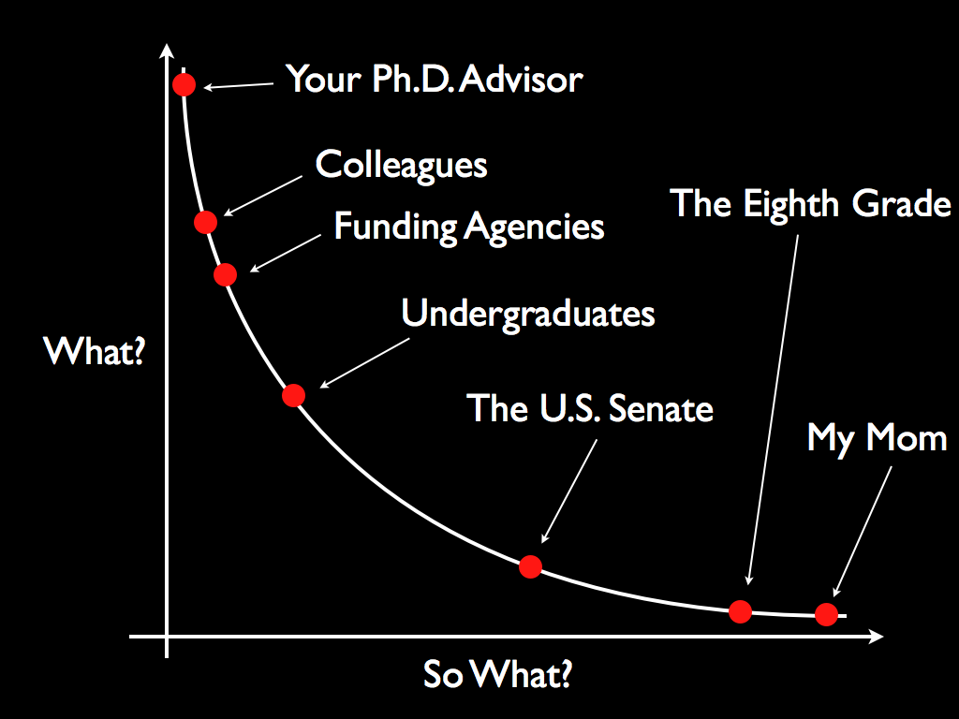
(How?)
Grandma
(Why?)
Adapted from T. Miller, 2009
Notes:
[Slide 5]
For your Ph.D. advisor and your lab colleagues, you’re going to give more of the detailed information about WHAT you did and HOW you did it. You’ll probably just skip the Why, because they will all know why you’re doing it.
But for your grandparents, and nephews and nieces and for the politicians who represent your fellow taxpayers, you’re probably going to focus a lot more on WHY you are spending all this time and money doing what you are doing – what is the ultimate goal of the research, besides getting you a degree and a job? What broader impact might it turn out to have?
You see, your lab partners already understand why you’re spending two months trying to figure out how to get this chemical to react with that chemical, or wiring this connection to pick up that faint signal. But a lot of audiences won’t. And you’re going to have to work to make them care. Usually your research project is a part of a bigger research project, which may be part of a bigger investigation that may help to accomplish a major scientific goal or meet an important engineering challenge. But unless you brief your audience on what this larger overall goal is about – unless you find a way to connect your day-to-day work with a larger human goal or purpose, very few people will have the stamina to listen to the details of your progress. So, when you’re trying to share your science with people outside your lab or your area – say, with your gang from the neighborhood, or, your soccer buddies, or your little brother or sister, you have to think about a way to capture their attention, hook their interest, understand why you care and why they should care about what you do. Our jargon for this is “context and meaning.” You supply context for your efforts and thus help to make them meaningful.
Will your efforts some day have the potential to ease the pressure on our strained health care budget? Could you come up with a way to decrease the need for the burning of fossil fuels? Will your widget save people hours of effort each week? Will you come up with the material strong enough to build an elevator to space? Tell us. Tell us what your dream application might be. And then tell us the story of trying to get there. You can use anything to help you. Analogies. Anecdotes. Word pictures. Gestures. Napkin drawings. Anything.

Slide 6
Academic Hiring
Committee?
Industry
Interviewer?
IP Lawyer?
(How?)
Grandma
Potential Investor?
University PR Office?
Journalist?
(Why?)
Adapted from T. Miller, 2009
Notes:
[Slide 6]
Now, as you move on in your career, you’re going to be making judgement calls about the background and interests of many people that you will need to talk to. I know some of you are interested in careers in industry or academia. So what I advise is that you develop a repertoire of personal introductions to yourself and to your work, that you store in the back pocket of your mind, ready to pull out when the occasion arises. Today, to get you warmed up for work with Museum audiences, we’re going to work at the low “What,” high “So What” end of the curve.

Slide 7
Academic Hiring
Committee?
Industry
Interviewer?
IP Lawyer?
(How?)
Grandma
Potential Investor?
Journalist?
University PR Office?
Journalist?
(Why?)
Adapted from T. Miller, 2009
Notes:
[Slide 7]
Today, to get you warmed up for work with Museum audiences, we’re going to work at the low end of “What,” and the high end of the “So What” part of the curve. .. In a few moments, I’m going to ask you to take a minute to design an intro to yourself and your work that you might be able to use with a very smart and curious 12-year old. What would you say or do to engage a smart 12-year old?

Slide 8
Pam Silver
Insert video clip:
“Silver-malaria-artemisinClip.mov”
(email: nano@mos.org for clips)
Intro to Synthetic Biology: Pam Silver, Wyss Institute
Notes:
[Slide 8]
For inspiration, I’m going to screen for you a brief one-minute introduction to a museum talk given by Pamela Silver, a researcher at the Wyss Institute for Biologically-Inspired Engineering at Harvard. See how she connects the context of her research to her audience.
[Run video]

Slide 9
Consider Your Audience
Real World Science Communication
Who are they?
What prior experience do they have?
Why should they care?
How can you hook them?
What do they want to know?
How much time do they have?
Notes:
[Slide 9]
You can see that in that one minute, Dr. Silver met her audience at a more basic introductory level that introduced the ”why”: malaria – killer disease in many equatorial countries – expensive to treat – treatment comes from hard to get plants; before she approached “the how”: use yeast cells – like those that make beer!
So now, we’re going to all do this for ourselves.

Slide 10
Introduction: A version for smart 12-year olds Rapid Prototyping: Draft One
Length: 30-60 seconds
Engage: How will you grab their attention?
Language: What words and concepts can you use?
Relevance: Can you relate it to something they already know or experience?
Notes:
[Slide 10]
You’re each going to spend about a minute drafting a rough 30-60 second introduction to your research area suitable for a smart – and polite – 12-year old. This is rapid prototyping. You get an idea and flesh it out. You don’t second-guess yourself too much. The idea is to go with your instinct for that particular audience. Here on the slide are some guidelines. After you’ve had a couple of minutes to work on your own on this, we’re going to gather in small groups and test the drafts, than we’ll go back to re-draft. [give a couple of minutes]

Slide 11
Providing Helpful Feedback:
Would they like it?
2. Identify what worked well.
(Content, approach, style, presence)
3. Identify areas that might be improved.
(Content, approach, style, presence)
4. Provide suggestions for improvement.
5. Be encouraging.
SDLKJ
Notes:
[Slide 11]
Before we assemble into small groups, I’d just like to say a few words about providing helpful feedback. Some people are shy about giving suggestions or feedback because they think it’s not polite or they think it will make the person feel bad. On the other hand, in my experience, most people would really rather receive helpful feedback in a relatively safe practice session like this - than make some mistakes at a time when it’s really going to count. So, let your colleagues in your small group know if you are open to receiving feedback, and colleagues, give it to them.

Slide 12
Introduction: A version for smart 12-year olds Rapid Prototyping: Try it Out!
Structure: Groups of 3, one speaker and two 12-year-olds.
Begin: One minute intro, up to 1-min for further discussion.
Feedback/Suggestions: Listeners provide 1-min each.
Rotate: Switch roles every 4-5 minutes.
When finished: Begin Draft Two.
Notes:
[Slide 12]
Here are the instructions for the small group work….
Try to form a group with 2 other people you don’t already know well.
Pick who is going to start.
[Brief further instructions, using slide. Begin.]
[You can time the minutes to keep them on track, e.g., “You should be on the second person by now…
You should be on the third person by now…OK, you all should be sitting down by now. Go ahead and work on Draft Two. Are there any questions?”]
[This is also a good time to workshop with one or two volunteers in front of the room, if you have time.]

Slide 13
Introduction: A version for smart 12-year olds Rapid Prototyping: Draft Two
Length: 30-60 seconds
Engage: How will you grab their attention?
Language: What words and concepts can you use?
Relevance: Can you relate it to something they already know or experience?
Notes:
[Slide 13]
All right, now you have a minute or two to work on Draft Two.

Slide 14
Introduction: A version for smart 12-year olds Rapid Prototyping: Try it Out Again!
Structure: Groups of 3, one speaker and two 12-year-olds.
Begin: One minute intro, up to 1-min for further discussion.
Feedback/Suggestions: Listeners provide 1-min each.
Rotate: Switch roles every 4-5 minutes.
When finished: Begin Draft Two.
Notes:
[Slide 14]
And now we’d like one person from each group to move to the next group, clockwise. This way each speaker will have one new listener and one listener who can note how the introduction has changed.
Pick who is going to start.
And proceed as you did before.
[You can time the minutes to keep them on track, e.g., “You should be on the second person by now…
You should be on the third person by now…OK, you all should be sitting down by now. Are there any questions?”]

Slide 15
What did you learn from the Rapid Prototyping Exercise?
Notes:
[Slide 15]
Let’s talk about what you learned from the Rapid Prototyping Exercise.
[Discussion: Reinforce the characteristics of good introductions or “elevator speeches.” ]

Slide 16
What did you learn from the Rapid Prototyping Exercise?
It takes practice!
Notes:
[Slide 16]
This is one of the messages we hope you take away with you.
If you develop a few versions of the 30-60 second introduction, and practice them aloud or with other people, they WILL soon become second nature to you, and you WILL become much more adept at mastering the kinds of professional and social situations in which they can be handy.

Slide 17
Brief Break

Slide 18
Sharing Science with Hands-On Demos
Notes:
[Slide 18]
Now, this part of the Workshop focuses on sharing science with hands-on demonstrations. It’s no surprise that people learn best through experience, and through inquiry about experiences, and that learning by doing is a characteristic of science as well.

Slide 19
Insert video clip
“TheOfficeClip.mov”
(email: nano@mos.org for clips)
The Office – Season 3 – Episode 19
Notes:
[Slide 19]
Do any of you remember that scene in TV show, The Office, when “Michael Scott” (played by Steve Carrell) and Pam are trying to figure out why another team’s safety training was better than their own? And, Michael has this revelation about the way people learn in science museums? Watch…
[play]
Well, maybe there’s a little more to it than that, but it’s true that…

Slide 20
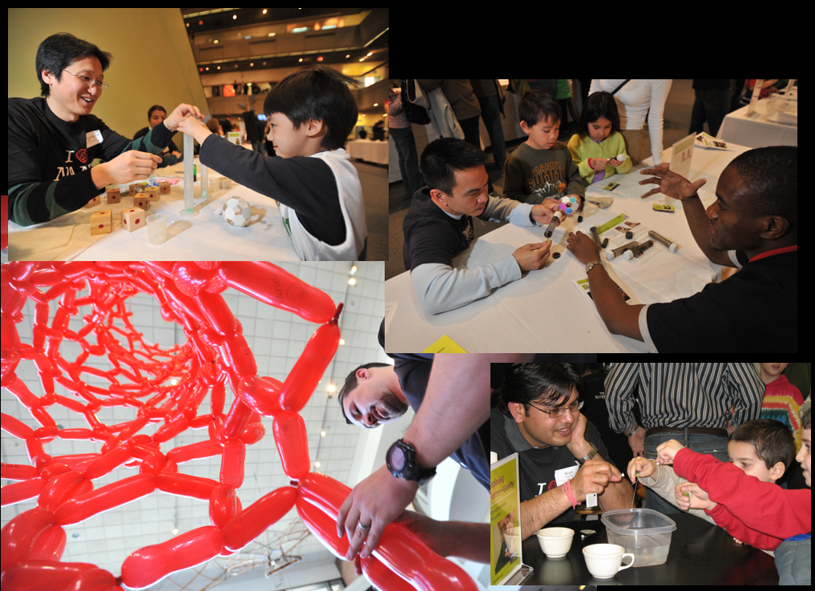
Hands-on, Minds-on Engagement
“I saw it with my own eyes!”
“It was so cool.”
“We learn by doing.”
“We had such GREAT
conversations with people….”
“I figured it out myself!”
“Exploring stuff is
way more fun than being told stuff.”
Notes:
[Slide 20]
….Science museums are about experiences.
Today, we’re going to explore hands-on demonstration experiences where visitors get to interact one-on-one with a person – YOU – as they explore and discover an idea or topic. We’ll discuss inquiry-based learning, elements of a successful hands-on demonstration, strategies for creating a positive visitor experience…

Slide 21
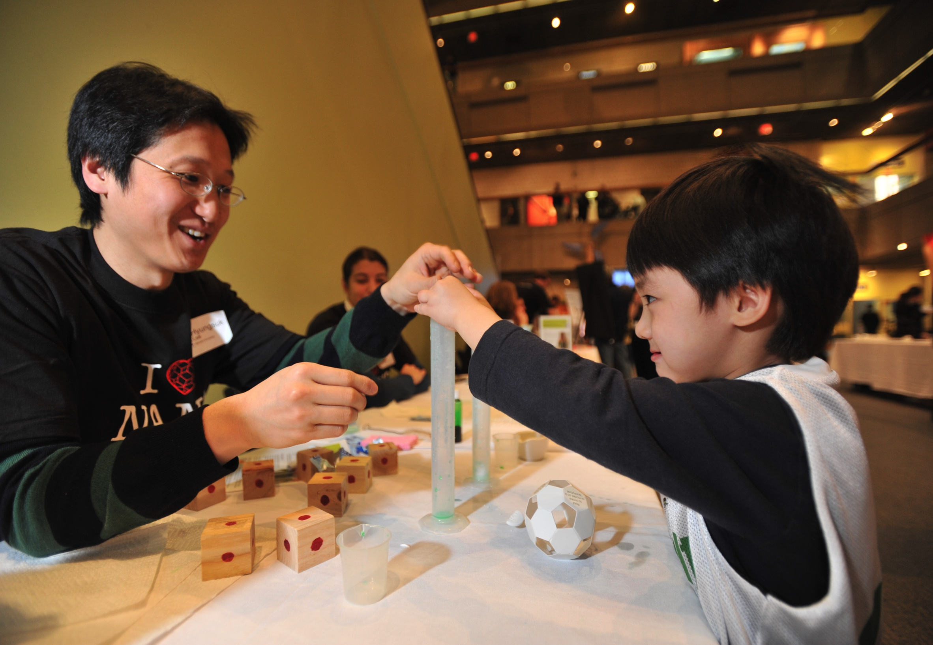
What makes for a good hands-on science demo experience?
Notes:
[Slide 21]
So, what makes for a good hands-on science demo experience?
Well, let’s try one, and see what you think.
I’ll demonstrate for you one way of facilitating a demo with a Museum visitor. We’ll call it a “Demo Demo.”
[Act out a really bad demo with facilitator and audience members. See sample workshop leader commentary in Section Four]
[Go through debrief and discussion. Then using best practices and audience suggestions, act out the demo again to show a more appropriate and engaging version.]

Slide 22
Insert video clip:
“LaurenZarzar-Hydrogel-demo-320x180.mov”
(email: nano@mos.org for clips)
Lauren Zarzar tests her demo with museum visitors
Notes:
[Slide 22]
Here’s a brief video of a Harvard graduate student named Lauren Zarzar who was working on hydrogels in 2010, and during a museum internship developed a hands-on demo to help people explore the extraordinary water retentive qualities of hydrogels. In this handheld video you’ll see her interacting with visitors on the first day she was trying out her prototype. Try to notice what Lauren does that works well and what you think might work even better. And also, notice the role that the parent plays in the interaction.
[Play video]
What are some strategies that Lauren used to engage they young boy? What was effective? What might you have done differently?
By the way, Lauren’s hydrogel demo proved so successful that it has been added to the NISE Net catalog of demos.

Slide 23
Working with Museum Visitors
Want to have FUN (not be lectured at)
Want to be ACTIVE (do stuff)
Parents usually want KIDS ENGAGED
DON’T want to be overloaded
May be distracted/hungry/tired/have tickets to a show/need the bathroom/have cranky kids/etc.
Notes:
[Slide 23] Here are a few observations about Museum visitors that are good to keep in mind.

Slide 24
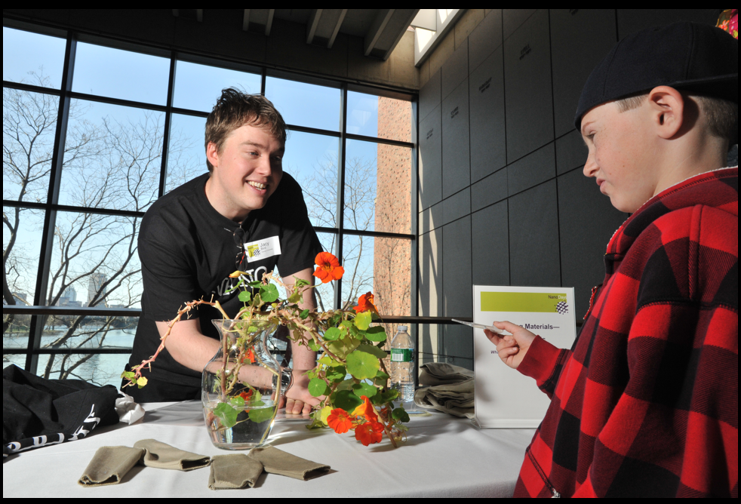
The Nanoscience Demonstrator’s Guide
Notes:
[Slide 24]
Now, to help you remember some of these key points about doing science demos, we’ve put together this handy Nanoscience Demonstrator’s Guide. [Hand-out]. These are 10 questions you should ask yourself and consider how to engage with your audience. They remind you that you are not here to fill up people’s minds with facts - you are here to guide them to make their own explorations and conclusion.
[Review “The Nanoscience Demonstrator’s Guide”]
And, now, it’s time for us to get our own hands on….

Slide 25
Inside the Box
Demo Materials
Activity Guides/Background Info (for YOU not the visitor!)
Notes:
[Slide 25]
When you get to your station, you will find a box. Inside the box you will find all the materials you need to run one NanoDays activity. Each activity has a “guide” that has 2 sides with the information you need to learn about how to run this activity for visitors.
The front of all the guides is divided into three sections:
“Try This!” which gives the instructions for doing the activity “What’s going on?” which explains what the visitor observed
“How is this nano?” which explains the nanoscale science and/or technology background for the activity
Many guides also have a back side, including:
Learning objectives – tells you what visitors will hopefully learn from participating in the activity
Materials – Check that you have all the materials needed for the activity.
Notes to the presenter – These may help give you some helpful hints to make the activity more successful
Some of the activities also include Extensions – which are extra activities that can be done.
Read over the guide, then review the other materials in your box. Next, you should craft an approach for leading this activity with visitors and practice with your partners. Don’t forget to use the Nanoscience Demonstrator’s Guide.

Slide 26
Take 20 min
to learn your demos
Don’t forget to use the
Nanoscience Demonstrator’s Guide
Notes:
[Slide 26]

Slide 27
Rotation 1
20 minutes
Demonstrators: Do your best to engage visitors in your demo. Try different strategies!
“Visitors:” Experience the demos as if you are a real museum visitor. Stay in character. Afterwards, offer constructive feedback.
Notes:
[Slide 27]

Slide 28
SWITCH
Notes:
[Slide 28]

Slide 29
Rotation 2
20 minutes
Demonstrators: Do your best to engage visitors in your demo. Try different strategies!
“Visitors:” Experience the demos as if you are a real museum visitor. Stay in character. Afterwards, offer constructive feedback.
Notes:
[Slide 29]

Slide 30
The Practicum:
Test out your skills
with visitors!
Notes:
[Slide 30]

Slide 31
Debrief & Discussion
What was the best part of the experience?
Was anything harder than you expected?
What strategies worked best?
Ideas to improve your demo?
Notes:
[Slide 31]

Slide 32
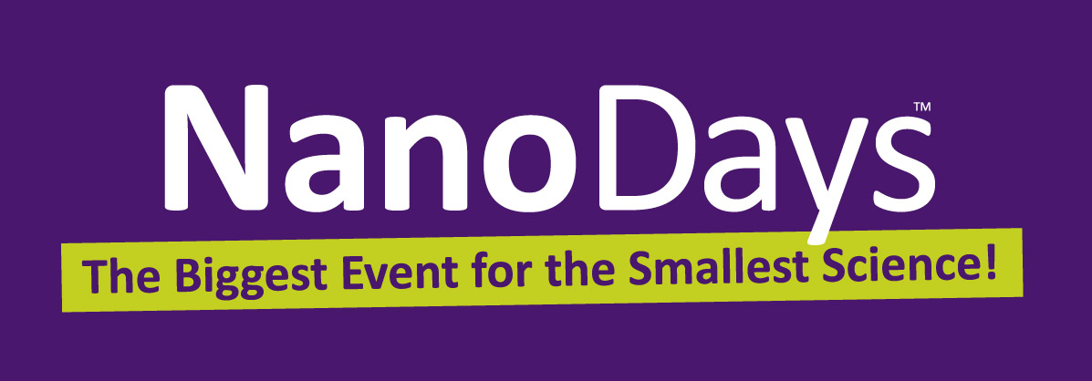
[Date]
[Time]
Volunteers: [time]
Notes:
[Slide 32]
So, your next chance to practice these skills is NanoDays…

Slide 33
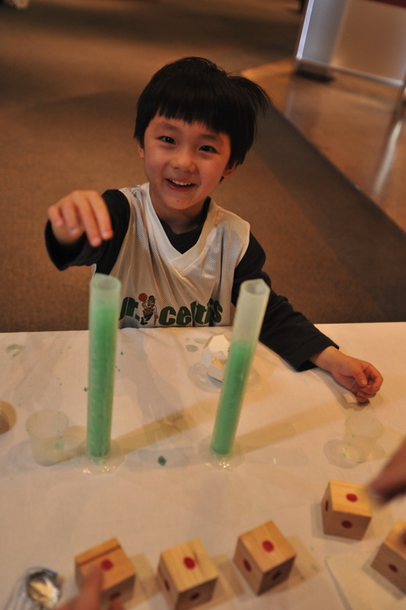
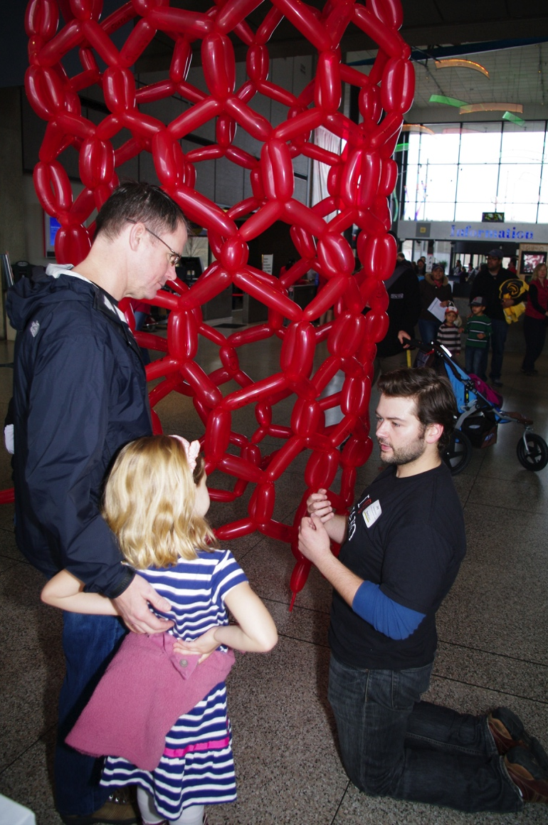
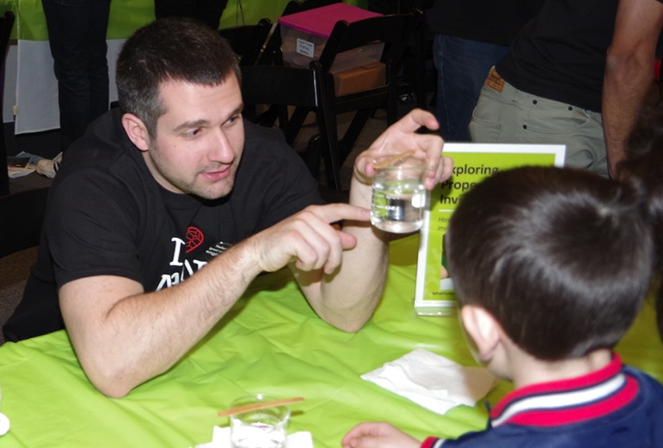
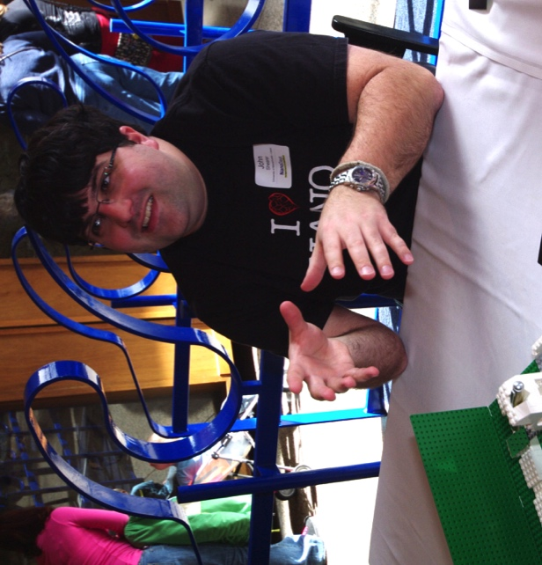
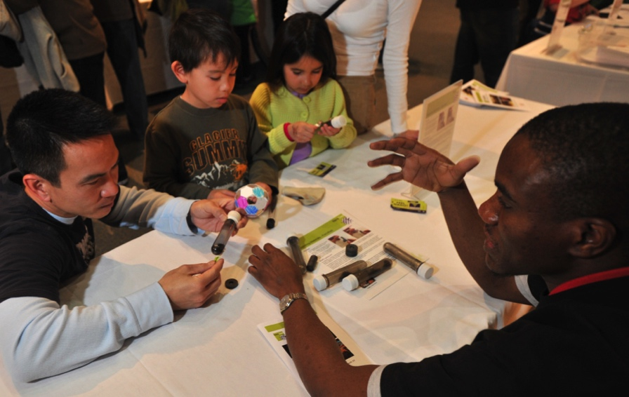
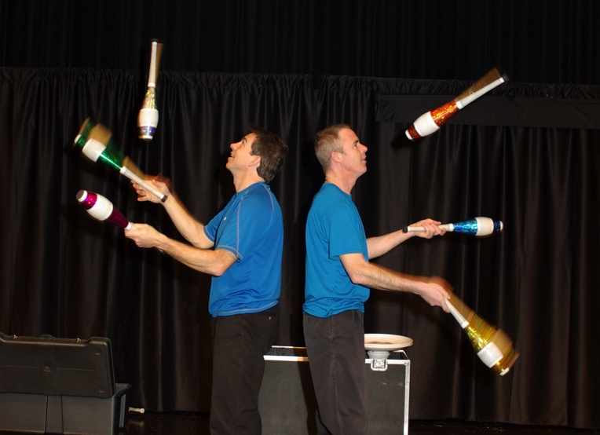
Notes:
[Slide 33]
Thank you so much for joining us today – looking forward to seeing you back here for NanoDays!
[We have a short survey for you to fill out about your experience here today. Optional photo release form for NanoDays.]

Slide 34
The Sharing Science Workshop & Practicum was developed by Carol Lynn Alpert, Karine Thate, and other members of the Strategic Projects Group at the Museum of Science, Boston, in collaboration with CHN, the Center for High-rate Nanomanufacturing NSF Nanoscale Science and Engineering Center (NSEC) headquartered at Northeastern University, and the “Nanoscale Systems and Their Device Applications” NSF NSEC headquartered at Harvard University. The University of Massachusetts Donahue Institute provided professional research and evaluation services. Funding was provided by the National Science Foundation and the Massachusetts Technology Collaborative through sub-awards from the two NSECs.
Production and dissemination of this Planning and Implementation Guide is supported by the National Science Foundation through the NISE Network under award 0940143. Any opinions, findings, and conclusions or recommendations are those of the author(s) and do not necessarily reflect the views of the Foundation.
© Museum of Science, 2015

