Slide 1
Universal Design for Public Programs

Slide 2
UD Online Workshop Team
Anna Lindgren-Streicher, Museum of Science
Juli Goss, Museum of Science
Vrylena Olney, Museum of Science
Brad Herring, Museum of Life and Science
Notes:
As the presentations goes along, share questions and examples in the chat box – we’ll go over them at the end of each section
Encourage everyone to connect to meeting audio through your computer – this will ensure you get all of the audio associated with the videos, as well as what the speakers are saying

Slide 3
Workshop Overview
Introduction
Repeat and reinforce main ideas
Multiple entry points / ways of engagement
Physical and sensory access
Questions?
Notes:
Will start with an introduction to the principles of universal design behind this work. Then will walk through the concepts that can be used to create and deliver a universally designed public program, based on the NISE Net UD programs guidelines, with photos and videos showing examples from NISE Net programs.

Slide 4
Defining disability
The social model of disability:
“…disability is a dimension of human differences (and not a defect), [and] derives its meaning from society’s response to individuals who deviate from cultural standards…”
Notes:
As defined by Dr. Carol Gill at the University of Illinois at Chicago

Slide 5
What does this mean for us?
The person is not the defect
Changes in design can either enable or “dis-able” visitors to learn
Certain design-visitor combinations are better than others

Slide 6
Evolution of approaches
Exclusion, charity
Rehabilitation, accommodation
Social justice, universal design

Slide 7
What is Universal Design?
The design of products and environments to be usable by all people, to the greatest extent possible, without the need for adaptation or specialized design.
(Center for Universal Design, 2002)

Slide 8
Aspects of universal design
Physically inclusive
Cognitively inclusive
Socially inclusive
(Blamires, 1999)

Slide 9
Universal design for learning
To support recognition learning, provide multiple, flexible methods of presentation.
To support strategic learning, provide multiple, flexible methods of expression and apprenticeship.
To support affective learning, provide multiple, flexible options for engagement.
(Rose and Meyer, 2002)

Slide 10
Assistive technology vs. universal design
Assistive technology – needs of one user in one environment
Universal design – create experiences that are accessible to users along a broad spectrum of abilities
Range of able to disabled is a result of individual need and the design of the environment

Slide 11
Universal design in museums
Museums are places where design is used to facilitate learning
Museums offer the possibility of multi-sensory learning activities
Museums provide groups of visitors with the opportunity to learn through social interaction

Slide 12
Questions?

Slide 13
Workshop Overview
Introduction
Repeat and reinforce main ideas
Multiple entry points / ways of engagement
Physical and sensory access
Questions?

Slide 14
Repeat and Reinforce Main Ideas
Why?
Considerations:
Developing a Program
Designing Props & Materials
Delivering your Presentation

Slide 15
Why repeat and reinforce main ideas?
People learn differently:
Listening
Touching
Visual images
Helpful for those with different attention spans or short-term memory.
Can relate to a disability or context
Notes:
Context: such as caring for a screaming child or sitting in the back of a crowded room

Slide 16
Considerations for Developing a Program
Focus the main idea.
Break down the program into discrete pieces.
Be explicit about this breakdown
Powerpoint slide from the Snowflakes: Nano at its Coolest program

Slide 17
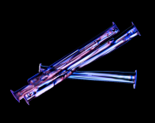
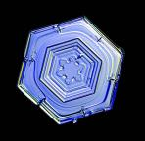
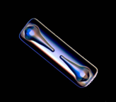
Snowflakes have many shapes

Slide 18
Developing a Program
Video: Tiny Solutions to Our Big Energy Problem
http://www.nisenet.org/catalog/programs/tiny_solutions_our_big_energy_problem
Karine identifies her main ideas in the form of questions.
Notes:
Karine’s questions:
Where do we get this energy?
Will we run out?
How can science and engineering help us secure a clean, safe and reliable source?

Slide 19
Designing Props and Materials
All information (visual, aural, and tactile) should support one another.
Have hands-on elements that can be passed around to reinforce main ideas.

Slide 20
Designing Props and Materials
Video: Intro to nano cart demo
http://www.nisenet.org/catalog/programs/intro_nano_cart_demo
Anders passes around tactile elements.

Slide 21
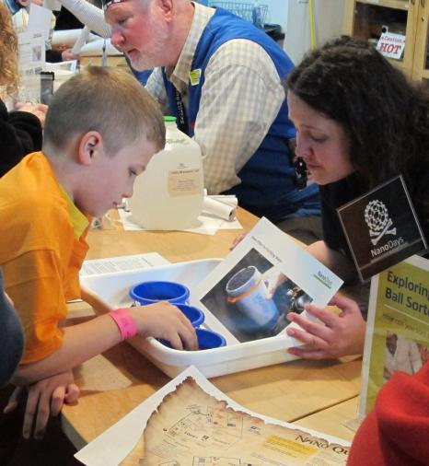
Delivering your Presentation
Repeat key ideas.
Use images and text for emphasis.
Check in with the audience along the way.
Next level: Offer opportunities to preview materials before the program.
Notes:
Repeat key ideas by telling visitors what you will tell them, telling them, then telling them what you told them

Slide 22
Delivering your Presentation
Video: Wheel of the Future
http://www.nisenet.org/catalog/programs/wheel_future
Steph reinforces concepts using posters with text and images.

Slide 23
Questions?

Slide 24
Workshop Overview
Introduction
Repeat and reinforce main ideas
Multiple entry points / ways of engagement
Physical and sensory access
Questions?

Slide 25
Multiple Ways of Engagement
Why?
Considerations:
Developing a Program
Delivering your Presentation

Slide 26
Why make multiple entry points and multiple ways of engagement available?
Different levels of content knowledge and personal experiences
Gives a wide range of visitors an avenue for understanding
Notes:
Visitors come in with different levels of understanding of the content, and different life experiences.
Different concepts, analogies, and life examples will connect with different visitors.
Eg sound of a heart, riding a bike
Need to think about this for initial connection, but also sustaining interest throughout the program

Slide 27
Developing a program
Connect to a range of prior experiences
Make it fun and engaging for all learners
Consider multiple analogies for the same idea
Use examples and non-examples
Build multiple layers into the program
Notes:
Use multiple real-world examples
Use both auditory and visual enhancements to compliment each other in program delivery
Different learners will enter at different places and take away different levels of messages and content

Slide 28
Developing a program
Notes:
Developed for Snowflakes program, but could apply so several self-assembly activities in NanoDays kit

Slide 29
Developing a program
Video: Intro to Nano
http://www.nisenet.org/catalog/programs/intro_nano_cart_demo
Anders uses multiple examples and analogies for explaining what “nano” means.

Slide 30
Delivering your Presentation
Find ways to engage audience members in the program
Ask questions during the program
Notes:
Engaging visitors through hands-on demos, passing around objects to touch & examine more closely, serving as helpers
Asking questions can encourage visitors to connect what you are discussing to situations from their everyday lives

Slide 31
Delivering your Presentation
Video: Treating Tumors with Gold
http://www.nisenet.org/catalog/programs/treating_tumors_gold
Lisa asks if audience members know anyone who has cancer, does verbal report-out on number of hands raised.

Slide 32
Questions?

Slide 33
Workshop Overview
Introduction
Repeat and reinforce main ideas
Multiple entry points / ways of engagement
Physical and sensory access
Questions?

Slide 34
Physical and Sensory Access
Why?
Considerations:
Props & Materials
Set Up & Prep
Delivering your Presentation

Slide 35
Why provide physical and sensory access?
People are diverse in their abilities:
How they can navigate an area
How much they can hear & see
How much they can sit or stand
Notes:
Some will walk, some visit in wheelchairs, and others push around wheeled vehicles
such as strollers.
They also vary in terms of how much and what they can see,
how much and what they can hear,
and how comfortable they are sitting for a long period of time
Allow for those with a wide range of abilities and disabilities to participate in program / engage in the content.
In powerpoint presentation, is text large enough and legible enough for someone with low vision to see?
If there are models, are they lightweight and easy enough for people with a range of upper body mobility to handle/pass around?

Slide 36
Designing Props and Materials
Large and high-contrast text and images
Caption video
Use color
Tactile models
Next level: Provide handouts
Notes:
Large and high-contrast text and image:
Consider the visual accessibility of all materials, including flash cards, slideshow graphics, print on models, and drawings.
Print accessibility is not only important for visitors who have low vision, but also for visitors who are dyslexic and read by identifying the shape of the word.
Seen by many at a distance.
Caption video presentations
Use color to impact meaning/draw distinctions
High contrast makes things easier to see from a distance
Draw visitors eye toward something
Tactile models – easy to handle & communication information through touch as well as vision
Provide additional materials for visitors who are deaf. Script with images from the presentations or a video with ASL interpretation.
For people with low vision, provide handouts with large print and any PowerPoint slides for visitors with low vision to view up close with their own personal magnifying devices.
- Exploring Size – Scented Balloons: visitors smell different colored balloons that have a flavored extract inside them and try to match the different scents. Talk about how the scent molecules are so small that you can’t see them, but your nose can detect them, and they can travel through the balloon membrane. Example of sensory access.

Slide 37
Designing Props and Materials
Large and high-contrast text and images
Exploring Size: Powers of Ten Game
Notes:
from the 2010 and 2011 NanoDays kits

Slide 38
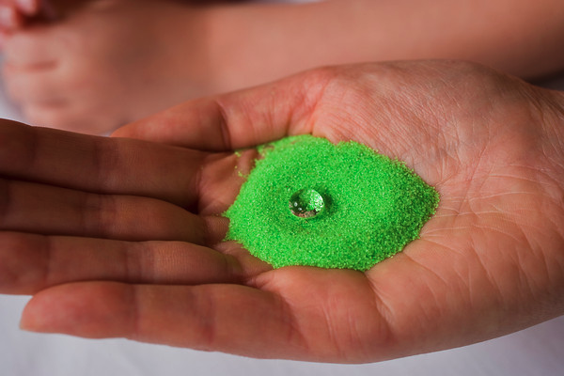
Designing Props and Materials
Tactile models
Exploring Products – Nano Sand activity
Notes:
from the 2011 NanoDays kit
- easy to handle & communication information through touch as well as vision
- Intro to Nano cart demonstration (carbon nanotubes)

Slide 39
Set Up and Prep
Good visibility of presenter’s face
Good visibility of materials on cart
Don’t block your slides / demos
Next level: Consider available seating
Next level: ASL interpreter
Notes:
Make sure presenter’s face isn’t in shadow, Esp. important for visitors who are hard of hearing and rely on lip reading
Make sure visitors can see materials particularly on a cart (think about range of heights: wheelchairs or small children)
Consider people far away.
Stand in different places on stage and ask colleague to view you from different angles of the audience to figure out best place to stand/put your materials.
Bring stools for younger visitors, people with lower back pain, people w/ low vision who need to be close to materials.
ASL interpreter to join you, then market experience to deaf community

Slide 40
Set Up and Prep
Video: Intro to Nano – Alka Seltzer demo
Notes:
Things people might see:
Not blocking demo
Use of color

Slide 41
Delivering your Presentation
Announce accessibility options
Encourage all learners to participate
Include pauses for processing ideas
Provide auditory descriptions
Notes:
Visitors with disabilities have a history of being excluded from learning, so unless you send an explicit message about the accessibility of your program, they will just assume that it is not accessible. Inform the audience if you have tactile models or other materials available for handling/viewing.
Rhythm of program: provide time for people to process important ideas with pauses and breaks

Slide 42
Delivering your Presentation
Use auditory descriptions of models and images
Video: Treating Tumors with Gold

Slide 43
Questions?

Slide 44
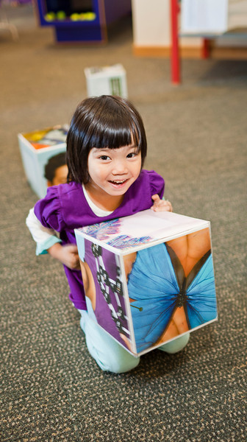
Workshop Overview
Introduction
Repeat and reinforce main ideas
Multiple entry points / ways of engagement
Physical and sensory access
Questions?

