Slide 1
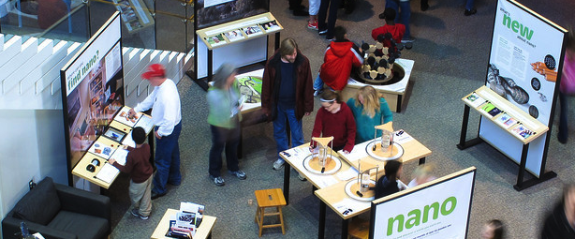


Creating exhibit
components, signage, and media
in conjunction with the Nano mini-exhibition
JUNE 2015
NETWORK-WIDE MEETING
NISENET.ORG
Notes:
Good morning

Slide 2
Creating exhibit
components, signage, and media
Introduction to resources
Catherine McCarthy, Science Museum of Minnesota, Saint Paul, MN
Presenters
Idalia Ramos, University of Puerto Rico at Humacao, Humacao, PR
Anji McStravic, Imaginarium Science Center, Fort Myers, FL
Jessica Enloe Murphy, Golisano Children's Museum of Naples, Naples, FL
Kelli Isenhour, SciWorks, Winston-Salem, NC
Michael Rathbun, Discovery Center Museum, Rockford, IL
Paul Freiling, Saint Louis Science Center, Saint Louis, MO
Questions & Discussion
r
JUNE 2015
NETWORK-WIDE MEETING
NISENET.ORG

Slide 3
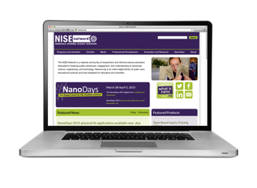


Resources to create your own exhibits
Available on nisenet.org
Creative Commons license
share
re-mix (adapt, modify)
conditions
attribution
adapt
non-commercial
share-alike
Notes:
The resources I’ll be talking about are available on nisenet.org
Most materials created by the NISE Network available under a Creative Commons license

Slide 4
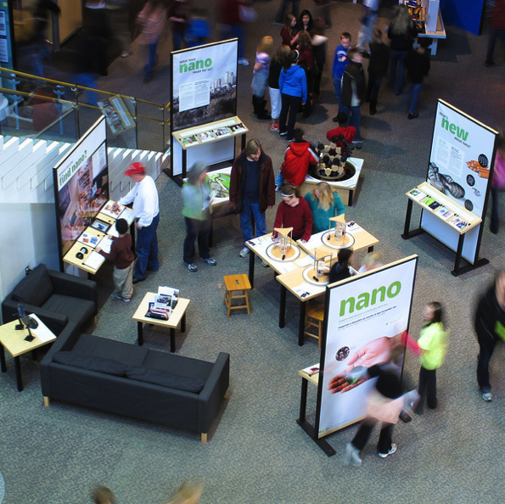
Resources to create your own exhibits
Exhibit
plans / drawings
signage
tech manuals
photos
evaluation reports
Notes:
For Nano mini-exhibition as well as earlier exhibits created by the NISE Network

Slide 5
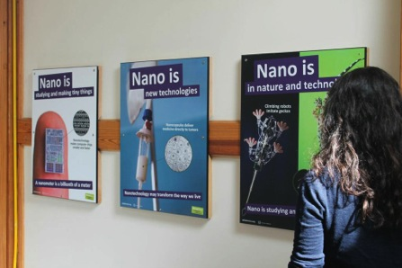

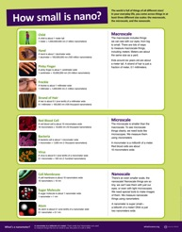
Resources to create your own exhibits
Posters
scale and size
Nano is...
Nano and society

Slide 6
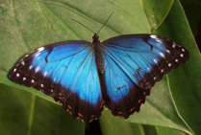
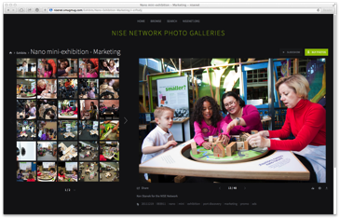
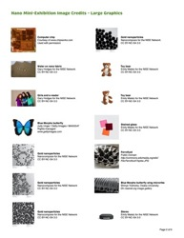
Resources to create your own exhibits
Images
Scientific image gallery on nisenet.org
Online gallery
http://nisenet.smugmug.com
Clear image sources for Nano exhibition

Slide 7
Resources to create your own exhibits
Signage
customizable museum labels

Slide 8
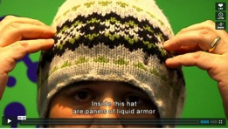
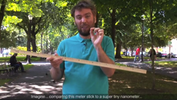
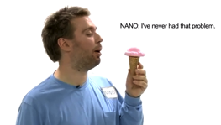
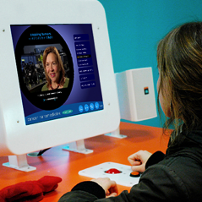
Resources to create your own exhibits
Videos
for public audiences on nisenet.org
Software
Nanomedicine kiosk
Notes:
Whole variety of video topics and lengths

Slide 9
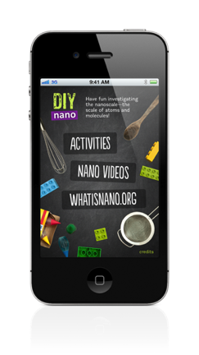
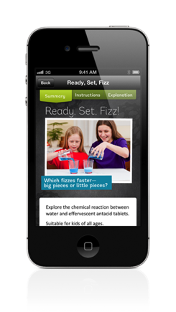
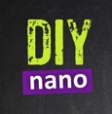


Resources to create your own exhibits
Apps
DIY Nano for iPods and iPads

Slide 10
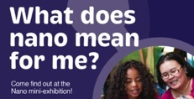

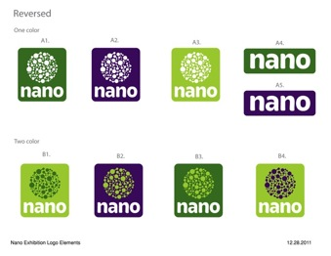

Resources to create your own exhibits
Marketing and
Promotional Materials
editable customizable ads and imagery
logos in variety of formats

Slide 11
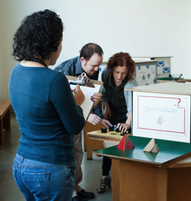
Resources to create your own exhibits
Evaluation reports
formative evaluation work about prototypes
summative work on final NISE Net exhibits
  impacts with specific audiences
Training Materials
Intro to nano
Nano & Society conversations
more

Slide 12
Creating exhibit
components, signage, and media
Introduction to resources
Catherine McCarthy, Science Museum of Minnesota, Saint Paul, MN
Presenters
Idalia Ramos, University of Puerto Rico at Humacao, Humacao, PR
Anji McStravic, Imaginarium Science Center, Fort Myers, FL
Jessica Enloe Murphy, Golisano Children's Museum of Naples, Naples, FL
Kelli Isenhour, SciWorks, Winston-Salem, NC
Michael Rathbun, Discovery Center Museum, Rockford, IL
Paul Freiling, Saint Louis Science Center, Saint Louis, MO
Questions & Discussion
r
JUNE 2015
NETWORK-WIDE MEETING
NISENET.ORG

Slide 13


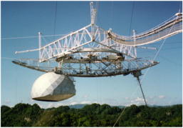
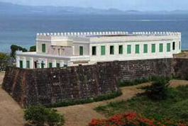
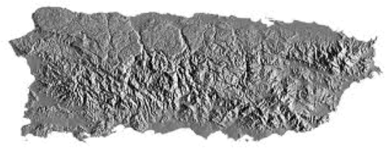
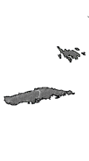
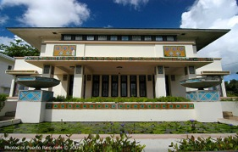
Nano Exhibition Hosts
“Nano” in Puerto Rico
Idalia Ramos, UPR-Humacao
Arecibo Observatory
2014-2015
Vieques Fort
2015-
Casa Roig Museum
University of Puerto Rico at Humacao
2013-2014
NSF-DMR-0934195, 1449445

Slide 14


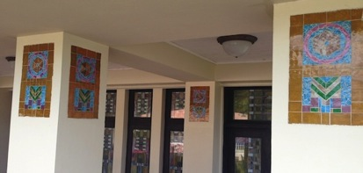
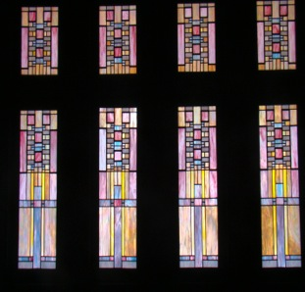
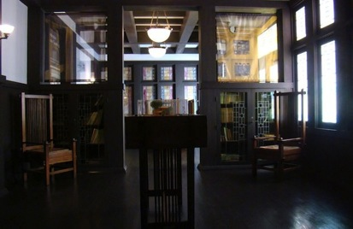
Integrating the Historic House to the Exhibition
Casa Roig Museum
The role of nanoparticles in the Stained Glasses and Mosaics of Casa Roig
Materials used in the Design and Construction of Casa Roig

Slide 15
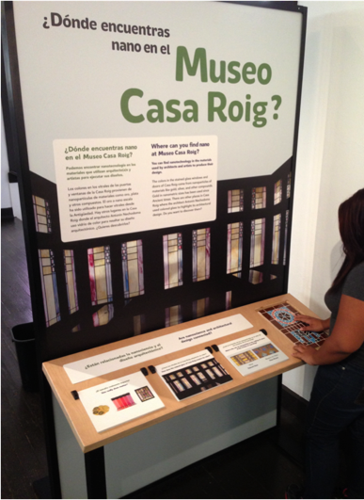
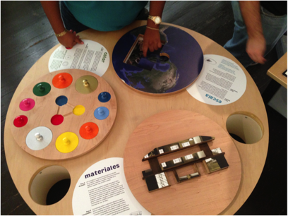
New Modules
Designed by HS students
Where can you find nano in Casa Roig?
Colors, Size, Scales and Materials in Casa Roig

Slide 16
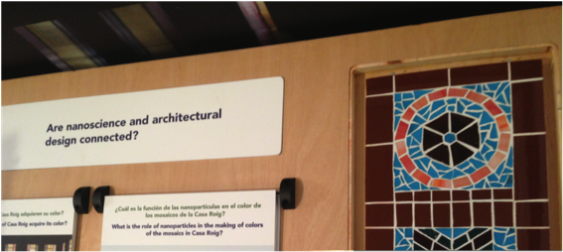
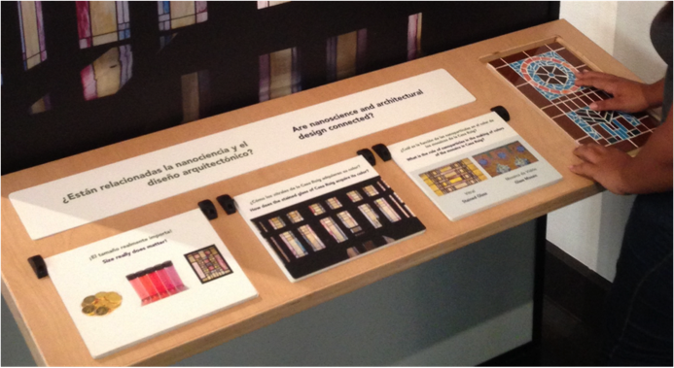

Slide 17
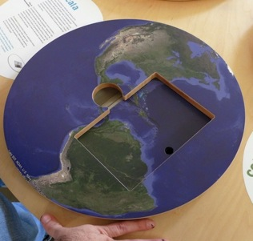
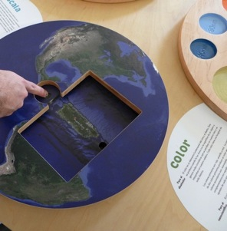
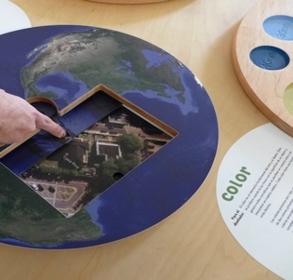
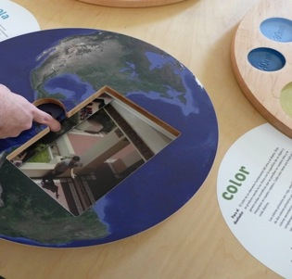
Comparative Scale

Slide 18
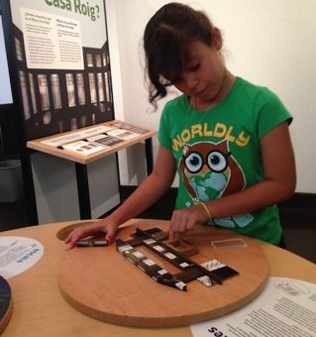
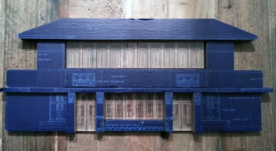
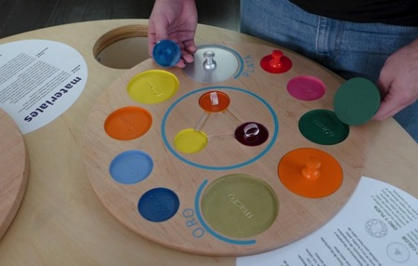
Materials
Size and Color
Notes:
)

Slide 19
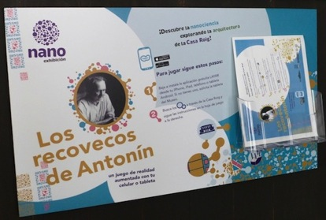
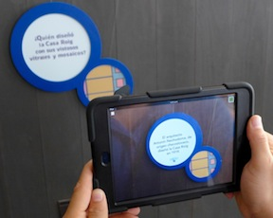
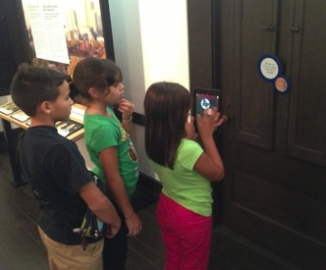
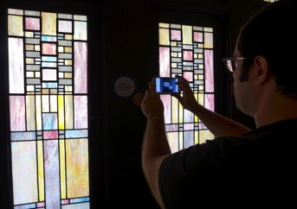
“Los Recovecos de Antonín”
Antonin’s Nooks and Crannies
Scavenger Hunt

Slide 20
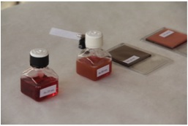
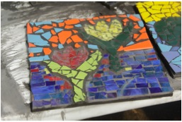
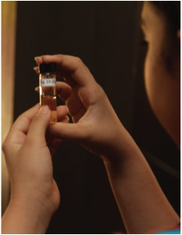
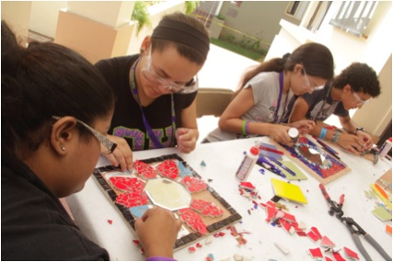
Workshop: Mosaics
Workshop: Mosaics
Notes:
)

Slide 21
Creating exhibit
components, signage, and media
Introduction to resources
Catherine McCarthy, Science Museum of Minnesota, Saint Paul, MN
Presenters
Idalia Ramos, University of Puerto Rico at Humacao, Humacao, PR
Anji McStravic, Imaginarium Science Center, Fort Myers, FL
Jessica Enloe Murphy, Golisano Children's Museum of Naples, Naples, FL
Kelli Isenhour, SciWorks, Winston-Salem, NC
Michael Rathbun, Discovery Center Museum, Rockford, IL
Paul Freiling, Saint Louis Science Center, Saint Louis, MO
Questions & Discussion
r
JUNE 2015
NETWORK-WIDE MEETING
NISENET.ORG

Slide 22
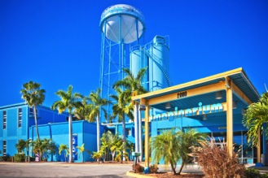
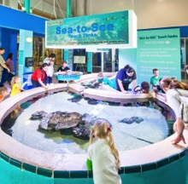
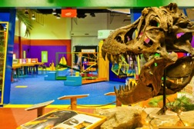

The primary mission and purpose of the Imaginarium Science Center is to engage guests in interactive experiences and educational programs that further their understanding of the natural and human-made world and nurture curiosity, discovery, and innovation. The Imaginarium Science Center is Southwest Florida’s only interactive hands-on center with a focus on STEM (Science, Technology, Engineering, Math) learning principles in an informal education setting.
www.i-sci.org

Slide 23
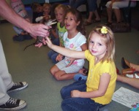
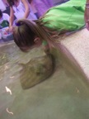





Educational Programming
FIELD TRIPS
  Curriculum Guides aligned to NGSSS
  Qualified Education Staff
  Interdisciplinary Approach
  Optional Workshops
  Critical Thinking
  Self-guided Inquiry
www.i-sci.org
www.i-sci.org

Slide 24






OUTREACH/FAMILY NIGHTS
  Curriculum Guides aligned to NGSSS
  Qualified Education Staff
  Interdisciplinary Approach
  Critical Thinking
  Self-guided Inquiry
  Grant Funding
www.i-sci.org

Slide 25







YOUNG SCIENTISTS HOMESCHOOL
  Curriculum Guides aligned to NGSSS
  Qualified Education Staff
  Interdisciplinary Approach
  Critical Thinking
  Self-guided Inquiry
  Extended Program Series
  “What Will Happen If We…?”
www.i-sci.org

Slide 26






SUMMER SCIENCE CAMP
  Themed week-long sessions
  Certified Teachers
  Interdisciplinary Approach
  Critical Thinking
  Self-guided Inquiry
  Field Trips
  Guest Speakers
www.i-sci.org

Slide 27






SCHOOLS OUT/CAMP’S IN
  Themed sessions
  Qualified Education Staff
  Interdisciplinary Approach
  Critical Thinking
  Self-guided Inquiry
  Field Trips
  Guest Speakers
www.i-sci.org

Slide 28





PROFESSIONAL DEVELOPMENT
  Educator Workshops
  Aligned to NGSSS
  Aligned to Academic Plans
  Grant Funding
www.i-sci.org

Slide 29




COMMUNITY EVENTS
  Super Science Saturdays
  STEMtastic Showcase
  Taste of the Town
  Circles of Care
  Elementary Science Expo
  Regional Science Fair
  Day of Discovery
  National Night Out
  Kidz World Expo
  First Tech Challenge
www.i-sci.org

Slide 30





PARTNERSHIPS
  S.T.E.M. Team of Southwest Florida
  Museum of Science, Boston
  Lee County Public Schools
  NISENet – Nanoscale Informal Science Education Network
  Whitaker Center – FGCU
  Conservancy of SWFL
www.i-sci.org

Slide 31



Old Nano Lab
www.i-sci.org

Slide 32









New Nano Lab, Clean Room & Mini-Exhibition
www.i-sci.org

Slide 33




Nano-size FUN!
www.i-sci.org

Slide 34
Creating exhibit
components, signage, and media
Introduction to resources
Catherine McCarthy, Science Museum of Minnesota, Saint Paul, MN
Presenters
Idalia Ramos, University of Puerto Rico at Humacao, Humacao, PR
Anji McStravic, Imaginarium Science Center, Fort Myers, FL
Jessica Enloe Murphy, Golisano Children's Museum of Naples, Naples, FL
Kelli Isenhour, SciWorks, Winston-Salem, NC
Michael Rathbun, Discovery Center Museum, Rockford, IL
Paul Freiling, Saint Louis Science Center, Saint Louis, MO
Questions & Discussion
r
JUNE 2015
NETWORK-WIDE MEETING
NISENET.ORG

Slide 35


The Golisano Children’s Museum of Naples
Jessica L. Enloe-Murphy Programs Coordinator
Mission: To provide an exciting, inspiring environment where children and their families play, learn, and dream together.
Founded in 2002 and opened in 2012. Our facility is a total of 38,000 square feet with 30,000 square feet under air.

Slide 36




Nano Room 2014
A classroom was converted in a complete Nano mini-exhibit space.
This dedicated space was visited by our daily guests and hosted special programing for our field trips.

Slide 37

Discovery Center: Exploration Stations 2015
A selection of the NanoDays kits were displayed in an exhibit space from Nano Week through the first week of June.
By incorporating Nano into a familiar exhibit, we created a welcoming environment of investigation for guests of all ages.

Slide 38

Pop-up Programs: Brain Bite Carts
Engaging our little learners requires the right approach.
Short interactive programs lead by our Play Specialists pique the interest of our young guests by turning high level scientific concepts into easy to understand play activities.

Slide 39

NCEF Science Enrichment Family Nights
C’mon provides evening outreach to Collier County Title I schools in the form of a STEM night.
We chose to incorporate the Graphene Nano Kit into our event.
We were already exploring the microscopic world with the display, Microscope Mania.
We revamped the display to become Macro, Micro, and Nano.

Slide 40
Creating exhibit
components, signage, and media
Introduction to resources
Catherine McCarthy, Science Museum of Minnesota, Saint Paul, MN
Presenters
Idalia Ramos, University of Puerto Rico at Humacao, Humacao, PR
Anji McStravic, Imaginarium Science Center, Fort Myers, FL
Jessica Enloe Murphy, Golisano Children's Museum of Naples, Naples, FL
Kelli Isenhour, SciWorks, Winston-Salem, NC
Michael Rathbun, Discovery Center Museum, Rockford, IL
Paul Freiling, Saint Louis Science Center, Saint Louis, MO
Questions & Discussion
r
JUNE 2015
NETWORK-WIDE MEETING
NISENET.ORG

Slide 41

NISE Network

Slide 42


Nano Demonstration Cart

Slide 43


Slide 44


Butterfly Wing Structures Exhibit

Slide 45


Blue Morpho Butterfly
Without Light
With Back-lighting

Slide 46


Orange Sulpher Butterfly
Without Light
With Back-lighting

Slide 47

Butterfly Wing Structures

Slide 48





Resources
Nano cart (mobile work station): Uline
www.Uline.com
Graphic: Nvizion Inc.
www.nvizioninc.com
Graphic Design: Firebird Design Studio
www.firebirddesignstudio.com
Butterflies: Butterfly Utopia
www.butterflyutopia.com

Slide 49
Creating exhibit
components, signage, and media
Introduction to resources
Catherine McCarthy, Science Museum of Minnesota, Saint Paul, MN
Presenters
Idalia Ramos, University of Puerto Rico at Humacao, Humacao, PR
Anji McStravic, Imaginarium Science Center, Fort Myers, FL
Jessica Enloe Murphy, Golisano Children's Museum of Naples, Naples, FL
Kelli Isenhour, SciWorks, Winston-Salem, NC
Michael Rathbun, Discovery Center Museum, Rockford, IL
Paul Freiling, Saint Louis Science Center, Saint Louis, MO
Questions & Discussion
r
JUNE 2015
NETWORK-WIDE MEETING
NISENET.ORG

Slide 50

Discovery Center Museum
Rockford, IL

Slide 51




Library kiosk
Carl Carbon’s
Career Quest
Intro to Nano / Powers of 10

Slide 52





Carbon Playground

Slide 53
Creating exhibit
components, signage, and media
Introduction to resources
Catherine McCarthy, Science Museum of Minnesota, Saint Paul, MN
Presenters
Idalia Ramos, University of Puerto Rico at Humacao, Humacao, PR
Anji McStravic, Imaginarium Science Center, Fort Myers, FL
Jessica Enloe Murphy, Golisano Children's Museum of Naples, Naples, FL
Kelli Isenhour, SciWorks, Winston-Salem, NC
Michael Rathbun, Discovery Center Museum, Rockford, IL
Paul Freiling, Saint Louis Science Center, Saint Louis, MO
Questions & Discussion
r
JUNE 2015
NETWORK-WIDE MEETING
NISENET.ORG

Slide 54


Saint Louis Science Center
Nano mini-exhibition
Utilizing Nano and Me Videos
Developing a Nano Prototype Exhibit

Slide 55


Slide 56





Slide 57


Nano and Me Videos
Nanometer-sized things are very small, and often behave differently than larger things do.
Video Topics
  Gold
  Silver
  Aluminum
  Gravity
  Pants
  Latex

Slide 58

Nano and Me Videos

Slide 59

Nano and Me Videos
Benefits to the Nano Exhibit
  Short, Attention Grabbing Videos
  Many Topics Covered
  Reinforces Nano Fundamentals: Nano is small and surprisingly different

Slide 60

Nano Exhibit Mini Grant:
Bumpy, Sticky, Shaky Exhibit
Prototype Process

Slide 61
Big Idea:
It is difficult to work with atoms at the nano scale because their behavior is
SHAKY
BUMPY
STICKY

Slide 62


Nano Exhibit Prototype 1:
Visitors use a magnetic wand to manipulate vibrating magnetic balls.

Slide 63

Prototype 1:
Formative Evaluation Results
Learning Objective: Visitors will be able to describe that, at the nano scale, it is difficult to work with atoms because their behavior is bumpy, sticky, and shaky.
Enjoyment:
  Exhibit is engaging
  Both children and adults enjoyed the activity
Learning Objectives:
  Visitors thought the exhibit was about magnets/magnetism
  Concept of bumpy was not apparent to visitors

Slide 64


Nano Exhibit Prototype 2:
Isolating the concepts of Bumpy, Sticky, and Shaky with the “main” interactive.

Slide 65
Prototype 2:
Formative Evaluation Results
Learning Objective: Visitors will be able to describe that, at the nano scale, it is difficult to work with atoms because their behavior is bumpy, sticky, and shaky.
Enjoyment:
  Almost all visitors enjoyed their experience
Learning Objectives:
  55% of visitors explained the exhibit was about atoms/nanoparticles
  65% of visitors communicated one of the learning objective components
  3% of visitors thought it was about magnetism

Slide 66

Final Nano Exhibit Prototype

Slide 67
Nano Exhibit Development
Lesson Learned
Let the Big Idea and the Learning Objectives be your guide
Exhibit Evaluation is invaluable
Use Iterative Prototyping: Keep refining until learning objectives are met

Slide 68



More ideas from partners!
Share via:
blog posts
linked products
recorded online brown-bag workshops
digital media, Buffalo Museum of Science
Punky’s Lab at
Bootheel Youth Museum

Slide 69





Exhibits
Wonderlab and Indiana University
Matter Factory, Children’s Museum of Houston
Nano Fabulous,
Port Discovery, Baltimore

Slide 70



Graphics
National Museum of Nuclear Science and History, NM
DaVinci Science Center, PA

Slide 71






Promotion & Signage
Casa Roig Museum, Puerto Rico
Nano spot signage at Science Center of iowa
Patricia and Phillip Frost Museum of Science, Miami, FL
WonderLab Museum of Science, Health and Technology in Bloomington, IN

Slide 72


Questions & Discussion

Slide 73



Thank you!
Cynthia Needham, ICAN Productions
This presentation is based on work supported by the National Science Foundation under Grant No. 0940143. Any opinions, findings, and conclusions or recommendations expressed in this presentation are those of the authors and do not necessarily reflect the views of the Foundation.

