Slide 1
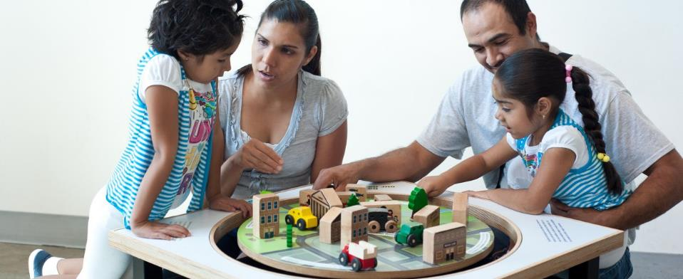


Engaging Young Audiences

Slide 2
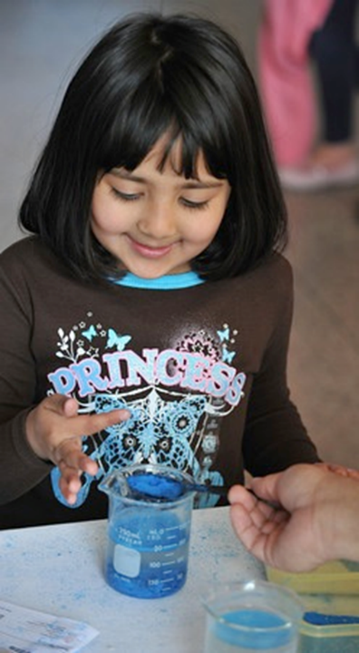
Overview
Welcome and Introductions
Presentations
Q&A
Presenters:
Anne Drake, Great Lakes Children’s Museum
Stephanie Kadam, Stepping Stones Museum for Children
Aaron Guerrero, Children’s Museum of Houston
Jacqueline Gardner, Children’s Museum of Eau Claire
John McCollum, Children’s Museum of Indianapolis
Kevin Velasquez, Children’s Museum of Houston

Slide 3
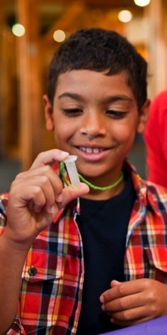

NISE Network
Nanoscale Informal Science Education Network
The NISE Network is a national community of researchers and informal science educators dedicated to fostering public awareness, engagement, and understanding of nanoscale science, engineering, and technology.

Slide 4

Great Lakes Children’s Museum
Anne Drake
Museum Educator
adrake@glcm.org
www.greatlakeskids.org

Slide 5
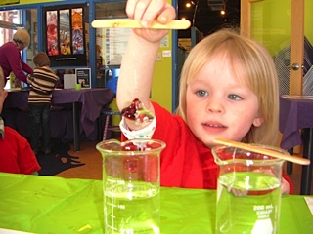
Exploring Properties- Invisibility

Slide 6
Exploring Size- Moving Molecules

Slide 7
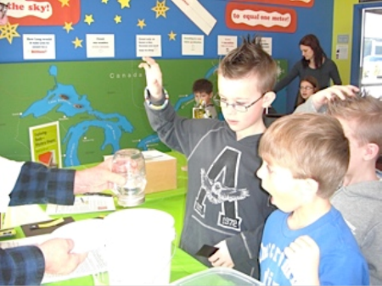
Exploring Forces- Gravity

Slide 8
Exploring Nano & Society- Space Elevator

Slide 9
Balloon Carbon Nanotube

Slide 10
Exploring Materials-
Stained-Glass Windows

Slide 11
Stephanie Kadam
Family Programs Manager
Stepping Stones Museum for Children
June 2015

Slide 12
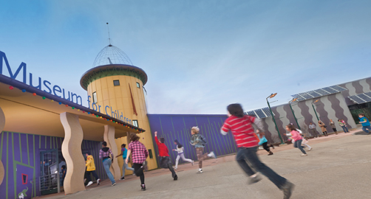
Who We Are
Stepping Stones Museum for Children
Located in the small city of Norwalk, CT
Children’s museum geared for children ages 10 and under
Committed to lifelong learning, the content of our programs and exhibits include literacy, art, STEM, culture and health

Slide 13
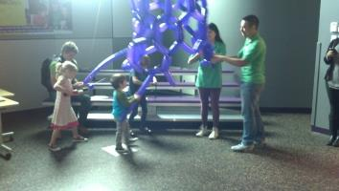
The museum’s involvement in NanoDays
5 years of participation
Originally heard about NanoDays at an ACM conference in 2009
First received a Physical Kit and participated in NanoDays in 2010
Participated each year since
2013 – awarded the Nano Mini Exhibit
2014 – received a mini grant
  Organized the kits
  Trained youth volunteers to facilitate the kits
  Held NanoFestival

Slide 14
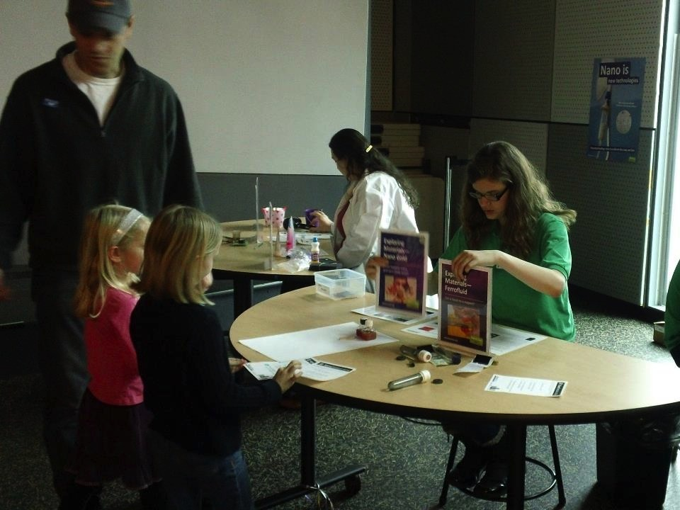
The museum’s involvement in NanoDays

Slide 15
Presenting the Nano Kits to our visitors
The Challenge
Deliver meaningful content about nanoscience to our average visitor
Appeal to parents and caregivers that think that nanoscience is not for their toddler – it is over their head
The Solution (or at least what we came up with)
Group kits together according to theme
The Benefits
Visitors participated at their level
Visitors maximized their attention span limits
Facilitators did not need as much in depth knowledge
about a particular topic

Slide 16
How the kits were grouped – NanoFest 2014
How big is nano?
Exploring Measurement—Ruler
Exploring Size—Ball Sorter
Exploring Size—Scented Balloons
Exploring Size—Measure Yourself
Exploring Size—Memory Game
Exploring Size—Powers of Ten Game
What does nano look like
and what can it do?
Exploring Structures—Buckyballs
Exploring Structures—Butterfly
Exploring Properties—UV Bracelets
Exploring Properties—Capillary Action
Exploring Properties—Electric Squeeze
Exploring Forces—Static Electricity
Exploring Properties—Invisibility
Exploring Products—Nano Sand
Exploring Materials—Nano Fabric
How do we learn about
things that are so small?
Exploring Tools—Mitten Challenge
What am I?
Exploring Tools—3D Imaging
Exploring Tools—Mystery Shapes
Exploring Tools—Special Microscopes
What can we make
with nanotechnology?
Exploring Materials—Graphene
Exploring Materials—Nano Gold
Exploring Materials—Oobleck
Exploring Materials—Ferrofluid
Exploring Products—Sunblock
Exploring Fabrication—Gummy Capsules
Exploring Materials—Hydrogel
Exploring Materials—Memory Metal

Slide 17
How the kits were grouped – NanoDays 2015
Making Nano
Exploring Tools—Mitten Challenge
Exploring Fabrication—Self-Assembly
Exploring Materials—Memory Metal
Exploring Materials—Ferrofluid
Nano Coats
Exploring Products—Nano Sand
Exploring Materials—Nano Fabric
Exploring Products—Kinetic Sand
Nano in Light
Exploring Materials—Polarizers
Exploring Properties—UV Bracelets
Exploring Properties—Invisibility
Seeing Nano
Exploring Tools—Mystery Shapes
What am I?
Exploring Tools—Special Microscopes
Exploring Tools—Transmission Electron Microscopes
Exploring Tools—3D Imaging
How big is small?
Exploring Size—Ball Sorter
Exploring Size—Powers of Ten Game
Exploring Products—Sunblock
Notes:
Kim and Dora

Slide 18
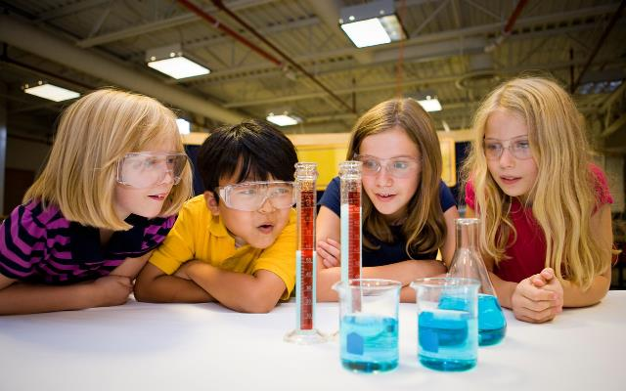

Engaging Young Audiences by using NISE Net Resources
Aaron Guerrero
Project Manager for XCL and 21-Tech
aguerrero@cmhouston.org

Slide 19
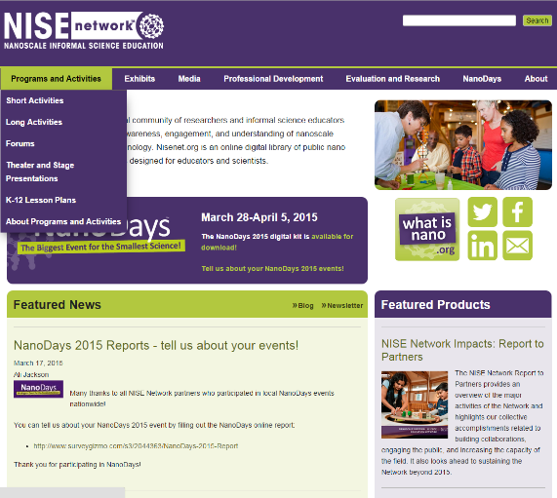
Website for Educators - nisenet.org
  Finding NISE Net Resources
  Activities
  Forums
  Presentations
  Lesson plans

Slide 20
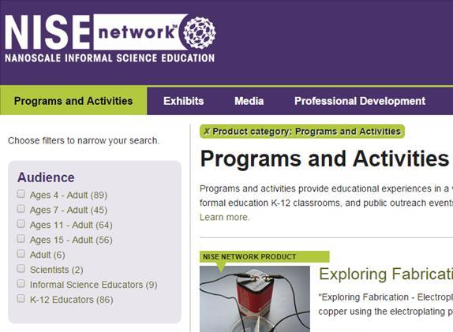
Use age filter function
Age filter

Slide 21
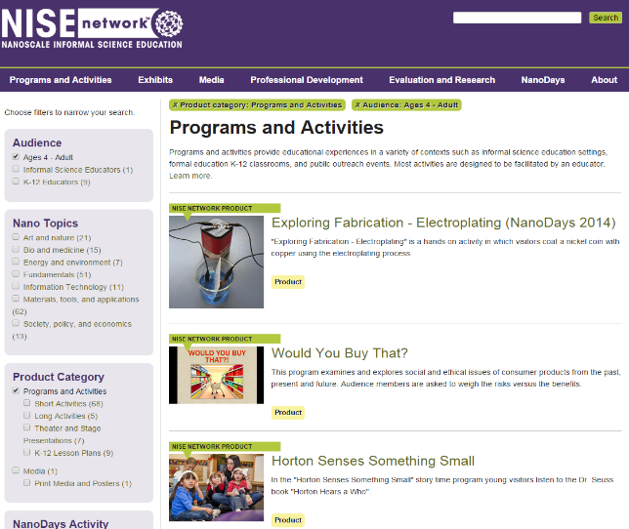
Programs and Activities
Age appropriate activities

Slide 22
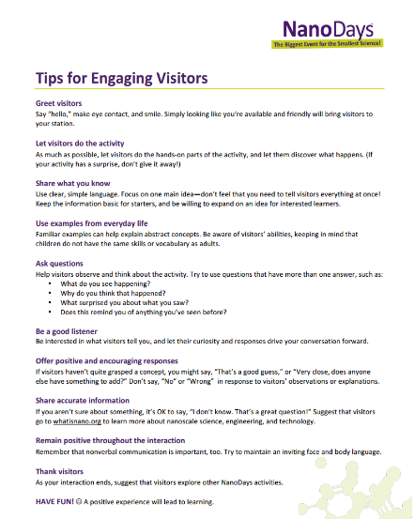
Engaging Visitor Tips
Able to use these tips for all visitors
http://nisenet.org/sites/default/files/catalog/uploads/8892/training_engaging_tips.pdf

Slide 23
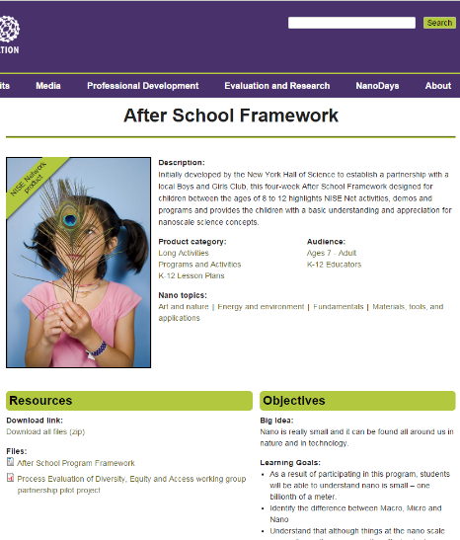

After School Framework

Slide 24
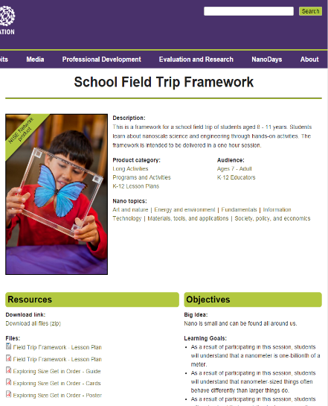
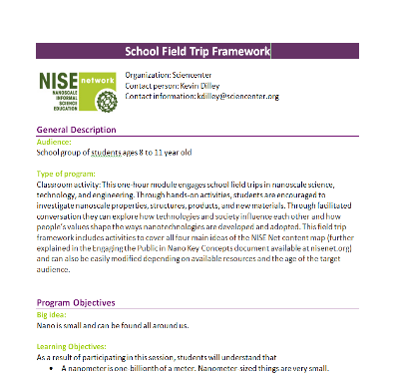
School Field Trip Framework

