Slide 1
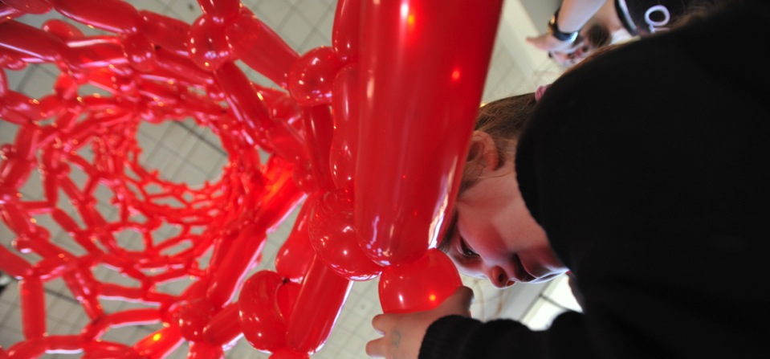



Scaling Up!
JUNE 2015
NETWORK-WIDE MEETING
NISENET.ORG
Notes:
Good morning

Slide 2
Scaling Up: How tailoring exhibits and programs to appeal to local audiences can help drive attendance
Jonah Cohen, Children’s Museum of CT
Jessie Herbert, SpectUM
Jordan Warner, Brooklyn Children’s Museum
Trudi Plummer, Maine Discovery Museum
Allison Schwanebeck, Science Center of Iowa
JUNE 2015
NETWORK-WIDE MEETING
NISENET.ORG
Notes:
NanoDays is a complex effort that includes multiple NISE Network teams working together to create resources and coordinate the participation of hundreds of partners. This presentation focuses on the tools, ideas, and processes that are specific to creating a nationwide event such as NanoDays, which is supported by a physical and digital kit that includes professional resources and educational products. We’ll describe the planning and development of NanoDays resources by a cross-organizational team, fabrication and distribution of the physical kits, and of course the implementation by hundreds of partners across the country through annual NanoDays events, and the impact of the initiative on public audiences.

Slide 3
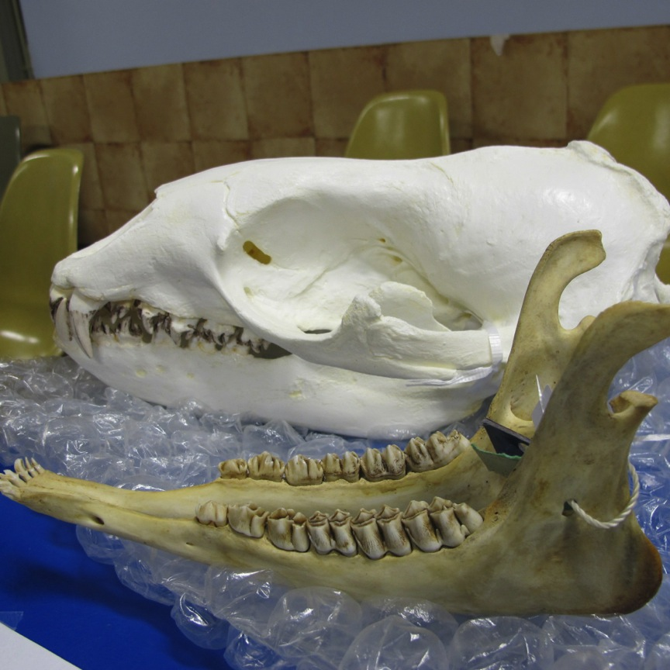

Slide 4
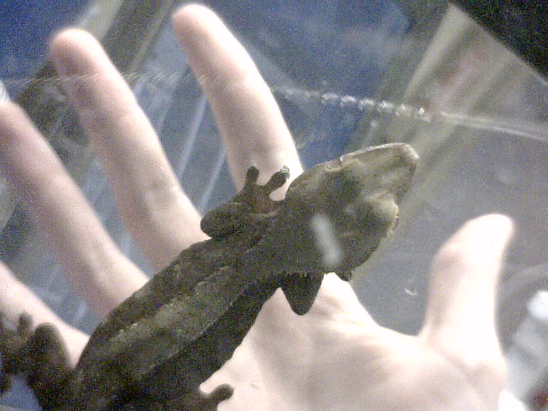

Slide 5
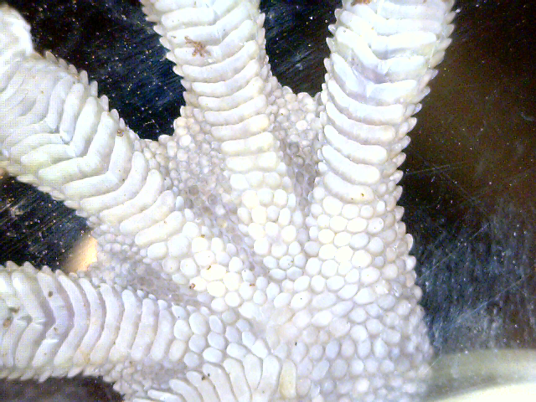

Slide 6
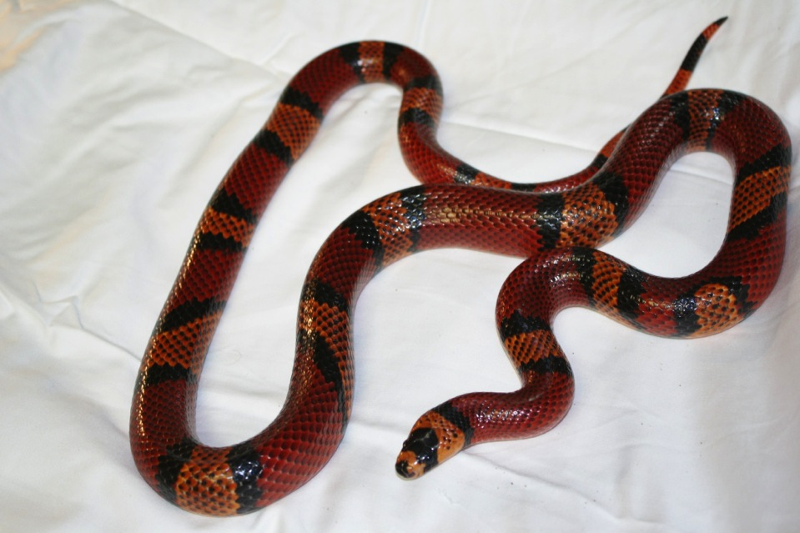

Slide 7


Slide 8
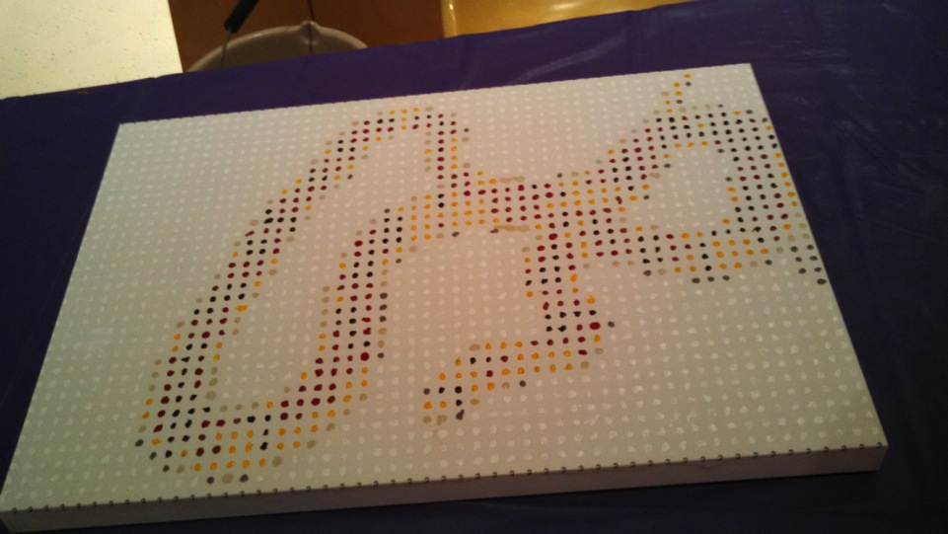

Slide 9
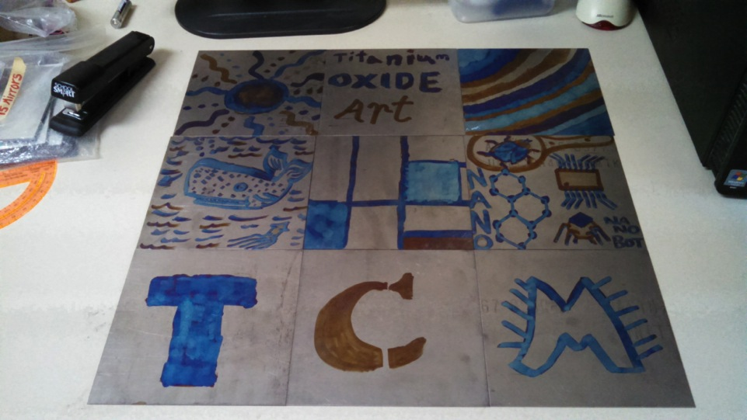

Slide 10
Scaling Up: How tailoring exhibits and programs to appeal to local audiences can help drive attendance
Jonah Cohen, Children’s Museum of CT
Jessie Herbert, SpectUM
Jordan Warner, Brooklyn Children’s Museum
Trudi Plummer, Maine Discovery Museum
Allison Schwanebeck, Science Center of Iowa
JUNE 2015
NETWORK-WIDE MEETING
NISENET.ORG
Notes:
NanoDays is a complex effort that includes multiple NISE Network teams working together to create resources and coordinate the participation of hundreds of partners. This presentation focuses on the tools, ideas, and processes that are specific to creating a nationwide event such as NanoDays, which is supported by a physical and digital kit that includes professional resources and educational products. We’ll describe the planning and development of NanoDays resources by a cross-organizational team, fabrication and distribution of the physical kits, and of course the implementation by hundreds of partners across the country through annual NanoDays events, and the impact of the initiative on public audiences.

Slide 11
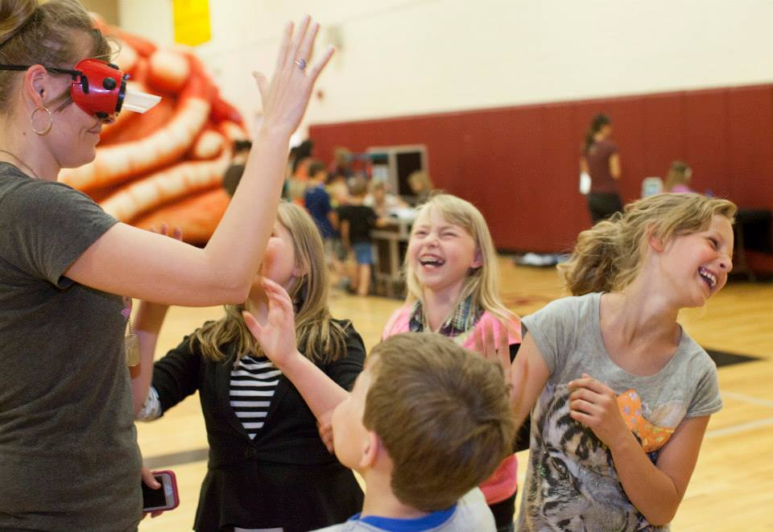
Tailoring Exhibits and Programs in Rural Montana
Jessie Herbert

Slide 12
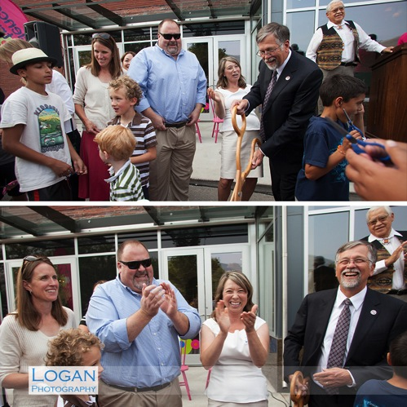
Opened in 2007
Expanded to downtown Missoula August of 2013
Serves 59,000 people annually

Slide 13
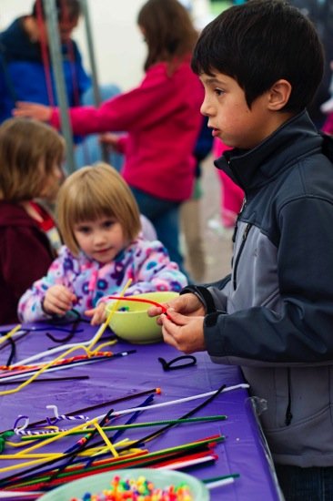
Mission
Inspiring All Montanans to pursue higher education, and possibly careers in science, technology, engineering, and mathematics, with the end goal of closing traditional opportunity and achievement gaps

Slide 15
Notes:
Hamilton – 45 miles from Missoula
Population of 5000, more with outlying communities

Slide 16

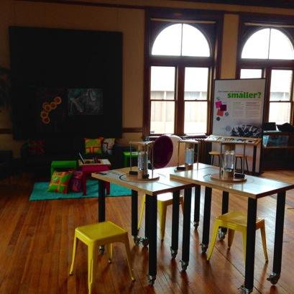
Partnership with spectrUM and the Ravalli County Museum and Historical Society
Funded by Jane S. Heman Foundation
May 7th-August 1st 2015
Notes:
Not just an exhibit rental
3 year project in the Bitterroot – Nano moves to different community each summer

Slide 17
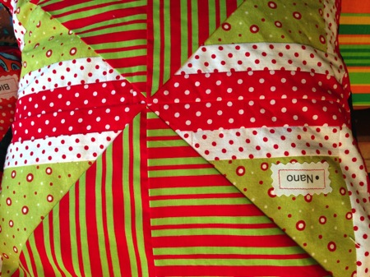
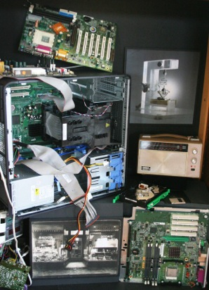
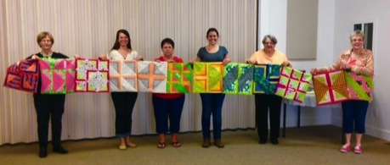
Additions to exhibit
Quilted pillows
Nano Timeline
Notes:
Bitterroot Quilters Guild
Hair Art

Slide 18
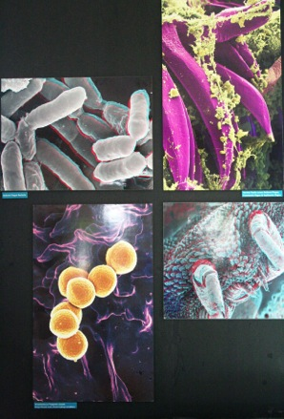
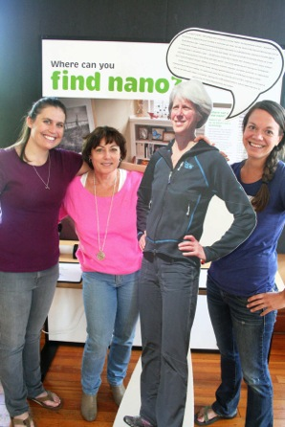
Additions to exhibit
Science in Wonderland Photos
Life Size STEM Role Models
Nano in Your Home
Early Prototyping and 3D printer

Slide 19
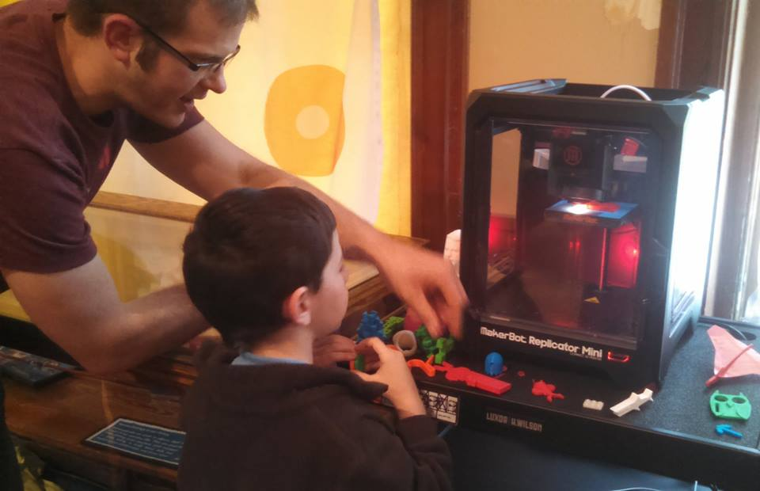
Additions to exhibit
Nano in Your Home
Early Prototyping and 3D printer

Slide 20
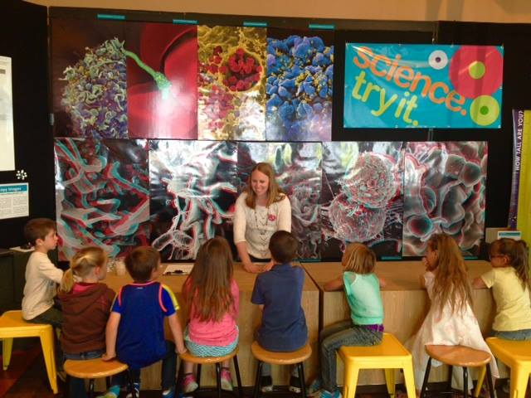
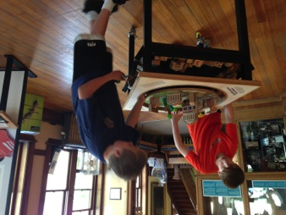
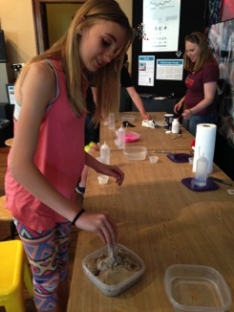
Field Trips
Served 900 K-8 students in the month of May
Notes:
Kids that haven’t been

Slide 21
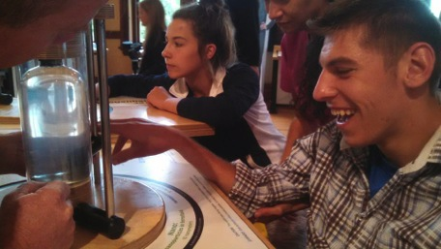
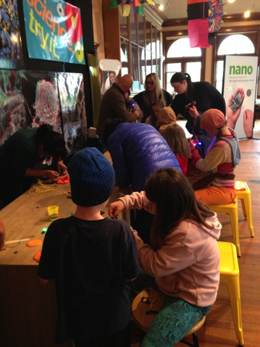
Science Saturdays
Served 400 people every Saturday during Farmers Market

Slide 22
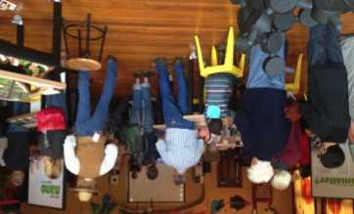
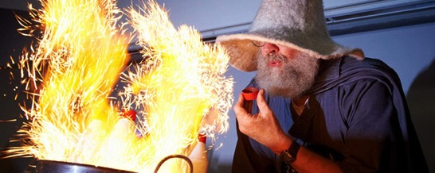
Thursday Lecture Series
Brought in UM faculty
Chemistry
Toxicology
Wildlife Biology
Ecology

Slide 23
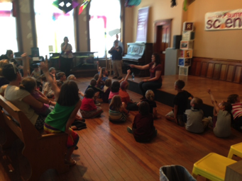
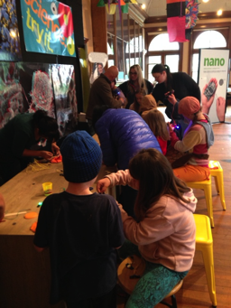
Community Feedback
“Thank you for bringing this to our town so the Bitterroot could participate in hands-on learning”
“Thank you for reminding our students that science is interesting and that they can be scientists too!”
“Thank you for making science fun and engaging! Connecting science to careers choice and college education is also helpful!”

Slide 24
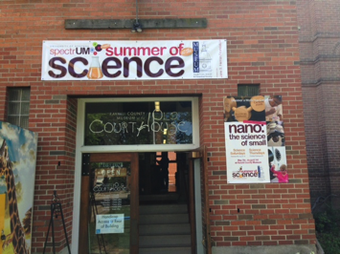
Projections for the rest of the summer
We have served 2,390 people in three weeks!
Over the remaining 10 weeks, we project we will serve:
4,000 more people through Science Saturdays
150 more people through lecture series
1,000 people from alternative field trips
500 people during public hours
200 people during RML event
Total of 8,240 people over 12 weeks

Slide 25
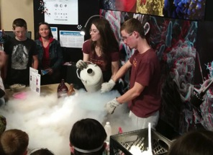
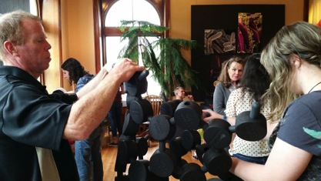
Challenges/Lessons Learned
Logo creation/visual identity
Marketing
Direct support for partners
Give the keys to the community!

Slide 26
Questions?
Jessie Herbert
STEM Education Program Manager
jessie.herbert@umontana.edu
Blog
www.spectrummosse.wordpress.com

