Slide 1
Scaling Up: How tailoring exhibits and programs to appeal to local audiences can help drive attendance
Jonah Cohen, Children’s Museum of CT
Jessie Herbert, SpectUM
Jordan Warner, Brooklyn Children’s Museum
Trudi Plummer, Maine Discovery Museum
Allison Schwanebeck, Science Center of Iowa
JUNE 2015
NETWORK-WIDE MEETING
NISENET.ORG
Notes:
NanoDays is a complex effort that includes multiple NISE Network teams working together to create resources and coordinate the participation of hundreds of partners. This presentation focuses on the tools, ideas, and processes that are specific to creating a nationwide event such as NanoDays, which is supported by a physical and digital kit that includes professional resources and educational products. We’ll describe the planning and development of NanoDays resources by a cross-organizational team, fabrication and distribution of the physical kits, and of course the implementation by hundreds of partners across the country through annual NanoDays events, and the impact of the initiative on public audiences.

Slide 2
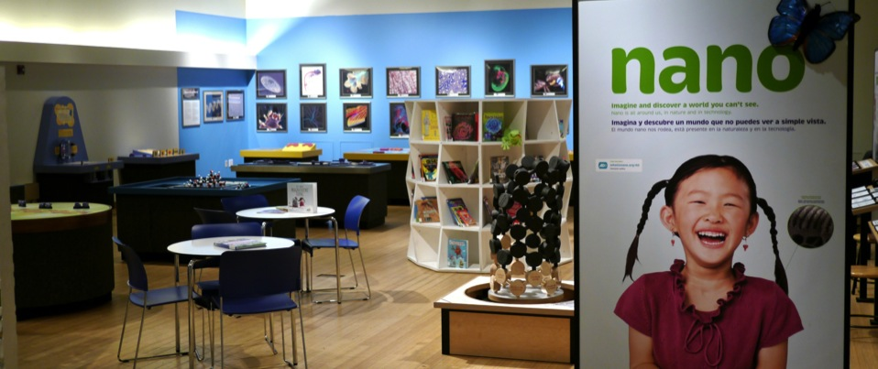
Nanoscience
@ Brooklyn Children’s Museum
JUNE 2015
NETWORK-WIDE MEETING
NISENET.ORG
Notes:
Good morning

Slide 3
Tailoring and scaling exhibits and programs to serve local audiences
Jordan Warner, Manager of Science Education, Brooklyn Children’s Museum
Marcos Stafne (not present), former VP of Programs and Visitor Experience, Brooklyn Children’s Museum
JUNE 2015
NETWORK-WIDE MEETING
NISENET.ORG

Slide 4
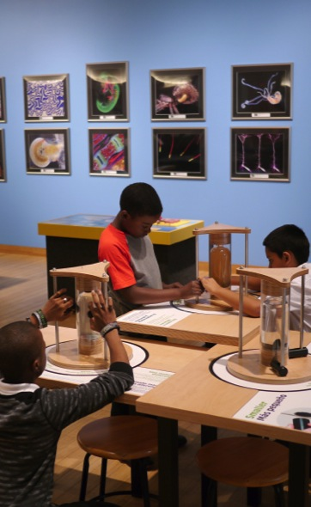
The “Multi-Pronged Attack”
Exhibition:
Nano Mini Exhibit (part of larger themed exhibit)
Materials:
“Nano-bio” cart (NISE Mini-Grant)
NISEnet Physical Kits (2014, 2015)
Programs:
Integrating nanoscience concepts into Public Programs

Slide 5
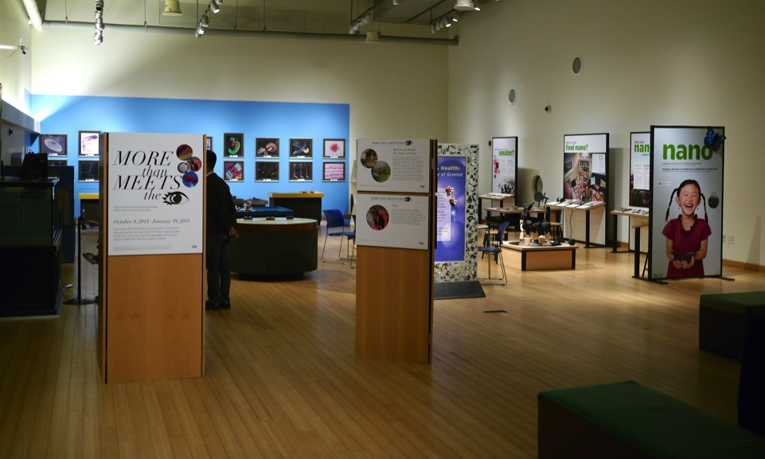
Exhibition: More Than Meets The “I”

Slide 6
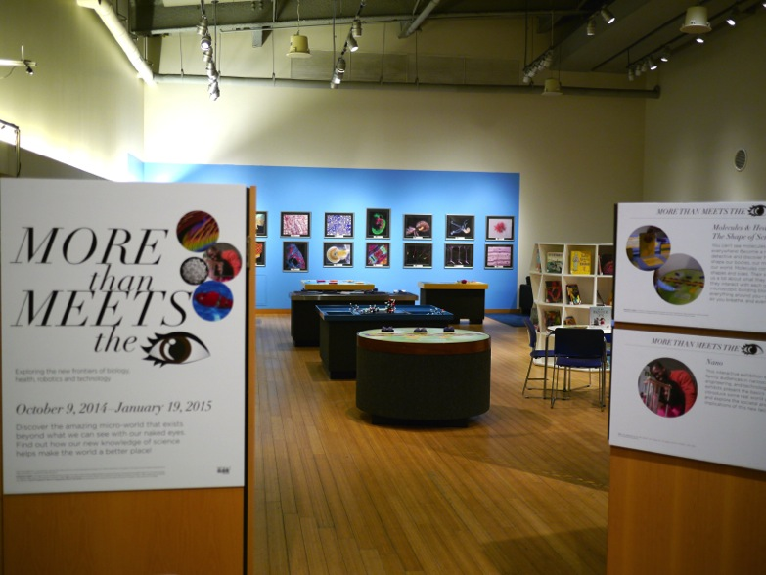
Exhibition: More Than Meets The “I”

Slide 7
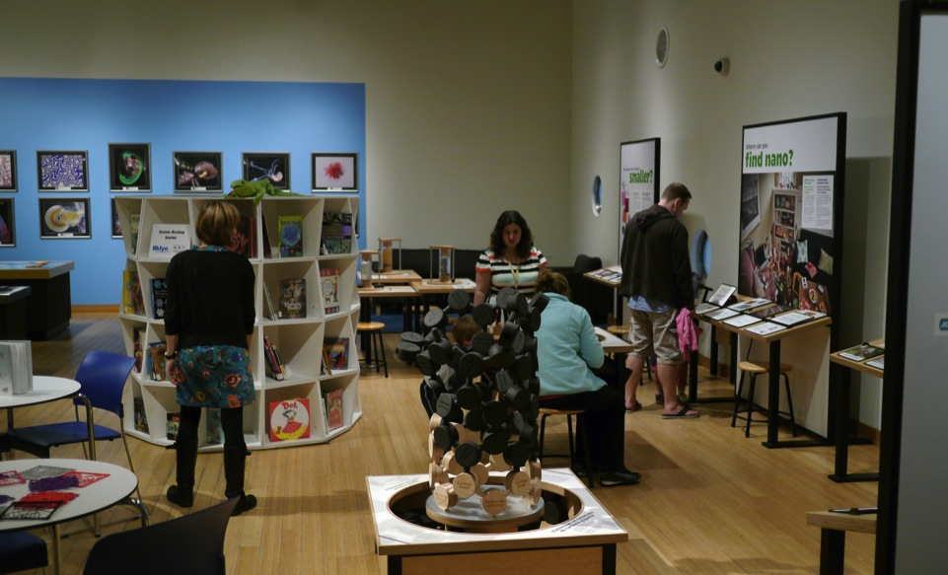
Nano Mini-Exhibit

Slide 8
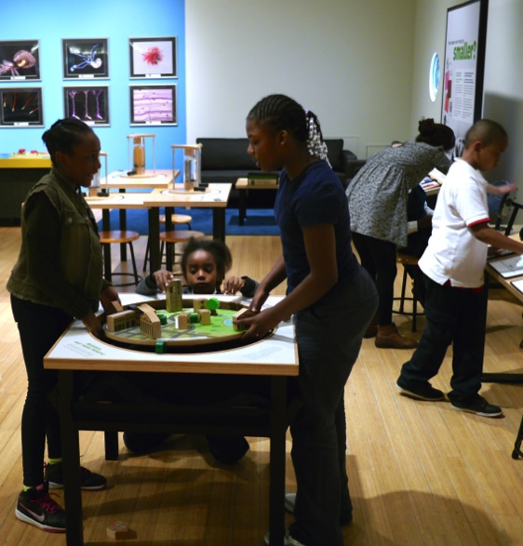
Nano Mini-Exhibit

Slide 9
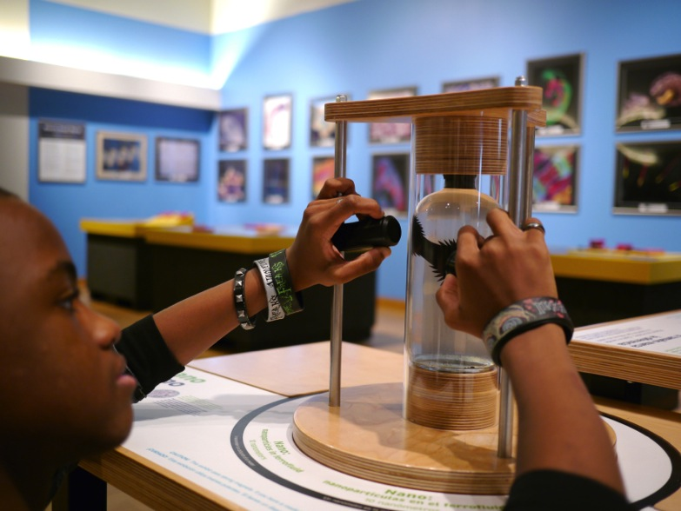
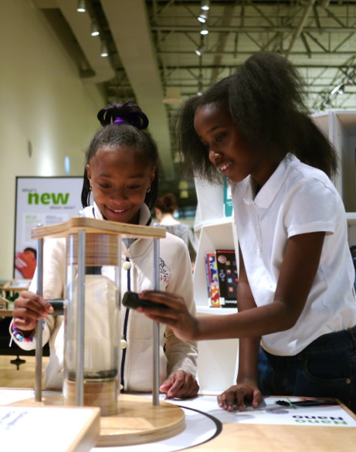
Nano Mini-Exhibit

Slide 10
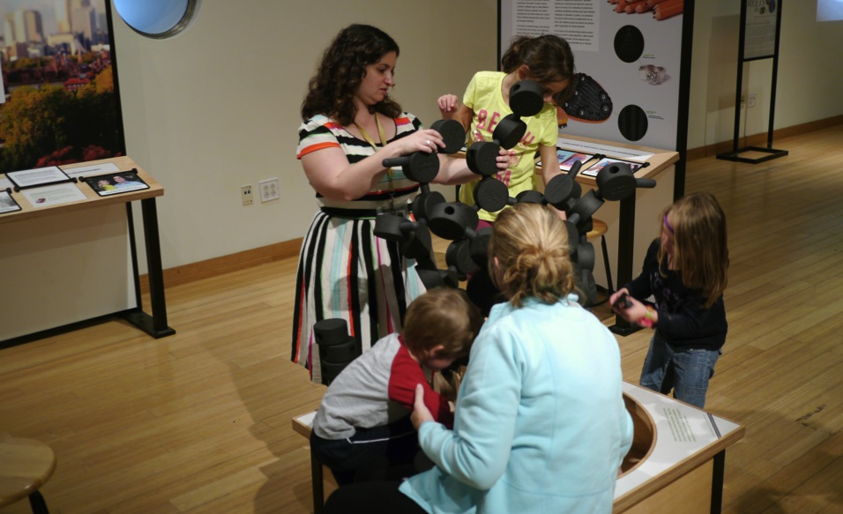
Nano Mini-Exhibit

Slide 11
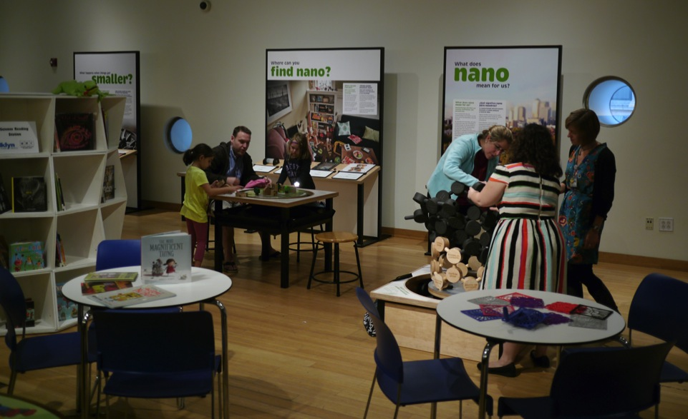
Nano Mini-Exhibit

Slide 12
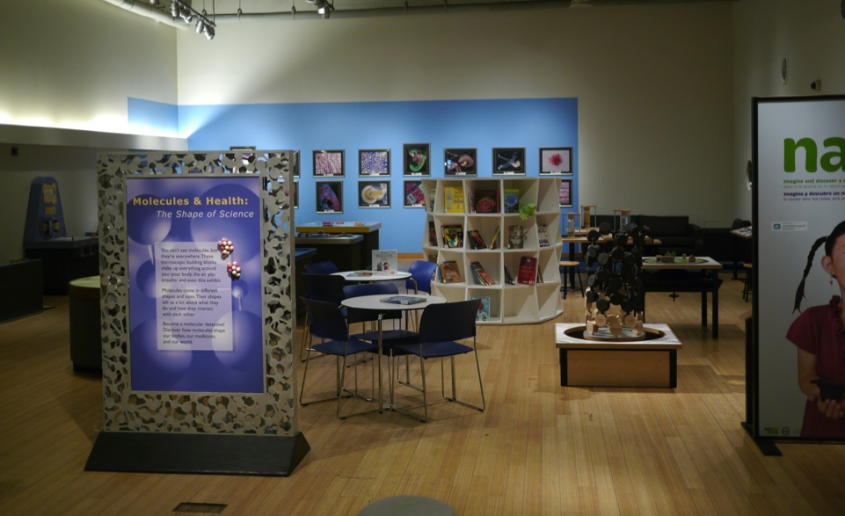
Molecules and Health (NYSCI)

Slide 13
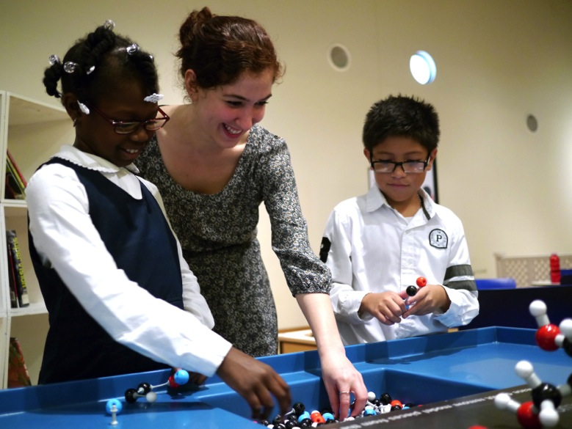
Molecules and Health (NYSCI)

Slide 14
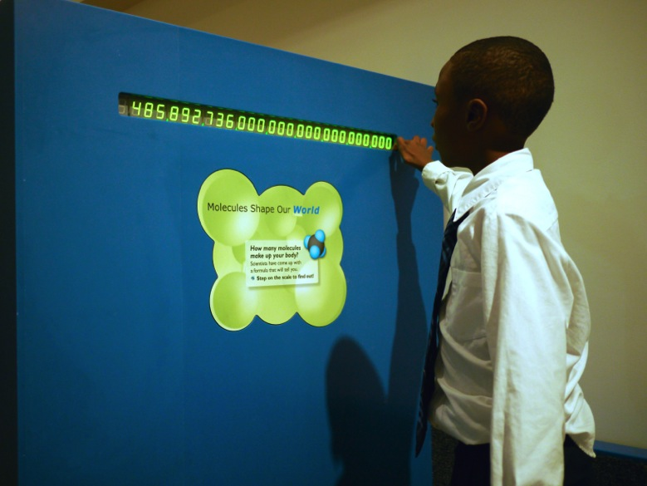
Molecules and Health (NYSCI)

Slide 15
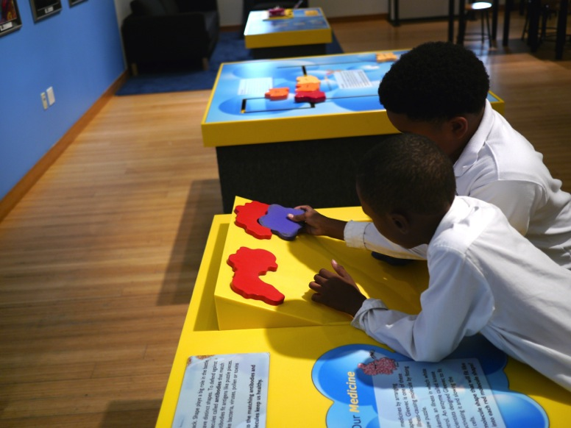
Molecules and Health (NYSCI)

Slide 16
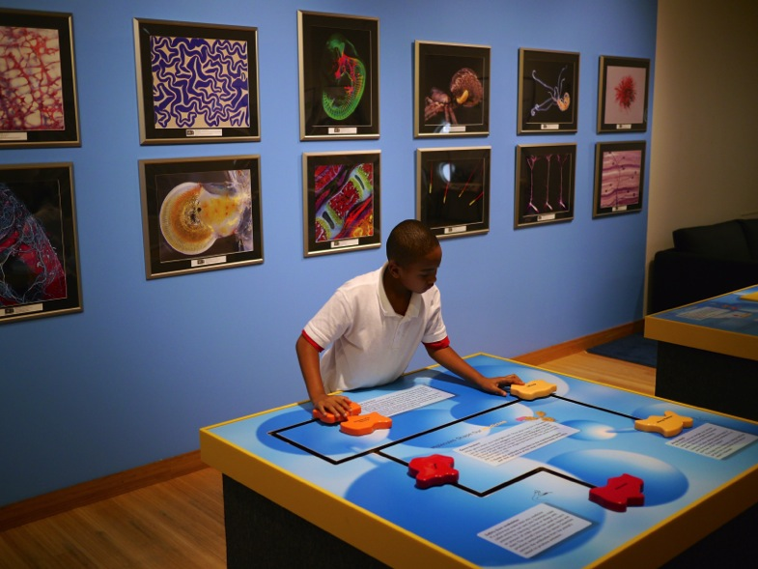
Molecules and Health (NYSCI)

Slide 17
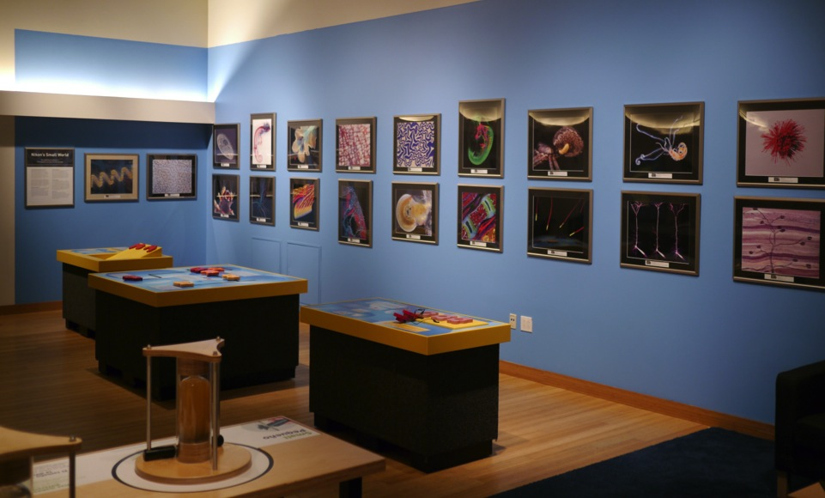
Nikon “Small World” Photos

Slide 18
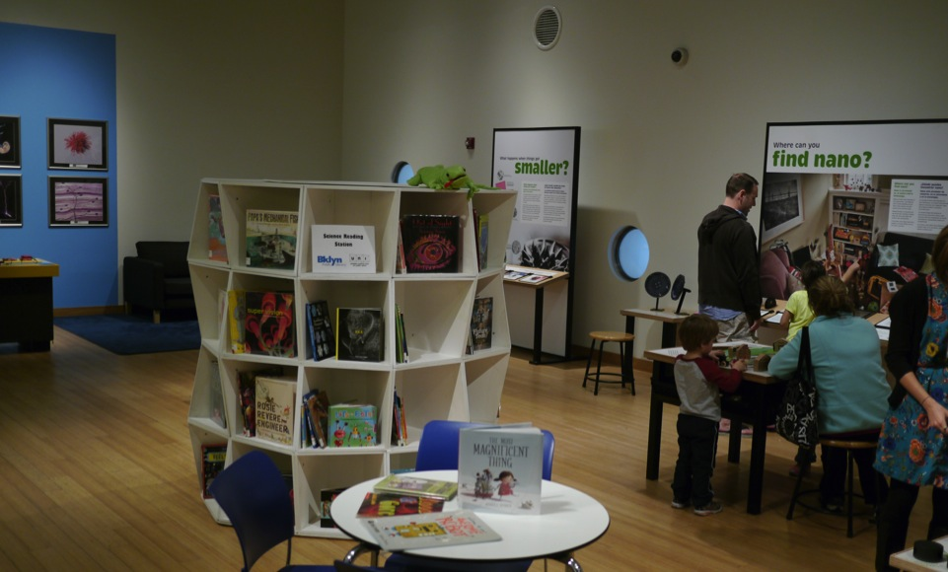
Brooklyn Public Library “Uni”
“Beginning in February 2014 the Uni has been rotating among Brooklyn single adult and family shelters spending up to a month at a time in each place. Residents are able to borrow materials whether or not they have a library card, and can do so easily at any time.”
http://www.bklynlibrary.org/outreach-services/uni

Slide 19
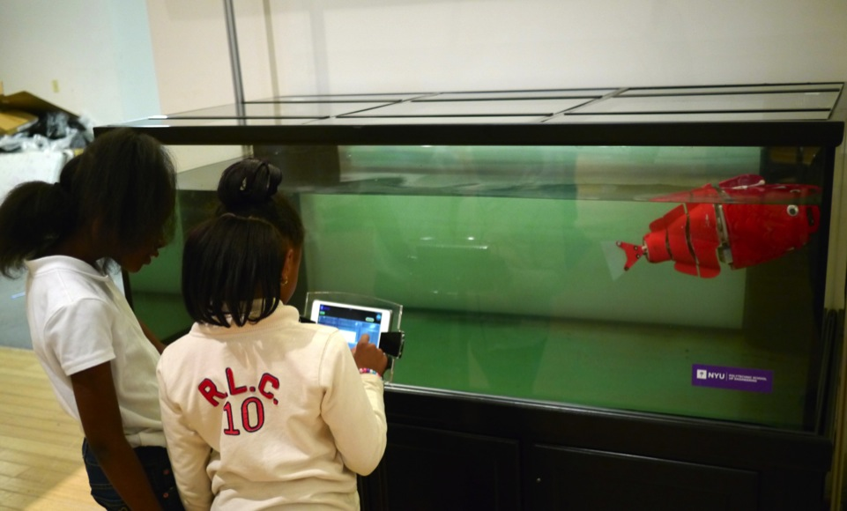
Commodore: Robotic Fish from NYU Polytechnic

Slide 20
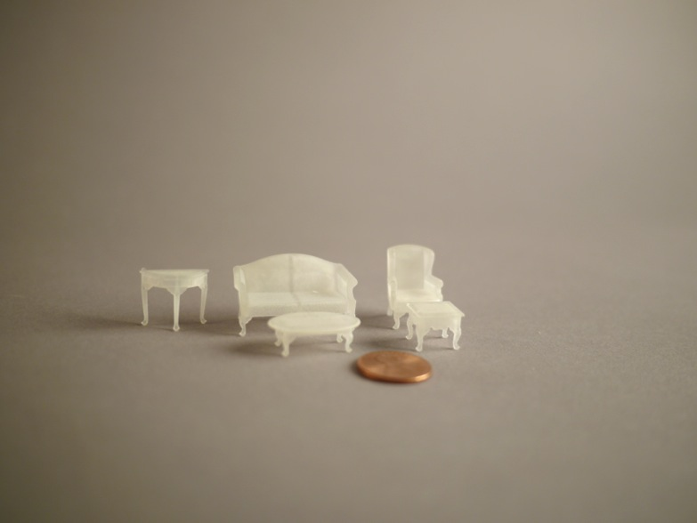
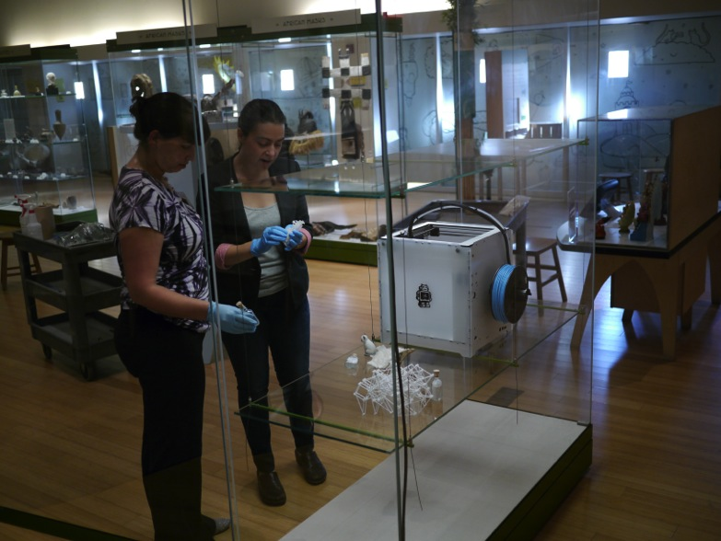
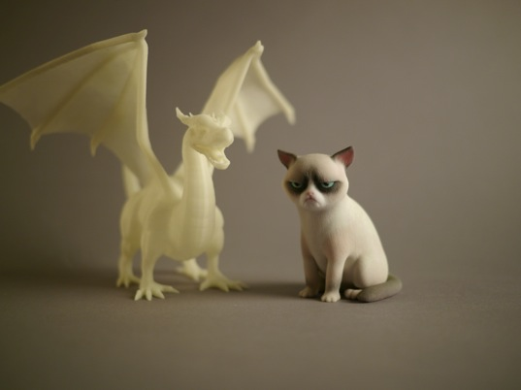
3-D Printing

Slide 21
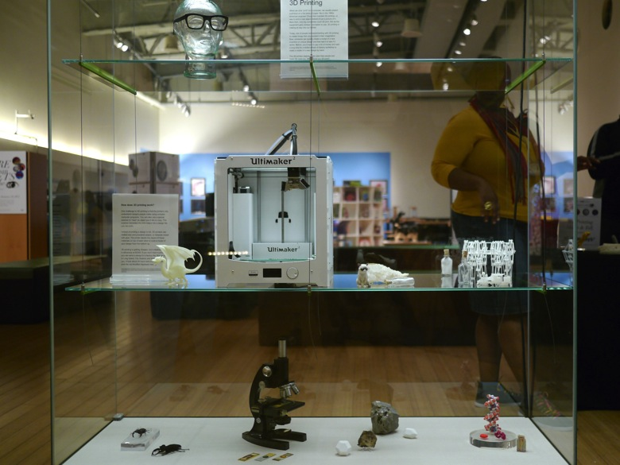
3-D Printing

Slide 22
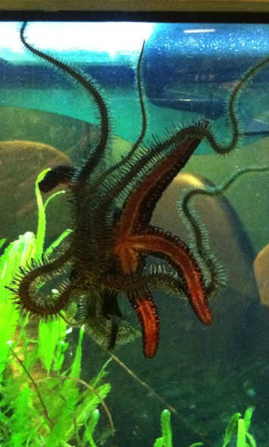
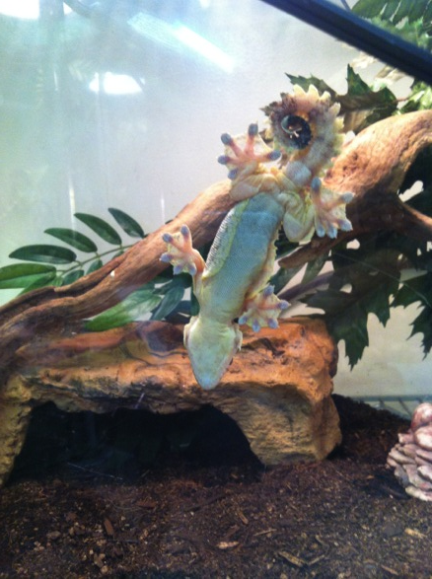
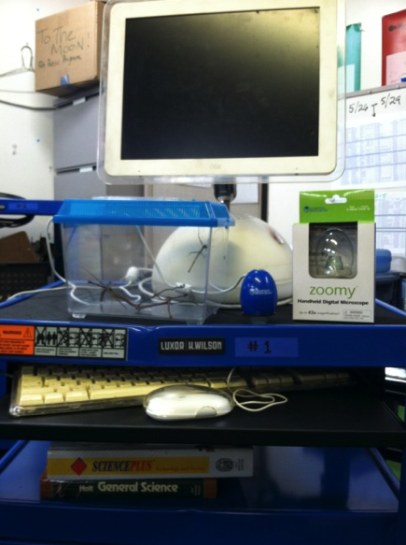
“Nano-Bio” Cart

Slide 23
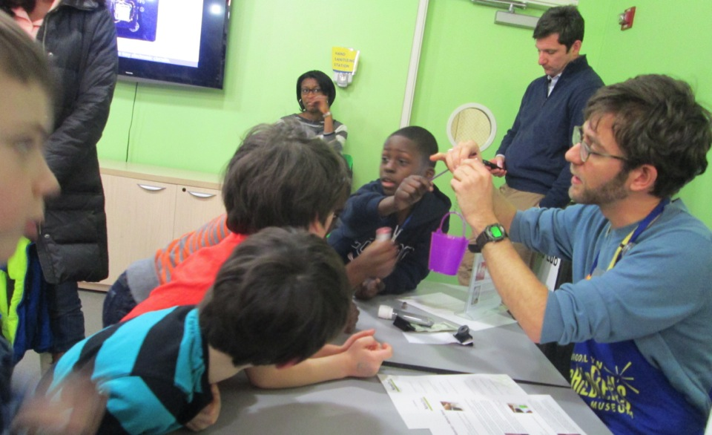
NanoDays & Physical Kit

Slide 24
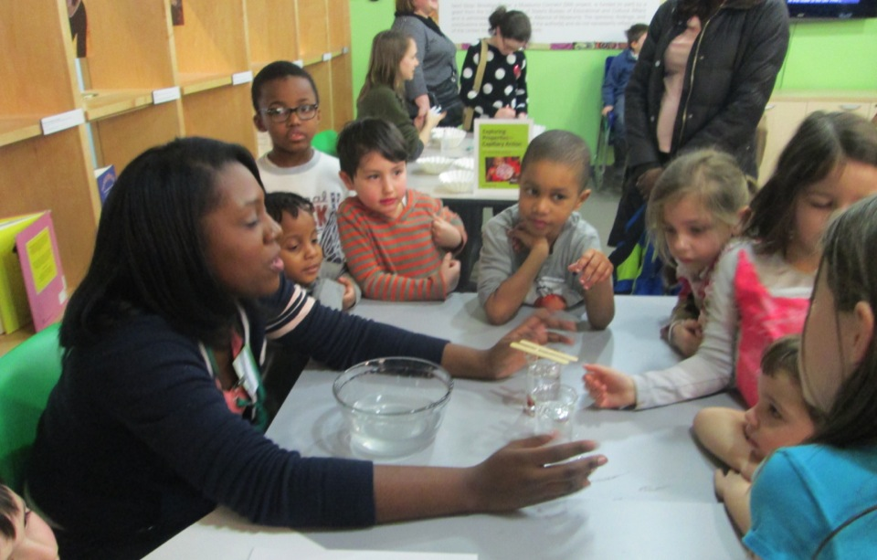
NanoDays 2014

Slide 25
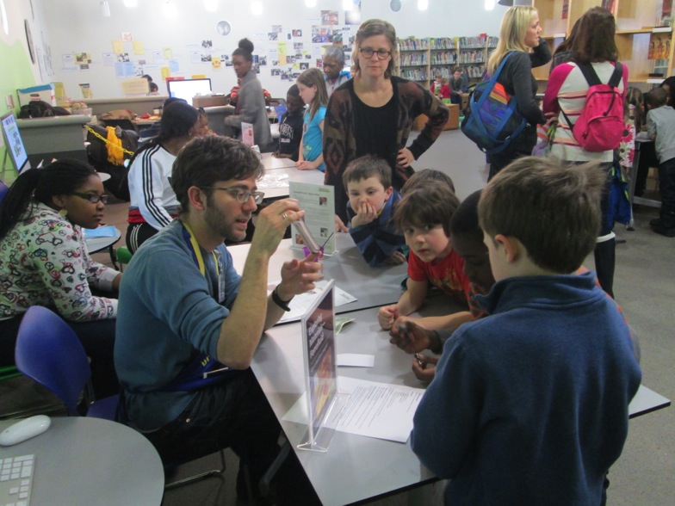
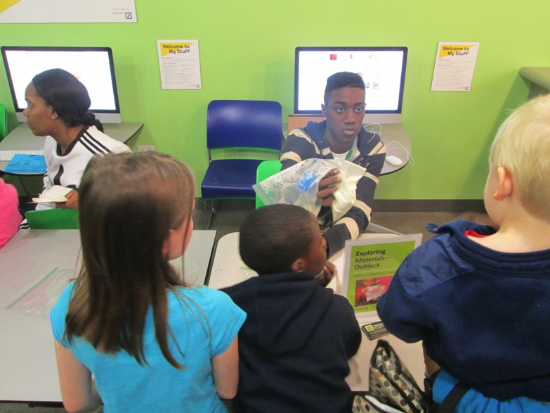
NanoDays 2014

Slide 26
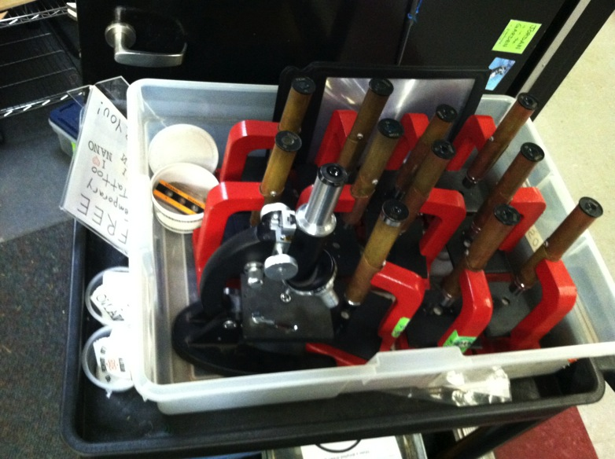
“Zoom In!”
“Zoom In”

Slide 27
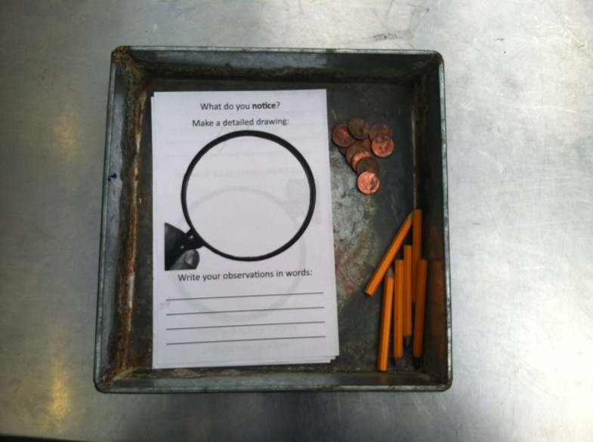
“Zoom In!”
“Zoom In”

Slide 28
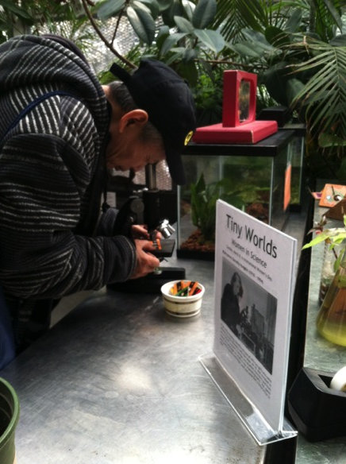
“Zoom In!”
“Zoom In”

Slide 29
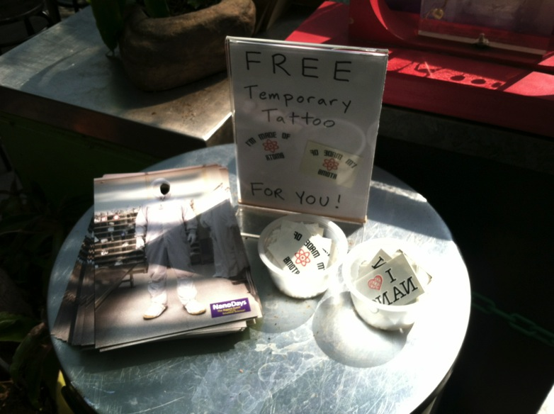
NanoDays 2015 Physical Kit Usage
“Zoom In”

Slide 30
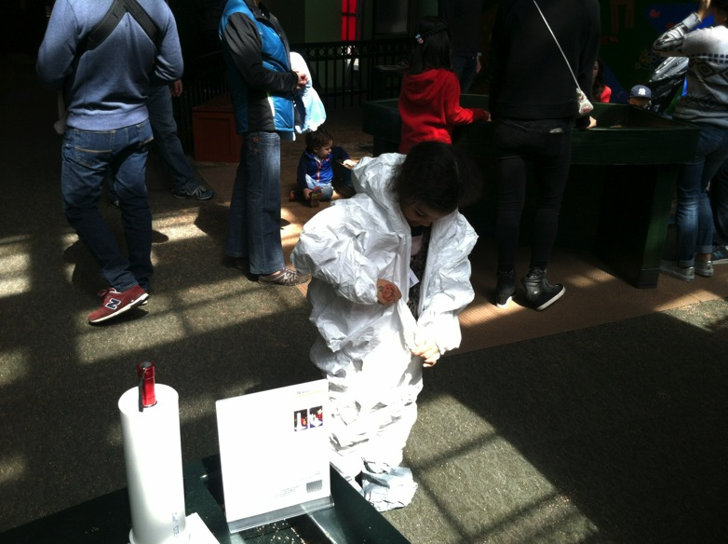
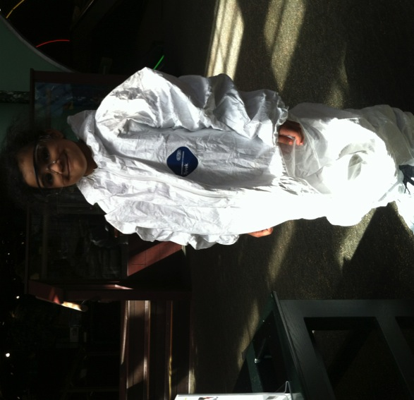
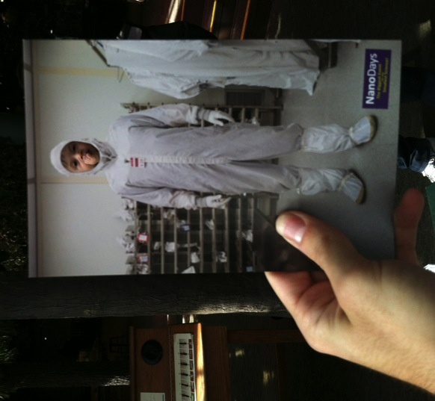
NanoDays 2015 Physical Kit Usage
“Zoom In”

Slide 31
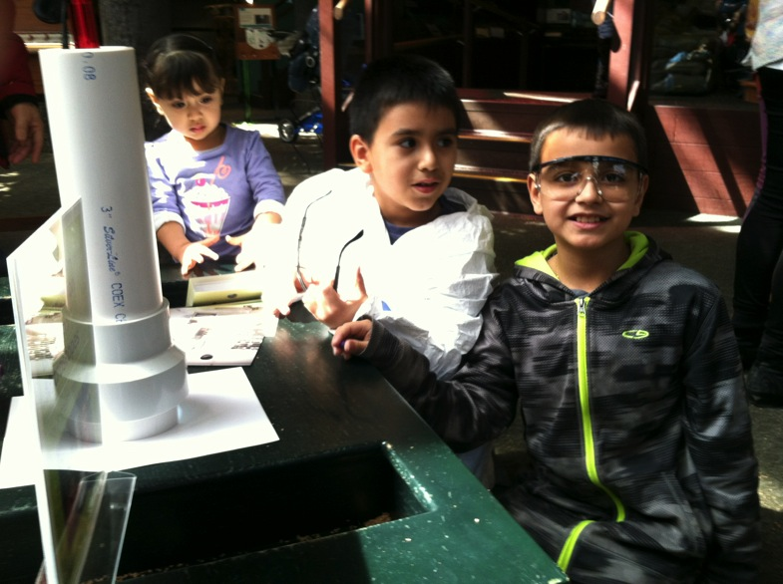
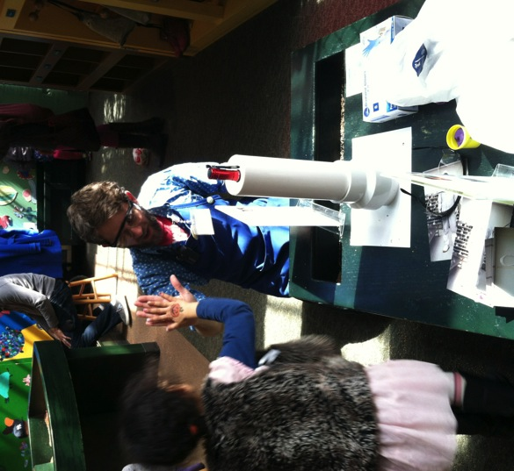
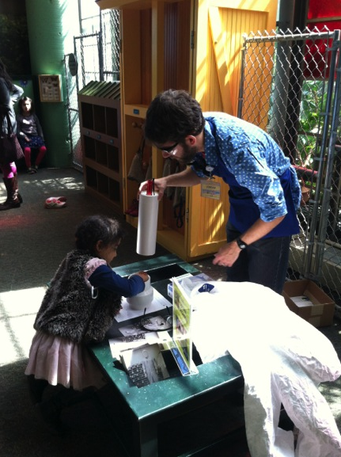
NanoDays 2015 Physical Kit Usage

Slide 32
Challenges
Audience:
80% eight yrs and under
80% of those five years and under
i.e. EARLY CHILDHOOD
Staffing:
Festival-style would work better with more “hands on deck”
Lacking sufficient tech support
Staffing transitions from 2014-15, staffing shortage, limited volunteer base/infrastructure… A “learning period”

Slide 33
Scaling Up: How tailoring exhibits and programs to appeal to local audiences can help drive attendance
Jonah Cohen, Children’s Museum of CT
Jessie Herbert, SpectUM
Jordan Warner, Brooklyn Children’s Museum
Trudi Plummer, Maine Discovery Museum
Allison Schwanebeck, Science Center of Iowa
JUNE 2015
NETWORK-WIDE MEETING
NISENET.ORG
Notes:
NanoDays is a complex effort that includes multiple NISE Network teams working together to create resources and coordinate the participation of hundreds of partners. This presentation focuses on the tools, ideas, and processes that are specific to creating a nationwide event such as NanoDays, which is supported by a physical and digital kit that includes professional resources and educational products. We’ll describe the planning and development of NanoDays resources by a cross-organizational team, fabrication and distribution of the physical kits, and of course the implementation by hundreds of partners across the country through annual NanoDays events, and the impact of the initiative on public audiences.

Slide 34
NanoScience And ME
www.mainediscoverymuseum.org

Slide 35
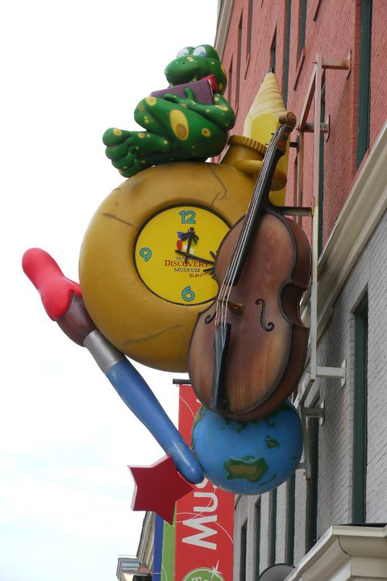
Maine Discovery Museum 74 Main Street, Bangor, Maine www.mainediscoverymuseum.org
As the largest children’s museum and science center north of Boston we serve 60 thousand visitors each year. We believe that hands-on learning creates a deeper understanding of Maine and the world we live in and that even the youngest children can be engaged in meaningful science if we build upon their innate sense of curiosity and wonder.

Slide 36
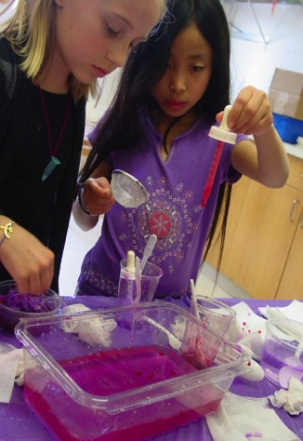
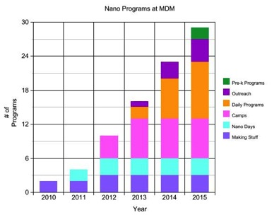
Nano News: What’s Been Happening at MDM?
We’ve handed out 4,000 nano brochures since July 2011
Visitors did 2,000 nano scavenger hunts since 2011
We went from facilitating just Nano Days in 2011 to now incorporating nano content in outreach, field trip programming, daily activities, and vacation camps for children ages 4-12, grant proposals, and new exhibits

Slide 37
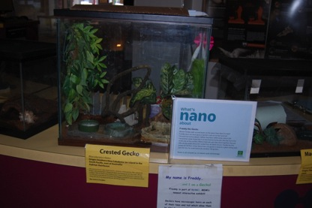
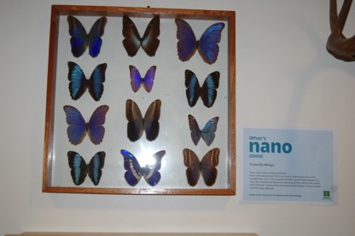
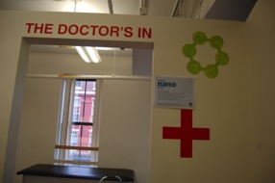
What is Nano in MDM?
Magnet Station
Freddy the Gecko
Dr.’s Office
Water Fountain
Charlotte’s Web
Gravity Tracks
Elevator
Smoke detectors
Mono butterfly display
Mood rings
Heat sensitive hand art wall
Freeze Your Shadow

Slide 38
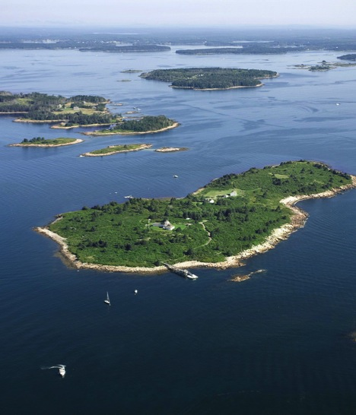
A Deeper and Broader Engagement With Nano Content
Scavenger hunts for school age children
Brochure for families to learn about nano science, nano research and industry in Maine
OUT-reach
We go WAY out to bring educational programming to underserved populations across Maine, including rural schools, coastal and island communities, and Native populations
In the next year we will incorporate QR codes into exhibits so parents and older kids can learn more

Slide 40
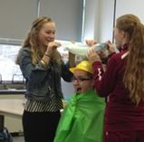
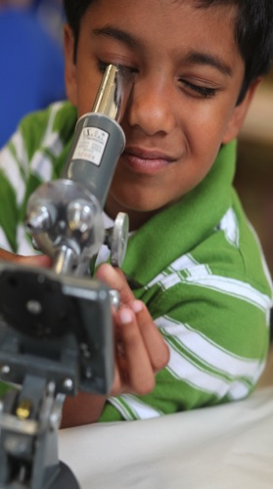
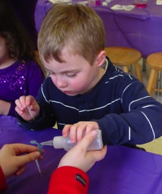
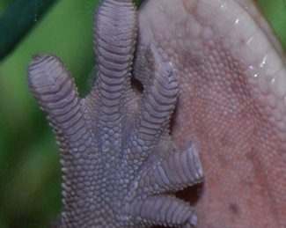
In House Programming
Shocking Science/Exploring Materials - Graphene
Sticky Situations/Biomimicry: From Nature to Nanotech
Exploding Diapers/Exploring Materials – Hydrogel

Slide 41
In House Programming
Lotions, Potions, &Scientific Notions/Exploring Size - Scented Balloons
Visiting a local water filtration lab and taking samples from the Penobscot River/Cleaning Our Water with nano technology
What’s nano About Pizza?

Slide 42
Nano for new audiences
Who do we reach other than the children and families coming through our doors?
Who else benefits from learning about Nano science?
Pre-service teachers at the University of Maine
Collaborated with the science methods professor at UMO who gave a selection of nano kits to education students to try and link them to the learning standards, organize them into cohesive units and develop lessons around the nano kits
PREP coalition:
Introduced kits and field trip and outreach nano content to
curriculum coordinators from regional schools. PREP is planning on
involving MDM in the development of the Pre-K science standards
OOS providers
Introduced nano content as part of the STEM curriculum at a weekly, 3 month long provider training
Parents
As part of a Penquis Head Start parent workshop
New media students
Maine Science Festival
Intersections
For the future: nano and STEAM; engaging artists, children on the spectrum, nano kits

Slide 44
Maine Discovery Museum
www.mainediscoverymuseum.org

Slide 45
Scaling Up: How tailoring exhibits and programs to appeal to local audiences can help drive attendance
Jonah Cohen, Children’s Museum of CT
Jessie Herbert, SpectUM
Jordan Warner, Brooklyn Children’s Museum
Trudi Plummer, Maine Discovery Museum
Allison Schwanebeck, Science Center of Iowa
JUNE 2015
NETWORK-WIDE MEETING
NISENET.ORG
Notes:
NanoDays is a complex effort that includes multiple NISE Network teams working together to create resources and coordinate the participation of hundreds of partners. This presentation focuses on the tools, ideas, and processes that are specific to creating a nationwide event such as NanoDays, which is supported by a physical and digital kit that includes professional resources and educational products. We’ll describe the planning and development of NanoDays resources by a cross-organizational team, fabrication and distribution of the physical kits, and of course the implementation by hundreds of partners across the country through annual NanoDays events, and the impact of the initiative on public audiences.

Slide 46
Science Center of Iowa
Des Moines, Iowa
Annual attendance 300,000
We LOVE Nano!

Slide 47
NANO Mini Exhibition
Anchor in our large central hall
Part of semi-permanent exhibit
Barrier during exhibit transition
Pass through space in our second floor balcony space

Slide 48
Nano Spot
Goals:
To extend nano content throughout the museum
Show visitors examples of nano in the world around them and in their daily lives
Try tracking QR codes and their usage by content or location in the museum
Partner with local research to showcase scientist/engineer working with nano

Slide 49
NANO Spot
How did it turn out?
Created a total of 8 labels located throughout the museum.
Cafe (4), Elevator, & 3 of our 4 permanent exhibits
Made connections with and Aerospace Engineer at ISU and would still like to potentially add this content to go next to our rocket launch exhibit.
QR code tracking didn’t work as expected and while we were tracking we saw low engagement/scanning

Slide 50
SEM Images
Partnered with University of Northern Iowa
Selected objects that most of our visitors would have interacted with
When images are on display, we would like to also have the objects available to view under a magnifying glass and microscope.

Slide 51
Questions & Discussion

Slide 52
Thank you!
Thank You!
Cynthia Needham, ICAN Productions
This presentation is based on work supported by the National Science Foundation under Grant No. 0940143. Any opinions, findings, and conclusions or recommendations expressed in this presentation are those of the authors and do not necessarily reflect the views of the Foundation.

Slide 53
NISE Net Marketing Materials

Slide 54
DIY Nano & App

