Slide 1
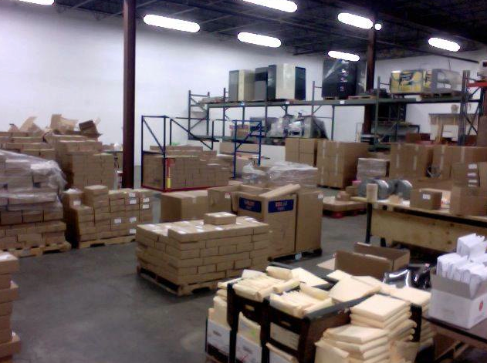
Fabrication
Notes:
So, you’ve developed your activities and tested them with visitors, now you need to get them to your intended audience.

Slide 2
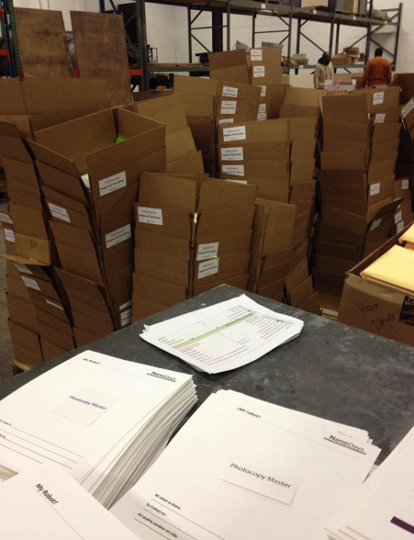
Fabrication
Fabrication in 5 easy steps:
Choosing vendors
Ordering materials
Fabricating materials
Packing materials
Shipping materials
Notes:
I’ve broken the process down into 5 steps.

Slide 3
Fabrication
Fabrication in 5 easy steps:
Choosing vendors
Ordering materials
Fabricating materials
Packing materials
Shipping materials
C.O.F.P.S

Slide 4
Fabrication
Choosing Vendors
Think about this early in process
Small vendors can be tricky
Notes:
-This should really be thought about in the development stage when you’re thinking about and testing supplies. This helps you keep an eye on your budget.
-Use caution when dealing with small vendors – you can run into supply issues, or timing issues
-The vendors we use for the NanoDays materials are included on the guides

Slide 5
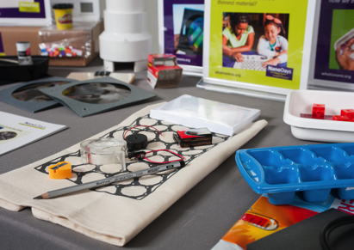
Fabrication
2. Ordering Materials
OVER ORDER!
Include EVERYTHING
> keep budget in mind here
Economy of scale
Notes:
-Order enough for 5-10 more kits than you intend to ship out.
-We found that people are much more likely to do the activity if everything is in the box, including clean-up supplies.
-You’ll obviously need to keep budget in mind, and maybe it’s not possible to include everything – and that’s a decision you’ll have to make. But again, if you’re thinking about this up front in the development stage, you can adjust accordingly.
-Because we send out 250 kits, we have the advantage of bulk ordering, which often reduces the per unit cost.

Slide 6
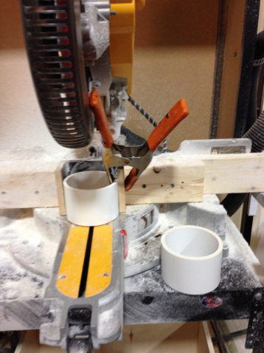
Fabrication
3. Fabricating Materials
Some activities require modifications
Where you can be creative!
Be sure to account for this in timeline
Notes:
-Some activities require some extra modifications
-This is where the developer and the fabricator can get a little creative! The developer might need the a specific tweaking for activity to work, but fabricator might come back and say that won’t fit in the box – and then offer an alternative solution.
-there’s really no secret tip here, other than to account for this process in your timeline. For NanoDays, this takes between one and two weeks – with anywhere from 2 to 6 people working on it, depending on the amount of work that needs to be done.

Slide 7
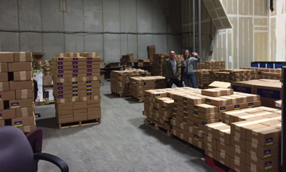
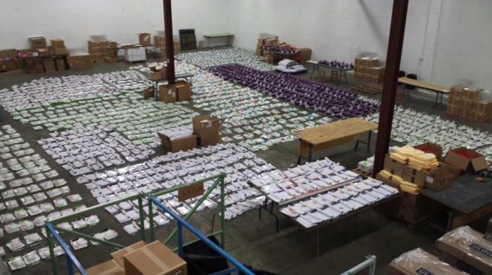
Fabrication
4. Packing Materials
SPACE!
Have all materials on-hand before packing begins
Notes:
-You will need more space than you think! There will be boxes everywhere.
-Make sure you have ALL supplies before you start packing – leaving half-filled boxes lying open takes up even MORE space. It’s not advisable ☺

Slide 8
Fabrication
4. Packing Materials
Packing team needs attention to detail
Notes:
-The packing team must be attentive – provide caffeine, sugar, whatever it takes to avoid mistakes. However…..

Slide 9
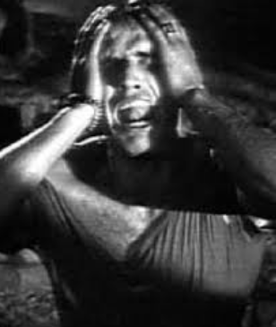
Fabrication
4. Packing Materials
Mistakes will be made
“Tweezers!!!”
Notes:
-There WILL be mistakes. And that’s ok!
-We didn’t include tweezers and alligator clips in this year’s kit. Included the wrong ammeter in last year’s kit. Three years ago, we didn’t get the ferrofluid in time, so we had to send that as a separate package. But ferrofluid can’t be subjected to very cold temperatures, and we were shipping them out in January from Minnesota….. So, we had to not only order a whole new set of smaller boxes, and create a whole new round of shipping labels, but we had to also insulate them as well, so they wouldn’t freeze while sitting in the FedEx truck.

Slide 10
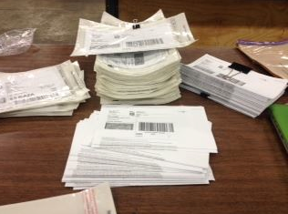
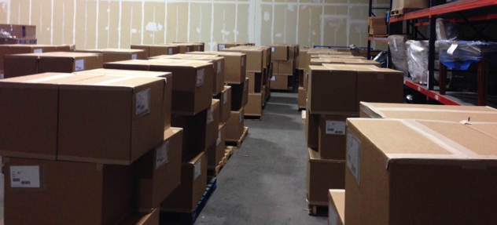
Fabrication
5. Shipping Materials
Choose delivery service
Reserve a pick-up
Communicate needs
Notes:
-Find a delivery service that you find reliable
-Reserve a pick-up time well in advance – and check in with the delivery service a few times before your scheduled pick-up date
-Communicate your total shipment size, estimated weight, total number of packages, and that they’re all going to different places.

Slide 11
Fabrication
Time Lapse of fabrication 2014 NanoDays kit
https://vimeo.com/89432550
Notes:
-Find a delivery service that you find reliable
-Reserve a pick-up time well in advance – and check in with the delivery service a few times before your scheduled pick-up date
-Communicate your total shipment size, estimated weight, total number of packages, and that they’re all going to different places.

Slide 12
NanoDays Evaluation
Activity and Kit Development
Peer review
Scientist review
Visitor and volunteer testing – TBI
NanoDays Reports
Your review
Your use
Summative evaluation
Visitor impact
Visitor reach
Volunteer impact
Notes:
We talked about the development process for everything, but here is the full set of just how much we have tested and learned about NanoDays and its various components.

Slide 13
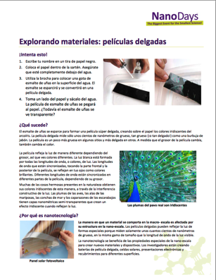
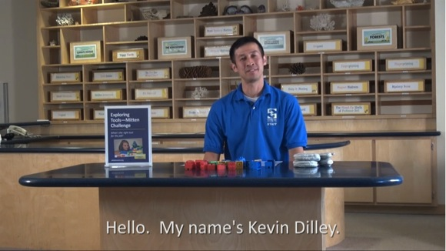
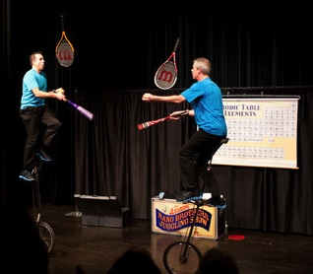
NanoDays Evaluation
Notes:
So, you all heard Paul talk about how the feedback you provided helped us continue improving upon what is, and is NOT, included. Here are a few big examples of how the NanoDays reports specifically led to us tailoring the kits.
Training Videos –
Translating into Spanish –
Canceling the long form programs –

Slide 14
NanoDays Summative Evaluation
Notes:
NanoDays events are successful in providing event attendees with an engaging experience and in promoting learning of nano concepts.
Event attendee data across all study sites demonstrate that attendees found NanoDays interesting and enjoyable. In addition, event attendees report statistically significant gains in confidence around talking about and describing different aspects of nano concepts aligned with the NISE Net Content map.
Almost everyone found it interesting and enjoyable or fun! These are big numbdrs. At SMM, we think something is effective if 70% fall in that range
93% said they would come back to another event
AND people learned!! 63% connected between their lives and the content, and adults and kids shomed gains in learning about areas of the content map

Slide 15
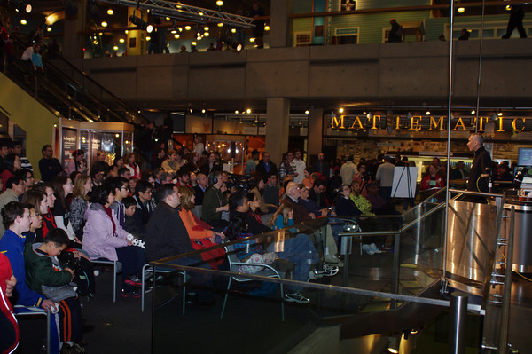
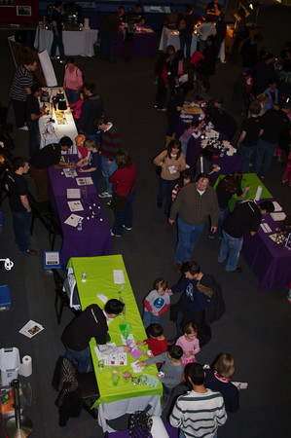
NanoDays Summative Evaluation
Notes:
The estimated public reach of NanoDays 2014 is over 458,000 encounters for event attendees, and nearly 5,000 volunteers, across all events.
Using rigorously developed encounter estimation factors from 2010, the updated number of public encounters with nano during NanoDays events in 2014 is 458,887. This conservative estimate reflects the 250 kits distributed in the spring of 2014. In addition, the NanoDays reports submitted by Network partners indicate that there were 4,992 volunteers at 210 institutions.
ND 2014 reached at least 458,000 visitors
Since 2008, ND has created 3.0-3.7 million encounters
Nearly 5,000 people volunteered in 2014

Slide 16
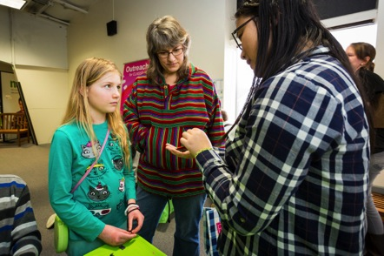
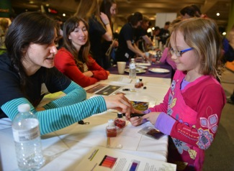
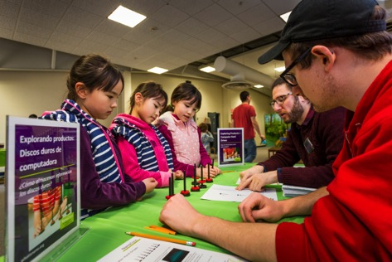
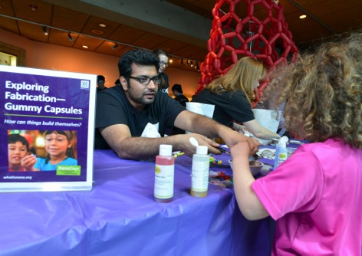
NanoDays Summative Evaluation
Notes:
NanoDays events are also successful in providing event volunteers with an engaging experience and in promoting learning of nano concepts.
Event volunteer data demonstrate that volunteers found their NanoDays experience engaging. Event volunteers also report statistically significant gains in confidence around talking about and describing different aspects of nano concepts aligned with the NISE Net Content map. These gains are larger than those reported by event attendees.
Greater gains on content map than visitors
Volunteering at NanoDays positively impacts interest in STEM activities/careers and confidence around engaging the public in nano.
Volunteer data indicates that volunteers report higher levels of interest in STEM. High school and undecided college students also report slightly higher levels of interest in STEM careers after their NanoDays experience. Event volunteers also report statistically significant gains in confidence around engaging the public in nano, despite nano being perceived as a potentially difficult topic to communicate to public audiences.
Interest in STEM increased across all types of volunteers
They talked about ND activities with others!
They gained confidence in talking to the public about STEM

Slide 17
Tools and Resources
NISE Net educational & NanoDays materials online
Engaging the Public in Nano: Key Concepts Guide
NISE Net Public Forums manual
NISE Net Science Café guide
NISE Net Nano exhibition guide
Nanotechnology and Society Guide
NISE Network TBI guide
NanoDays & Programs Training Videos
Archived Online Workshops
NanoDays Planning Guide and promotional materials (annual)
NanoDays training materials online

Slide 18
Additional Resources
NISE Net NanoDays guide(Fall 2015)
NISE Net Programs guide(Fall 2015)
NanoDays Compendium (Fall 2015)
DIY Nano Compendium (Fall 2015)
Upcoming Kit: Building with Biology (2016)
Upcoming Kit: SustinABLE kits (2016, 2017)

Slide 19
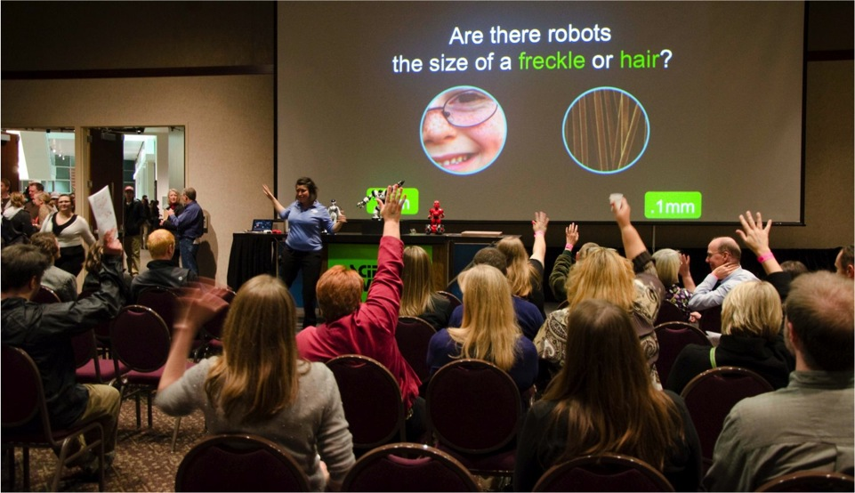
Questions & Discussion

Slide 20
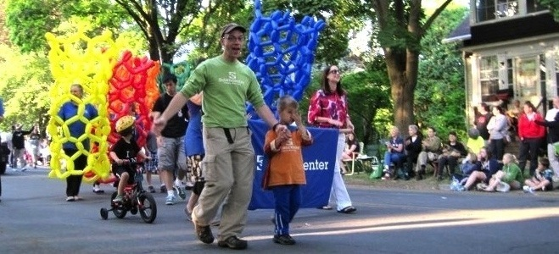
Thank you!
Cynthia Needham, ICAN Productions
This presentation is based on work supported by the National Science Foundation under Grant No. 0940143. Any opinions, findings, and conclusions or recommendations expressed in this presentation are those of the authors and do not necessarily reflect the views of the Foundation.

Slide 21
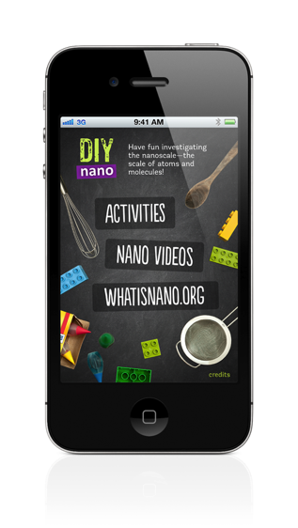
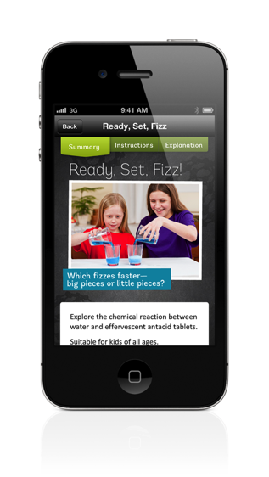
DIY Nano & App

