Slide 1
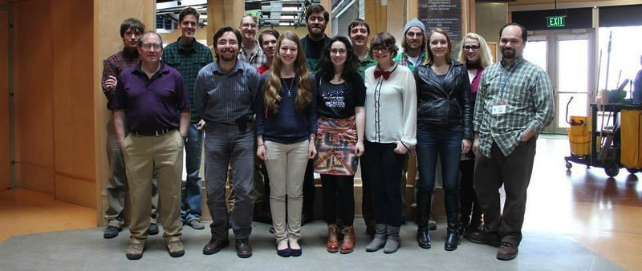


After the “First Date”…
JUNE 2015
NETWORK-WIDE MEETING
NISENET.ORG
Notes:
Good morning

Slide 2
Sustaining University-Museum Partnerships Through Nano
Tifferney White, DISCOVERY Children’s Museum
Donna Hammer, University of Maryland
Joelle Adolfi, Rochester Museum & Science Center
K.S.V. Santhanam, Rochester Institute of Technology
Luke Donforth, University of Vermont
JUNE 2015
NETWORK-WIDE MEETING
NISENET.ORG

Slide 3

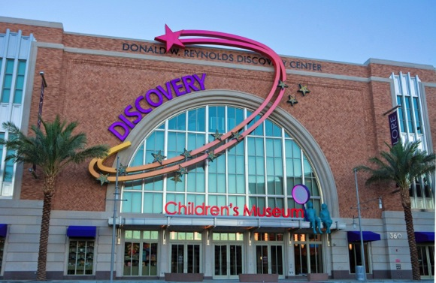

The New
DISCOVERY Children’s Museum
Las Vegas, Nevada
In existence since 1990; New location opened March 2013
Target Audience: Children 0-12 years old and their families
Three floors, 58,000 square feet
Nine (9) hands-on and immersive exhibit galleries plus Traveling Exhibition Gallery
Involved with NISENET since 2009 and doing NanoDays since 2010

Slide 4
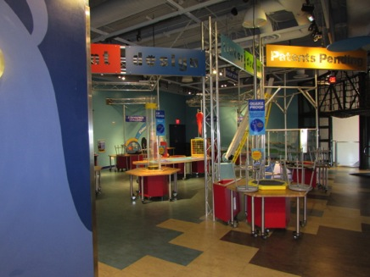
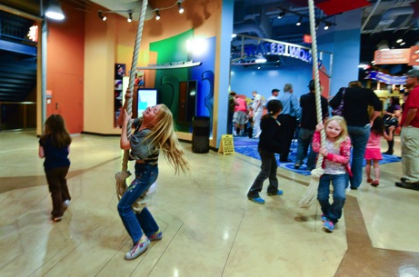
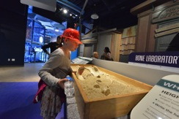
The New
DISCOVERY Children’s Museum
Museum designed to incorporate the entire family in the experiences
Content Focus: Science & Nature and Arts & Humanities valuing Early Childhood Education

Slide 5
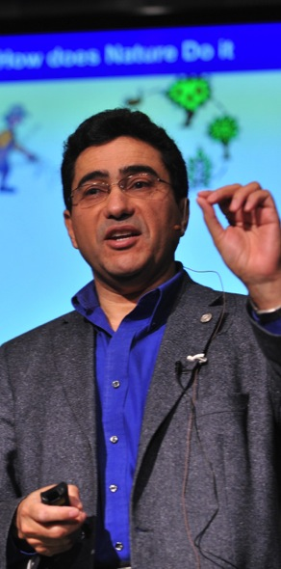
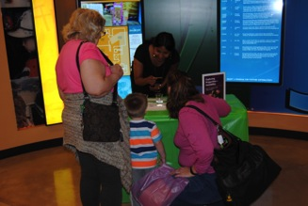
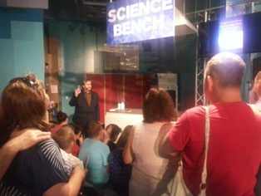
Partners…
Partner institutions:
University of Nevada, Las Vegas
  Chemicals Interactions Club
  Nevada Nanotechnology Center
National Securities Technologies

Slide 6
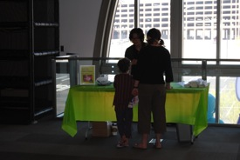
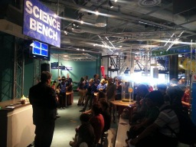
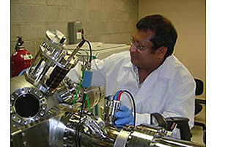
History of the Partnerships
Timeline:
2011, 2013, 2014, 2015
  University of Nevada, Las Vegas
    Chemicals Interactions Club
2013, 2014, 2015
  National Securities Technologies
2014
  University of Nevada, Las Vegas
    Nevada Nanotechnology Center

Slide 7
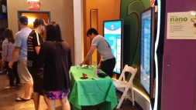
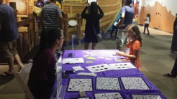
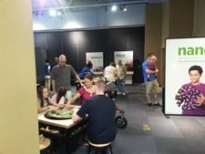
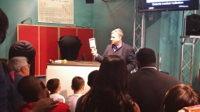
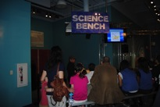
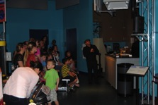
Partnership Projects
University of Nevada, Las Vegas
  Chemical Interactions Club
    NanoDays
National Securities Technologies
  Minigrant – Scientist Spotlight
  NanoDays
University of Nevada, Las Vegas
  Nevada Nanotechnology Center
    NanoDays

Slide 8
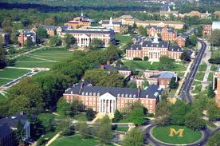
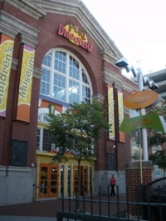
Univ. of MD/Port Discovery
Your institution:
University of Maryland, College Park, MD
Physics Department and former MRSEC
Partner institution(s):
Port Discovery Children’s Museum, Baltimore, MD

Slide 9
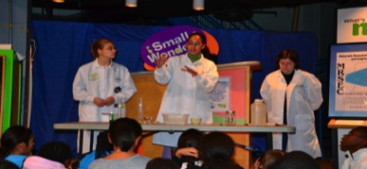
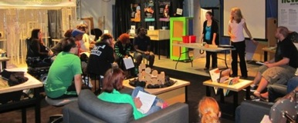
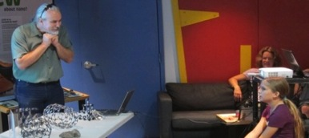
Timeline and Projects of the Partnership
2009 Partnership began - PDCM’s STEM initiative and MRSEC broader impacts
2010 began joint NanoDays activities and Discovery Days
2011 began NanoFabuous exhibit project (7 months for research, design and construction)

Slide 10
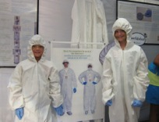
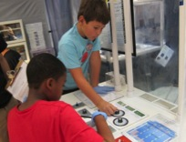
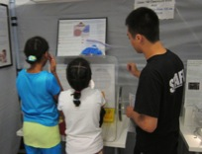
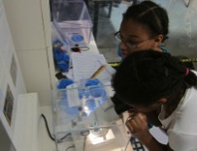
Timeline and Projects of the Partnership
2012 NanoFabulous installed and Grand Opening
Began Exhibit programming
  Scavenger Hunts
  School Group Visits
  Summer Camps
  Meet a Scientist
  Educator Workshops

Slide 11
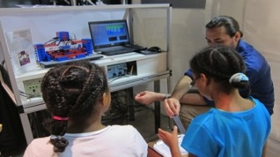
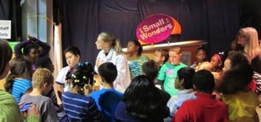
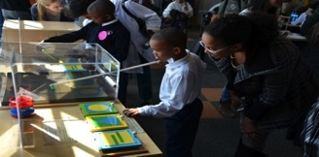
Timeline and Projects of the Partnership
2013 How Do You Nan-Know? Mini Grant
  Conversations about Nano and Society
Nano-vention Convention and continued exhibit programming
2014 Society of Physics Students (SPS) Percussion Garden

Slide 12
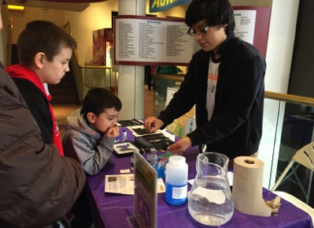
Rochester Museum & Science Center
History
Rochester, New York -- Monroe County
Established in 1912
Target audience – Families with Children age 7-14 yrs old.
Mission:
The Rochester Museum & Science Center stimulates broad community interest and understanding of science and technology, and their impact—past, present, future—on our lives.
Partner institution(s):
Rochester Institute of Technology
SIMPore Inc.
American Chemical Society

Slide 13

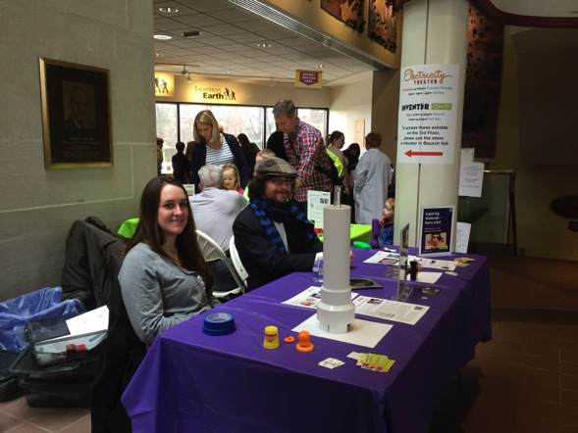
NanoDays Ago…
NanoDays - 2 day weekend event at the museum.
2012: RIT and SIMPore Inc.
2013: RIT, SIMPore Inc. and ACS
2014: RIT, SIMPore Inc., ACS and Bruce Ha
2015: Continued partnerships

Slide 14
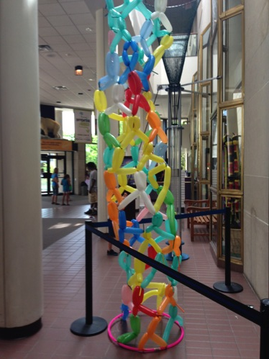
Doing more than just Nanodays
Summer Fun 2014
Nano Exploration Camp 12-15 yr olds
SIMPore Inc. guest speakers
RIT Clean Lab tour
Summer Fun 2015
Nano: It’s a Small World 12-15 yrs
NanoExploration 9-11 yrs.

Slide 15
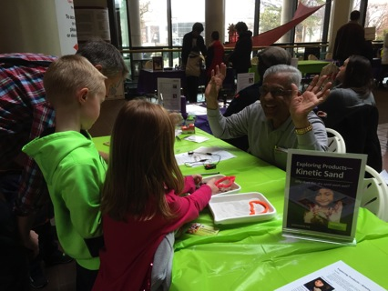
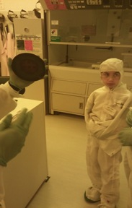
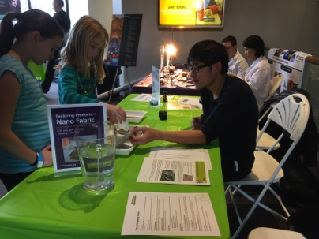
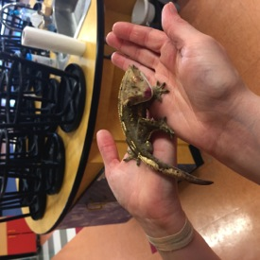

Slide 16
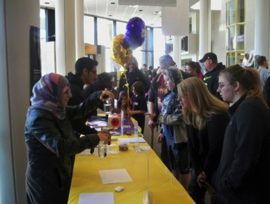
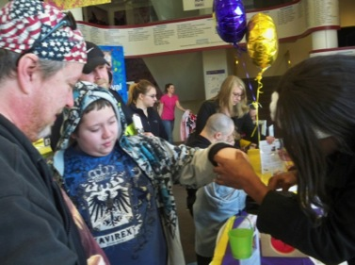



RIT: Partnership
ROCHESTER INSTITUTE OF TECHNOLOGY
Founded in 1829; enrollment: 18,000
A place where brilliant minds assemble and collaborate
Pool individual talents across disciplines in service of big projects and big ideas
Partner institution(s):
Rochester Museum and Science Center

Slide 17
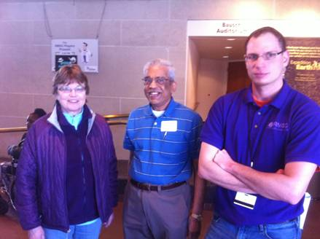
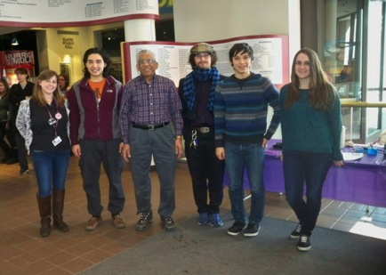
History of partnership
RIT was the first institution in Rochester participating in Nanodays celebrations with NISE.
Partnership with RMSC started in 2011
Motivation is to bring greater awareness to the public of all ages.
Notes:
President of Rochester Museum and Science Center, Kate Bennett, Prof. K.S.V. Santhanam (Convener, Nano Day celebrations, RIT) and Dan Winklebleck (Public Program Officer, RMSC) watching the nano demo.
Mr. Dan Winklebleck, Dr. Uzelemeier, Rich Serapilio initiated the partnership.
Since 2013, Ms. Joelle Adolfi is the program officer and the partnership has grown further.

Slide 18


Partnership projects
Partnership enables public to gain knowledge on RIT research activities of Materials Science and Engineering program.
RIT Nanopower demonstrations on solar powered gadgets.
At RMSC, display of posters
showing research on nanosensors, packaging etc.
Notes:
See the following websites.
http://www.rit.edu/cos/nanodays-2014
http://www.rit.edu/cos/nanodays-2013
http://www.rit.edu/cos/nanodays-2012
http://www.rit.edu/cos/nanodays-2011
https://www.rit.edu/cos/newsandevents_NanoDays2009Photos.php

Slide 19
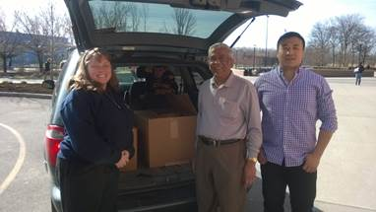
Community Partners: Imagine RIT
Annual festival for RIT community
Attended by near 35,000 visitors of all ages
Display NISE Net kits along with RIT research on nanomaterials
Nanodays kits are donated to schools after the event.
Notes:
Visitors reading the RIT posters on Hydrogen production using nanomaterials and solar power
Visitors at the DNA extraction table watching the demo
NISE Nanoday Kits are donated to schools after the event. Three schools
have acquired them.a) Pittsford high school, NY b) Dundee central school, NY and c) Fairport school, NY
From: Kristin Larsen [klarsen@fairport.org]
Sent: Monday, May 11, 2015 1:46 PM
To: Kalathur Santhanam
Cc: Casey Miller
Subject: Re: Nano Kits for Fairport
Thank you very much for getting back to me Professor Santhanam, we are very excited about the kits! Casey, I believe you mentioned in your last email a pickup on 5/15, do you have a time that works best for you?
Thanks again,
Kristin

Slide 20
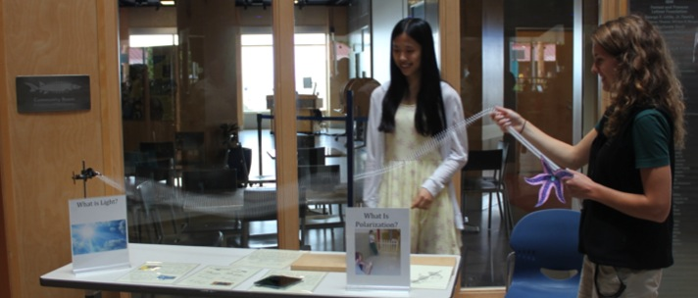
UVM & ECHO
University of Vermont:
Already has strong partnership with ECHO, but on biology side
Physics Dept.
wants more
Physics @
ECHO
Undergrads
Grads
Faculty
Staff
ECHO Lake Aquarium and Science Center:
State’s largest science museum
Focused on the watershed
Hundreds of visitors per day
Seen as almost children’s museum

Slide 21
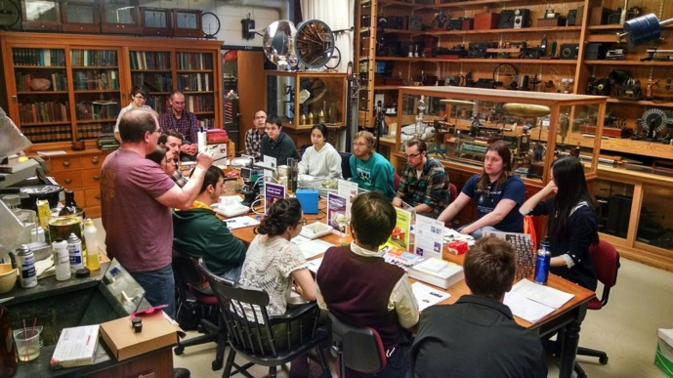
We Can’t Leave Well Enough Alone
NISE Net Partnership predates my relationship to UVM
We use our resources to add on and expand to the kit
Relationship has grown to more than NanoDays
(traveling exhibits, science café, collaborations)

Slide 22
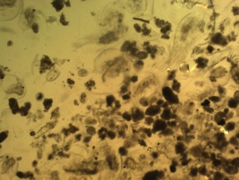
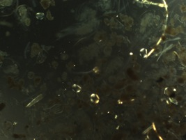
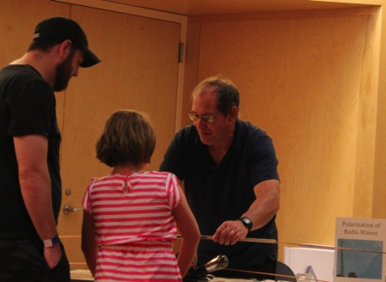
A Plethora of Polarization
Expanding the Partnership:
MiniGrant from NISE Net
Outreach Requirements for Faculty
An Additional Day of Activities
Respect everyone’s schedule
Relevant to both parties
Long term utility (training, toys)
Strengths and weaknesses

Slide 23
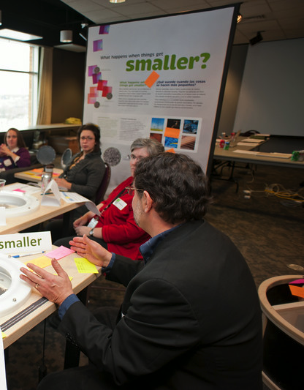
What strengthens partnerships?
Motivation
Communication
Evolution
Growth
Sustainability

Slide 24
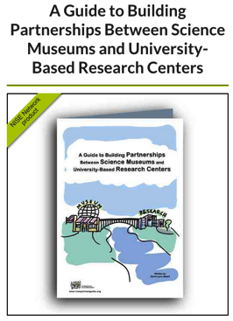
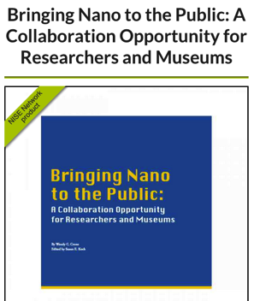
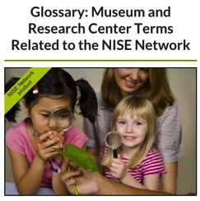
NISE Net Resources
Notes:
http://nisenet.org/partner_guide
http://nisenet.org/catalog/tools_guides/bringing_nano_public_collaboration_opportunity_researchers_museums
http://nisenet.org/catalog/tools_guides/glossary_museum_research_center_terms_related_nise_network

Slide 25


Questions & Discussion

Slide 26



Thank you!
Cynthia Needham, ICAN Productions
This presentation is based on work supported by the National Science Foundation under Grant No. 0940143. Any opinions, findings, and conclusions or recommendations expressed in this presentation are those of the authors and do not necessarily reflect the views of the Foundation.

