Slide 1
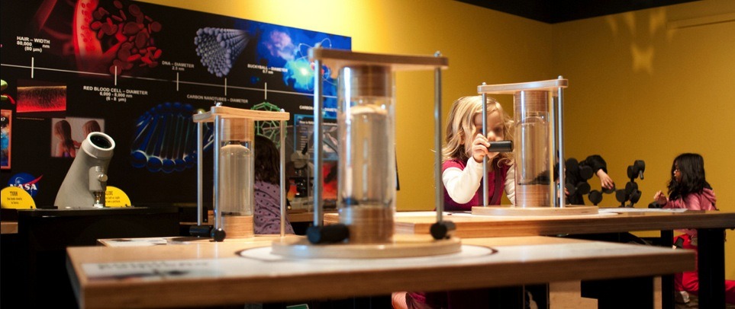


Evaluation & Research
What We’ve Learned About NISE Net’s Effects on the Public
Marjorie Bequette, Chair
NISENET.ORG
Notes:
Good morning

Slide 2
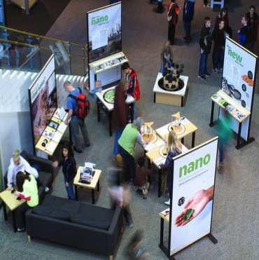
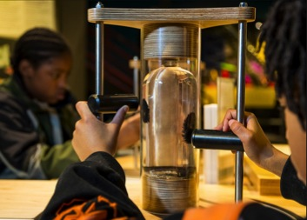
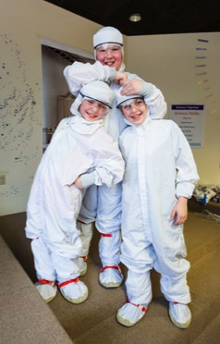
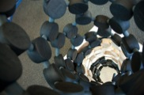

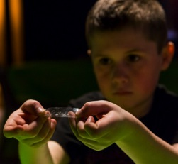
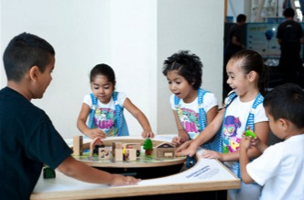
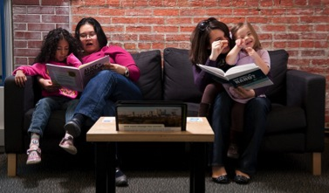

Nano Impacting the Public
Notes:
My name is Steven Guberman and I work at the Science Museum of Minnesota.
I am presenting about an evaluation project that we’ve been calling the “Nano Rich Study.”
As I’m sure you all know, one goal—perhaps the primary goal – of NISE Net has been to infuse museums across the country with nano offering for the public.
But what does that look like? What does it mean to be nano infused, and what is the impact of a nano-infused museum on its audience?
From other studies, we know a lot about individual products
Specifically, the public impact of NanoDays (which Gina will be talking about)
And the impact of the mini-exhibition (which Liz will talk about)
But the question we are trying to answer is:
What is the public impact when an organization has a lot of different nano offerings as a result of participating in NISE Net?

Slide 3
Nano-Rich Organizations
Steven R. Guberman, Science Museum of Minnesota
David Milavetz, Science Museum of Minnesota
Eric LaPlant, Science Museum of Minnesota
Chris Cardiel, Oregon Museum of Science and Industry
NISENET.ORG
Notes:
That is what I have been working on with my colleagues
David Milavetz and Eric LaPlant from the Science Museum here and
Chris Cardiel from the Oregon Museum of Science and Industry in Portland
This study is still in progress, but I have some results to share with you today.

Slide 4
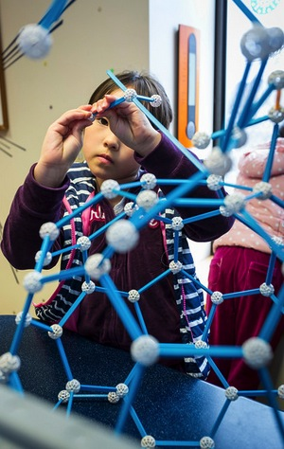
Evaluation Goals
FOCUS 1: DESCRIBING THE NETWORK
What does the network look like with respect to nano offerings for the public?
FOCUS 2: DESCRIBING NANO-RICH ORGANIZATIONS
What are different ways that organizations can be nano rich?
What do staff at nano rich organizations hope and think visitors are learning?
Notes:
There are two complimentary parts of our study:
The first focus is to describe what the network looks like in terms of nano offerings for the public:
The aim here is to come up with an overall sense of what nano infusion looks like across the network.
In focus 2, we turn to looking at a few of the organizations that we’ve identified as being rich in nano offerings: We are interested in learning more about what nano-rich means and looks like
Are there different ways that organizations can be nano rich?
What do staff members at these nano-rich organizations hope and think their visitors are getting from the nano-related experiences they provide?
Finally, another goal was not to collect a lot more data, to avoid asking everyone – all of you – to fill out yet another survey.
As much as possible, we wanted to use information that had already been collected.

Slide 5
Focus 1: Describing the Network
METHOD
Included all highly involved organizations (N = 203)
Created 6 indicators of nano richness
  4 indicators from previously collected information
    NanoDays 2014 reports
    Mini-exhibition
    Mini-grant
    Use of NanoDays kits outside of NanoDays
  2 indicators from Regional Hub Leaders
    NanoDays 2014
    Overall Nano Richness
Notes:
We are still analyzing the data from Focus 2, so today I’m going to focus on just the first focus – Describing the Network.
Turning to Focus 1:
Again, the aim here was to create a picture of the network at a particular point in time: we settled on Spring 2014.
Our data set includes small and large science museums and science centers, children’s museum, universities, and other organizations.
We started by looking through previously collected information for things that would help us describe the network.
This included:
Annual Partner Survey that many of you may have filled out
Other reports that many of you have probably filled out
Such as reports about NanoDays, the mini-exhibition, and mini-grants
And a variety of previous NISE Net evaluation reports, that many of you may have participated in:
Such as evaluations of NanoDays and the mini-exhibition
From this previously collected data, we came up with four indicators of nano-richness
First, from the NanoDays 2014 reports:
We took information about your NanoDays and rated each organization for how much of a public impact it was likely to have on the organization’s audience
Second, we used the mini-exhibition as another indicator of nano richness
We reasoning that audiences that had one full time were more likely to be exposed to nano than audiences that had one part time or did not have one at all
Third, we looked at mini-grants
We gave higher ratings to organizations that used a mini-grant to increase their public impact compared to organizations that used them for something else or did not have one
And fourth, we used responses to a question on the NanoDays Report about how organizations use materials from the NanoDays kits outside of NanoDays
We rated responses as indicating a high, medium, or low public impact.
We also recognized that the RHLs have a rich amount of information about the sites in their hub, and decided to tap into that:
We developed two measures that we asked the Regional Hub Leaders to provide information for:
First, we asked them to rate what they thought the public impact of NanoDays 2014 for each organization in their hub
High, medium, or low public impact
And second, we asked them to rate each organization’s nano-richness
For each indicator, we developed scoring rubrics and guides with examples, and met with the Regional Hub Leaders to have some agreement on what we meant by high, medium, and low nano richness
IMPORTANT…
Finally, I want to emphasize that we tried to control for museum and audience size:
We were interested in the nano impact on each organization’s own audience
Not the absolute number of people affected
That is, we wanted to know how likely audience members of each organization were to have an experience that includes nano content.

Slide 6
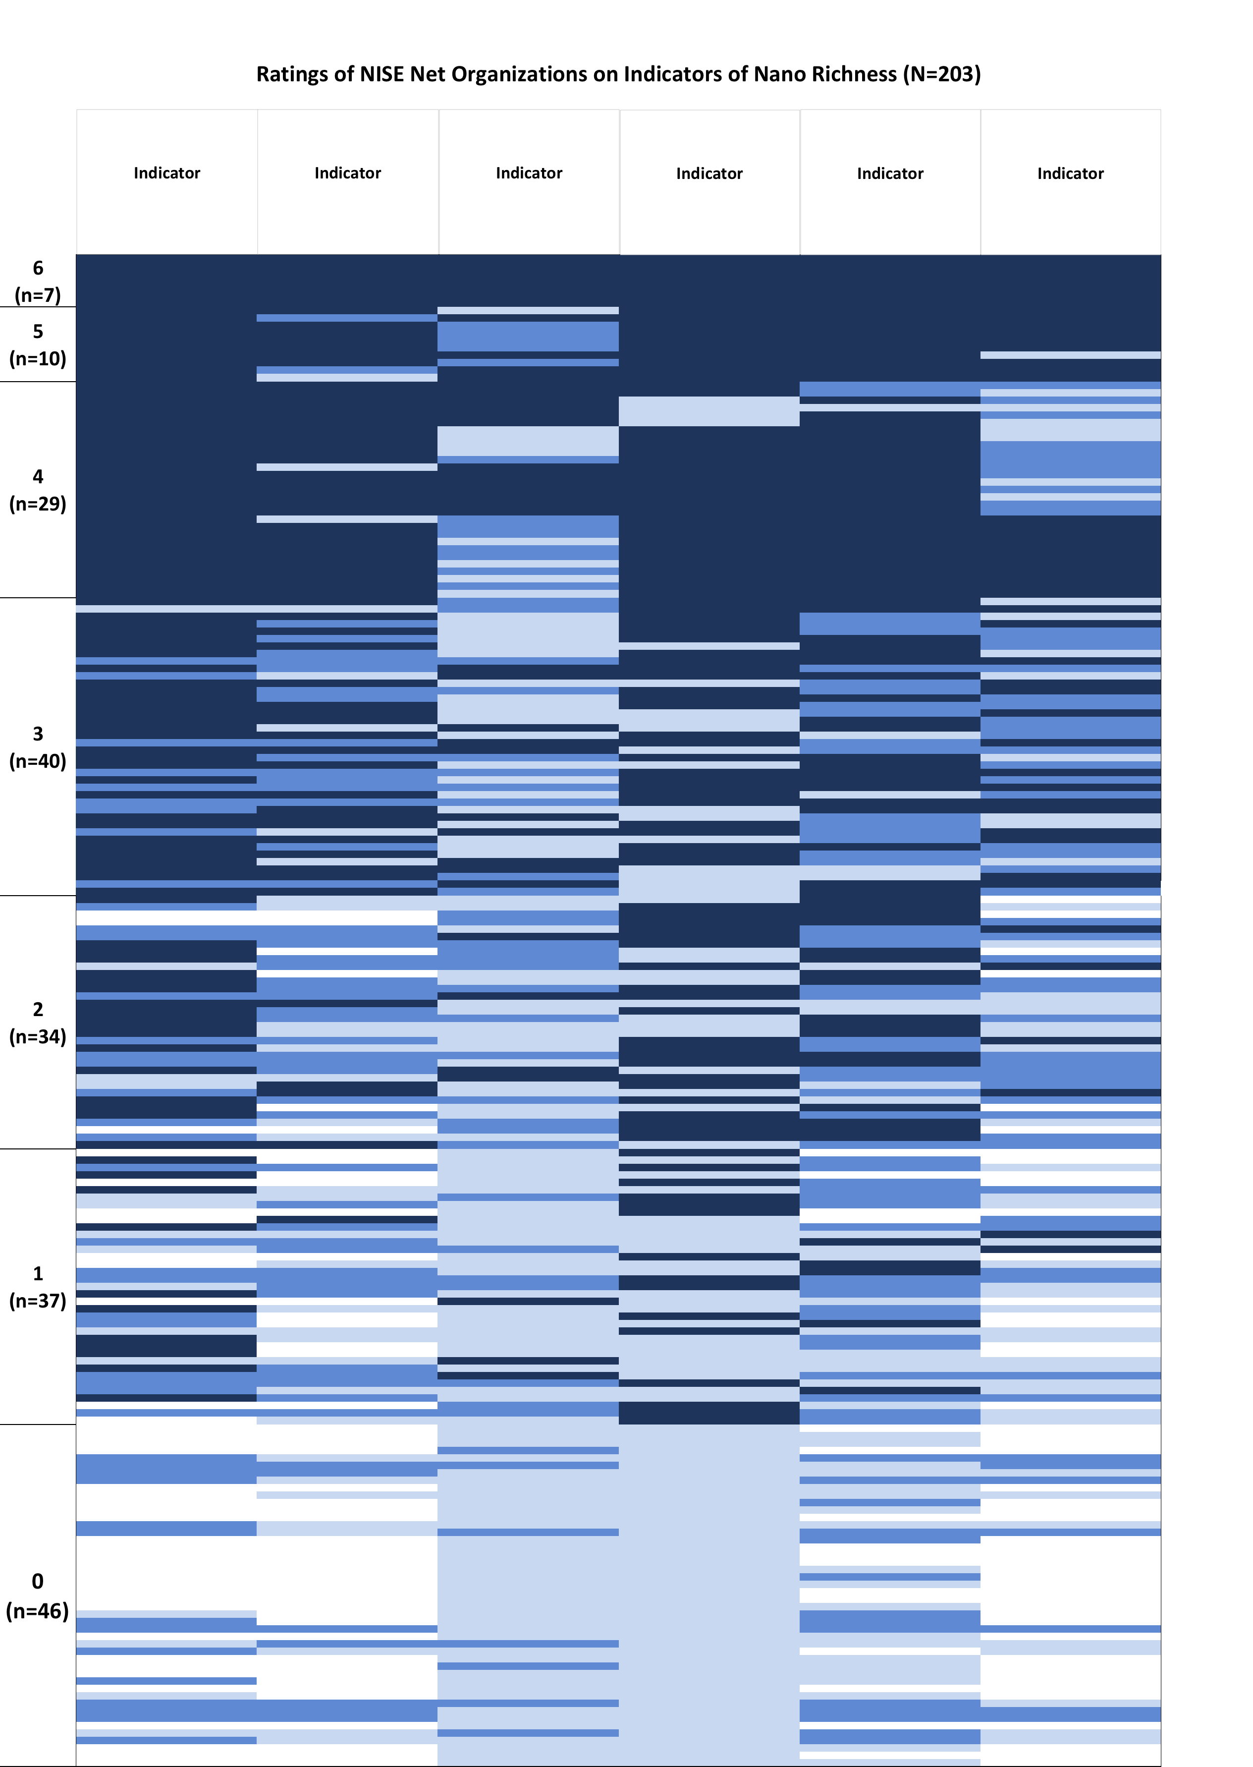
Network Overview
Six Indicators of Nano Richness
Notes:
This chart is intended to provide an overall impression of the entire network
Each column is one of the six indicators
I did not include the names of the indicators because the goal here is an overall sense of the network
I’ll say more about the indicators soon
And each row represents one organization’s ratings on the 6 indicators
There are 203 rows, one for each of the organizations in the study
For each indicator:
Dark blue signifies that the organization received a high rating on nano richness or public impact on the indicator
Medium blue signifies a medium public impact
Light blue indicates a low public impact.
And white indicates that we did not have enough information to give the organization a rating on the impact
Some things to note about this chart:
First, there’s a lot of blue in it:
NISE Net is offering the public a whole lot of opportunities to engage with nano
And this is only for the six indicators for which we have information
Organizations are doing a lot more nano than we could include in our study
Also note that only 7 organizations—the top 7 rows—scored high on all six of our measures
And 46 organization—the bottom 46 rows--scored high on none of our indicators
We know that for some of our measures set a very high bar to receive a high impact rating
We know this by comparing RHL ratings with our ratings
They were much more likely to say an organization was very nano rich compared to our measures
One of the things that stands out to me is the variability across the indicators:
Each organization has nearly a distinct pattern of high, medium, and low ratings
For instance, looking at the 40 organizations that received three high ratings, there’s a lot of variability in which of the three indicators on which they were rated high:
Some may have a mini-exhibition and some do not
Some may have a very extensive NanoDays and some may have a more modest NanoDays
That is, there are many different ways of being a Nano-Rich Organization
Some Nano-Rich organizations do a lot of programs with nano content and some do very few
Some organizations may focus their nano offerings in programs, some may focus nano in their exhibits, and some in outreach
And you don’t need to be a great big place to be a Nano Rich organization and have a large public impact.

Slide 7
Indicators of Nano Richness
Indicator: Use of NanoDays kit materials outside of NanoDays
NanoDays 2014 Reports (Q19): Approximately how often does your organization use NanoDays kit materials for additional programming outside of NanoDays events? (1=once a year, 6=daily)
Types of activities
Cart demonstrations
Special events
K-12 school outreach
Camps
Professional development
Outreach with community partners
Longer museum programs
Longer term display of materials in public spaces
Lesson activities with college courses
Our measure of nano-richness
We summed the frequency rating of each type of activity (Possible scores: 0 – 54)
Notes:
I have time to discuss one of the six indicators of nano richness.
We thought that one indicator of Nano Richness would be how much an organization used materials from the NanoDays kit in other events.
We know that many organizations—perhaps all—use the kit materials outside of NanoDays, and this was a question on the NanoDays 2014 report that some of you may remember filling out
You were asked to consider 9 types of activities—cart demonstrations, special events, school outreach, and so forth— and, if you used NanoDays materials in them, to rate how often, from once a year to daily.
We considered a variety of ways to create a measure of nano-richness from these data, and ended up summing the frequency scores across the nine activity types.
The chart shows the results and how we segmented scores into high, medium, and low ratings.
In this chart:
Low ratings = 50 organizations
Medium rating = 56 organizations
High rating = 48 organizations
It is interesting to note that the maximum score was 34, whereas the highest possible score is 54.
So there’s room for improvement: you could include nano in absolutely everything you do and make sure to do it all every day (All Nano, All the Time, which might make Paul and Larry very happy).
But more realistically, we again see variability in how organizations are providing nano opportunities for their public audience – some are including nano in camps, some in professional development, some in exhibits, and so forth.
As an example, I’ll briefly describe one site that we studied:
This was a science center of modest size and attendance.
They didn’t have a lot of programs or demonstrations, either onsite and through outreach
As one staff member told us, they just don’t have a lot of staff to do many programs, especially since they often were busy with school groups
The only program they did offer was to put on a family night for local schools
Schools can choose one of a few topics: one of them is nano (for which the center uses materials from several different ND kits)
They used to sponsor their own NanoDays event onsite, and now their NanoDays is integrated into a county-wide STEM event that attracts a lot of people.
They used a mini-grant to design their own Nano exhibition
Mostly table-top interactive activities using materials from past NanoDays kits ND kits
They received a mini-exhibition and installed it in a place where everyone who comes to the center sees it
And they used a second mini-grant to expand their nano exhibition and integrate it with the mini-exhibition
This example shows that even with limited staff, modest resources, and few programs, we consider this small science center to be Nano Rich because they make nano experiences available for most of their audience.
We have similar kinds of analyses for each of the six indicators, and we’ll post the full report and all the details to NISENet.org when it’s completed.

Slide 8
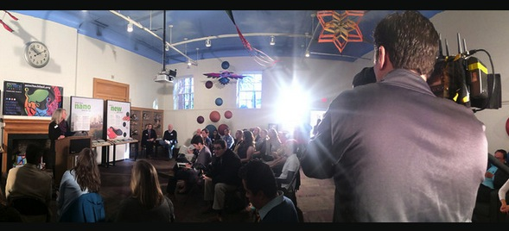

Conclusions and Future Directions
Notes:
To conclude, my basic points have been that:
NISE Net partners are providing a lot of opportunities for the public to engage with nano
And that each organization is doing Nano Rich in its own way
As I mentioned at the start, we also collected information from staff members at a few organizations that we identified as being Nano Rich.
We interviewed 19 staff members at 14 organizations.
We are analyzing the interviews to better understand several issues:
What are staff members trying to get across to the public about nano in their offerings?
And what messages do they think visitors are actually getting?
We also are looking at whether these nano-related offerings and goals differ across various segments of the audience – casual visitors, school groups, adults attending programs, and so forth.
So far, we are seeing that staff members have a wide range of goals
Some are about science in general (“You don’t need to be afraid of science”)
And some are about issues specific to nano (“Nano is really small and things behave differently at the nanoscale”).
I expect to have more results soon – at least by the time our funding runs out.
Until then, thanks for choosing this session– I know the competition was tough -- and thanks for listening.
And now Gina is going to talk about NanoDays.

Slide 9
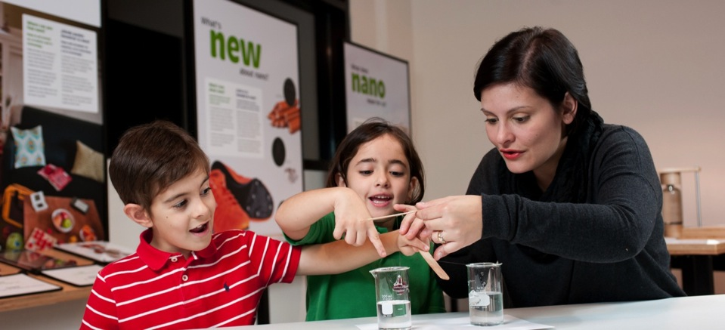


Summative Evaluation of
NanoDays 2014
www.nisenet.org
Notes:
Thanks Steve.
I will talk about the Summative Evaluation of NanoDays events that we did in Spring 2014.
Just to provide a bit of background and context,

Slide 10
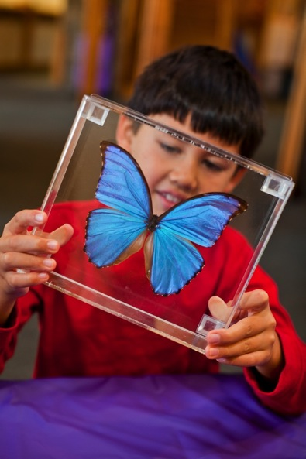
Summative Study of NanoDays
Network goals related to public audiences at NanoDays events:
Provide engaging programming related to NSET (Nanoscale Science, Engineering, & Technology)
Engage the public in content learning related to NSET, as defined by the NISE Net Content Map areas
Notes:
we can go back to the Network’s goals about engaging public audiences at NanoDays events:
[talk through]

Slide 11
Summative Study of NanoDays
Study goals:
- Focus on exploring learning at NanoDays events
- Include an updated public reach estimate for 2014
Two public audiences:
- event attendees
- event volunteers
A “hybrid” public-professional audience
Notes:
based on these goals, the designed the study to do two things:
- examine the LEARNING at NanoDays events
- and, develop a public reach estimate for the 2014 events that reflected the current number of kits being distributed throughout the Network.
In addition, we decided to focus on two different public audiences – event attendees, so the visitors who would come to museums and attend events, and event volunteers.
Event volunteers can actually be seen as a “hybrid” public/professional audience, since they are not the ISE professionals working in our institutions, but they do engage in similar practices while facilitating nano activities for the public during NanoDays events.

Slide 12
Summative Evaluation Questions
  What is the estimated public reach of NanoDays 2014 events?
  Are “mature” NanoDays events successful in providing engaging experiences and promoting learning of nano concepts for both event attendees and event volunteers?
  Does volunteering at NanoDays events have other impacts on event volunteers?
Notes:
Based on these goals and audiences, here are the evaluations we came up with:
[read]
- “mature” = not the first time the event is being offered.

Slide 13
Methods
Reach Estimates
Estimation factors from prior studies were used to project number of encounters for 2014, based on 250 kits and distribution
Event attendees
- Nine “mature” NanoDays Events
- Adults surveyed, some interviewed
- Smaller sample of youth interviewed
Notes:
The methods we used for the study varied depending on our questions.
For the reach estimates, we used factors from previous studies to update numbers for 2014, based on 250 kids and where the kits were distributed.
For the event attendees, [read]

Slide 14
Methods
Study sample for event attendees, collected across nine different events:
Adult surveys: n = 325
Adult interviews: n = 96
Youth interviews: n = 87
Notes:
we collected data at nine different events across the nation. we selected these sites in consultation with Network Leadership and the regional hub leaders.
across the sites, we ended up with 325 adult surveys, 96 adult interviews, and 87 youth interviews.

Slide 15
Methods
Reach Estimates
Estimation factors from prior studies were used to project number of encounters for 2014, based on 250 kits and distribution
Event attendees
- Nine “mature” NanoDays Events
- Adults surveyed, some interviewed
- Smaller sample of youth interviewed
Event volunteers
- Online survey for volunteers
- NanoDays reports from partners
Notes:
For event volunteers, [read]

Slide 16
Methods
Thank you!
Reach Estimates
Estimation factors from prior studies were used to project number of encounters for 2014, based on 250 kits and distribution
Event attendees
- Nine “mature” NanoDays Events
- Adults surveyed, some interviewed
- Smaller sample of youth interviewed
Event volunteers
- Online survey for volunteers
- NanoDays reports from partners
Notes:
Just a quick word of thanks to the sites that helped us out with visitor data collection, and also to all Network partners who sent on the survey link to their volunteers and filled out NanoDays reports – we really appreciate it!

Slide 17
Sample: Event Volunteers
Study sample:
All responses to online survey = 347
Viable responses: n = 325
Minimum response rate: 6.8%
Repeat volunteers: 23%
Volunteers were from 58 NanoDays events across the nation
63% volunteered at museums
34% volunteered at universities
Notes:
response rate is great, considering how we recruited volunteers to the survey (AGAIN, THANKS FOR YOUR HELP!)
347 responses, almost 5,000 volunteers – minimum response rate
58 events, consider 250 kits – we got responses from about 23% of host institutions
63% of respondents volunteered at museums
34% of respondents volunteered at universities

Slide 18
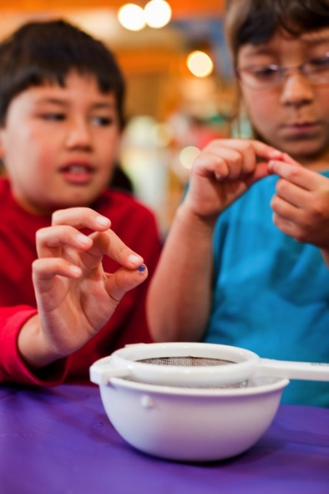
Findings: Public reach
NanoDays 2014 events resulted in at least 458,000 encounters for event attendees across the nation.
Since 2008, NanoDays events have resulted in approximately
3.0 million – 3.7 million encounters for event attendees.
Nearly 5,000 people volunteered at NanoDays events in 2014.
(median: 15; mean: 21)
Notes:
Ok, so let’s get onto the findings.
[read]
We report our estimates in encounters, not people, because of the way our data was collected back in 2009/2010. People at NanoDays events can engage in more than one activity, or more than one encounter.
From the NanoDays 2014 reports, we estimate that nearly 5,000 people volunteered at NanoDays events in 2014. MEDIAN NUMBER:15; AVERAGE: 21
So the take away here is that NanoDays 2014 had a broad public reach!

Slide 19
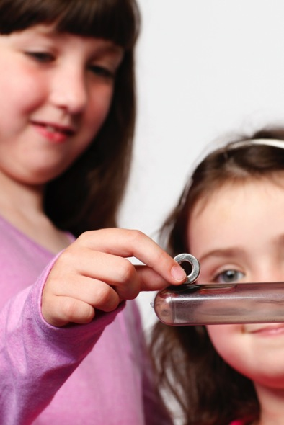
Findings: Event Attendees
Notes:
ok. so next, let’s move on to examining the engagement and learning of event attendees.

Slide 20
Findings: Event Attendees
Engaging Programming:
Almost all adults surveyed found the event interesting and enjoyable (97% and 98% respectively).
Almost all adults interviewed (93%) said they’d come back to another NanoDays event.
Almost all youth interviewed (96%) found NanoDays fun.
Notes:
in terms of engaging programming:
[read through]
interesting and enjoyable – percentages represent top two levels

Slide 21
Findings: Event Attendees
Learning about Nano
Adult survey respondents demonstrate gains in confidence around the different areas of the NISE Net content map.
Over half (63%) of adults interviewed for the study reported learning about something that connected to their own lives.
Notes:
Increases in confidence
One way we are measuring learning in the study is to ask visitors to report their confidence levels in doing a variety of things – like talk about nano, describe nano to a friend, identify one way nano can impact your life, etc – both before and after their experience on the exit interview. This is called a “retrospective pre” questioning approach, which can be particularly useful when examining outcomes related complex topics that people don’t know what they don’t know.
By looking at the difference in visitor confidence levels, we see that over half of visitors report an overall increase in confidence after having seen the mini-exhibition. That is very exciting!
Exploring learning of NISE Net content areas a bit further, over half (63%) of adult event attendees interviewed for the study reported that they learned about something that connected to an aspect of their own life during NanoDays.
In addition, most of the youth attendees (88%) who were interviewed were able to identify something specific to a NanoDays activity when asked if they had heard about any “new inventions or high-tech stuff” during their time at the museum during the NanoDays event.

Slide 22
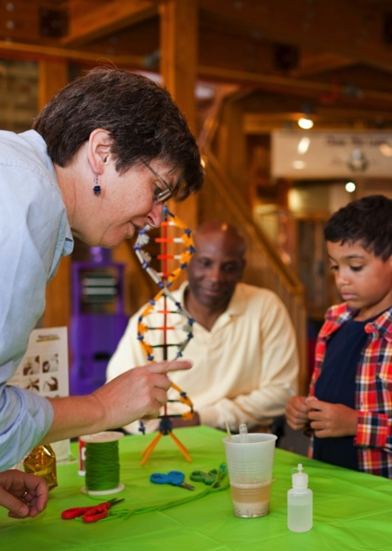
Findings: Event Volunteers
Notes:
Switching gears now to event volunteers

Slide 23
Findings: Event Volunteers
Volunteer Engagement:
Why volunteer at NanoDays? Top three reasons chosen:
It was an opportunity for outreach with youth in science education (65%)
NanoDays sounded like a fun event (47%)
I wanted to support the institution where I volunteered (36%)
Most popular aspects of volunteering? Top three aspects chosen:
watching people’s reactions to demos/activities (66%)
seeing enthusiasm around nanotechnology and science (60%)
interacting with NanoDays attendees (52%)
Notes:
Why volunteer at NanoDays? Top three reasons chosen:
It was an opportunity for outreach with youth in science education (65%)
NanoDays sounded like a fun event (47%)
I wanted to support the institution where I volunteered (36%)
Most popular aspects of volunteering? Top three aspects chosen:
watching people’s reactions to demos/activities (66%)
seeing enthusiasm around nanotechnology and science (60%)
interacting with NanoDays attendees (52%)

Slide 24
Findings: Event Volunteers
Volunteer Engagement:
Most challenging aspects? Top three reasons chosen:
adapting the concepts of nanotechnology for younger audiences (54%)
communicating the principles of nanotechnology (44%)
engaging attendees during the demo/activity (24%)
What gained from volunteering? Top three themes:
experience engaging people around science (46%)
gained nano-related knowledge (25%)
great experience/fun (21%)
Notes:
Most challenging aspects? Top three reasons chosen:
adapting the concepts of nanotechnology for younger audiences (54%)
communicating the principles of nanotechnology (44%)
engaging attendees during the demo/activity (24%)
What gained from volunteering? Top three themes:
experience engaging people around science (46%)
gained nano-related knowledge (25%)
great experience/fun (21%)

Slide 25
Findings: Event Volunteers
Learning about nano
Volunteer survey respondents demonstrate gains in confidence around the different areas of the NISE Net content map.
These gains are larger than the gains of event attendees.
Notes:
again, we asked about confidence around nano topics, just like with the event attendees.
Volunteers also show gains in confidence around nano topics, just like event attendees.
[Volunteers started with higher confidence and ended with higher for mean scores, pre and post]
But these gains were bigger than the gains of the event attendees (visitors)

Slide 26
Findings: Event Volunteers
Additional Impacts
Across all groups, interest in STEM activities increases.
  For HS Students/Undecided undergrads, interest in STEM careers also increase!
Use/awareness of NISE Net materials continues beyond NanoDays events for volunteers.
Notes:
Our last Evaluation question explored whether there were other impacts for volunteers outside of engagement and learning about nano.
Interest in STEM
things like checking out news stories online, going to museums, zoos, aquariums, talking to friends and family about science
HS/undergrads: asked about learning more about science & engineering careers and taking science courses
Use/awareness – go to tables

Slide 27
Findings: Event Volunteers
Group 2: Educators (ISE, PK-12, Outreach
Notes:
highlight the first one here – 71%! (n=45)
also, use in the classroom – 29% - about 13 respondents

Slide 28
Findings: Event Volunteers
Group 3: Volunteers on the STEM Career Track
(decided undergrads, grad students, sci/eng/profs)
Notes:
n=121
highlight first one – 65%
use in the classroom – 17% - about 20 respondents
10% - about 12 - have initiated partnerships.

Slide 29
Findings: Event Volunteers
Additional Impacts
Across all groups, interest in STEM activities increases.
  For HS Students/Undecided undergrads, interest in STEM careers also increase!
Use/awareness of NISE Net materials continues beyond NanoDays events for volunteers.
Volunteer respondents report gains in confidence around engaging the public.
Notes:
Engaging the public – things like engaging young children, engaging adults, communicating to public about current research.
overlap with questions from professional impacts study.

Slide 30
Conclusion
Public goals for NanoDays:
provide engaging programing
engage the public in learning
✔
✔
Notes:
So if we go back to the goals of the network for public audiences at nanodays,
we see that we’ve met them.

Slide 31

Conclusion
Public goals for NanoDays:
provide engaging programing
engage the public in learning
Professional goals for NanoDays:
increase capacity for nano programming
increase reach over time
✔
✔
✔
✔
Notes:
And in addition, if we look at the Network’s professional goals for NanoDays,
we even see that through the volunteers, NanoDays can meet these goals through public audiences as well.
So, yeah – great work!

Slide 32
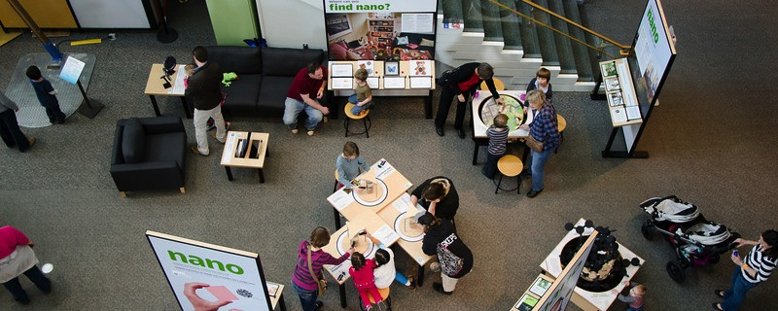
Research on connections between Nano and relevance
JUNE 2015
NETWORK-WIDE MEETING
NISENET.ORG
Notes:
Hello, my name is Liz Kollmann, and I am a member of the research team that studied connections between the NISE Net’s Nano mini-exhibition and relevance.
More specifically, we were trying to answer: How do visitors use, interact with, and talk about the exhibit components within the Nano mini-exhibition to learn about the relevance of nano to their lives?
I am from the Museum of Science, Boston, and I lead this study with Gina Svarovsky from the University of Notre Dame.
Also on the team are Stephanie Iacovelli from the Museum of Science, Boston and Maggie Sandford from the Science Museum of Minnesota.

Slide 33
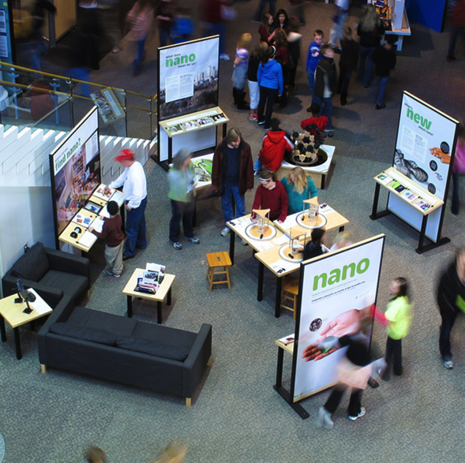
Nano Summative Evaluation: Reach
7.1 million visitors annually
(Svarovsky et al., 2013)
22 million visitors by 2015
(Svarovsky et al., 2015)
Notes:
The Nano summative evaluation found that the mini-exhibition has a large reach.
The report estimated that if all original 70 copies of the mini-exhibition stayed out on the floor for the entire year that there would be 7.1 million visitors who would see the exhibition annually
This number was subsequently re-visited after more copies were distributed, and estimates show that 22 million visitors will have seen the mini-exhibition by the end of 2015
This means that the mini-exhibition is the NISE Net product with the greatest reach to the public.

Slide 34
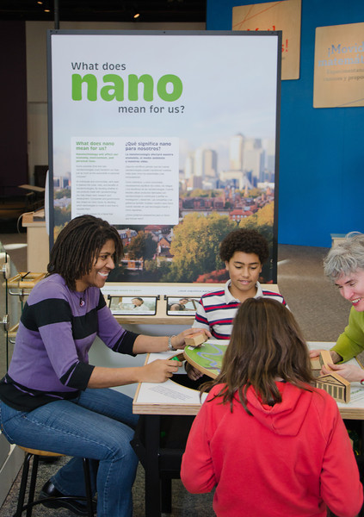
Nano Summative Evaluation: Relevance
59% of visitors reported finding connections between the mini-exhibition experiences and their daily lives
(Svarovsky et al., 2013)
Notes:
However, for our study, we were more interested in it because the summative evaluation of found that 59% of visitors reported finding connections between their mini-exhibition experiences and their daily lives.
In fact, this was the most common area of the content map referenced by visitors as a part of the evaluation.

Slide 35
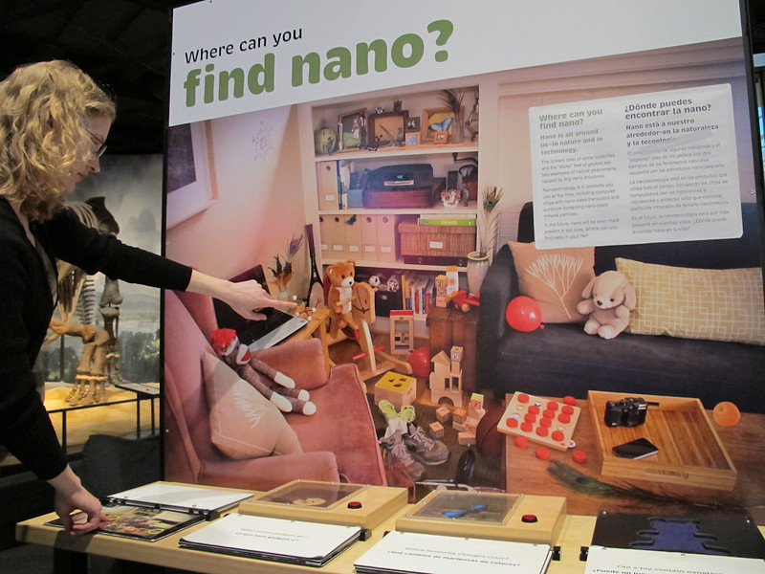
Nano Mini-Exhibition
Notes:
As you may know, the Nano mini-exhibition contains examples of how nanotechnology is used as a part of everyday products and applications,
It also describes possible societal concerns related to the use and implementation of nanotechnology
Finally, the mini-exhibition even encourages discussion related to the balance between nano and society.
So, we knew that there was content within the exhibition that could lead visitors to understand the relevance of nanotechnology to their lives and experiences
And we knew from the evaluation that visitors were making this connection
However, we still weren’t sure what kinds of relevance connections visitors were making.

Slide 36
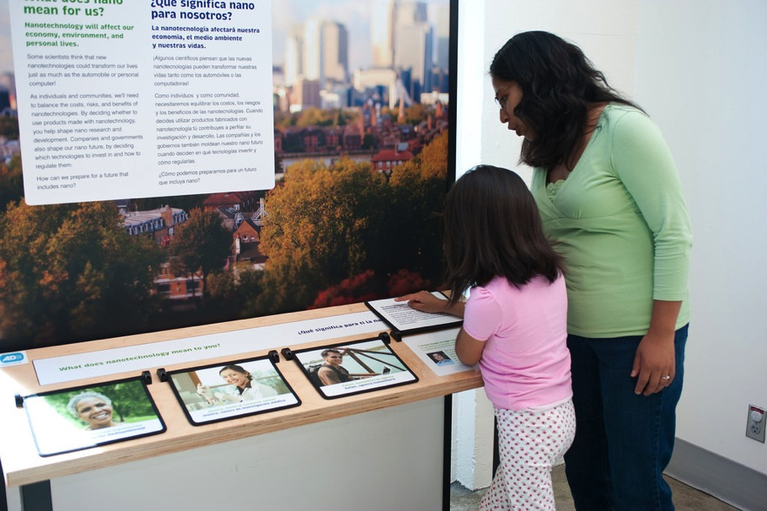
Nano Mini-Exhibition
Notes:
It also describes possible societal concerns related to the use and implementation of nanotechnology

Slide 37
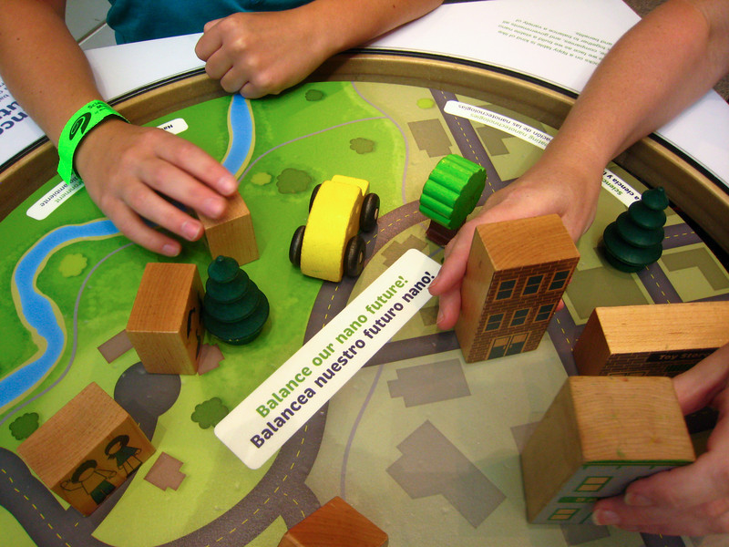
Nano Mini-Exhibition
Notes:
Finally, the mini-exhibition even encourages discussion related to the balance between nano and society.
So, we knew that there was content within the exhibition that could lead visitors to understand the relevance of nanotechnology to their lives and experiences
And we knew from the evaluation that visitors were making this connection
However, we still weren’t sure what kinds of relevance connections visitors were making.

Slide 38
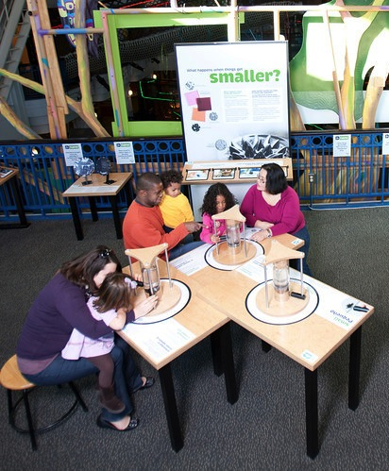
Study Methods
Data collection:
33 visitor groups
Audio and video recording
Reflective interview
Coding:
29 groups completed
How are visitors making relevance connections with the exhibition?
Notes:
Therefore, we set out to conduct an exploratory study to understand what visitors were saying and doing within the exhibition that led them to feel this relevance connection with nanotechnology.
To do this, we audio and video recorded 33 visitor groups as they used the mini-exhibition
Then we conducted a reflective interview with them about their experience, the kinds of relevance they found in the exhibition, and where they felt this relevance.
This interview was conducted in the exhibition which allowed visitors to point out exhibits they were referencing in their responses.
We are currently coding visitor discussions and interviews
We have completed the coding for 29 of our 33 groups.
As a part of this coding, we are paying special attention to what visitors say within the exhibition but we are also looking to the interviews to see if there are any areas in the exhibition where visitors found relevance, or a connection to their lives and experiences, that we can’t understand through their exhibition interactions.
For our coding scheme, among other things, we are trying to understand whether the relevance is coming from information contained directly in the mini-exhibition or whether something about the mini-exhibition is prompting visitors to bring something up about their own lives
This is what I’ll talk more about today

Slide 39
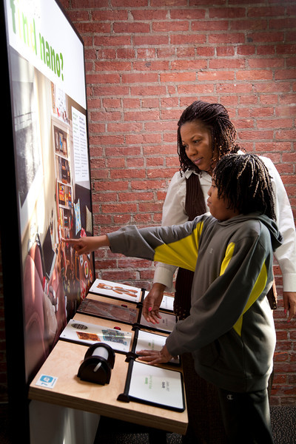
Study Findings
All the groups in our sample made some connection between the Nano Mini-Exhibition and their everyday lives or experiences
Notes:
We found that, in an exhibition that contains content about applications and societal and ethical implications, everyone in our sample (29 of 29) was able to make some kind of relevance connection.

Slide 40
Study Findings: Exhibit Connection
29 of 29 groups made internal connections to content provided in the exhibition
          “Something over there was saying that it’s in the food, and it’s in, uh, your toys, …it’s like all over the place.”
          “What were the snow crystals compared to? The computer chip… So that’s what’s made my little phone do what a huge computer used to do...”
Notes:
When people made these relevance connections, they made two kinds of connections between nano content that they felt was relevant and the exhibition
The first of these was to make connections to content provided within the exhibition.
This was recorded when visitors made a connection, which we could observe either while they were using the exhibition or in the interview, with content that was a part of the exhibition.
This included comments such as:
“Something over there was saying that it’s in the food, and it’s in, uh, your toys, …it’s like all over the place.”
Which was about “What happens when things get smaller?”
“What were the snow crystals compared to? The computer chip… So that’s what’s made my little phone do what a huge computer used to do...”
Which was about “What’s new about nano?”

Slide 41
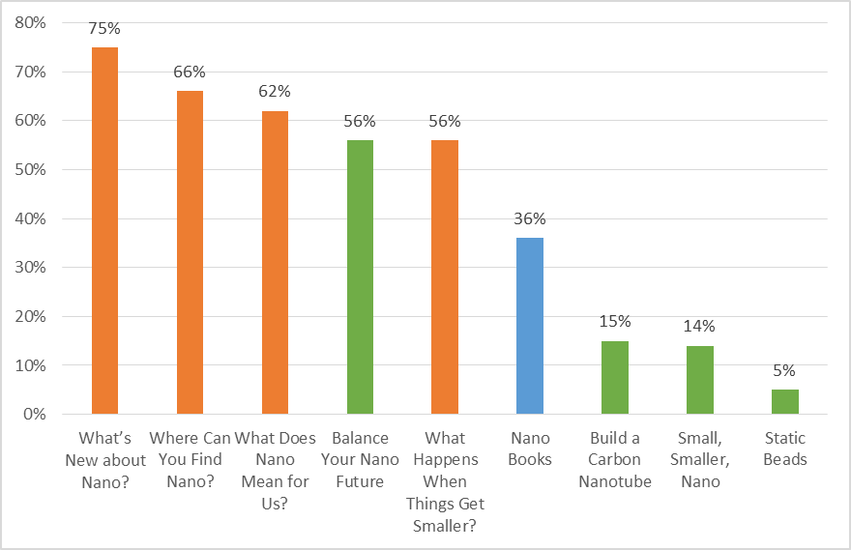
Study Findings: % of Groups Finding Internal Connections to Content
Panels
Interactives
Other
Notes:
These kinds of relevance connections to content that was a part of the exhibition tended to happened at the four panels including:
What’s new about nano? (21 of 28)
Where can you find nano? (19 of 29)
What does nano mean for us? (16 of 26)
What happens when things get smaller? (15 of 27)
It also happened at Balance Your Nano Future or the tippy table (15 of 27)

Slide 42
Study Findings: Exhibit Connection
28 of 29 groups extended this connection to content external to the exhibition
“Have you seen the straws?… When I was in my communications class we had to argue which charity to donate to… and… then we had to fight for which one it should go to... and that was one of them.”
“Also, you know, with medicine, having tiny little robots filming a Magic School Bus style action film… zapping the bad guys.”
Notes:
However, we found that almost all visitors (97%) extended their relevance connections beyond what was included within the mini-exhibition.
For example, one person said
“Have you seen the straws?… when I was in my communications class we had to argue which charity to donate to… and… then we had to fight for which one it should go to... and that was one of them.”
“Also, you know, with medicine, having tiny little robots filming a Magic School Bus style action film… zapping the bad guys.”
Both of these quotes were about applications that were included as a part of “What happens when things get smaller?”
The nano filter tea bags, and
Gold nanoshells for cancer treatment
You can see that in these cases, something that visitors saw within the exhibition led them to think something similar that they knew about that was not directly included in the exhibition

Slide 43
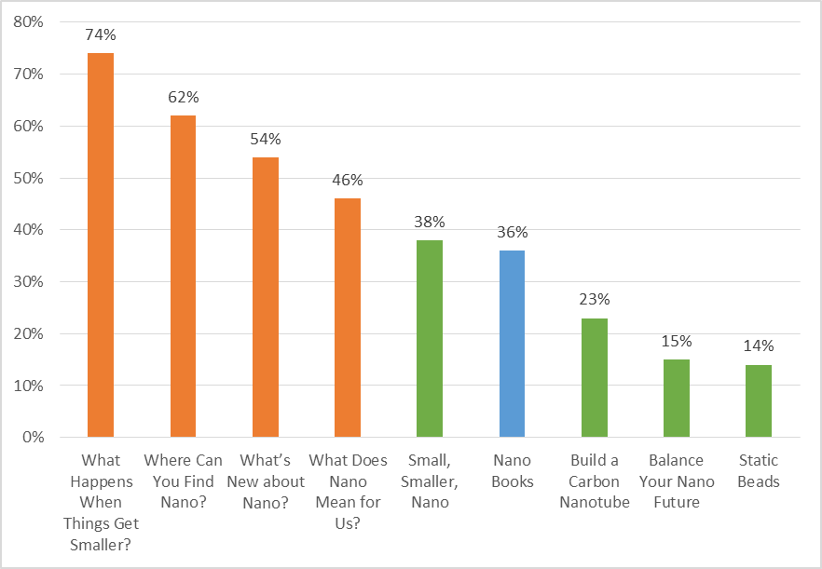
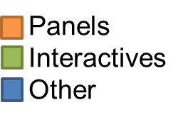
Study Findings: % of Groups Finding External Connections to Content
Notes:
When people brought in these external connection to content, they tended to be at three of the panels including:
What happens when things get smaller? (20 of 27)
Where can you find nano? (18 of 29)
What’s new about nano? (15 of 28)
We are still trying to understand more about what these data mean, but it may be that these external connections are more likely to occur at exhibits that contain information about applications or everyday products whereas internal relevance connections can happen when either societal level concerns or applications are included as a part of an exhibit

Slide 44
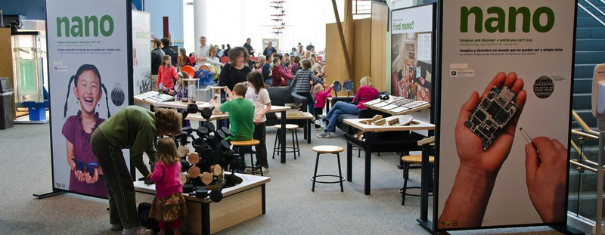
In Conclusion
All groups were able to make some kind of relevance connection to the exhibition by drawing on content within the exhibition
Most groups extended this information to examples from their own lives or experiences
Although more study is needed, it seems that purposefully adding content about applications and societal implications can lead people to feel a connection between STEM and their lives
Notes:
All groups were able to make some kind of relevance connection to the exhibition by drawing on content within the exhibition
Most groups extended this information to examples from their own lives or experiences
Although more study is needed, it seems that purposefully adding content about applications and societal implications can lead people to feel a connection between STEM and their lives

Slide 45
References
Kember, D., Ho, A., & Hong, C. (2008). The importance of establishing relevance in motivating student learning. Active Learning in Higher Education, 9(3), 249 - 263.
Svarovsky, G., Goss, J., Ostgaard, G., Reyes, N., Cahill, C., Auster, R., et al. (2013). Summative study of the Nano mini-exhibition. Saint Paul, MN: NISE Network.
Svarovsky, G., Goss, J., Bequette, M., & Kollmann, E.K. (2015). NISE Net Public Reach Memo. Saint Paul, MN: NISE Network.
JUNE 2015
NETWORK-WIDE MEETING
NISENET.ORG

