Slide 1
Training museum
staff and volunteers
Kevin Dilley, Sciencenter, Ithaca, NY
Abigail Goodlaxson, Maryland Science Center, Baltimore, MD
David Mues, Powerhouse Science Center, Sacramento, CA
Kathy Fournier, McWane Science Center, Birmingham, AL
Margaret Hennessey Springe, Kansas Children’s Discovery Center, Topeka, KS
Yana Jimenez, Imaginarium of South Texas, Laredo, TX
JUNE 2015
NETWORK-WIDE MEETING
NISENET.ORG

Slide 2
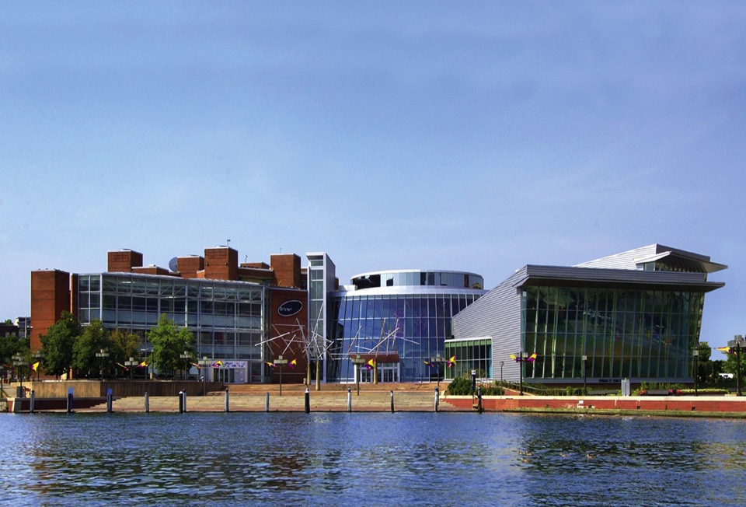
M A R Y L A N D S C I E N C E C E N T E R

Slide 3
G O A L S
presenters will gain an understanding of NISE Net’s key concepts
presenters will be prepared to facilitate personal connections between nano and diverse guests

Slide 4
K E Y C O N C E P T S
nano is studying and making tiny things
nano is small and different
nano is part of our society and future
nano is new technologies

Slide 5
N A N O I S S M A L L A N D D I F F E R E N T
Exploring Forces – Gravity (big cup, little cup)
Exploring Properties – Surface Area (Alka-Seltzer)
counting surfaces of blocks activity
similar to Surface Area – Cart Demo
Exploring Materials – Nano Gold

Slide 6
N A N O I S S T U D Y I N G A N D M A K I N G T I N Y T H I N G S
Exploring Materials – Thin Films (nail polish)
with iridescent insect extension
Exploring Products – Nano Fabrics
with kale leaf extension
Exploring Fabrication – Self Assembly (full body game)

Slide 7
N A N O I S N E W T E C H N O L O G I E S
Exploring Products – Sunblock
with UV bead & UV light extension
free exploration of:
technology cards from Nano Around the World
http://www.nanosupermarket.org/products
http://www.nanotechproject.org/cpi/browse/

Slide 8
N A N O I S P A R T O F O U R S O C I E T Y A N D F U T U R E
Exploring Nano & Society – Invisibility Cloak
Exploring Nano & Society – You Decide!
with supplemental cards from
Nano Around the World card game

Slide 9
PRESENTATION SKILLS
Questions Only Game
Positive Responses Game
Practice Facilitating Observations
Butterfly Wings
Dichroic Glass

Slide 10
I M P A C T
How knowledgeable do you feel about…
pre -
training
post -
training
nanoscale science and engineering?
how nanoscale things behave differently?
how nano relates to our daily lives?
not
at all
very

Slide 11
Q U E S T I O N S
Abby Goodlaxson
agoodlaxson@mdsci.org

Slide 12
Summer Camp Schedule 2014
Little Scientists Ages 5 – 6 9 am – 12 noon
Sciventures Ages 7 – 8 9 am – 4 pm
She Knows Science Ages 7 – 8 9 am – 4 pm
Space Explorers Ages 7 – 8 9 am – 4 pm
Science Sleuths* Ages 9 – 11 9 am – 4 pm
Engineering Antics Ages 9 – 11 9 am – 4 pm

Slide 13
Sample Class Description
Science Sleuths
This camp is for kids that are curious, full of questions, and eager to investigate the world around them. Learn about science on many different levels - from the nano size and up! Gain experience using scientific tools and processes during lessons that are guaranteed to thrill. Campers explore multiple science fields. Participants are introduced to crime scene investigation using fingerprint evidence and chemical analysis. Study marine biology with a dissection of a real specimen. Chemical experiments reveal unimaginable results! For those with outer space on the brain, a two and a half hour Challenger Learning Center mission is offered. These activities and many more make up an exciting week for your science sleuth!

Slide 14
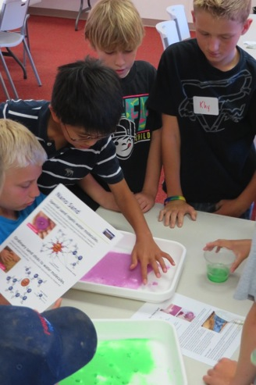
Nano Kits Used in Camps
Thin Films Scented Balloons
Nano Sand Sunblock
Ferrofluid Invisibility
Nano Fabric
Memory Metal
Measure Yourself
Special Microscopes
UV Bracelets
Mitten Challenge
Exploring Size

Slide 15
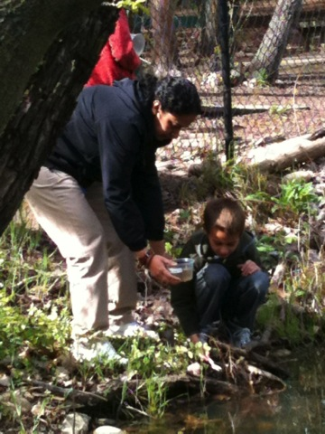
Camp Staff
Paid Museum Staff
Guest Presenters
Group/Corporate Volunteers
Adult Volunteers
Youth Volunteers (16 – 18)

Slide 16
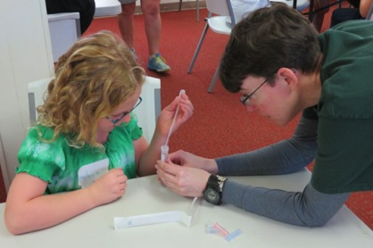
Paid Museum Staff Training
Paid Staff are familiar with techniques of presenting educational content.
Most just need more information about nanotechnology
How to incorporate Nano
Days Kits and nanotechnology
education into existing
lessons and activities is
discussed.

Slide 17
Paid Museum Staff Training
Nano Days Kit materials*
Nisenet.org
Nano.gov
Whatisnano.org
Howtosmile.org

Slide 18
Paid Museum Staff Training
Nanotechnology and Society: A Practical Guide to Engaging Museum Visitors in Conversations
(nisenet.org Nanotechnology and Society Guide)
Engaging the Public
In Key Nano Concepts
(nisenet.org)
Intro to Nano video
(Nanotechnology:
What’s the Big Deal?)
(nisenet.org)

Slide 19
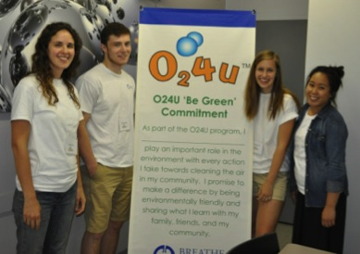
Guest Presenter Training
Most guest presenters need little training because they are trained by their organization.
Policies and procedures regarding student behavioral expectations are discussed with all guest presenters.
Some younger presenters benefitted from tips on time management.

Slide 20
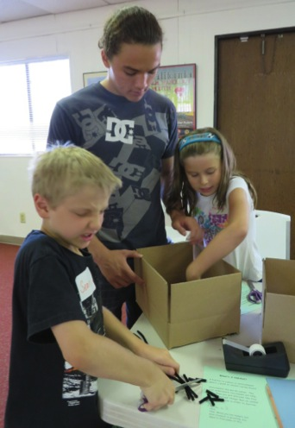
Volunteer Training
Volunteers assist paid staff and guest presenters.
Volunteer training consists of meetings prior to first day of camp and reviews at the end of each camp day.
Each volunteer is provided with a handbook laying out museum policies and procedures.

Slide 21
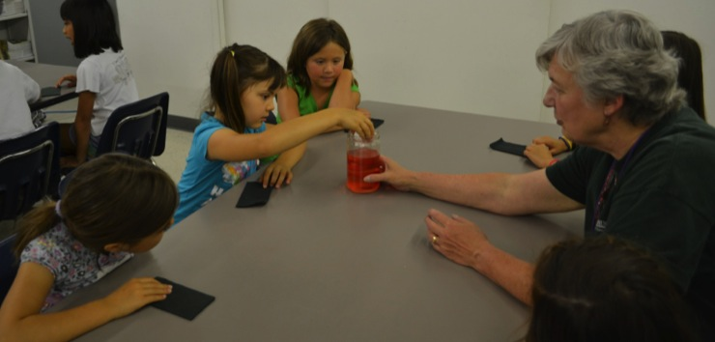
Volunteer Training
Retired teachers are especially valuable. They are already familiar with presentation techniques and can act a mentors to younger volunteers.

Slide 22
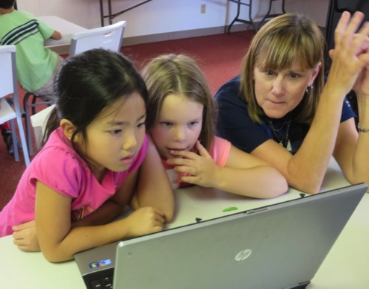
Volunteer Training - Tips
Help students be successful, but don’t do the work for them.
Try to guide students to the solution rather than giving it to them.

Slide 23
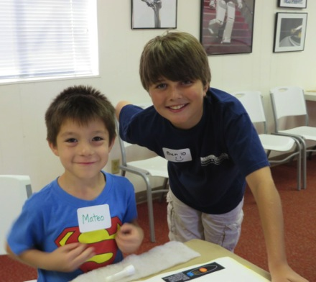
Volunteer Training - Tips
Remember that different students will have different abilities.
Interact with all students in a manner appropriate for their age.

Slide 24
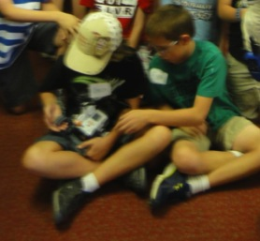
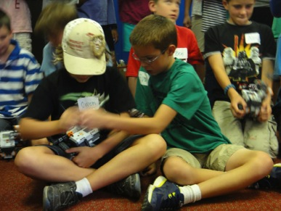
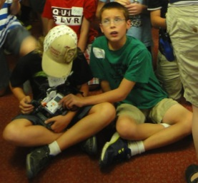
Volunteer Training - Tips
Be on the lookout for a potential problem situation.
Notify a staff member or diffuse it before it gets out of hand.

Slide 25
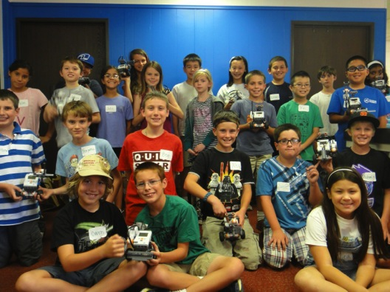
Volunteer Training - Tips
Whenever possible, try to find solutions that work for everyone.

Slide 26
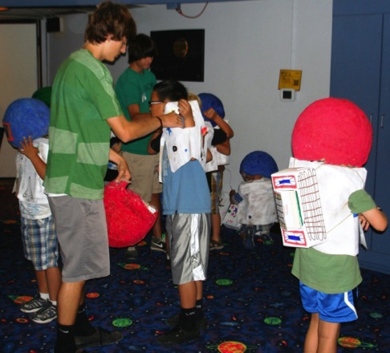
Volunteer Training - Tips
For youth volunteers: have fun with students but don’t try to be their friend.
Also be sure to wear appropriate clothing, use appropriate language and limit cell phone use.

Slide 27
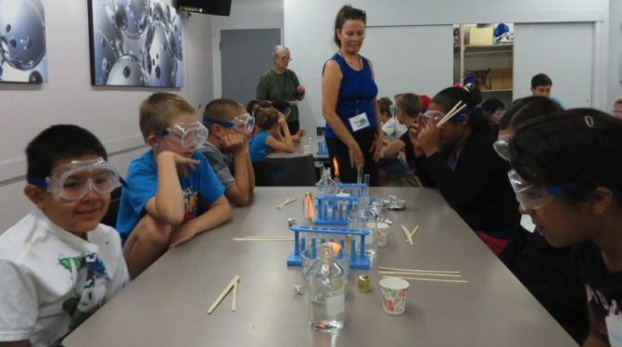
Volunteer Training - Tips
Be aware of emergency procedures, including evacuation plans, locations of fire extinguishers, eye wash stations, etc.

Slide 28
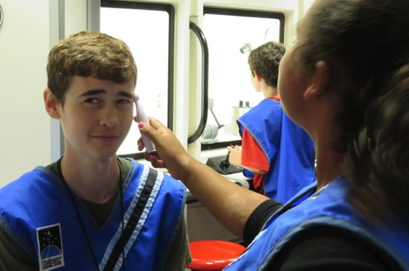
Volunteer Training - Tips
Don’t be afraid to try new things.

Slide 29
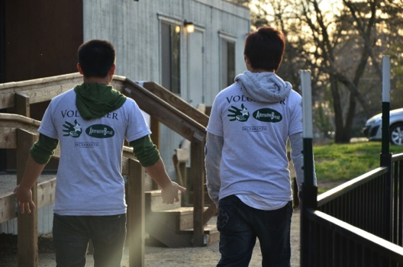
Volunteer Training - Tips
Enjoy yourself! We want happy volunteers who will return next year.

