Slide 1
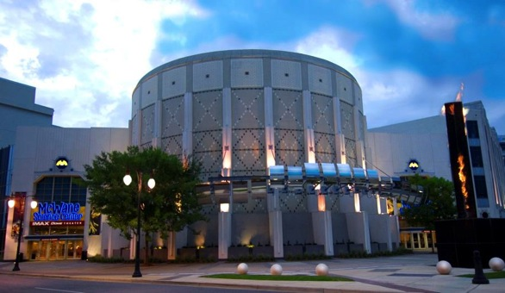

Kathy Fournier
Vice President of Education
Birmingham, Alabama
205-714-8254
kfournier@mcwane.org
www.mcwane.org

Slide 2
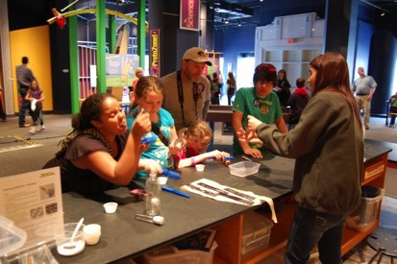
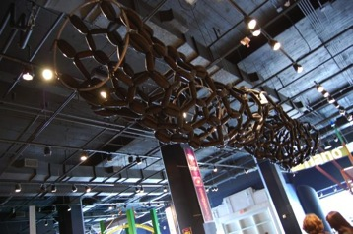
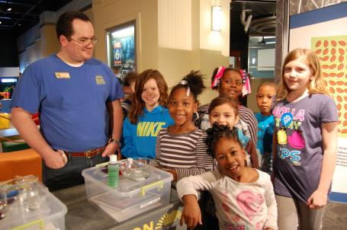
NANO at McWane

Slide 3

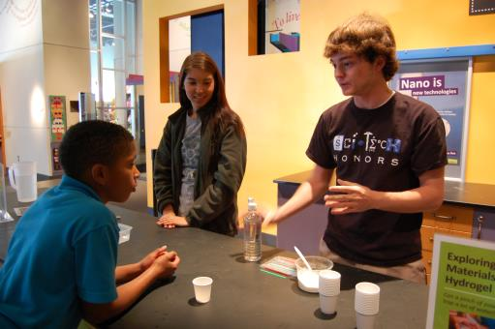

NANO PROGRAMMING
Nano Days 2008-2014 and going….
4 Reserved School Programs
6th -8th Weighing In on Scale: The Science of Nanotechnology 9th -12th Nanotechnology: BIG Science…Small Scale
3rd-12th What is Nano?
9th-12th Science and Society NEW!
Home School
Camps
Family Science Nights
Donor Events
GRANTS AND PARTNERSHIPS
NSF/MSP with Tuskegee University
NISEnet Mini Grant with UAB

Slide 4
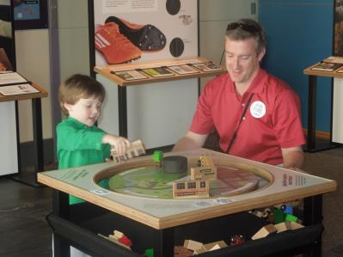
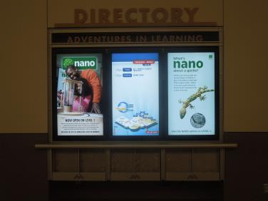
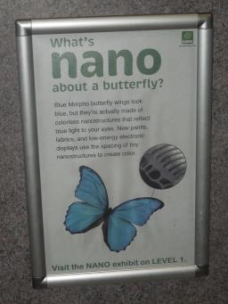
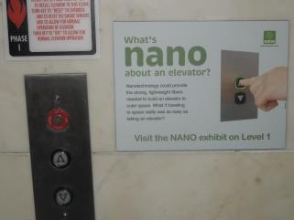
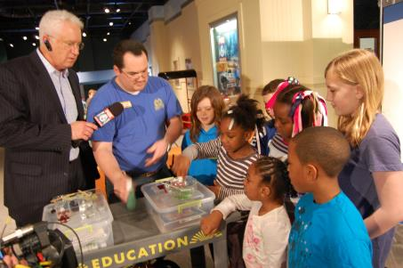
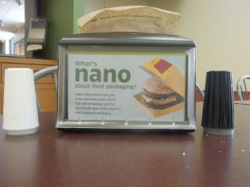
EXHIBIT
INTERNAL PROMOTION
Nano in the bathrooms
Nano on our digital signs
MEDIA
Nano at the elevator
Nano in the Cafe

Slide 5
TRAINING @McWane
Staff
Volunteers
Professionals (Engineers, Scientists, K-12)
http://www.nisenet.org/catalog/tools_guides/nanodays_training_materials

Slide 6
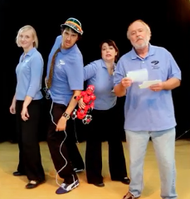
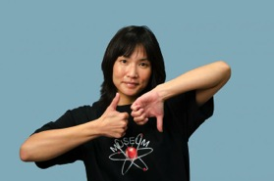
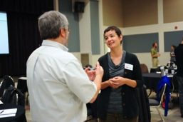
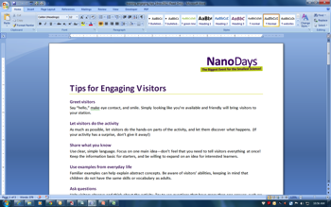
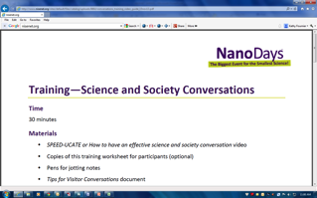
TRAINING VIDEOS
WHAT?
America’s Next Top Presenter
How TO Interact With Visitors
How NOT to Interact With Visitors
HAND-OUTS
Speed-ucate Video Or How To Have An Effective Science and Society Conversation
http://www.nisenet.org/catalog/tools_guides/nanodays_training_materials

Slide 7
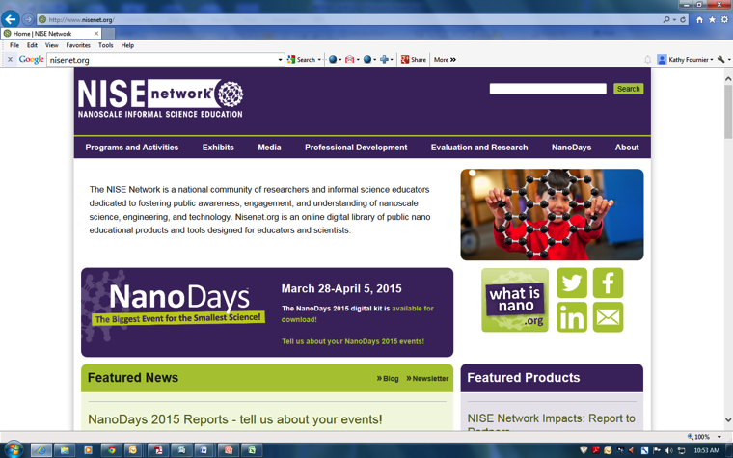
WHERE?
Navigating www.NISEnet.org

Slide 8
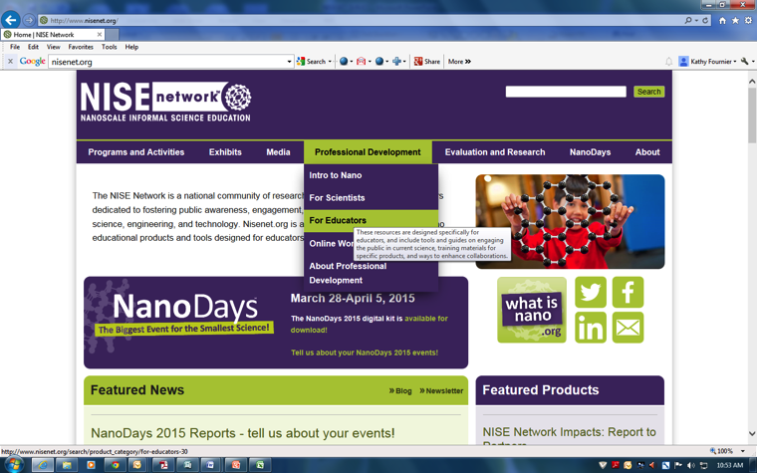
Navigating www.NISEnet.org

Slide 9
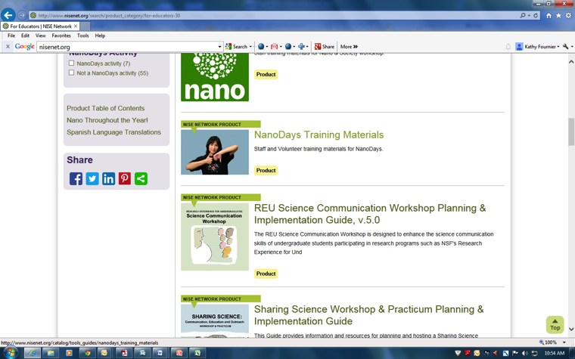
Navigating www.NISEnet.org

Slide 10
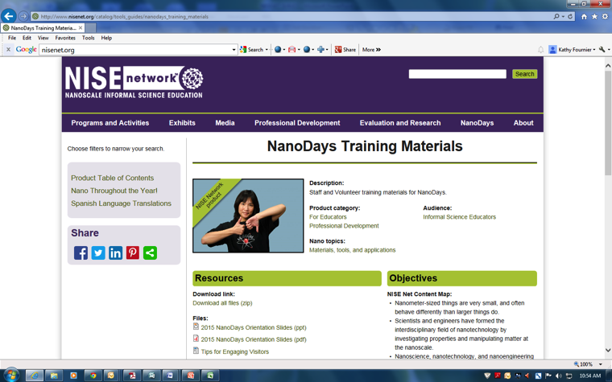
Navigating www.NISEnet.org

Slide 11
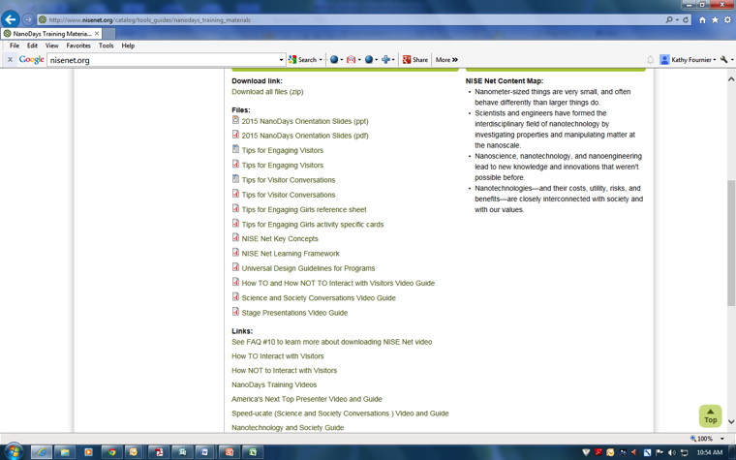
Navigating www.NISEnet.org

Slide 12
HOW?
Incorporated into training manual (handouts)
-managers review with new hires
Reviewed in education staff training
-Improv, Team Based Inquiry, Universal Design
Volunteer Training
-handbook, videos, teen leader skits
Teacher Training
- Nano specific content and activities, Science and Society, Best Practices
Community Partner Training
-share hand outs via email, or use videos and handouts if face to face
Scientists/Grad Students
-share hand outs via email, or use videos and handouts if face to face

Slide 13
Thoughts from staff
“It was great just to reevaluate myself. I think it is important to allow presenters to have time to reflect on their own performance. The videos were a good reminder of how to better do my job.” -Kalli Mitchell, Educator
I liked the “How To” and “How Not To” videos. It did help me better present the Nano Kits by giving me strategies and tips to engage with visitors. It reinforced the idea of allowing the visitors to engage and interact with the materials. For example, when playing with the hydrophobic sand, I allowed the visitors to use the pipette to drop water onto the regular sand and hydrophobic magic sand and observe the differences. The same with the nano pants. That then led us to discuss what caused the differences. One thing that the “How To” video helped me do better was to ask visitors how might this nano product benefit them and can they think of any other applications.”
-Alia Carter, Educator
“Although the content of the training materials is geared to Nano, the tips and techniques apply to many other science topics. Using the NISEnet resources as a template, we have developed training materials for other areas of our facility, an example of this is the Visitor Engagement Tips sheet for the Shark and Ray Touch Tank.” - Lawrence Cooper, Director of Community Programs and Partnerships
“Mostly the training reinforced my general understanding of presenting and provided some good reminders for me that I often share with volunteers.
      Always remember to check your supplies before you start-especially lighters
      Be confident. If you are not, do the prep work to become confident.
      Even in large presentations, you need to interact with the audience”
-Katie Fancher, Educator

Slide 14
Kathy Fournier
Vice President of Education
Birmingham, Alabama
205-714-8254
kfournier@mcwane.org
www.mcwane.org

Slide 15
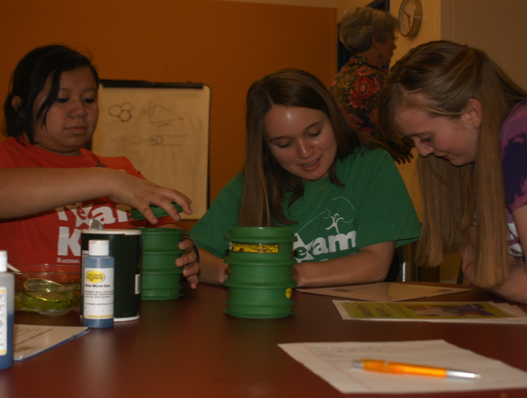


Training Template for enhancing
the visitor experience
JUNE 2015
NETWORK-WIDE MEETING
NISENET.ORG

Slide 16

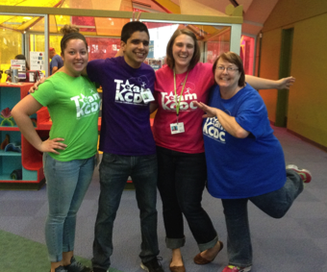
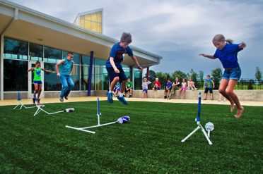
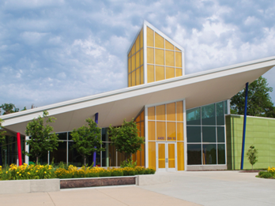
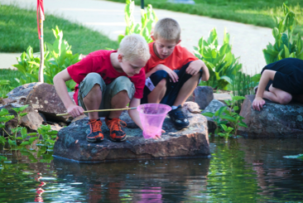
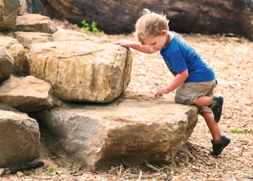

KCDC Stats

Slide 17





Partners
JUNE 2015
NETWORK-WIDE MEETING
NISENET.ORG
Notes:
Long list of partners
One specific workshop utilized partners expertise now use as model

Slide 18
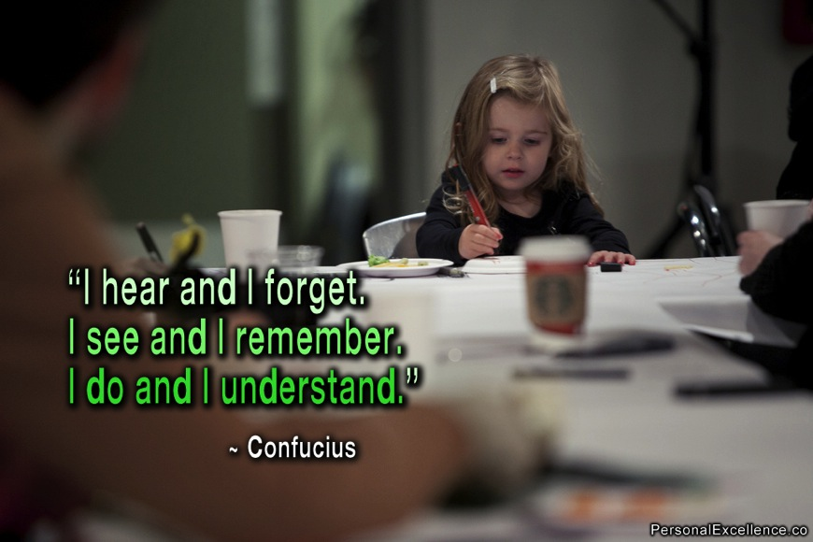

Notes:
Learner centered pedagogy
Simple Modified to fit all types of training
Multiple access points
Access to funding, without these resources we would not be able to make leaps
Need strong partner

Slide 19

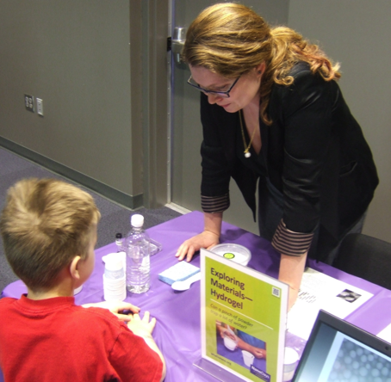
Training Goals
Understanding of concept
Hands on opportunity
Information and vocabulary that is easy to use and understand
Notes:
Talked multiple times, narrowed down objectives
The first part overview then each kit in detail
Cognizant not everyone a scientist
Why it is relevant
Most important

Slide 20
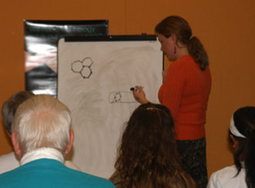
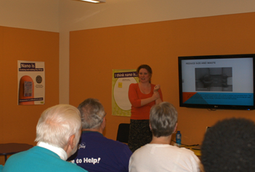
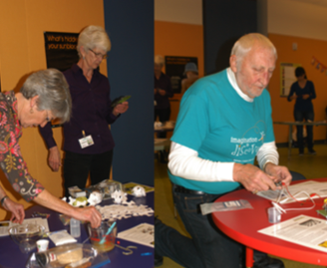
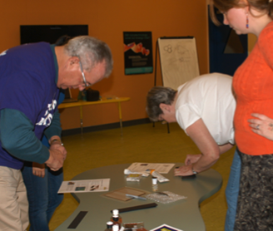
NISE Training Workshop
Notes:
The second half of training – hands on
Dr. Betz circulated
Two fold

Slide 21
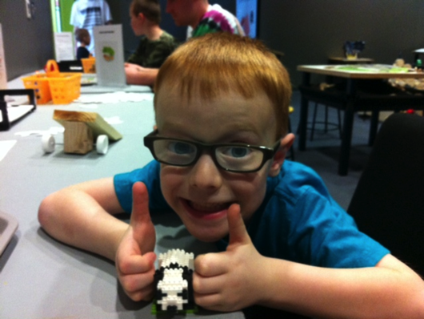


Thank you!
Cynthia Needham, ICAN Productions
This presentation is based on work supported by the National Science Foundation under Grant No. 0940143. Any opinions, findings, and conclusions or recommendations expressed in this presentation are those of the authors and do not necessarily reflect the views of the Foundation.

Slide 22


Slide 23

WELCOME VOLUNTEERS
Volunteers are an essential part of the Museum's operations. Without the dedicated efforts of volunteers, we could not sustain the quality or quantity of services and programs that we provide to our community. Activities such as Spring Break & Summer Camp, daily museum operations, workshops & birthday party activities, and special events would not be successful without the help of our volunteers.
We have a variety of volunteer opportunities available for everyone - whether you'd prefer to work directly with museum patrons, or work behind the scenes. We have a place for your special interests, hobbies, and hidden talents!
Volunteers are an essential part of the museum's daily operations. Without the dedicated efforts of volunteers, we could not sustain the quality or quantity of services and programs provided to our community.
Activities such as Spring Break & Summer Camp, daily museum operations, workshops & birthday party activities, and special events would not be successful without the help of our volunteers.
We have a variety of volunteer opportunities available for everyone - whether you'd prefer to work directly with museum patrons, or work behind the scenes. We have a place for your special interests, hobbies, and hidden talents!
MARCH 31, 2015

Slide 24

VOLUNTEER CHECK LIST…
Submit a complete volunteer application including all three (3) signatures (volunteer, parent, and school counselor) applications are available online at www.istx.org or at the museum.
Two (2) letters of recommendation (one from a teacher and one from their school counselor)
Applications and letters of recommendation should be presented in a neat and professional manner.
Attend Orientation
Purchase T-Shirt $10.00 (plus tax)
Read the code of Conduct and Museum Policies

Slide 25

REQUIREMENTS
Volunteers must be at least 14 years of age to qualify as a volunteer at the Imaginarium of South Texas
Volunteers over the age of 18 must submit application with an official police/sheriff background check.
Volunteers under the age 18 must submit application with two (2) recommendation letters ( one from a teacher and one from their school counselor)
Volunteers are required to purchase the Imaginarium T-shirt ($10 plus tax) in which it is required for work use.

Slide 26

ISTX CODE OF CONDUCT/POLICIES
The Imaginarium of South Texas, Inc. rely upon the assistance of volunteers. The job of volunteers and employees are to create a safe hands-on learning environment for our children and guest by working together.
Volunteers are expected to comply with all rules and regulations given by the ISTX. Duties for employees, who work on the floor, at the museum are equally distributed with volunteers. The Imaginarium of South Texas reserves the right to dismiss any volunteers if at any time policies and duties are disregarded.
Some days the museum has a small amount of guest. When business is slow, museum employees and/or management may ask a volunteer to come back at a later time. We suggest for volunteers to call the museum in advance to check for availability

Slide 27
CODE OF CONDUCT/ POLICIES CONT.
ISTX is NOT responsible for any lost or stolen items. Therefore, volunteers are not to leave any personal belongings in any area of the museum not designated by museum management.
ISTX facilities and/or special events are not to be treated as social events. Volunteers are not to socialize. Volunteers may interact with other volunteers, employees, and guest in a constructive manner. Employees may give volunteers verbal notice when an exceed amount of socializing is accruing and may be asked to leave if verbal notice is disregarded. Volunteers interact with young children on a daily basis. Therefore, safety precautions, good behavior and respect should be practiced at all times.

Slide 28

As a Volunteer, I am committed to:
Safety
Do NOT consume/obtain/possess or be under the influence of alcohol or illegal drugs at any time.
Abstain from all illegal activity, carrying or displaying weapons of any kind.
Do not touch, hit, or horseplay with other volunteers or children in the museum.
VOLUNTEER T-SHIRT IS REQUIRED FOR ALL VOLUNTEER SERVICES.
Report suspicious activities to my supervisor
ALL cellphones or any electronic devices must be turned off and may not be used until volunteer duties are completed.

Slide 29

As a Volunteer, I am committed to
The following will not be permitted:
Ripped, patched or stained clothing
Oversized clothing (specifically “baggy” or “sagging” pants)
Clothing with offensive language or displaying of alcohol/tobacco
Dangling chains/earrings
Open-toed or open- heeled shoes. (wear comfortable shoes)
Sweat or stretch pants
Excessively short, tight, or revealing clothing
Visible body piercing jewelry or exposed clothing

Slide 30

Thank You
The Imaginarium of South Texas would like to sincerely Thank You for your interest in assisting our organization. We are always in search of lively and self-motivated youth to contribute to our museum family. Your involvement with our team will provide you the opportunity to touch the lives of children and help you become an active member of our community.
Thank You Imaginarium Volunteers!

Slide 31

Yana Y. Jimenez
Laredo Children’s Museum
dba Imaginarium of South Texas
Assistant Director
956 645-8545

Slide 32
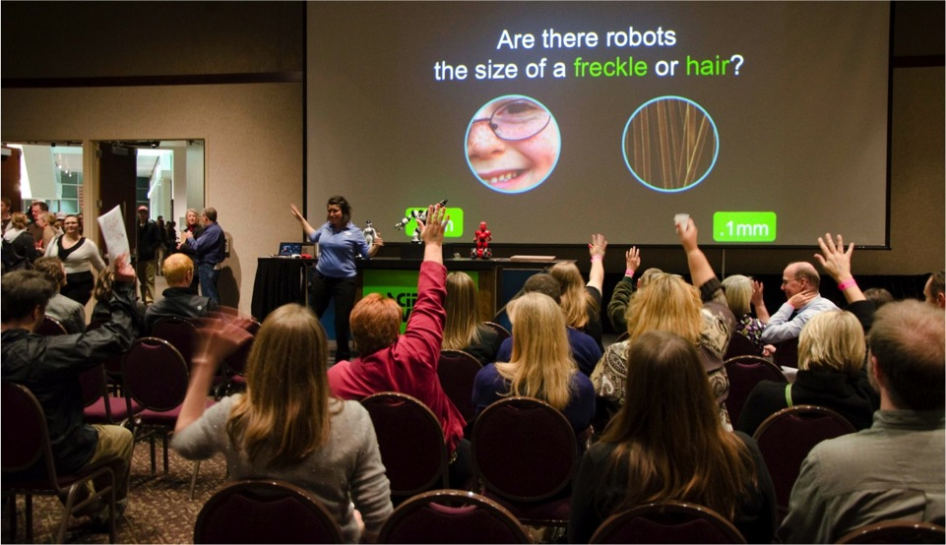
Questions & Discussion

Slide 33
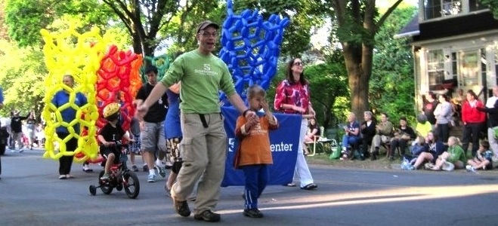
Thank you!
Cynthia Needham, ICAN Productions
This presentation is based on work supported by the National Science Foundation under Grant No. 0940143. Any opinions, findings, and conclusions or recommendations expressed in this presentation are those of the authors and do not necessarily reflect the views of the Foundation.

