Slide 1
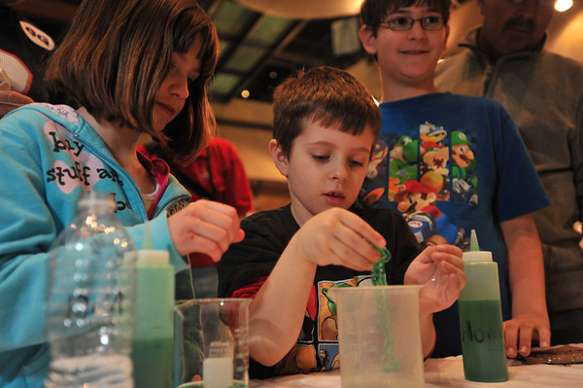
Incorporating Nano Content into Afterschool Programs
JUNE 2015
NETWORK-WIDE MEETING
NISENET.ORG
Notes:
Good morning

Slide 2
Incorporating Nano Content into Afterschool Programs
(Moderators) Lizzie Hager-Barnard and Frank Kusiak, Lawrence Hall of Science
Melissa Ballard, Afterschool Alliance
Jessica Liken, Perot Museum of Nature and Science
Bethany Thomas, Children’s Discovery Museum
Jenny Young, Science Central
Heather Armstrong, University of New Mexico
JUNE 2015
NETWORK-WIDE MEETING
NISENET.ORG

Slide 3
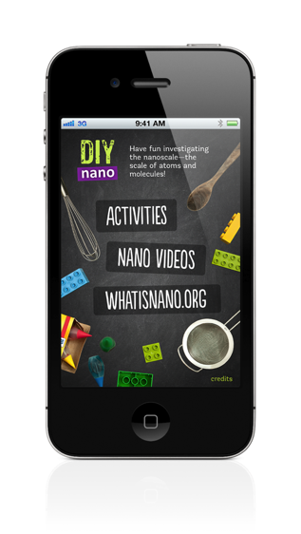
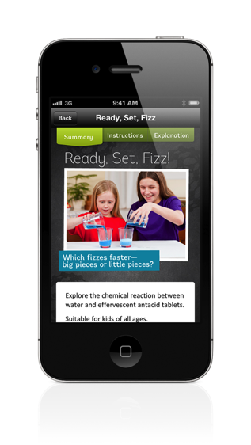
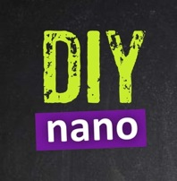
To Continue the Learning At Home

Slide 4
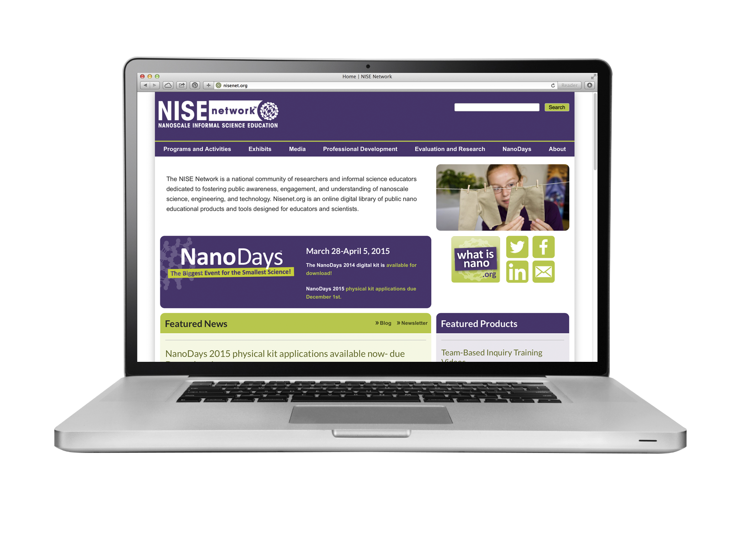
Resources
NISE’s After School Framework: http://www.nisenet.org/catalog/programs/after_school_framework_0
List of NISE Mini-Grants: http://www.nisenet.org/mini-grants
NISE tips on working with different audiences: http://www.nisenet.org/Audiences
Tips for engaging girls: http://www.nisenet.org/sites/default/files/catalog/uploads/ND_engaging_girls_sheet.pdf

Slide 5
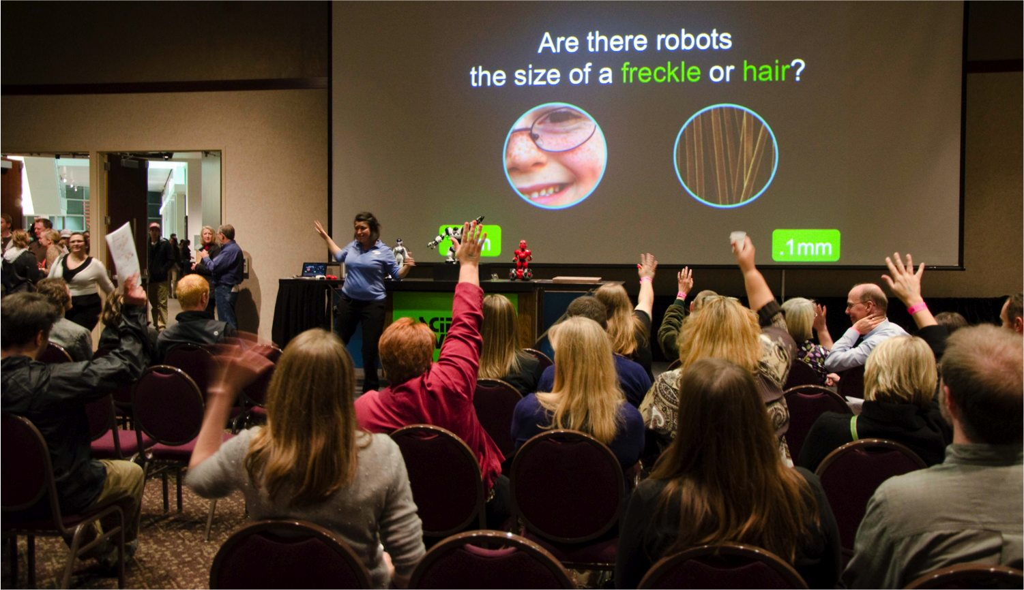
Questions & Discussion

Slide 6
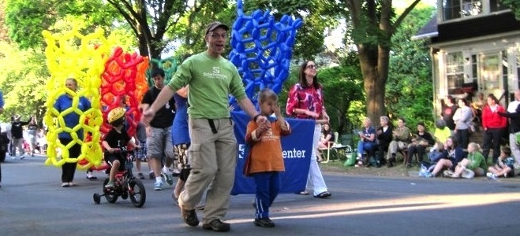
Thank you!
Cynthia Needham, ICAN Productions
This presentation is based on work supported by the National Science Foundation under Grant No. 0940143. Any opinions, findings, and conclusions or recommendations expressed in this presentation are those of the authors and do not necessarily reflect the views of the Foundation.

