Slide 1
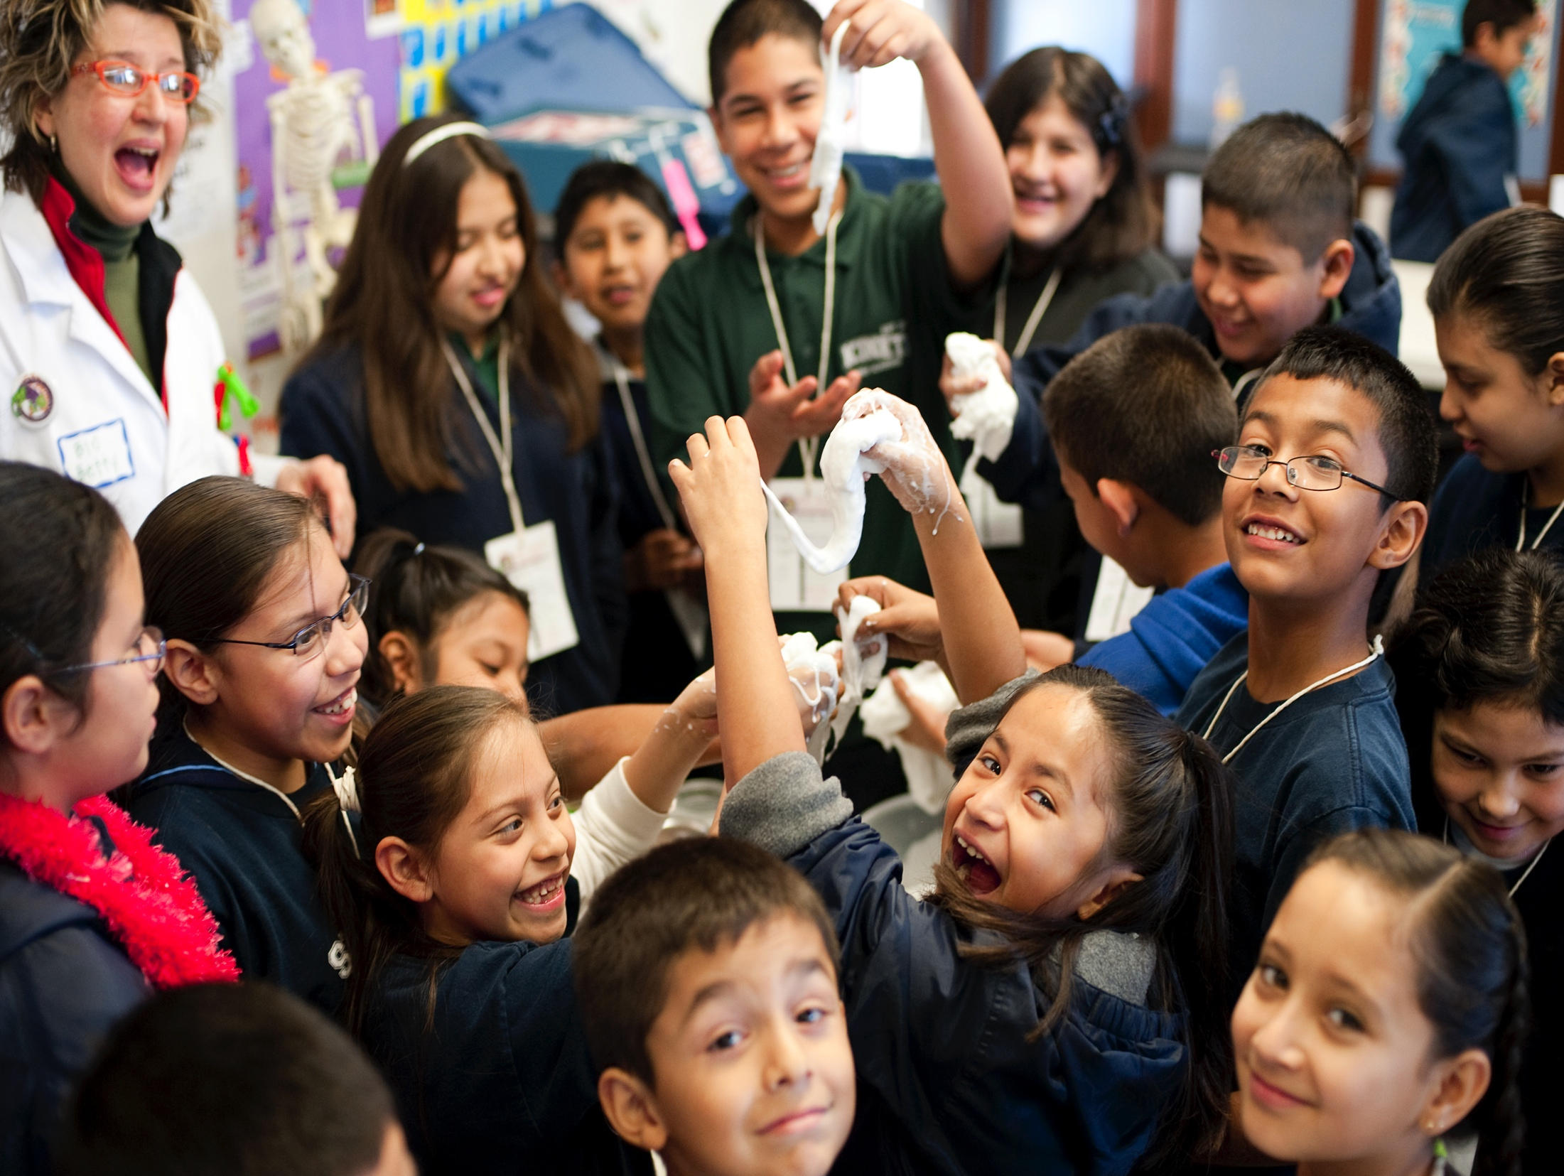
The Afterschool Landscape:
Getting to Know Your Potential Partners
Notes:
Give you a larger view of the afterschool field before we get into the partnership examples and to help you think about potential partners in your own communities and your goals for those partnerships.
Spoiler alert about where I’m going with my presentation—but I really think these types of partnerships are less about another outreach platform, but more about equity in STEM education.

Slide 2
Who is “Afterschool”?
Afterschool Providers
4-H; Boys & Girls Club;
YMCA/YWCA; Girls, Inc.; 21st CCLC; Libraries; Parks & Rec; Comm. Centers; Religious Orgs
Philanthropic & Corporate Funders
C. S. Mott; Noyce; Bechtel; NSF, CNCS (VISTA)
Key Players
National Organizations
Afterschool Alliance; National Afterschool Association; National Summer Learning Association
State & Local Orgs
Statewide Afterschool Networks (48 states);
City intermediaries (e.g. Every Hour Counts); School district managers
Notes:
The field is very large and very diverse. According to our 2014 research, there are about 10.2 million children in afterschool programs across the U.S.
You’re likely familiar with all of the national providers, but there’s also local community centers, organizations that serve particular immigrant or religious populations, parks & rec departments, etc.
All of these are considered community-based organizations (although not all CBO’s are afterschool providers), or youth-serving organizations. Most of these would also self-identify as the youth development field i.e. concerned with larger outcomes than academics.
One key thing to note, is that when we say “afterschool”, we don’t mean a school-run club that happens when the school day ends. The kind of afterschool programs we’re talking about have kids attending 4-5 days a week, are in communication with families and schools, and are concerned more broadly with a child’s welfare, rather than just academics. Most follow the model of offering a snack or meal, homework help, and then enrichment activities.
When you partner with an afterschool program, you’re plugging into an established support system and offering them much-needed support for their enrichment activities.

Slide 3
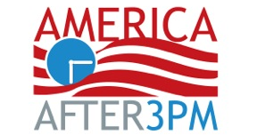
“Where” is afterschool?
Parents say their kids attend afterschool here*:
Private 11%
4-H 5%
YWCA 5%
YMCA 15%
Public 43%
Boys & Girls Clubs 18%
7%
3%
* Not all categories of afterschool sites reported on are represented in this chart.
Notes:
Just to help think about where the kids are…not necessarily a bad thing that so few at science centers. Obviously on-site programs targeted towards underserved communities would be a logistical nightmare. This number also doesn’t include afterschool programs where science centers are partners—coming in one day a week for programming or supporting curriculum or PD efforts behind the scenes.

Slide 4
How is afterschool unique?
Youth Development Goals
Empowering young people Socio-emotional competence Non-academic skills like leadership, confidence, teamwork, service Positive relationships with adults
Approach to STEM Learning
Hands-on, experiential Project-based Experimentation & failure New entry points to science Connected to communities, home cultures, and student knowledge & experiences
Environment
Low-stakes Flexible in time and space Community partnerships
Notes:
I would say the box on STEM learning is perhaps how afterschool providers are oriented, but this is not to say that all afterschool programs are doing exemplary informal science education. Many are still figuring it out. With the right kinds of partnerships and support, that can combine with strengths in youth development and the type of learning environment--there’s a ton of potential.
And thinking about populations that more often have very negative experiences in school science, we think that ISE can provide new entry points and a curriculum that culturally responsive.

Slide 5
State of Afterschool Science 2014 Afterschool Science Networks Study from SRI International
California’s publicly funded afterschool programs
415 sites | 9 case studies
87% of sites offered science (48% weekly+), but only 22% offered science frequently and with deep science experiences.
Partnerships brought deeper science learning opportunities to program sites – 63% had a partner to support science programming.
Notes:
We’ve heard informally from statewide afterschool networks & 21ST CCLC leads that they suspect that quality isn’t there. Or people are doing “fun” hands-on science without deeper connections along a curriculum and to cross-cutting concepts
California’s After School Education and Safety (ASES) program is the largest state- funded afterschool program in the country ($550M each year). More than 4,100 afterschool sites across the state (all with at least 50% FRPL population)
Examines the state of science offerings & external sources of support for science in California’s public afterschool programs
Five-year NSF research study (2009-2014)
Programs diverse geographically & demographically, with differing in philosophies, approaches & resources
Used NRC’s six "strands" of informal science learning.
For each strand, sites were given scores of high, medium, or low based on whether the science activities aligned with that strand and whether the activities provided strong related learning opportunities.
Partnerships allowed sites to go beyond INTEREST.

Slide 6
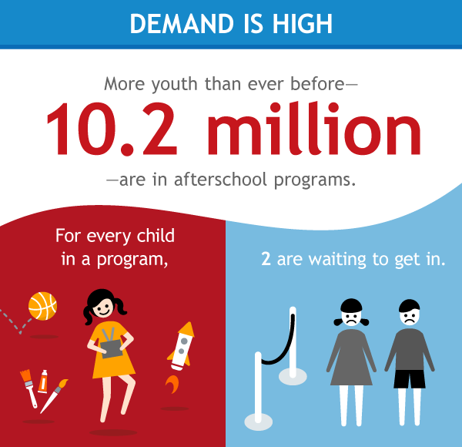
America After 3PM
Household survey of how kids spend the hours after school
Attendance & demand much higher in low-income, African-American, & Latino households
Notes:
America After 3PM – 13.7K households surveyed, nationally representative sample with state-level data.
Parent overwhelmingly cited access and cost as their biggest hurdles.

Slide 7
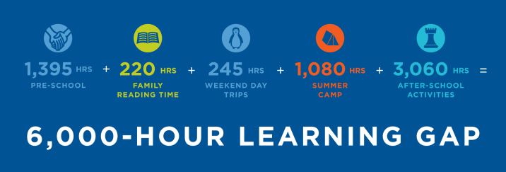
Equity as Access
Source: The After School Corporation (TASC)
Notes:
What is 6,000 hours? Let’s say you are in school learning 6 hours per day, 5 days per week = 25 hours per week. How many weeks of learning is that? 6000/25=240 weeks. How many years in school is that? Most states require 180 days (180/5=36 weeks/year). 240/36 = 6.67 academic years.
Afterschool activities they were looking at here include the music lessons, robots clubs, science competitions, etc….the kinds of opportunities that are much more common among families with a disposable income.
So if your institution's goals are to move the needle on STEM education in your community, afterschool partnerships really can be an effective way to meet them.

Slide 8
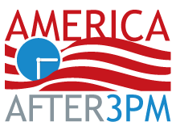
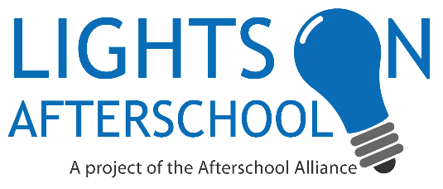
The Afterschool Alliance
1 | Policy & Advocacy | 2 | Research | 3 | Field-Building
National policy Families & children; STEM Advocacy day on Capitol Hill Lights On Afterschool |  | Translate & synthesize research Issue briefs & reports Collect data |  | 48 state networks Partnerships for policy, research, & practice Best practices & models Webinars, blogs, toolkits, & other resources
Notes:
National non-profit based in DC. Advocate on behalf of afterschool programs across the U.S. and work to ensure that all kids have access to affordable, quality afterschool programs.
Afterschool is an issue for many groups – child welfare, juvenile justice, health and physical activity, arts & music education, and of course those interested in STEM education!
Major projects – defining youth outcomes and impacts of afterschool STEM; messaging & communications working group

Slide 9
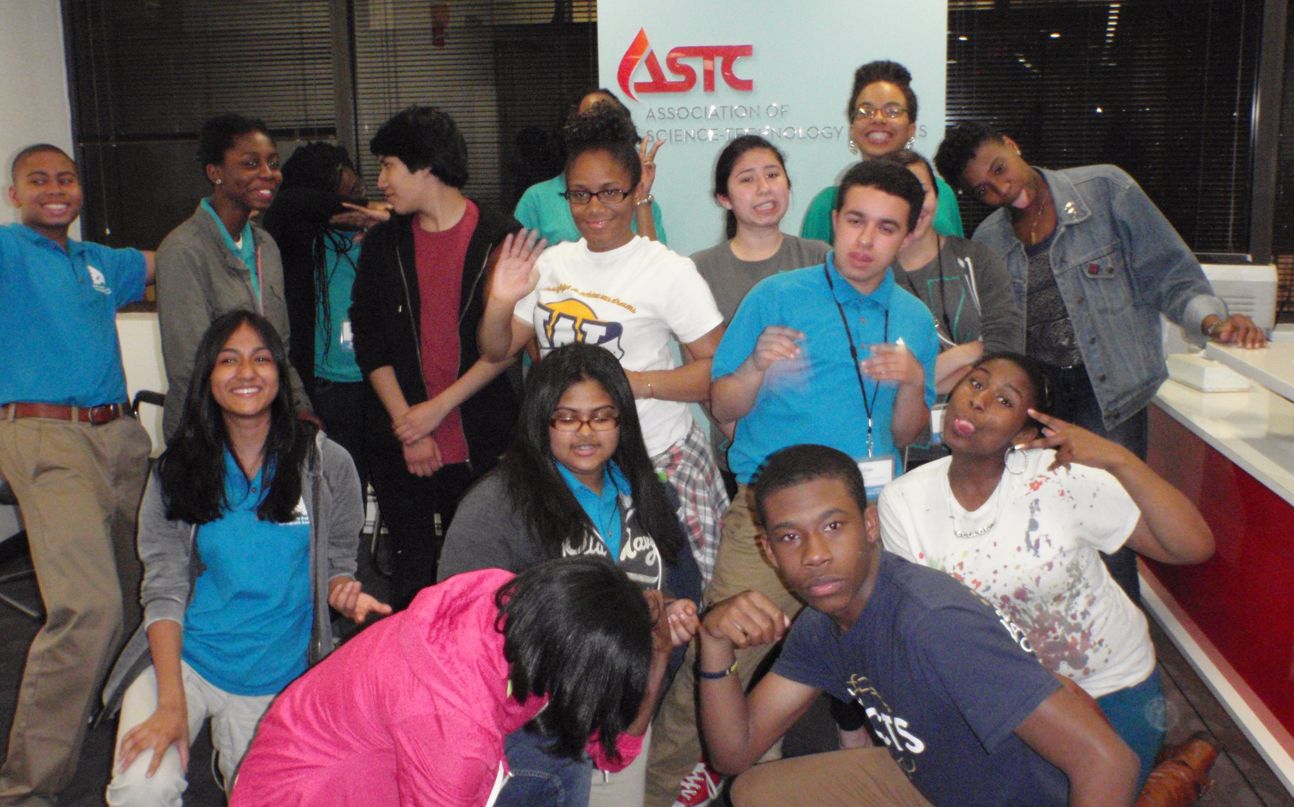
Partnership with ASTC
ASTC’s 2013 & 2014 annual conference
Science center youth at the 2014 & 2015 Afterschool for All Challenge
Lights On Afterschool mini-grants
ASTC Community of Practice for Afterschool STEM
PREVIOUSLY
Professional development for afterschool educators, hosted by science centers
2016
Notes:
At ASTC’s conference we have brought leaders of the statewide networks, hosted the Community of Practice for Afterschool STEM, facilitated a couple sessions, and in 2013 we did a deep dive on partnerships with a half day pre-conference session.

