Slide 1
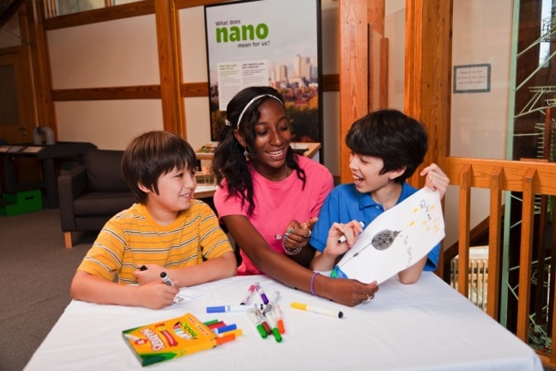


Integrating Nano Into Larger
Themes
JUNE 2015
NETWORK-WIDE MEETING
NISENET.ORG
Notes:
Good morning

Slide 2
Integrating Nano Into Larger
Themes
Victoria Scalise, Palouse Discovery Science Center
Kathleen Lawson, Arkansas Discovery Network
Summer Lazenby, Challenger Learning Center of Alaska
Frank Kusiak, Lawrence Hall of Science
JUNE 2015
NETWORK-WIDE MEETING
NISENET.ORG

Slide 3
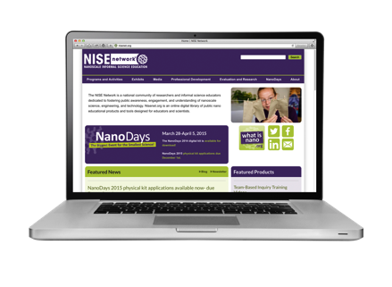
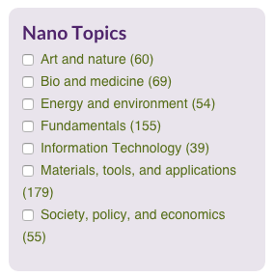
Resources
NISE’s Catalog: http://www.nisenet.org/search/product_category/programs-and-activities-10
List of NISE Mini-Grants:
http://www.nisenet.org/mini-grants
NISE tips on working with different audiences: http://www.nisenet.org/Audiences
How to Smile
http://howtosmile.org

Slide 4
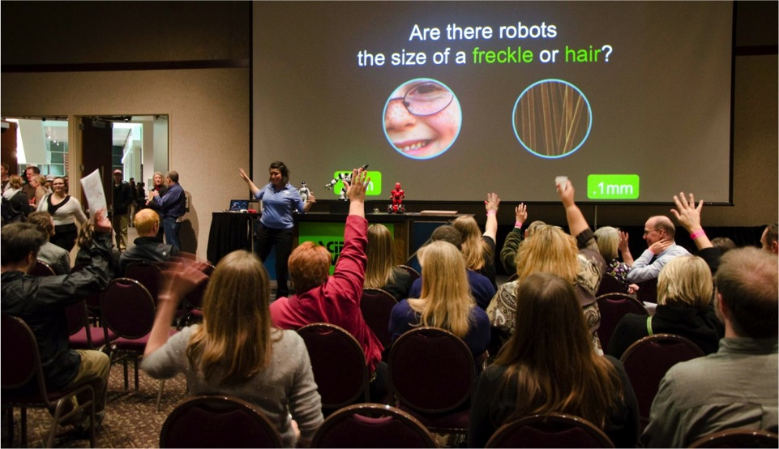

Questions & Discussion

Slide 5
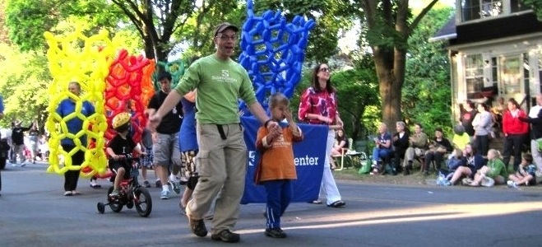


Thank you!
Cynthia Needham, ICAN Productions
This presentation is based on work supported by the National Science Foundation under Grant No. 0940143. Any opinions, findings, and conclusions or recommendations expressed in this presentation are those of the authors and do not necessarily reflect the views of the Foundation.

Slide 6
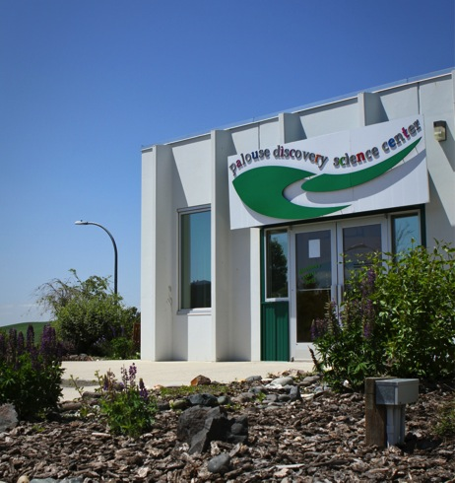
Palouse Discovery Science Center
Pullman, Washington
Victoria Scalise, Executive Director

Slide 7
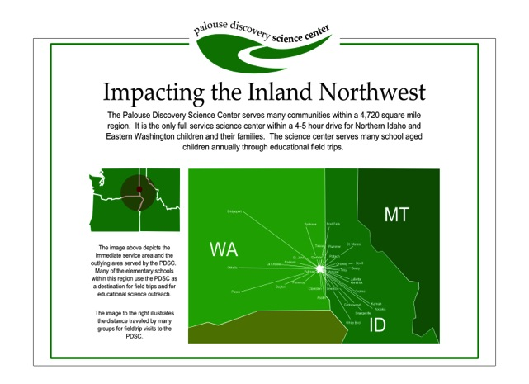
Palouse Discovery Science Center
Pullman, Washington
Victoria Scalise, Executive Director

Slide 8
Palouse Discovery Science Center
Pullman, Washington
NISE Network Partner
NISE Network Partner since 2008
Nano Exhibit
Nano Mini Grant
Incorporating Nano in museum practice and science delivery

Slide 9
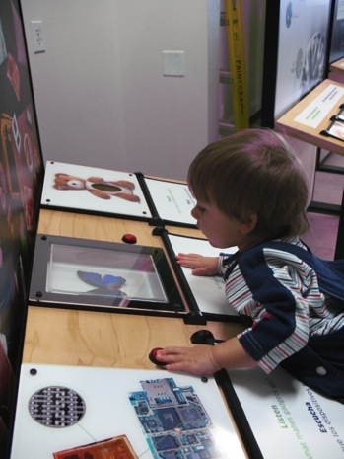
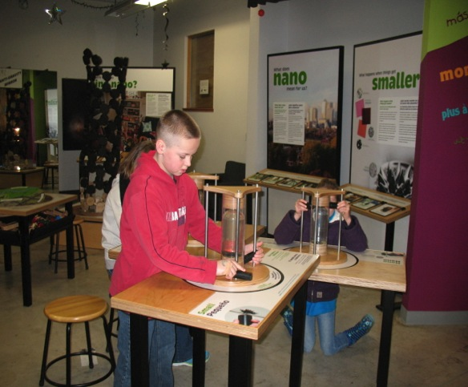
Palouse Discovery Science Center
Pullman, Washington
Nano Exhibit

Slide 10
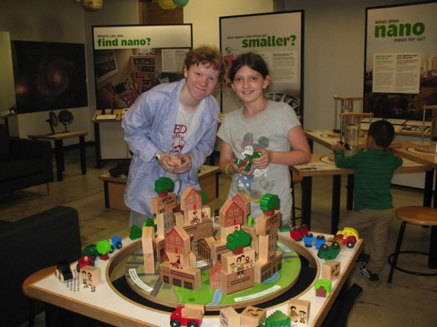
Palouse Discovery Science Center
Pullman, Washington
Nano Exhibit

Slide 11
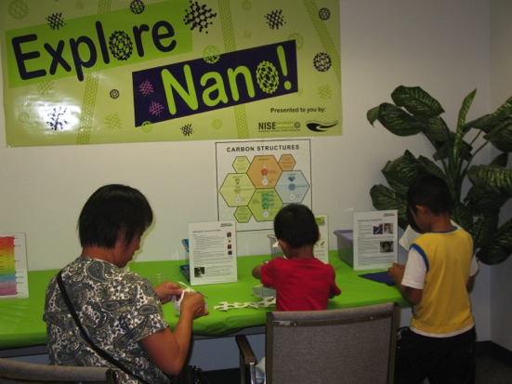
Palouse Discovery Science Center
Pullman, Washington
Nano Corner

Slide 12
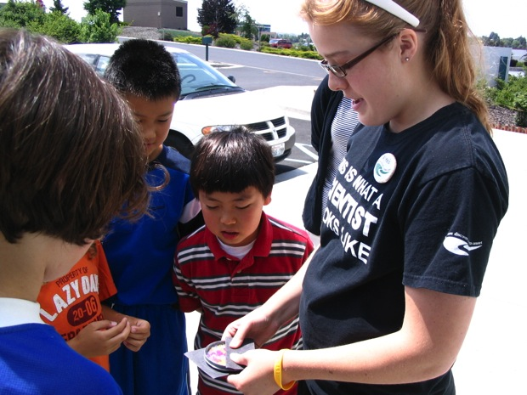
Palouse Discovery Science Center
Pullman, Washington
Girls in Science

Slide 13
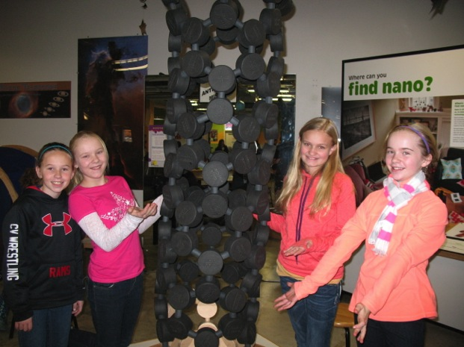
Palouse Discovery Science Center
Pullman, Washington
School Field Trips

Slide 14
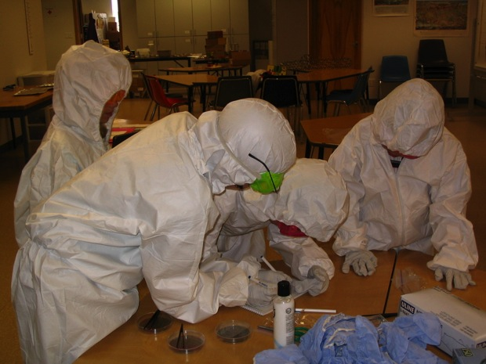
Palouse Discovery Science Center
Pullman, Washington
Summer Camps

Slide 15
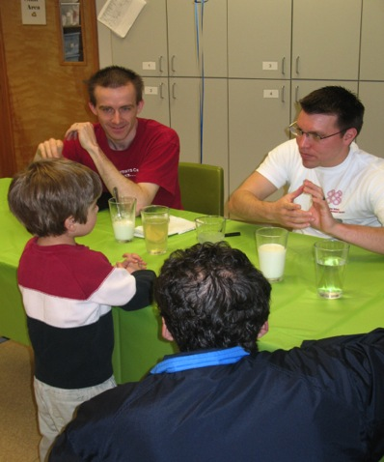
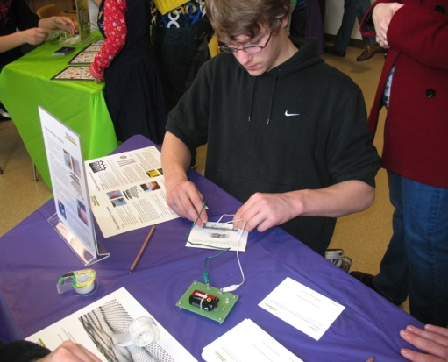
Palouse Discovery Science Center
Pullman, Washington
NanoDays

Slide 16
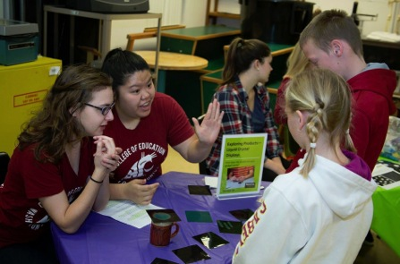
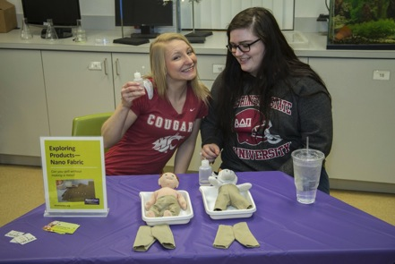
Palouse Discovery Science Center
Pullman, Washington
“Last weekend I had the wonderful opportunity of sharing
nanotechnology lessons with children and adults at the science center!”

Slide 17
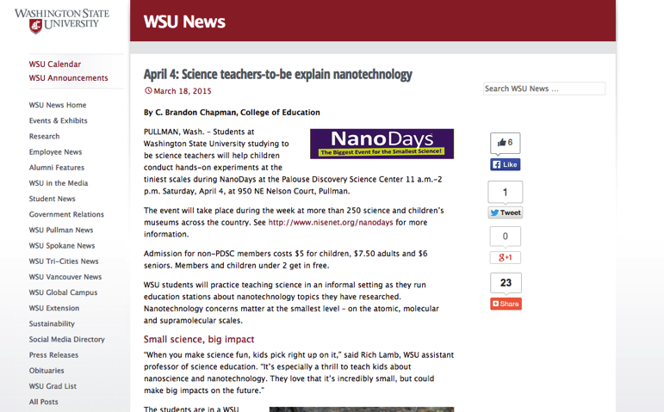
Palouse Discovery Science Center
Pullman, Washington
“Last weekend I had the wonderful opportunity of sharing
nanotechnology lessons with children and adults at the science center!”

Slide 18
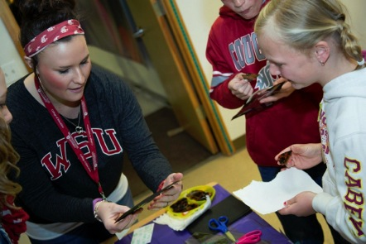
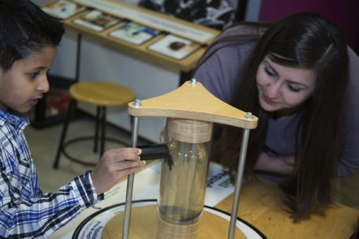
Palouse Discovery Science Center
Pullman, Washington
“Presenting a lesson on nanotechnology at the science center was an eye opening and great learning experience regarding science instruction!”

Slide 19
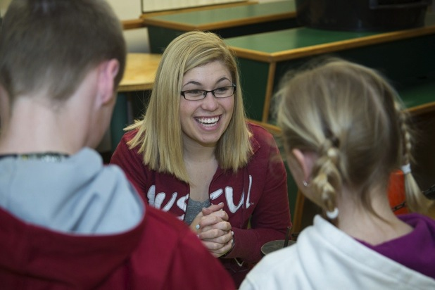
Palouse Discovery Science Center
Pullman, Washington

Slide 20
Thank you!
Cynthia Needham, ICAN Productions
This presentation is based on work supported by the National Science Foundation under Grant No. 0940143. Any opinions, findings, and conclusions or recommendations expressed in this presentation are those of the authors and do not necessarily reflect the views of the Foundation.

Slide 21
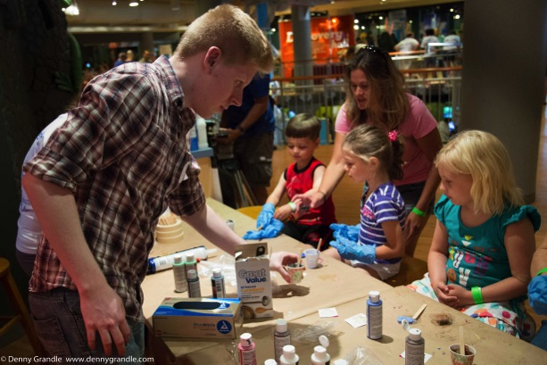
Nano & Tinkering
JUNE 2015
NETWORK-WIDE MEETING
NISENET.ORG
Notes:
Good morning

Slide 22
Overview
Applause-On-Demand
Arkansas Discovery Network
Tinkerfest
Oogoo
Tiny Drawings
The Good, the Bad, the Smelly
JUNE 2015
NETWORK-WIDE MEETING
NISENET.ORG

Slide 23






Partner Locations

Slide 24
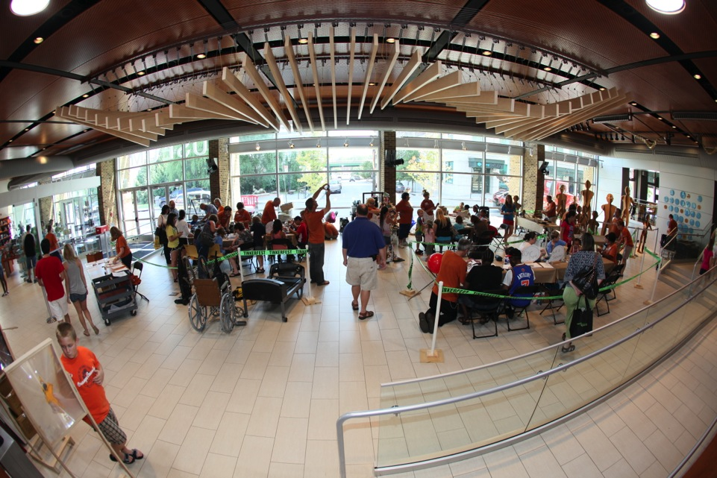
Tinkerfest

Slide 25
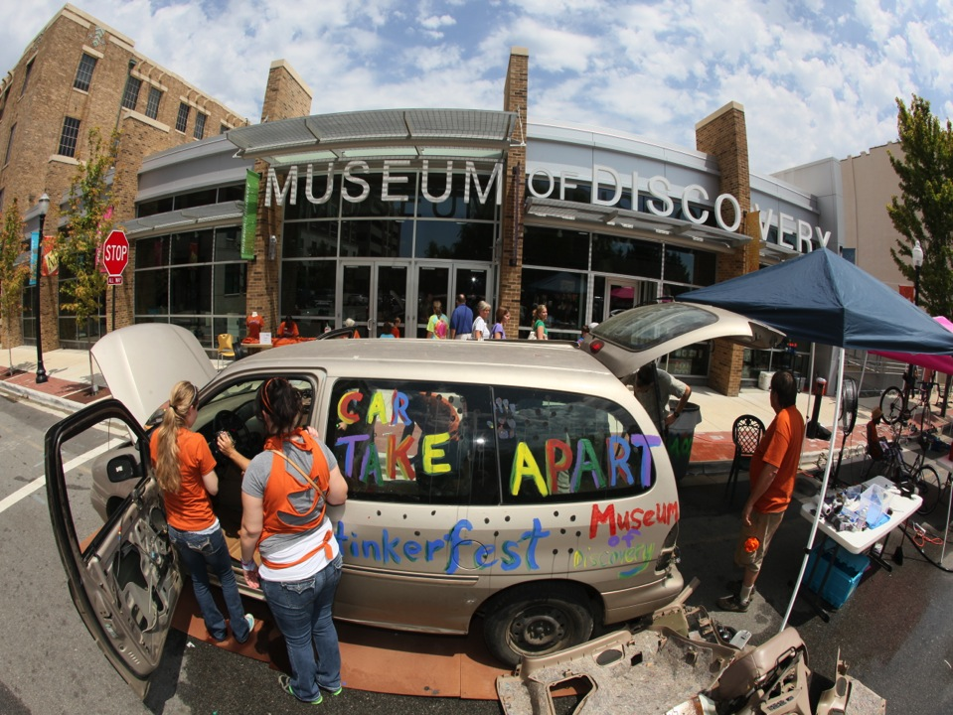

Slide 26
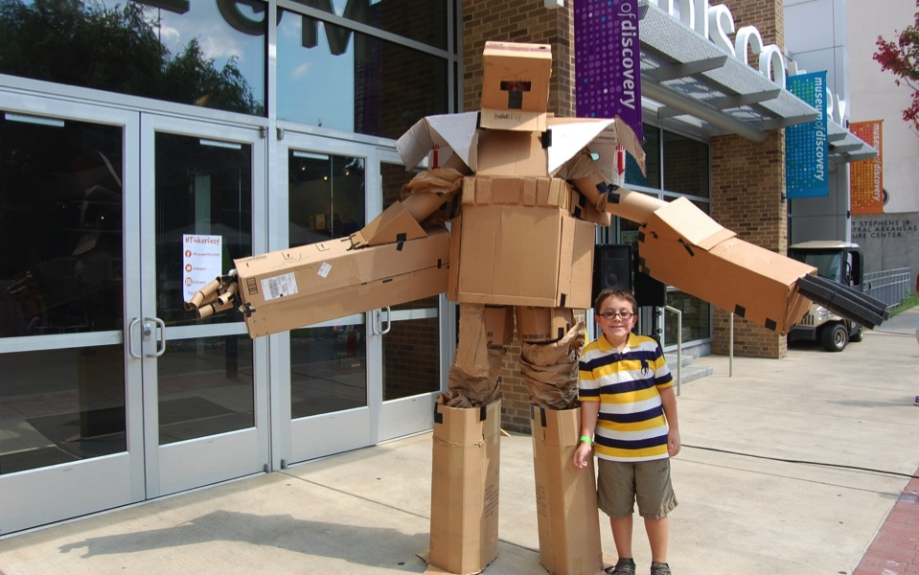

Finding Nano Among All The Bigs

Slide 27
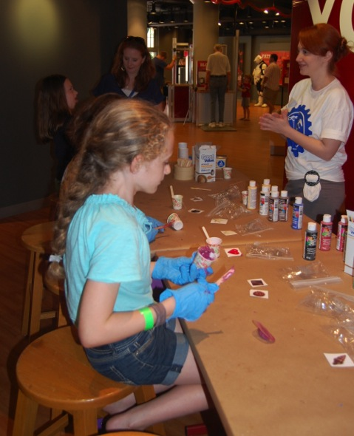
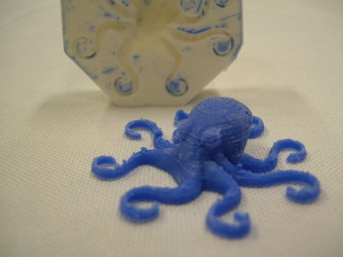
Oogoo
Clear Silicon Caulk
+ Cornstarch
Oogoo

Slide 28
Oogoo and Nano
Highlighting on the idea of materials technology and polymer science
Visitors can see how combining household materials can create a new, useful material
Gives visitors a model that is descriptive of the way nanoparticles are used to make materials while creating a tangible object
Visitors create a model that represents the mix of double-walled carbon nanotubes and cross-linkable organic polymers

Slide 29
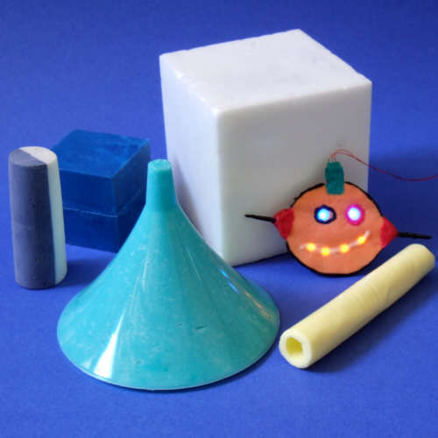
Oogoo and Making
Beginner Making as a Basic Mold
More Advanced with Embedded Electronic Circuits in Flexible Forms
  Instructables: “How To Make Your Own Sugru Substitute”
    Soft Circuit LED that can be embedded into clothing
    Cleanly etched conductive fabric circuits
    Make conductive glue
    Embedded circuits in Oogoo

Slide 30
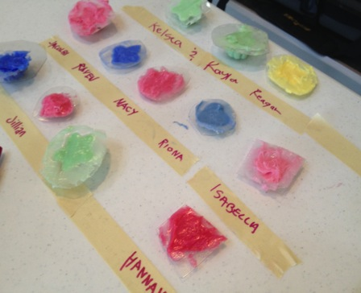
Oogoo: The Good, the Bad, the Smelly
The Good:
Provides a tangible takeaway
Fun to make
Relatively low cost
The Bad:
Hard to make strong nano connection in festival setting
High on consumables
Messy
Smelly

Slide 31
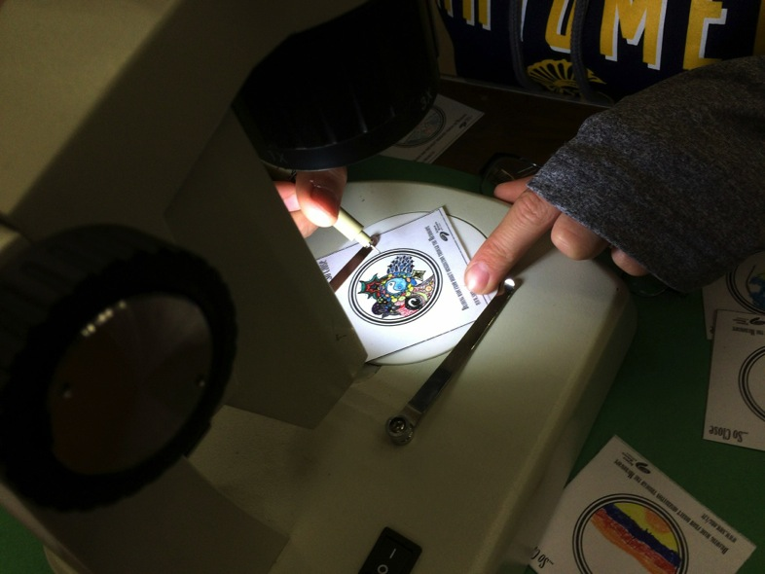
Tiny Drawings

Slide 32
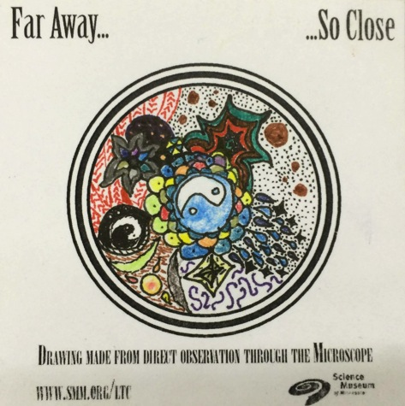
Tiny Drawings
This visitor stayed drawing through microscopes for 30 minutes to a full at the MN Mini Maker Faire
Photo Credit: Keith Braafladt, Science Museum of Minnesota

Slide 33
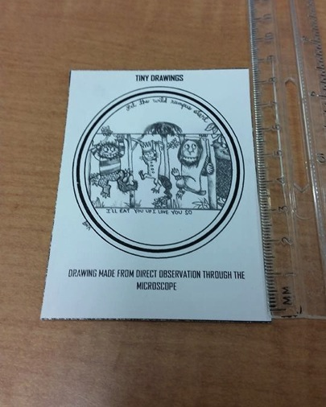
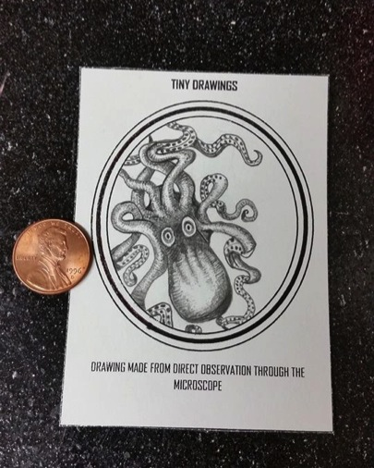
Tiny Drawings

Slide 34
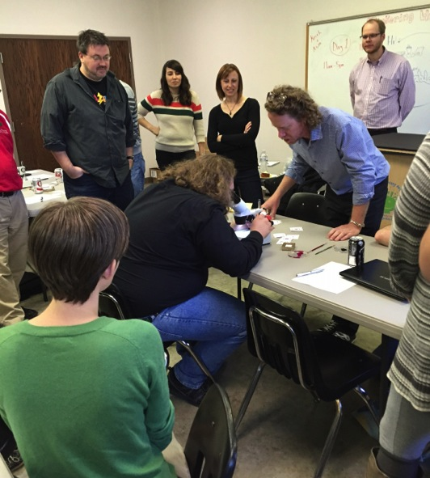
Tiny Drawings
Introduced from Science Museum of Minnesota
Workshop prior to implementation

Slide 35
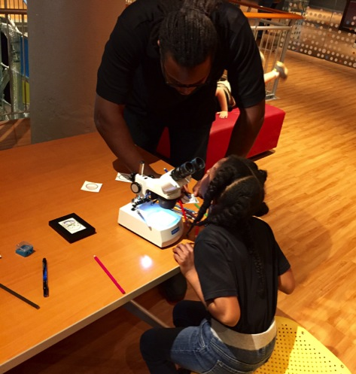
Tiny Drawings and Nano
Introduces Scale
  Understanding scale is a critical first step toward recognizing the possibilities of nanotechnology
Visitors are first asked to make a period mark on the card.
  A period is roughly 100-1000 micrometers.

Slide 36
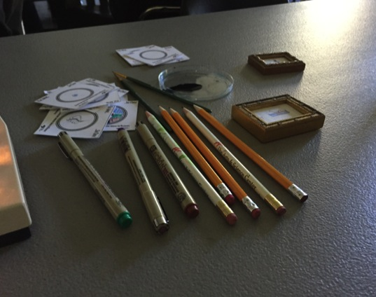
Tiny Drawings and Making
Uses common materials in a different way
STEAM Intersection
Tried and true
  World Maker Faire
Telescope extension

Slide 37
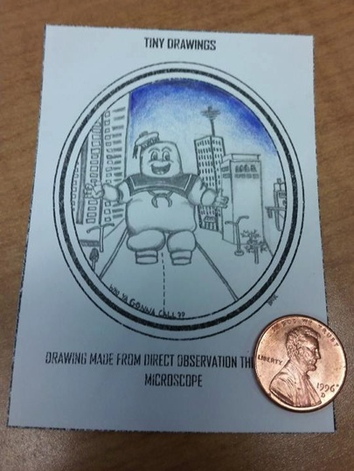
Tiny Drawings
The Good:
Low cost consumables
Unexpected experience
Interactive way to introduce nanoscale
The Bad:
Initial equipment cost
No passerby wow factor
Limited # of participants at a time
  2 microscopes:1 facilitator

Slide 38
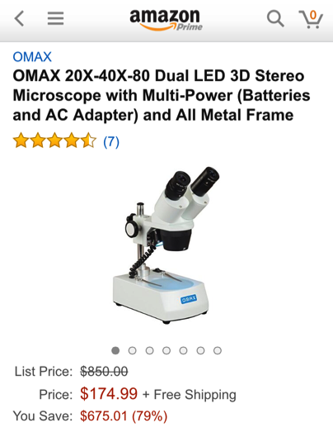
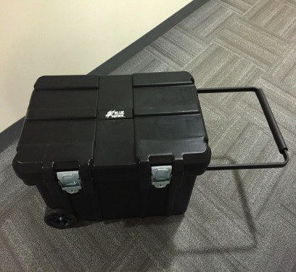
Tiny Drawings Kit

Slide 39
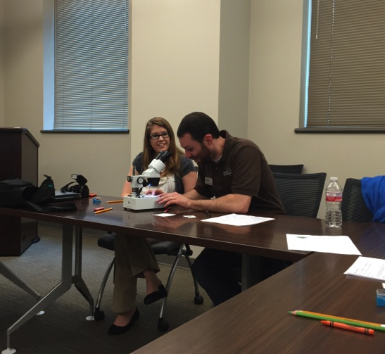
University of Arkansas at Little Rock
Center for Integrative Nanotechnology Science
Workshops
Updates on Latest Research
Nano Days Participant
Student Facilitators

Slide 40
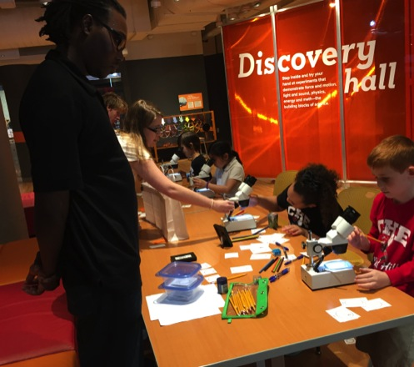
Thank you!
Cynthia Needham, ICAN Productions
This presentation is based on work supported by the National Science Foundation under Grant No. 0940143. Any opinions, findings, and conclusions or recommendations expressed in this presentation are those of the authors and do not necessarily reflect the views of the Foundation.

Slide 41
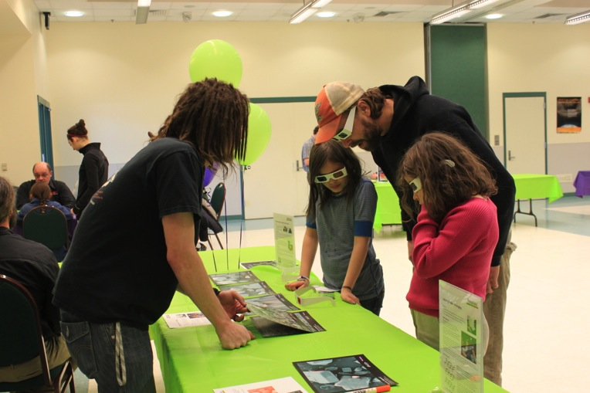
Challenger Learning Center of Alaska
Summer Lazenby
Director of Educational Operations

Slide 42
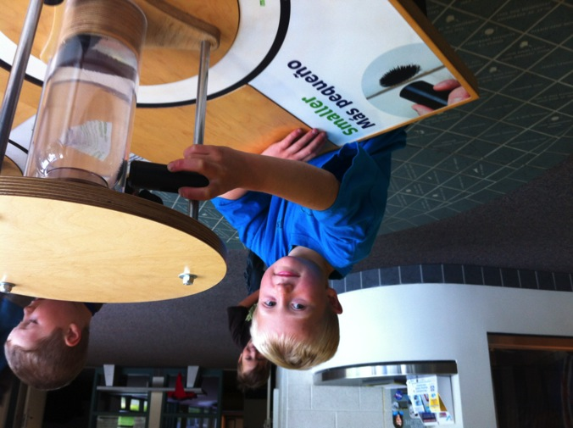
Incorporating NanoTechnology into Space Science

Slide 43
Questions?

