Slide 1
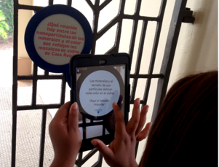
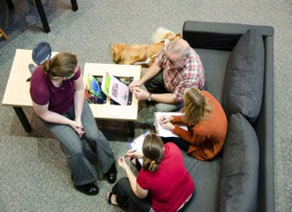
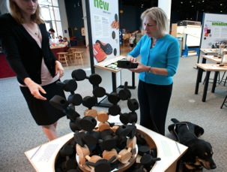
Making the most of the mini-exhibition as a platform for programming
Christina Akers, Science Museum of Minnesota
Stephanie Graves, Delaware Museum of Natural History
Joshua Sarver , COSI Columbus, Ohio
Karlisa Callwood, Patricia and Phillip Frost Museum of Science
Notes:
Cakers

Slide 2
Agenda
Welcome & Introductions
Stephanie Graves
Joshua Sarver
Karlisa Callwood
Further Examples from Christina (time allowing)
Q & A
Notes:
Cakers

Slide 3
“Who is your audience for programming around the mini-exhibition?” From a poll earlier this year
Partners told us…
Children & adults
Spanish speakers
School groups & families
Young children, pre-K to 2nd grade
Families with children 2+, engaging all family members
High school students
Workshops for museums hosting the exhibit about doing nano with young audiences
Notes:
Cakers
Use data from pre-application survey to fuel any conversation here!!!

Slide 4
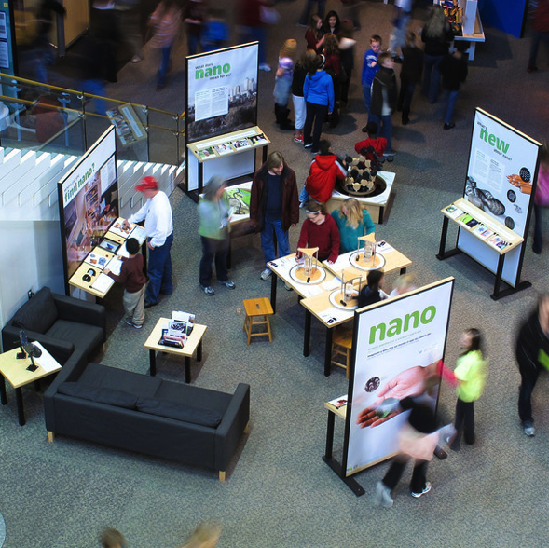
Nano Mini-Exhibition: There is room
Fast Facts
Three recommended configurations
400 ft² – 700 ft²
Double-sided
Notes:
As you’ve no-doubt just learned, this is a reasonably sized exhibit – 400-700 feet squared and double-sized, so you’ve got a lot of flexibility. Let’s talk about how we brought in NanoLab

Slide 5
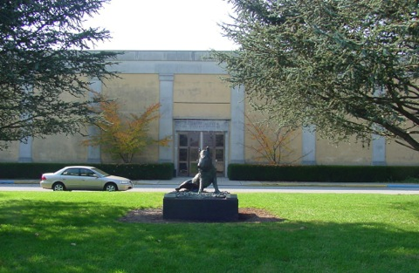
Delaware Museum of Natural History
Fast Facts
Opened 1972
Wilmington, DE
Rural setting
65,000 – 75,000 visitors annually
~ 15 Full-Time Staff
10 acre campus
23,000 ft² of gallery space
Notes:
We are the Delaware Museum of Natural History
Founded in 1972, in rural Wilmington, DE, we see 65-75k visitors per year with a pretty small staff.
Undergoing some big change recently with a 2005 renovation that modernized our nature-focused museum and beginning a strategic planning process which hints at renovating our permanent exhibits.

Slide 6
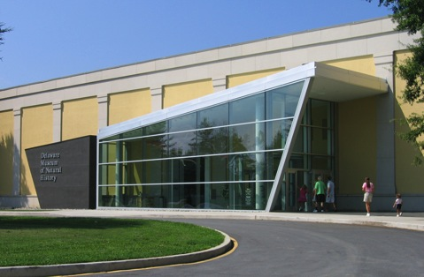
Delaware Museum of Natural History
Fast Facts
Opened 1972
Wilmington, DE
Rural setting
65,000 – 75,000 visitors annually
~ 15 Full-Time Staff
10 acre campus
23,000 ft² of gallery space
Notes:
We are the Delaware Museum of Natural History
Founded in 1972, in rural Wilmington, DE, we see 65-75k visitors per year with a pretty small staff.
Undergoing some big change recently with a 2005 renovation that modernized our nature-focused museum and beginning a strategic planning process which hints at renovating our permanent exhibits.

Slide 7
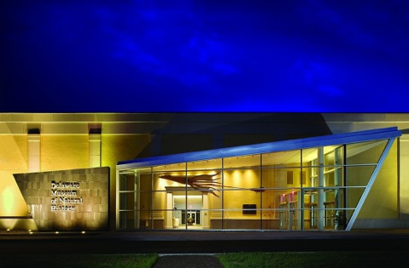
Delaware Museum of Natural History
Fast Facts
Opened 1972
Wilmington, DE
Rural setting
65,000 – 75,000 visitors annually
~ 15 Full-Time Staff
10 acre campus
23,000 ft² of gallery space
Notes:
We are the Delaware Museum of Natural History
Founded in 1972, in rural Wilmington, DE, we see 65-75k visitors per year with a pretty small staff.
Undergoing some big change recently with a 2005 renovation that modernized our nature-focused museum and beginning a strategic planning process which hints at renovating our permanent exhibits.

Slide 8
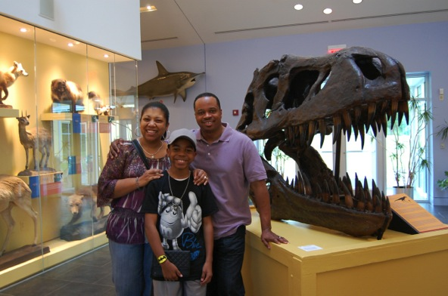
Delaware Museum of Natural History
Considerations
Location
Connection to nature
Staffing
Notes:
We had several considerations when bringing in this exhibit – only six months ago: Location, connection to nature, and staffing. I’m going to show you how we did it and give you a little inspiration for your (hopeful) Nano exhibit acquisition.

Slide 9
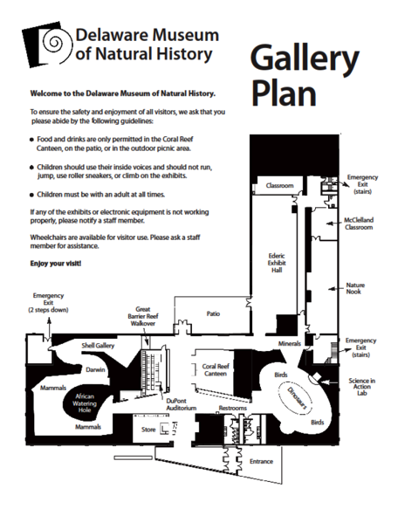
Location
Notes:
We have a nature-focused museum, as I mentioned – with permanent galleries for earth, sea, and sky, so there wasn’t any immediately obvious location for Nano. We then started looking at Multipurpose spaces, which included the Ederic Exhibit Hall – nearly 3,000 square-feet for traveling exhibits- and the Coral Reef Canteen – our café and vending machine space seating about 40.

Slide 10
Location
Sea
Sky
Earth
Notes:
We have a nature-focused museum, as I mentioned – with permanent galleries for earth, sea, and sky, so there wasn’t any immediately obvious location for Nano. We then started looking at Multipurpose spaces, which included the Ederic Exhibit Hall – nearly 3,000 square-feet for traveling exhibits- and the Coral Reef Canteen – our café and vending machine space seating about 40.

Slide 11
Location
Sea
Sky
Earth
Notes:
We have a nature-focused museum, as I mentioned – with permanent galleries for earth, sea, and sky, so there wasn’t any immediately obvious location for Nano. We then started looking at Multipurpose spaces, which included the Ederic Exhibit Hall – nearly 3,000 square-feet for traveling exhibits- and the Coral Reef Canteen – our café and vending machine space seating about 40.

Slide 12
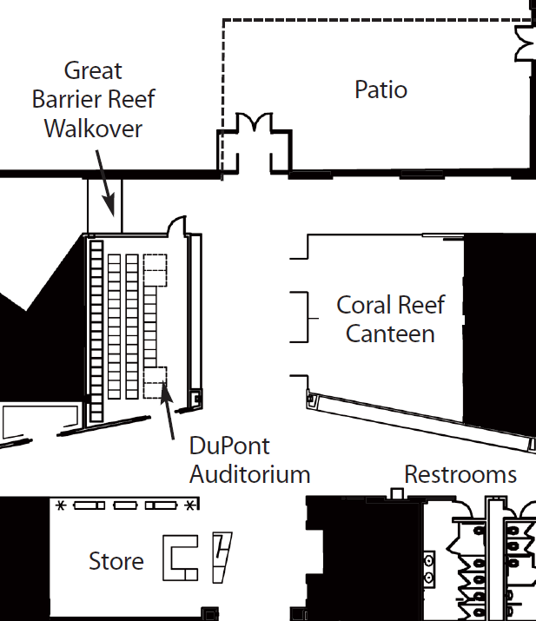
Location
Coral Reef Canteen:
Underutilized space
Tour lunches
Vending machines
Centrally located
Adaptable
Notes:
We eventually decided on the Canteen, for several reasons – underutilization, central location, and adaptability. We also soon realized, that this was the original purpose of the space, complete with a glass partition – Who knew?!

Slide 13
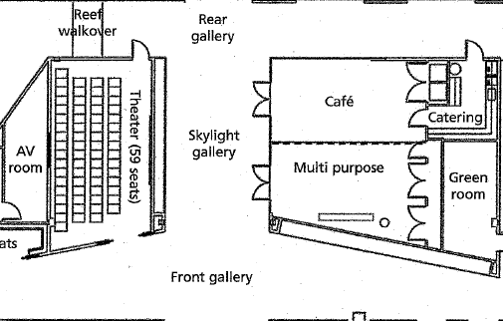
Location
Notes:
We eventually decided on the Canteen, for several reasons – underutilization, central location, and adaptability. We also soon realized, that this was the original purpose of the space, complete with a glass partition – Who knew?!

Slide 14
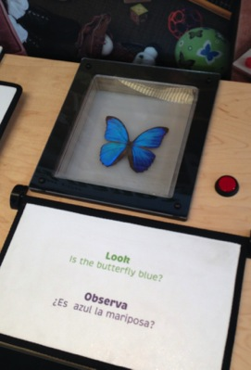
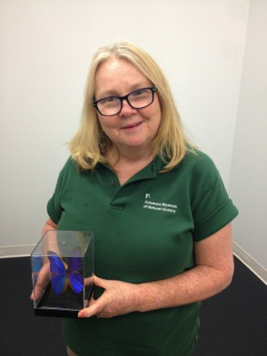
Connection to Nature
Notes:
With location settled, we moved on to making ties to nature in our existing collections and exhibits. Specimens in Nano, match our Education collections – almost exactly with the blue butterfly that kids can hold themselves and crested geckos that kids can touch and feed themselves. And again, a connection to our pollinator garden out back that kids can search through to find similar specimens. The connection to nature was pretty clear.

Slide 15
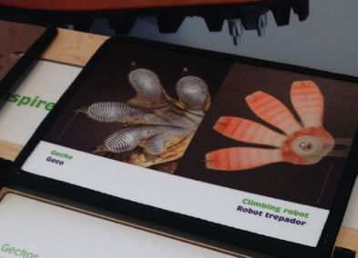
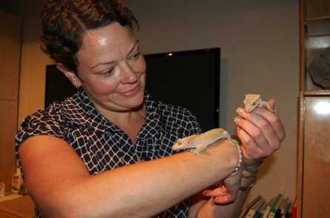
Connection to Nature
Notes:
With location settled, we moved on to making ties to nature in our existing collections and exhibits. Specimens in Nano, match our Education collections – almost exactly with the blue butterfly that kids can hold themselves and crested geckos that kids can touch and feed themselves. And again, a connection to our pollinator garden out back that kids can search through to find similar specimens. The connection to nature was pretty clear.

Slide 16
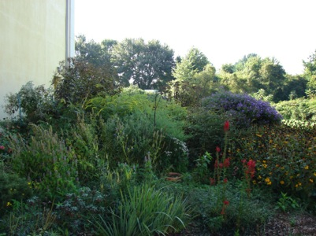
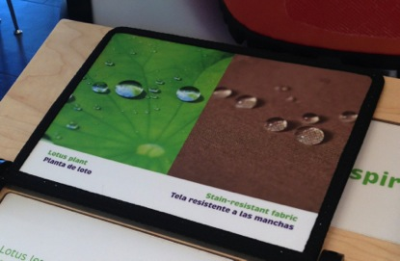
Connection to Nature
Notes:
With location settled, we moved on to making ties to nature in our existing collections and exhibits. Specimens in Nano, match our Education collections – almost exactly with the blue butterfly that kids can hold themselves and crested geckos that kids can touch and feed themselves. And again, a connection to our pollinator garden out back that kids can search through to find similar specimens. The connection to nature was pretty clear.

Slide 17
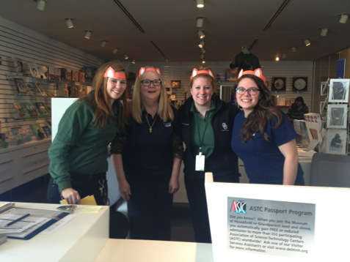
Staffing
New additions to current programming:
Static Electricity and Geckos
Making Edible Blood
Notes:
The most difficult challenge for us: staffing. That’s me with three of our part-time staff – one of which actually works in two different departments. With 15 full-time staff and about 24 part-time staff serving 65-75k guests per year, we’re pretty busy, so we made the transition pretty straightforward – bring Nano into what you’re already doing:

Slide 18
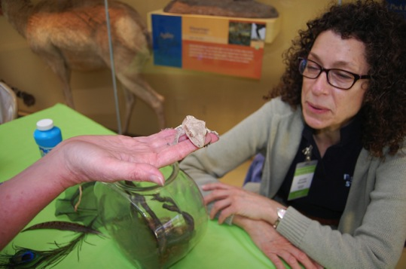
Staffing
New additions to current programming:
Static Electricity and Geckos
Making Edible Blood
Notes:
Camp - Static electricity and geckos (CATHY TO PROVIDE)

Slide 19
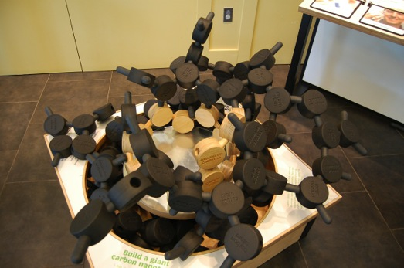
Staffing
New additions to current programming:
Static Electricity and Geckos
Making Edible Blood
Notes:
Grossology Camp – making edible blood

Slide 20
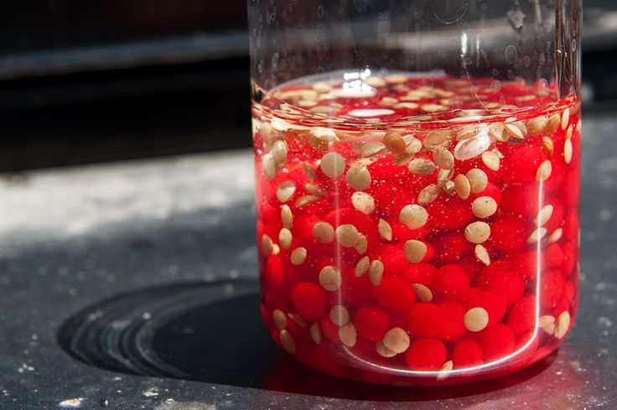
Staffing
New additions to current programming:
Static Electricity and Geckos
Making Edible Blood
Notes:
Grossology Camp – making edible blood
Impromptu learning opportunities – tours, welcoming guests, a pit stop for anyone and everyone. Adding education value to rental events.

Slide 21
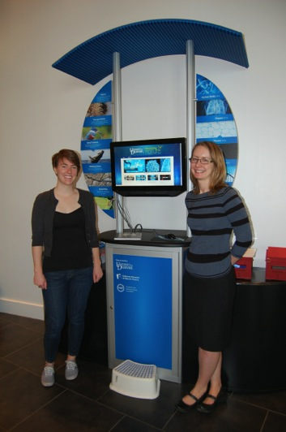
Staffing
Partners
University of Delaware
Robotics Teams
First State Ballet Theatre
Notes:
Community Center – we bring in other partners to reach a wide audience – Nano is for everyone! Anyone who wants to participate in Nano Day or other nano programming, we can make that connection.
In a partnership with the University of Delaware, we’ve built a biomimicry kiosk called Mimicking Nature with chief researcher and professor April Kloxin, newly installed at the Museum, which discusses the same sorts of biomimicry and nano-scale science – shark skin for preventing bacteria build-up and hydrogels that work together on the molecular level for a number of purposes (bandages, diapers, etc).

Slide 22
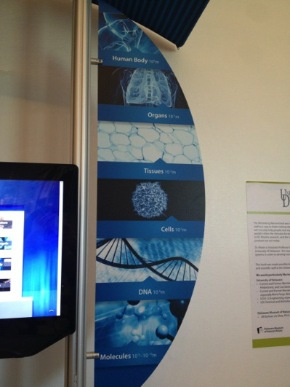
Staffing
Partners
University of Delaware
Robotics Teams
First State Ballet Theatre
Notes:
Community Center – we bring in other partners to reach a wide audience – Nano is for everyone! Anyone who wants to participate in Nano Day or other nano programming, we can make that connection.
In a partnership with the University of Delaware, we’ve built a biomimicry kiosk called Mimicking Nature with chief researcher and professor April Kloxin, newly installed at the Museum, which discusses the same sorts of biomimicry and nano-scale science – shark skin for preventing bacteria build-up and hydrogels that work together on the molecular level for a number of purposes (bandages, diapers, etc).

Slide 23
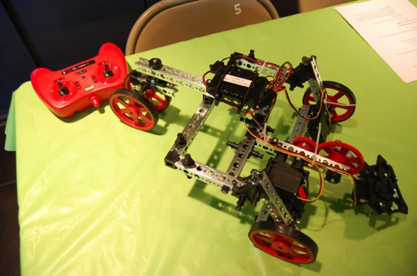
Staffing
Partners
University of Delaware
Robotics Teams
First State Ballet Theatre
Notes:
MOE, FIRST Team 365 (First State Robotics team)
FIRST Lego League - ThunderMinds
FIRST – For Inspiration and Recognition of Science and Technology
Not actually steel, copper, and plastic bits
4/9/2014 - "This is the first time that biological therapy has been able to match how a computer processor works," study co-author Ido Bachelet, from the Institute of Nanotechnology and Advanced Materials at Bar Ilan University in Israel, told New Scientist. The scientists said it should be possible to improve the computing power of the nanobots to approach that of an "8-bit computer, equivalent to a Commodore 64 or Atari 800 from the 1980s.“ - http://www.popsci.com/article/science/nano-robots-compute-dna-installed-living-cockroach
10/4/2012 - Other labs have worked with DNA to build distinct shapes—a process colloquially known as DNA origami—but most have produced nonfunctional objects. At the University of California at San Francisco, Douglas folds his to have a mission. "He is the first to have realized the dream of a truly programmable container for delivering therapies to cells in a targeted way," says Paul Rothemund, a biochemical engineer at Caltech. - http://www.popsci.com/science/article/2012-09/shawn-douglas-programs-dna-nanorobots-kill-cancer
Nano-robots are controllable machines at the nano (10-9) meter or molecular scale that are composed of nano-scale components. With the modern scientific capabilities, it has become possible to attempt the creation of nanorobotic devices and interface them with the macro world for control. There are countless such machines that exist in nature and there is an opportunity to build more of them by mimicking nature (ATP Synthase). Even if the field of nanorobotics is fundamentally different than that of macro robots due to the differences in scale and material, there are many similarities in design and control techniques that eventually could be projected and applied. A roadmap towards the progression of this field is proposed and some design concept and philosophies are illustrated. Two types of control mechanisms are given with examples and further hybrid mechanisms are proposed. There are many applications for nanorobotic systems and its biggest impact would be in the area of medicine. - http://www.fractal.org/Bio-Nano-Robotics/Nanorobotics.pdf

Slide 24
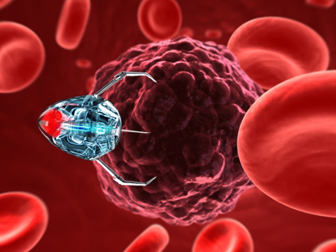
Staffing
Partners
University of Delaware
Robotics Teams
First State Ballet Theatre
Notes:
Personalized medicine is the future of healthcare: disease treatment will be designed and tailored specifically to each patient, based on the their genetics, medical history, and immune system strength. In this image (not to scale), a virus called bacteriophagehas been "trained" to find a cancerous tumor cell and inject it with medicinal nanoparticles - selectively killing the tumor, without side effects, while nearby healthy cells remain unaffected. The need for painful chemotherapy, radiation, or surgery is effectively eradicated. - http://www.omninano.org/nano/our-future-and-nanotech

Slide 25
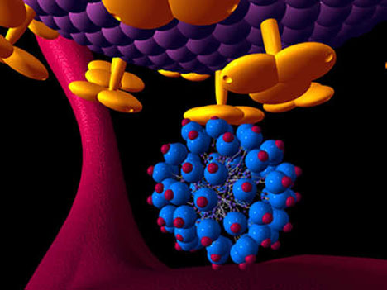
Staffing
Partners
University of Delaware
Robotics Teams
First State Ballet Theatre
Notes:
Blog from UCLA – A nano molecule called dendrimire, created through nanotechnology, attaches to the HIV virus and prevents it from being able to enter T-cells, thus preventing infection - http://artsci.ucla.edu/biotech177/blog/?p=821

Slide 26
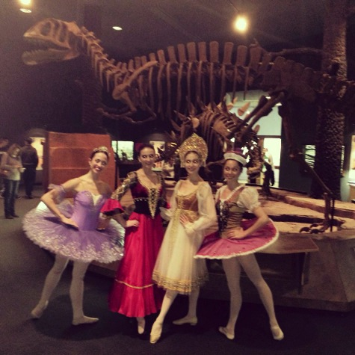
Staffing
Partners
University of Delaware
Robotics Teams
First State Ballet Theatre
Notes:
First State Ballet Theatre: Can you pirouette like nanofibers?
Tie to the National Defense Education Program - http://www.ndep.us/Spinning-Nanofibers
Visitors will learn how to pirouette (spin) with the help of the dancers. Scientists can spin nanofibers into fabrics that are then used medicine to catch germs. They’re also working on making clothes that you can plug your iPod into and play music!

Slide 27
Staffing
Partners
University of Delaware
Robotics Teams
First State Ballet Theatre
Notes:
First State Ballet Theatre: Can you pirouette like nanofibers?
Tie to the National Defense Education Program - http://www.ndep.us/Spinning-Nanofibers
Visitors will learn how to pirouette (spin) with the help of the dancers. Scientists can spin nanofibers into fabrics that are then coated in antibodies that catch germs and bacteria, such as E. coli.

Slide 28
Staffing
Partners
University of Delaware
Robotics Teams
First State Ballet Theatre
http://www.ndep.us/Spinning-Nanofibers
Notes:
First State Ballet Theatre: Can you pirouette like nanofibers?
Visitors will learn how to pirouette (spin) with the help of the dancers. Scientists can spin nanofibers into fabrics that are then coated in antibodies that catch germs and bacteria, such as E. coli.

Slide 29
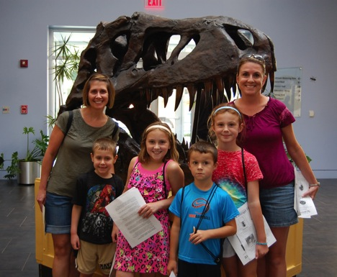
Future
Strategic Plan
Renovation
Reorientation

