Slide 1
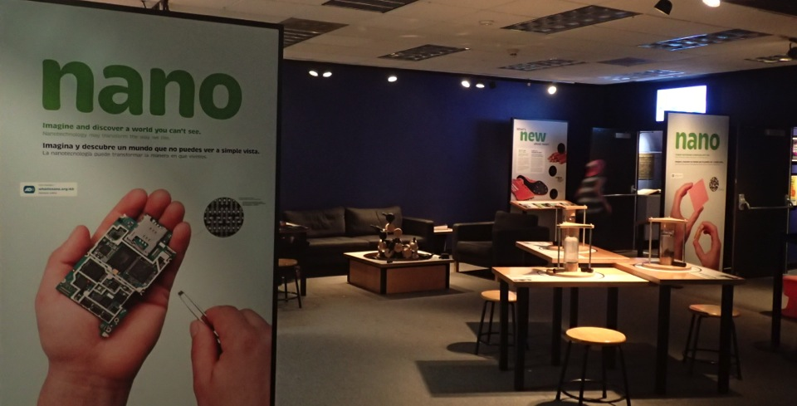
Nano Mini Exhibit at Frost Science
Karlisa Callwood
Director, Programs and Content Development
Patricia and Phillip Frost Museum of Science
JUNE 2015
NETWORK-WIDE MEETING
NISENET.ORG
Notes:
Good morning

Slide 2
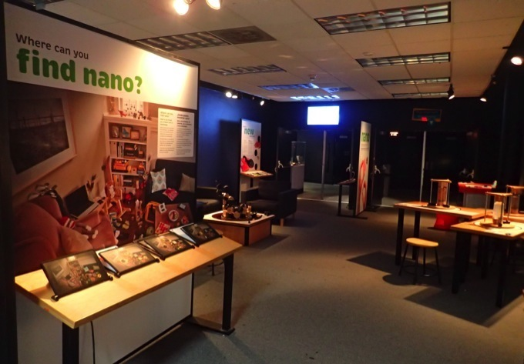
Obtained in 2012
Placed in Space Gallery
Queuing area for planetarium
Used for other programs: camps, birthdays, events
Photo Exhibition Gallery

Slide 3
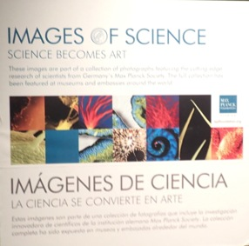
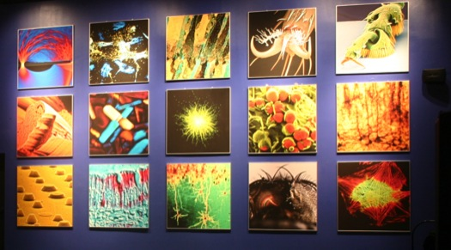
Max Planck Foundation Photo Exhibit
Notes:
Showcased a collection of 40 photos taken on the micro- and nano- scale by scientists from around the world
Other Related Photo Exhibits – Emerging Technologies;

Slide 4
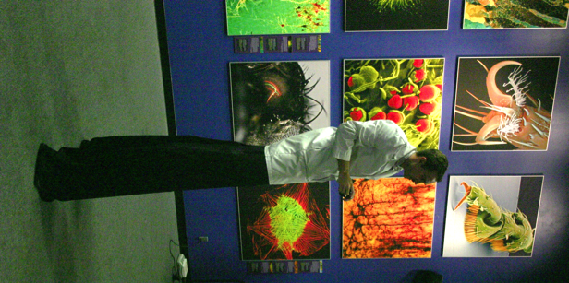
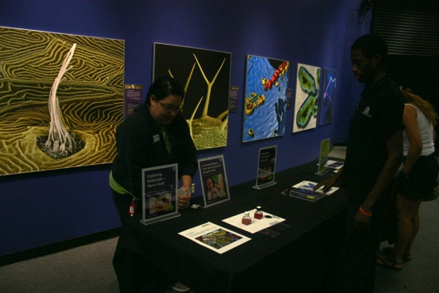
Max Planck Foundation Photo Exhibit
Served as a backdrop for our Nano Days
Mini Exhibit + Photo Exhibit used as resource for nano-themed camp

Slide 5
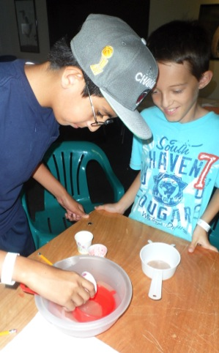
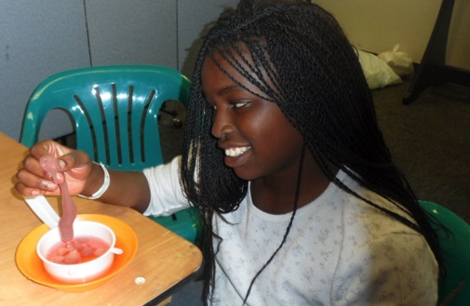
Summer Programming
2012 Mini Grant
Nanoscience themed class for summer camp
Introduced nano and tech education to underserved youth
4th – 8th graders

Slide 6
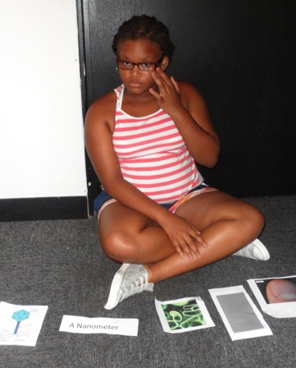
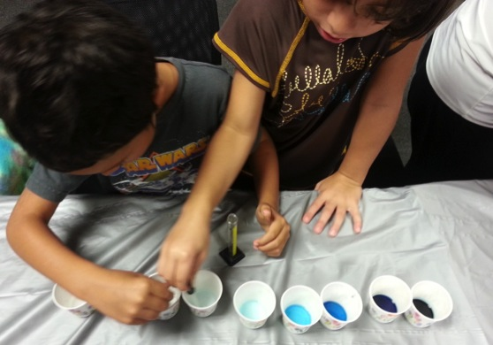
Summer Programming
Components of Program
Hands-on activities and experiments
Activities from Nano Days kits
Nano Theater Shows
Nano Mini Exhibit

Slide 7
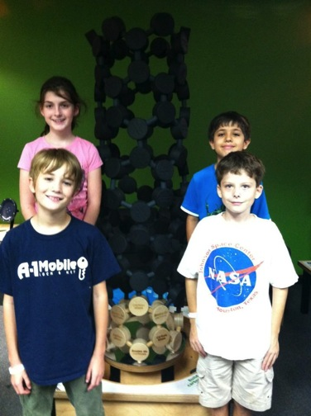
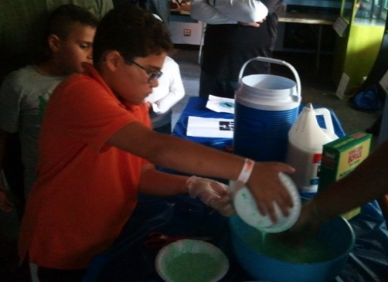
Summer Programming
Culminating Activity
Participants developed own nano-themed activities to present within exhibit
Some activities presented in additional languages (Spanish, Creole)

Slide 8
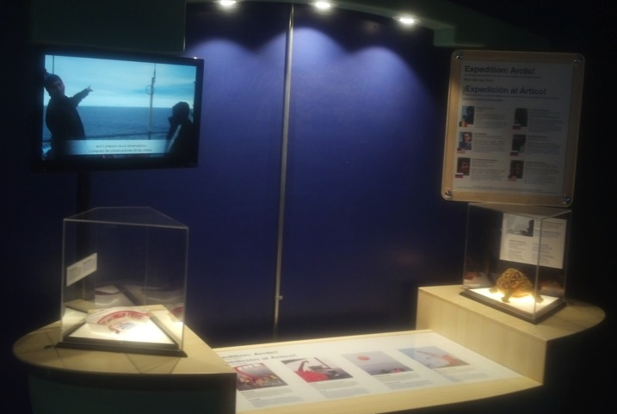
Flexible Scientist Spotlight Space
2014 Mini Grant: Exhibit strategy that incorporates current, ongoing local scientist stories
Notes:
Develop and review an exhibit strategy that incorporates current, ongoing science and local scientists stories into our various exhibit galleries, utilizing various science communication strategies and creating flexibility in terms of location and content.

Slide 9
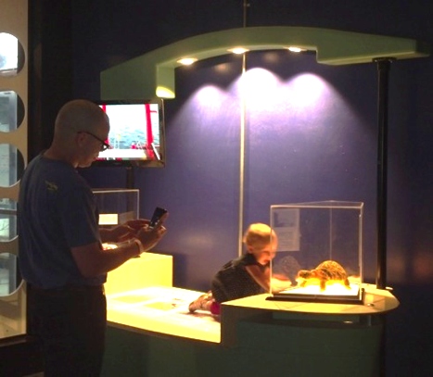
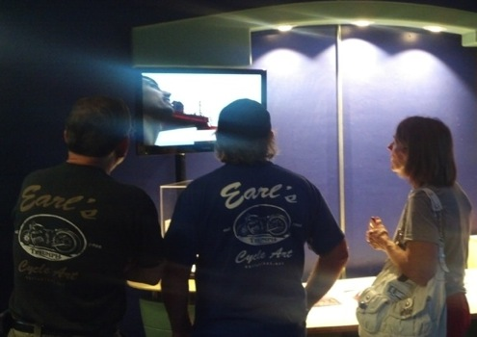
Flexible Scientist Spotlight Space
Components:
Flexibility
Monitor and Short video
Flat table surface
Display cases
Graphic Positions
Notes:
Develop and review an exhibit strategy that incorporates current, ongoing science and local scientists stories into our various exhibit galleries, utilizing various science communication strategies and creating flexibility in terms of location and content.

Slide 10
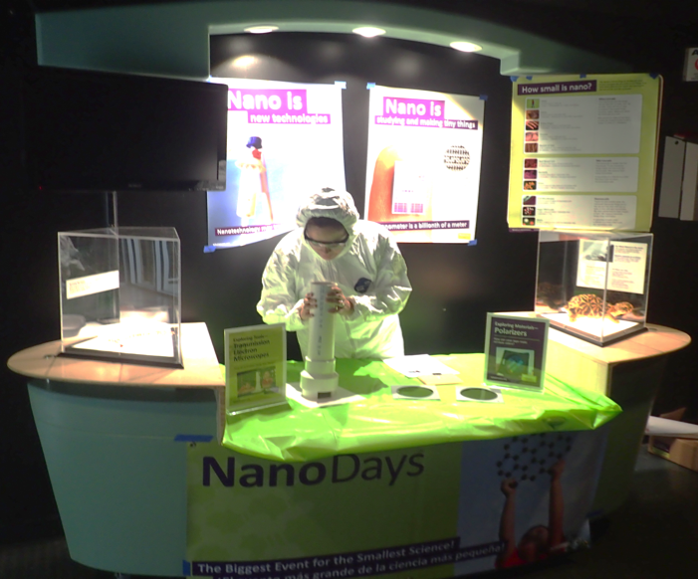
Flexible Scientist Spotlight Space
Notes:
Develop and review an exhibit strategy that incorporates current, ongoing science and local scientists stories into our various exhibit galleries, utilizing various science communication strategies and creating flexibility in terms of location and content.

