Slide 1



Examples
Using the Nano exhibition as a platform for programming by…
  Inserting nano into current museum offerings
  Expanding upon the exhibition with additional components and programming
  …Location, Location, Location!!!

Slide 2
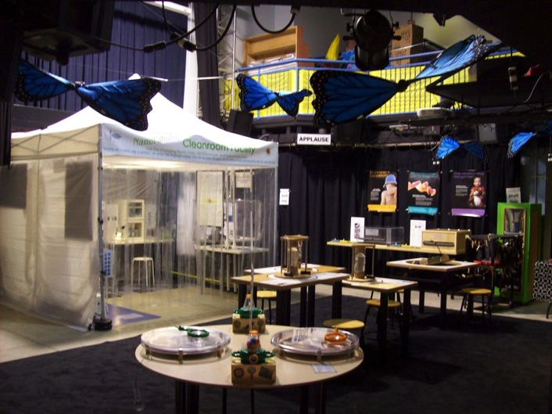
Where in the USA is the Nano mini-exhibition?
Port Discovery Children’s Museum

Slide 3


Two Ingredients for a Successful Nano Exhibit
Enthusiastic
and dedicated staff!

Slide 4
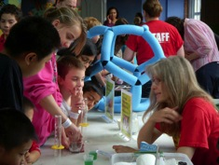
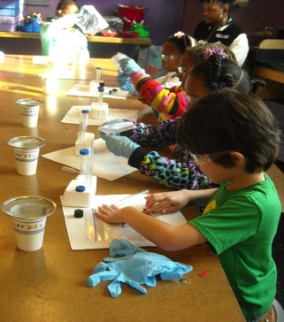
Overview:
Expanding Upon Nano Exhibit Programming
  General Visitors: Meet a Nanoscientist, Small Wonders Cabinet & Science Time
  School Groups: Nano Time! & MRSEC Programs
  Home School Groups: Freaky Fridays
  Family Programs: The Science of the Small: Nanoscience Exposed!
  After School: STEMventures: Rules of NanoLand

Slide 5

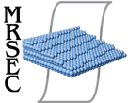

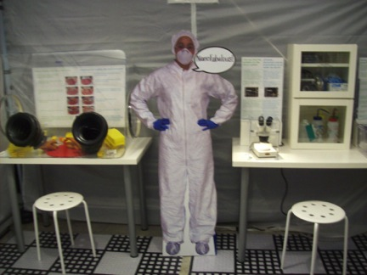
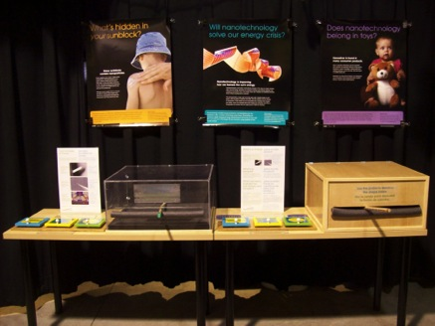
Exhibit Expansion
Nano Cleanroom
Probe Station

Slide 6
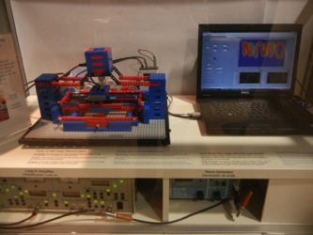
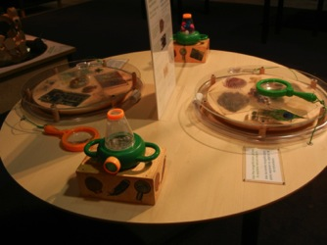
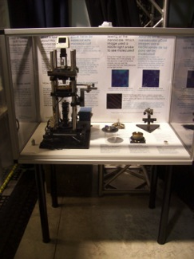
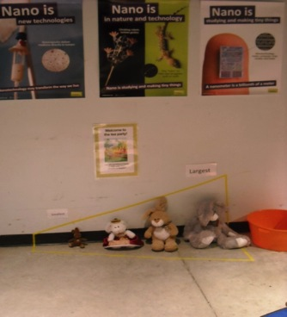
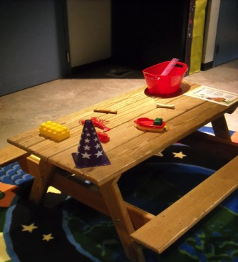
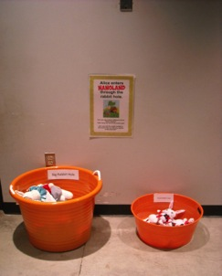
Exhibit Expansion Continued…
LEGO SPM
Magnification Table
NSOM
Measure the toys!
Sort the rabbits in the rabbit holes!
Order the rabbits by size!

Slide 7

Where in the USA is the Nano mini-exhibition?
Science Center of Iowa
“Nano Spot” Signage
Notes:
Slide post Allison’s presentation

Slide 8

Goals
Overview:
Inserting Nano into Current Programming
Increase constant presence of “nano” on floor
Integrate nano into other areas of museum
Find ways to make nano-content readily accessible to more visitors
Tie to Nano mini-exhibition with NISE Net graphic components
“Bite Size” Info: links to more content, like whatisnano.org

Slide 9
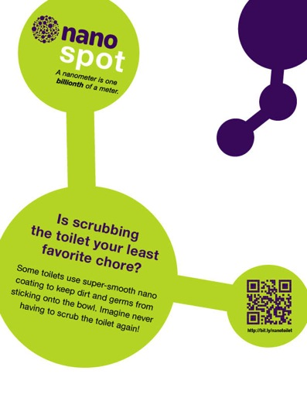





Signage
Signage

Slide 10
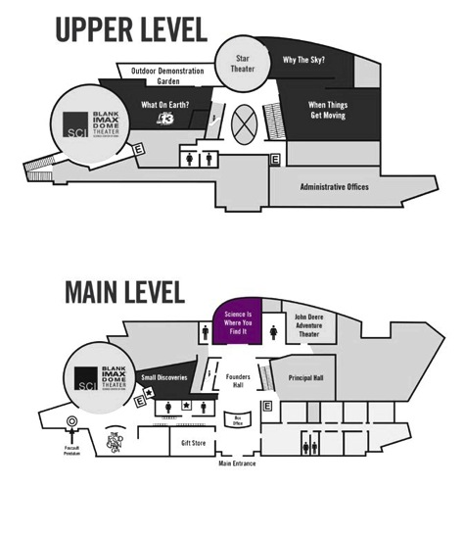
Signage Locations
Signage Locations
●
●
●
●
●
●
●
●
●
●
●

Slide 11


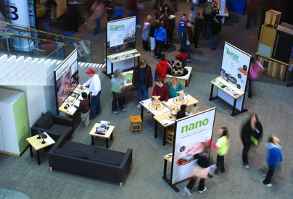

Slide 12
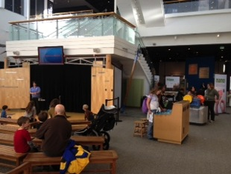
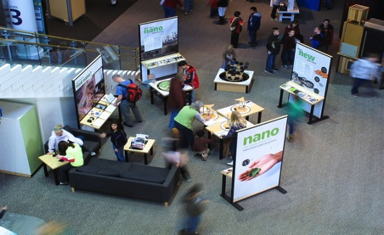
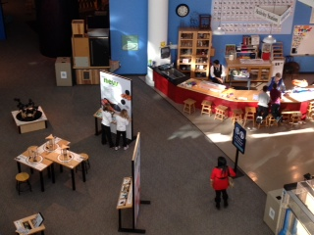
Science Museum of Minnesota
Right side: Atrium Stage
Left side: Experiment Gallery Activity Station
Notes:
Cakers

Slide 13
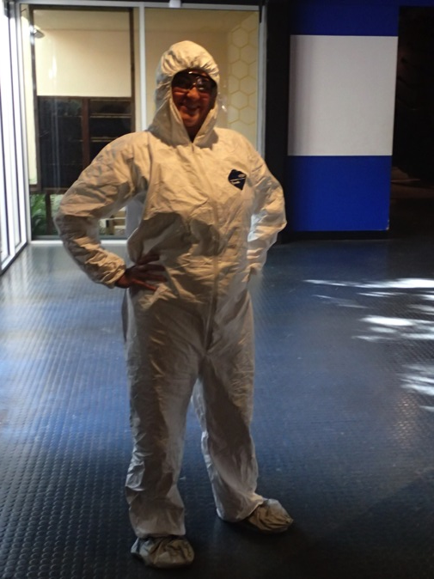

Questions?

Slide 14


THANK YOU!
This presentation is based on work supported by the National Science Foundation under Grant No. 0940143.
Any opinions, findings, and conclusions or recommendations expressed in this presentation are those of the author(s) and do not necessarily reflect the views of the Foundation.

Slide 15


Avoid reinventing the Wheel!
There’s a NISE Net product for that!
  nisenet.org/catalog/exhibits/nano_mini-exhibition
  whatisnano.org/nano-exhibit
  Links to:
  Exhibition info & resources for download
  Video walk-thru & photos
  Audio Description & Bilingual Resources
  Selected books about nano
  Intro to Nano – Reference Articles
  Evaluation guidelines & templates
  Training videos & orientation materials

Slide 16

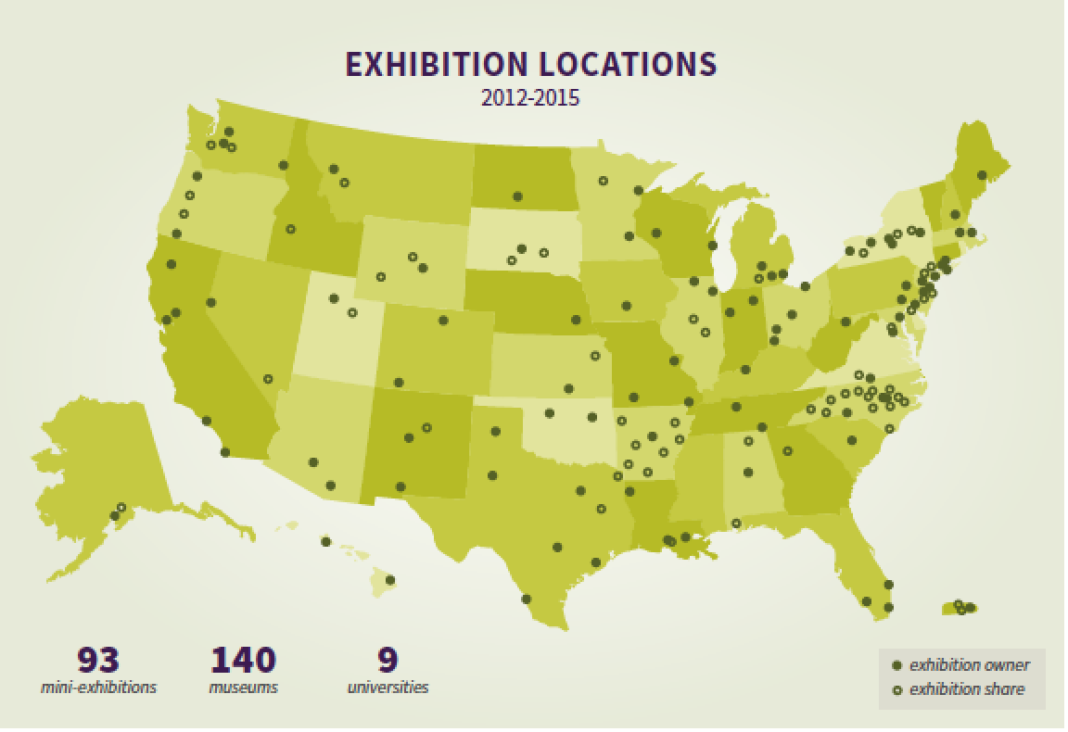
Where in the USA is .
Notes:
Batch 1: 49
Batch 2: 21
Subtotal 70
Batch 3: 23 (not on this map)
Total: 93

