Slide 1
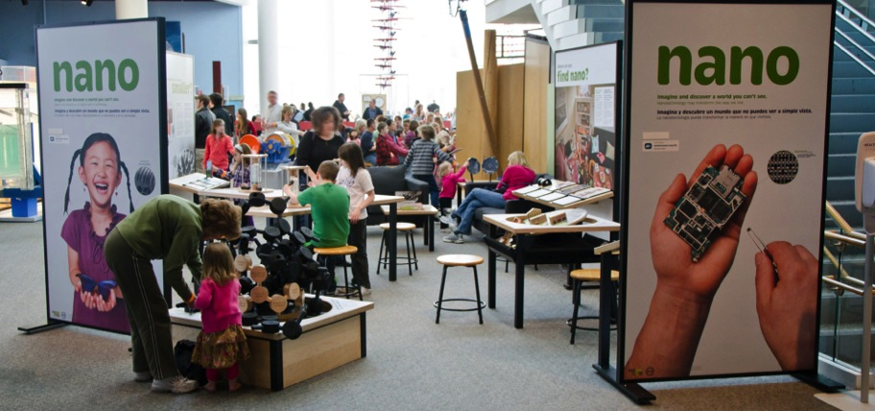
Small footprint exhibitions
www.nisenet.org

Slide 2
Overview
Nano small footprint exhibition
Possible future directions
Discussion

Slide 3
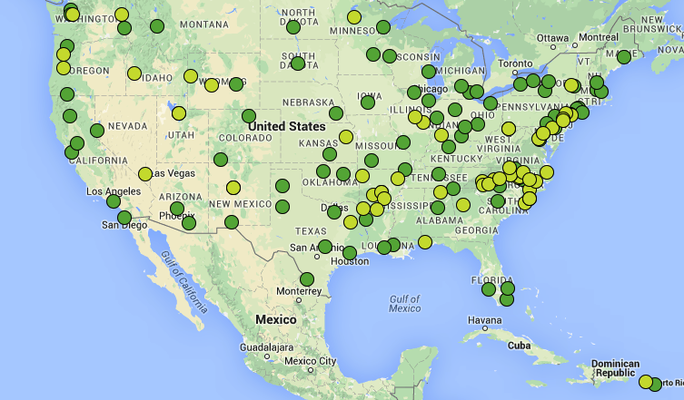
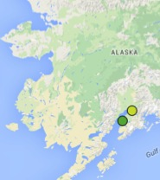
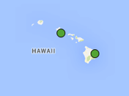
Nano exhibition
• Owning = 93
• Sharing = 56
Total = 149

Slide 4
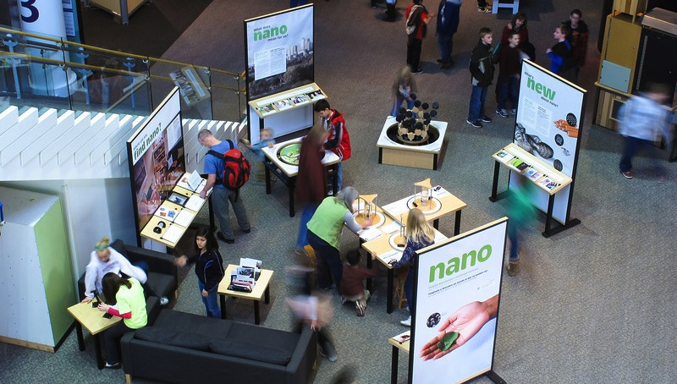
Science Museum of Minnesota

Slide 5
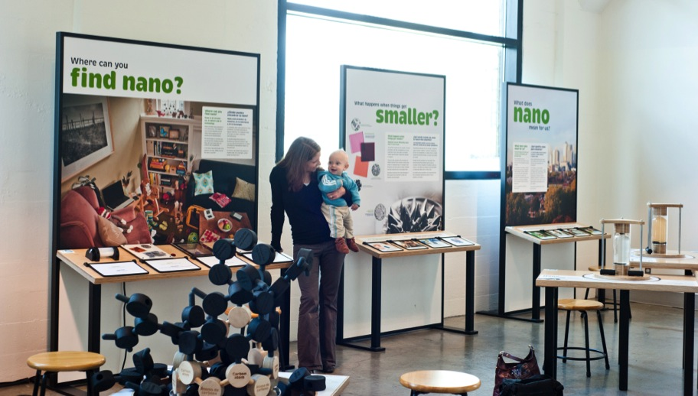
OMSI

Slide 6
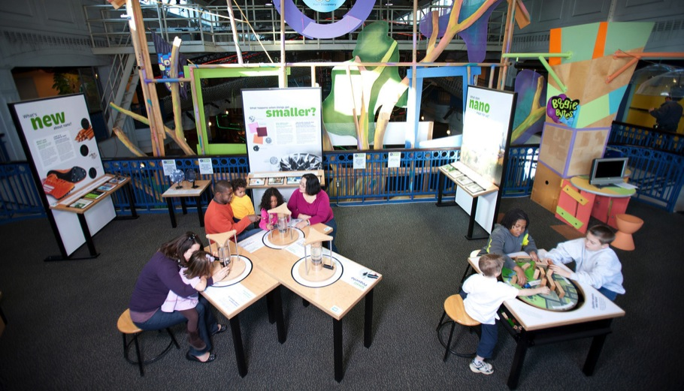
Port Discovery

Slide 7
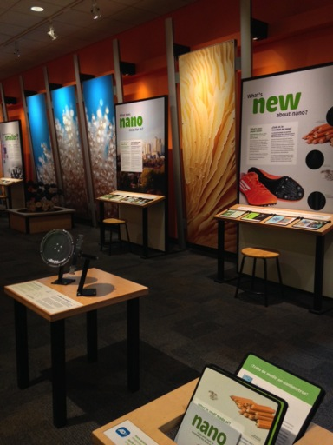
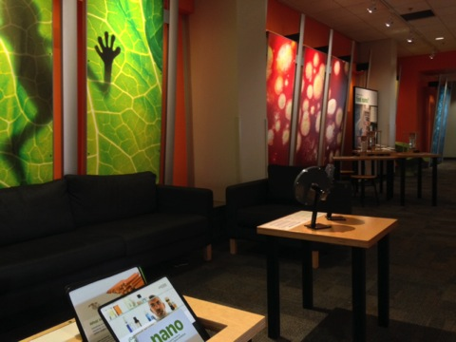
COSI

Slide 8
Small footprint exhibition

Slide 9
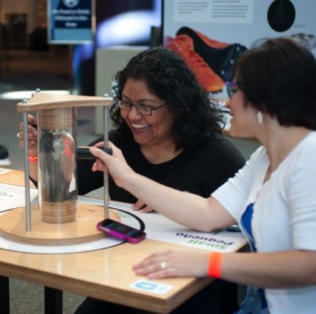
Small, smaller, nano
Notes:
Exploring the question: What happens when things get smaller?
LEFT: Museum visitors using Small, Smaller, Nano at Port Discovery Children’s Museum.
RIGHT: Bilingual design consultants using the component at SMM.

Slide 10
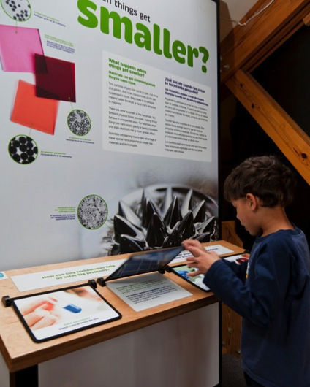
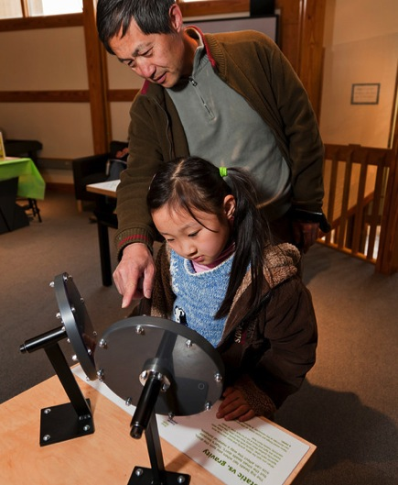
Graphic panel Static vs. gravity
Notes:
Museum visitors using a graphic panel and the Static vs. Gravity component at the Sciencenter in Ithaca, NY.

Slide 11
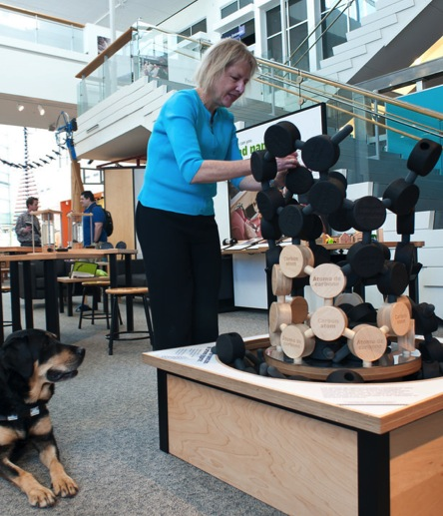
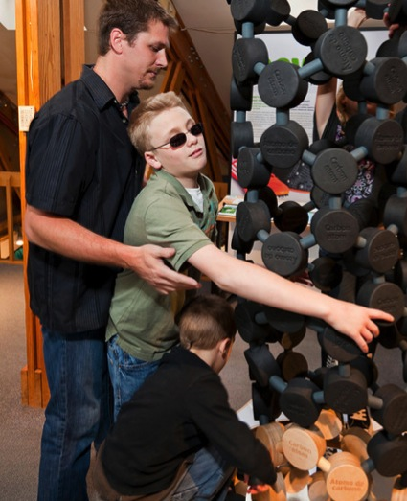
Build a giant carbon nanotube
Notes:
LEFT: Blind universal design consultant using the Build a Giant Carbon Nanotube component at the Science Museum of Minnesota.
Experts with disabilities helped the exhibition team make Nano as accessible as possible.
RIGHT: Museum visitors using Build a Giant Carbon Nanotube component at the Sciencenter, Ithaca, NY.
The older boy in this family is blind. He is working with his father and brother to build the model.

Slide 12
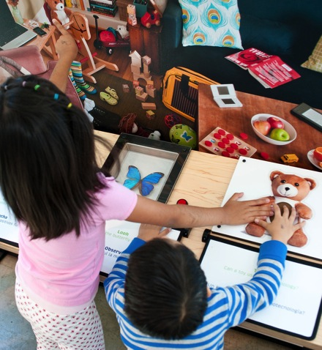
I spy nano!
Notes:
Exploring the question: Where can you find nano?
LEFT: Museum visitors using I Spy Nano at the Port Discovery Children’s Museum.
RIGHT: The component at OMSI.

Slide 13
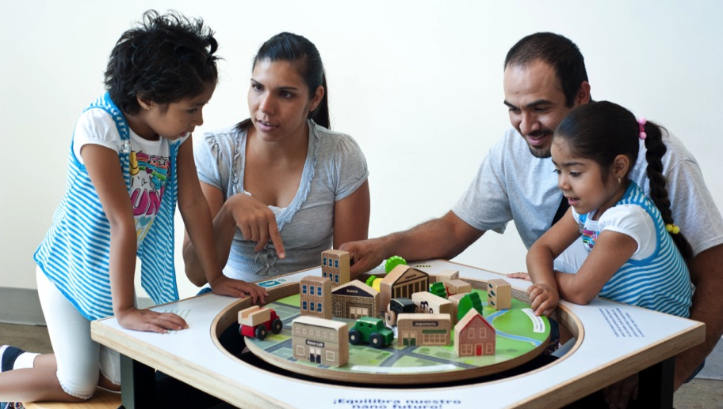
Balance our nano future
Notes:
Exploring the question: What does nano mean for us?
Museum visitors using Balance Our Nano Future at OMSI.

Slide 14
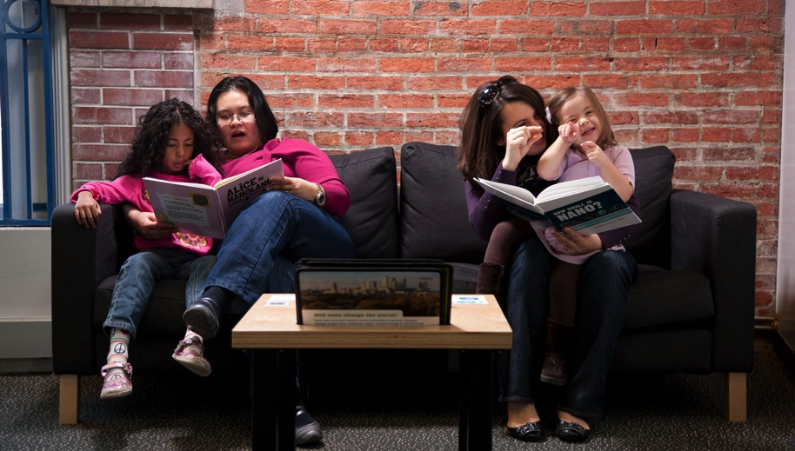
Reading area
Notes:
Museum visitors relaxing in the exhibition seating area at the Port Discovery Children’s Museum.

Slide 16
Notes:
Around 10 million people per year now that all 93 copies are distributed.

Slide 17
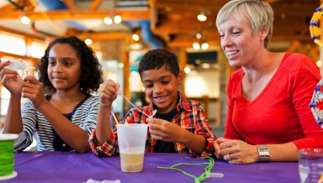
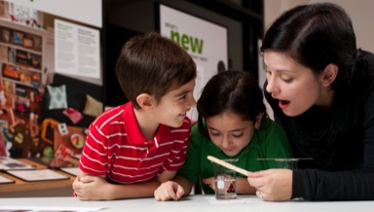
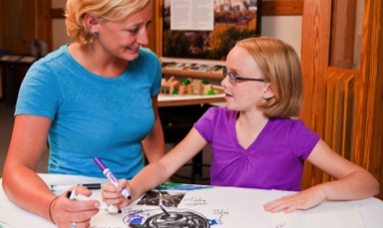
NanoDays kits
Notes:
NanoDays activity kits complement the exhibition

Slide 18
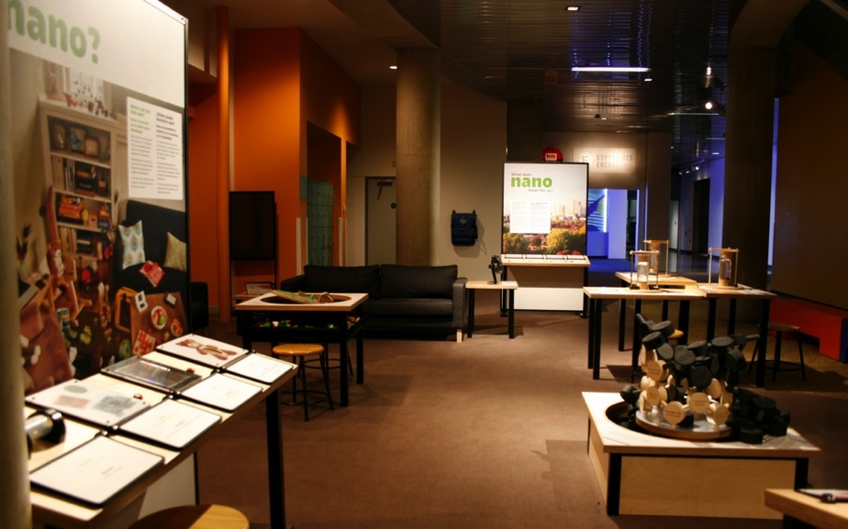
Future directions
Notes:
Image St. Louis Science Center

Slide 19
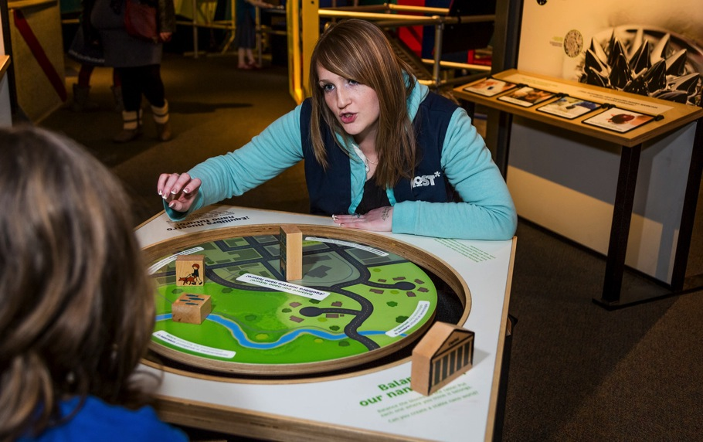
Discussion
Notes:
Small group discussion
Specific questions. General feedback and suggestions also welcome.

Slide 20
Questions
Model
Does this seem like a viable business model? Would museums be interested in buying this product for this price?
Does this model offer potential to build capacity and collaboration across the field? Would museums be interested in working together on challenging topics or new modes of engagement?
Specifics
What topics are likely to be broad interest?
What price range seems workable?
Is 400 square feet a good size?
Would there be interest in related activity kits?
Notes:
We can do this as a plenary discussion if the group is small, or if there’s a large group we can ask each table to discuss and take notes to share with the organizers.

Slide 21
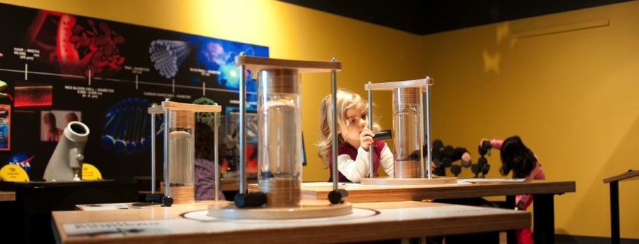
Thank you
Cynthia Needham, ICAN Productions
This presentation is based on work supported by the National Science Foundation under Grant No. 0940143. Any opinions, findings, and conclusions or recommendations expressed in this presentation are those of the authors and do not necessarily reflect the views of the Foundation.
Notes:
LARRY

