Slide 1
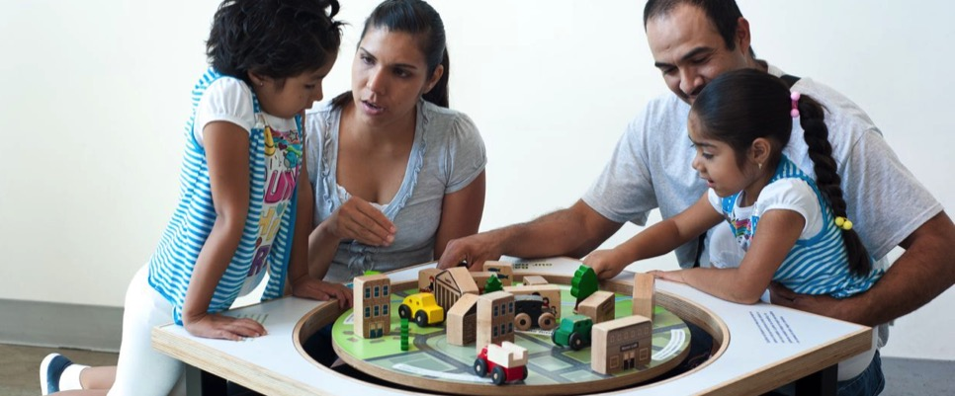



Engaging Visitors in Science and Society Conversations

Slide 2
Presenters
Heather Barnes – Museum of Science and Industry (heather.barnes@msichicago.org)
Douglas Coler – Disovery Place (douglasc@disoveryplace.org)
Stephanie Long – Science Museum of Minnesota (slong@smm.org)

Slide 3
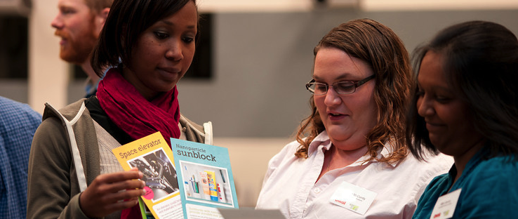





Nano & Society Workshops
Notes:
We held four 2-day workshops in the fall of 2012 focused on preparing museum educators to engage the public in conversations about the relationship between nanotechnology and society. The reason you see 5 listed here is bc we held the pilot workshop at the ASC.
Nano & Society Three Big Ideas:
Values shape technologies
Technologies affect social relationships.
Technologies work because they are part of larger systems.
Methods and practices for engaging the public:
Conversational techniques for facilitating interactions with visitors.
Team-based inquiry approaches to improving and learning from professional practice.
We wont be getting into the TBI aspect in this webinar but if this is something that you’re interested in we have plenty of resources online in the NISE Net catalog.

Slide 4
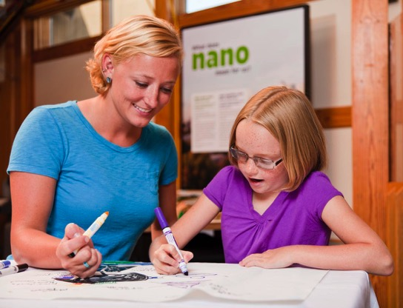
Overarching goal
To empower educators and visitors to reflect on the relevance of technology to their lives.
Notes:
First, let’s start by looking at this overarching goal: Empower both educators and visitors to think about, reflect, and understand the relevancy of nanotechnology to their daily lives.
We’re achieving this goal through both public engagement and professional development strategies:
For Public engagement, the NISE Net has created a variety of educational experiences that can be used to engage a broad range of public audiences in conversations about the relevance of nanotechnology in their lives.
And for Professional development, well that what we’re doing today. We are trying to increase the capacity of our field to effectively engage public audiences in these conversations about nanotechnology and society.

Slide 5

Goals for Engaging Visitors in Conversations
Educators and visitors participate in open-ended, engaging conversations.
Educators and visitors have distinct, equally important roles in the conversation.
Participating in a conversation is a meaningful learning experience for visitors.
Facilitating a conversation is a valuable interpretive method for facilitators.
Notes:
Refer to handouts

Slide 6
Two Approaches to Engaging Visitors
Demonstration
Scientist/educator has knowledge and expertise to share
Visitors discover phenomena and laws of nature
The facilitator communicates facts
Visitors ask questions and receive answers
Promotes basic goal public understanding
Use this approach to explain the Bernoulli Principle to visitors
Conversation
Everyone has their own values and perspective to share
Facilitators and visitors consider facts and values
Facilitators and visitors ask questions and receive responses
Visitors form opinions and explore ideas
Promotes basic goal of public engagement
Try this approach to engage visitors in nano and society
Notes:
**Conversational Cheat Sheet and Tips for Visitor Conversations and refer to both.
So now we’re going to look at both the demonstration and conversation side by side. Keep in mind, we’re not suggesting that you abandon the demo…think of them as two different approaches in your toolkit.
These conversations are often based on questions about values. For example: What do we want the world to be like in the future? This is not something you can research and uncover the correct answer. Each visitor will have a different response and no response is wrong.
Scientists are not the experts in this topic, and neither are you or your visitors. Everyone has their own values and makes their own decisions about how a technology impacts their lives. This means you’re not on the spot to be the expert to know everything about nanotechnology and how it might affect our lives. You’re just there as a facilitator trying to get the visitor to explore and express their opinions and values. There is no right or wrong answer. There will always be things we don’t know. Science can only inform us and help us make our own decisions based on the facts.
For some educators, this might be a big change. The center of expertise shifts when you’re talking about how nano will affect individuals and society as a whole. Visitors have important expertise here: they have the best idea of how something will impact their lives. And so they have an equal place in the conversation, alongside educators and scientists.

Slide 7
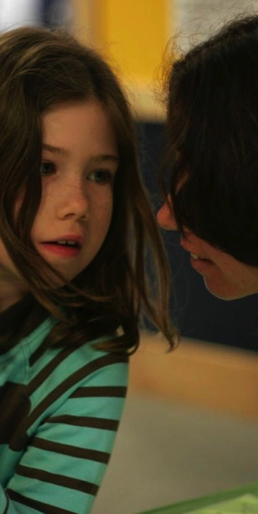

THREE BIG IDEAS
Notes:
For the next 10 minutes I’ll be talking about the concept around engaging with visitors in conversations on the relevancy of nano and society to our daily lives. I’ll cover some of the goals for engaging visitors in nano and society, why we think museums are a great place for conversations to happen and what a convo looks like, and how it differs from a demo.

Slide 8
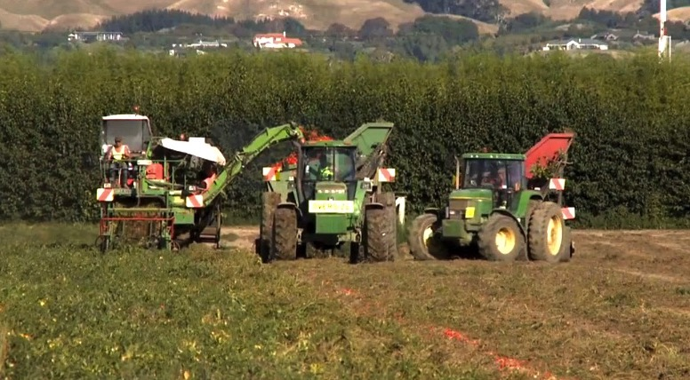
BIG IDEA: Values
Values shape how technologies are developed and adopted.

Slide 9
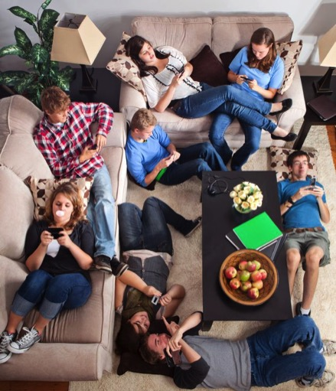
BIG IDEA: Relationships
Technologies affect social relationships.

Slide 10
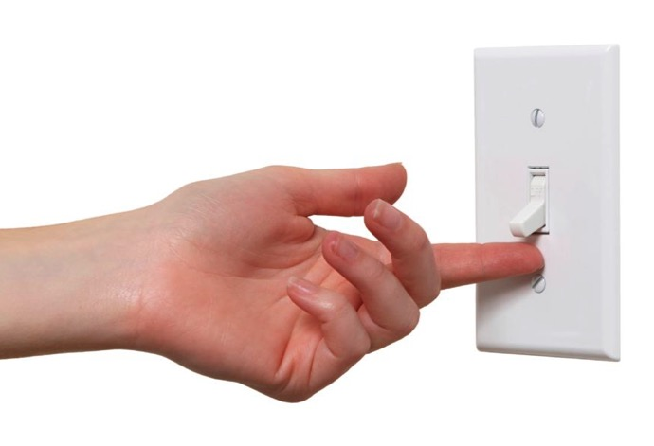
BIG IDEA: Systems
Technologies work because they’re part of systems.

Slide 11
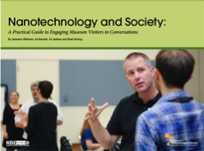
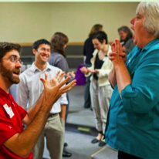
Nano & Society Tools
  Nano & Society
  training
  materials
  • slideshows
  • videos
  • tip sheets
  • team-based
  inquiry sheets
  Improv Exercises for staff and volunteers
  Technology & Society Guide
  More info: www.nisenet.org/catalog/tools_guides/nano_society_training_materials
Notes:
You’ll find all the resources we’ve created by visiting the NISE Net catalog link on this slide.
PowerPoints, Guides for following along with certain parts of the training and videos,

Slide 12
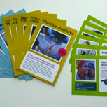
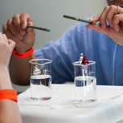
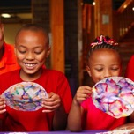
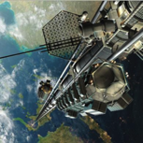
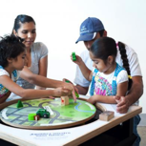
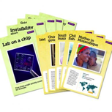
Educational Products in Catalog
  Nano Around
  the World
  card game
  Exploring Properties –
  Capillary Action
  Exploring Nano & Society – Tippy Table
  Exploring Nano & Society –
  Invisibility Cloak
  Exploring Nano & Society –
  Space Elevator
  Exploring Nano & Society –
  You Decide!
  More info: nisenet.org/catalog

Slide 13
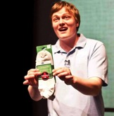
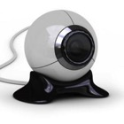

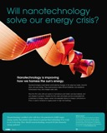
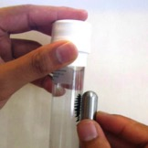
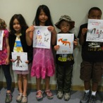

Educational Products in Catalog
  Forums:
  Nanomedicine
  Energy
  Privacy
  Who Decides?
  Cognitive Enhancement
  Nano & Society Posters
  Robots & People
  Would you buy that?
  Public program
  Wonders and Worries of Nanotechnology
  Video episodes
  Exploring Materials – Ferrofluid
  More info: nisenet.org/catalog

Slide 14
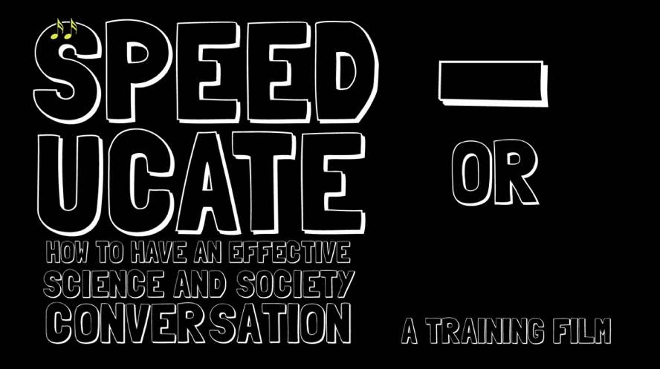
Speed-ucate Video
More info: http://www.nisenet.org/catalog/tools_guides/speed-ucate_video_or_how_have_effective_science_society_conversation

Slide 15
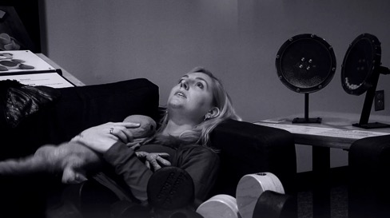
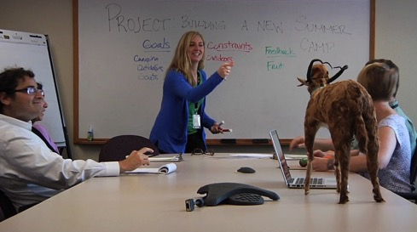
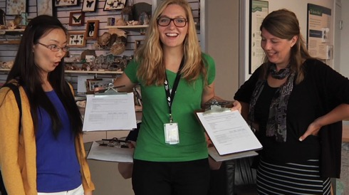
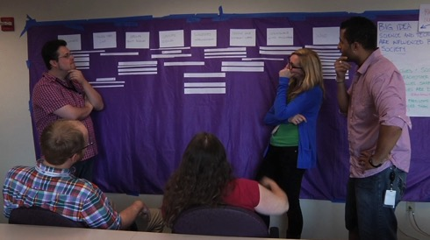
Team-Based Inquiry Training
  More info: http://nisenet.org/catalog/tools_guides/team-based_inquiry_guide

Slide 16
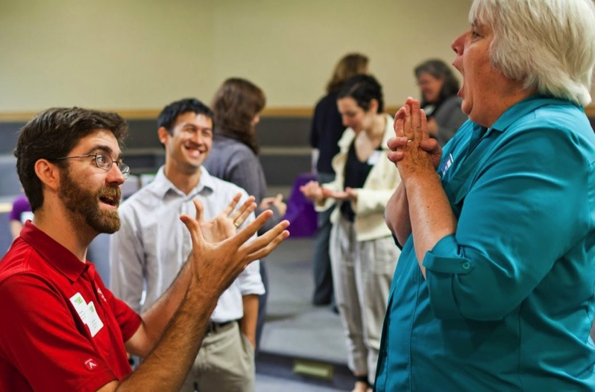
TRAINING: Improv Exercise
More info: nisenet.org/catalog/tools_guides/improv_exercises
Notes:
Debrief:
What skills are we practicing in this activity?
- Next slide has list of skills-

Slide 17
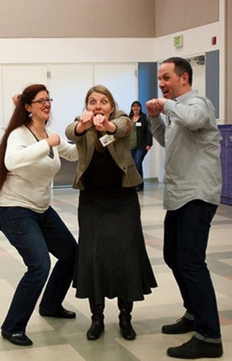
Why implement improv exercises ?
  Incorporating improv exercises into staff and volunteer training helps create a supportive and upbeat environment for educators to practice and strengthen essential skills.
  Warm up skills required for interacting with visitors
  Encourage conversations: with visitors (rather than reciting scripts)
  Be better listeners: think on your feet and respond in the moment
  Be responsive: better tailor content to visitors responses and integrate visitor feedback
  Be positioned as equals with visitors not “the expert”
  Foster teamwork & creativity: create a fun, supportive, positive work environment to practice skills
More info: nisenet.org/catalog/tools_guides/improv_exercises

Slide 18

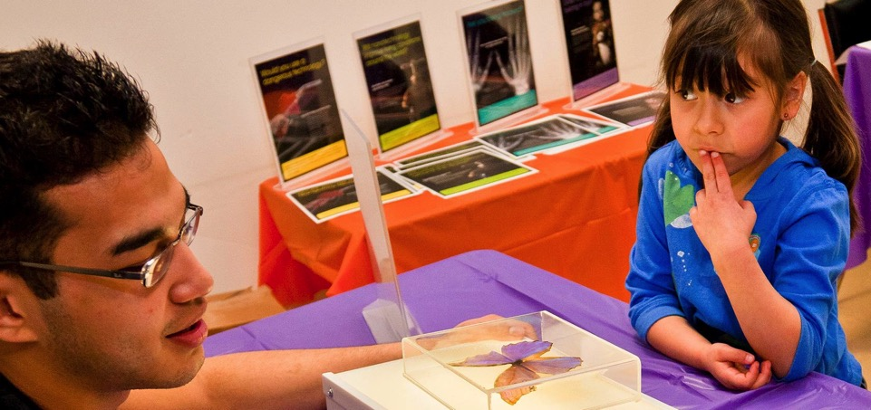
This presentation is based on work supported by the National Science Foundation under Grant No. 0940143.
Any opinions, findings, and conclusions or recommendations expressed in this presentation are those of the authors and do not necessarily reflect the views of the Foundation.

