Slide 1



Stephanie Long
Science Live, Director
Science Museum of Minnesota
slong@smm.org

Slide 2
Parts to a story Robert Mckee
Inciting Incident
Progressive Complications
Inner Conflict
External Conflict
Status
Motivation or Super Objective
Crisis
  What is at stake?
Climax
  The story builds to a moment of absolute change
Resolution
  Closed Ending or Open Ending

Slide 3
Other elements of a good story
Beats
Silence
Every line is an action
Acting is reacting
Not too many facts
Limit teaching goals
Limit the number of characters

Slide 4

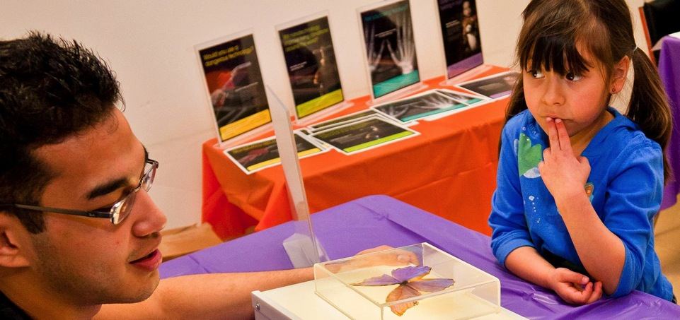

This presentation is based on work supported by the National Science Foundation under Grant No. 0940143.
Any opinions, findings, and conclusions or recommendations expressed in this presentation are those of the authors and do not necessarily reflect the views of the Foundation.

