Slide 1
Overview
Notes:
[This slide presentation provides an overview of Frankenstein200, and can be used to introduce staff and volunteers to the project and its educational materials. You can customize this training presentation to fit your organization and programming.]

Slide 2
Overview
Frankenstein200 project
Our event
Activity kit
Leading the activities
Alternate reality game
Questions
Notes:
Welcome to our Frankenstein200 overview! In this presentation, we’re going to go through quite a bit of information related to the national Frankenstein200 project, as well as the programming we are doing here. We’ll have time at the end for questions, but feel free to ask for clarification throughout.

Slide 3
FRANKENSTEIN200
Notes:
The project is called Frankenstein200. That’s because it’s celebrating the 200th anniversary of the publication of Mary Shelley’s story, Frankenstein.

Slide 4


Frankenstein200 project
Celebrating the 200th anniversary of Mary Shelley’s Frankenstein!
Over 50 museums, libraries, and other organizations across the United States are participating.
Notes:
Frankenstein200 is a national project that focuses on the bicentennial. Over 50 museums and other organizations across the United States are participating in this project, and many more are doing other activities related to the 200th anniversary of the Frankenstein story.

Slide 5
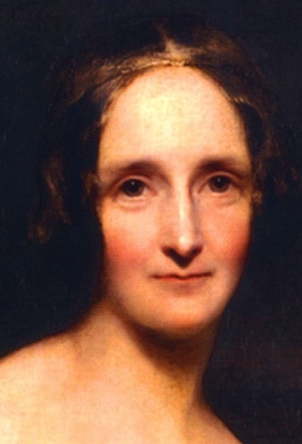
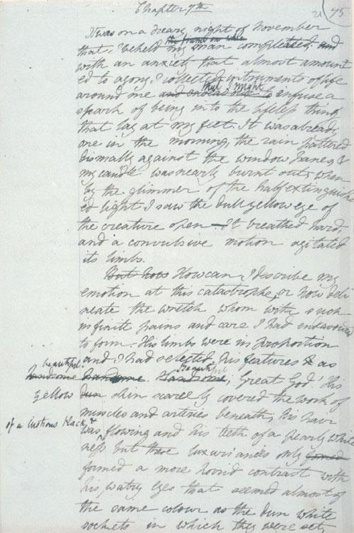
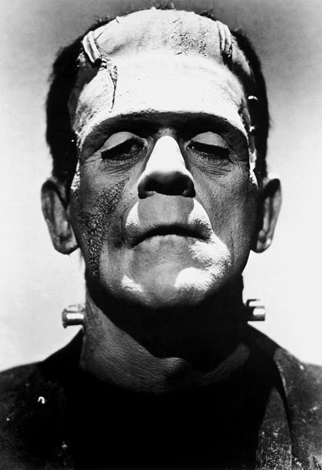
Mary Shelley’s Frankenstein
Mary Shelley
Draft of Frankenstein
Boris Karloff as Frankenstein’s creature
Notes:
Mary Shelley’s Frankenstein has endured in the popular imagination for two hundred years. Shelley got the idea for the novel following a ghost story competition among famous authors in 1816. Her novel was published on January 1, 1818, when she was only 20 years old. This thrilling tale of Victor Frankenstein and his stitched-together creature has never been out of print, and is currently the most-assigned novel in university courses. Its themes of innovation and its consequences remain relevant today.

Slide 6
Opportunities for learning
Practice 21st century skills such as creativity and collaboration
Reflect on responsible innovation
Explore emerging technologies such as artificial intelligence, robotics, synthetic biology, and human enhancement
Notes:
The Frankenstein200 project uses themes from Frankenstein to examine emerging technologies such as artificial intelligence, robotics, synthetic biology, and human enhancement. It promotes the development of 21st century skills related to creative collaboration and critical thinking, and gives participants a chance to think about important questions related to responsible innovation.

Slide 7
Key questions
What is life?
Why do we create?
What are our responsibilities as creators, scientists, and engineers?
Notes:
Frankenstein200 explores three key questions:
1. What is life?
2. Why do we create?
3. What are our responsibilities as creators, scientists, and engineers?
These important questions are easy to understand but hard to answer! People of all ages can explore these questions.

Slide 8
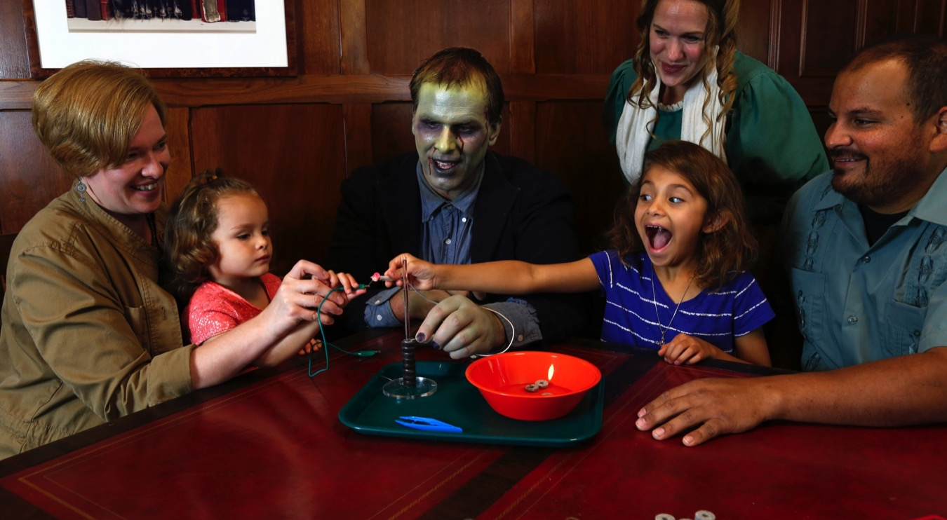
Transmedia learning
Notes:
Frankenstein200 is a transmedia project, which means “across media.” It is studying the learning that occurs when people participate in a combination of hands-on activities and immersive digital experiences. Later on, we’ll talk more about the different activities that are part of the project.

Slide 9
OUR EVENT

Slide 10
Event overview
Background
Who’s here
Orientation
Safety
Policies
Schedule
Future events
Notes:
[In this section of the presentation, you can add in more information about your programming.]

Slide 11
ACTIVITY KIT

Slide 12
Frankenstein200 kits
Hands-on activities
Automata
Battery Stack
Dough Creature
Frankentoy
Monster Mask
Scribble Bot
Spark of Life
Notes:
The Frankenstein200 kits include seven hands-on activities. All of them encourage creativity and reflection about responsible innovation.

Slide 13
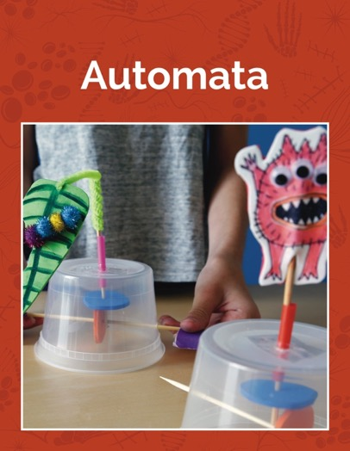
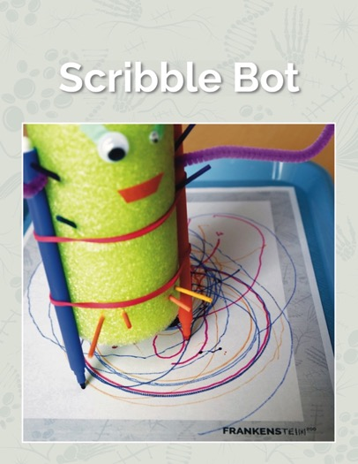
Creativity and responsible innovation
Artificial intelligence and robotics
Notes:
Two of the activities, Automata and Scribble Bot, make connections to research on robotics and artificial intelligence.

Slide 14
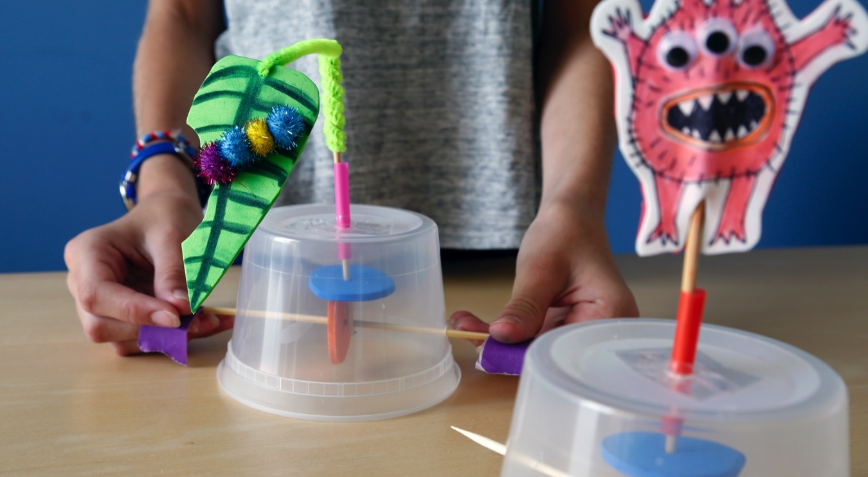
Automata
Notes:
In the Automata activity, learners make automata, which are moving mechanical devices that imitate the movement of a human, animal, or other living thing.

Slide 15
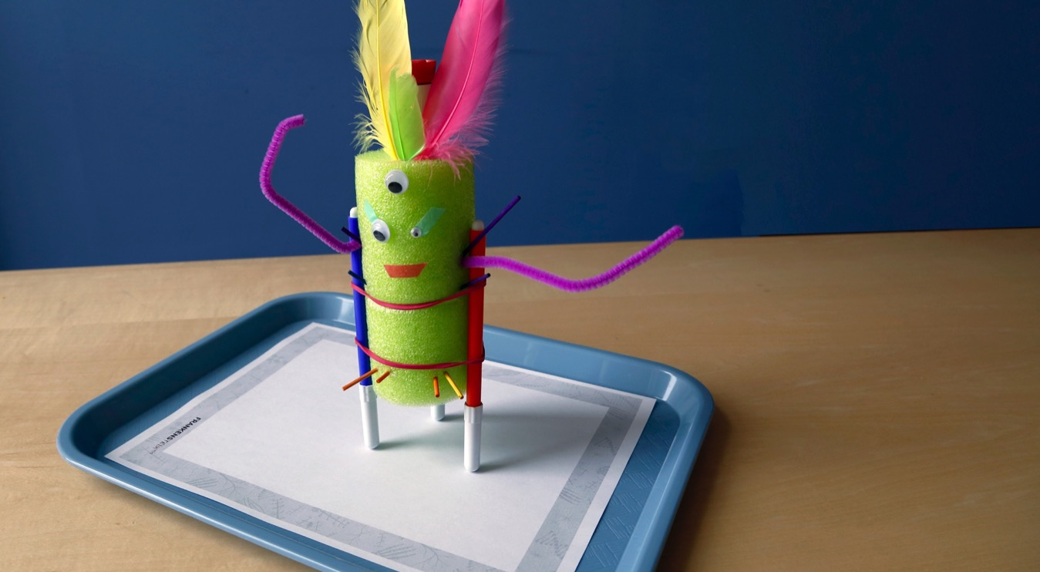
Scribble Bot
Notes:
In the Scribble Bot activity, learners make a toy bot with a surprising ability: it scribbles on a sheet of paper.

Slide 16
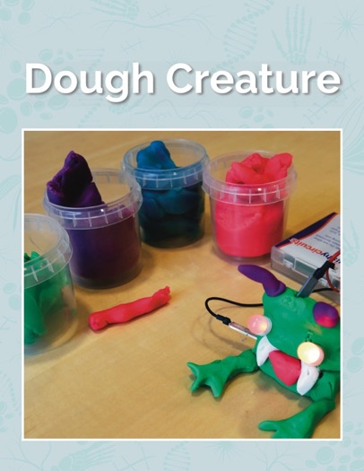
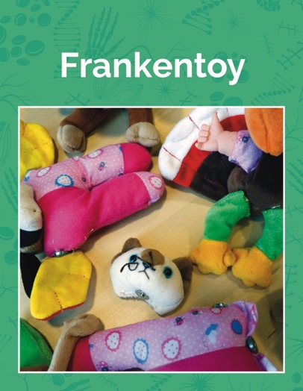
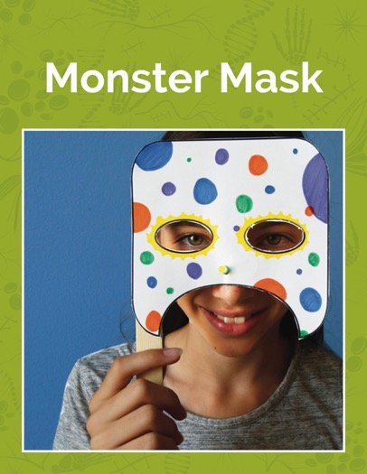
Creativity and responsible innovation
Genetic engineering and synthetic biology
Notes:
Dough Creature, Frankentoy, and “Monster Mask explore research in fields such as genetic engineering and synthetic biology.

Slide 17
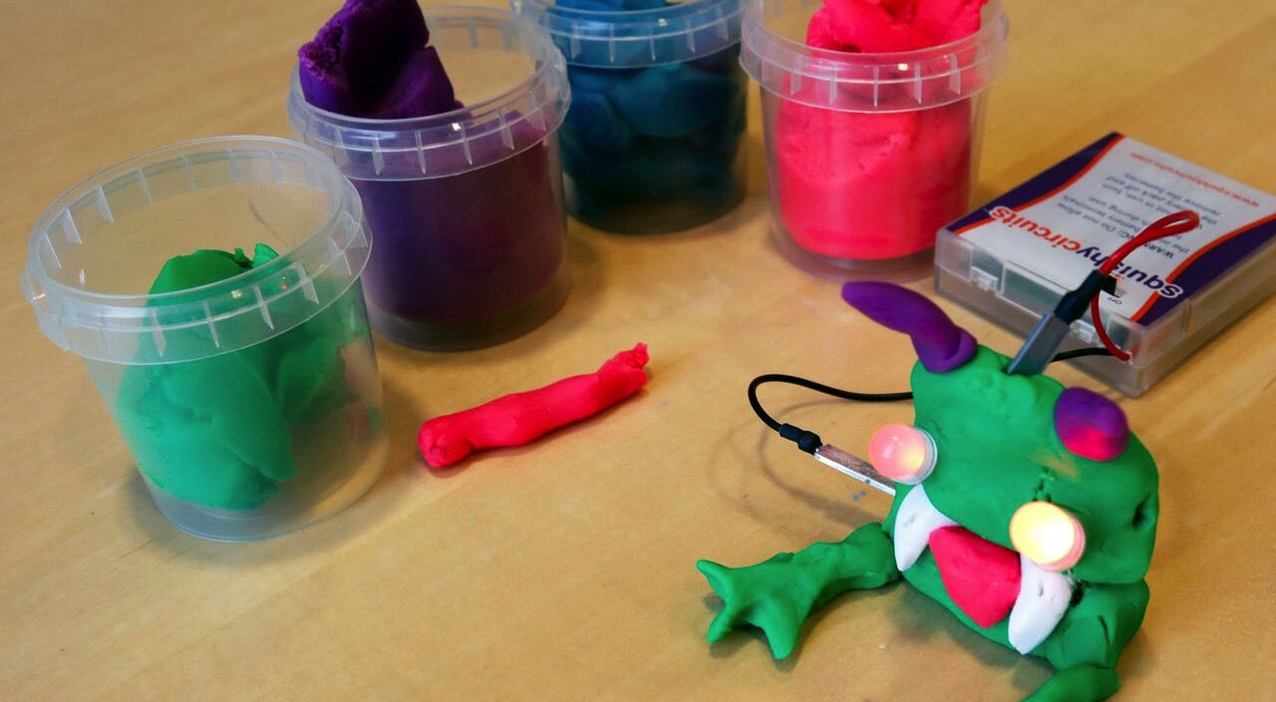
Dough Creature
Notes:
In Dough Creature, learners make a creature out of play dough and use it to create an electrical circuit.

Slide 18
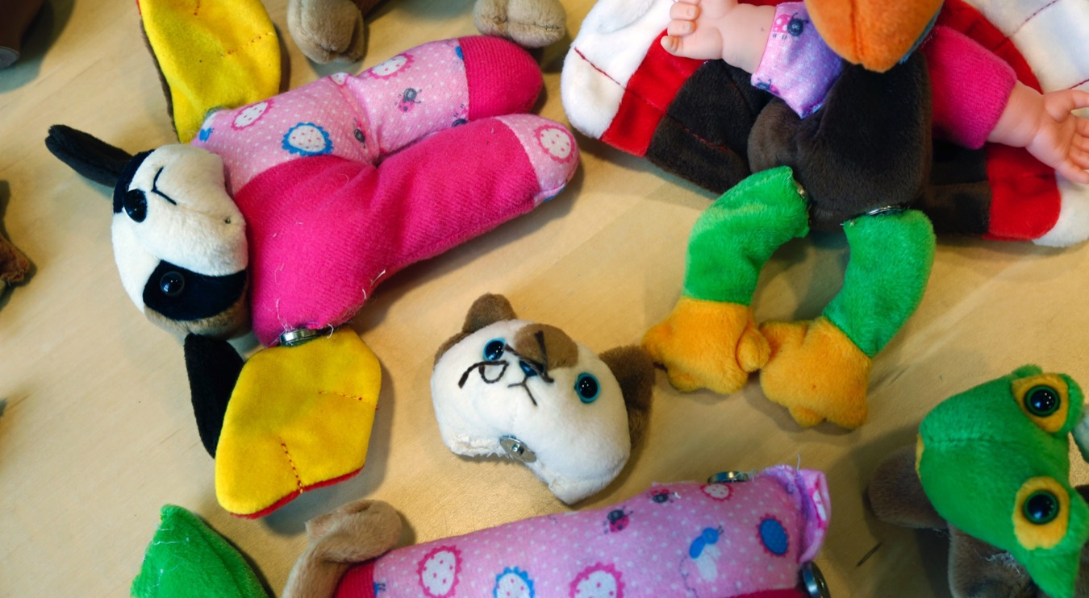
Frankentoy
Notes:
In the Frankentoy activity, learners make a “creature” by mixing and matching different parts of toys.

Slide 19
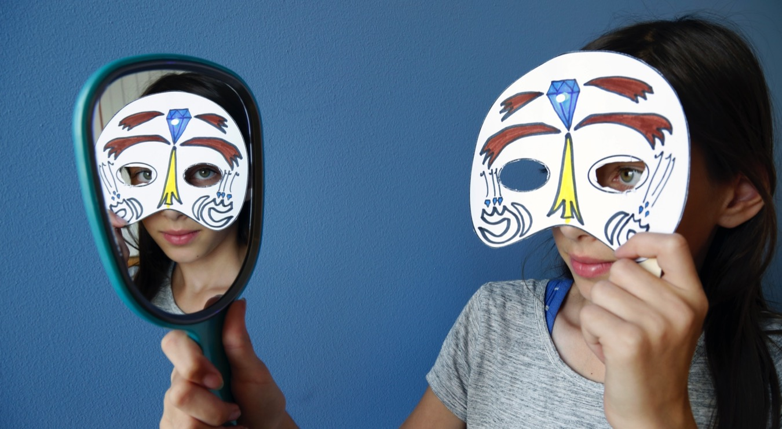
Monster Mask
Notes:
In Monster Mask, learners make a disguise with a special feature: an LED bulb that lights up.

Slide 20
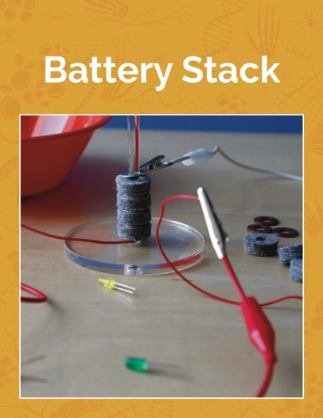
Scientific exploration and responsible innovation
Science of Mary Shelley’s time
Notes:
Battery Stack and Spark of Life explore the science of Mary Shelley’s time.

Slide 21
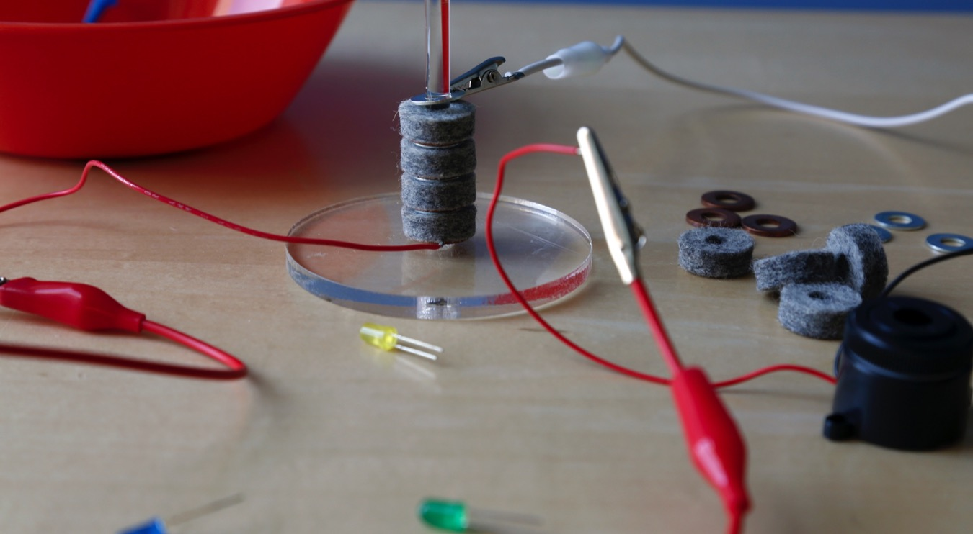
Battery Stack
Notes:
In the Battery Stack activity, learners make a voltaic pile, the first kind of battery.

Slide 22
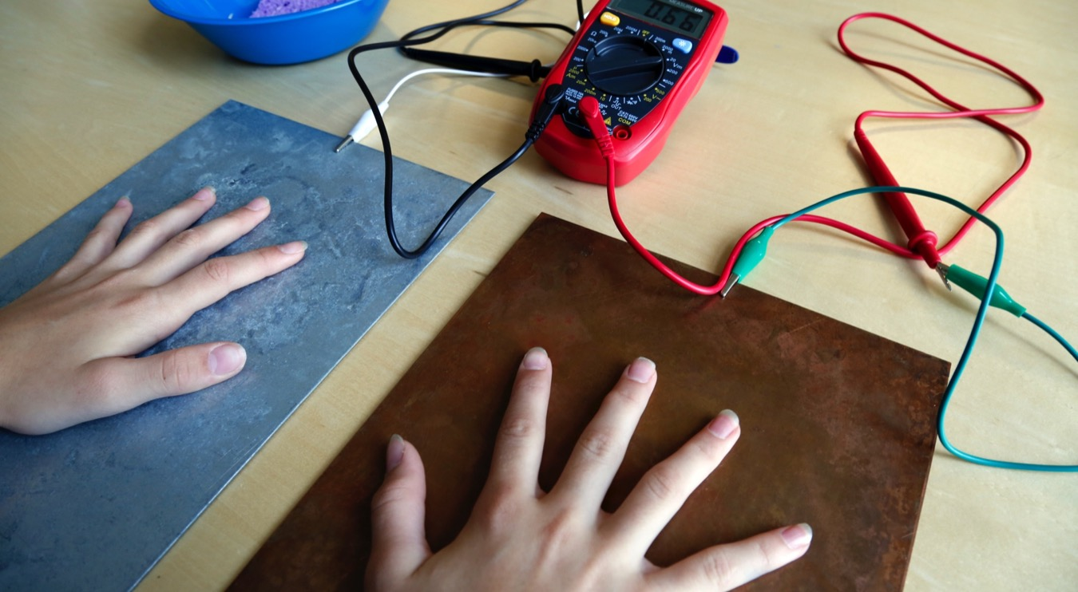
Spark of Life
Notes:
Finally, in the Spark of Life activity, learners create a battery from two kinds of metal and their own body! This activity also has an optional demonstration of a TENS unit (TENS stands for transcutaneous electrical nerve stimulation).

Slide 23
LEADING THE ACTIVITIES

Slide 24
Activity materials
Notes:
We’ve just taken a very quick look at all seven activities in the Frankenstein200 kit. Now, we’ll review some tips for leading these activities with participants, using the example of just one activity, Automata.

Slide 25
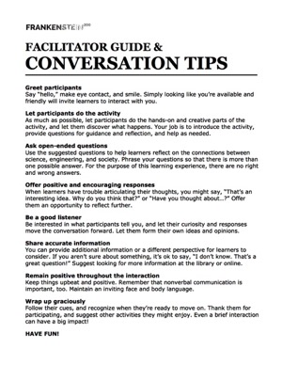
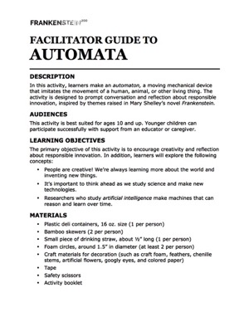
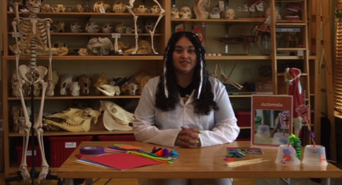
Activity materials
Notes:
Each activity comes complete with all the materials and supplies you need. They’re all packaged together in one cardboard box.
In the box, you’ll find two kinds of print materials: one kind that you can use and share with participants, and one kind with extra information just for you, the activity facilitator.
There is a colorful activity booklet that will help participants do the activity. The nooklet will also help you to learn to facilitate the activity! Some activities also include colorful information sheets or other graphic materials.
There are also more plain-looking materials that provide extra information for you as activity facilitators. You should review these prior to doing the activity. Unlike the colorful booklets, these are just for you and are not meant to be shared with participants.
Finally, please note that there is a training video for each activity, which you can watch to help you learn the activity before you do it with participants.

Slide 26
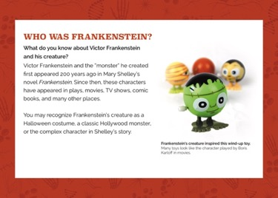
Activity booklets
Notes:
Now let’s look at some of these materials a bit more closely. Here is an example of an activity booklet.
The activity booklets are structured to help you lead learners through hands-on science activities.

Slide 27
Activity booklets
Notes:
The first section introduces the Frankenstein story and the activity itself. It’s called “Who was Frankenstein?” Be sure to connect the activity with the Frankenstein story as you invite visitors to participate in the activity!

Slide 28
Activity booklets
Notes:
The next section provides instructions for the activity. In this guide, the instruction section is called “Make a Creature.”
The instructions will help participants make a successful project, but there’s plenty of room for creativity and exploration.

Slide 29
Activity booklets
Notes:
The final sections connect the story to current science and technology, and also return to relevant themes from Mary Shelley’s Frankenstein. These sections are called, “People are Creative,” “Monster or Mistreated?” and “Responsible Innovation.”
They include some conversation and reflection prompts that you can ask participants. These questions reconnect the activity to some of the themes from Frankenstein, and will help participants consider how their ideas relate to the work researchers are doing today. Note that for the purposes of this activity, there are no right or wrong answers to the reflection questions. They are intended to help participants think about what it means to be responsible and think ahead as we create new things. You may choose to select just one or two questions, or modify the questions, to work better for different participants.

Slide 30
Activity booklets
Notes:
This particular activity also has an info sheet, which provides a closer look at different ways to build the project.

Slide 31

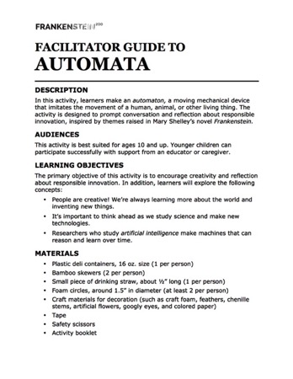
Facilitator guides and training videos
Notes:
Here are examples of the materials that are intended for you, the activity facilitator (and not intended to share with participants).

Slide 32
Facilitator guides and training videos
Notes:
The facilitator guide lists the activity learning objectives, explains the materials, and includes important notes related to setup, safety, activity flow, and other important information.

Slide 33
Facilitator guides and training videos
Notes:
Additionally, each activity contains a reference sheet with tips for engaging your guests in conversation, a brief overview of the project, and a quick summary of the plot of Mary Shelley’s Frankenstein.

Slide 34
Facilitator guides and training videos
Notes:
All of this information is also covered in the training video.
The most important thing to remember when you do these activities is to have fun! Enjoy being creative, exploring science and engineering, and thinking about responsible innovation with participants!

Slide 35
Alternate reality game
Notes:
The Frankenstein200 project has also created an online interactive educational experience.

Slide 36
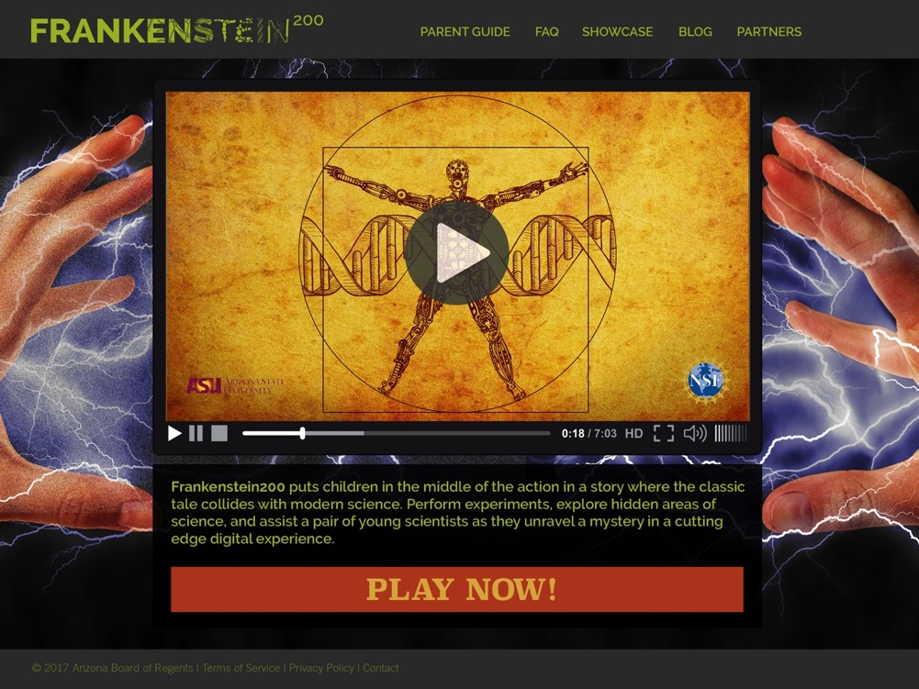
Frankenstein200 L.I.F.E. game
Notes:
This “alternate reality game” combines videos, online activities, and at-home hands-on activities to create an immersive, modern interpretation of Mary Shelley’s Frankenstein story. This game takes place at the fictional Frankenstein Laboratory for Innovation and Fantastical Innovation, or “L.I.F.E.” The premise of the game is that players have been invited to join the lab. They get an inside look at the lab under the direction of two young research associates: razor-sharp Mya, who is investigating new methods of manipulating DNA, and smart and reliable Xavier, who is building a robot. Almost immediately, Mya’s investigations take a surprising turn, when she uncovers something mysterious in her own DNA. She enlists Xavier’s––and the players’––help in an attempt to discover the truth. In the end, each player decides the fates of Mya and the Lab’s mysterious founder, Dr. Tori Frankenstein.
As guests enjoy the hands-on activities at the museum, they can also see a movie trailer that introduces the game and sign up to get more information.

Slide 37
Questions?

Slide 38



Thank you
Copyright 2017, Arizona State University. Published under a Creative Commons Attribution-Noncommercial-ShareAlike license: http://creativecommons.org/licenses/by-nc-sa/3.0/us/
Distributed in collaboration with the National Informal STEM Education Network: nisenet.org
This project was supported by the National Science Foundation under Grant Number 1516684. Any opinions, findings, conclusions, or recommendations expressed in this program are those of the authors and do not necessarily reflect the views of the Foundation.
Image Credits
Activity instruction and promotion photos by the Science Museum of Minnesota for Frankenstein200. ARG promotion graphic by No Mimes Media for Frankenstein200.
Portrait of Mary Shelley from Wikimedia Commons. Retrieved from: https://commons.wikimedia.org/wiki/File:Rothwell_-_Mary_Shelley_(Enanced_Crop).jpg
Manuscript page from Frankenstein by Mary Shelley from Wikimedia Commons. Retrieved from: https://en.wikipedia.org/wiki/File:FrankensteinDraft.jpg
Photograph of Boris Karloff as Frankenstein’s monster from Wikimedia Commons. Retrieved from: https://commons.wikimedia.org/wiki/File:Frankenstein%27s_monster_(Boris_Karloff).jpg

