Slide 1
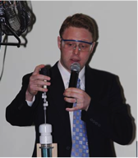
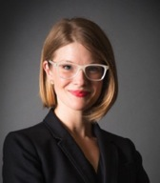
Building with Biology
Larry Bell David Sittenfeld Megan Palmer
Notes:
THURSDAY LUNCH, 12PM
LARRY
Larry makes transition from NISE Net to Building with Biology and introduces David
David describes BwB project and introduces Megan
Megan talks about syn bio

Slide 2
New opportunities
Notes:
LARRY

Slide 3
Building with Biology
Larry Bell David Sittenfeld Megan Palmer
Notes:
THURSDAY LUNCH, 12PM
LARRY
Larry makes transition from NISE Net to Building with Biology and introduces David
David describes BwB project and introduces Megan
Megan talks about syn bio

Slide 4
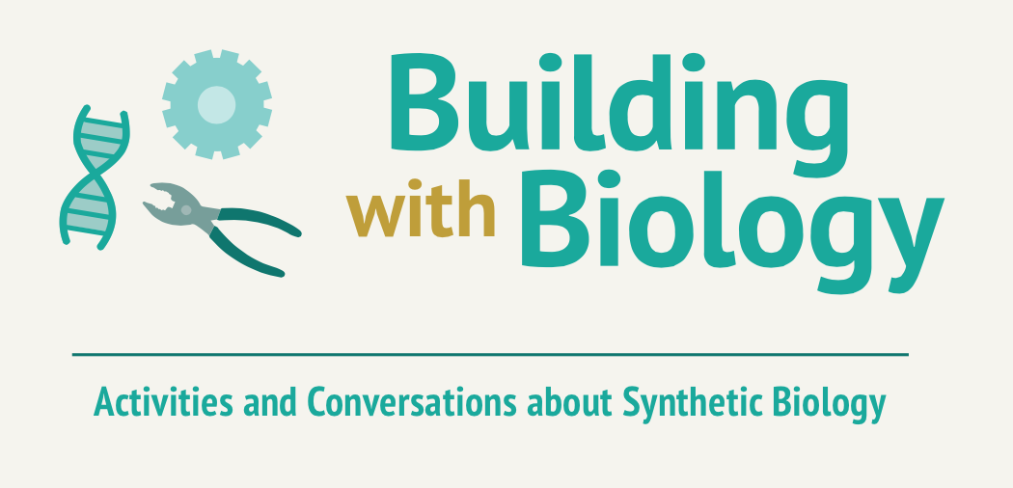
Megan Palmer
David Sittenfeld NISE Net Network-Wide Meeting
This project is funded by the Advancing Informal STEM Learning (AISL) program in the Education and Human Resources Directorate of the National Science Foundation through award no. DRL-1421179
Notes:
I want to start by thanking Larry and all of SMM folks for giving us this opportunity and hosting this amazing meeting. Megan and I are going to talk about a new project, funded by the National Science Foundation, that will use the infrastructure of the NISE Net to engage visitors at hundreds of museums around a new topic, and create and evaluate new kinds of conversations between scientists and the public. It involves many of the people in this room so let me just begin by asking anyone associated with the MSPES project to stand up so I don’t forget to acknowledge you.

Slide 5
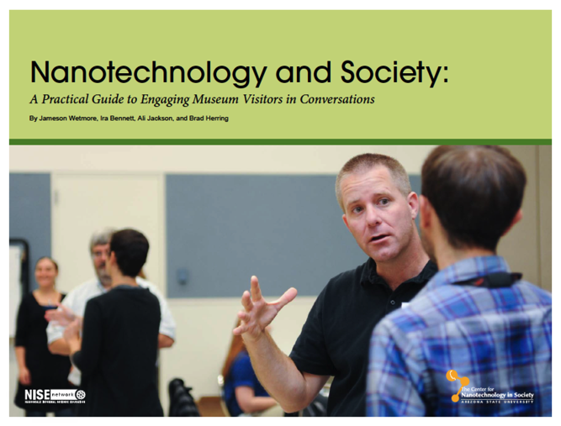
Notes:
As Larry described to begin the opening plenary, a major accomplishment of the NISE Net has been bringing current research into science centers. The N&S project was a major breakthrough because it allowed museums to engage visitors around the societal dimensions of an emerging technology in ways that were comfortable and low-risk for the institutions at a time when we were seeing a desire for this kind of work in the leadership of the informal science education community.

Slide 6
Toronto Declaration, 2008
5th Science Center World Congress:
“We will actively seek out issues related to science and society where the voices of citizens should be heard and ensure that dialogue occurs.”
Cape Town Declaration, 2011
6th Science Center World Congress:
“Further promote dialogue between scientists and the general public, so that public opinions on science and technology can be heard and incorporated into decision-making processes.”
Notes:
Here are quotes from the science center world congress which meets every three years and makes declarations about strategic directions that attendees agree science museums should go in. We can see that in 2008 the people writing these declarations felt that science museums needed to promote conversations between their visitors around societal dimensions and three years later there was language added about promoting dialogue between scientists and the public.

Slide 7
Mechelen Declaration, 2014
“Increasingly, science centres are moving beyond the traditional hands-on exploration of scientific phenomena.
Many centres are engaging with their audiences in the dialogues that address global challenges, and equipping them to become active players within their communities.”
Notes:
This has become institutionalized in science centers in Europe. Science centers are increasingly seeing their visitors not only as learners who may one day become scientists and engineers, but as citizens and decision-makers in society who use the outputs of science and technology. The NISE Net has advanced this work tremendously in the US but has mostly been focused on increasing the capacity of us as science museum educators to engage our visitors around these kinds of issues, while scientists themselves have acted as content advisors or presenters rather than as listeners to the public

Slide 8
“We need to move beyond what too often has been seen as a paternalistic stance. We need to engage the public in a more open and honest bidirectional dialogue about science and technology and their products, including not only their benefits but also their limits, perils, and pitfalls.”
http://www.aaas.org/pes
Alan Leshner,
Former CEO, AAAS
(American Association for the Advancement of Science), 2003
Notes:
At the same time, the need for this was clearly expressed by Alan Leshner, who is the head of AAAS who has been arguing for this for over a decade. AAAS has embraced this philosophy and their website does a great job of explaining what they mean by public engagement with science. And he has come twice to the annual ASTC conference to ask us to do this kind of work. So it was clear that there was a partnership to be had with AAAS around this philosophy and we just had to find the right group of scientists and the right project to try it.

Slide 9
Notes:
To give a sense of what we are talking about here I’m going to share this slide which describes three dimensions of public engagement from an NSF project that Larry Bell and Liz Kunz Kollmann had a few years back. exploring PES mechanisms and perspectives in ISE educational offerings. They looked at over 200 projects from the informal science education field and asked people who created and ran them to categorize their offerings along these three dimensions, which center on the content focus of the activity, the role of the public, and the role of the participating scientists. Things that are towards the bottom of each spectrum are more towards the kinds of work Alan Leshner challenged us to do and that this project is targeting.

Slide 10
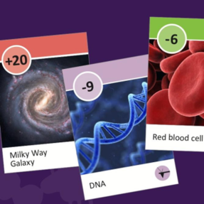
Dimensions of PUS to PES
More PUS-like
Focus
Public
Experts
More PES-like
Notes:
Here is another example using programmatic activities which is probably more like what we will create as a part of the MSPES project
At the PUS end of the spectra would be a card game like the Powers of Ten Game from the NanoDays kit
In this game, the content focus is exploring the relative sizes of various objects and is something that is not open to debate and scientists have particular expertise.
The public is involved by interacting and watching
Experts were involved by acting as advisors during the development process

Slide 11
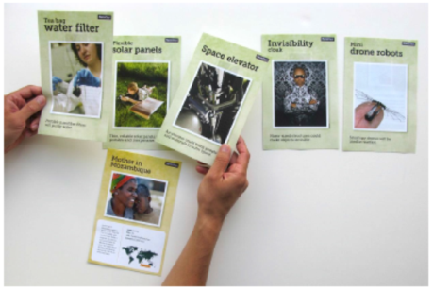
Dimensions of PUS to PES
More PUS-like
Focus
Public
Experts
More PES-like
Notes:
More PES-like is the NISE Net You Decide game, and this is something like what you may want to think about creating for this project
The content focus of this game is nano products. People also learn about different populations of people and their values related to nanotechnology.
The public is involved by thinking about and discussing their own values and the values of these other groups and prioritizing the technologies that they think would be most important to these groups.
Again, the experts were involved as advisors during the development process, but it could be possible to get them more involved by…

Slide 12
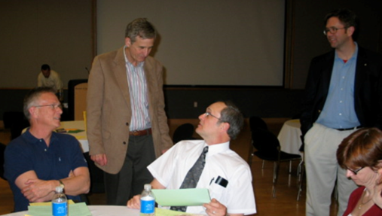
Dimensions of PUS to PES
More PUS-like
Focus
Public
Experts
More PES-like
Notes:
Having them interact with the public and gather information from the public about their feelings and values related to different nanotechnologies
It might also be possible to turn an activity like You Decide into a longer forum program where scientists and the public learn about and discuss an issue related to the use of different nanotechnologies

Slide 13
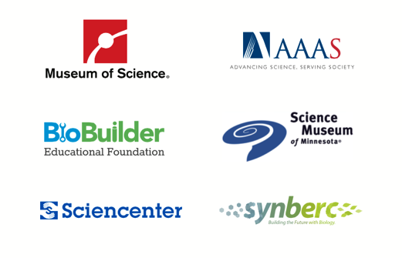
Multi-Site Public Engagement with Science (MSPES) – Synthetic Biology
This project is funded by the Advancing Informal STEM Learning (AISL) program in the Education and Human Resources Directorate of the National Science Foundation through award no. DRL-1421179
Notes:
Happily, we are 9 months into a 3–year NSF-funded project that building upon a number of public engagement with science projects to engage the public around the societal impliclations of synthetic biology. Brings together a number of science museums with broader scientific community (AAAS) and as a public engagmenet and dissemination mechanism for scientists, and the synbio community (SynBERC and BioBuilder) and a number of partners fomr the social science and science policy community who we have gotten to know through the NISE Net. Builds upon the Nano and Society work and uses the NISE net as an infrastructure for deliverables through the participating science museums, and as you will hear, we’ll be offering products we hope you will want to use.

Slide 14
Multi-Site Public Engagement with Science (MSPES) – Synthetic Biology
“The aim of this project is to foster activities in science museums through which public audiences can engage with scientists and engineers in conversations about what synthetic biology is, how research in the field is carried out, and the potential products, outcomes, and implications for society of this work. Researchers and publics will explore personal and societal values and priorities as well as research outcomes so that both groups can learn from each other.”
This project is funded by the Advancing Informal STEM Learning (AISL) program in the Education and Human Resources Directorate of the National Science Foundation through award no. DRL-1421179
Notes:
Read the slide aloud (statement from our project abstract). Here is the primary aim for our MSPES project. So this is both a project about synthetic biology and about public engagement. In this case scientists are actually a target audience along with ISE professionals, and so we as we discussed have co-created the project activities and materials with scientists.

Slide 15
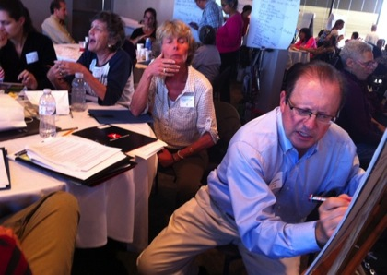
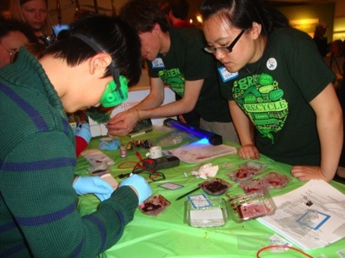
Impacts on Visitors
PES Evaluation
Notes:
What do members of the public learn from their PES experiences?
2. What do members of the public learn from scientists?
3. Does participation in a PES event increase public participants’ interests in public engagement or science topics?
4. How, if at all, do members of the public follow up on their interactions with scientists?
5. What do members of the public value about their participation in PES events?

Slide 16
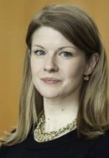
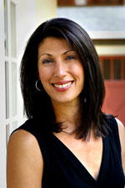
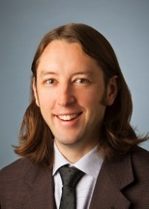
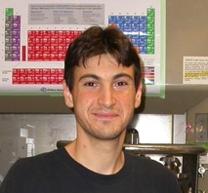
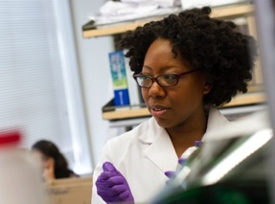
PES Evaluation
Notes:
But in addition to the visitors, we also want to learn about the impacts that these kinds of programs have upon our participating scientists. Here are six of the many sceintists who have worked with us to create some of the activities and programs I’ll discuss later and that you’ll experience in the showcase after this talk. Our evaluation team, headed by Liz Kollmann, is working very hard to explore questions such as:
What do scientists learn from their interactions with the public
2. What do scientists learn from members of the public?
3. What kind of motivation, value , and benefits do scientists identify from participating in PES activtiies ?

Slide 17
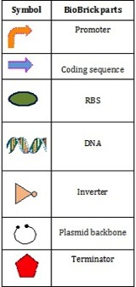
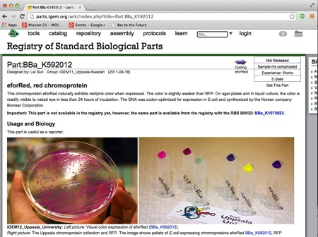
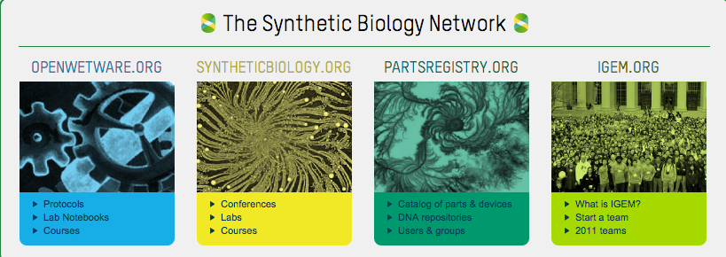
Synthetic Biology and PES
Notes:
And to that point, my colleague Megan Palmer, who a bioengineer and policy researcher at UC-Berkeley and Stanford, is going to talk now about why synthetic biology is such a great fit for a project like this, about some of the ideas and concepts we will be exploring with our partnering scientists during the Building with Biology events, and then I’ll come back to talk about the kinds of activities and products we’re making and how you can be involved.

Slide 19
Why this topic, why now?
What is syn bio?
How might I engage?

Slide 20
Why syn bio, why now?
What is syn bio?
How might you engage with syn bio?

Slide 21
WHY SYN BIO, WHY NOW?
First….A STORY

Slide 22
WHAT IS SYNTHETIC BIOLOGY?
“BIG IDEAS”

Slide 23
Synthetic biology
builds biological systems as a way to explore how principles of engineering apply to the life sciences.
Synthetic biology generates new tools and knowledge to enable biology-based solutions to societal challenges
Synthetic biology welcomes participation
of communities with diverse training to foster creativity and growth of the field.
Synthetic biology
is interconnected with human values through the uses, costs, benefits, and risks of science and technology.

Slide 24
Synthetic biology
builds biological systems as a way to explore how principles of engineering apply to the life sciences.

Slide 25
Synthetic biology generates new tools and knowledge to enable biology-based solutions to societal challenges

Slide 26
Synthetic biology welcomes participation
of communities with diverse training to foster creativity and growth of the field.

Slide 27
Synthetic biology
is interconnected with human values through the uses, costs, benefits, and risks of science and technology.

Slide 28
HOW MIGHT YOU ENGAGE?
ONE KEY LESSON

Slide 29
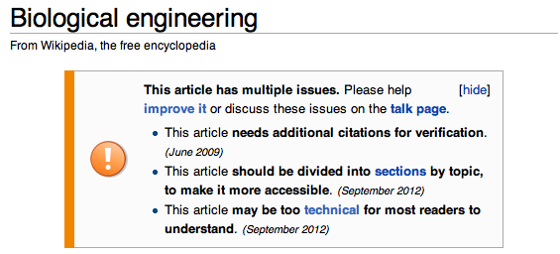

Slide 30
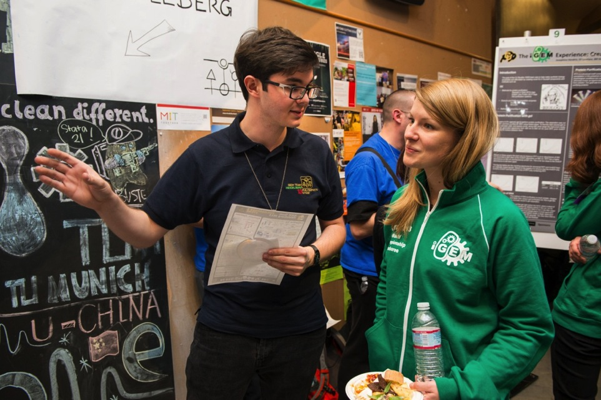

Slide 31
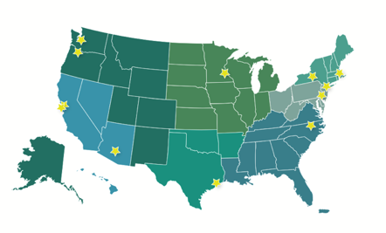
Co-Created Engagement Activities
Arizona Science Center/Arizona State University
Chabot Space & Science Cntr/UC-Berkeley
Children’s Museum of Houston/Rice University
Franklin Institute/Univ. of Pennsylvania
Lawrence Hall of Science/UC-Berkeley
Museum of Life & Science/NC State
Museum of Science/MIT/BioBuilder
Sciencenter/Cornell
NY Hall of Science/GenSpace
Oregon Museum of Science and Industry/Oregon Health and Science Univ.
Science Museum of Minnesota/Univ. of Minnesota
Pacific Science Center/Umass-Dartmouth
Notes:
So what are we maknig? AS I said we are about 9 months into this project but we have had to hit the ground running and have been fortunate to have the infrastructure of this amazing project to springboard from. Our project paired12 synthetic biology researchers with informal science educators to co-create pilot hands-on activities, many of which you will see in the showcase following this talk.

Slide 32
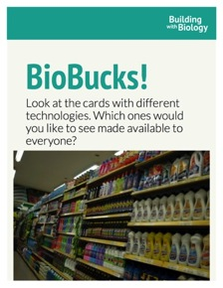
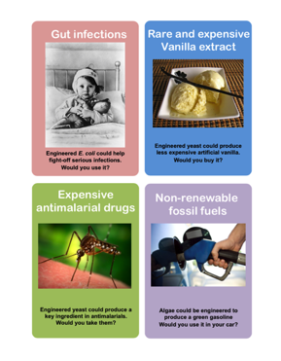
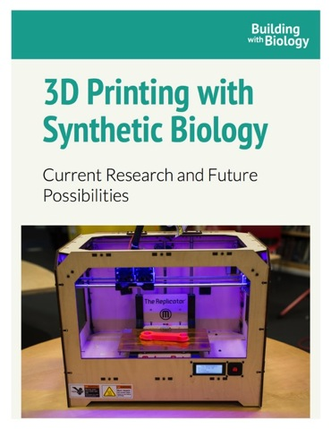
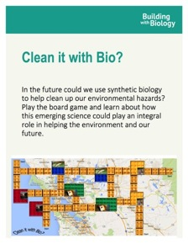
Co-created engagement activities
Notes:
Here are just a few examples from the 19 draft activities we’ve co-created with partnering scientists in each site. The activities will be evaluated and some will be refined and included into a kit that will be sent out in 2016 to 200 institutions thorugh the infrastructure of the NISE Net.
We are just 9 months into the project but have learned a lot. It’s very different co-creating the activities with scientists and stipulating that they are going to be the facilitators of the ideas and discussions we’ve been talking about in this session. It’s highly rewarding but also presents new challenges, because we need to create an environment that is comfortable for them while simultaneously being accessible and interesting to the kinds of visitors we often get at our institutions. AAAS and SynBerc have been great partners in this effort thus far.

Slide 33
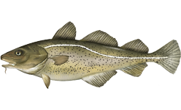
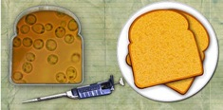
Which method of Vitamin A production would you support? Place a poker chip in the appropriate box:
Atlantic Cod image from NOAA
Credit BioBuilder.org
From non-living sources?
From (once) living sources?
From biologically engineered yeast?
What info would you want to know before deciding?
How do you think these items should be labeled?
Vitamin A: You Choose!
Notes:
Here is an example of another activity created by MOS with Natalie Kuldell, who is our partnering scientist at MIT. In this activity, visitor learn how yeast can be transformed to make its own Vitamin A, and then talk with the scientists about different tradeoffs between different ways of getting vitamin A to supplement the diet. Ultimately they say how they would want to get vitamin A and why.

Slide 34
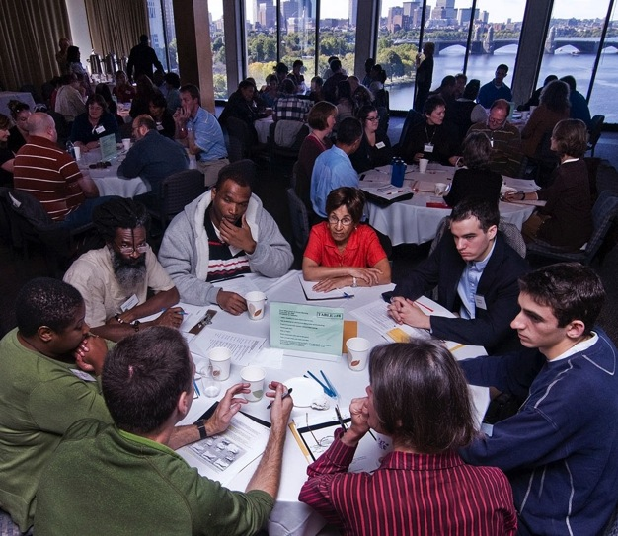
Forums are dialogue programs
They usually focus on societal and ethical issues related to science and technology
They dig into science content but also into personal experiences and social values
They provide an opportunity to learn from publics that are informed and engaged in a deliberative process
BwB Forums
Notes:
We are hoping that these arctivities will provide a window or gateway drug into deeper engagement. SO we are also creating more delibeative forum programs, some very similar to the ones people have done for the NISE Net and some in a shorter format. A distinguishing difference between the hands-on activities and these forum programs is that the scientists are not facilitating but actually another kind of participants in the conversations.

Slide 35
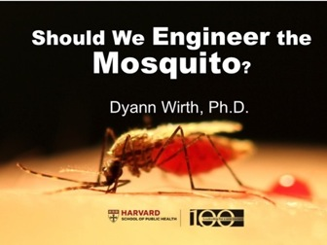
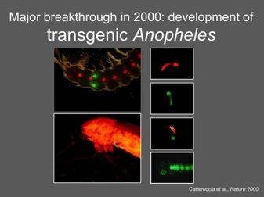
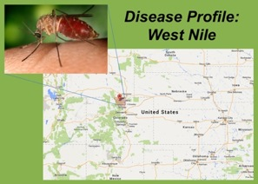
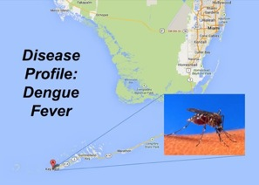
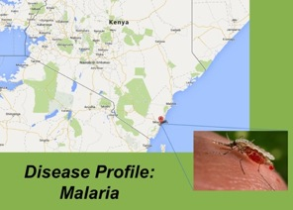
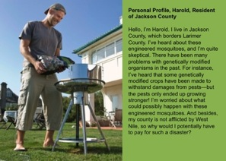
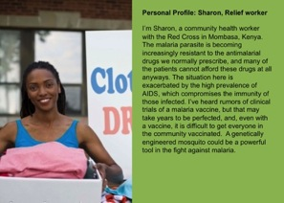
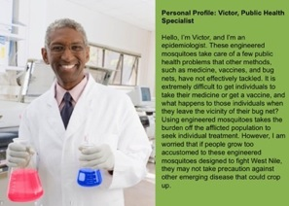
Mosquito engineering Forum
Notes:
Here is an example of one such forum program we have done on a synbio-related topic that includes all of these elements.
In November of 2013 we held a forum called “Should We Engineer the Mosquito”. We had a speaker from the Harvard School of Public Health who presented the techniques, rationale, and tradeoffs around the idea of GM mosquitoes and then participants were presented with three cases studies in Kenya, Colorado, Florida, and Massachusetts, considering a number of perspectives and deciding whether and how they would release GM mosquitoes in the community to address a growing burden of vector-borne disease. Here are some of the cards and tools that people used in their discussions.

Slide 36
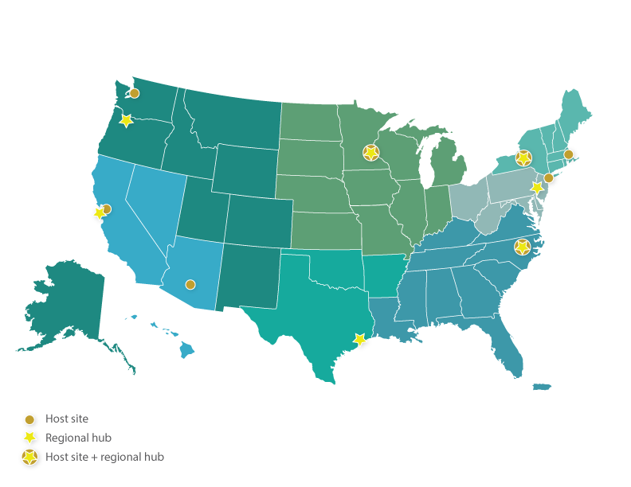
Building With Biology Pilot Events
Notes:
12 institutions have co-created at least one activity with a partnering synbio scientist. 8 museums will host and evaluate BwB events this summer. (Maybe include a screenshot of the passport in next slide?)

Slide 37
Building With Biology Pilot Events
Institution | Location | Event Date(s) | Primary Host Site Contact
Pacific Science Center | Seattle, WA | 7/26 | Melissa Telemeco
Museum of Science | Boston, MA | 8/1-8/2 | David Sittenfeld
Chabot Space and Science Center | Oakland, CA | 8/15 | Dan Stanton
New York Hall of Science | New York, NY | 8/23 | Erin Thelen
Museum of Life and Science | Durham, NC | 8/30 | Brad Herring
Science Museum of Minnesota | St. Paul, MN | TBD | Christina Akers
Arizona Science Center | Phoenix, AZ | 9/7,9/19 | Kamlynn Thomas
Sciencenter | Ithaca, NY | 9/12 | Michelle Kortenaar
Notes:
Each of the organizers is holding one or more orientation events for the scientists. These orientations are being designed by our colleagues at AAAS, led by Jeanne Braha and Tiffany Lohwater who oversee their office of public engagement

Slide 38
Building With Biology Pilot Events
Scientist orientations:
7-14 days before events
Designed by AAAS (Jeanne Braha, Tiffany Lohwater, Linda Hosler)
Administered by host sites
Events use at least 8 activities and one forum
Host sites work with R&E to evaluate impacts on target audiences

Slide 39
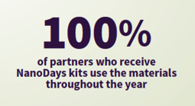
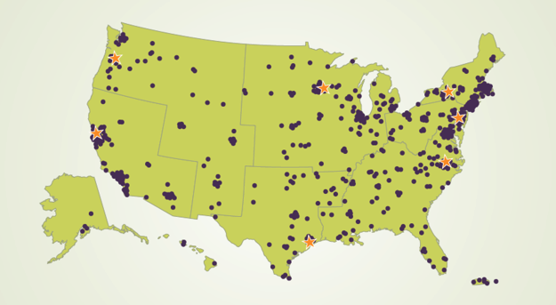
NISE Net kit developers at Sciencenter and Science Museum of Minnesota will turn summer 2015 activities into components of a kit (similar to NanoDays kits)
Seven regional hubs from NISE Net will help us reach 200 sites across the US!
BwB Kits
Notes:
On the slide

Slide 40
Project Milestones
Time | Activity
Fall 2015 | Project launch
Winter/Spring 2015 | Pilot Activity development, team evaluation, and revisions
Summer/Fall 2015 | Pilot Building with Biology events at 8 host sites
Fall 2015 | Evaluation of Pilot Activities
Fall/Winter 2015 | Creation of Building with Biology Kits
January 2016 | Kit Applications Due
Summer 2016 | Building with Biology Kits sent to 200 sites
Late 2016-2017 | Project Evaluation, Creation of Guides

Slide 41
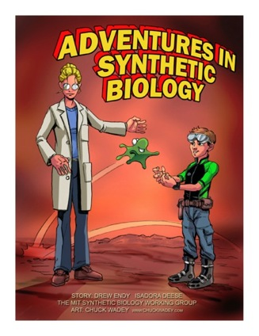
Thank you!
http://bit.ly/buildingwithbiology
#meetsynbio
#buildingwithbiology
This project is funded by the Advancing Informal STEM Learning (AISL) program in the Education and Human Resources Directorate of the National Science Foundation through award no. DRL-1421179
Notes:
Invite participants to check out the activities in the showcase and ask questions. Here is a temporary link to our project website.

Slide 42
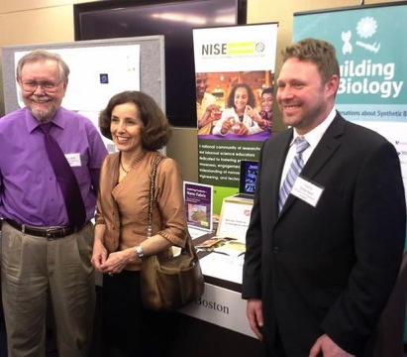
Showcase B
EVEN numbered posters and tables will be staffed
Thursday, 1:30pm-2:45pm
Building with Biology #4 - #34
Notes:
LARRY
Showcase in hallways outside this room
please see list in your packet
Includes a group of national youth serving organizations (Afterschool Alliance, National Girls Collaborative Project, Boys & Girls Clubs, 4H,

Slide 43
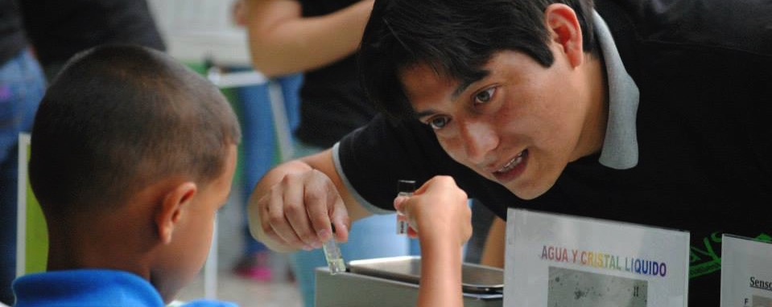
Thank you
Cynthia Needham, ICAN Productions
This presentation is based on work supported by the National Science Foundation under Grant No. 0940143. Any opinions, findings, and conclusions or recommendations expressed in this presentation are those of the authors and do not necessarily reflect the views of the Foundation.
Notes:
LARRY

Slide 44
