Slide 1

PARTNER BREAKFAST
ACM 2019

Slide 2

WELCOME!
Rae Ostman
Director
NISE Network
Co-Director, Center for Innovation in Informal STEM Learning
Arizona State University
Notes:
INTRODUCE RAE
Rae Ostman is Co-director of the Center for Innovation in Informal STEM Learning at Arizona State University. She is director of the NISE Network and a co-investigator of the Earth and space project.
She is presenting on accomplishments and evaluation findings to date for the Earth and space project and future plans for the project and Network

Slide 3
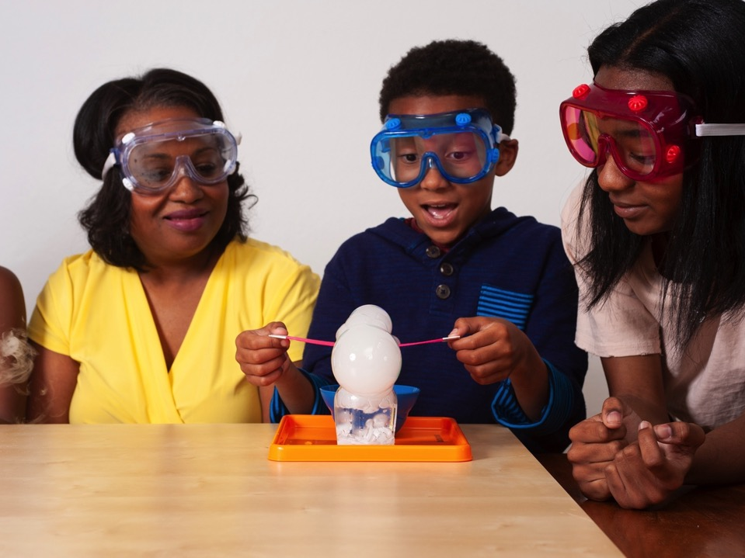
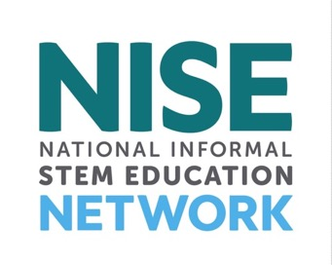
nisenet.org
Contents
Overview
Project highlights
Opportunities
What’s next

Slide 4
NISE NETWORK

Slide 5
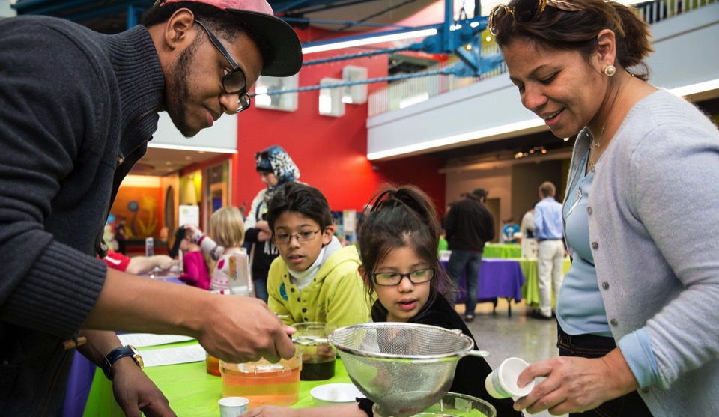
The National Informal STEM Education Network is dedicated to supporting learning about science, technology, engineering, and math (STEM).
Our activities
are fun and accessible
for everyone.

Slide 6
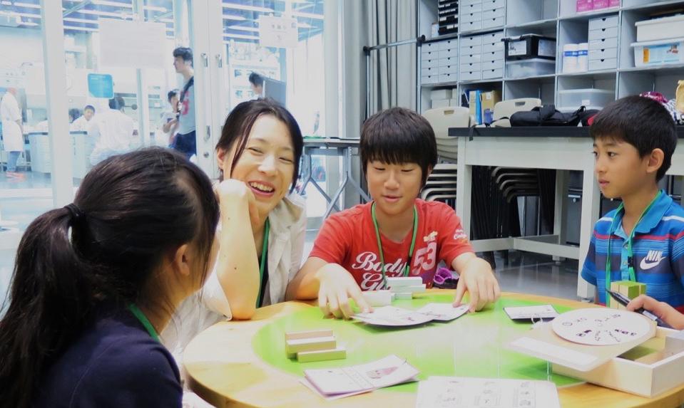
We create and share products and practices materials with partners around the world.
Our resources
are available to everyone for free download from nisenet.org

Slide 7
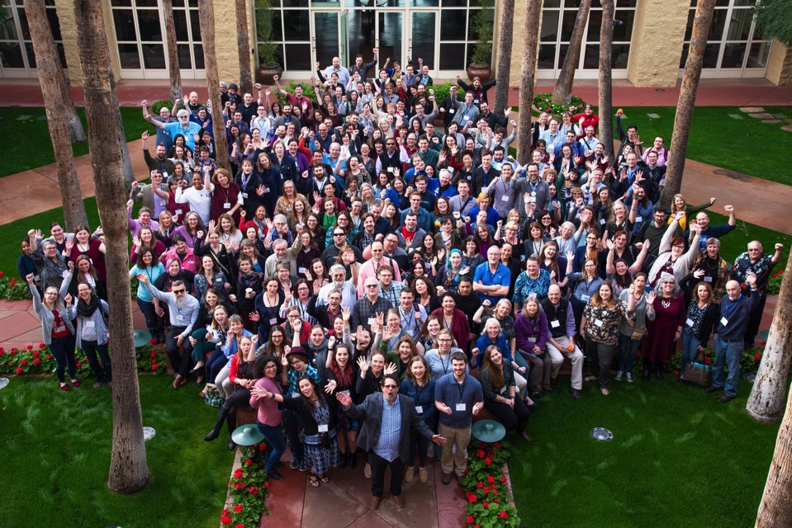
Hundreds of organizations participate in the NISE Network, including museums and universities.
Our community
includes educators, researcher/evaluators, and scientists
at museums
and universities.

Slide 8
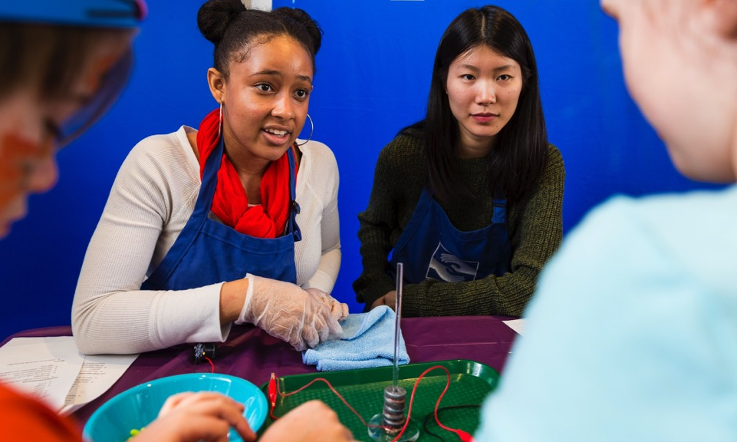
Partner organizations use Network resources to engage audiences in their communities.
Local implementation
brings people together to share and learn
from each other.

Slide 9
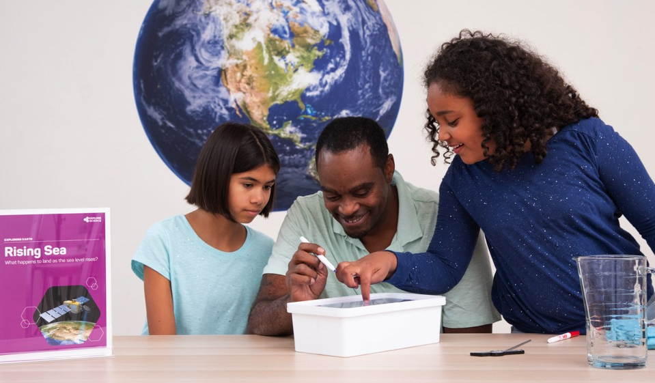
NISE Net projects tackle challenging problems and develop relevant knowledge, tools, and practices.
NISE Network relationships,
knowledge, and infrastructure support a variety of projects.

Slide 10
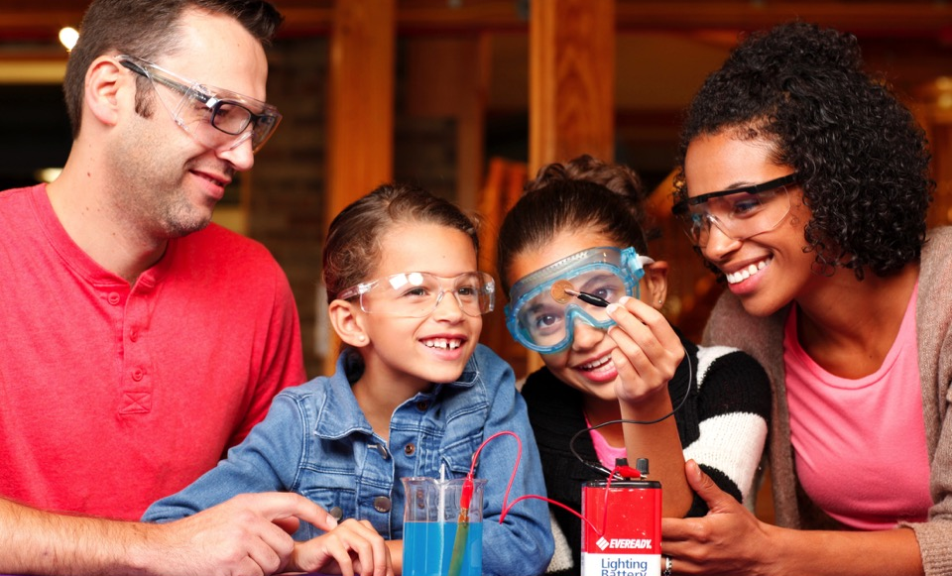
Together we reach millions of people each year!
Our impact
grows each year through the efforts of our partner organizations.

Slide 11
PROJECT HIGHLIGHTS

Slide 12
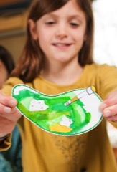
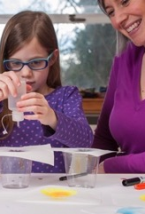
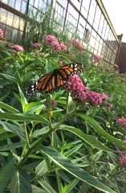
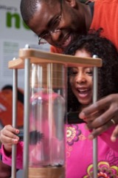
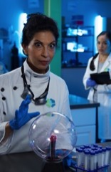
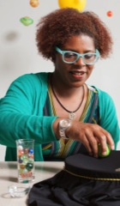
Current projects explore many STEM topics!
Synthetic biology
2014-2018
Chemistry
2016-2019
Sustainability
2018-2020
2005
2020
Nanotechnology
2005-2017
Innovation
2015-2019
Earth and space
2016-2021

Slide 13
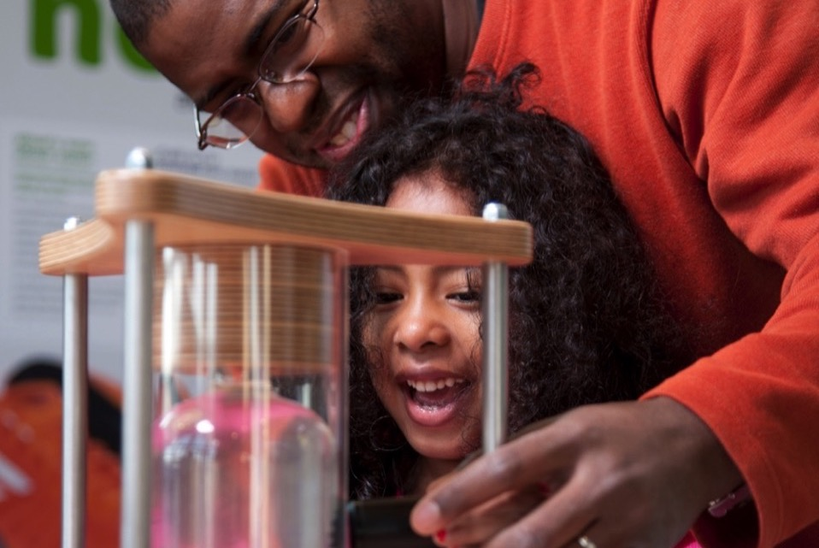
Nanoscale Informal Science Education Network
Building a national network
to engage audiences
in learning about current STEM research

Slide 14
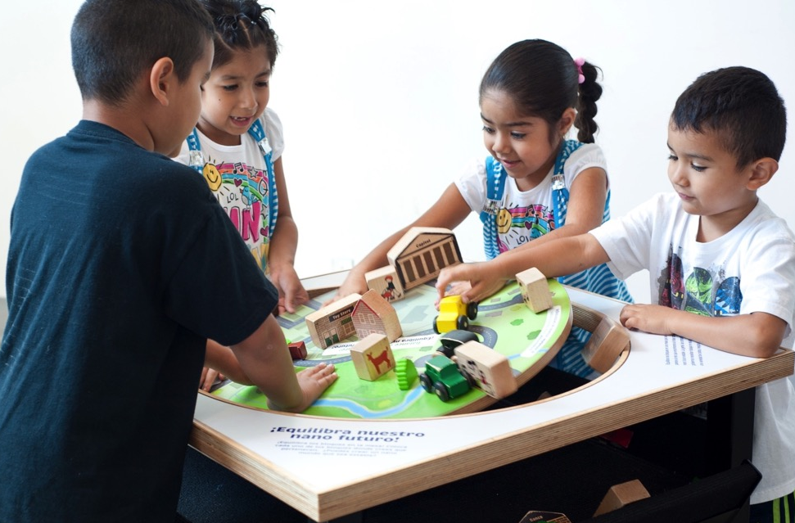
Nanoscale Informal Science Education Network
60,000,000
people reached to date through the Nano project

Slide 15
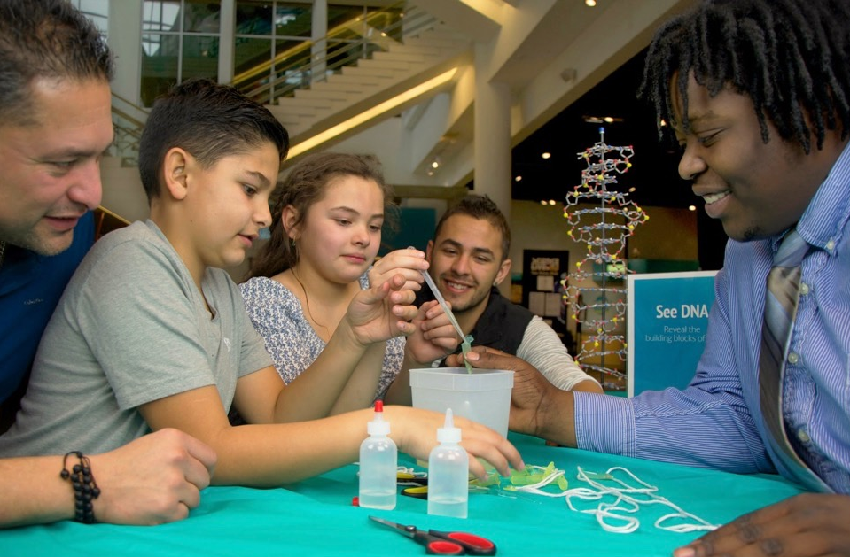
Building with Biology
Creating dialogue
among researchers, educators, and public audiences about STEM and society

Slide 16
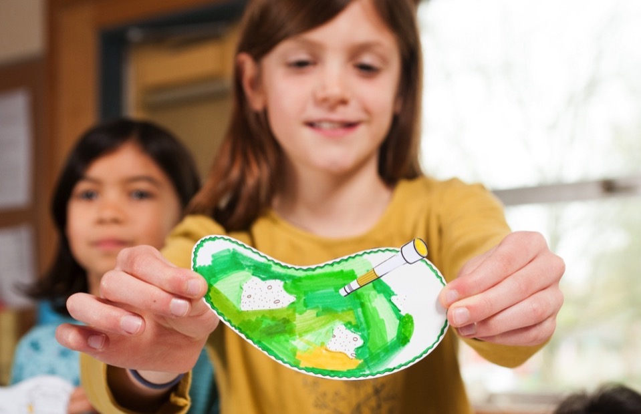
Building with Biology
90% +
of participants at public events did an activity, talked to a scientist, and asked a volunteer a question

Slide 17
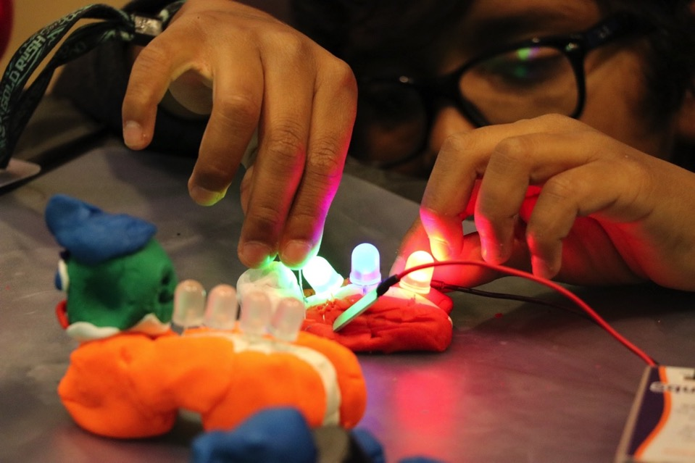
Frankenstein200
Exploring creativity
and responsible innovation in a transmedia environment

Slide 18
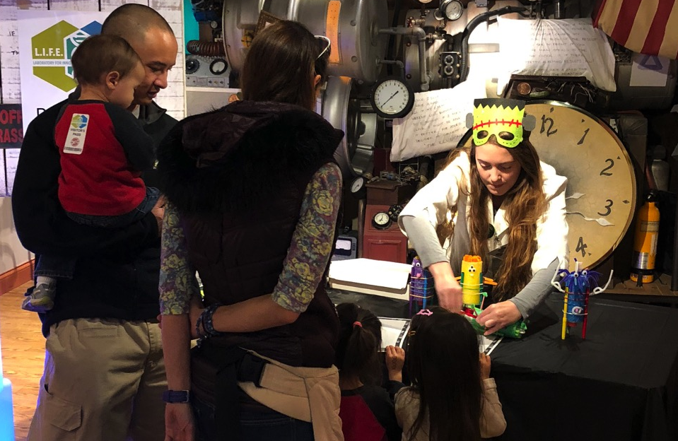
Frankenstein200
90% +
of family visitors describe the hands-on activities as “fun” and “imaginative”

Slide 19
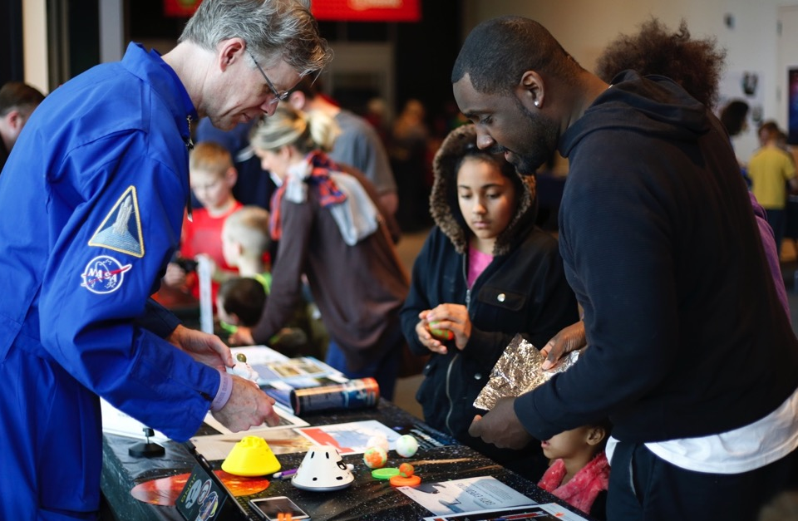
Space & Earth Informal STEM Education
Connecting learners
to authentic
Earth and space science and experts

Slide 20
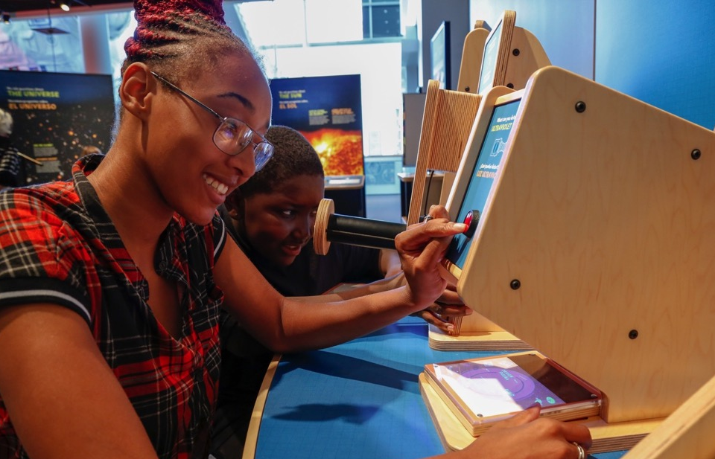
Space & Earth Informal STEM Education
3,400,000
people reached through the
Earth & Space project

Slide 21
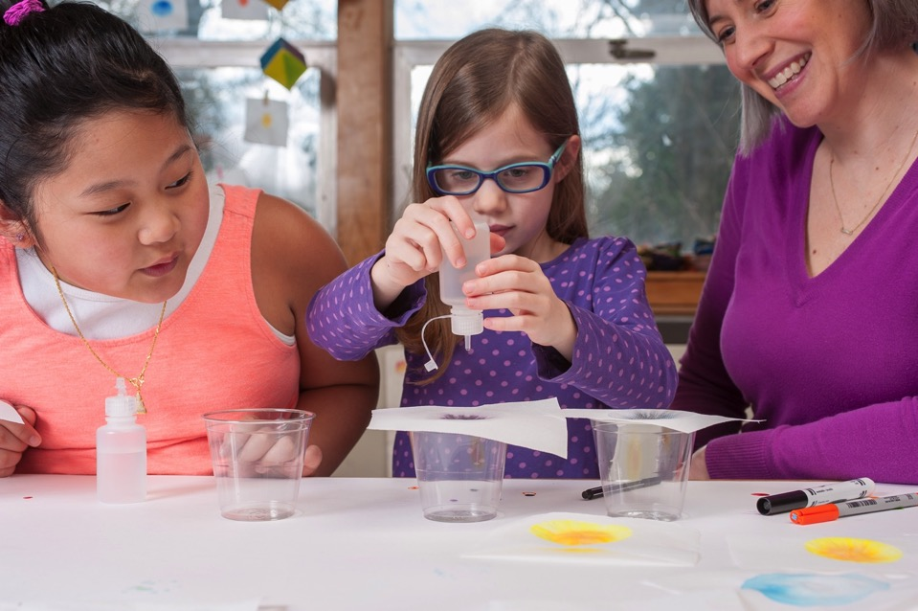
Explore Science: Let’s Do Chemistry
Promoting positive attitudes
toward learning chemistry

Slide 22
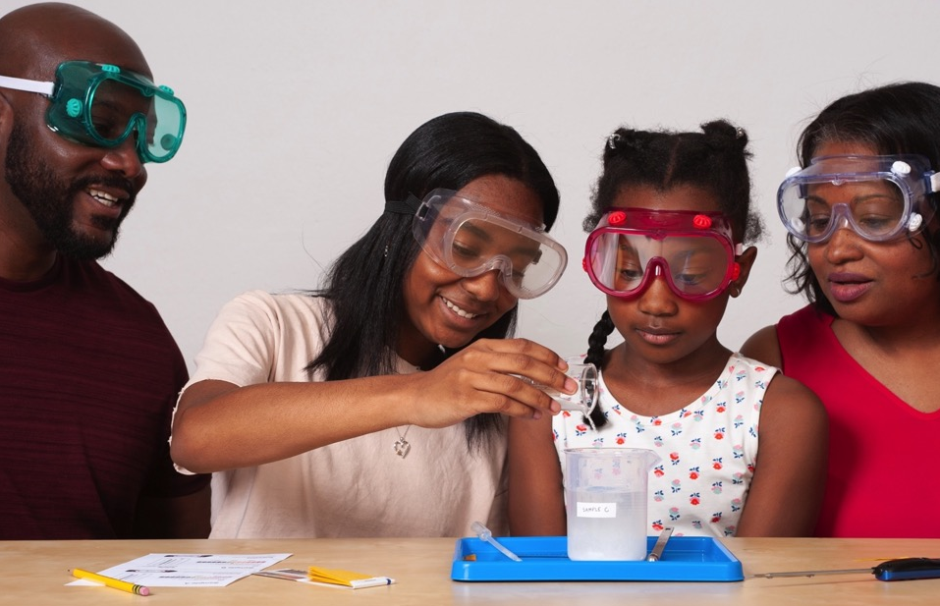
Explore Science: Let’s Do Chemistry
89%
of National Chemistry Week events engaged underserved
audiences

Slide 23
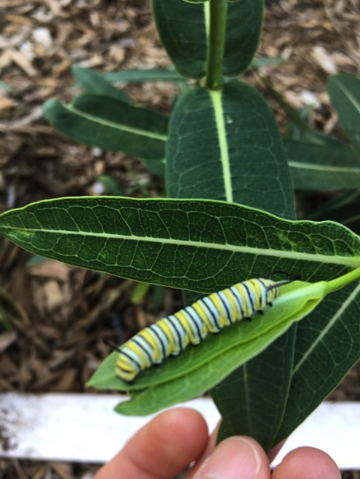
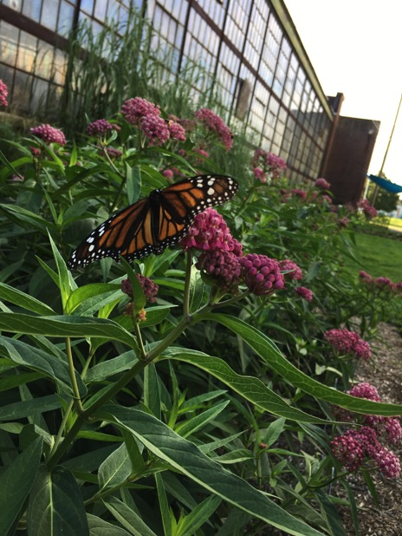
NEW! Sustainable Futures
Empowering
museums to create future-focused projects related to sustainability

Slide 24
OPPORTUNITIES

Slide 25
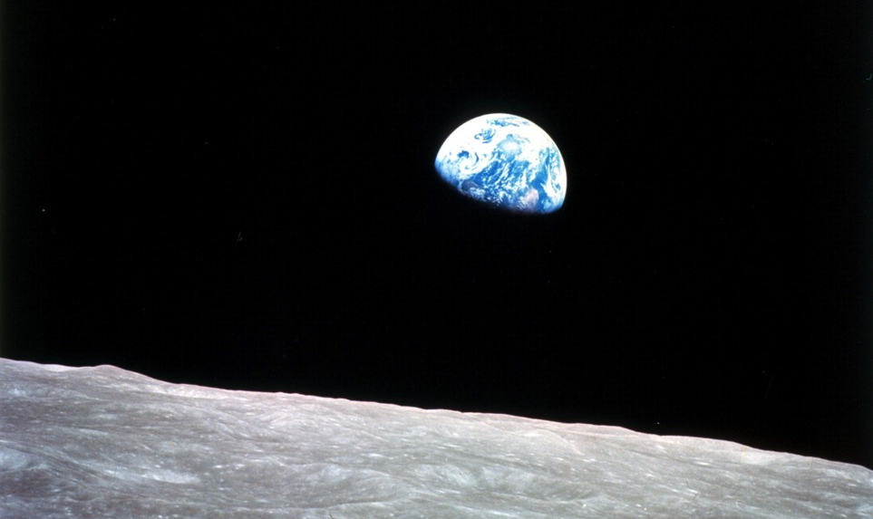
Summer, 2019
50th anniversary of Apollo 11 moon landing
More information on Sustainable Futures
Events and resources
nisenet.org

Slide 26
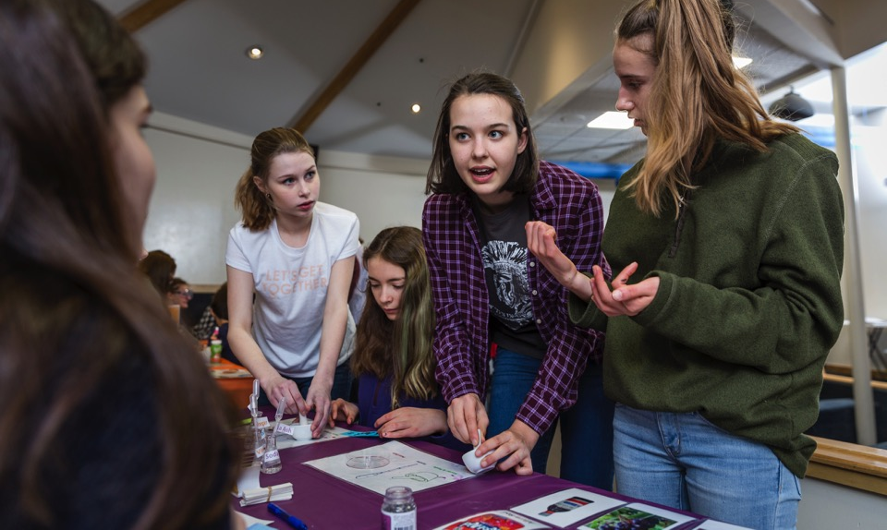
Fall, 2019
Oct. 20-26: National Chemistry Week
Nov. 1: Earth & Space 2020 toolkit application
Please sign in
using the sheets on the tables

Slide 27
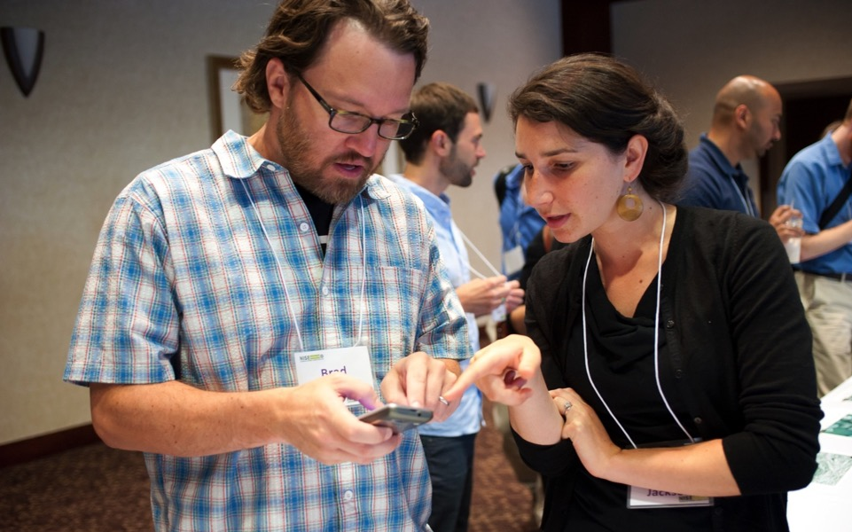
Regional hub leaders are your connection to all Network activities!
Get in touch!
Hub leaders: nisenet.org/contact

Slide 28




nisenet.org has a digital library of our resources available for free download!
nisenet.org
Monthly newsletter
nisenet.org/newsletter
Social networking: nisenet.org/social

Slide 29
WHAT’S NEXT

Slide 30
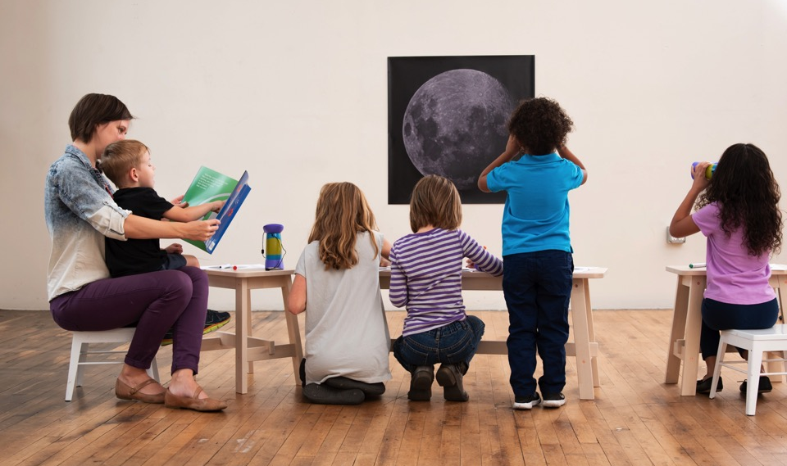
Earth and space science
(Years 6-10)
Planning
Paul Martin
Rae Ostman

Slide 31
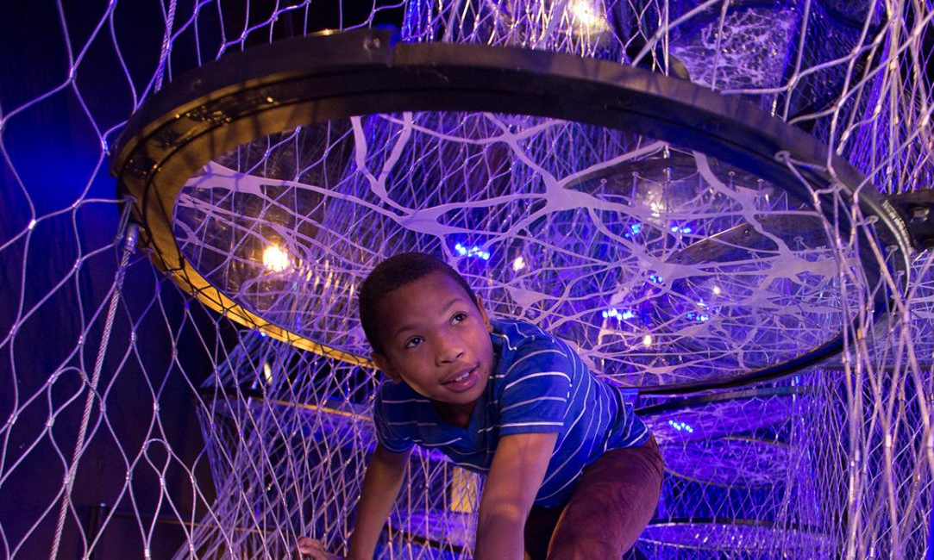
Brain science and technologies
and their societal implications
Planning
Jayatri Das
Darrell Porcello

Slide 32
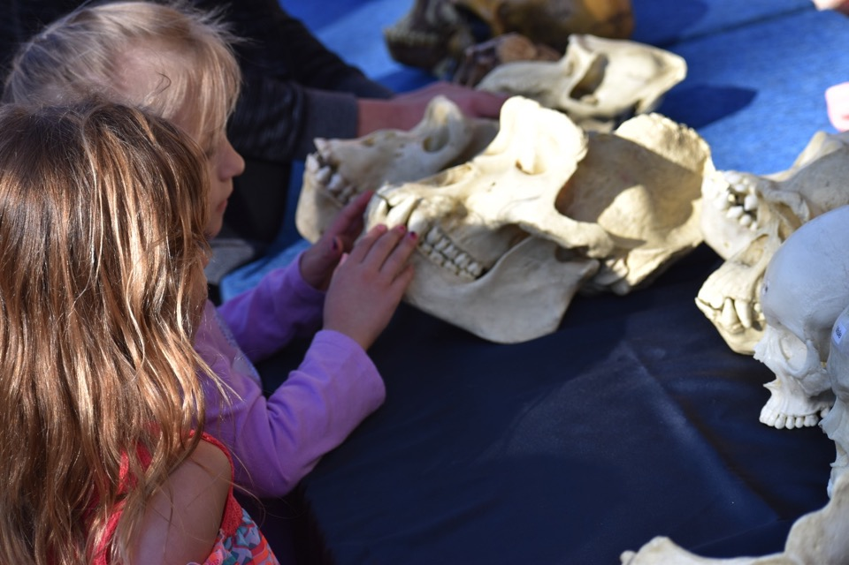
Human origins
Biological, cultural, and environmental change
Planning
Paul Martin
Rae Ostman

Slide 33
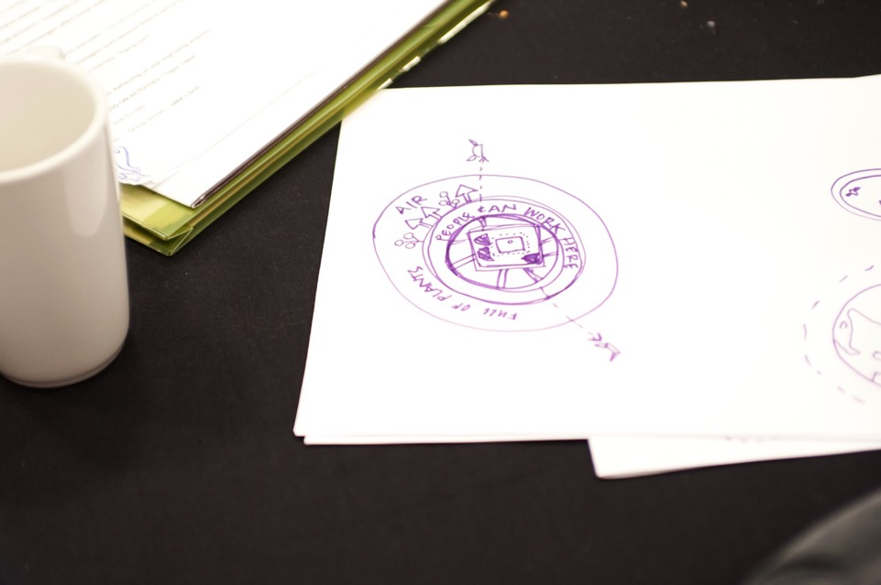
Let us know!
In early stages
Sustainability
Earth and space
Brain
Human origins
How do these topics connect to your museum?
What do you need and want? What do you have to share?
Do you have other ideas for new projects we can work on together?

Slide 34
THANK YOU

Slide 35
Online digital library:
nisenet.org
Monthly newsletter
nisenet.org/newsletter
Social networking: nisenet.org/social

Slide 36

Leadership
Arizona State University
Children’s Creativity Museum
Children’s Museum of Houston
Museum of Life and Science
Museum of Science
Oregon Museum of Science & Industry
Science Museum of Minnesota
Sciencenter
The Franklin Institute
Tulsa Children’s Museum
University of California Berkeley – Lawrence Hall of Science
Advisors
Association of Children’s Museums
Center for the Advancement of Informal STEM Learning, Association of Science-Technology Centers
National Girls Collaborative Project

Slide 37



Acknowledgements
The Nanoscale Informal Science Education Network was supported by the National Science Foundation under award numbers 0532536 and 0940143. Multi-Site Public Engagement in Science is supported by the National Science Foundation under award number 1421179. Increasing Learning and Efficacy is supported by the National Science Foundation under award number 1516684. ChemAttitudes is supported by the National Science Foundation under award number 1612482. Any opinions, findings, and conclusions or recommendations expressed in this presentation are those of the authors and do not necessarily reflect the views of the Foundation.
Space and Earth Informal STEM Education is supported by NASA under cooperative agreement number NNX16AC67A and 80NSSC18M0061. Moon and Beyond is supported by NASA under grant number 80NSSC18K1219. Any opinions, findings, and conclusions or recommendations expressed in this material are those of the author(s) and do not necessarily reflect the view of the National Aeronautics and Space Administration (NASA).
Sustainability in Science & Technology Museums is supported by the Rob and Melani Walton Foundation.
Public Engagement with Neuroscience and Society conference and landscape study is funded by The Kavli Foundation.

