Slide 1
Team-Based Evaluation Workshop
www.nisenet.org

Slide 2
Session Overview
Leaders:
Christine Reich & Amy Grack Nelson
Introduction
Defining evaluation
Planning an evaluation
Data collection
Data analysis
Wrap-up
Notes:
Add at the end our goals and expectations for this group: help them to further understanding evaluation and its process so that they may begin to embed evaluation into their work. We do not expect that by the end you will be able to conduct a thorough evaluation study on your own, but, we hope you will learn tools and techniques for embedding systematic inquiry into your work so that you can better test your assumptions.
We will do this through explicit instruction (such as this PowerPoint), group discussion activities, and modeling ways you can embed systematic inquiry into your work.

Slide 3
Likert-scale line-up
How familiar are you with the process of conducting an evaluation?
Not at all Familiar
Familiar
5. Very Familiar

Slide 4
Your thoughts on evaluation
Write down what you think of when you hear the word “evaluation”
(words, pictures, etc.)

Slide 5
What is evaluation?
Michael Quinn Patton
Evaluation is the systematic collection of information about the activities, characteristics, and outcomes of programs to make judgments about the program, improve program effectiveness, and inform decisions about future programming.
Preskill and Torres
We envision evaluative inquiry as an on-going process for investigating and understanding critical organization issues. It is also an approach to learning that is fully integrated with an organization’s work practices, and as such, it engenders (a) organization members’ interest and ability in exploring critical issues using evaluation logic, (b) organization members’ involvement in evaluative processes, and (c) the personal and professional growth of the individuals within the organization.

Slide 6
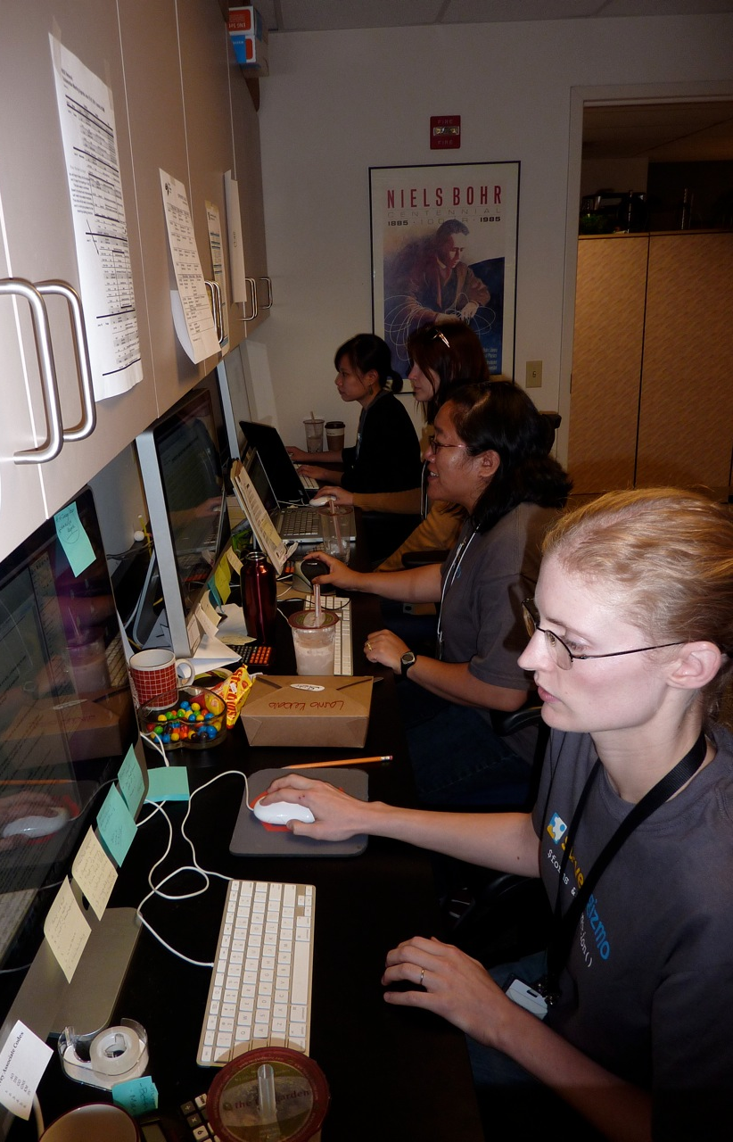
Group activity
Chocolate Chip Cookie Evaluation

Slide 7
Cookie activity
Exercise to understand the underlying logic of evaluation.
Complete the first two columns, deciding on: Criteria for judging Standards for judging
Taste the cookies
Complete the last two columns: Measuring performance Judging worth
Keep track of your process, including challenges faced.

Slide 8
Planning an
Evaluation

Slide 9
Evaluation process

Slide 10
Purpose of the evaluation
Why are you carrying out an evaluation?
Front-end evaluation
Formative evaluation
Summative evaluation
What information do you need to advance your understanding of your practice?

Slide 11
Evaluation questions
Who are the stakeholders and what do they want to know?
What are the goals, outcomes or objectives for the product or activity?
Questions should relate to purpose and use
Questions often start with:
How…?
To what extent…?
What…?
Notes:
Evaluation Questions are not the same as survey or interview questions
Shy away from yes/no questions and why questions

Slide 12
Evaluation planning matrix
Evaluation Questions | Information Needed | Information Source | Data Collection Method
Fitzpatrick, J.L., Sanders, J.R., & Worthen, B.R. (2004). Program evaluation: Alternative approaches and practical guidelines. Saddle River, NH: Pearson Education, Inc.

Slide 13
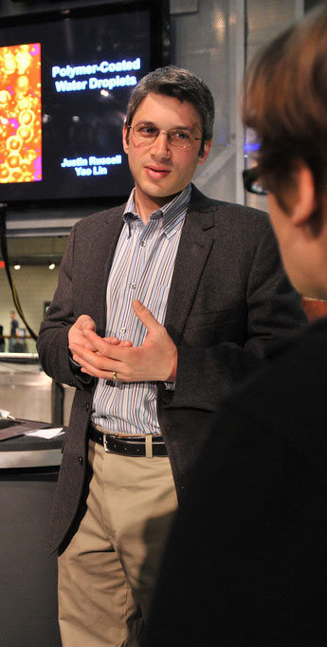
Data Collection

Slide 14
Writing survey questions
Ask one question at a time – avoid “and” or “or.”
Make sure response categories do not overlap.
Avoid using “neutral” when it is likely people will have an opinion.
Avoid using the word “not” in question wording.
Consider if the question applies to everyone taking the survey.
Avoid using “check all that apply” type questions.

Slide 15
Writing survey questions
Rating scales
It is often best to label each point on a rating scale.
Use the same number of positive and negative categories.
Use the same order or direction of scales throughout the survey

Slide 16
Laying out the survey
Every question should relate to the survey’s purpose
Make the first question easy & interesting
Group similar topics
Place objectionable questions at the end
Consider if any of the questions influence how someone answers other questions.
Don’t forget to pilot test your survey!

Slide 17
Data Analysis

Slide 18
Data Analysis
Quantitative analysis, focus on descriptive statistics
Qualitative analysis, focus on coding

Slide 19
Quantitative analysis
Descriptive statistics
Describes your data
Frequencies
Measures of central tendency (mean, median, mode)
Distribution (range, standard deviation)
Inferential statistics
Infers from your sample to the larger population
Comparisons (ANOVA, t-test, chi-square)
Correlations

Slide 20
Descriptive Statistics
How likely is it that you would recommend the Museum of Science to a friend or colleague? (Scale goes from 0 to 10)
Measures of central tendency
Mean: 9
Mode: 10
Median: 10
Distribution
Min: 0
Max: 10
Variance: 2

Slide 21
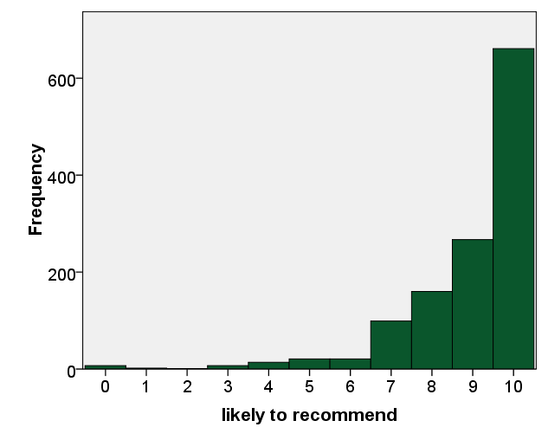
Descriptive Statistics
How likely is it that you would recommend the Museum of Science to a friend or colleague?
0 – 6 | 7 – 8 | 9 – 10 | Net score
6% | 20% | 74% | 68%

Slide 22
Coding qualitative data
Inductive or emergent coding: themes emerge from the data
Sort comments into similar groupings
Create definitions for the grouping
Assign each comment to a different grouping
Iterative process
Content analysis: themes are pre-determined
Groups based on pre-existing categories
Create definitions for the categories
Assign each comment to a different grouping
Challenge: defining a comment
A comment is a statement that can stand on its own
General rule of thumb is that each comments is assigned to no more than one grouping

Slide 23
Coding qualitative data
Activity: Assigning visitor comments into groups
Data source: MOS visitor comment cards
Kinds of analysis: content and inductive analysis
Assignment: Code a subset of comments using either content or inductive analysis
Reflection: Compare results and processes

Slide 24
Wrap Up

Slide 25
References
Dillman, D. A. (2000). Mail and Internet surveys: The tailored design method. (2nd ed.). New York, NY: John Wiley & Sons, Inc.
Fitzpatrick, J.L., Sanders, J.R., & Worthen, B.R. (2004). Program evaluation: Alternative approaches and practical guidelines. Saddle River, NH: Pearson Education, Inc.
Frary, R. B. (1996). Hints for designing effective questionnaires. Practical Assessment, Research & Evaluation, 5(3). Retrieved October 18, 2010 from http://PAREonline.net/getvn.asp?v=5&n=3.
King, J. A. (2009, March). Interactive evaluation practice. Session presented at the Minnesota Evaluation Studies Institute, Bloomington, MN.
Patten, M. L. (2001). Questionnaire research: A practical guide. (2nd ed.). Los Angeles, CA: Pyrczak Publishing.
Patton, M.Q. (2008). Utilization-focused evaluation. (4th ed.). Thousand Oaks, CA: Sage Publications.
Preskill, H., & Russ-Efts, D. (2005). Building evaluation capacity: 72 activities for teaching and training. Thousand Oaks, CA: Sage Publications.
Preskill, H., &Torres, K.T. (1999). Evaluative Inquiry for Learning in Organizations. Thousand Oaks, CA: Sage Publications.

Slide 26
Moving forward
Additional resources
Diamond, J., Luke, J., & Uttal, D. (2009). Practical evaluation guide: Tools for museums and other informal educational settings. Walnut Creek, CA: Altamira.
Patton, M. Q. (2002). Qualitative research and evaluation methods (3rd ed.). Thousand Oaks, CA: Sage Publications, Inc.
http://www.evaluationspringboard.org/science
Contact information
Christine Reich, creich@mos.org
Amy Grack Nelson, agnelson@smm.org

Slide 27
This presentation is based on work supported by the National Science Foundation under Grant No. 0940143.
Any opinions, findings, and conclusions or recommendations expressed in this presentation are those of the author(s) and do not necessarily reflect the views of the Foundation.

