Slide 1
THE SCIENCE
OF SMALL

Slide 2
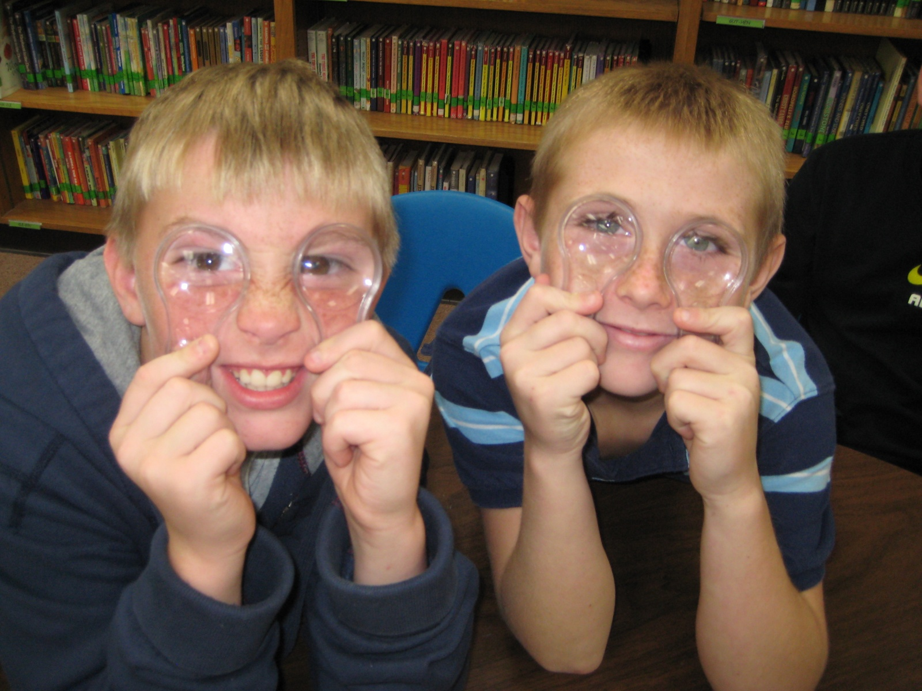
The WONDERtorium has created a series of three traveling programs serving 3rd, 4th and 5th grades.
The programs provide building blocks for children to understand our world looks different when we look at it microscopically.

Slide 3
SAND ROCKS!!!
3rd GRADE
Students explore sands from all over the world using microscopes.

Slide 4
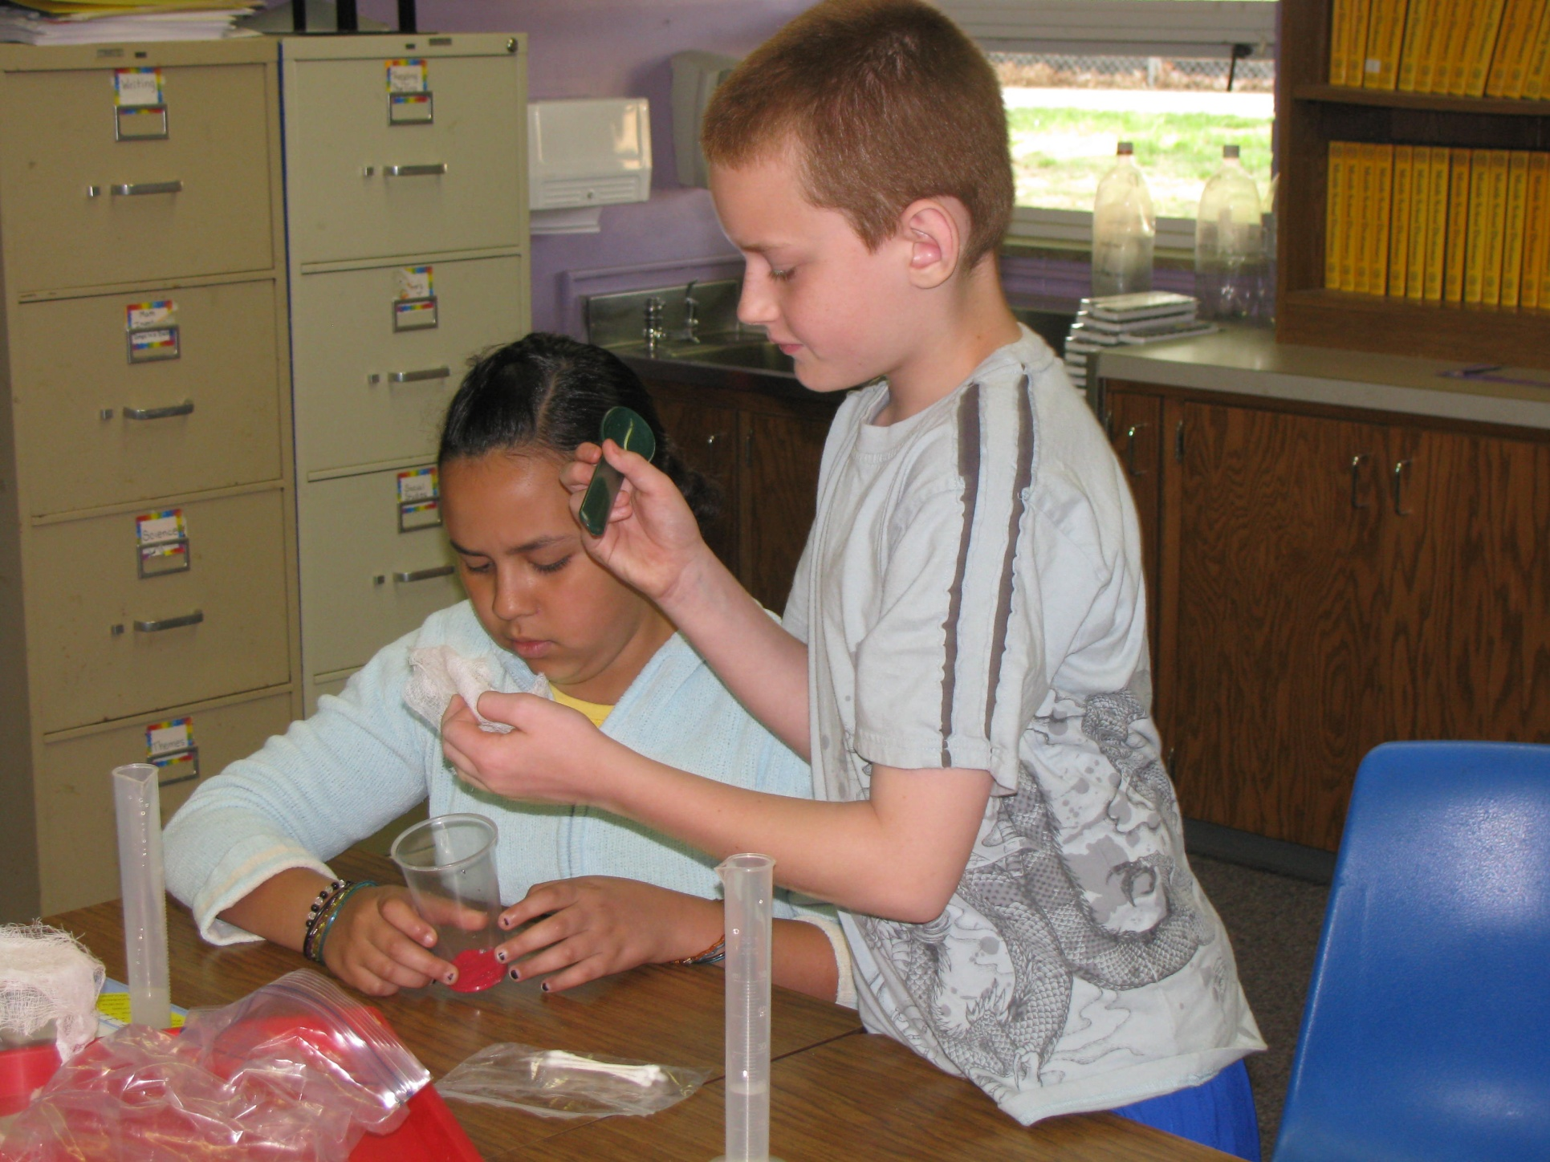
ITSY BITSY EENSY
WEENSY SCIENCE
4TH GRADE
The way a material behaves on the macroscale is affected by its structure on the nanoscale.

Slide 5
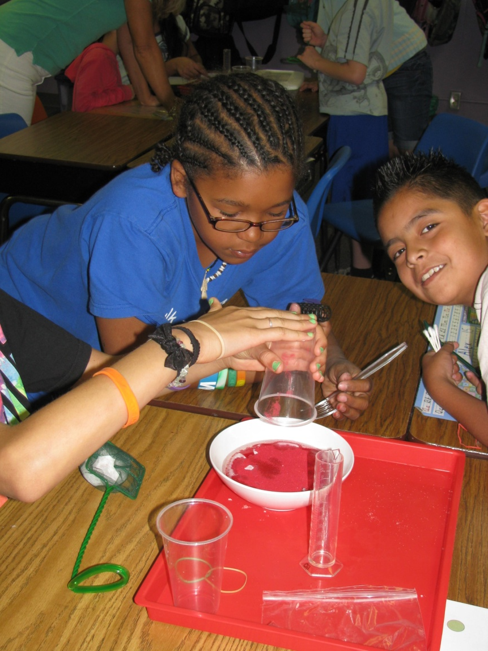
What if we could change the way sand acts?

Slide 6
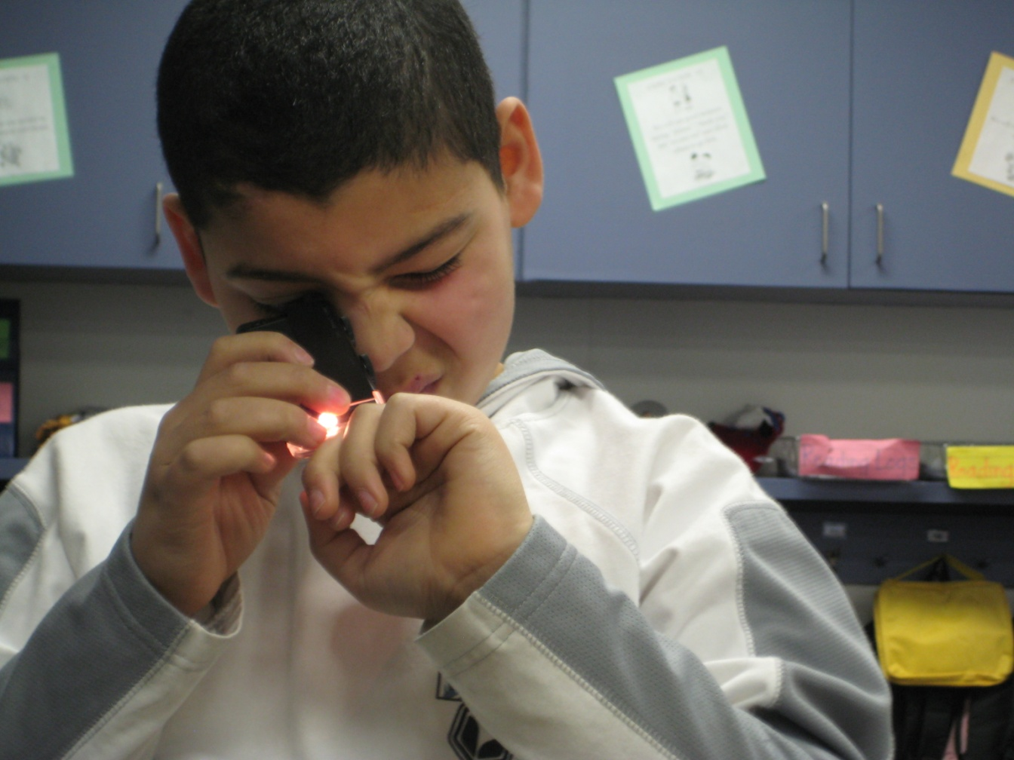
PLANT VIRUS EXPLORATION
5TH GRADE
This program compliments a study of micro-worlds done by 5th graders in our community.
At this age students are familiar with atoms and molecules.
Our program gives them an opportunity to explore this world a little deeper.

Slide 7
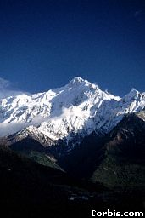
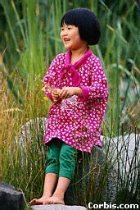
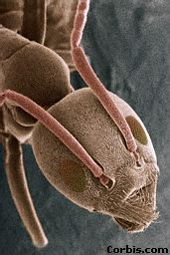
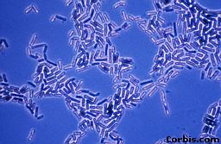
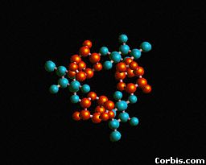
How small is that, really?
Mountain
1 km
1000 m
0.001 km = 1 m
Child
1 m
1,000 X Smaller
Ant
1 mm
0.001 m
1,000 mm = 1 m
1,000 X
Smaller
Bacteria
1 µm
0.000001 m
1,000,000 µm = 1 m
1 Million X Smaller
Sugar Molecule
1 nm
0.000000001 m
1,000,000,000 nm = 1 m
1 Billion X Smaller
Notes:
1 kilometer = 1000 meters
1 meter = 1000 mm
µm = micrometer - 1 micrometer is 1 million times smaller than a meter
1 nm is 1 billion times smaller than a meter
Extend it upwards:
1 Mm : Texas
1 Gm : Orbit of moon
1 Tm : Orbit of Jupiter
End with: Show different types of nanotechnology. Not necessarily exhaustive, but representative.

Slide 8
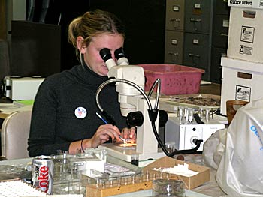
Nanoscale science focuses on
the building blocks of our world, atoms and molecules.
Scientists use special tools and equipment to detect and manipulate tiny, nano-sized particles.

Slide 9
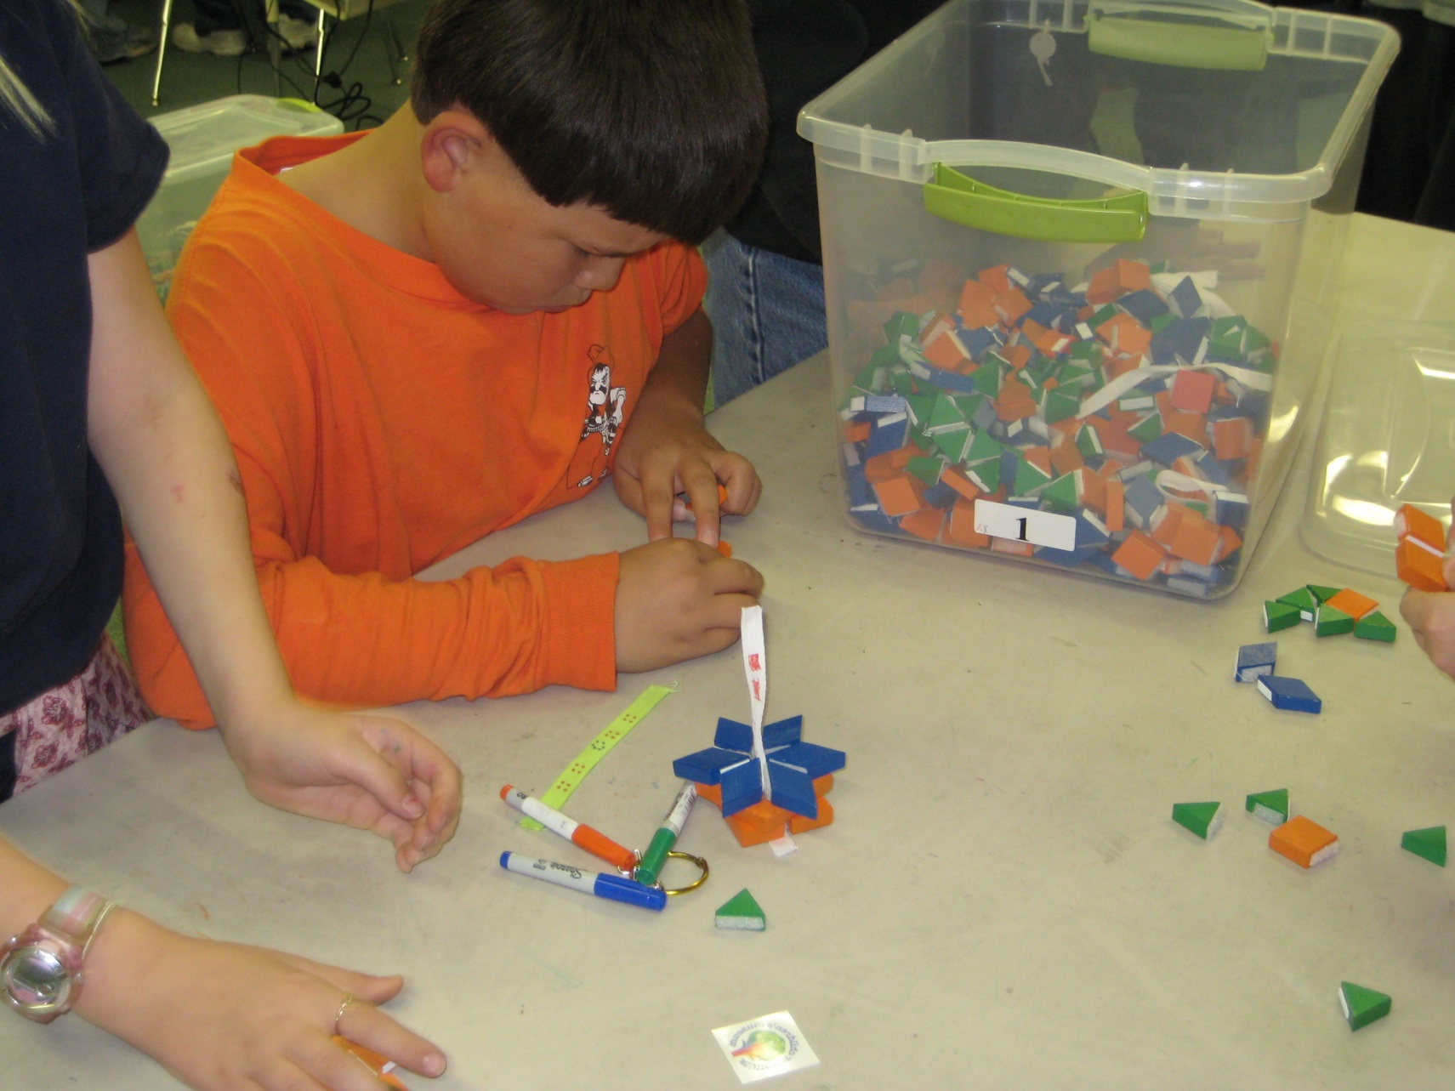
Culminating Activity
In teams, students race to see who can replicate the most viruses.

Slide 10
Coming Spring 2013 Traveling Exhibit “The Science of Small” (working title)

