Slide 1
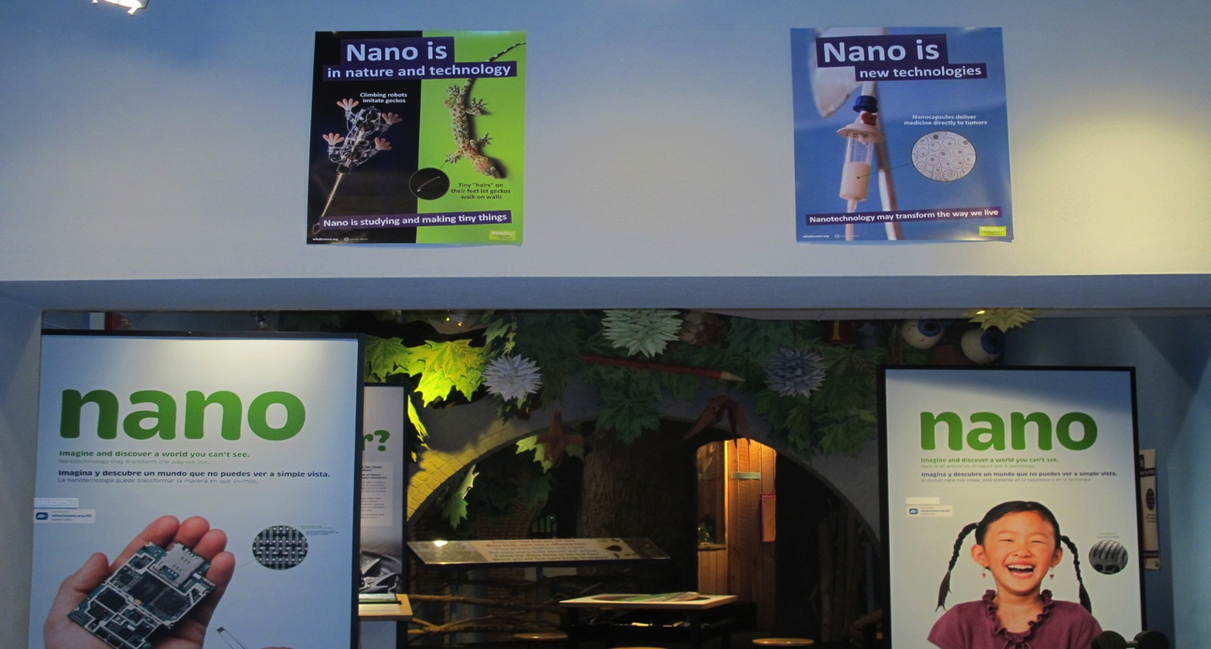
Highlighting Nano
in Your Existing Museum Exhibits

Slide 2
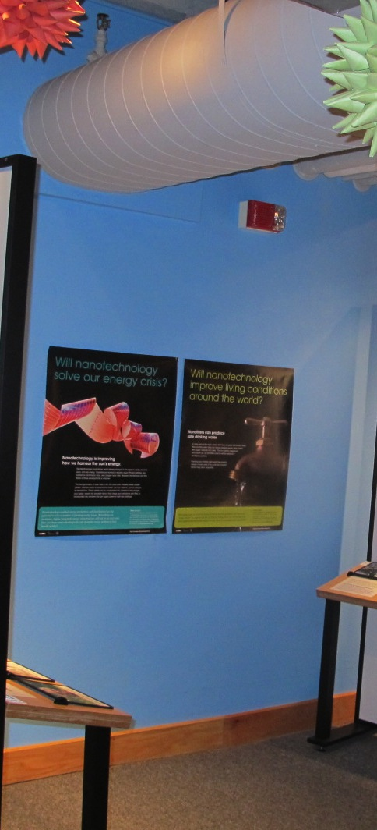
Trudi Plummer, Maine Discovery Museum
Kelli Isenhour, SciWorks
Lauren Hubbard, Maritime Explorium
Rei Cameron, Arizona Science Center
Sarah Fisk, Children’s Museum of Science and Technology
Ali Jackson, Sciencenter
Welcome!

Slide 3
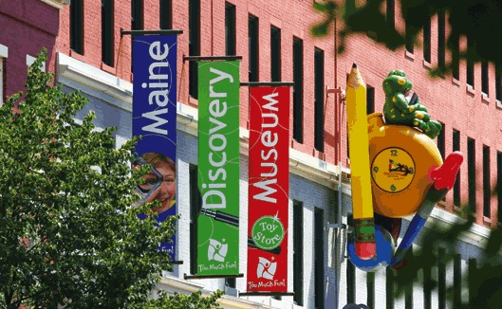
Main Discovery Museum

Slide 4
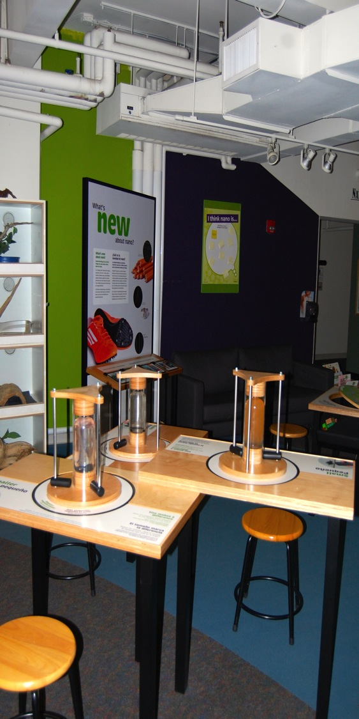

The Hunt for Nano in Maine Begins at the Maine Discovery Museum!
Maine Discovery Museum: 28000 square feet, about 60000 visitors per year;
42% from every Maine County, 38% from the greater Bangor Area, 20% from out-of state.
3600 school children/year, 5000 monthly website hits, 668 member families.
The biggest change at MDM is about the science of the smallest things
>1500 brochures since July 2011.
>About 800 scavenger hunts, averaging 6 /week or 20-40 on Nano themed days or school
(Image can go here)

Slide 5
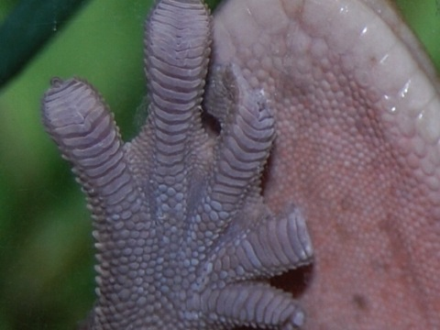
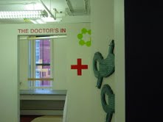
Magnet station T-Rex jaw
Freddy the gecko Dr.’s Office
Water fountain Gravity tracks
Smoke detectors Elevator
Sticker Booth Mood Rings
Mono butterfly display case
Heat Sensitive “Hand Art” Wall
“Freeze your shadow”
Tangram puzzle with magnetic paint
Charlotte’s web (spider web)
Areas identified as connected to
Nano science, technology and engineering in our museum:
Sample Scavenger Hunt Questions:
What is a Nano? Ask and explain
How many nanometers are in a centimeter?
Draw: what does the underside of Freddy’s foot look like?
What is the smallest thing in the museum you can still see? Write or draw
How tall are you in nanometers?
How long is your hand in nanometers? Draw
How DOES the gecko stick to the wall?
What can Nano silver do? Hint: visit the doctor’s office
What can Nano filters do? Hint: visit the Nano exhibit and the water fountain.

Slide 6
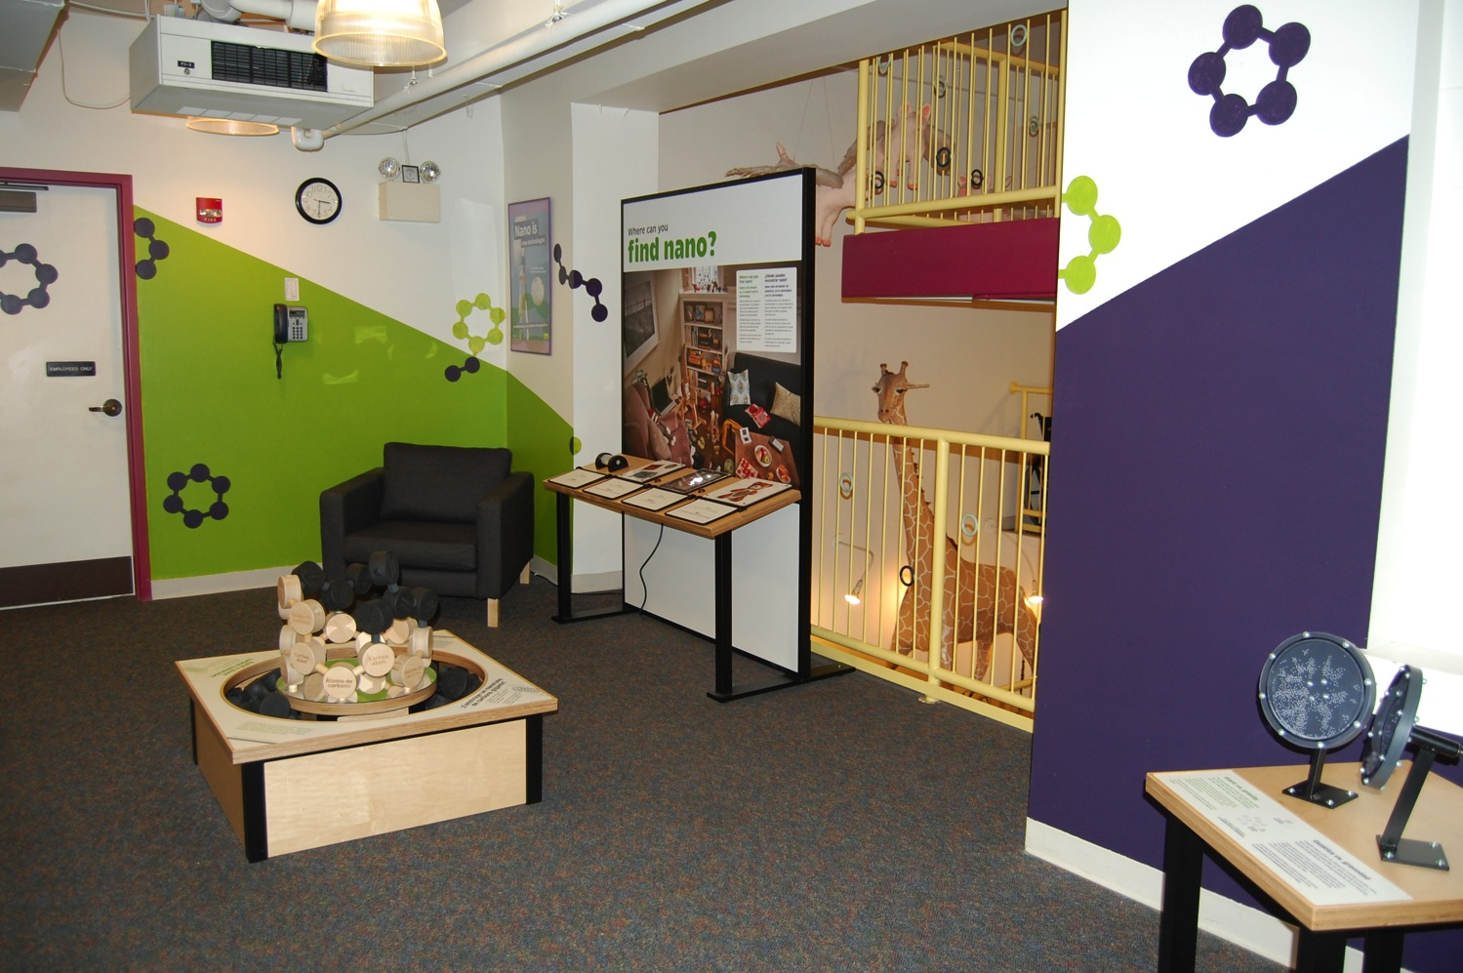

Slide 7
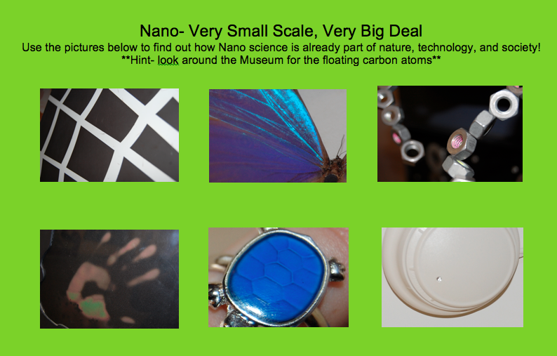

Slide 8
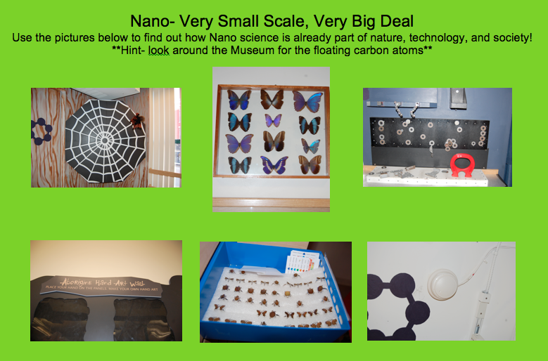

Slide 9
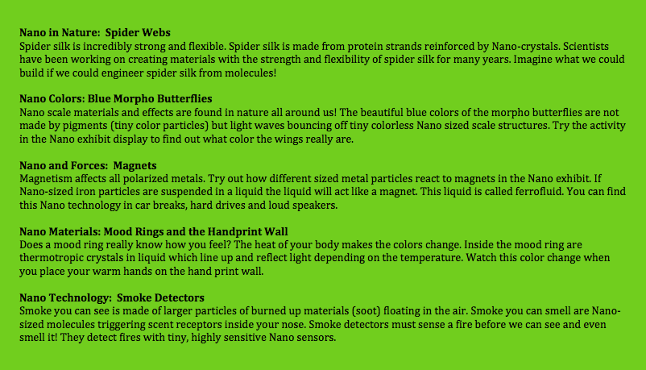

Slide 10
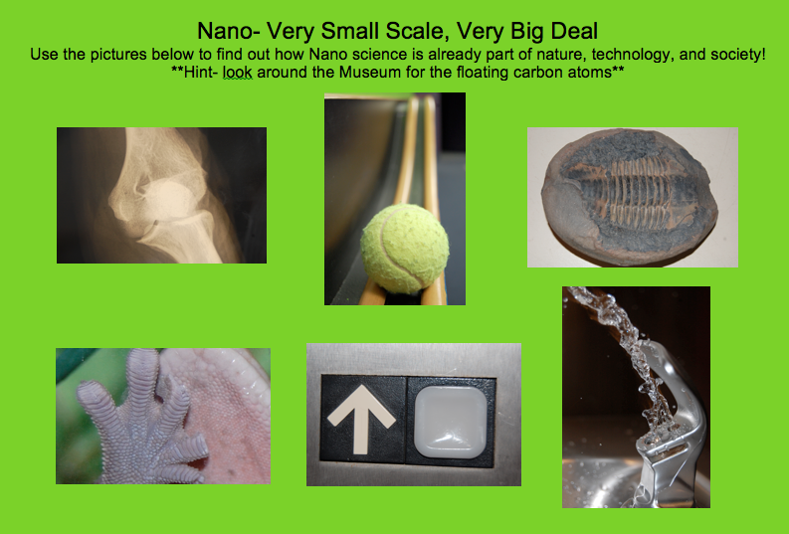
Notes:
And as always, thank you to NSF for supporting this project!

Slide 11
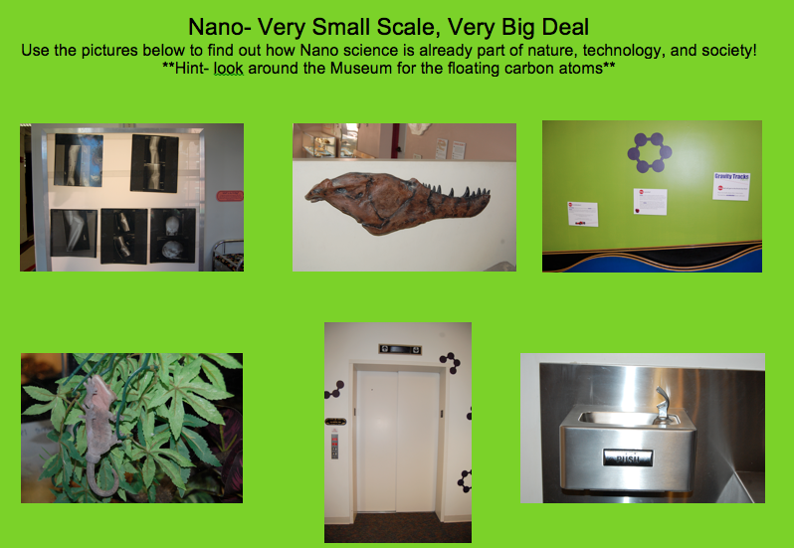

Slide 12
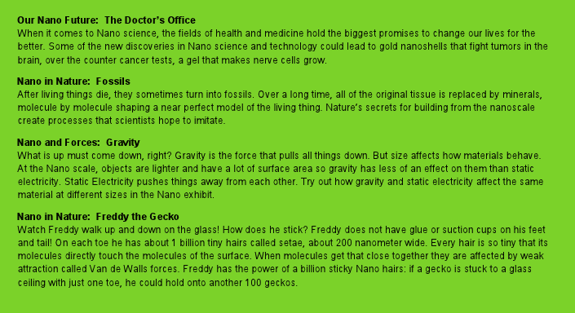
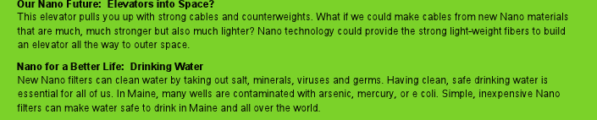

Slide 13

NISE Network Mini-Grant

Slide 14
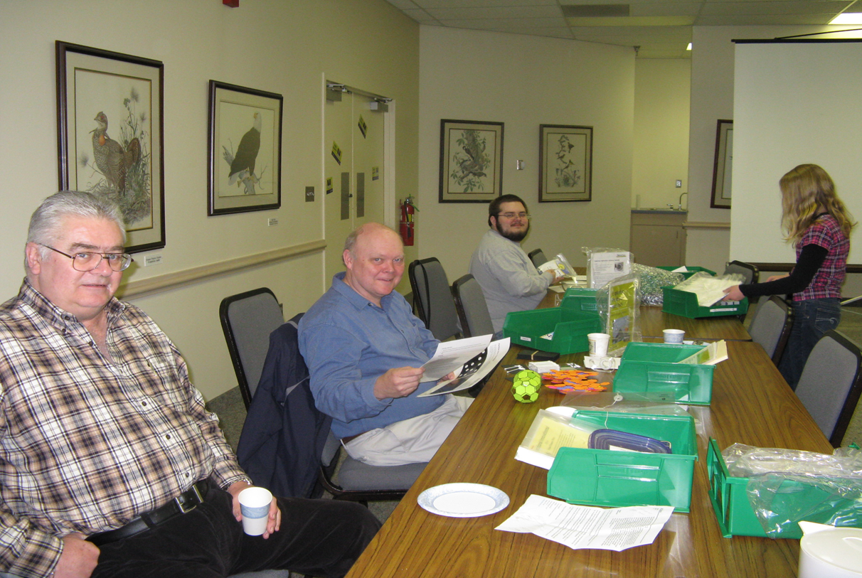
Nano Volunteer Training Workshop

Slide 15
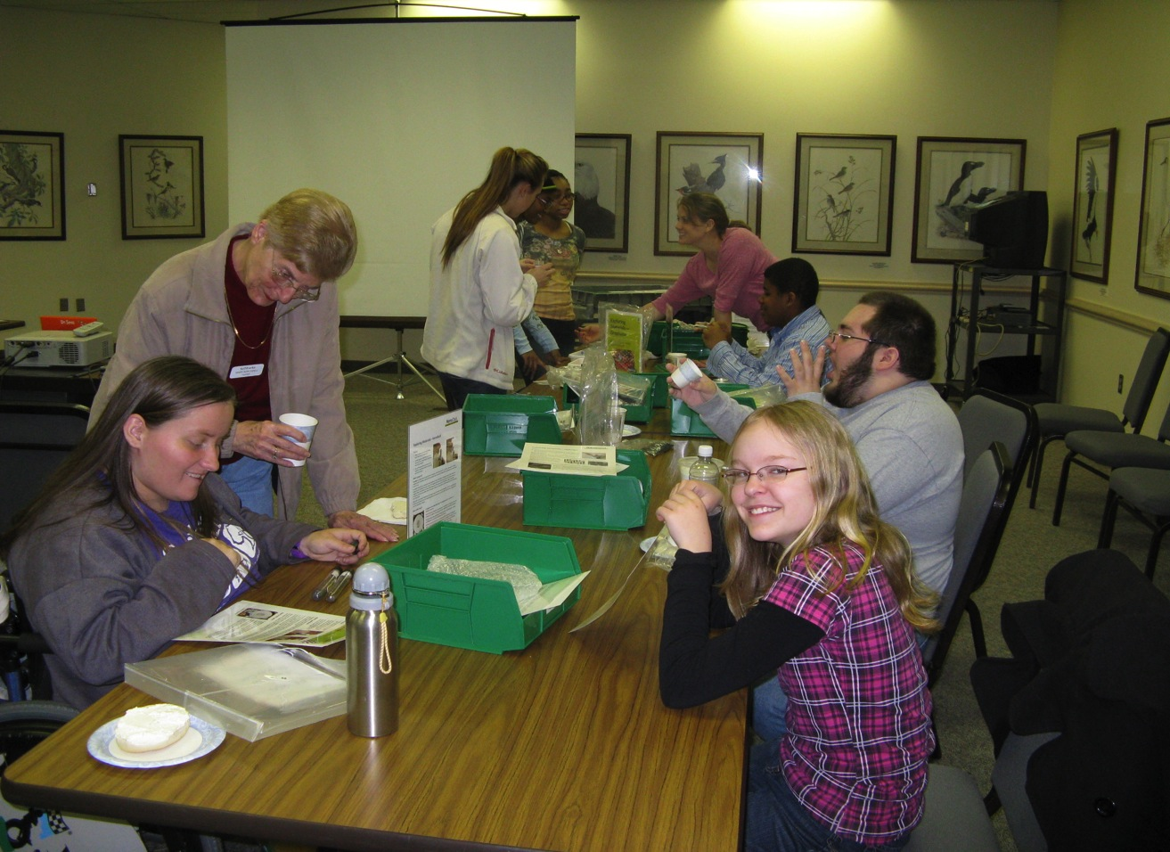

Slide 16
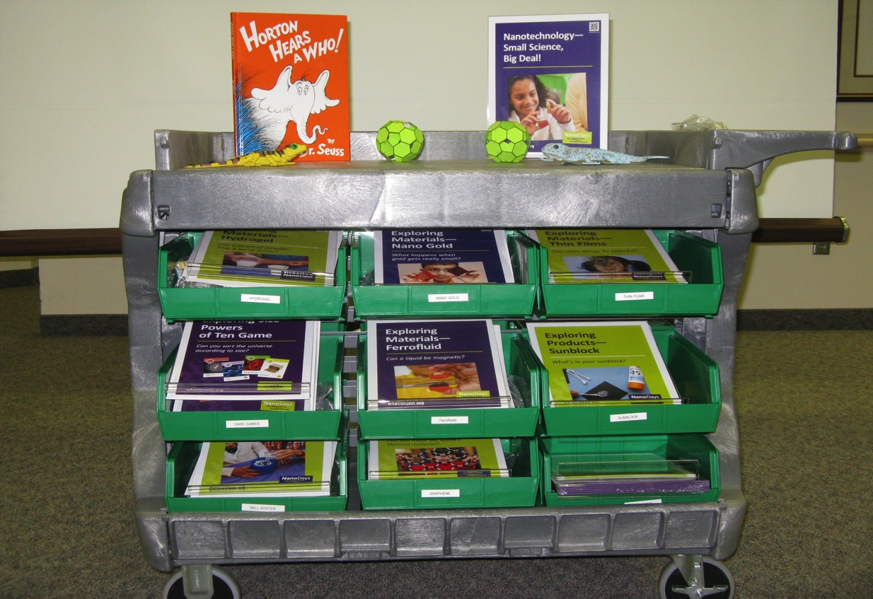
Nano Demonstration Cart

Slide 17
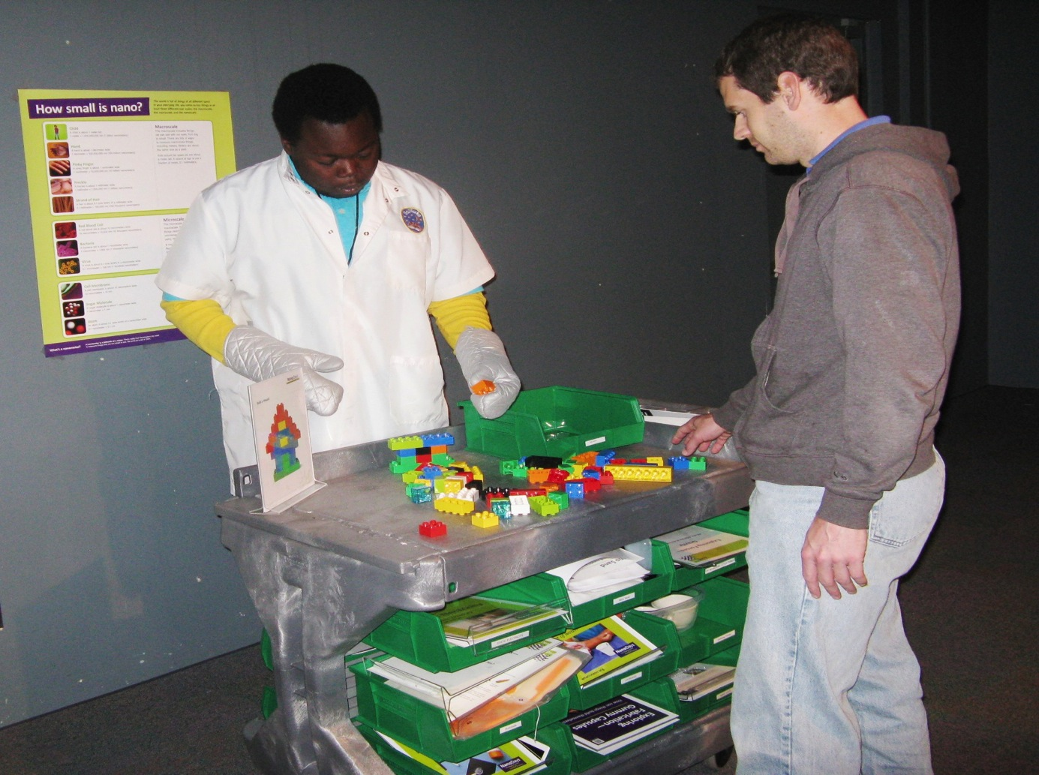

Slide 18
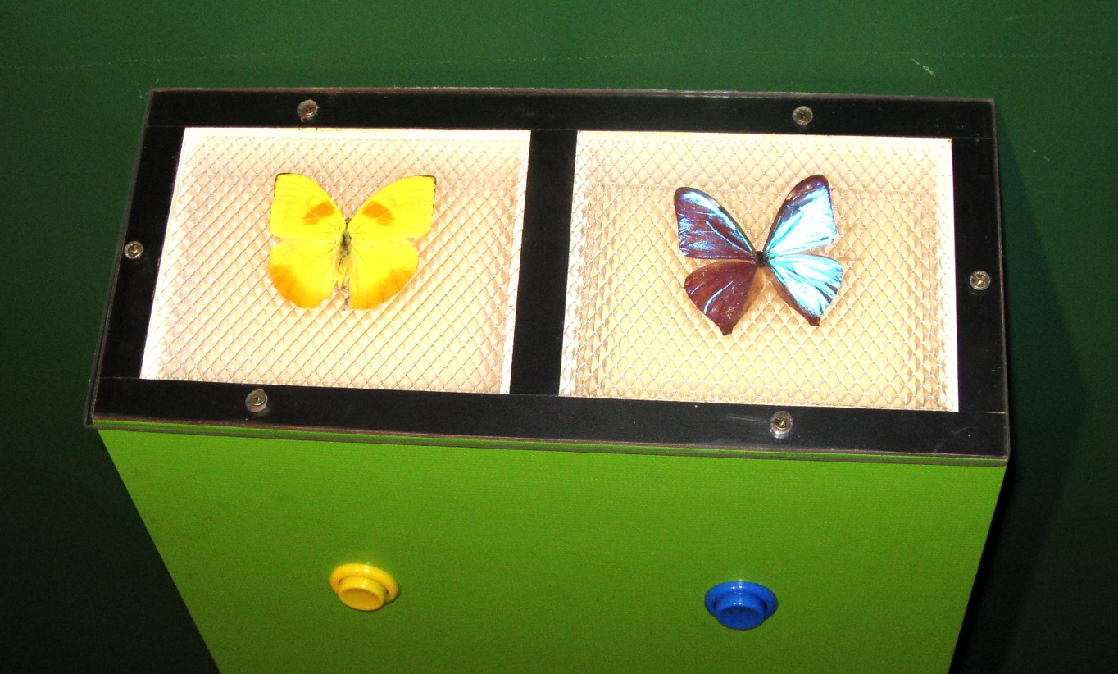
Butterfly Wing Structures Exhibit

Slide 19
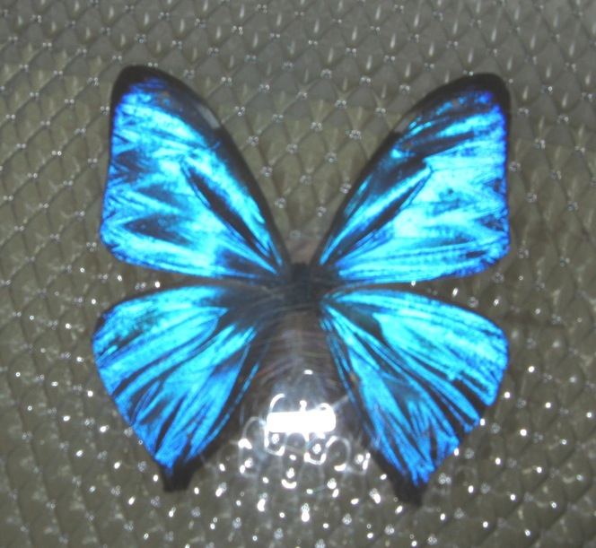
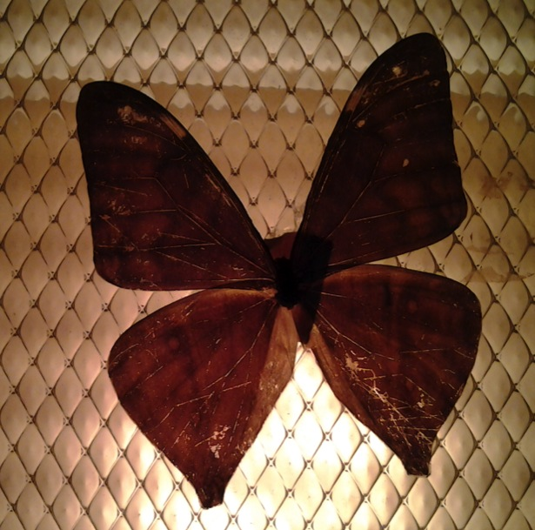
Blue Morpho Butterfly
Without Light
With Back-lighting

Slide 20
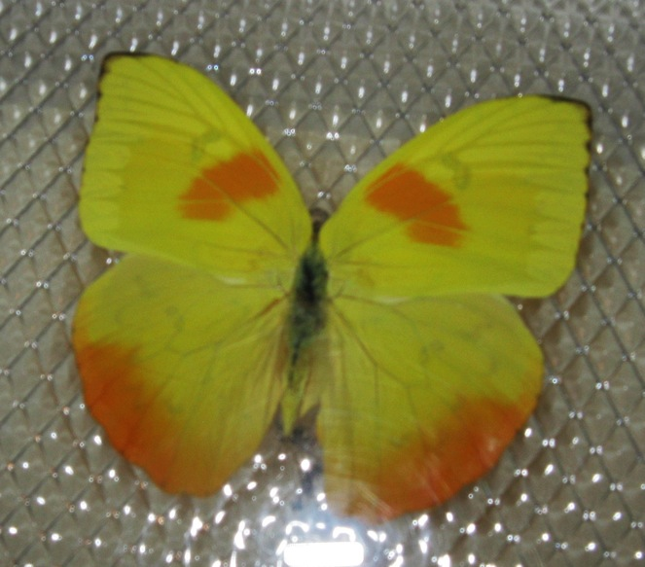
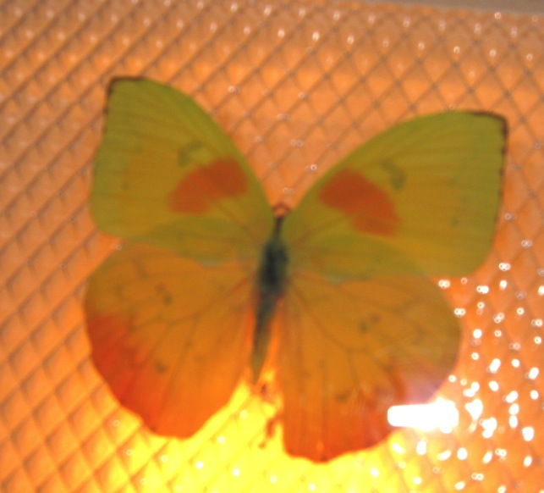
Orange Sulpher Butterfly
Without Light
With Back-lighting

Slide 21
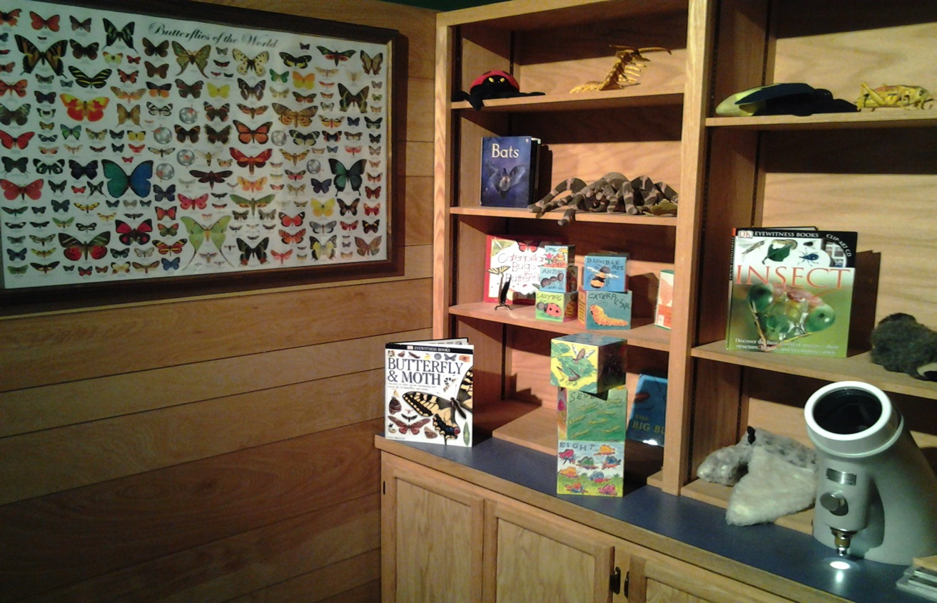
Field Station Exhibit

Slide 22
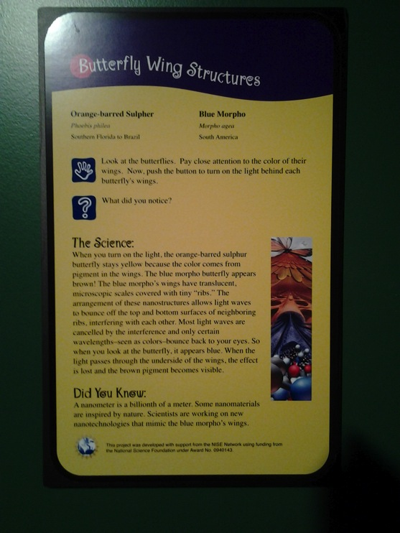
Butterfly Wing Structures

Slide 23





Resources
Nano cart (mobile work station): Uline
www.Uline.com
Graphic: Nvizion Inc.
www.nvizioninc.com
Graphic Design: Firebird Design Studio
www.firebirddesignstudio.com
Butterflies: Butterfly Utopia
www.butterflyutopia.com

Slide 24

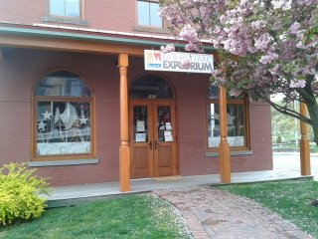
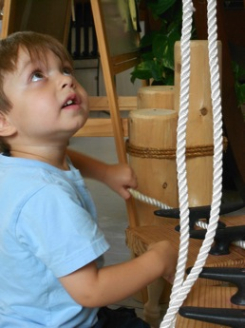
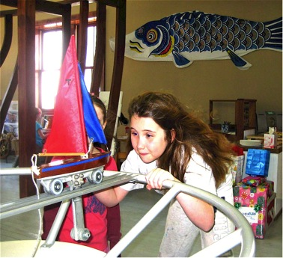
The Maritime Explorium is a lighthouse learning center for all ages – one that launches authentic science learning within a celebration of the unique maritime history of Long Island.
Housed in the historic Chandlery Building on Port Jefferson Harbor, the Explorium offers children and families an array of interactive exhibits.
Notes:
24

Slide 25
Goal:
Modify six existing exhibit signs to highlight nano science and nanotechnology connections as they pertain to existing exhibits at the Maritime Explorium.
Challenge:
To stay true to our model of hands-on exhibits we wanted to find a way to incorporate interactive features into the signage.
Notes:
25

Slide 26
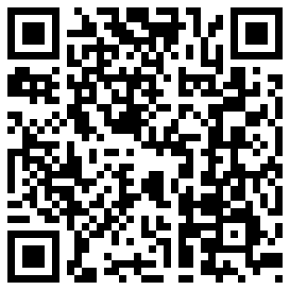

Solution:
CHANDLERY
The building you are standing in today was built in the 1890's and served as a chandlery, a store that sold nautical gear, candles, rope, sail repair kits and all of the other equipment a ship would need for a long voyage. Today, a chandlery carries different items many of which are made possible through nanotechnology, such as barnacle busting paints and energy efficient tools.
10 ⁻⁹
NANO SPOT
Visit our Smartboard and click on
“CHANDLERY”
for more information about how nanotechnology is used in materials today.
Funding for the Smartboard and Programming provided by
The Laura B. Vogler Foundation,
Captain Planet Foundation and Hofstra University
Notes:
26

Slide 27
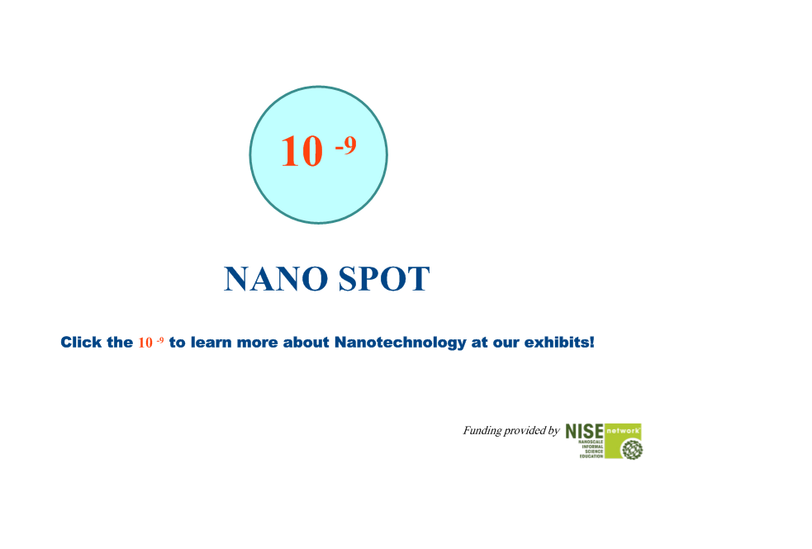
Notes:
27

Slide 28
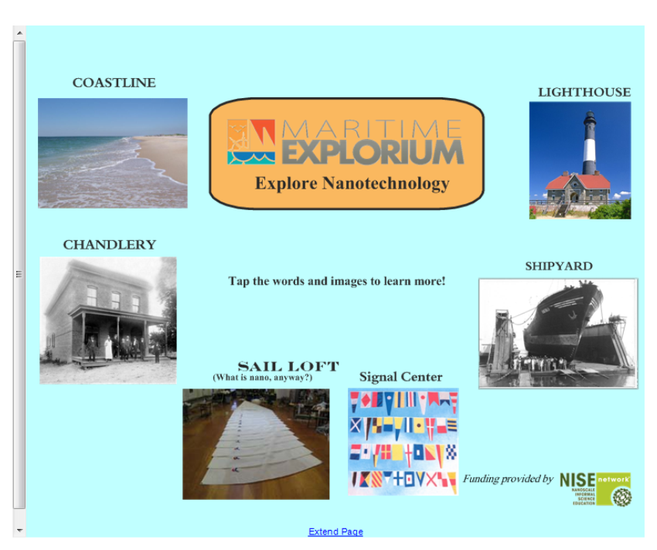
Notes:
28

Slide 29
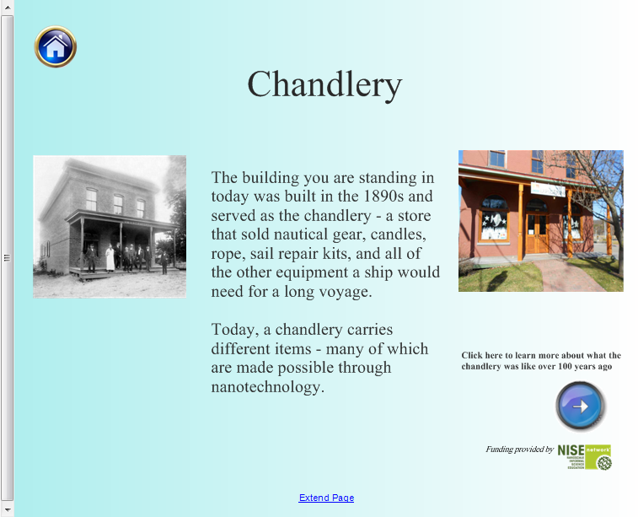
Notes:
29

Slide 30
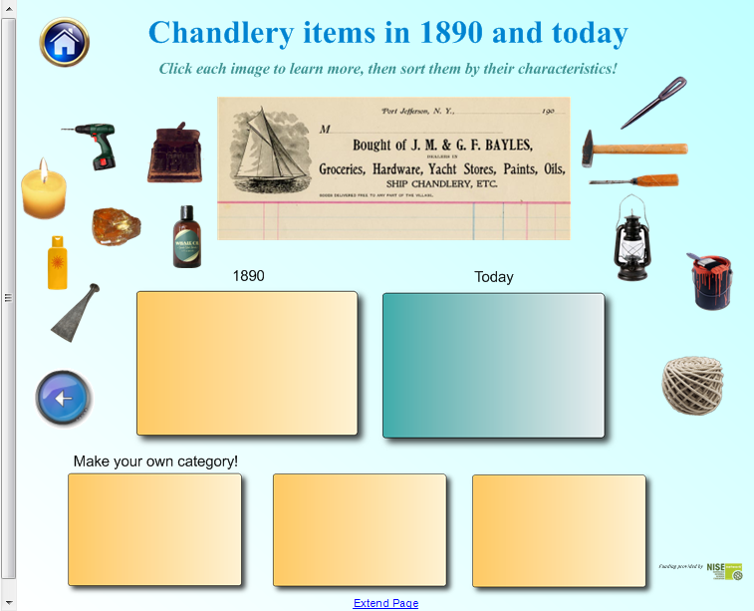
Notes:
30

Slide 31
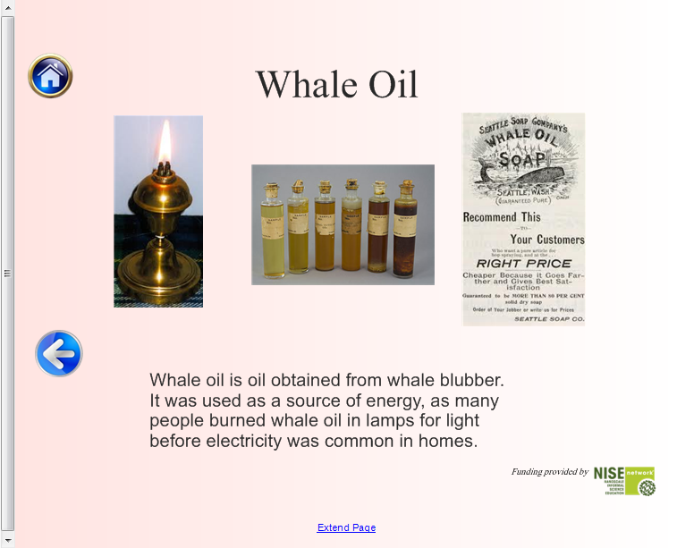
Notes:
31

Slide 32
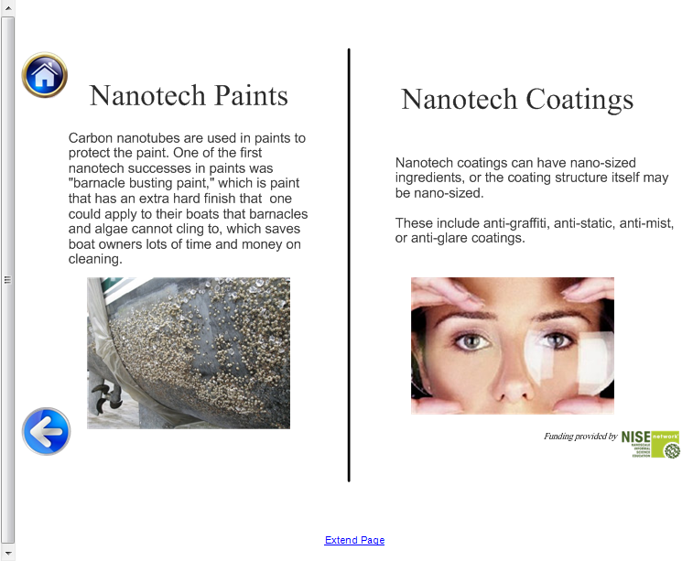
Notes:
32

Slide 33
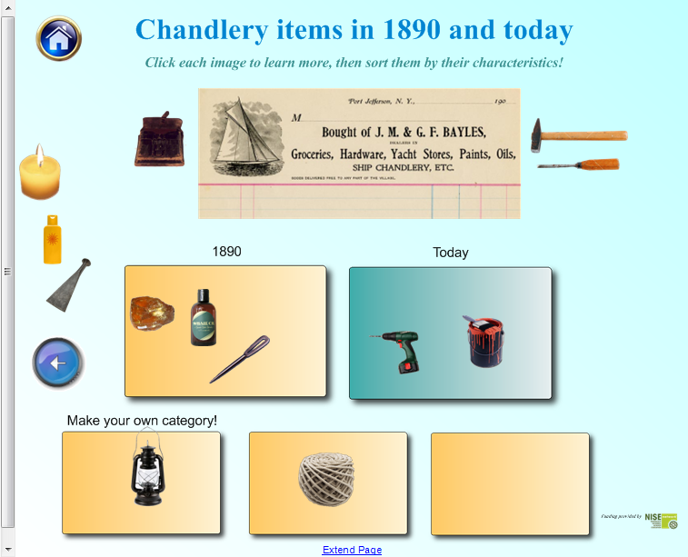
Notes:
33

Slide 34
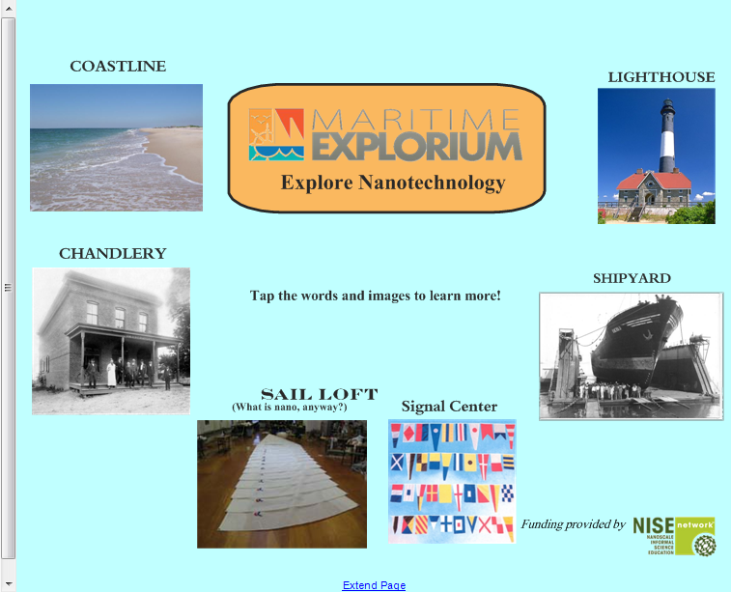
Notes:
34

Slide 35
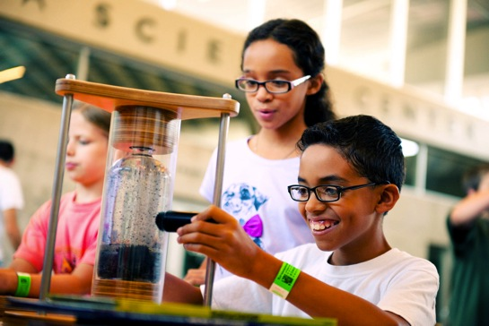

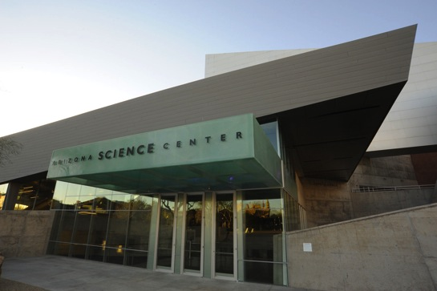
Small, Smaller, Nano!
Arizona Science Center’s Nano-Podcasts

Slide 36
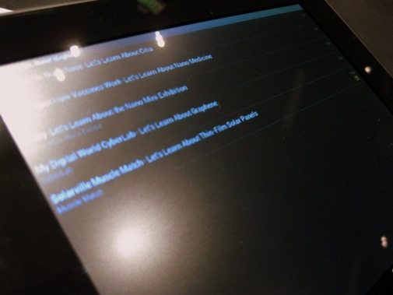
Goals of the project:
Design a set of five bilingual (English and Spanish) nano-themed podcasts that would highlight nanoscience in select exhibits around Arizona Science Center
Incorporate QR-codes that would link from the exhibits to the podcasts on ASC’s website

Slide 37
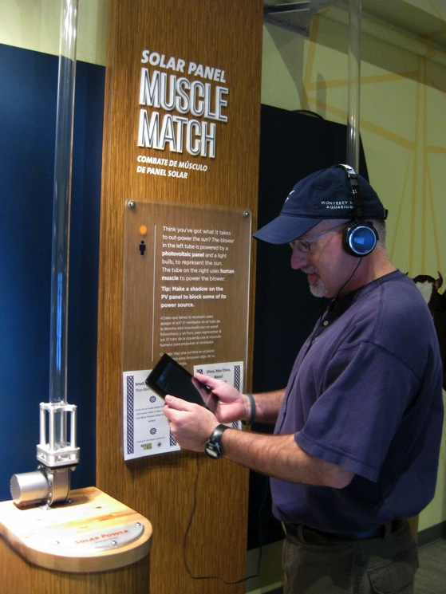
Benefits:
Fills a demographic need by making nanoscience accessible to the underserved Spanish-speaking population in Phoenix
The podcast tour naturally serves as assistive device, adding audio content for guests who are visually impaired
The use of tablet computers allows for the incorporation of videos, apps, and various media into future podcasts

Slide 38
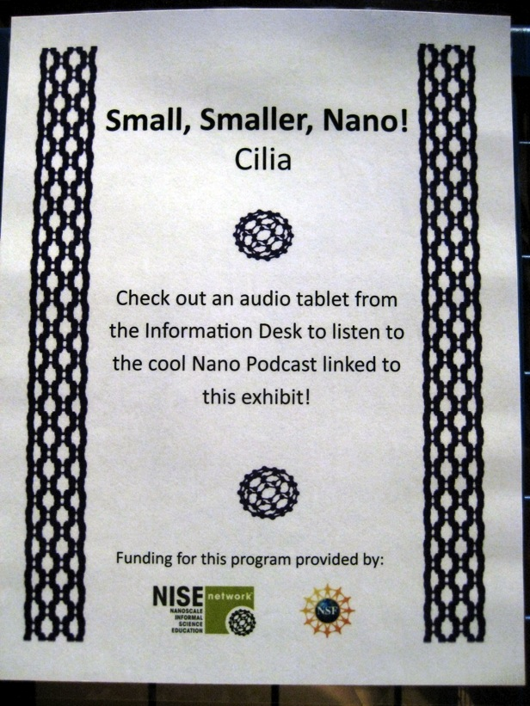
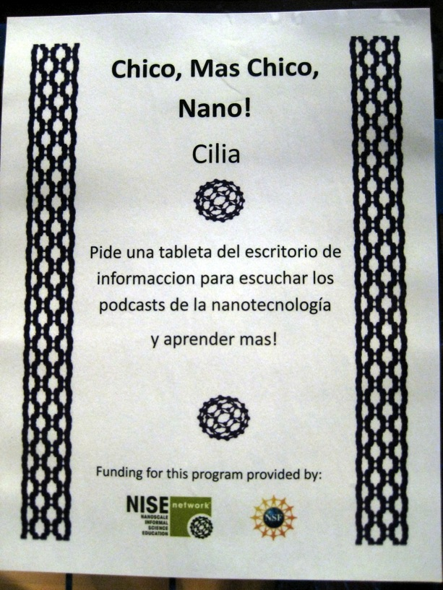
Signage at Exhibits

Slide 39
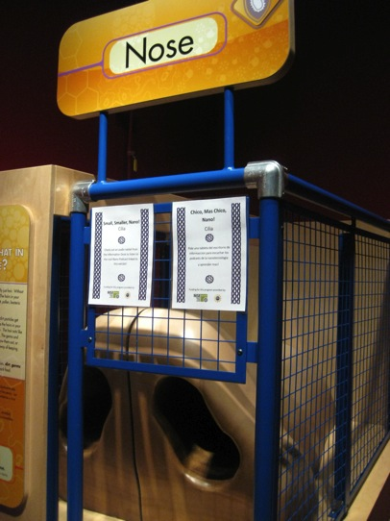
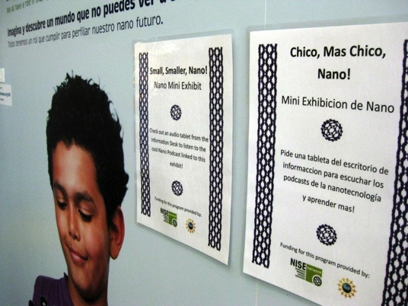

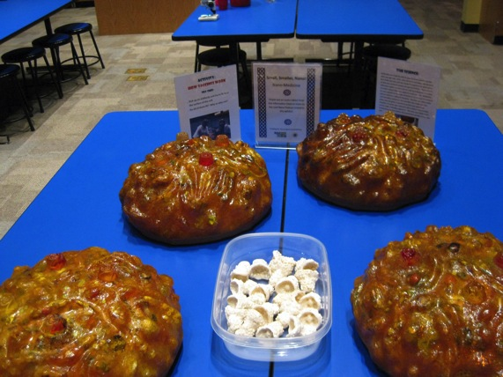
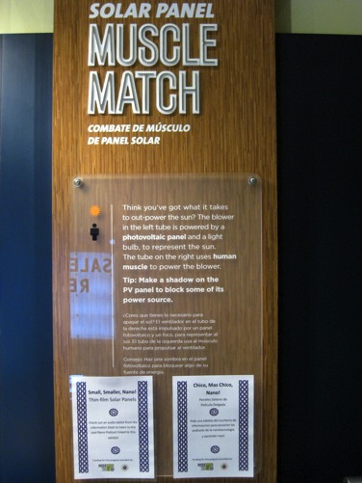
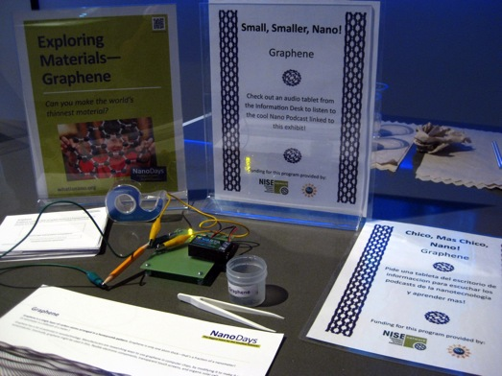
Exhibits

Slide 40
Guest Feedback
Very clear, informative and straight to the point
More to listen to
Need more content and it would be great!

Slide 41
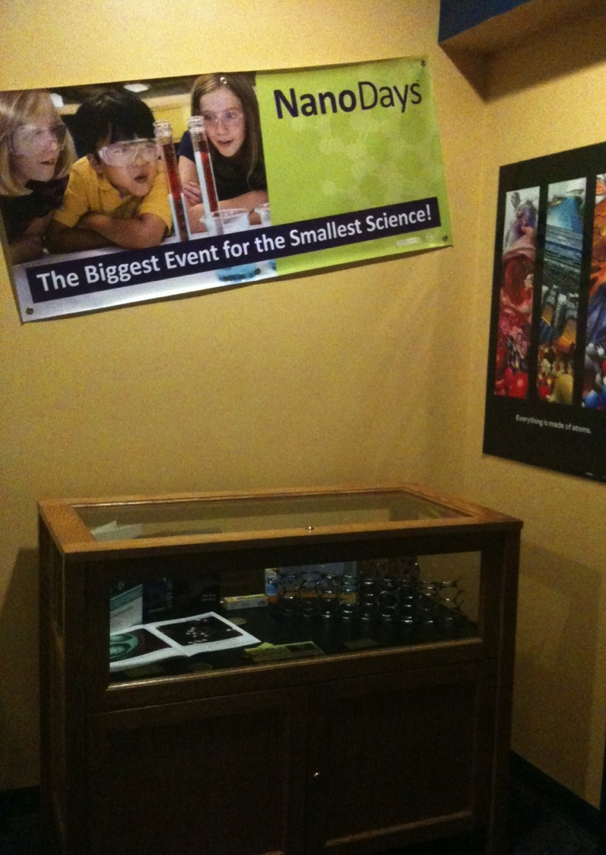

Adding Nano To Exhibits
Sarah Fisk

Slide 42
CMOST - Challenges
  A small staff of approximately 10 people.
  12,000 feet of exhibit space.
  Limited available funds for exhibits.

Slide 43
CMOST – What Worked In Programs
  Incorporating Nano programming from NISE into our exhibit programs.
  Utilizing “pieces and parts.”

Slide 44
CMOST - Exhibits
  Incorporating Nano content into current exhibits.
  Bucky Ball symbols in current exhibits indicate Nano information.
  Developed a Nano brochure as exhibit guide.

Slide 45

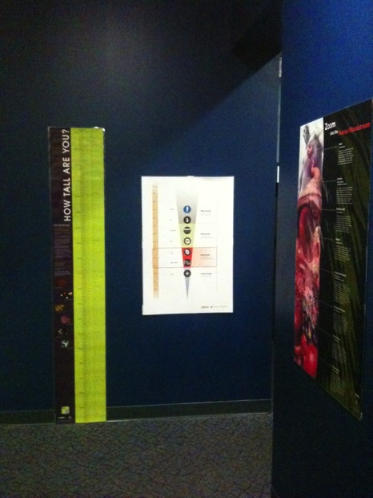



CMOST – Nano within the exhibits

Slide 46


Slide 47


Slide 48

THANK YOU!

Slide 49


This presentation is based on work supported by the National Science Foundation under Grant No. 0940143.
Any opinions, findings, and conclusions or recommendations expressed in this presentation are those of the author(s) and do not necessarily reflect the views of the Foundation.
Notes:
And as always, thank you to NSF for supporting this project!

Slide 50
Questions and Discussion?

