Slide 1
How to Prepare Researchers for Working with Public Audiences
Science Museums:
Karine Thate & Carol Lynn Alpert - Museum of Science
University-Based Research Centers:
Andrew Greenberg – University of Wisconsin-Madison Heather Armstrong – University of New Mexico
Government Science Agencies:
Rick Borchelt – NIH National Cancer Institute
Notes:
Welcome
My name is Carol Lynn Alpert and this is my colleague Karine Thate, here at the Museum of Science, and we have an excellent panel joining us: Andrew Greenberg of the University of Wisconsin-Madison, Heather Armstrong of the University of New Mexico, and Rick Borchelt of the National Cancer Institute.
Karine and I are going to discuss museum-initiated science communication professional development programs for science and engineering researchers, Andrew and Heather are going to discuss university-initiated science communication programs for science and engineering researchers, and Rick is going to discuss his approach to media relations training for scientists at a government science agency. Then we’ll throw it open for discussion.
But we’d like to begin by learning who is here with us in the room, and what your focus or primary interest is.
For starters,

Slide 2
Partnership Resources nisenet.org/rise
Notes:
We’re going to start with some models that have been developed partially with NISE Net funding, under the RISE initiative. That’s the Research Center – Informal Science Education partnership initiative. That initiative is designed to help local science museums and university-based research centers develop sustainable partnerships for ongoing education outreach.

Slide 3
Updated Partnership-Building Guide in Catalog, under ‘Tools and Guides,’ and in NanoDays Kits
Notes:
And we have just produced this guide –which is going out in every NanoDays kit to guide the development of such partnerships. (Pass one or two around the room).
We have had several long-term partnerships with local university-based research centers, funded by sub-awards from these centers, and our science communication development programs grew organically out of the efforts of the partners to help get young researchers - in particular - involved with outreach.

Slide 4
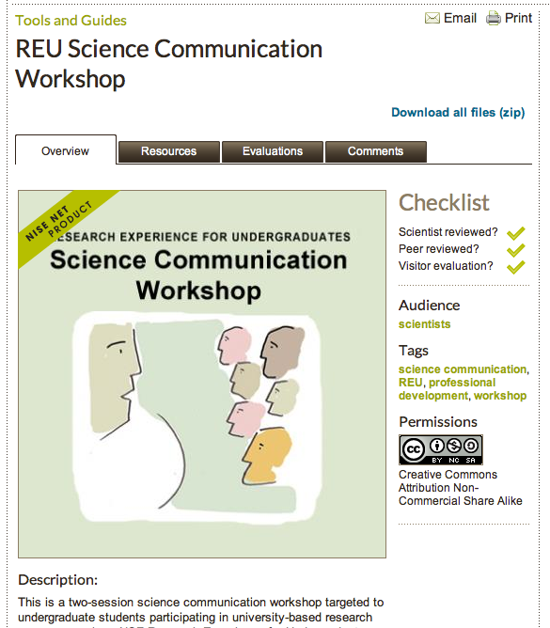
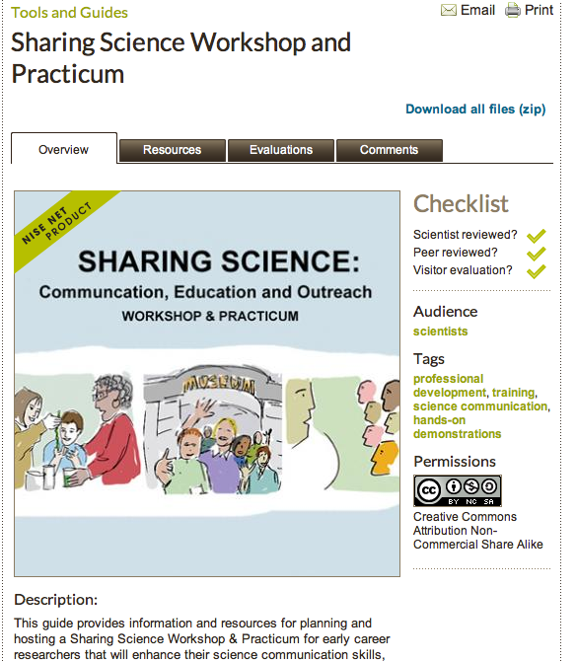
Workshop Guides and ‘Packages’ in Catalog under ‘Tools & Guides’
Notes:
Two of these PD programs have been packaged with instructions and materials for running the workshops, and they are available on the NISE Net catalog for download. Karine is going to show you those in a minute.
Our goal is to help folks at other institutions – science museums or universities -- to build the capacity to offer these workshops themselves – adapting them for their own environments.

Slide 5
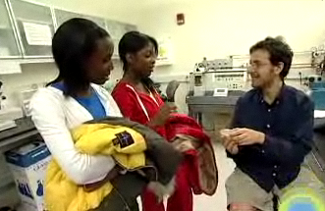
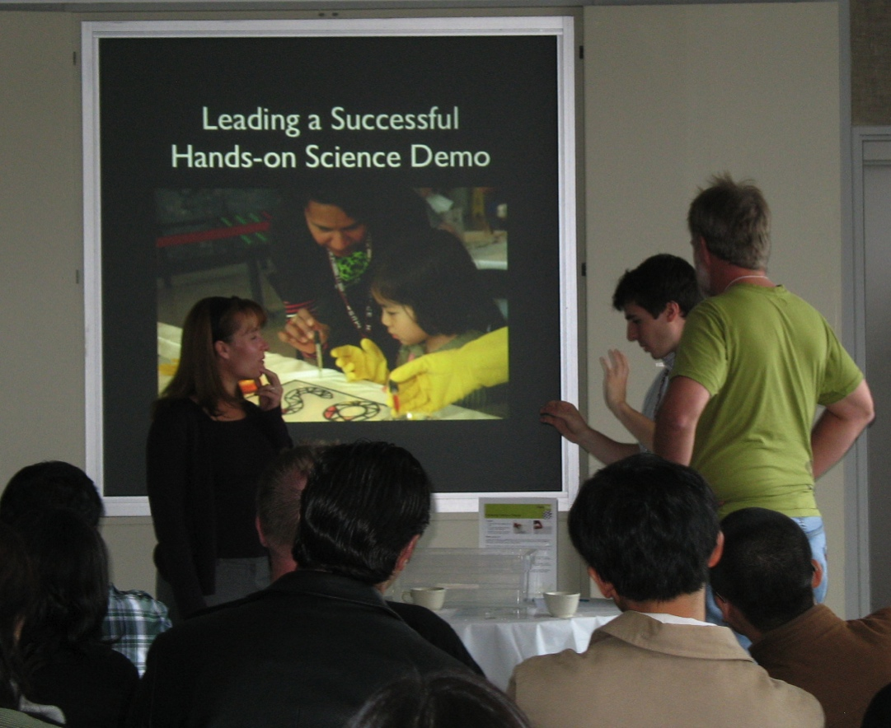
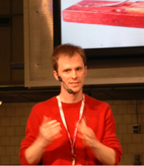
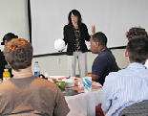
Sharing Science Workshop & Practicum
Graduate students explore science communication and education
“It made me to think about my
research from a different perspective.”
- Workshop participant
“I had to go for an interview in the evening, and the workshop experience helped me communicate my work better.” - Workshop participant
Notes:
Sharing Science Workshop and Practicum is an ideal format for preparing local researchers to be involved in NanoDays- like events, with an emphasis on inquiry-based learning and hands-on demos. Graduate students, post-docs, and early career faculty are its primary audience.

Slide 6
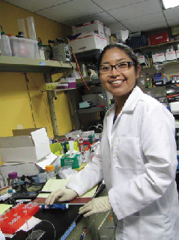
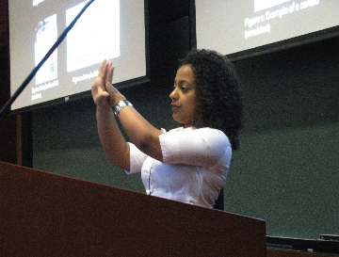
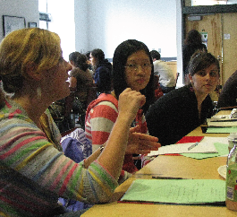
REU Science Communication Workshop
Prepare undergraduates for success in graduate study
Notes:
The REU SCW is designed for university folks or museum folks in collaboration with science museum folks to help undergraduates involved in research experiences to learn the associated communication skills that can help them feel successful in science and confident to move on to graduate level research.

Slide 7
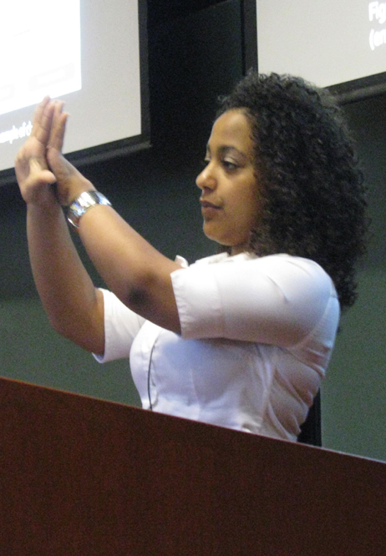
REU Science Communication Workshops
“Significant improvement in confidence and communication skills”
- UMass Donahue Institute for Research and Evaluation
“I wish all the professors and research people would take part in such a workshop. It makes you aware that no matter how great your results are, they don’t mean anything if you can’t communicate them to others.”
- REU student participant
Notes:
We began developing the model for this workshop in 2003.
Many iterations – very well studied
This program has been extensively evaluated and it has tested successfully

Slide 8
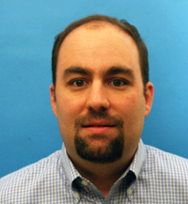
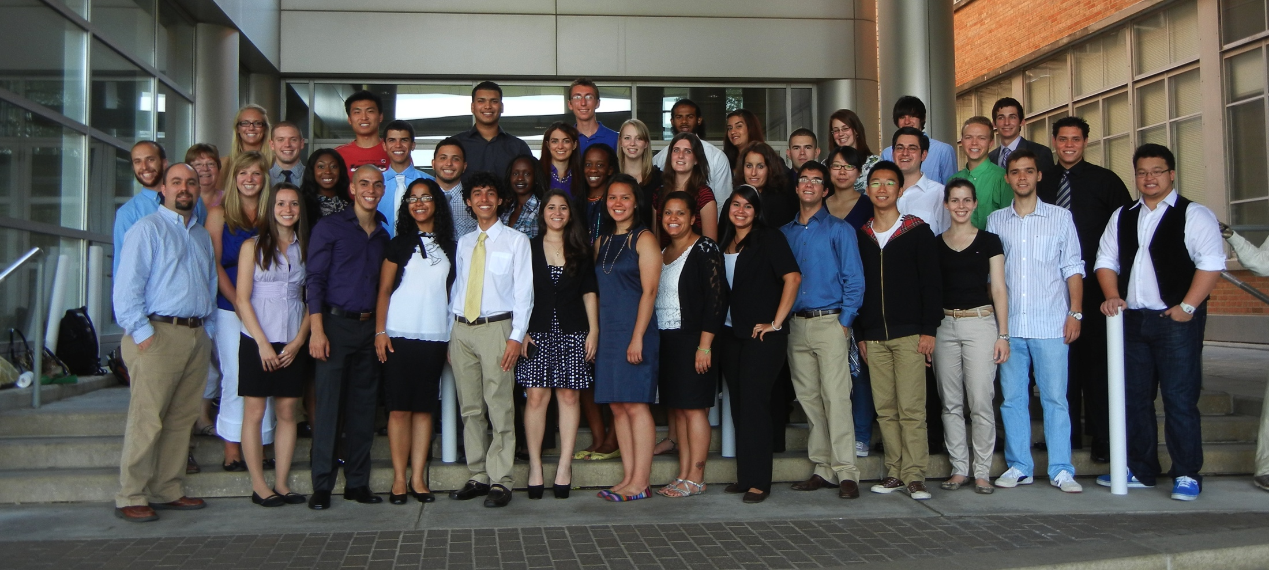
Andrew Greenberg REU Program Director
2010-2011 REU SCW Dissemination Experiment
Notes:
and become embedded in the REU program at UW-Madison by our friend Andrew Greenberg.

Slide 9
“Train the Trainers” Workshop: Summer 2012
The Center for Nanotechnology/NNIN
University of Washington
Lurie Nanofabrication Facility/NNIN, U Michigan, Ann Arbor
Center of Integrated
Nanomechanical Systems
UC Berkeley
Center for Energy Efficient Electronics Science. UC Berkeley
Institute for Electronics & Nanotechnology/NNIN
Georgia Tech
Engineering the Grid
North Carolina State University
NNIN/The UCSB Nanofabrication Facility
UC Santa Barbara
TX Institute of Intelligent Bio-Nano Materials & Structures for Aerospace Vehicles (TiiMS)
Texas A&M University
Notes:
And this summer, the NISE Net helped us run a dissemination workshop in which 8 nano and mrsec REU program directors from research centers around the country came to Boston

Slide 10
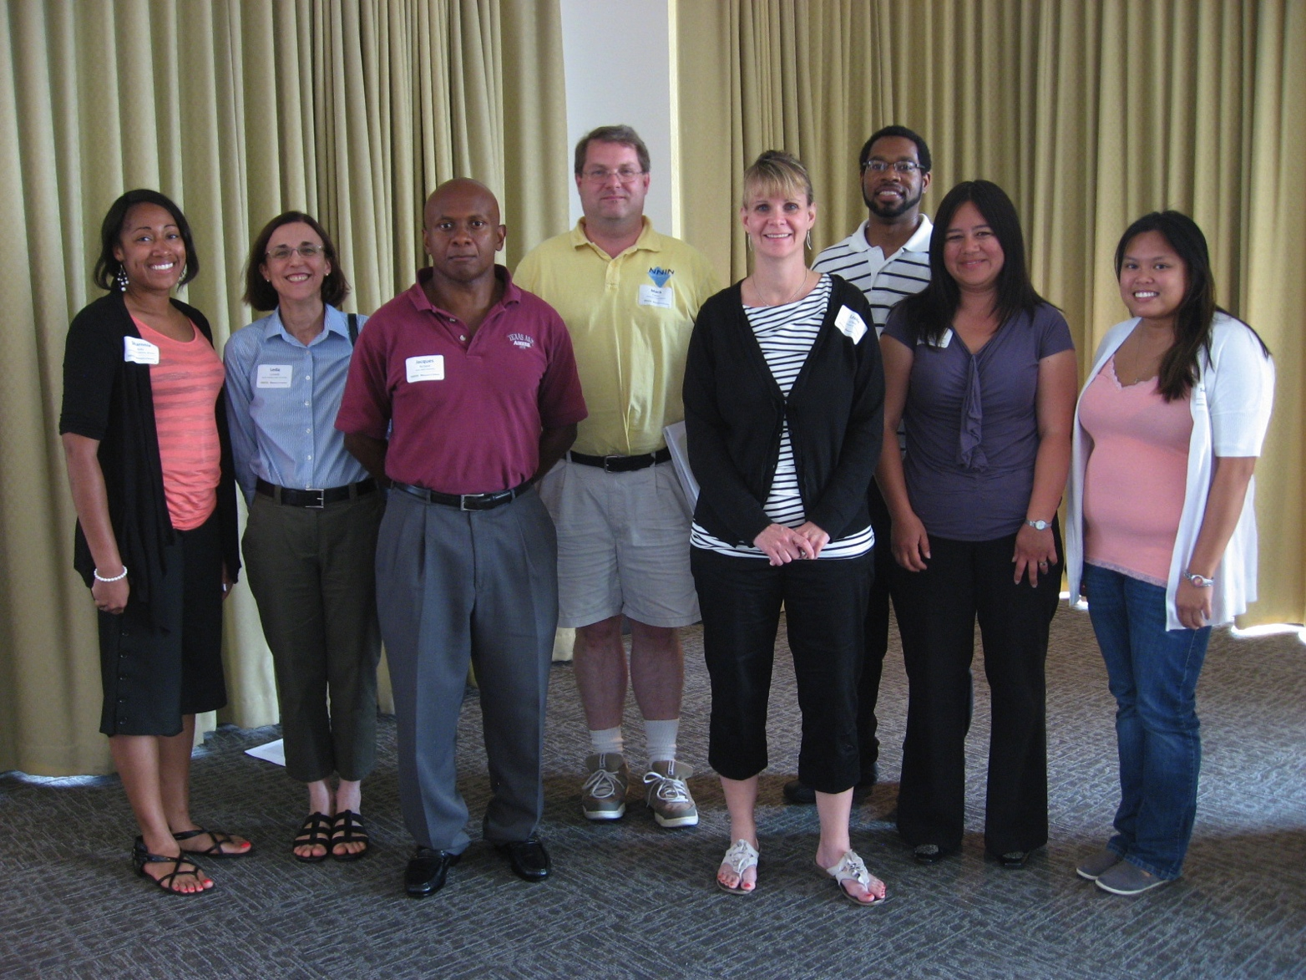
Train-the-Trainers” iREU Workshop: Summer 2012
Sharnnia Artis, Mack Carter, Samantha Cruz, Meltem Erol, Brandon Lucas, Leda Lunardi, Leslie O’Neill, Jacques Richard
Notes:
and watched us deliver both sessions of the program and then brought it back to their institutions and delivered it there

Slide 11
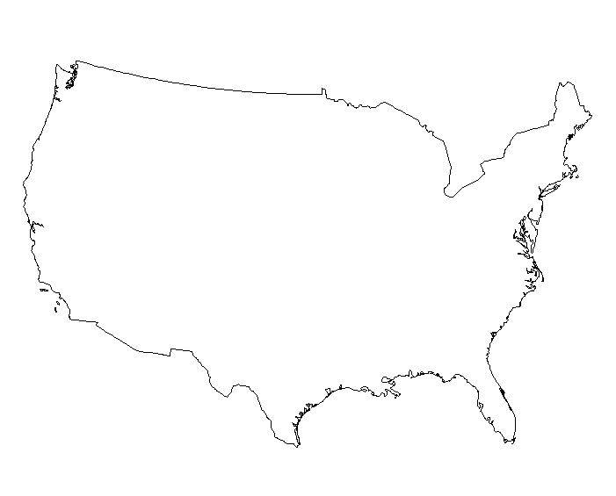
REU Sci Comm Workshops: Summer 2012
REU Students Reached:
58 in 2010 - at 4 campuses
197 in 2012 - at 12 campuses
Notes:
Currently Building database of evaluation results.

Slide 12
Workshop Guides and ‘Packages’ in Catalog, under ‘Tools & Guides’
Notes:
Here’s Karine to give you a bit more detail about what’s contained in these programs and the program guides, and also to tell you about what the Portal to the Public program has to offer.

Slide 13
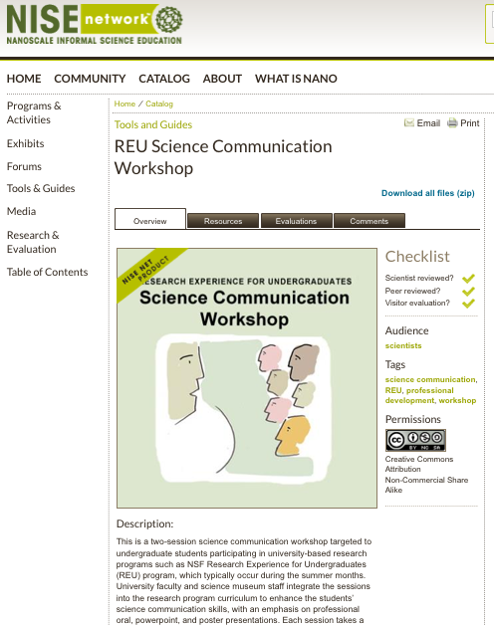
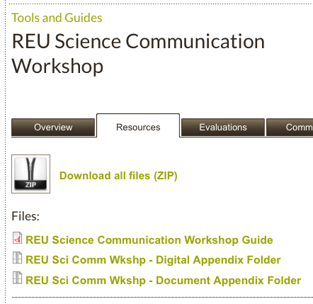

Slide 14
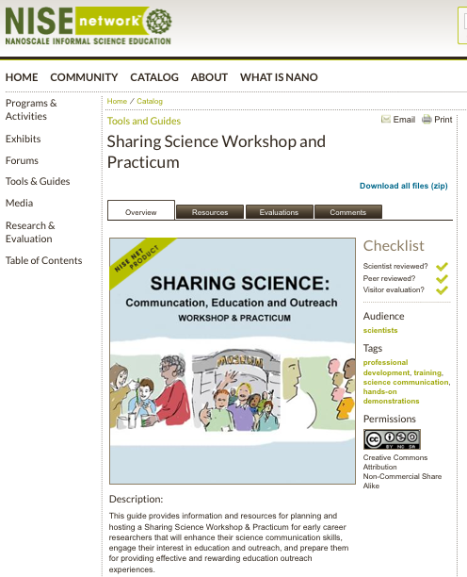

Slide 15
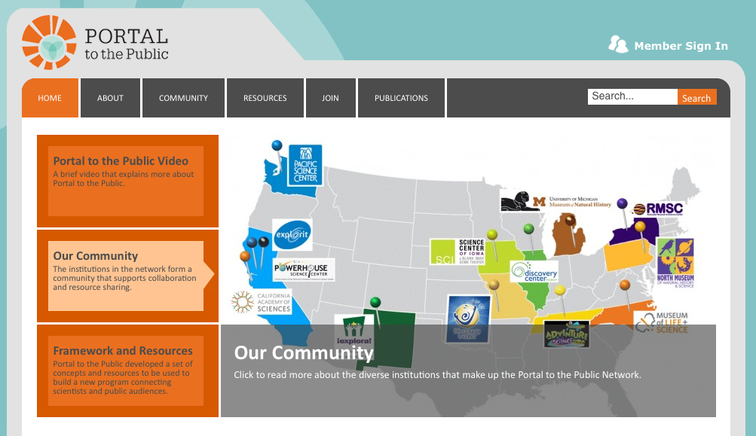
Portal to the Public
popnet.pacificsciencecenter.org

Slide 16
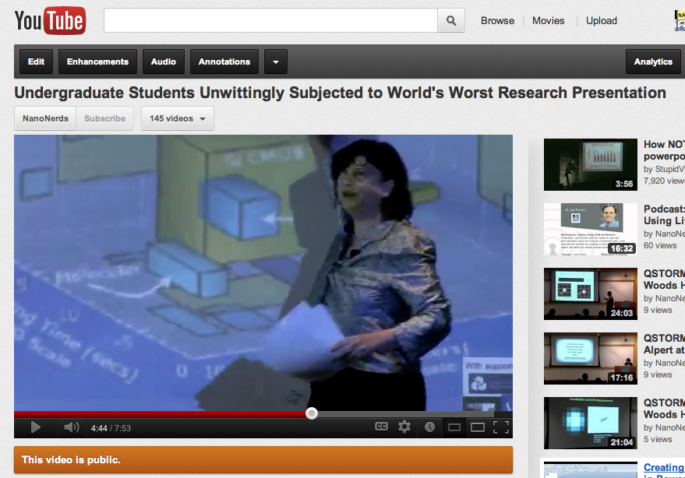
Fun Resource Produced During 2012 iREU Workshop

