Slide 1



Team-Based Inquiry
Making Evaluative Thinking Part of Your Work
Network-Wide Meeting
December 2012
Notes:
Welcome to the team-based inquiry session. Who here has heard of TBI, including folks who went to the nano & society workshops?
To give you a little background about how and why TBI was developed, the idea began about two and a half years ago, when the Network leadership team was writing a renewal proposal to NSF.
By that time, it was becoming obvious that it was impossible for the Network evaluation to support all of the work that was going on across the country and evaluate all the countless products being developed.
It was also clear that an important part of the Network’s success was giving partner organizations the flexibility to tailor Network products and resources to their own needs and audiences.
So, the Network was interested in providing tools and resources to help project teams, partners, and non-evaluation professionals build evaluation and data-based decision making into their work.
The result was team-based inquiry—a practical approach to empowering teams and professionals to get the data they needed, when they needed, to improve their products and practices and ultimately, more effectively engage public and professional audiences with nano.
This session will focus of team-based inquiry: an approach to professional inquiry the Network has developed to support partners in (1) improving nano education products and practices, (2) fostering effective teams and organizations, and (3) building evaluation capacity.
The overall goal of is familiarize you with TBI and provide you with some practical tools and resources that you can adapt for you own projects and goals at your institutions.

Slide 2
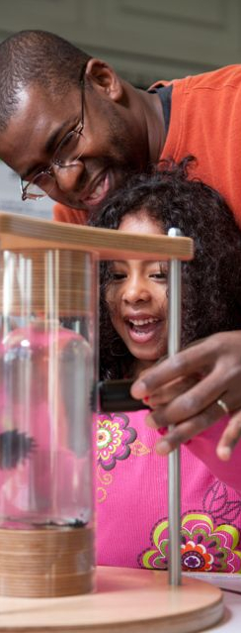

Team-Based Inquiry
Scott Pattison, OMSI, spattison@omsi.edu
Gabby Burlacu, OMSI, gburlacu@omsi.edu
Sarah Cohn, SMM, scohn@smm.org
Liz Kollman, MOS, lkollman@mos.org
Ali Jackson, Sciencenter, ajackson@sciencenter.org
Sookram Ramsaroop, NySci, sramsaroop@nysci.org
Notes:
A variety of folks will be presenting and facilitating today. [Brief introductions, for face recognition.] I’ll let the presenters introduce themselves more thoroughly when they come up here.
This is very much a practically-oriented, rather than academically-oriented approach to professional inquiry and so our team represents a range of museum professionals, including evaluators, program developers, and educators

Slide 3

Team-Based Inquiry
1. Question
2. Investigate
3.
Reflect
4.
Improve
Notes:
Drawing from a variety of evaluation and research traditions, we developed team-based inquiry as a practical approach to empowering non-evaluation professionals to get the data they need, when they need it, to improve their products and practices.
A the heart of TBI is an easy to follow inquiry cycle.
At any point in a project, professionals can go through this process: asking questions related to your work or practice, collecting data to answer those questions, analyzing and reflecting on the data, and identifying concrete ways to improve based on findings.

Slide 4
Team-Based Inquiry
Led by non-evaluation professionals
Collaborative and team-based
Small scale and focused
Embedded in ongoing work
Systematic
1. Question
2. Investigate
3.
Reflect
4.
Improve
Notes:
Other key characteristics of TBI…

Slide 5
Team-Based Inquiry
Improving products and practice
Fostering effective teams and organizations
Building evaluation capacity
1. Question
2. Investigate
3.
Reflect
4.
Improve
Notes:
As I mentioned earlier, TBI was designed to provide several benefits to the Network and partner organizations…

Slide 6
Team-Based Inquiry
1. Question
2. Investigate
3.
Reflect
4.
Improve
Notes:
So, that is some background and an overview of what TBI is.
Today, we are going to walk through each of these four steps, practice some different data discussion and analysis techniques, and get familiar with tools and resources for each step.
At the end of day, our hope is that by experiencing the whole process, TBI will feel like something that you can realistically start experimenting with at your own institutions.
To make the process even more concrete, today we are going to focus on the types of TBI you might do when developing or modifying a nano education program or activity. However, keep in mind that this process can be used to inform any aspect of your work, including exhibits, programs, staff trainings, audience outreach, organizational processes, etc. The sky is the limit!
And now, Sarah is going to start us off with asking TBI questions.

Slide 7
Question
1. Question
2. Investigate
3.
Reflect
4.
Improve

Slide 8
Asking Questions
Maybe you have TONS of questions
Team-Based Inquiry Questions can…
1) NOT be easily answered,
2) be ACTED upon immediately, and
3) be INVESTIGATED, given current resources (time, money, visitors, etc.)
Notes:
You have this program that you think ROCKS! It was well researched, methodically developed, and you have crafted into a thoroughly entertaining piece. Then you start to imagine how an audience or some visitors might respond to it once you take it out on the floor. The questions start flooding in – Will they like it? Will they get it? Will they laugh at all the right places? Will they make the connection between the program and museum’s exhibits and actually go look at them? I’m sure there have been points in each of our lives when the questions just don’t cease. Team-Based Inquiry is built for just that! This process will allow you to tackle some of those question.
But which questions are the right questions? Three major elements of every Team-Based Inquiry question are…
If you can answer it, either by taking time to think about it or by walking down the hall or picking up the telephone to talk to a colleague, then it isn’t worth the time and effort of Team-Based Inquiry. Go connect with that friend or colleague, or yourself, and answer the question – stop worrying about it and act!
Once you get insights from visitors, a group of colleagues, whomever, what you find out will push you to make a decision (leave it, change it) and take action (take it on the floor, go back to the drawing board with some things). What you find needs to actually be critical to your work; otherwise, what’s the point?
Maybe you really want to know the educational impacts of your program on the 4th grade school groups you present to. While a fantastic question, it is way outside of the realm of what is possible with a Team-Based Inquiry question. These are small in scale in terms of resources – YOU and your teammates need to have the time available to dedicate to creating an instrument, collecting the data, analyzing the data, and then making changes and acting on it. The question should be small and feasible for what you are able to take on.

Slide 9
Asking Questions
Program Goals and Objectives: ____________________________
Product Question | Why is this question interesting / important to you and your team? | What sources of data would you need to answer this question? | What resources would you need to answer this question? | How long will it take to answer this question? | Based on all of this, how high a priority is this question? H=High, M=Medium, L=Low, E=Eliminate
 |  |  |  |  | H M L E
 |  |  |  |  | H M L E
 |  |  |  |  | H M L E
Notes:
Written out, and crafted as a worksheet, are the major elements that you need to work through to find THE ONE (or two-three) question you will tackle through Team-Based Inquiry in one round. You, most likely, cannot answer all of your questions in the same way or in the same process without overwhelming visitors, or colleagues, causing them to walk away.
MOST IMPORTANT – you need to clearly articulate your program’s, exhibit’s, etc.’s goals and objectives before diving into this. Without the frame of reference the program’s goals offers you, you will not be able to get your team aligned around the key questions and things to be searching for through the Team-Based Inquiry process. AND, you won’t know if what you found is truly relevant if your program does not have a fundamental objective for the visitor. Though you most likely have the goals and objectives of the program clearly embedded in your mind, you need to get it out on paper for both yourself and the rest of your Team-Based Inquiry team to see and refer to throughout the process. Developing these for the team could also help illuminate questions that can be removed because of point 1 (answerable by someone else near you).
Now, start writing down those swirling questions – all of them – into the first column. Order doesn’t matter – just get them down on paper. From there, take each question and begin answering the rest of the questions along the row.
Let’s fill it out now for practice. Take a moment or two to write down 1-2 questions you have about a program of yours and try to fill in all of the cells for those questions.
NOTE: this table has been adapted from a National Science Foundation, Directorate for Education and Human Resources worksheet.

Slide 10
Investigate
1. Question
2. Investigate
3.
Reflect
4.
Improve
Notes:
Now that you have determined the focus of your TBI, it’s time to think about collecting data to answer your TBI question.
In this example we are going to imagine that we want to answer one question: (1) how can this staff-facilitated activity be improved so that visitors have a better experience and they walk away with an awareness of the program main messages about nano.
A great way to collect this type of data is to ask visitors to answer a few questions after they complete the program.
Has anyone here done any visitor surveys or interviews before?

Slide 11
Visitor Survey
Notes:
Here is an example survey that you can use if you don’t already have tools developed.
It is designed to be completely in just a few minutes by visitor groups immediately after they have completed an activity or program.
It focuses on two types of data that we have found useful for improving programs (and that relate directly to our TBI questions): (1) visitor suggestions for what is working and what could be improved and (2) visitor reports of what they perceive to be the goals of the activity.
With this information, you can make changes based directly on visitor suggestions, as well as based on whether or not visitor are walking away with the intended messages or big ideas.
The form also has some basic visitor information to give you context when you are analyzing the responses.
To get a feel for the survey, let’s try taking it now as if we were visitors.
Take a few minutes to fill out the form based on a nano program or activity that you experienced here at the meeting.
Thoughts, comments, or reflections?
A few final tips:
Remember to tailor this survey to your specific TBI questions.
Make a rule for yourself when recruiting visitors to avoid an unintentional selection bias. For example, ask every visitor group after they finish the activity to complete a form.
Start with adults to avoid issues of consent for children.

Slide 12
Reflect
1. Question
2. Investigate
3.
Reflect
4.
Improve

Slide 13
Data Reflection
Once you’ve identified your TBI question and collected your data, you can discuss that data as a team to identify:
Themes
Interesting or unusual
data points
After this discussion, you can apply those themes to your data and begin to think about how they might inform or improve your practice .
1. Question
2. Investigate
3.
Reflect
4.
Improve
13
Notes:
ADD DATA RELFECTION STEPS

Slide 14
Data Reflection Steps
Describe and clarify
Observe and discuss
Immerse and notice
Categorize and explain
Reflect
14

Slide 15
Activity Instructions
Take a moment to read over the data on your handout.
Around your table, discuss
  One piece of data you find interesting and why
  One theme you see occurring in the data
15

Slide 16
Data Reflection Steps
Describe and clarify
Observe and discuss
Immerse and notice
Categorize and explain
Reflect
16

Slide 17
Improve
1. Question
2. Investigate
3.
Reflect
4.
Improve

Slide 18

“Horton Senses Something Small”
Does the program engage young children? How could it be improved?
Data collection
Observations of participants
Surveys with caregivers and parents
Debrief with program developers
Lessons learned
Program works best for ages 3-5
Prompt participation during the story
Notes:
To make this more concrete, here are some examples of TBI projects by different NISE Network teams.
In each case, the team identified a question they needed to answer in order to move forward effectively with their work.
In the case of “Horton Senses Something Small,” the team was developing a new program and wanted to know how young children would respond to it.
Data collection can include both traditional evaluation techniques, as well as more creative data collection that leverages the types of information we deal with every day as part of our work (e.g., meeting notes, e-mails, informal observations, etc.).
In this case, the program facilitator worked with an evaluator to create forms to more systematically document their reflections and input from participants.
In TBI, project teams identify specific lessons learned and ways to improve.
In this case, the developer was able to identify:
The appropriate age group for the program, and
A particularly effective facilitation strategy.

Slide 19
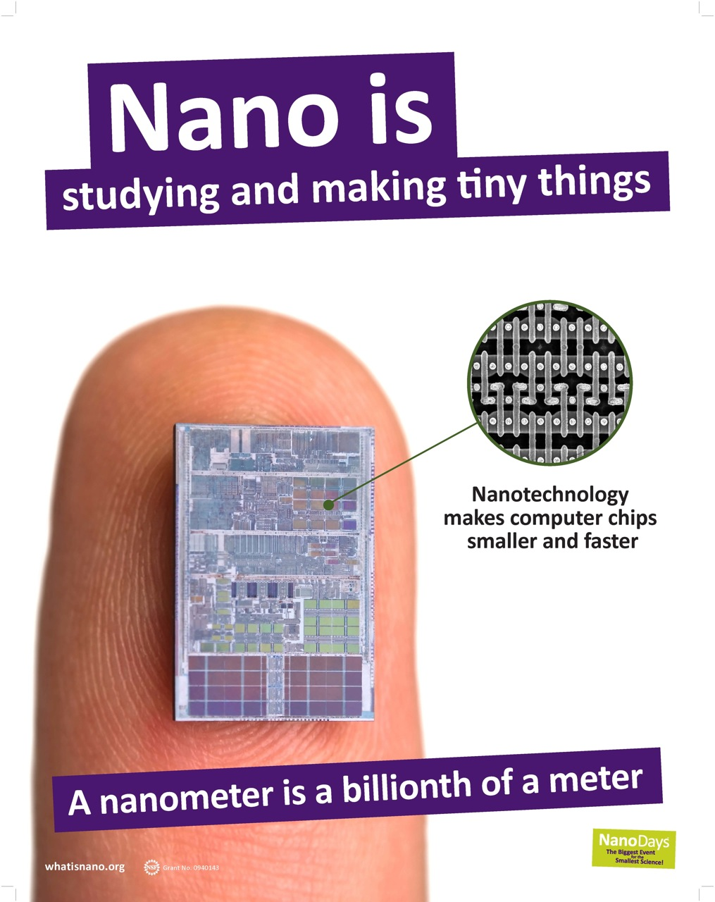


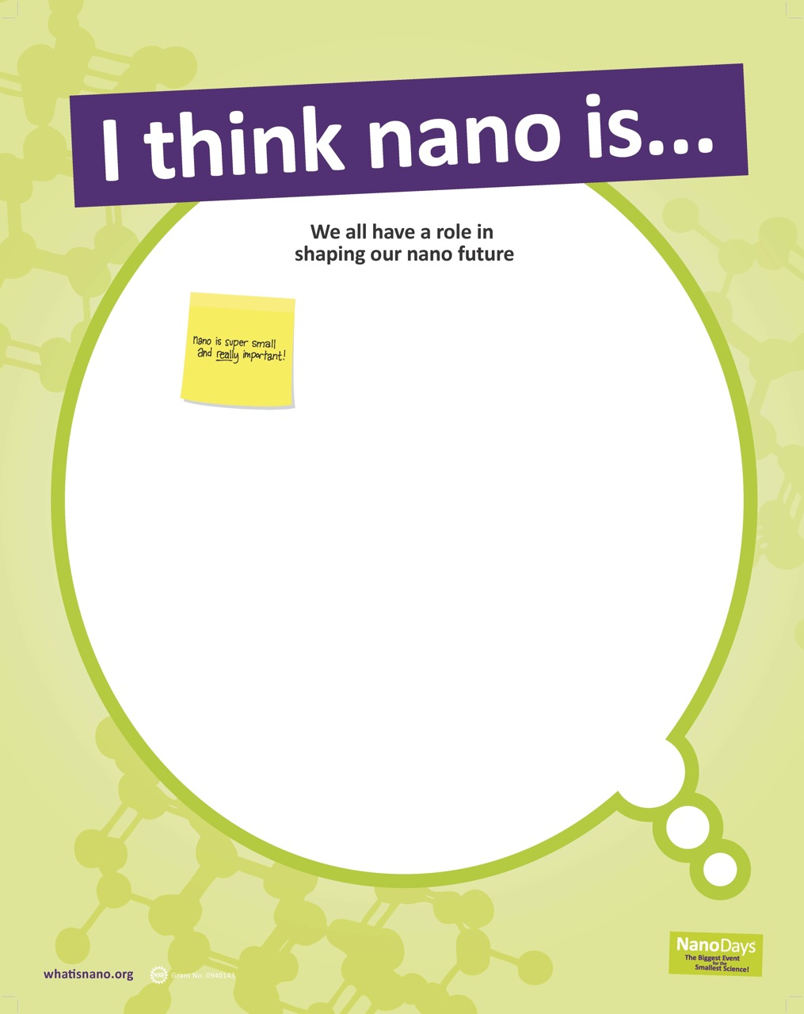
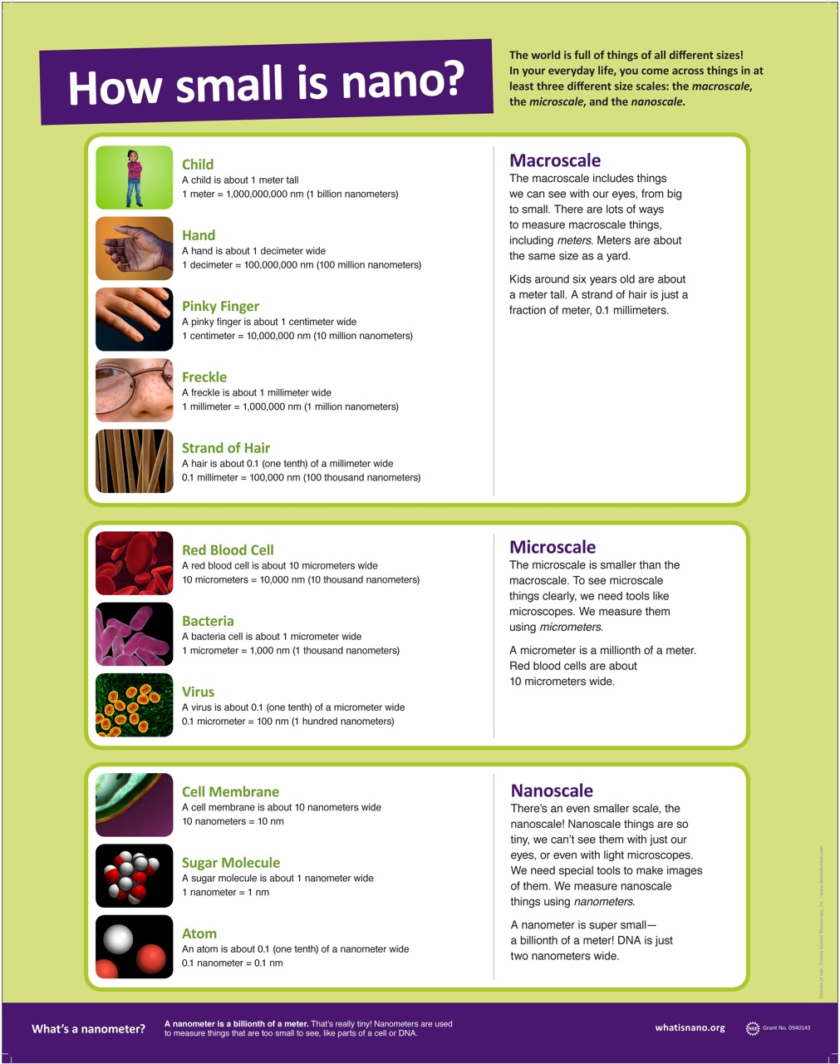
NanoDays 2012 Posters
Are educational posters worth including in the NanoDays 2012 kit?
Data collection
Interviews with 30 visitors at three museums
Informal observations by team
Debrief with educators
Lessons learned
Visitors liked the graphics and suggested improvements
Educators felt graphics attracted attention and defined space
Notes:
Another example…
The NanoDays 2012 educational posters
In this case, the NanoDays team was interested in learning if it was worthwhile to include the posters in the NanoDays Kit
To study this, NISE Net team members:
Conducted interviews with museum visitors,
Observed visitors as they interacted with the posters, and
Debriefed with educators about what they thought about the posters
Here, practitioners learned that:
Visitors liked the posters but had some suggestions for improvement, and
Educators liked how the posters branded the space
Therefore, it was decided to include the posters in future NanoDays kits but major stylistic changes were made. (You might not think these posters carry much content, but that’s a direct result of visitor testing and observation, we found that while educators and visitors like the concept of having the posters, visitors wanted bolder images, and less written content.)

Slide 20
Improve
1. Question
2. Investigate
3.
Reflect
4.
Improve
Notes:
So, that is some background and an overview of what TBI is.
Today, we are going to walk through each of these four steps, practice some different data discussion and analysis techniques, and get familiar with tools and resources for each step.
At the end of day, our hope is that by experiencing the whole process, TBI will feel like something that you can realistically start experimenting with at your own institutions.
To make the process even more concrete, today we are going to focus on the types of TBI you might do when developing or modifying a nano education program or activity. However, keep in mind that this process can be used to inform any aspect of your work, including exhibits, programs, staff trainings, audience outreach, organizational processes, etc. The sky is the limit!
And now, Sarah is going to start us off with asking TBI questions.

Slide 21
TBI Report Template
Notes:
The NISE Net TBI report template is an example of an easy way to carefully and quickly document the process your team used to ask questions, collect data, reflect on your work and practice, and make improvements.
(Review basic elements of report)
Question: What we hoped to learn and why it was important
Include the following information in this section:
For educational products only, describe the product type, audience, topic, and provide a short description of the product (activity, demo, program, exhibit)
Details the Questions your group wanted to answer
Investigate: How we answered our question(s)
Include the following information in this section:
• Start and end dates of the study
• Who we collected data from
• How we collected data
• Types of data we collected
• How we analyzed the data
Reflect: What we found out
Include the following information in this section:
Summary of the data (possibly including tables or graphs)
Improve: How we changed our practice
Include the following information in this section:
• How our working group responded or plans to respond to the findings
• Recommendations for other working groups
***Suggest that people would probably introduce this TBI process after their staff are trained and feel confident
Introducing this tool to your staff can be very rewarding but also very challenging.
It’s difficult for educators to make or find time for this
There are myriad ways to get your team to go through this process. For some projects it makes sense to go through all of this as a cohesive team, for others you’ll need to break into smaller groups. At Sciencenter, we have a pretty small group of us working on these projects, so we’ll often informally discuss the questions we have about a product, and then share data we’ve collected from other educators or visitors, again discuss that data following the format you all just practiced, and then make collective decisions about what we can do to improve, but then we tend to have just one person write up the TBI report. The report can be reviewed by the whole team, but we find it more streamlined to put one person in charge.
***What thoughts do you have about how you might introduce and use this tool with your staff? How can this be related to things you are already doing with your staff members?***

Slide 22
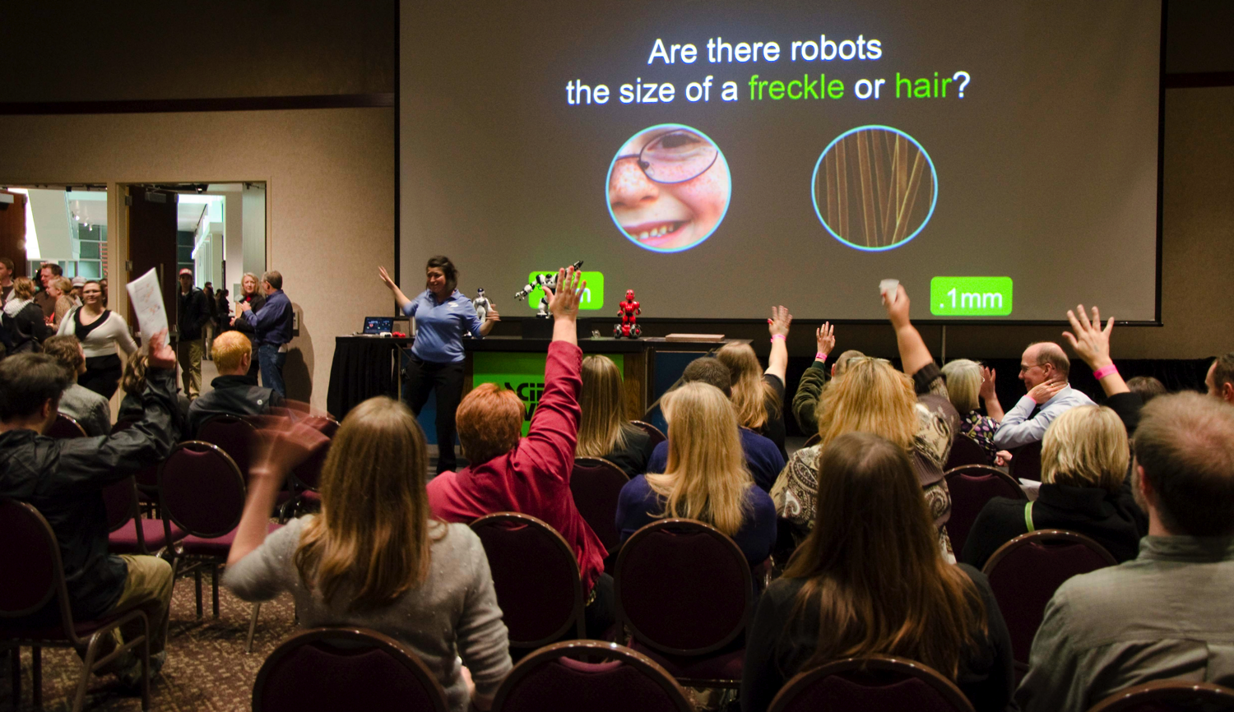

Questions and Discussion?
Notes:
Hopefully that gives you a sense of for the overall process of TBI and gives you some tools to get started, especially for TBI related to developing or modifing programings and activities.
Keep in mind that this is intended to be a flexible approach that can be applied to investigate and improve any aspect of your work.
Questions, thoughts, or comments about anything we have discussed today?
What ideas do you have about how you might implement this at your own institutions, both in terms of opportunities and challenges?
Keep your eye out over the six months for additional TBI resources. Our goal is to these resources and more posted to the webite by NanoDays. And please send us your comments and feedback if you have a chance to use these tools.
Before you go, please give us your feedback to help improve this training and the tools and resoures we presented. We are handing out another copy of the visitor survey. Please fill it out for this workshop (don’t worry about the demographic info) and we’ll collect the responses as you leave.
Thank you!

Slide 23

This presentation is based on work supported by the National Science Foundation under Grant No. 0940143.
Any opinions, findings, and conclusions or recommendations expressed in this presentation are those of the author(s) and do not necessarily reflect the views of the Foundation.
Notes:
And as always, thank you to NSF for supporting this project!

Slide 24
Team-Based Inquiry
Scott Pattison, OMSI, spattison@omsi.edu
Gabby Burlacu, OMSI, gburlacu@omsi.edu
Sarah Cohn, SMM, scohn@smm.org
Liz Kollman, MOS, lkollman@mos.org
Ali Jackson, Sciencenter, ajackson@sciencenter.org
Sookram Ramsaroop, NySci, sramsaroop@nysci.org
Notes:
A variety of folks will be presenting and facilitating today. [Brief introductions, for face recognition.] I’ll let the presenters introduce themselves more thoroughly when they come up here.
This is very much a practically-oriented, rather than academically-oriented approach to professional inquiry and so our team represents a range of museum professionals, including evaluators, program developers, and educators

