Slide 1
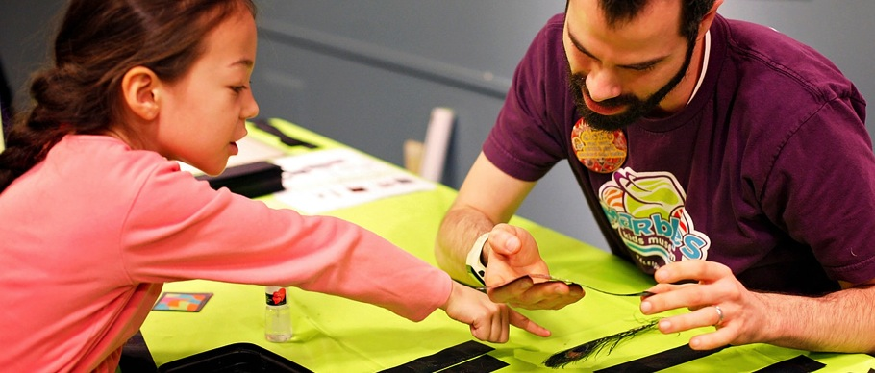

MUSEUMS AND
COMMUNITY PARTNERSHIPS:
Leveraging Resources
and Increasing Impact
www.nisenet.org

Slide 2


Presenters
Melissa Ballard
Afterschool Alliance
Catherine McCarthy
Science Museum of Minnesota
Keith Ostfeld
Children’s Museum of Houston
Rae Ostman
Science Museum of Minnesota
Karen Peterson
National Girls Collaborative Project

Slide 3
Overview
Collaboration networking exercise (Karen)
Museums and community partnerships
  NISE Network (Rae, Catherine)
  Children’s Museum of Houston (Keith)
Collaboration opportunities, best practices, and lessons learned
  Afterschool Alliance (Melissa)
  National Girls Collaborative Project (Karen)
Discussion and Q&A
Notes:
Collaboration networking: 15 min
MCP: 10 min
CMH: 8 min
AA: 8 min
NGCP: 8 min
Q&A: remaining time

Slide 4
COLLABORATION NETWORKING
Karen Peterson
National Girls Collaborative Project

Slide 5
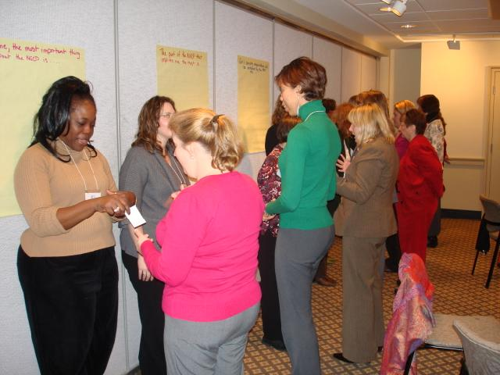
Speed (Collaboration) Networking

Slide 6
Collaboration Networking
Your Name
Your Organization/Program & Role
Resources (what do you have to share?)
Needs (what do you need to meet your goals?)
2 Minutes Each
Bring your business card to exchange
You might need a pen to write down great ideas!
Notes:
Remember to debrief after by asking for a few “connections”.

Slide 7
MUSEUMS & COMMUNITY PARTNERSHIPS
Rae Ostman + Catherine McCarthy
National Informal STEM Education Network

Slide 8
NISE Network
National Network
Originally dedicated to nanoscale science, engineering, and technology
Now have projects on a range of STEM topics
Activities
Public engagement
Professional development
Knowledge and practices related to informal learning
Partnerships
National
Local

Slide 9
NISE Network

Slide 10
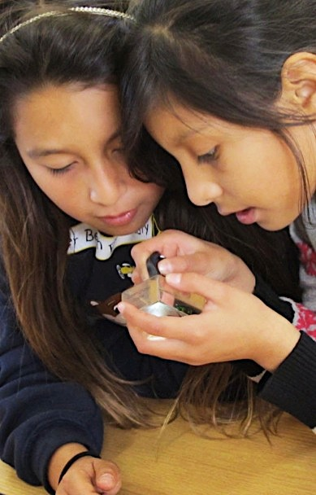
Museums & Community Partnerships
Project goals:
Engage local communities more broadly in STEM learning, focusing on nanoscale science, engineering, and technology
Develop local partnerships between museums and community organizations, helping museums reach new audiences and helping community organizations provide high-quality STEM learning experiences for their audiences
Identify, develop, and share successful practices and models for reaching new audiences and developing successful collaborations among local organizations

Slide 11
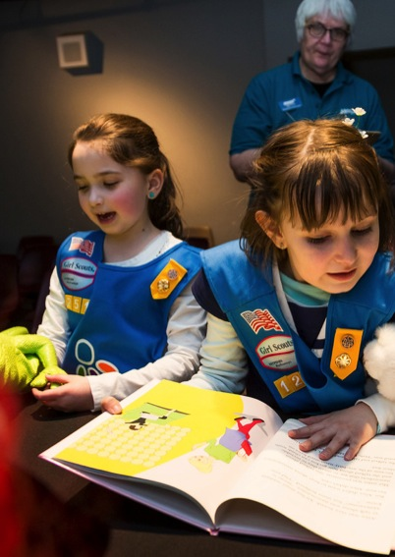
National Partners
Core partners
Afterschool Alliance
Boys & Girls Clubs of America
Girls Inc.
National Girls Collaborative Project
4-H
Additional participation
American Library Association
Arizona State Library
Boy Scouts of America
Girl Scouts
Parent Teacher Association (PTA)
Y (YMCA)
YWCA

Slide 12
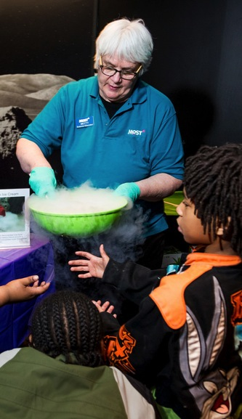
Project overview
Target audience
Elementary
Traditionally underserved and underrepresented
Process
Existing and new partnerships
NISE Net partners apply, receive kits, and report
Partnership is defined and managed locally
Resources
100 kits
Timeline
Kits delivered winter 2016
Program delivery spring-summer
Report on activities summer 2016
Evaluation results winter 2017

Slide 13
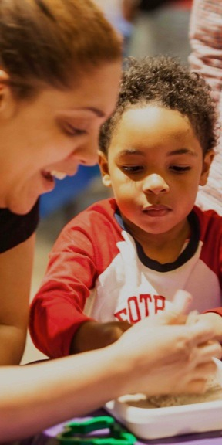
Materials
Public engagement
Hands-on activities
Videos and supporting materials
Professional resources
Planning and promotional materials
Training videos, slides, and guides
Collaboration guide, video, and tools
Notes:
RAE:
Public engagement: variety of settings, in one-hour units or as individual activities
Professional resources: engaging diverse audiences, STEM in out of school settings
CATHERINE:
Next session

Slide 14
MUSEUMS & COMMUNITY PARTNERSHIPS
Keith Ostfeld
Children’s Museum of Houston

Slide 15
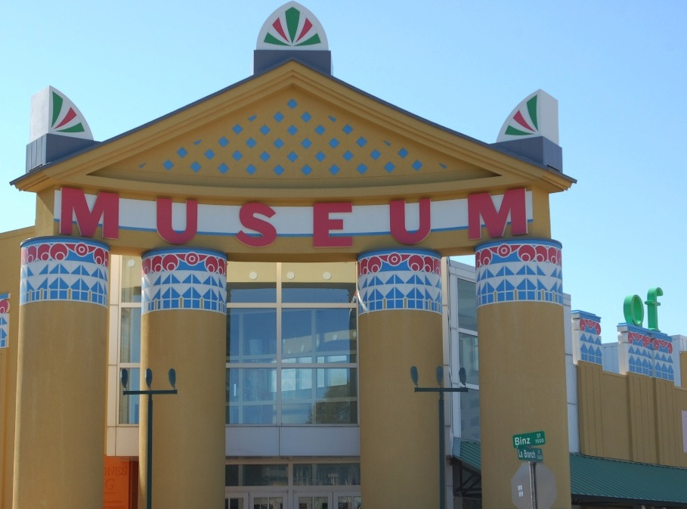
Visitor Demographics:
816,000 annual visitors
+315,000 through outreach programming
58% of visitors receive free or reduced admissions
Serve children age 0-12 years and their parents and caregivers
To transform communities through innovative, child-centered learning
Notes:
Mission and Age Range
Audience Size – 810,000 on site and 344,000 in outreach
Audience Demographics – According to the Kinder Institute for Urban Research, Hobby Center for the Study of Texas, and American Community Survey, the greater Houston area has a greater degree of racial and ethnic diversity than any of the nation’s major metropolitan areas. School districts report that 112 languages are spoken by their students. Minorty majority population and CMH reflects that.
Accessibility - 58% free (31%)/reduced(27%) admission and ALL Outreach programming is provided free of charge to the participants.

Slide 16
Notes:
Who we work with in the community:
Museum Field Experiences: 475 schools
Open Doors Partners: 781 community organizations
After School Programs and Family Learning: 238 schools, libraries, and community organizations

Slide 17
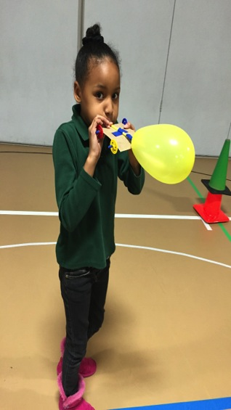
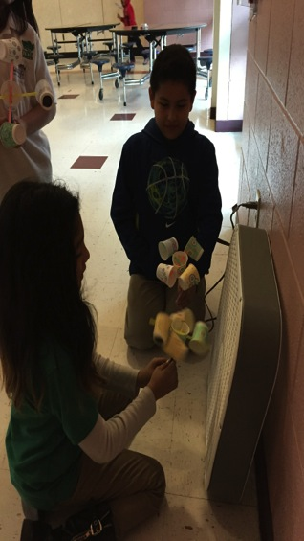
A’STEAM Program
After-school Science, Technology, Engineering, Arts (Design), and Mathematics
Notes:
Partnership with the Greater Houston YMCA.
Started in 30 sites in the first year, grew to 46 sites in the past year, and we expect it to grow more next year

Slide 18
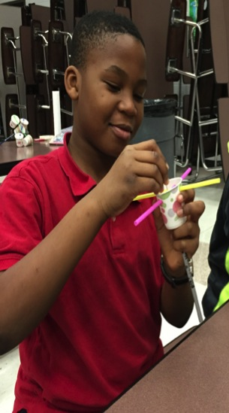
Notes:
History – started as Summer Learning Loss prevention program
Each kit

Slide 19
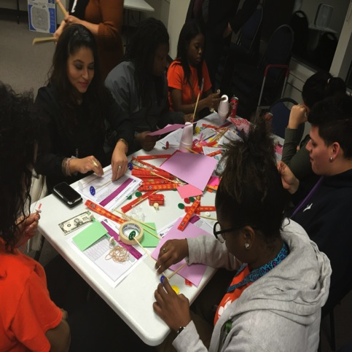
Notes:
Each month, sites gather together in larger groups for train-the trainer sessions on that month’s activities
Training videos for each activity are also online for refresher

Slide 20
BEST PRACTICES + LESSONS LEARNED
Melissa Ballard
Afterschool Alliance

Slide 21
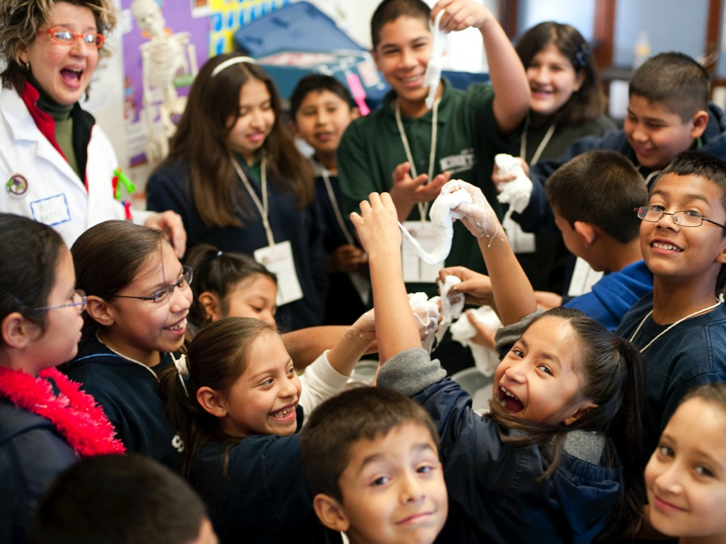

The Afterschool Landscape:
Getting to Know Your Potential Partners
Notes:
This conference features a community solution that addresses issues that were impossible for one organization, or even one sector, to solve on its own. I’m sure it’s got you thinking about new and exciting ways to expand your museum’s reach and tackle some larger community issues.
My goal is to point you to some of the issues that are top of mind for afterschool providers, where you might be able to find potential partners, and what we’ve seen are key to successful collaborations.
One key thing to note, is that when we say “afterschool”, we don’t mean a school-run club that happens when the school day ends. The kind of afterschool programs we’re talking about have kids attending 4-5 days a week, are in communication with families and schools, and are concerned more broadly with a child’s welfare, rather than just academics. The point being, is that when partnering with an afterschool program, you’re plugging into an established system that often can provide the wrap-around support services that museums likely can’t provide.
Also note, that even though I’m saying “afterschool”, most of the organizations I’m talking about also provide summer programs, and might provide before school and weekend programming as well.

Slide 22



The Afterschool Alliance
1 | Policy & Advocacy | 2 | Research | 3 | Field-Building
National policy Families & children; STEM Advocacy day on Capitol Hill Lights On Afterschool |  | Translate & synthesize research Issue briefs & reports Collect data |  | 50 state networks Partnerships for policy, research, & practice Best practices & models Webinars, blogs, toolkits, & other resources
Notes:
National non-profit based in DC. Advocate on behalf of afterschool programs across the U.S. and work to ensure that all kids have access to affordable, quality afterschool programs.
Afterschool is an issue for many groups – child hunger, juvenile justice, workforce concerns, health and physical activity, arts & music education, STEM education, working families….

Slide 23


America After 3PM
Household survey of how kids spend the hours after school
Attendance & demand much higher in low-income, African-American, & Latino households
Notes:
13.7K households surveyed, nationally representative sample with state-level data.
Parent overwhelmingly cited access (availability and transport) and cost as their biggest hurdles.

Slide 24

Where are kids going?
Parents say their kids attend afterschool here*:
Private 11%
4-H 5%
YWCA 5%
YMCA 15%
Public 43%
Boys & Girls Clubs 18%
7%
3%
* Not all categories of afterschool sites reported on are represented in this chart.
Notes:
This just reflects on-site programming, as parents may not be aware their child’s afterschool program is delivered in partnership with a museum or science center.

Slide 25
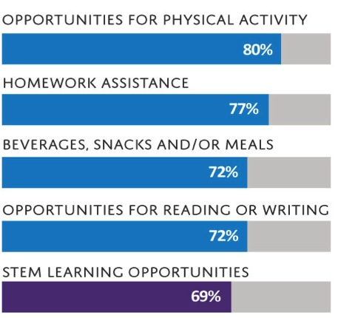
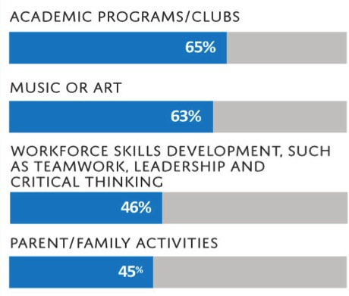
What are kids doing?
Notes:
Note that these all map to pressing national concerns – child hunger, health and physical activity, arts & music education, STEM education, workforce, etc.

Slide 26
How is afterschool unique?
Youth Development Goals
Empowering young people Socio-emotional learning Positive relationships with adults Non-academic skills like leadership, confidence, teamwork, service (21st Century)
Approach to Learning*
Hands-on, experiential Project-based Experimentation & failure New entry points to topics Connected to communities, home cultures, and student knowledge & experiences
Environment
Low-stakes Flexible in time and space Community partnerships
Resource: What does youth development look like in practice?
Notes:
*Caveat for Learning Approach – I wouldn’t say this is universal in practice. Quality and professionalization varies.

Slide 27
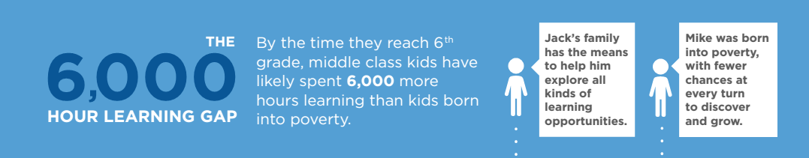
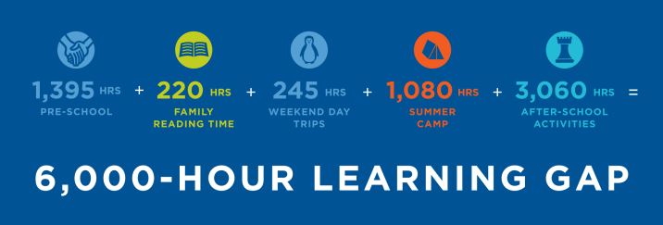

Addressing Equity
Notes:
Afterschool activities they were looking at here include the music lessons, robots clubs, science competitions, etc….the kinds of opportunities that are much more common among families with a disposable income.
So if your institution's goals are to move the needle on education in your community, afterschool partnerships really can be an effective way to meet them.
What is 6,000 hours? Let’s say you are in school learning 6 hours per day, 5 days per week = 25 hours per week. How many weeks of learning is that? 6000/25=240 weeks. How many years in school is that? Most states require 180 days (180/5=36 weeks/year). 240/36 = 6.67 academic years.

Slide 28







Afterschool Providers
National Providers
Community-Based Organizations
Religious-based organizations, local community centers, public housing centers, immigrant or refugee service providers, etc.
School-Based Sites
Unique to every community!
The Connectory
Database of STEM program providers looking for partners & resources
Post your programs to the parent portal
Others
City-run afterschool programs through your Parks & Recreation Department or Police Athletic League.
Notes:
People often go first to national providers because they have the name recognition, but there’s really a lot of other youth-serving organizations out there!
This is an incredibly diverse field, which is of course a challenge as well. Quality varies greatly, and finding the “yes” person can be hard.

Slide 29





System-Builders for Afterschool
State & Local
Statewide Afterschool Networks Funded by C.S. Mott
City / Regional Intermediaries
e.g. Every Hour Counts
National Organizations
National Afterschool Association
National Summer Learning Association
Afterschool Alliance
Notes:
System-building organizations can help connect and orient you to your local afterschool scene. They are often great relationship brokers and can introduce you to savvy program providers. Plug into existing or burgeoning initiatives, and attend meet-ups / conferences.

Slide 30
Partnership Tips
Key Steps:
Get a sense for your local landscape (youth-serving org in general)
Connect with system-builders
Make sure you have a respect for afterschool providers’ expertise & experiences
Learn to speak each other’s language
Start with a small, concrete activity to do together
Keep in mind:
Afterschool practitioners can have limited conception of creative or more substantive museum partnerships
Won’t necessarily understand the museum field
Savvy leaders are key!

Slide 31
What could you do?
Community of Practice
Professional development
Themed event
Committees / Networks / Boards
Advocacy
Outreach programming
Co-teaching models
Notes:
We’ve seen a really wide range of successful partnership initiatives. Which one you choose is really based on both organizations’ needs, immediate goal, and current capacity. Some of these might serve as an easy entry point or grow into ongoing projects. And the scale of involvement and commitment on each of these varies!

Slide 32
BEST PRACTICES + LESSONS LEARNED
Karen Peterson
National Girls Collaborative Project

Slide 33

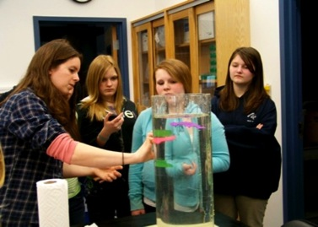
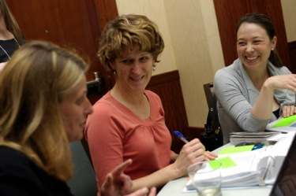
Best Practices in Successful Collaborations
Prepare
Look
Plan
Build
http://ngcproject.org/ngcp-extended-webinar-session-increasing-program-impact-best-practices-collaboration

Slide 34
Prepare to Collaborate
Reflect on past collaborations and the characteristics of successful or ineffective collaborations.
Create a quick summary of your program services you can easily share when you first meet potential collaborators.

Slide 35
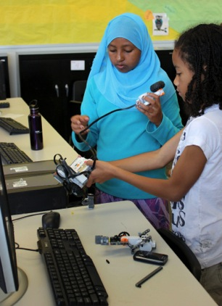
Prepare to Collaborate
Identify your strengths and challenges.
Identify the resources you have to offer.
Identify your needs.

Slide 36
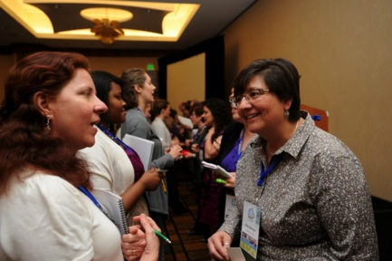
Look for Collaborators
Find the “home” of your audience who can benefit from your program and services.
Identify guides.
Network with purpose.

Slide 37
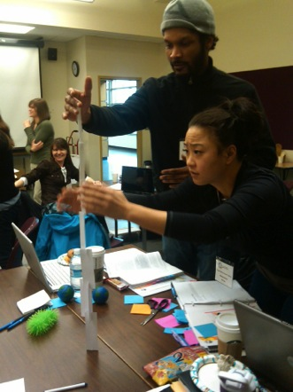
Plan for a Successful Collaboration
Be flexible and patient.
Be explicit about project benefits.
Create a collaboration agreement.

Slide 38
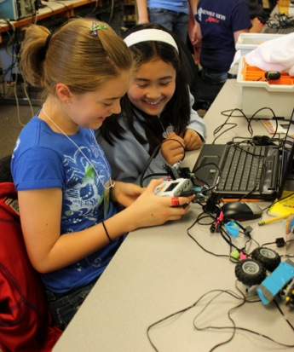
Build a Successful Collaborative Project
Communicate frequently.
Adapt as personnel, plans, and needs change.
Celebrate successes.
Debrief the collaboration.

Slide 40
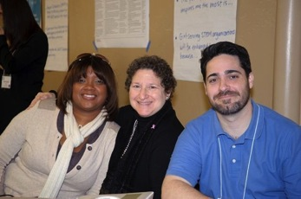
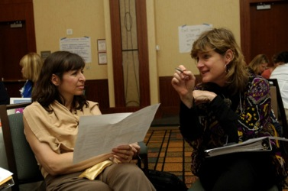
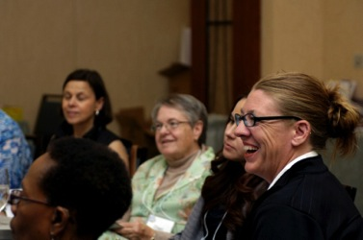
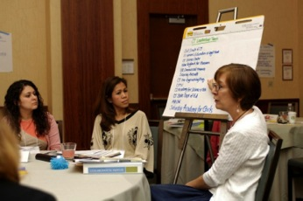
Collaboration Mash-Up

Slide 41
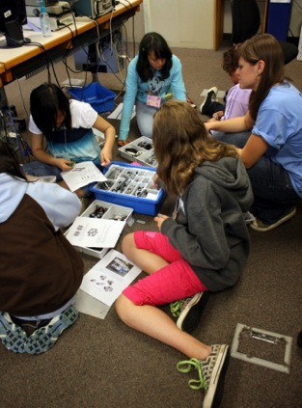
Mash-Up Guidelines
Group Activity
Create a project or activity that uses and builds upon all of your resources and strengths
You have $1000
Only 8 minutes to plan

Slide 42
DISCUSSION +
Q&A

Slide 43
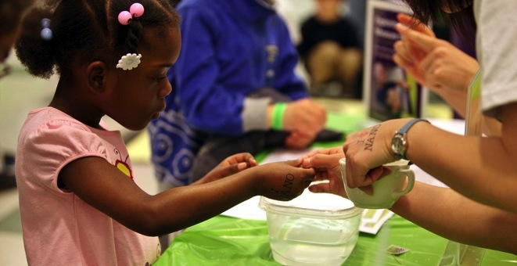


Thank you
Cynthia Needham, ICAN Productions
This presentation is based on work supported by the National Science Foundation under Grant No. 0940143. Any opinions, findings, and conclusions or recommendations expressed in this presentation are those of the authors and do not necessarily reflect the views of the Foundation.
Notes:
LARRY

