Slide 1
Tools for Collaboration:
increasing your museum's local impact through partnerships:
Rae Ostman, Arizona State University
Brad Herring, Museum of Life and Science
Catherine McCarthy, Science Museum of Minnesota
Ali Jackson, Sciencenter, Ithaca, NY
Discussion
Melissa Ballard, Afterschool Alliance
Karen Peterson, National Girls Collaborative Project
Keith Ostfeld, Children’s Museum of Houston
Interactivity Association of Children’s Museums Conference, May 2016
Notes:
The purpose of this session is to learn about ways to increase your organization's impact and relevance by partnering with local youth-serving organizations such as after-school programs, Presenters will talk about broad strategies as well as specific advice to create successful collaborations. We have some materials you can take with you today and more available online. Presenters:
Rae Ostman: overview of Museums & Community Partnership Project (5)
Brad Herring: video (8)
Catherine McCarthy: Guide & Tools (5)
Al Jackson: Kit photos/contents (5)
Discussion: (40) helpw with the discussion are Karen Peterson, Melissa Ballard (Keith Ostfeld may stay)

Slide 2
Levels of Partnerships – Continuum
Tools for Collaboration:
increasing your museum's local impact through partnerships
Museum & Community Partnerships Project Overview
Rae Ostman
Arizona State University
Tempe, AZ
Rae.Ostman@asu.edu
Interactivity
Association of Children’s Museums Conference
May 2016
Stamford, Connecticut

Slide 3
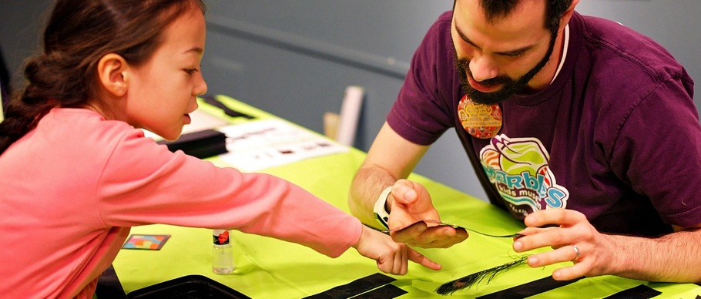
MUSEUMS AND
COMMUNITY PARTNERSHIPS:
Leveraging Resources
and Increasing Impact
www.nisenet.org

Slide 4
MUSEUMS & COMMUNITY PARTNERSHIPS
Rae Ostman + Catherine McCarthy
National Informal STEM Education Network

Slide 5
NISE Network
National Network
Originally dedicated to nanoscale science, engineering, and technology
Now have projects on a range of STEM topics
Activities
Public engagement
Professional development
Knowledge and practices related to informal learning
Partnerships
National
Local

Slide 6
NISE Network

Slide 7
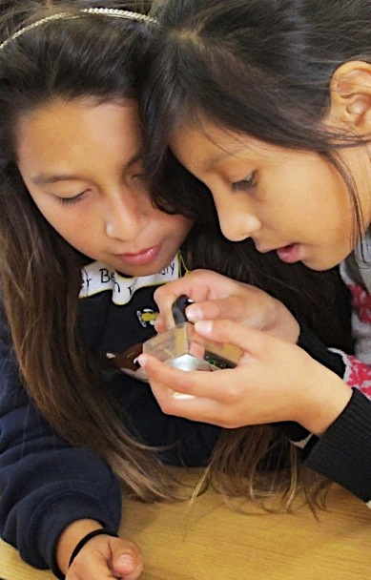
Museums & Community Partnerships
Project goals:
Engage local communities more broadly in STEM learning, focusing on nanoscale science, engineering, and technology
Develop local partnerships between museums and community organizations, helping museums reach new audiences and helping community organizations provide high-quality STEM learning experiences for their audiences
Identify, develop, and share successful practices and models for reaching new audiences and developing successful collaborations among local organizations

Slide 8
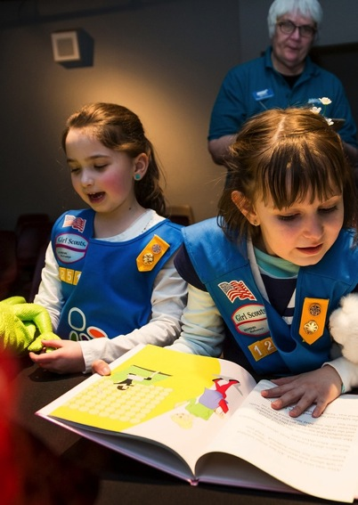
National Partners
Core partners
Afterschool Alliance
Boys & Girls Clubs of America
Girls Inc.
National Girls Collaborative Project
4-H
Additional participation
American Library Association
Arizona State Library
Boy Scouts of America
Girl Scouts
Parent Teacher Association (PTA)
Y (YMCA)
YWCA

Slide 9
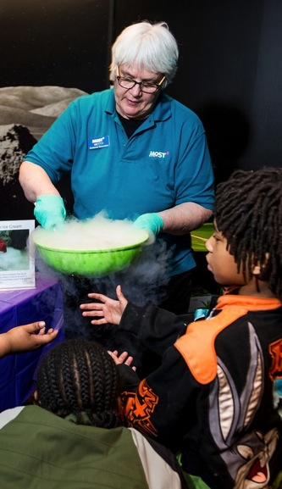
Project overview
Target audience
Elementary
Traditionally underserved and underrepresented
Process
Existing and new partnerships
NISE Net partners apply, receive kits, and report
Partnership is defined and managed locally
Resources
100 kits
Timeline
Kits delivered winter 2016
Program delivery spring-summer
Report on activities summer 2016
Evaluation results winter 2017

Slide 10
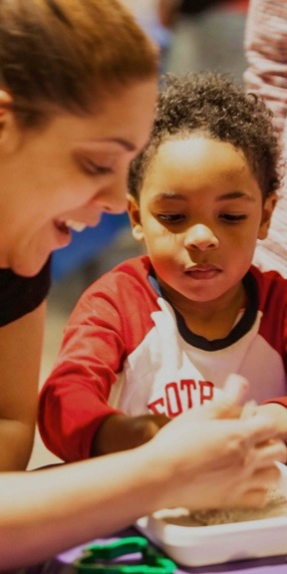
Materials
Public engagement
Hands-on activities
Videos and supporting materials
Professional resources
Planning and promotional materials
Training videos, slides, and guides
Collaboration guide, video, and tools
Notes:
RAE:
Public engagement: variety of settings, in one-hour units or as individual activities
Professional resources: engaging diverse audiences, STEM in out of school settings
CATHERINE:
Next session

Slide 11
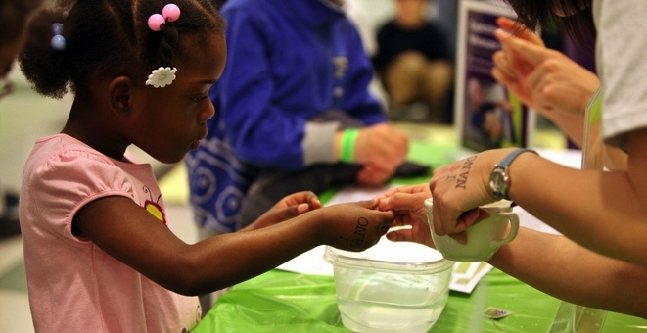
Thank you
Cynthia Needham, ICAN Productions
This presentation is based on work supported by the National Science Foundation under Grant No. 0940143. Any opinions, findings, and conclusions or recommendations expressed in this presentation are those of the authors and do not necessarily reflect the views of the Foundation.
Notes:
LARRY

Slide 12
Levels of Partnerships – Continuum
Tools for Collaboration:
increasing your museum's local impact through partnerships
Creating a Video: Advice for successful collaborations
Brad Herring
Museum of Life and Science
Durham, NC
bradh@ncmls.org
Interactivity
Association of Children’s Museums Conference
May 2016
Stamford, Connecticut
Notes:
get advice from experienced professionals who were great collaborators
create a video for professionals

Slide 13
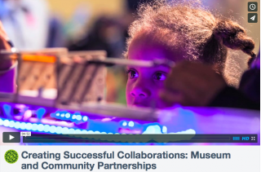
Video: Creating Successful Collaborations: Museum and Community Partnerships
￼
￼
￼￼
Available at www.nisenet.org/collaboration-guide
and
https://vimeo.com/139256428

Slide 14
Tools for Collaboration: increasing your museum's local impact through partnerships Collaboration Guide and Tools
Catherine McCarthy, PhD
Project Leader
Science Museum of Minnesota Saint Paul, Minnesota
cmccarthy@smm.org
651-262-3850
www.nisenet.org
Interactivity
Association of Children’s Museums Conference
May 2016
Stamford, Connecticut

Slide 15
Why Collaborate?
To achieve something you can’t do on your own!
Collaboration occurs when organizations and individuals make a commitment to work together and contribute resources and expertise to achieve a common, long-term goal.
To share resources, expertise, and connections
To build upon existing strengths
To reach new audiences
Notes:
Communities face a variety of challenging and complex problems that can be addressed through collaborative public, private, and nonprofit partnerships. Many of these challenges simply cannot be addressed effectively by one organization acting alone, and require the diverse resources and expertise of government agencies, community-based organizations, state and national organizations, businesses, schools, and individuals. When surveying case studies of local communities who have successfully addressed complex problems, collaborative strategic partnerships are almost always a key ingredient in these success stories. Partnerships can ultimately improve the health and welfare of children, families, and communities.

Slide 16
Available at www.nisenet.org/collaboration-guide
Notes:
This guide offers an introduction to collaborations between museums and youth-serving community organizations. While this guide is designed specifically for museums and community organizations, much of the content contained in this document can be applied to all kinds and levels of partnerships. This guide includes an overview of why to collaborate, levels of partnerships, how to start a partnership, and a variety of resources to sustain and deepen your collaborative relationships.

Slide 17
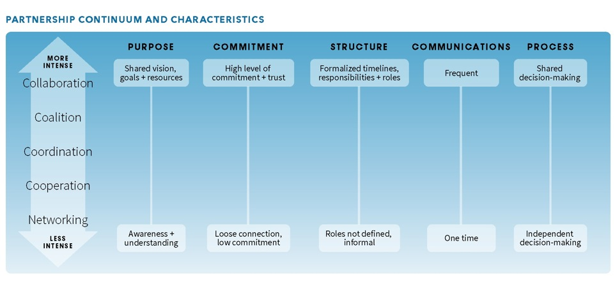
Levels of Partnerships – Continuum
Notes:
Page 7 of the guide
There are many ways to think about and categorize organizational partnerships. It is useful to view partnerships as a continuum of possibilities, with increasing levels of partnership ranging from informal networking all the way up to a more intensive collaboration at the top. The intensity of a partnership and interdependence of a relationship between two organizations will typically vary over time and with different projects. It is important to determine what level of partnership works best for your specific situation. Different types of situations are appropriate for various situations with different partners. Take things slowly and let the relationship evolve.

Slide 18
Tips for Successful Partnerships
Be patient! Collaboration takes time
Start small; developing a relationship and building trust takes time
Communicating takes time: your organizations have different cultures and terminology
Always keep the long-term relationship in mind while working on shorter-term projects
Start early; your partner’s schedule will vary from your own, so be sure to include enough lead time so that you both can be prepared for the work of the collaboration
Notes:
The guide includes advice for successful partnerships based on a literature review and interviews with experienced collaborators.

Slide 19
Tips for Successful Partnerships
Be clear about your goals and expectations
What: Decide on your common goals; be sure your partnership is mutually beneficial
How: Agree upon activities to meet your shared goals and missions
Who: Clarify your roles and responsibilities for all project activities
Where: Decide upon the locations of activities
When: Agree upon a timeline and key dates, and check in regularly
Notes:
Discuss: What, How, Who Where, and When

Slide 20
Tips for Successful Partnerships
Get to know each other
Each partner has a lot to learn and a lot to offer
Familiarize yourself with your partner organization through websites, newsletters, events, and other opportunities
The more you understand about each other’s purpose, activities, audiences, and culture, the easier your partnership will be
Individuals come to a partnership with different strengths and experiences; every group needs dreamers, developers, and doers

Slide 21
Tips for Successful Partnerships
Communication is critical
Strive to achieve a flexible, trusting atmosphere; be open and honest while still being tactful and supportive
Things may not always go smoothly, so don’t hesitate to pick up the phone and have an honest conversation to work things out
Involve more than one contact person at each organization at different levels to ensure a deeper relationship that can survive changing circumstances and turnover

Slide 22
Tips for Successful Partnerships
Stay focused on your goals And don’t forget to celebrate your successes
Reflect on the original goals of your partnership and project, and consider how you want to improve, change course, or evolve the relationship
As you work together, keep your long-term relationship in mind; by leveraging your combined resources and strengths, you can each do much more for your community

Slide 23
Collaborating with National Youth Serving Organizations
1. 4-H
2. Afterschool Alliance
3. Boys & Girls Clubs of America
4. Boy Scouts of America
5. Girls Inc.
6. Girl Scouts
7. Libraries
8. National Girls Collaborative Project
9. Parent Teacher Association (PTA)
10. Y (YMCA)
11. YWCA
Notes:
Collaborating with youth-serving organizations on STEM activities locally. The Museum & Community Partnerships project was designed to help NISE Network partners reach underserved audiences in your community that you aren’t currently reaching with nanoscale science, engineering, and technology (“nano”) through new or expanded museum and community-based partnerships. To be eligible, existing NISE Network partners must collaborate with a community partner, such as a local community group, afterschool program, library, or a local chapter of a national youth-serving group.
Collaborating with an existing youth-serving organization on STEM activities is an effective way for museums and university outreach programs to connect with audiences they may not regularly reach, particularly underserved audiences.
Profiles of national youth-serving organizations have been compiled to assist museums and university outreach programs in developing partnerships with a community
organization or a local chapter of a national youth-serving organization. These profiles are intended to provide a brief introduction to each organization.

Slide 24
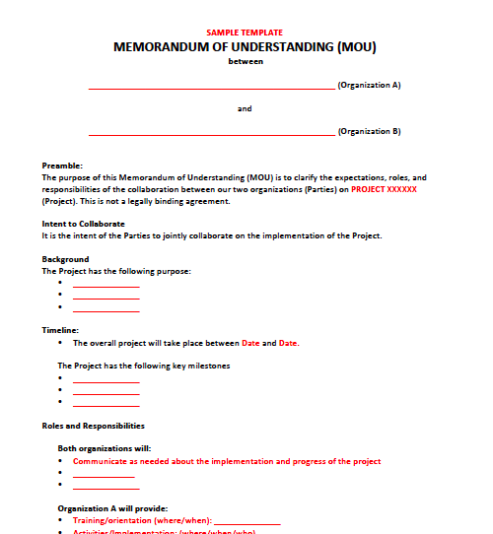
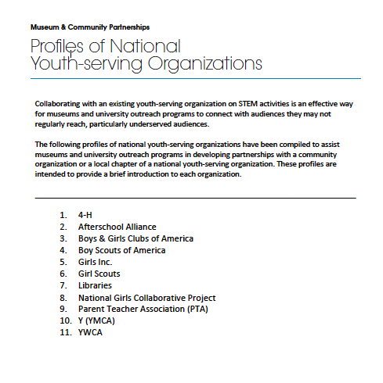
Tools and Templates
Profiles of National
Youth-Service Organizations
Template MOUs & emails
Notes:
We created several tools and templates including sample email templates, and a sample Memorandum of Understanding.
The profiles of national youth-serving organizations have been compiled to assist museums and university outreach programs in developing partnerships with a community organization or a local chapter of a national youth-serving organization. These profiles are intended to provide a brief introduction to each organization.
1. 4-H
2. Afterschool Alliance
3. Boys & Girls Clubs of America
4. Boy Scouts of America
5. Girls Inc.
6. Girl Scouts
7. Libraries
8. National Girls Collaborative Project
9. Parent Teacher Association (PTA)
10. Y (YMCA)
11. YWCA

Slide 25
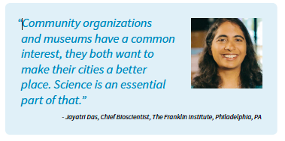
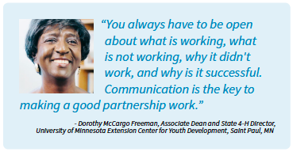
Illustrative Stories and Advice
Notes:
Sprinkled throughout the collaboration guide is advice from experienced collaborators as well as examples of different ways museums and community organizations are collaborating to increase access for underserved audiences, improve STEM equity, increase school readiness, support family learning, and engage different audiences.

Slide 26
Barriers to Success
Lack of time and capacity to sustain the relationship
Lack of clear purpose or common vision
Lack of understanding roles or responsibilities
Lack of commitment or buy-in by key individuals
Major differences in philosophies and styles of working
Unacceptable balance of power and control
Staff turnover
Failure to communicate
Lack of feedback
Failure to respond to feedback and evaluation
Financial input and time commitments outweigh potential benefits
Notes:
Barriers to a successful collaboration typically stem from the following common themes:

