Slide 1
Levels of Partnerships – Continuum
Tools for Collaboration:
increasing your museum's local impact through partnerships
Museum & Community Partnerships Project kit contents
Ali Jackson
Sciencenter
Ithaca, NY
ajackson@sciencenter.org
Interactivity
Association of Children’s Museums Conference
May 2016
Stamford, Connecticut

Slide 2
Activity Kit Overview

Slide 3
Explore Science kits
Designed for hands-on learning
Adaptable to different settings and learners
Five units, each with several activities
Everything you need is in the kit!
Notes:
The kits focus on hands-on science activities. They are adaptable to different settings and different kinds of learners. The kits include five units. Each unit has several activities that contribute to the overall theme of the unit. Each kit includes everything you need for all the activities, with supplies for about 100 people.

Slide 4
Themes
Intro to Nano
Small and Surprising
Labs and Tools
Tech and Nature
Nano and Our Lives
Notes:
There are five units, which cover these themes:
Introduction to Nano: a nanometer is a billionth of a meter.
Small and Surprising: nano-sized things can behave in surprising ways.
Labs and Tools: nano scientists use special tools and equipment.
Technology and Nature: nano research lets us create new technologies and understand nature.
Nano and Our Lives: nanotechnologies will be part of our lives—now and in the future.

Slide 5
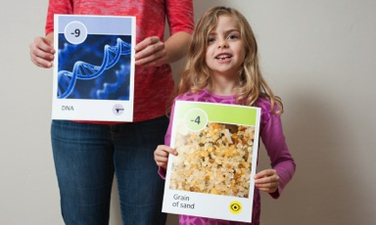
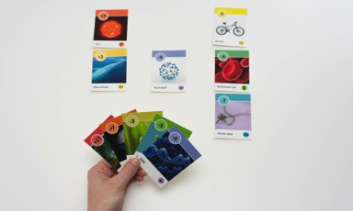
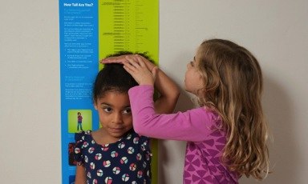
Zoom into Nano
A nanometer is a billionth of a meter.
That’s very, very small!
Get in Order
Powers of Ten
Measure Yourself
Notes:
The INTRO TO NANO unit explores the following theme:
A nanometer is a billionth of a meter.
This unit includes three activities:
Get in Order: In this small group activity, learners are each given a card that shows a picture of an object. The group is then challenged to line up in order of the size of the objects on their cards.
Measure Yourself: Learners use a height chart to measure themselves in nanometers.
Powers of Ten: In this card game, learners try to be the first to get rid of all their cards by putting them in order of size.

Slide 6
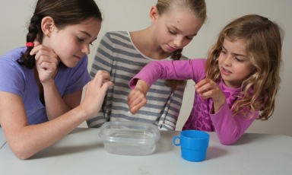


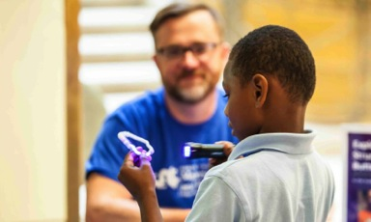
Small and Surprising
Nano-sized things can behave in surprising ways.
Gravity Fail
Smelly Balloons
Ready, Set, Fizz
UV Bracelets
Notes:
The SMALL AND SURPRISING unit explores the following theme:
Nano-sized things can behave in surprising ways.
This unit includes four activities:
Gravity Fail: In this activity, learners pour water out of a regular-sized cup, and then try to pour water out of a tiny cup.
Ready, Set, Fizz: Learners investigate how quickly antacid tablets react with water when they are broken into big and small pieces.
Smelly Balloons: Learners try to detect scents hidden inside of balloons.
UV Bracelets: Learners make bracelets using beads that react to UV light by changing color.

Slide 7

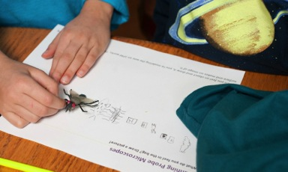

Labs and Tools
Nano scientists use special tools and equipment.
Draw a Circuit
Mystery Shapes
Gummy Shapes
Notes:
The LABS AND TOOLS unit explores the following theme:
Nano scientists use special tools and equipment.
This unit includes three activities:
Draw a Circuit: Learners discover that a thin layer of graphite (pencil lead) conducts electricity.
Gummy Shapes: Learners create “self-assembling” gummy capsules.
Mystery Shapes: Learners feel hidden objects and draw pictures of them, modeling the way a special tool called an atomic force microscope (or AFM) works.

Slide 8
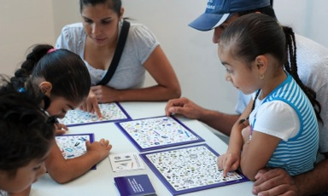
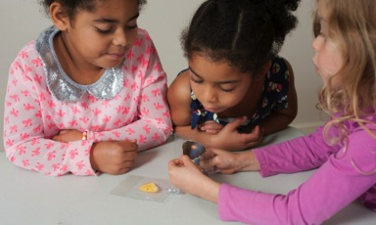

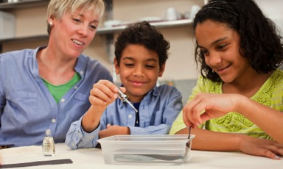
Tech and Nature
Nano research lets us create new
technologies and understand nature.
I Spy Game
Morphing Butterfly
Invisible Sunblock
Rainbow Film
Notes:
The TECH AND NATURE unit explores the following theme:
Nano research lets us create new technologies and understand nature.
This unit includes four activities:
I Spy Game: Learners compete to be the first to find objects that are examples of nano in nature and technology.
Invisible Sunblock: Learners compare sunblocks that use nano-sized mineral particles and larger particles.
Morphing Butterfly: Learners find out how some butterfly wings get their color.
Rainbow Film: Learners create a rainbow-colored film out of clear nail polish.

Slide 9
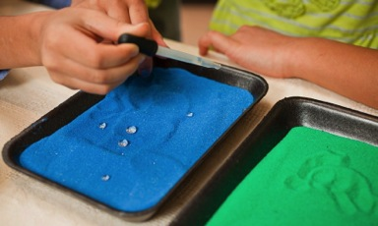
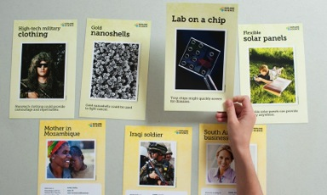
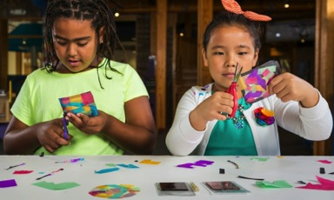
Nano and Our Lives
Nanotechnologies will be part of our lives—now and in the future.
Mystery Sand
You Decide!
Stained Glass Art
Notes:
The NANO AND OUR LIVES unit explores the following theme:
Nanotechnologies will be part of our lives—now and in the future.
This unit includes three activities:
Mystery Sand: Learners compare ordinary colored sand and sand that has a water-repellent nano coating.
Stained Glass Art: Learners craft a suncatcher that resembles stained glass.
You Decide: Learners talk about which nanotechnologies they think are most important to develop.

Slide 10
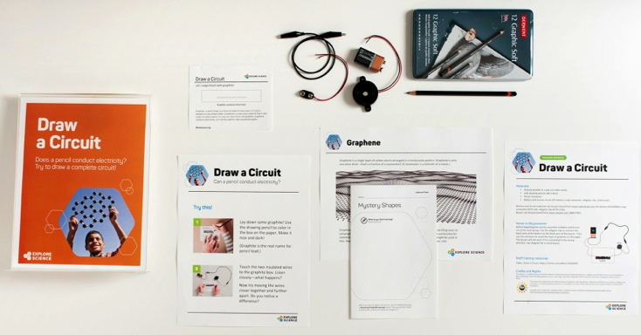
Activity materials
Notes:
We’ve just taken a very quick look at all 16 activities in the Explore Science kit. Here is an example of just one activity, Draw a Circuit. The image shows all the materials needed to do the activity.
You can see that some of these materials are intended for the learners to use. These include the supplies they need to do the activity (the pencil, paper, electrical circuit, and instructions). These things should all be out and accessible for learners.
It also includes some materials for the facilitator to use. These include sheets with some notes about things like setup and safety, and some tips to help you do a great job leading the activity.

Slide 11
Activity instructions
Notes:
Here is an example of an activity guide, for the Draw a Circuit activity.
The activity guides are structured to help facilitators lead learners through hands-on science activities.
The front side includes step-by-step instructions in the section called “Try this!”
The back side describes what learners observe—and explains why it happens—in the section called “What’s going on?”
Finally, the guide relates the activity to nanoscale science, engineering, and technology in the section called “How is this nano?”
Facilitators can leave these guides out on the table so that learners can read them and look at the pictures. (They’re available in both English and Spanish versions.)

Slide 12
Info sheets and worksheets
Notes:
The Graphene sheet on the left is an example of a supplemental sheet that provides extra information beyond what’s in the activity guide. In this case, it shows a larger illustration of what the material graphene looks like on the nanoscale.
The two Draw a Circuit sheets on the right are the worksheets that learners need for the activity. The top sheet is only for this activity, while the bottom document is a small activity booklet that includes worksheets for all the activities in this unit. The single-activity worksheet is especially intended for events, or individual use of activities, while the booklet is intended for out of school programs that are using the activities in units—but programmers can choose to use whichever material works best for their structure. (The booklets require that you’d have all the activities in that unit available.)

Slide 13
Notes and tips
Notes:
The “Notes and tips” guide is for the activity leader.
The front side lists the activity materials and includes important notes related to setup, safety, and other aspects of the activity.
The back side has tips that will help the facilitator lead the activity.

Slide 14
Planning materials
Notes:
Finally, there are two guides that will help the facilitator plan for the use these materials in different settings.
The Events Guide helps organizers plan and implement an event—like a family science event—where all the activities are out at once, and a relatively large group of learners can circulate to many or all of the activities in the kits.
The Out of School Programs Guide helps organizers plan and implement a program such as a camp or afterschool program, where the activities are delivered in units to small groups of learners.
Out of school time programs may also use these materials in other settings, that take advantage of their own knowledge and expertise to design the program.

Slide 15





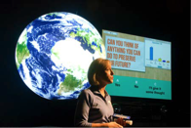
NISE Network Projects
Project Opportunities
NanoDays
Museum & Community Partnerships Explore Science – Zoom into Nano kits
Building with Biology kit
Sustainability in Science Museums kit
Space and Earth Informal STEM Education
Transmedia Museum
(Frankenstein anniversary)
Notes:
The Museum & Community Partnerships Explore Science Zoom into Nano - 100 kits have all been distributed, digital materials are all available online
Do have opportunities for other partnerships
Handout with information about each of them

Slide 16
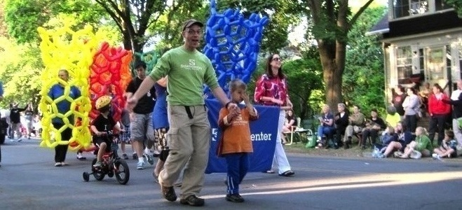




Thank you NSF and partners!
This presentation is based on work supported by the National Science Foundation under Grant No. 0940143. Any opinions, findings, and conclusions or recommendations expressed in this presentation are those of the authors and do not necessarily reflect the views of the Foundation.
Notes:
We would like to thank our funder the National Science Foundation for making the Museums & Community Partnerships project possible.
We would like to thank partners who helped develop the guide and materials and all the partners who are implementing these programs and partnerships in their local communities across the United States.

Slide 17
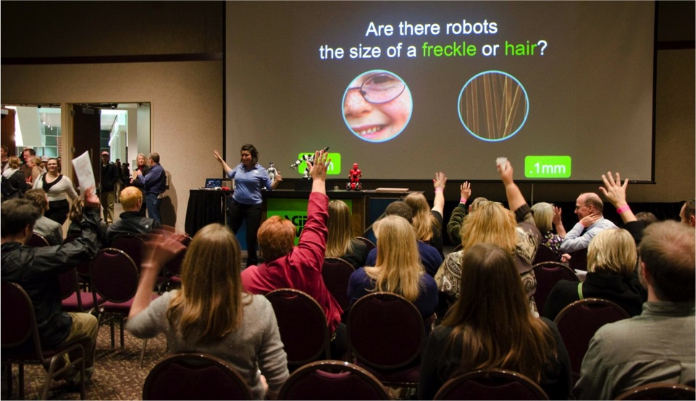
Discussion

Slide 18

Discussion
Tell us about challenges
you have experienced in your collaborations
we can discuss strategies for working through them
changes in personnel
changing organizational priorities (on either side)
how do you foster organizational buy-in?
characteristics to identify
the right partnership right now
Notes:
-we have some possible discussion topics listed above
-Note we want to avoid getting bogged down in too many details
-steer towards working together on finding funding rather than focusing on the lack of funding

