Slide 1

Hi AI! Playful Early Encounters with Artificial Intelligence
Catherine McCarthy, Arizona State University, NISE Network
Darrell Porcello, Children’s Creativity Museum, San Francisco
Ari Krakowski, Lawrence Hall of Science, Berkeley, CA
Chip Lindsey, Discovery Lab, Tulsa, OK
Friday, May 17, 2024 1:15 p.m.–2:30 p.m.
Association of Children’s Museums InterActivity - May 2024 Conference
Notes:
Dive into the exciting world of Artificial Intelligence (AI)! Learn strategies and techniques for engaging children and families creatively in this rapidly evolving technology that is already affecting our lives and transforming aspects of society. Discover a range of hands-on activities designed to engage families in understanding AI concepts playfully. Attendees will explore how robots and people are different, how facial recognition works, and how machine learning can be used in activities and exhibits. This participatory session will include facilitated table discussions about talking with children about the future and fostering intergenerational learning and curiosity about the possibilities of AI.

Slide 2
Who is here?
How many of you intentionally used AI this week?

Slide 3
Who is here?
How many of you have tried out ChatGPT?

Slide 4
Who is here?
How many of you have tried out creating AI artwork?

Slide 5
Our Plan for Today
Very brief introduction to AI (10 minutes)
Presenters share what they have been working on (3x8 minutes)
Rotate tables to try out activities (30 minutes)
Conversation and Discussions (20 minutes)

Slide 6
Catherine McCarthy
Arizona State University
& NISE Network
cmccarthystem@gmail.com

Slide 7


Why AI in Children’s Museums?
Catherine McCarthy
Project Manager Senior - NISE Network
Arizona State University, Tempe, AZ
cmccarthystem@gmail.com
www.nisenet.org
Association of Children’s Museums InterActivity Conference - May 2024

Slide 8
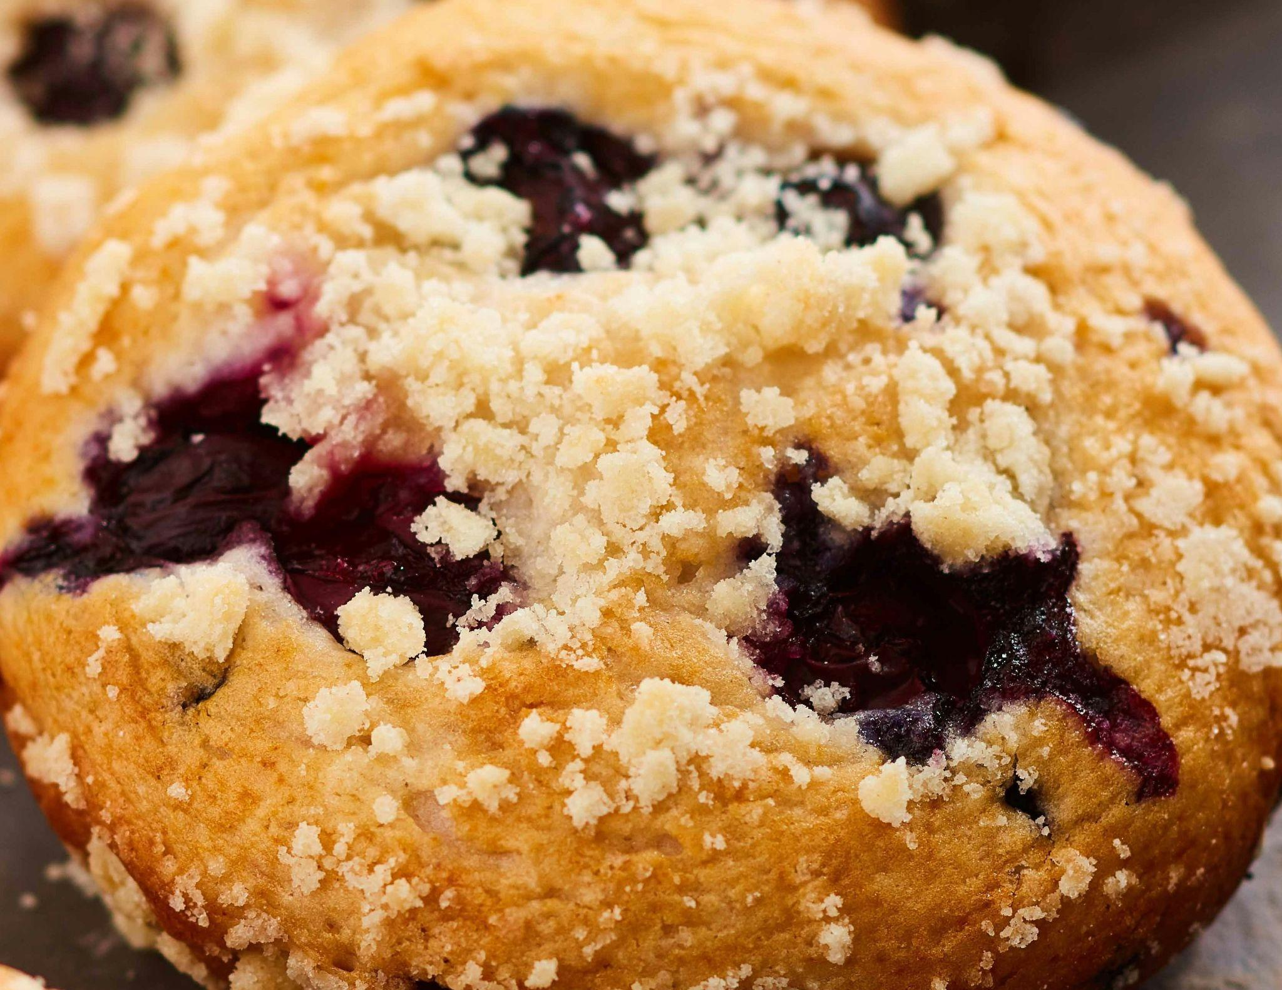
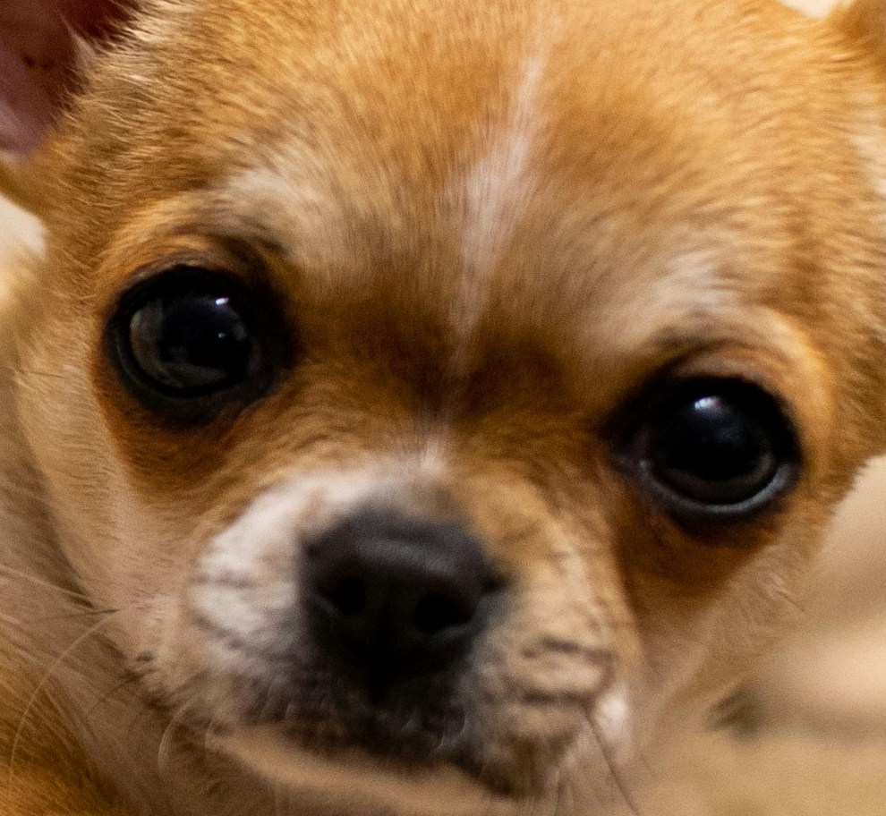
What is Artificial Intelligence ?
Machine learning
find patterns and make predictions based on training data
Some patterns and predictions are much easier humans than computers
Blueberry Muffin Photo by Roberto Martinez on Unsplash
Chihuahua dog Photo by David Vives on Unsplash

Slide 9

What is Artificial Intelligence ?
Generative AI
Generate new things based on training data
AI be transformative to our lives
New tools have made AI much accessible to non-experts
Created with AI DeepDreamGenerator
Prompt: “Chihuahua dog eating a blueberry muffin while wearing solar eclipse glasses”
Notice these are sunglasses NOT safe eclipse viewing glasses
Notes:
Generative AI has a wide range of applications, including:
Language generation: Creating human-like text, including articles, and stories
Image generation: Producing images, artwork, and designs
Content creation: Generating content for various purposes, such as marketing, social media, and more.
Data augmentation: Creating synthetic data to enhance machine learning models' training.

Slide 10
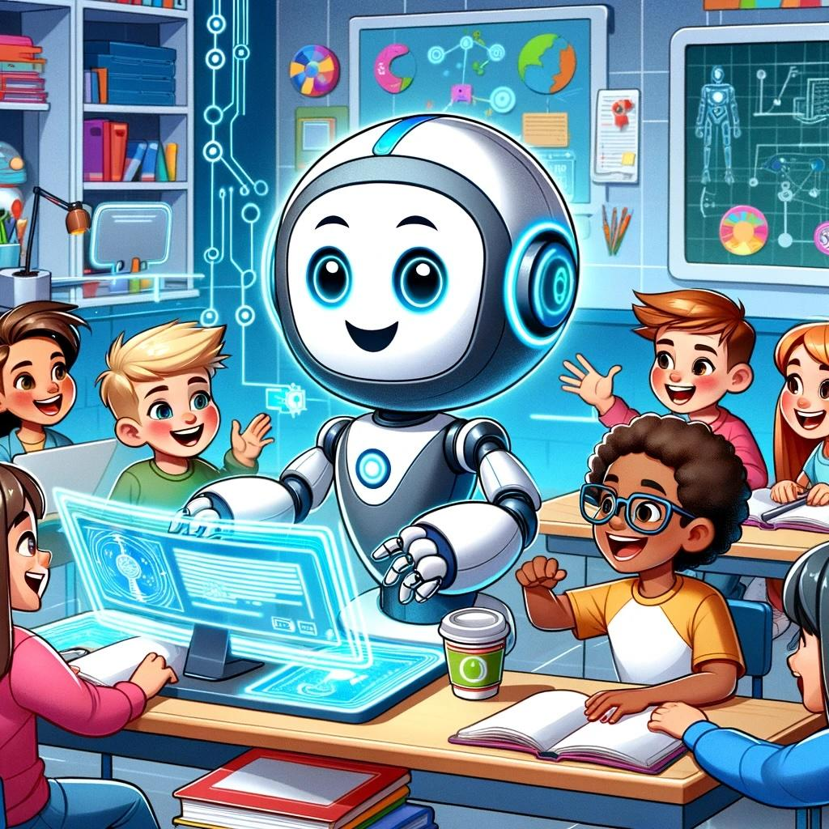
Things to look forward to??
Sparking creativity, have fun
Help with mundane tasks
Personalized learning
Generative AI image created with DALL-E 3 using the prompt “generate a cartoon style image showing the bright future of kids and AI working together”
Notice the kids’ faces, potential biases

Slide 11
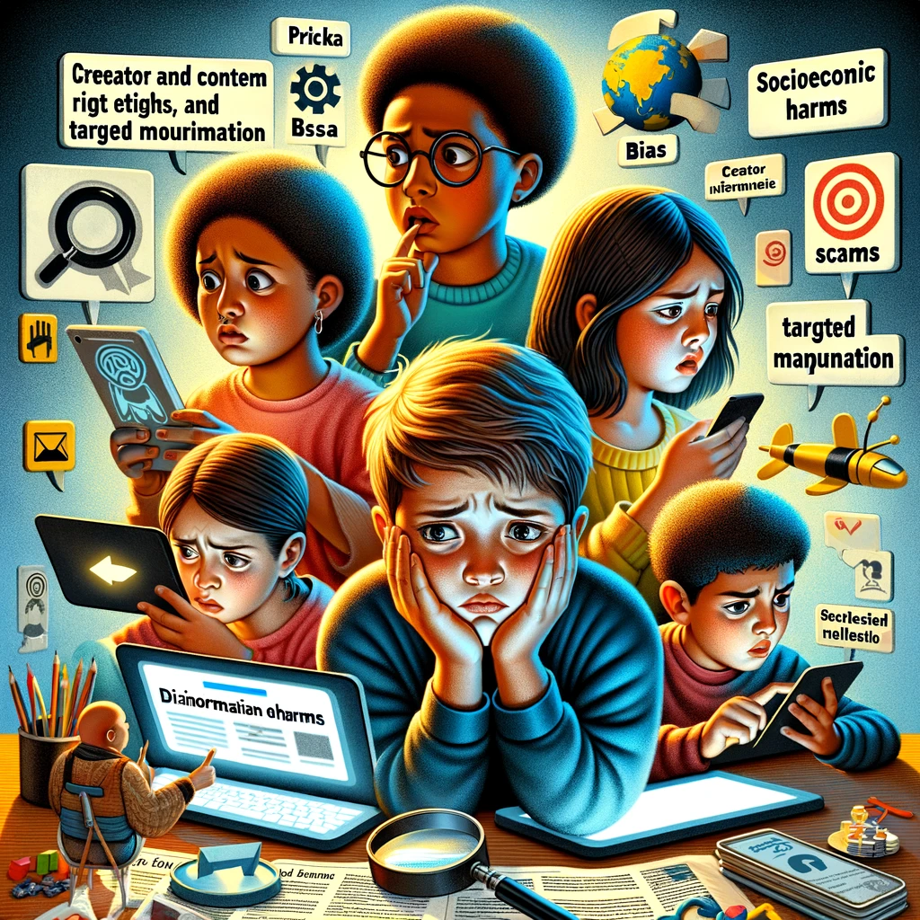
Things to worry about?
Bias: discrimination, stereotypes, exclusion
Misinformation (unintended inaccuracies, "hallucinations")
Disinformation (material intended to deceive) more effective, harder to detect
Privacy risks
Creator and content rights and ethics
Fraud, scams, and targeted manipulation
Socioeconomic harms (e.g. job losses)
Generative AI image created with DALL-E 3 using the prompt “give me a suitable image for a presentation slide that shows kids” and the full bullet list under “Things to worry about”
List adapted from Weidinger, Laura, et al. "Taxonomy of risks posed by language models." Proceedings of the 2022 ACM Conference on Fairness, Accountability, and Transparency. 2022.
https://dl.acm.org/doi/pdf/10.1145/3531146.3533088
Notice bias with the kids/hair
Notes:
Generative A.I. scrubs the depth and breadth of the internet bringing all its collective good as well as society's ills. Implicit bias emerges based on social, cultural, racial, gender stereotypes are baked into the cake. Generative A.I. assumptions should be critically examined, knowing that it is not without culture, simply because it represents dominant culture.

Slide 12
Priorities for Children
UNICEF Recommendations for Child-Centered AI
1 Support children’s development and well-being
Let AI help me develop to my full potential.
2 Ensure inclusion of and for children
Include me and those around me.
3 Prioritize fairness and non-discrimination for children
AI must be for all children.
4 Protect children’s data and privacy
Ensure my privacy in an AI world.
5 Ensure safety for children
I need to be safe in the AI world.
6 Provide transparency, explainability, and accountability for children
I need to know how AI impacts me. You need to be accountable for that.
7 Empower governments and businesses with knowledge of AI and children’s rights
You must know what my rights are and uphold them.
8 Prepare children for present and future developments in AI
If I am well prepared now, I can contribute to responsible AI for the future.
9 Create an enabling environment
Make it possible for all to contribute to child-centred AI.
UNICEF (2022) Policy guidance on AI for children v2.0
https://www.unicef.org/innocenti/reports/policy-guidance-ai-children
Notes:
The good news is a lot of people have been thinking hard about how this may affect society, including special attention on children.
- UNICEF Policy guidance on AI for children “AI systems are fundamentally changing the world and affecting present and future generations of children. Children are already interacting with AI technologies in many different ways: they are embedded in toys, virtual assistants, video games, and adaptive learning software. Algorithms provide recommendations to children on what videos to watch next, what news to read, what music to listen to and who to be friends with. “

Slide 13
Aspects of AI children’s and science museums to focus on for children and families???
Understanding what AI is
Preparing for the future (and the present)
Having fun with AI, being creative
Media literacy
Future societal changes
AI in Education
Notes:
We all want to learn strategies and techniques for engaging children and families creatively in this rapidly evolving technology that is already affecting our lives and transforming aspects of society. But this is a daunting topic! talking with children about the future and fostering intergenerational learning and curiosity about the possibilities of AI.

Slide 14
Ari Krakowski
Lawrence Hall of Science
Berkeley, CA
akrakowski@berkeley.edu

Slide 15
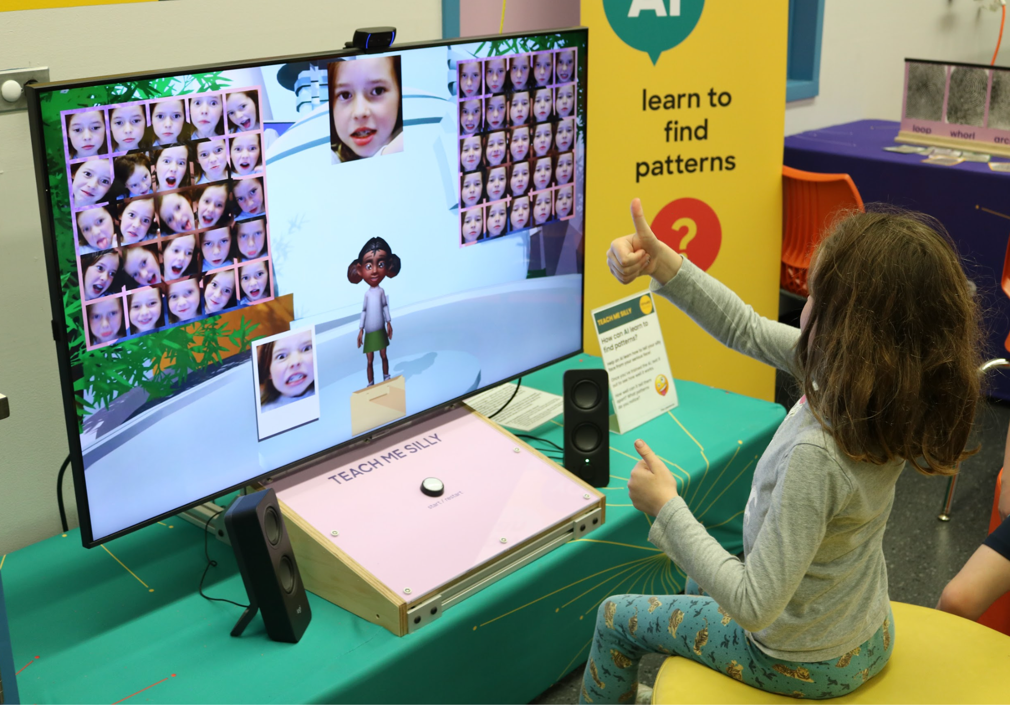
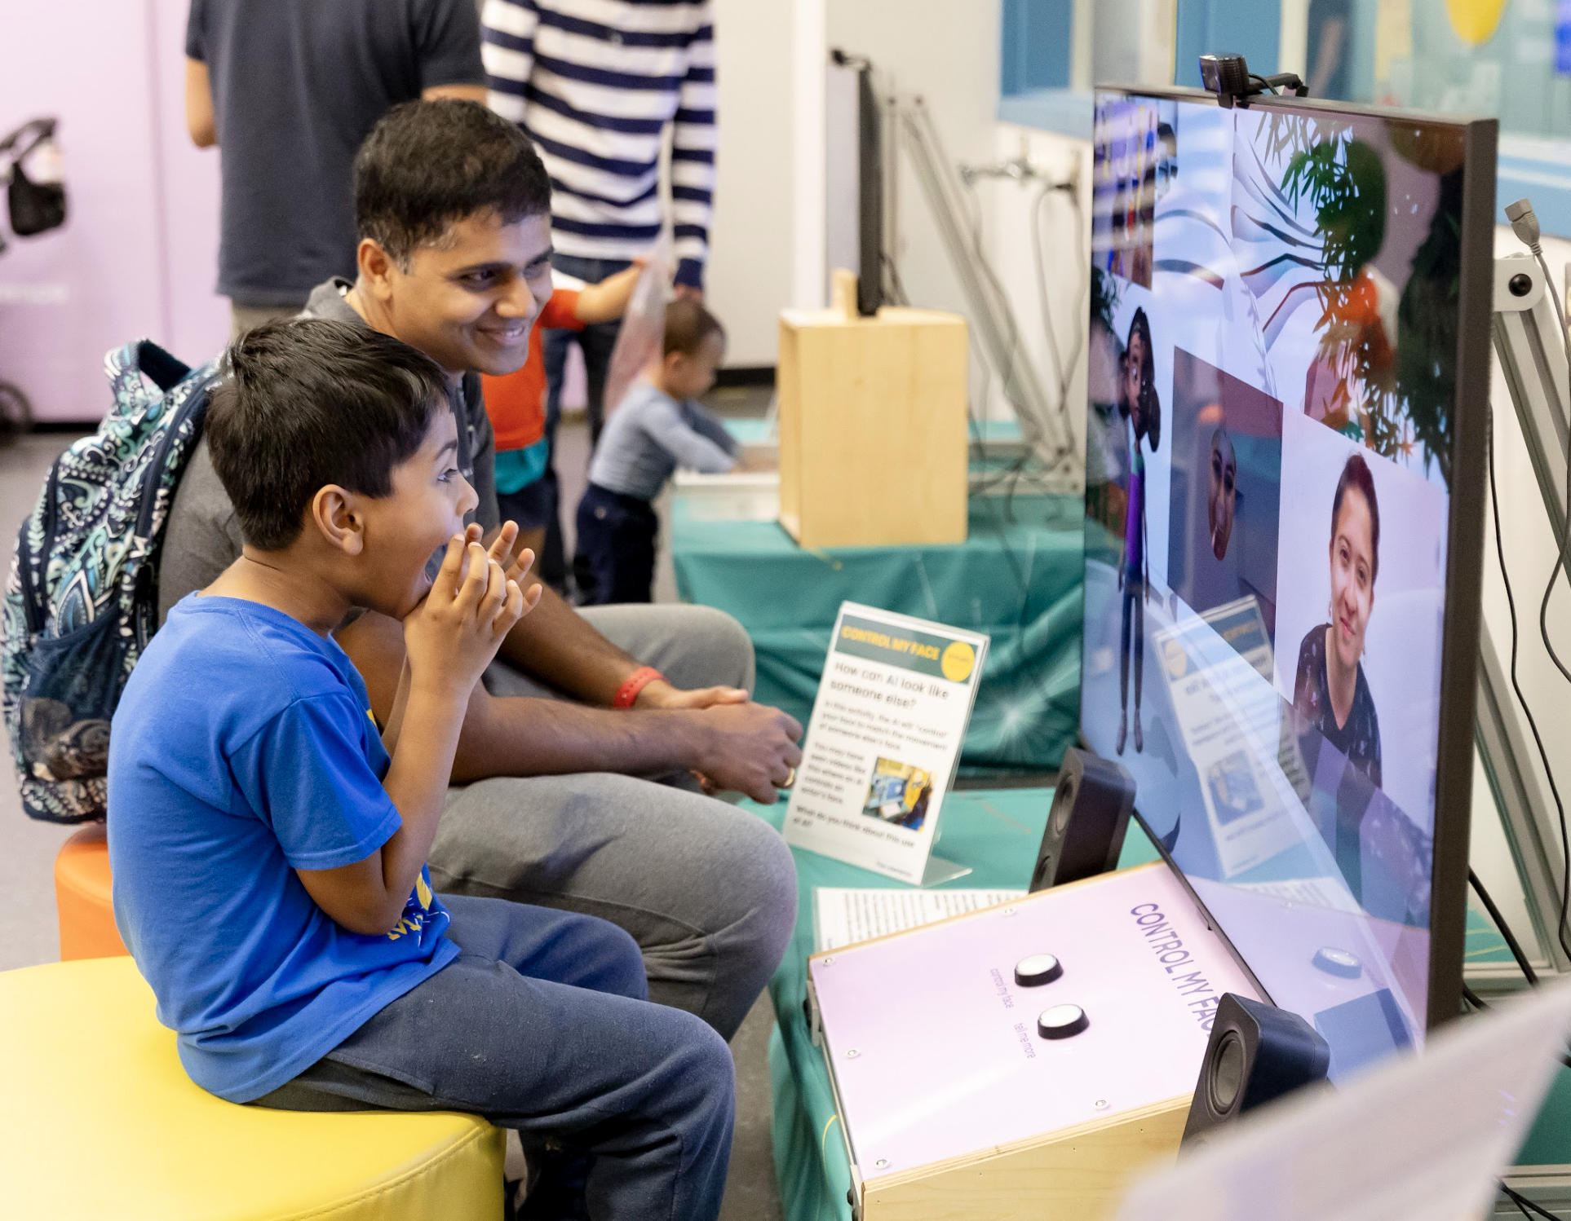

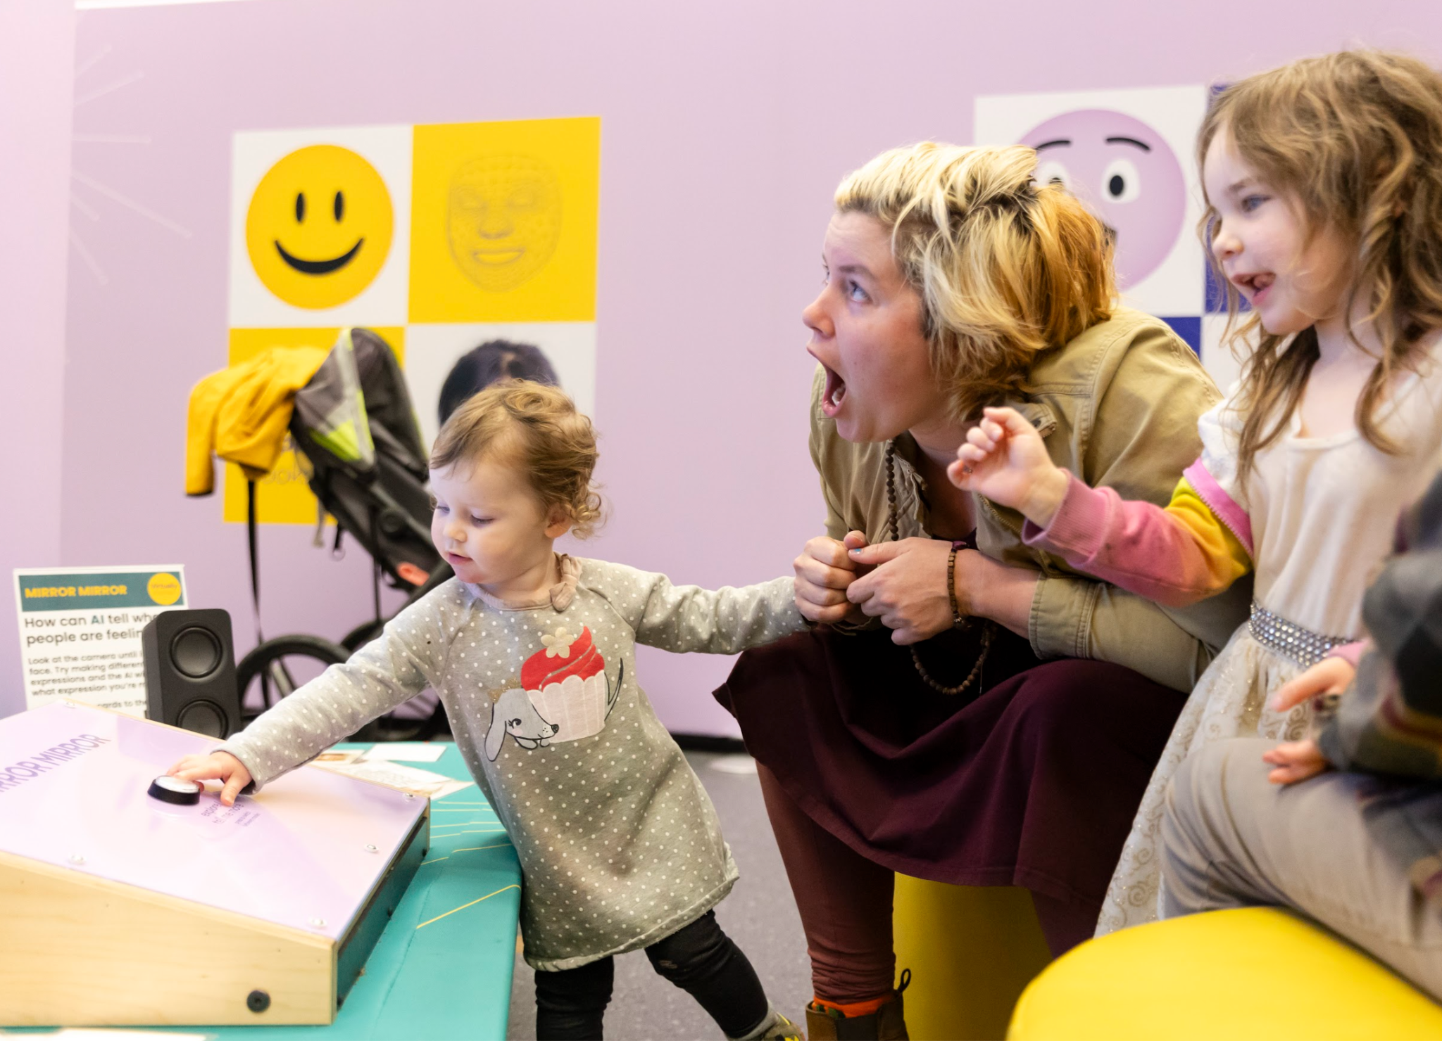
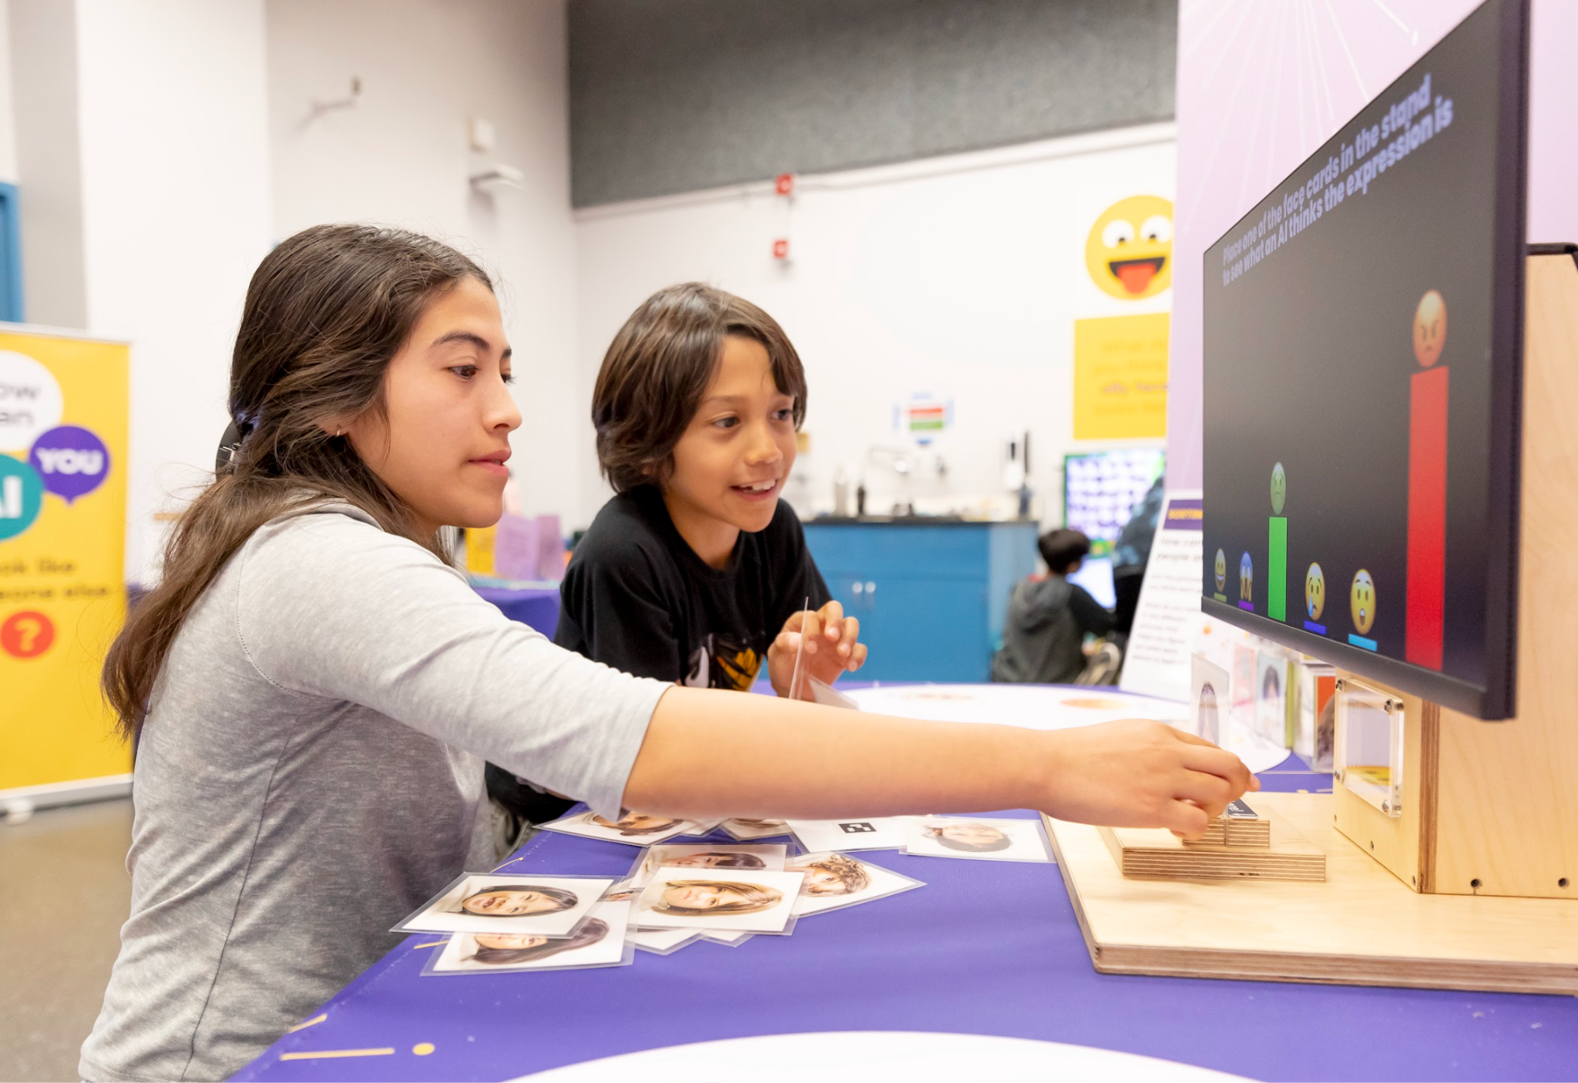
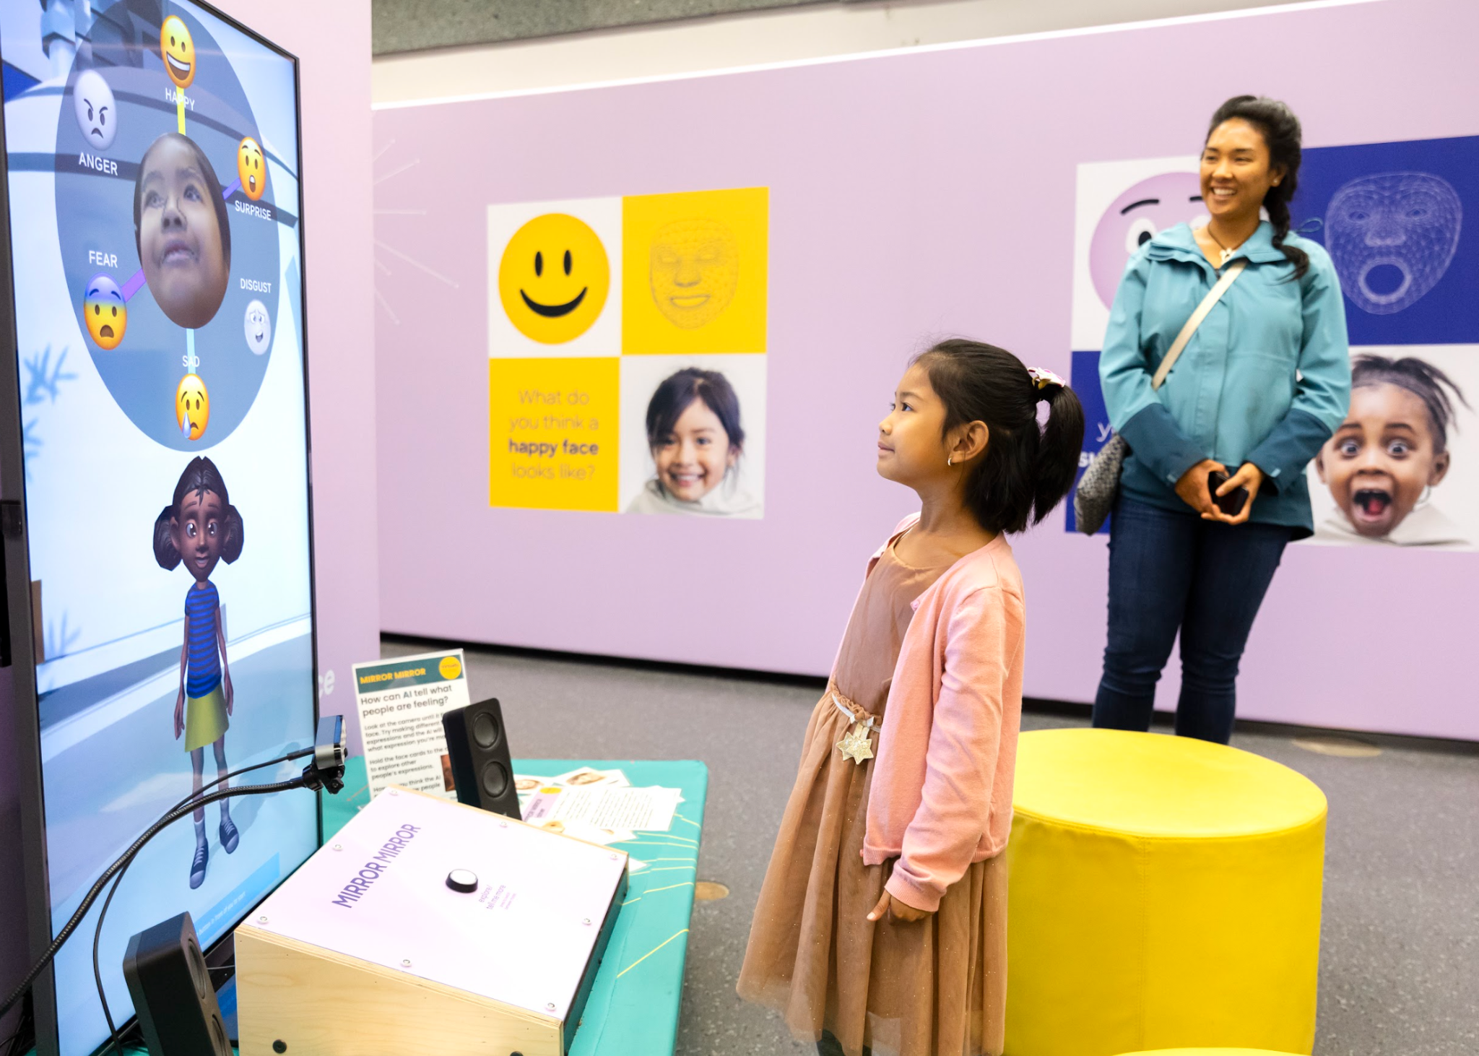
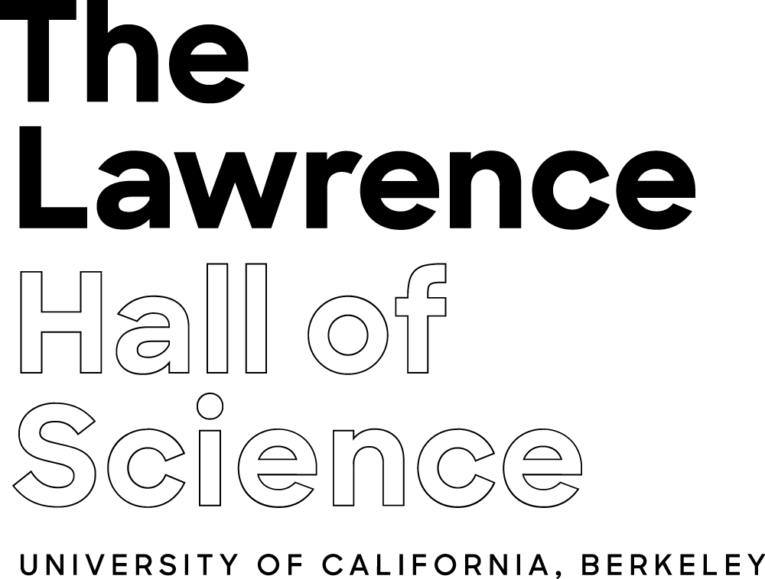

Slide 16
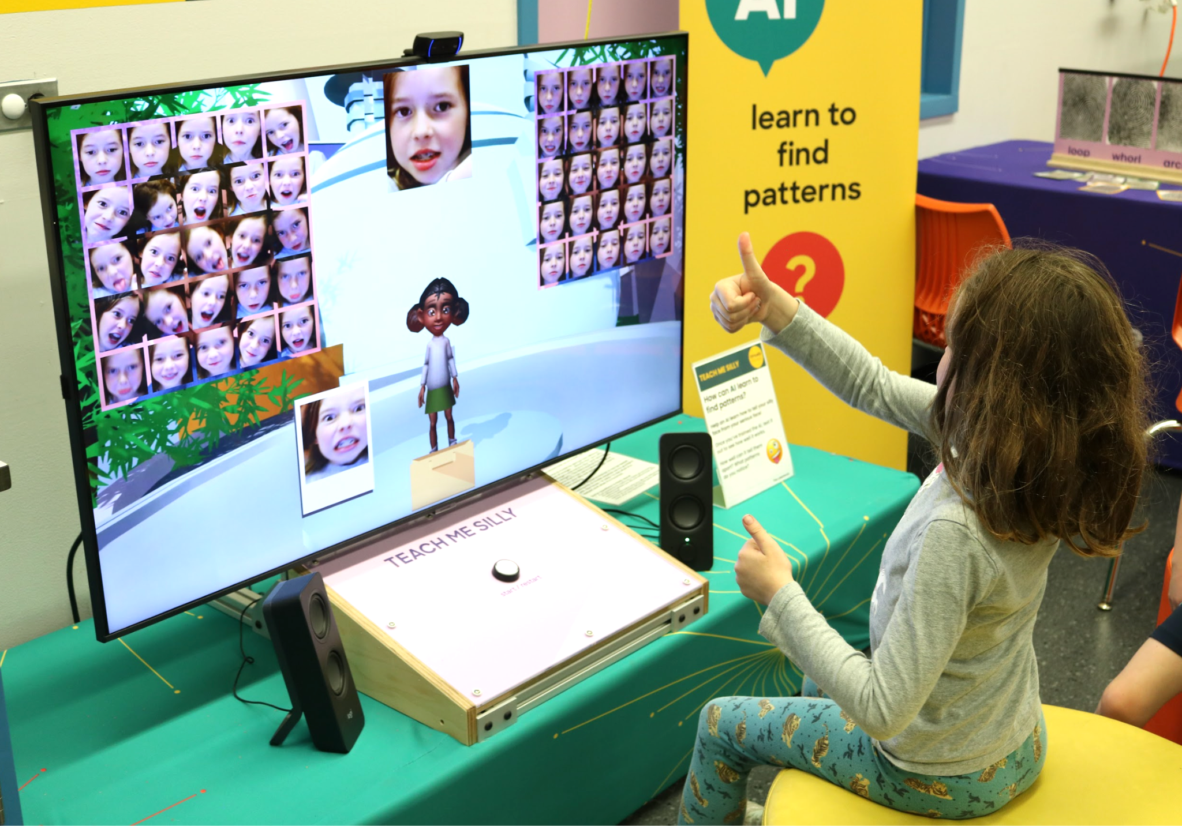
STRATEGIES FOR ENGAGING
CHILDREN & FAMILIES WITH AI
Connect AI engagement to human experience
Build on the familiar, relatable
Kids naturally make connections between how they learn/solve a problem and how machines do the same task. This presents an opportunity to draw parallels vs distinctions as appropriate

Slide 17
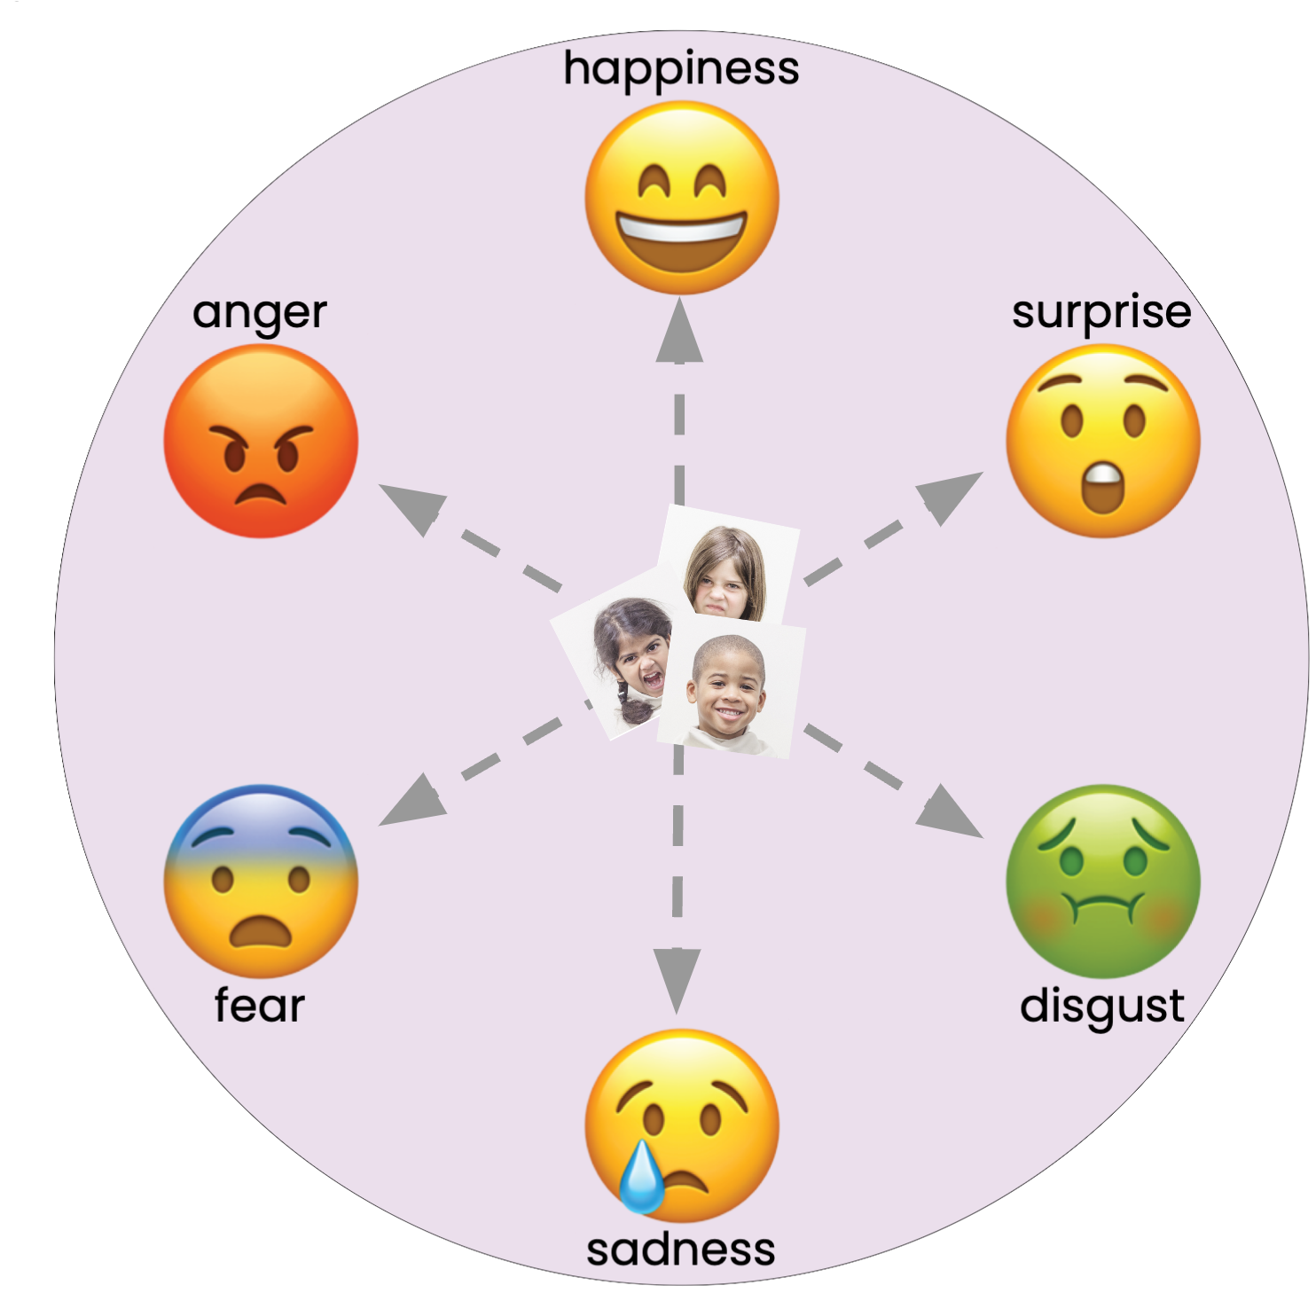

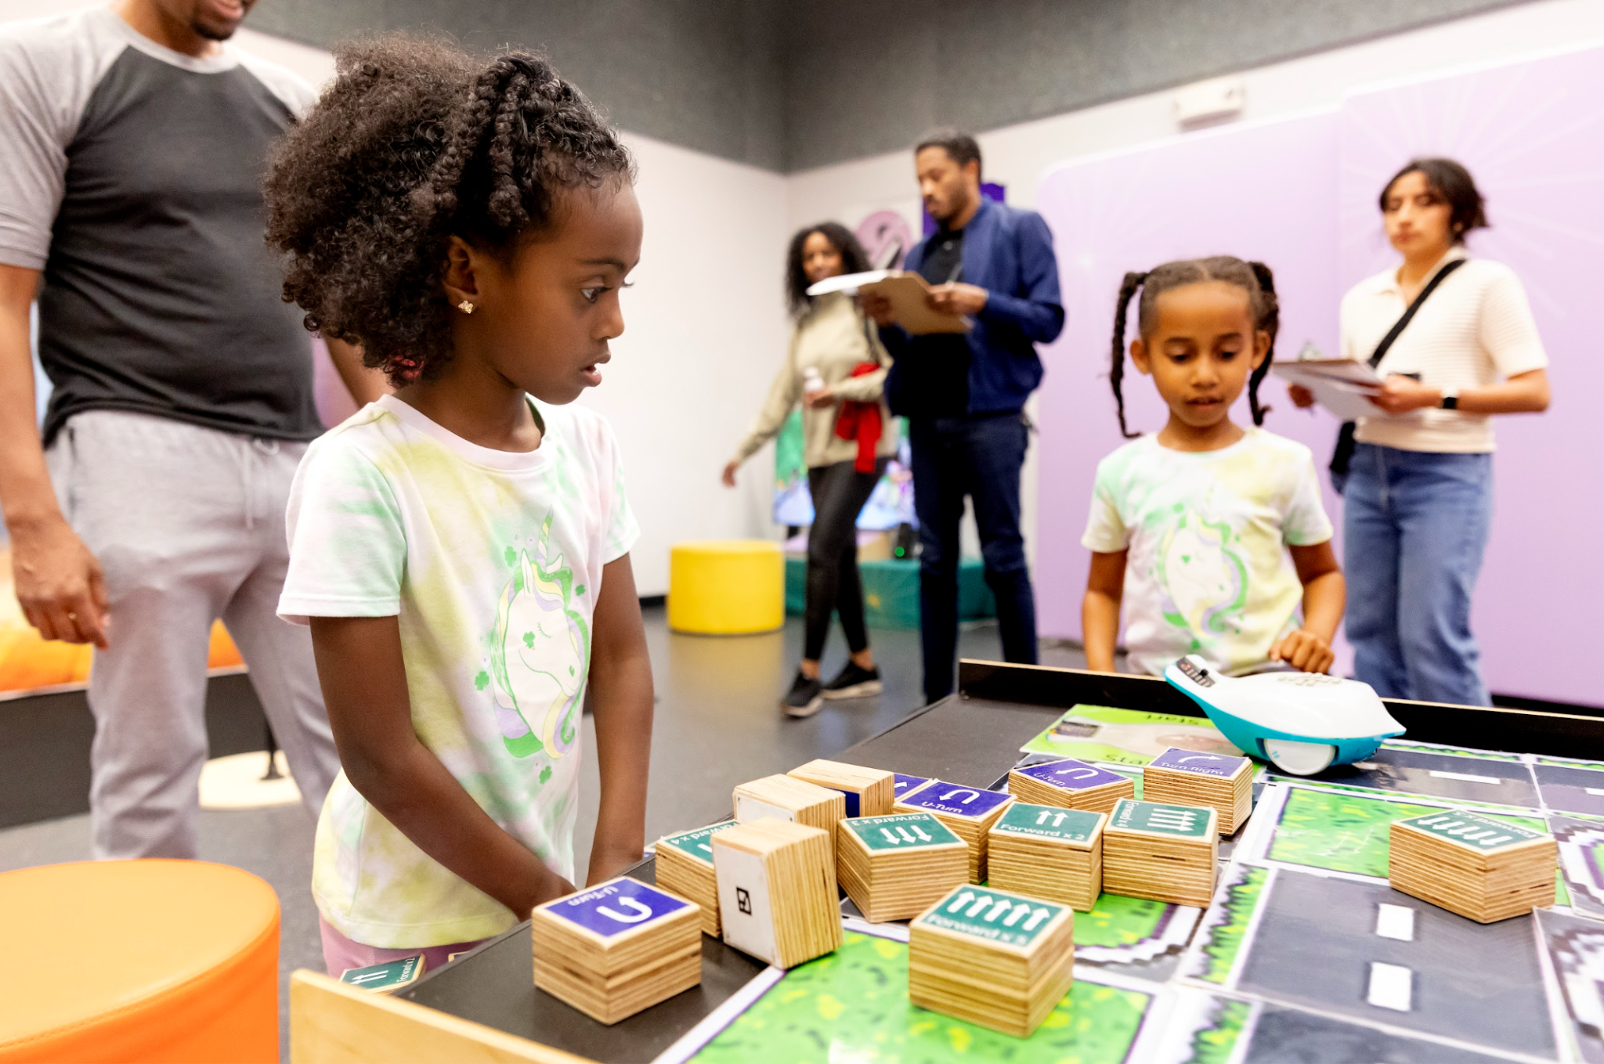
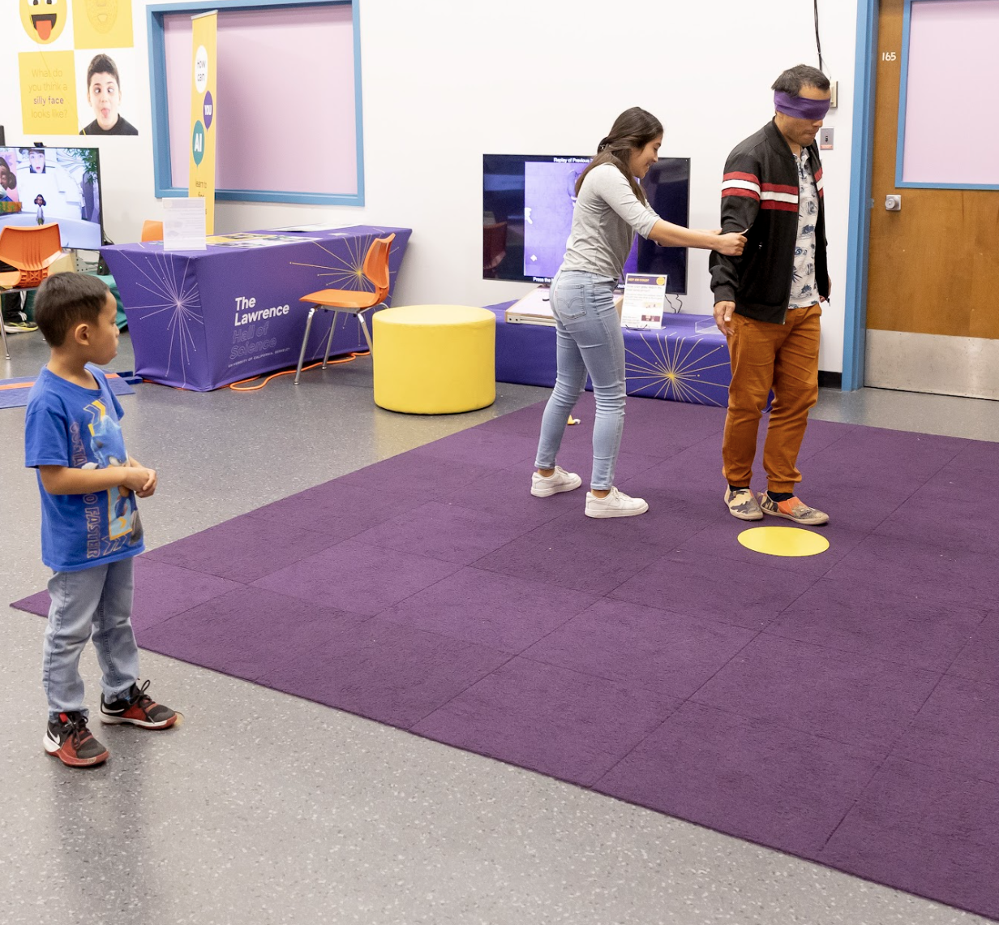
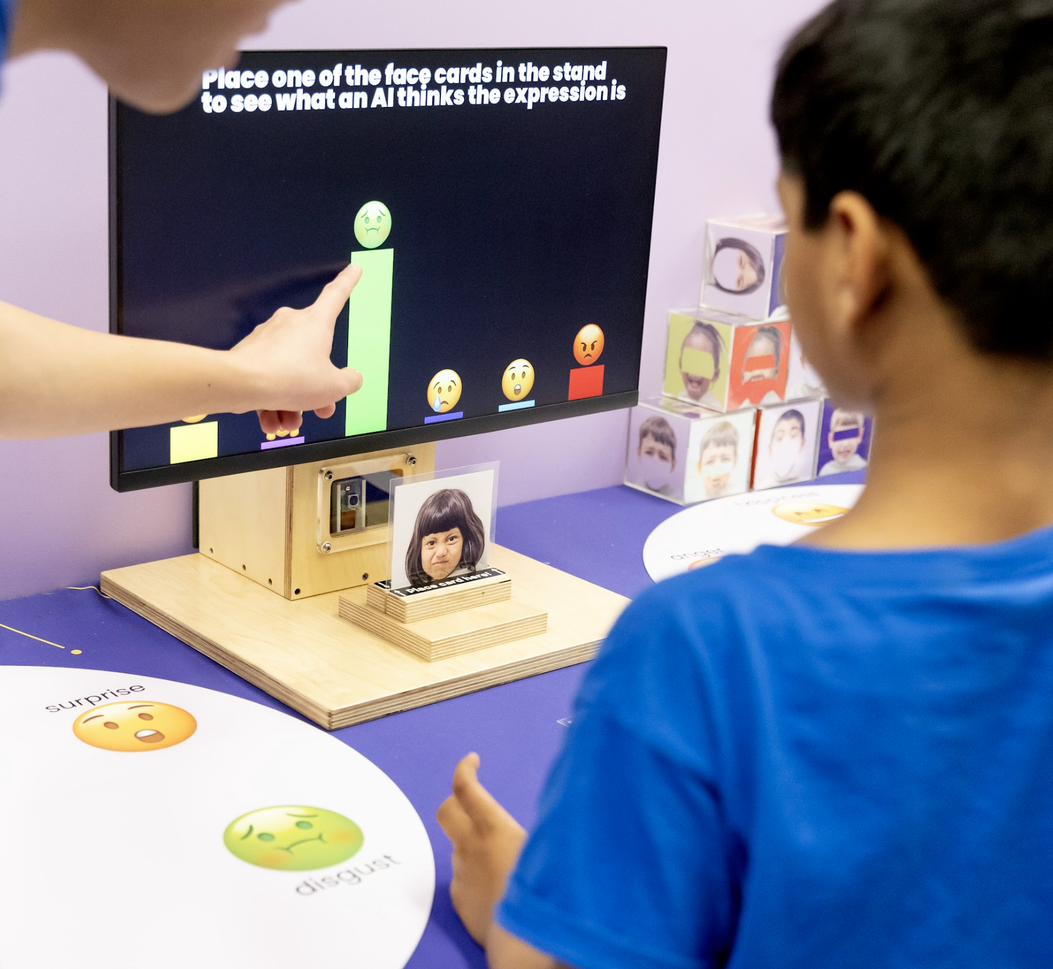
STRATEGIES FOR ENGAGING
CHILDREN & FAMILIES WITH AI
Balance engagement
with machines & screens with interpersonal engagement, unplugged opportunities for sensemaking

Slide 18
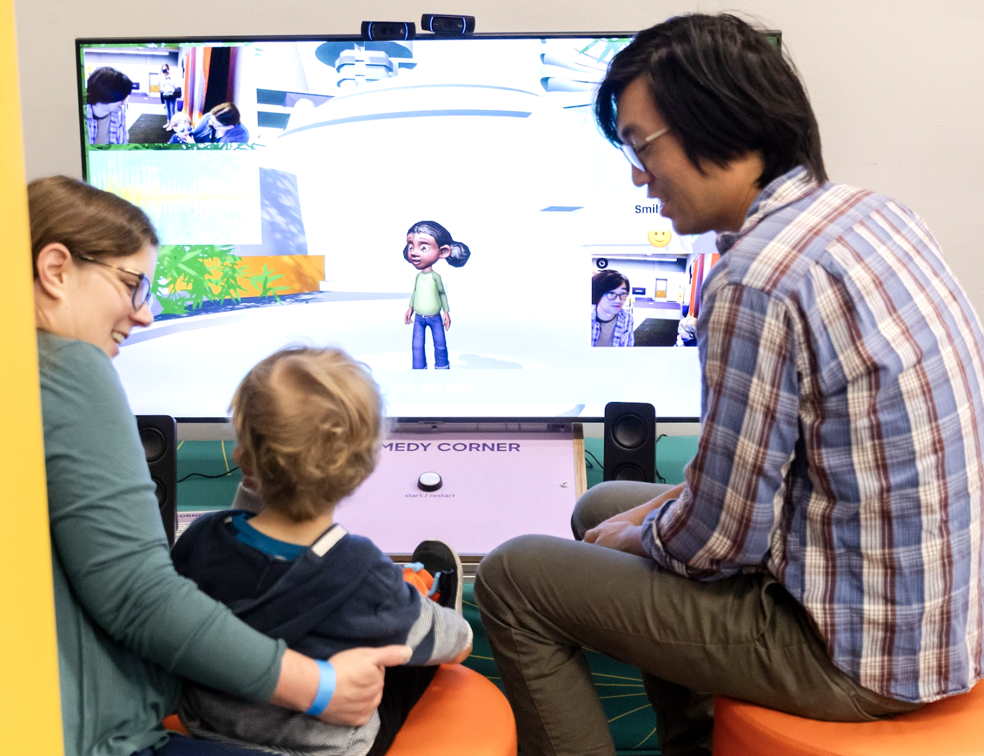
STRATEGIES FOR ENGAGING
CHILDREN & FAMILIES WITH AI
Positioning parents & caregivers to facilitate childrens’ engagement
AI models might help too

Slide 19
defining experience goals
feeling(s) about AI
playful
excited
amazed
critical
curious
fascinated
reflective
AI literacy & learning
what’s AI?
this is AI
AI involves things like…
AI works like this
awareness
understanding

Slide 20
other considerations
AI is and will continue to be changing rapidly
Societal context matters

Slide 21
Darrell Porcello
Children’s Creativity Museum
San Francisco, CA
porcello@gmail.com

Slide 22
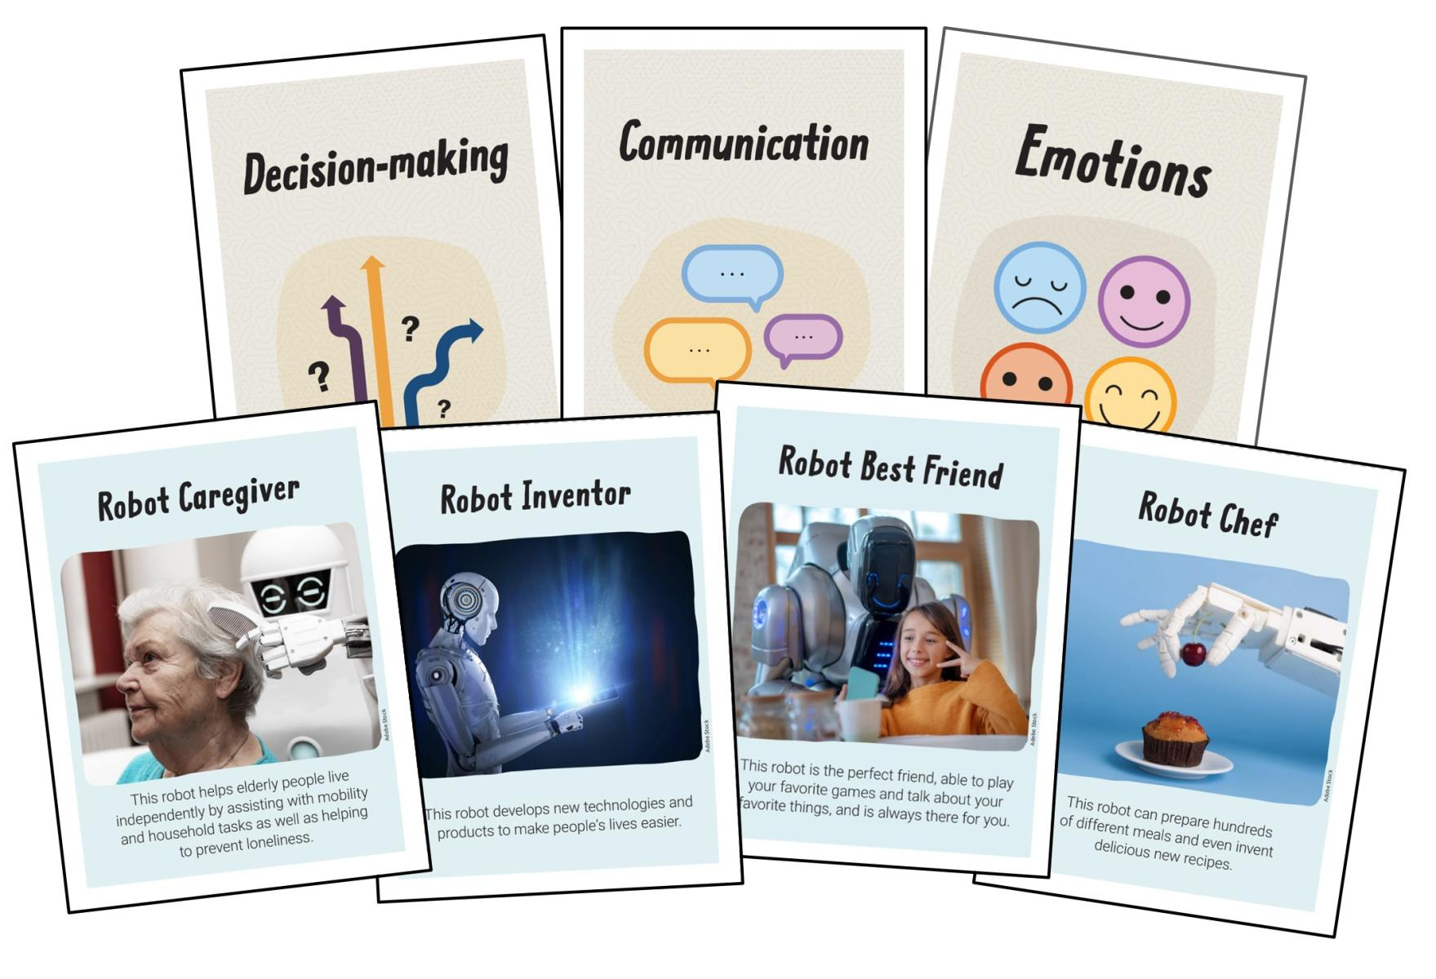
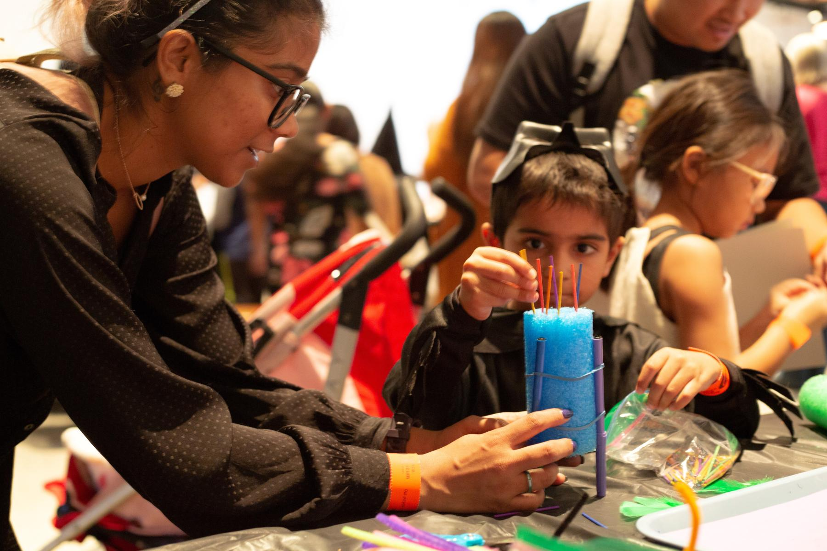
Hands-on activities with AI themes you an use today
What Makes Us Human
Scribble Bot
https://www.nisenet.org/catalog/what-makes-us-human
https://www.nisenet.org/catalog/scribble-bot

Slide 23
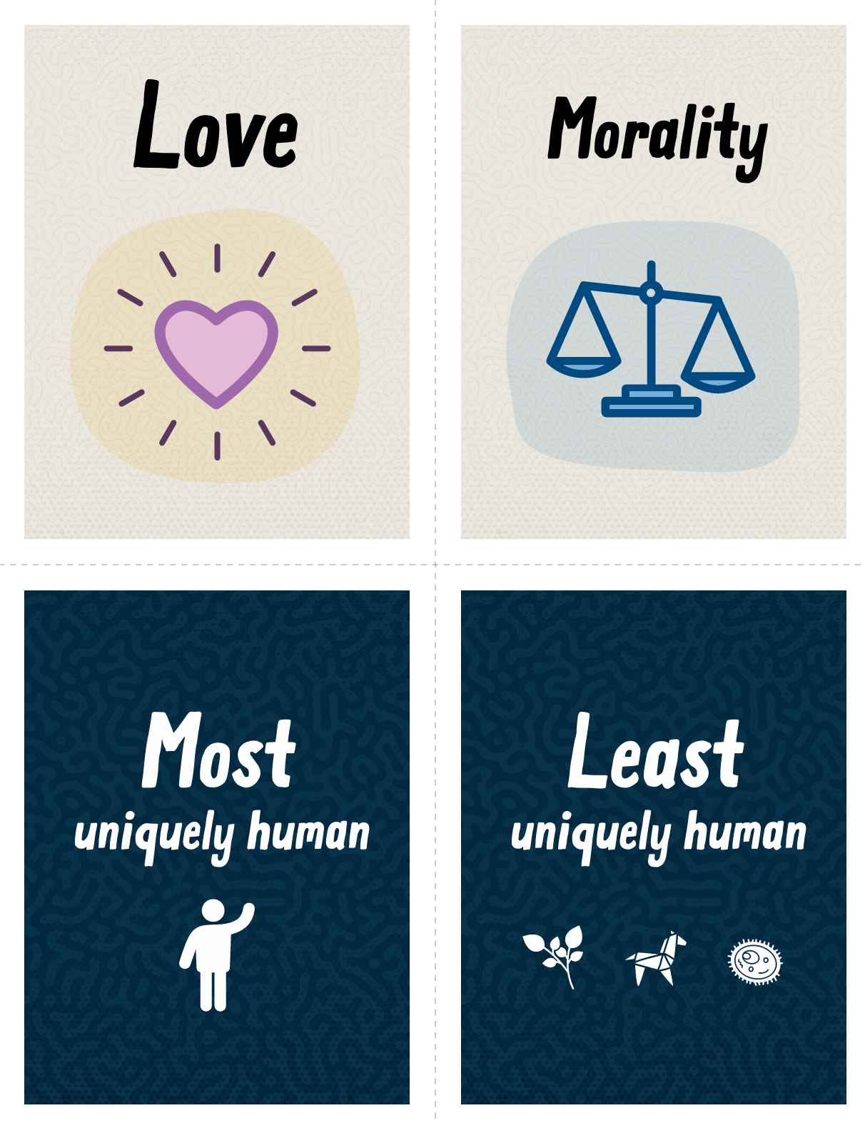
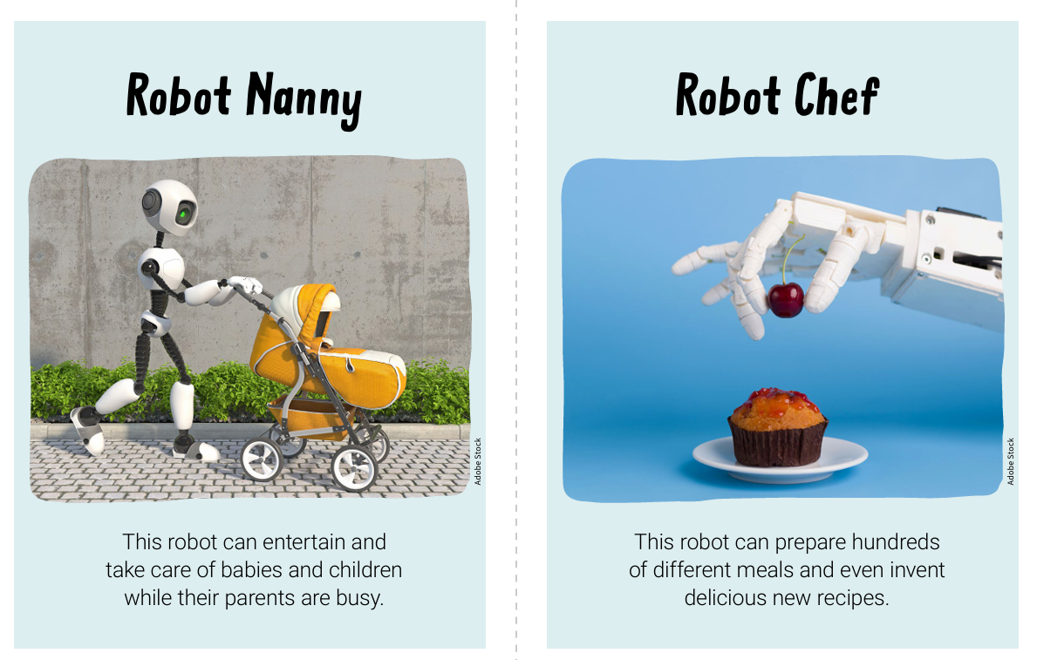
What Makes Us Human
Activity helps to scaffold conversations that explore how close AI may be coming to having human abilities.
Interactive Elements: Learners sort abilities by their uniqueness to humans, then assign them to robots for specific tasks.
Critical Thinking: Participants decide how their custom robots would react in novel situations, reflecting on the "human-like" qualities of their creations.
Open-ended Discussion: The activity encourages thoughtful debate on whether robots should embody human traits, without right or wrong answers.
Audience Engagement: Suitable for both children and adults.
Resources Provided: Includes downloadable cards, activity guides, and a facilitation training video.

Slide 24
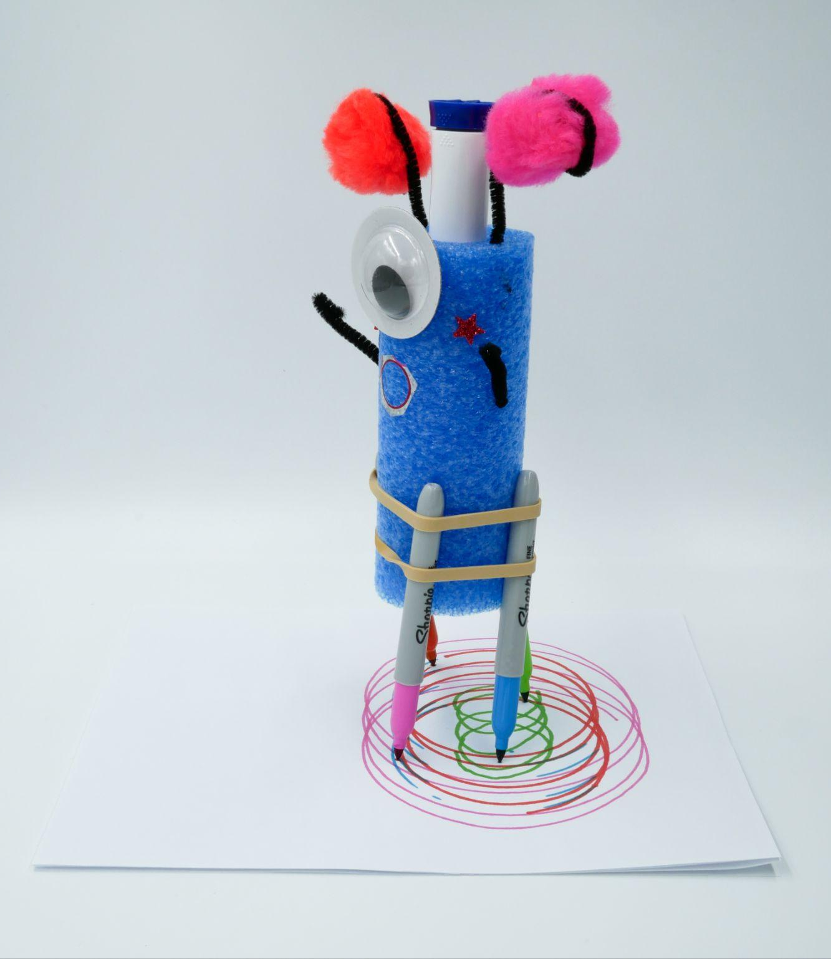
Scribble Bot
Participants create a homemade robot which can autonomously scribble on paper.
Engagement Goal: Designed to spark discussions about accountability and responsibility regarding the actions of AI and robotic creations.
Ethical Considerations: Explores questions of responsibility for harm and recognition for benefits derived from human-like technologies.
Target Audience: Fun and creative for young children; thought-provoking discussion topics suitable for older children and adults.
Educational Focus: Encourages thinking about responsible innovation and the ethical implications of new technologies.

Slide 25
Chip Lindsey
Discovery Lab
Tulsa, OK
clindsey@discoverylab.org

Slide 26

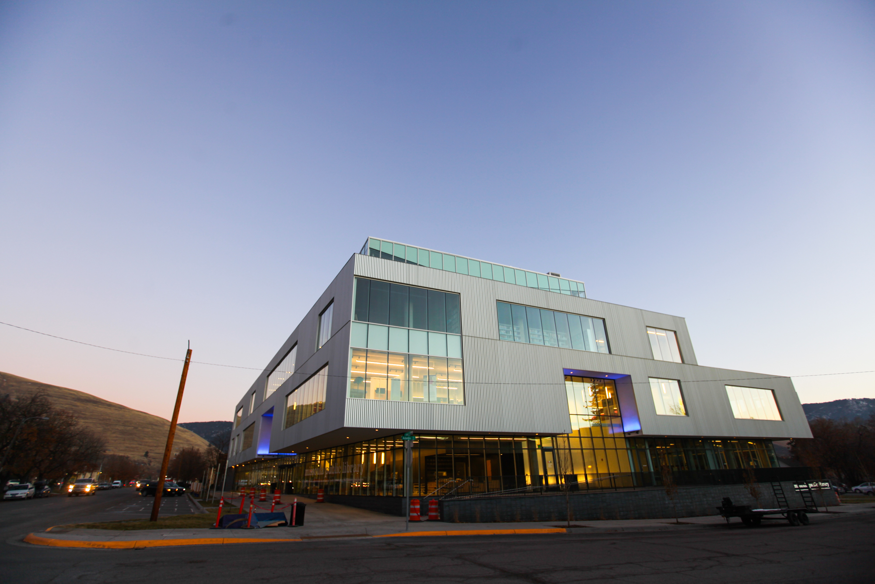
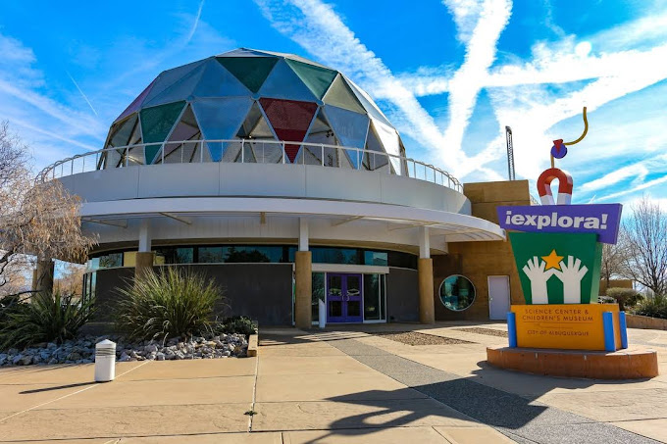

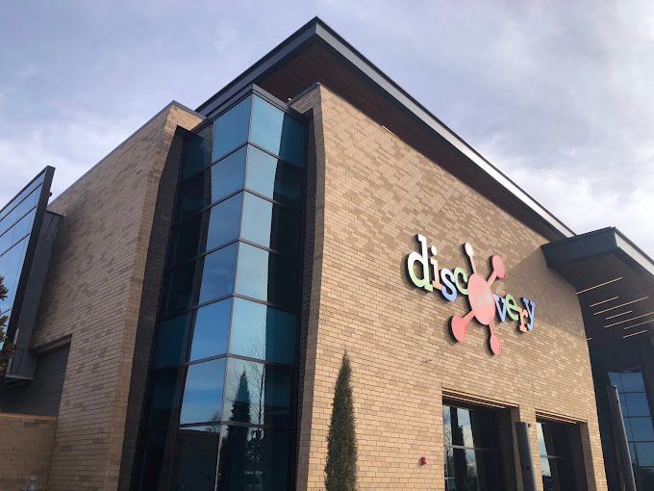

A model for inclusive, co-generation with A.I.
Discovery Lab, Tulsa with Urban Coders Guild
Explora, Albuquerque, with NM Mesa teen program
SpectrUM, Missoula, with SciNation
Notes:
Later this year, and pending funding, Discovery Lab, Explora, and SpectrUM will engage with their existing community partners serving teens to create OST activities that allow exploration of generative A.I. and a critical look at issues that arise around A.I use from the perspective of BIPOC youth. This can serve as one potential for encouraging a critical approach to generative AI use and provide a springboard for community engagement in the ISE landscape. A.I creates the potential for broad ethical and societal implications in equity and access.

Slide 27
Try out the activities
Detect Your Expressions
Teaching Your Silly Face
Control My Face
Try out Chat GPT
What Makes Us Human card game
What Makes Us Human card game

Slide 28
Questions and Discussion
Notes:
Image Credit: NISE Network
Image Description: Large group of professionals attending conference seated at tables listening to speaker and watching slideshow.

Slide 29
Table Conversations - Provocative questions
What else do YOU want to talk about during the conversation?
What questions does this bring up to you
We want to hear from as many people at tables as possible
What is biggest concern for your organization? Your region?
Where do you see this fitting into your offerings?
How do you feel about unfacilitated experience?

Slide 30

Thank You!

