Slide 1
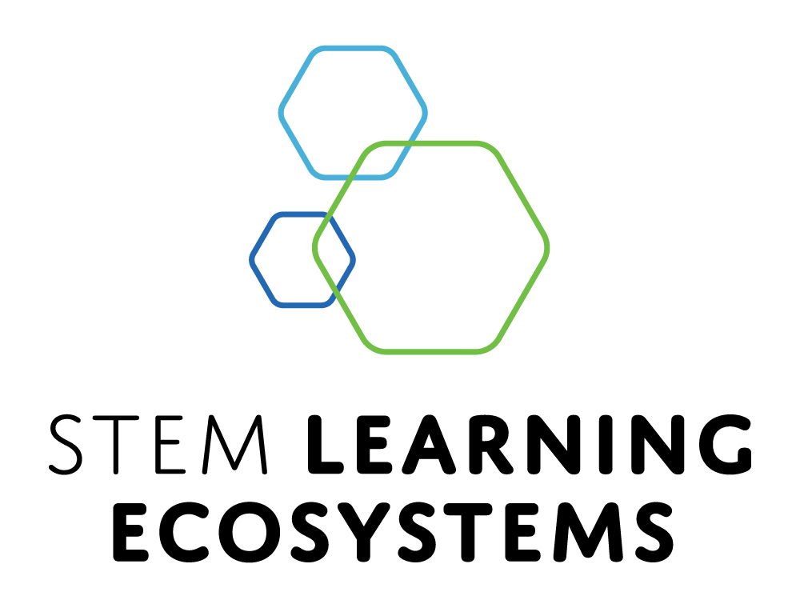
How Can Children's Museums Participate in STEM Learning Ecosystems
Catherine McCarthy, Arizona State University, NISE Network
Allison Anderson, Museum of Science, Boston, MA
Ali Jackson, Sciencenter, Ithaca, NY
Lynnsey Childress-Wimp, Discovery Lab, Tulsa, OK
Debbie Coppula, Children’s Museum of Pittsburgh, PA
Thursday, May 16, 3:45 p.m.–5:00 p.m.
Association of Children’s Museums InterActivity - May 2024 Conference

Slide 2
Catherine McCarthy
Arizona State University
& NISE Network
cmccarthystem@gmail.com

Slide 3

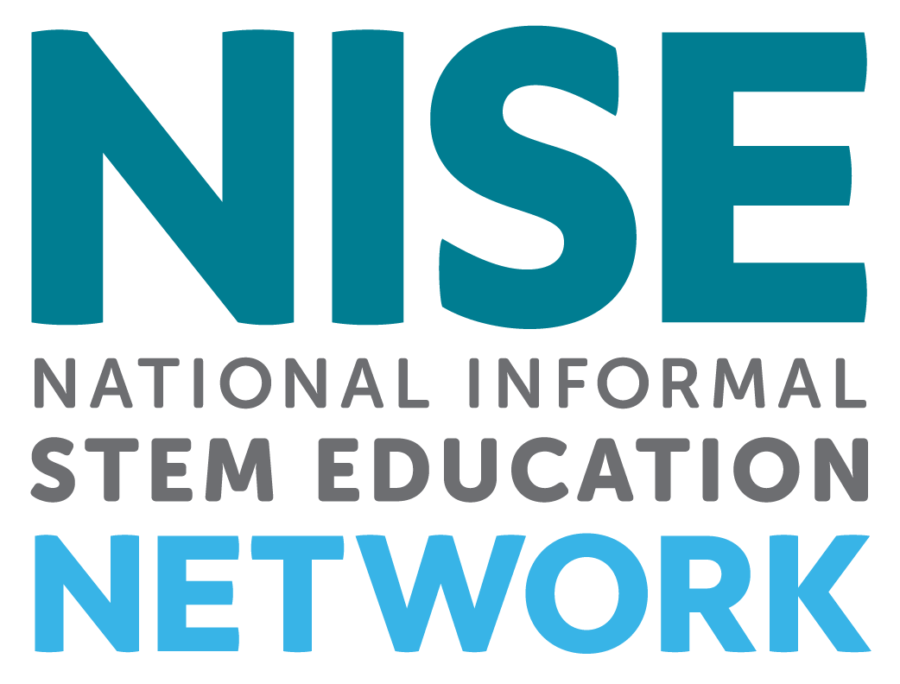
STEM Learning Ecosystems
Catherine McCarthy
Project Manager Senior - NISE Network
Arizona State University, Tempe, AZ
cmccarthystem@gmail.com
www.nisenet.org
Association of Children’s Museums InterActivity Conference - May 2024

Slide 4
Who is here?
How many of you are actively part of a STEM Learning Ecosystem?

Slide 5
Who is here?
Who is from an emerging museum or a museum without walls?

Slide 6
Who is here?
What size museum are you from?
  Small
  Medium
  Large

Slide 7
Our Plan for Today
Overview of STEM Learning Ecosystems (Allison Allison) (15 minutes)
Sciencenter, Ithaca, discussion activity (Ali Jackson) (20 minutes)
Tulsa OK experiences and partnerships (Lynnsey Childress) (10 minutes)
Pittsburgh PA, accessibility tools, development processes (Debbie Coppula) (10)
Conversation and Discussions (15 minutes)

Slide 8
Our Session Goals
Introduce and describe characteristics of STEM learning ecosystems
Participants will learn about real-life experiences, learn about relevant resources useful for community collaborations, and how to connect with existing ecosystems.
Participants will leave with tools to share with their organizations and community, how to connect with existing STEM learning ecosystems, and tools to take action for collaborating locally.

Slide 9
Allison Anderson
Museum of Science
Boston, MA
aanderson@mos.org

Slide 10
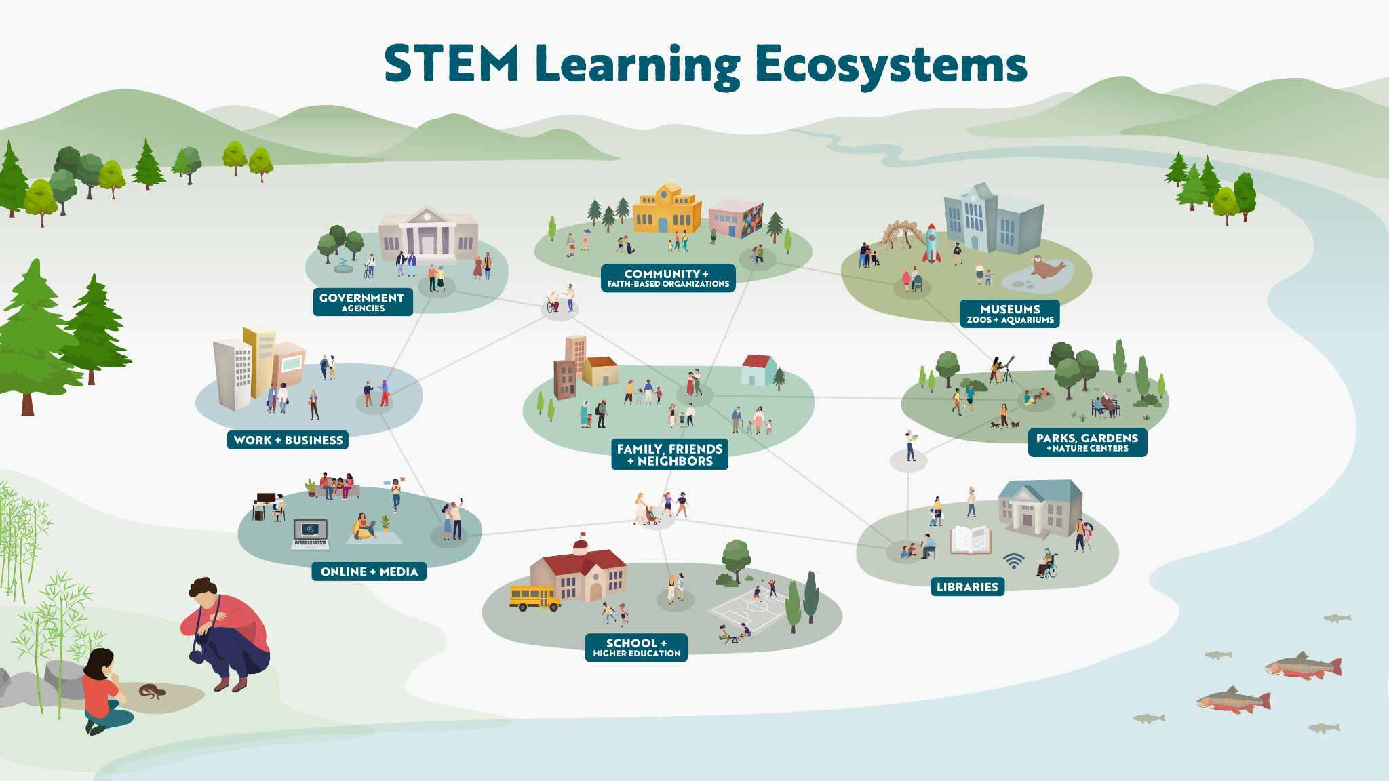
Notes:
[1:10]
I’m going to start our session with an overview of STEM learning ecosystems and what they are, and then share some of what we learned through the SciAct STEM Ecosystems Project.
In this project we have been using the lens of learning ecosystems to think about and depict our work. Learning ecosystems use the concept of a natural ecosystem to describe how organizations, projects, and people can work together toward the common goal of supporting STEM learning across their community. In our project, we looked specifically at how STEM learning ecosystems can be intentionally designed to broaden participation and support authentic learning in STEM. Our findings pull together literature reviews, conversations with members of these ecosystems, and team discussions, all of which helped us identify strategies that ecosystems use to engage their local audiences.
This is a picture of a generalized STEM learning ecosystem. It highlights some of the many different people and organizations who might participate in STEM learning and shows that learning can take place in many different settings and stages of life.

Slide 11


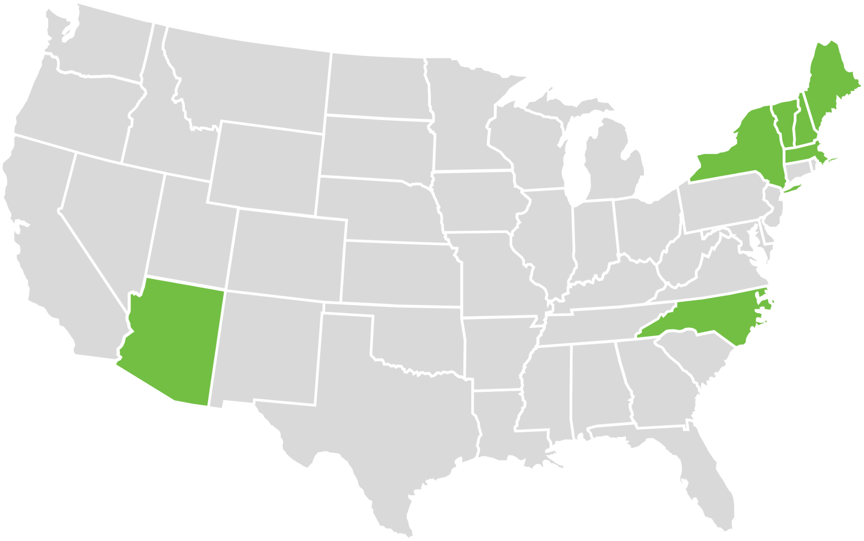


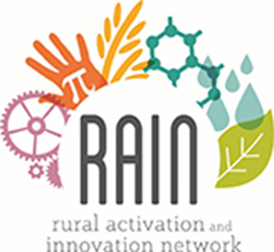
Learning from STEM learning ecosystems
Notes:
[0:40]
In our project, we talked to people from four projects, Arctic & Earth Signs in Alaska, Rural Activation and Innovation Network in Arizona, the Smoky Mountain STEM collaborative in North Carolina, and Learning Ecosystems Northeast across multiple states in that region.
All four of these projects primarily work in rural contexts, and three of them were originally funded by the NASA Science Activation program to expand access to NASA data and experts, the fourth was initially funded by NSF and now has funding support from NASA. They all coordinate place-based learning for their communities, whether that is helping to build new resources, adapt existing resources or opportunities, or connect people to existing resources.

Slide 12
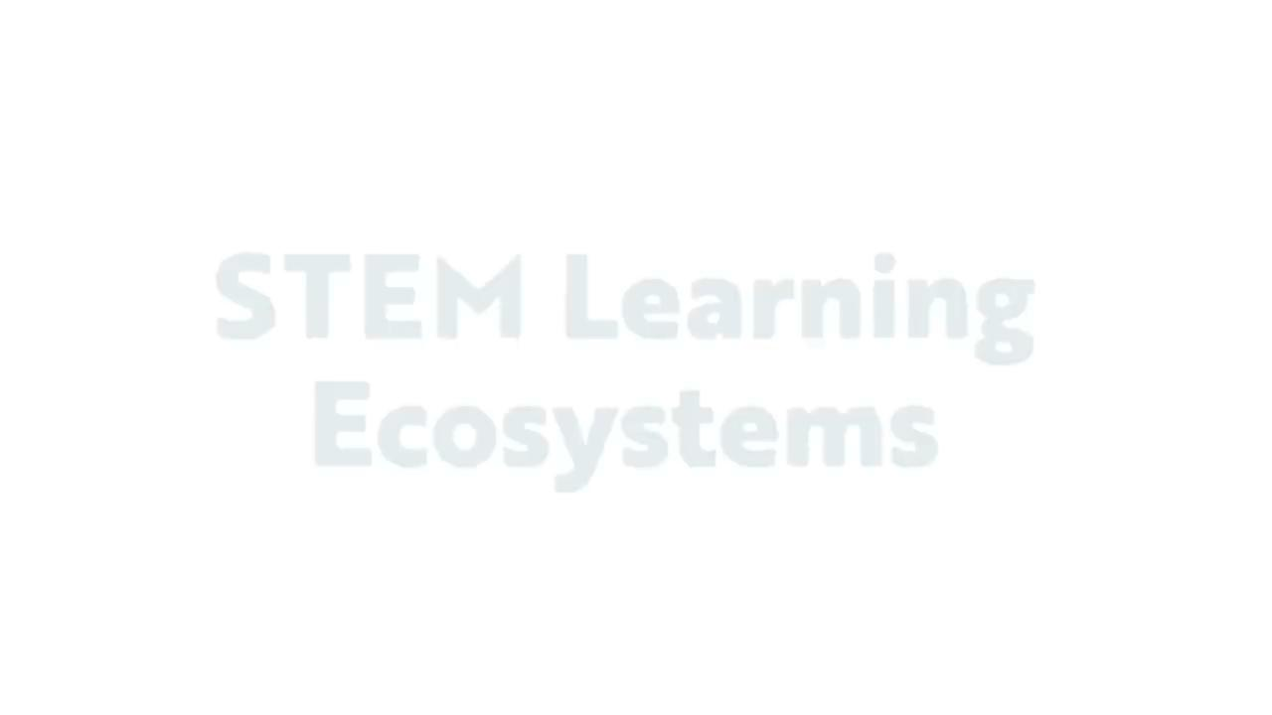
https://vimeo.com/877268398
Notes:
https://vimeo.com/877268398
[2 min] From this project, we have created a series of short videos introducing ecosystems and the strategies we learned about through the project. I’m going to share just one of these videos, as it very nicely defines STEM learning ecosystems. This, and all of our videos that also contain a lot of rich, real-world examples, will be linked at the end of today’s presentation.

Slide 13
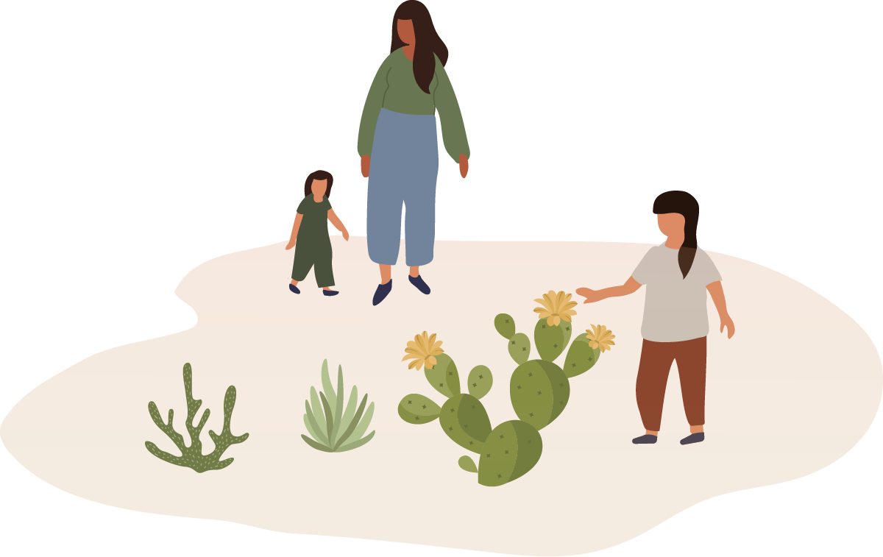
STEM Learning Ecosystems
KEY IDEAS
Community
STEM learning ecosystems are built and sustained through intentional practices; thrive through reciprocal relationships; and are grounded in their geographic and cultural context.
Notes:
[0:30]
Our first big finding strove to align literature with practical experience, and is used to describe what an effective STEM learning ecosystem is.
[Read Finding]

Slide 14
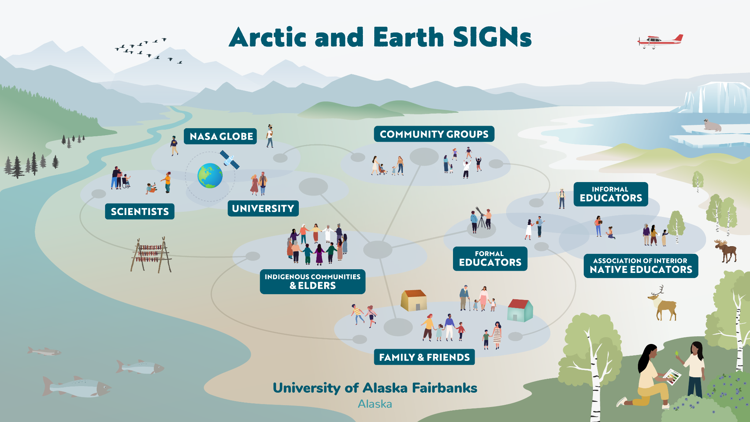
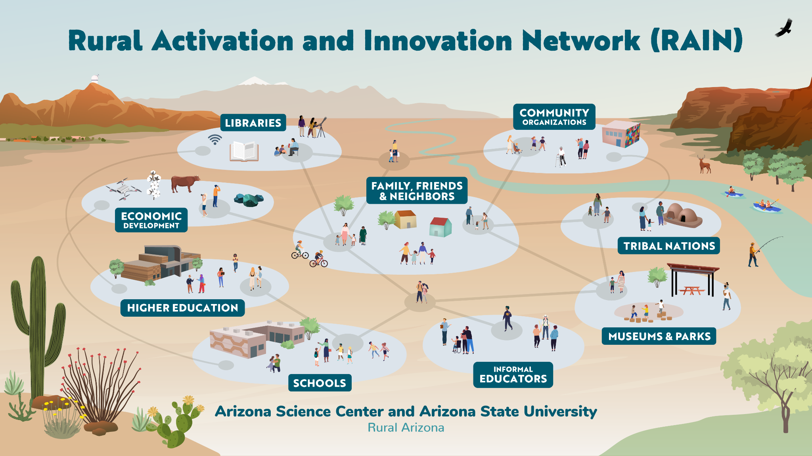
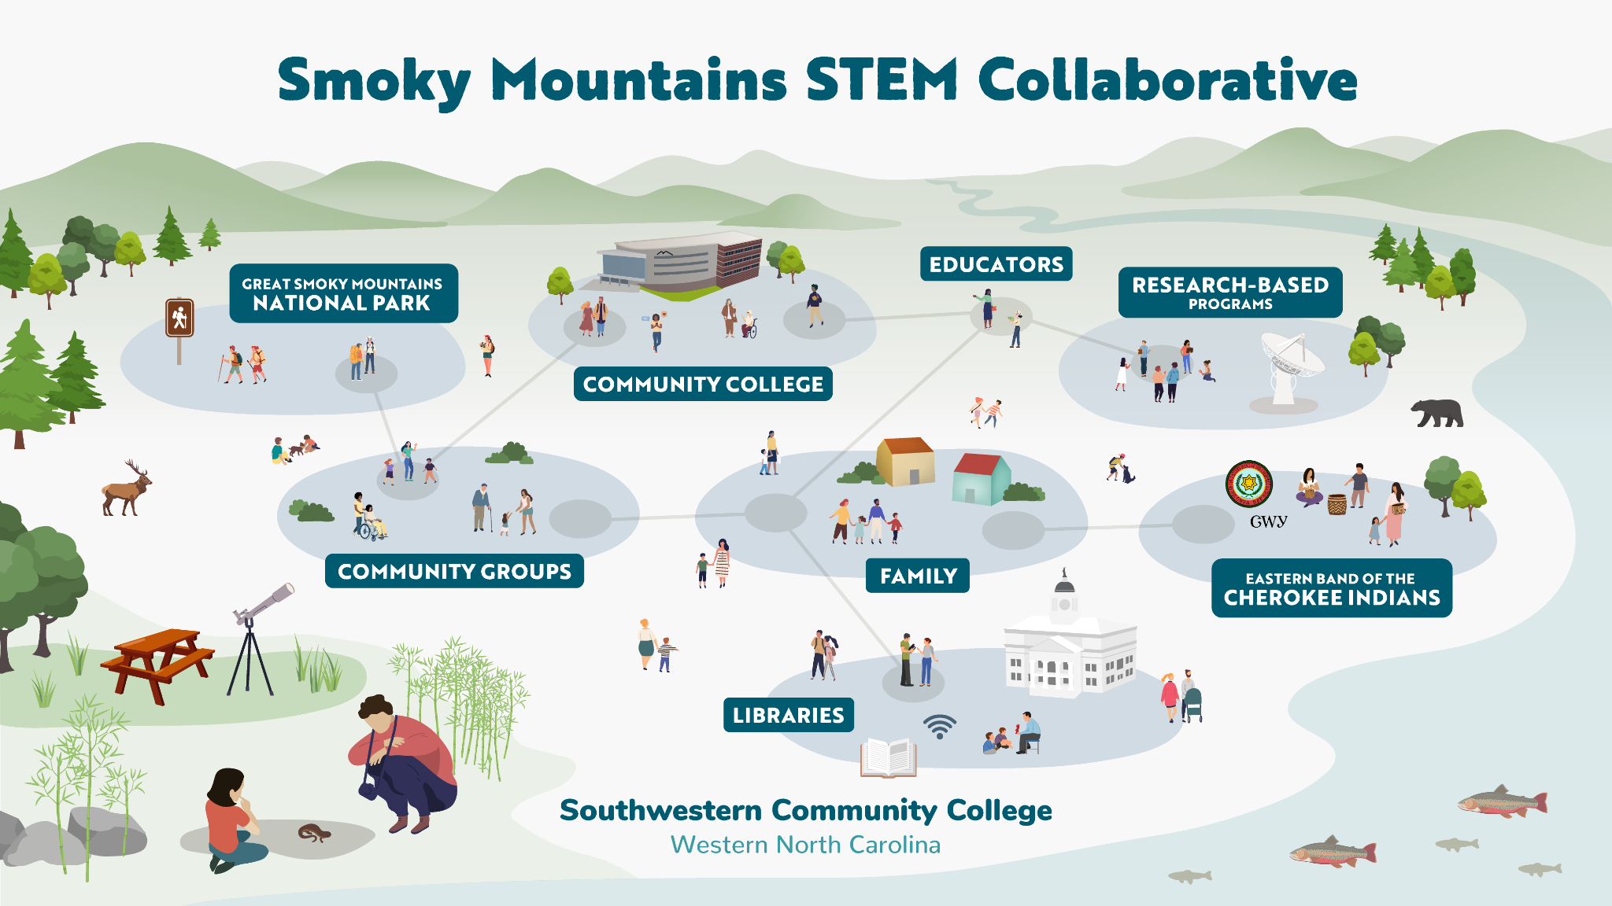
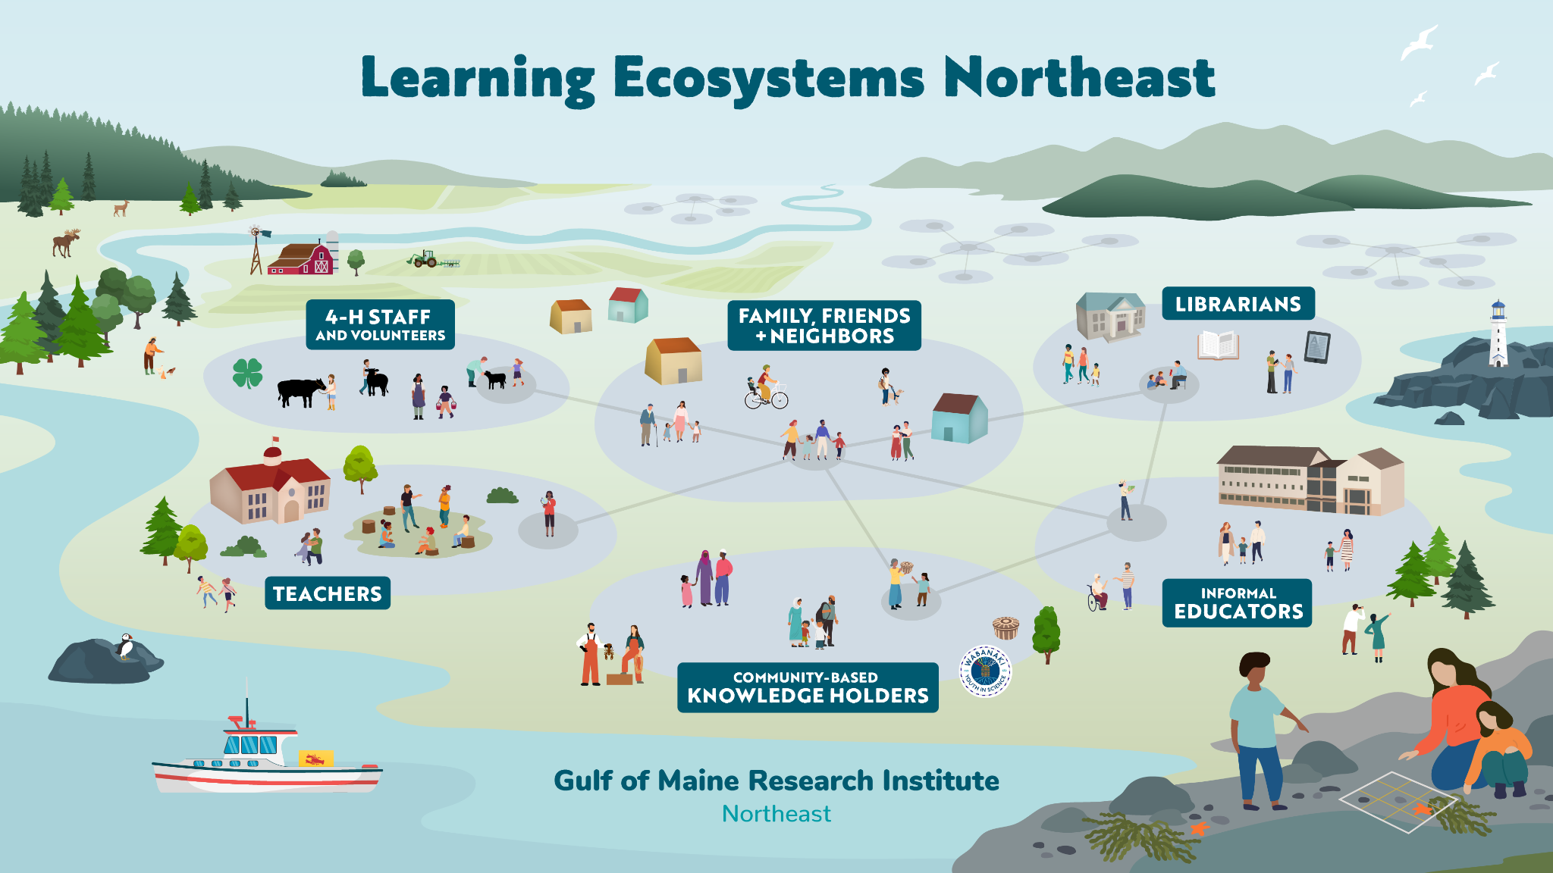
Notes:
[2:00]
We have also created simplified illustrations to communicate the importance of partnerships and place for the four STEM learning ecosystems that participated in our project. These represent the different ways the projects have used ecosystem structure, intentionally adapting the structure to respond to their community’s priorities, building on their assets, and creating equitable opportunities to participate in STEM.
Here are some examples of how each one is responding to priorities in their community:
Arctic & Earth SIGNs is located in Alaska, and builds on previous work with GLOBE. They are focused on braiding Indigenous and western science around locally relevant topics.
LENE is seeding local ecosystems across New England and New York, and does work around supporting educators to engage audiences with place-based learning experiences, and Ali will be sharing more about that particular project today
SMSC is located in North Carolina, and does work creating pathways for people underrepresented in STEM to excel in higher education and careers.
RAIN is in Arizona, and they respond to local context through building hyper-local ecosystems across the state, with a shared goal to of growing a STEM-connected workforce and provide opportunities for communities across rural AZ to engage with STEM learning.

Slide 15

Diversity, Equity, Accessibility,
Inclusion, and Belonging (DEIAB)
Diversity refers to the ways in which people are similar and different, including identities, social positions, lived experiences, values, and beliefs.
Equity means providing different people with fair access to resources so they can participate fully in society and meet their own needs.
Accessibility means accommodating everyone along the continuum of human ability and experience.
Inclusion is valuing diverse ideas, backgrounds, and perspectives and creating an environment of involvement, respect, and connection.
Belonging refers to the feeling of being connected to a community, place, or situation, and being supported and welcomed there.
Notes:
One of the areas were interested in was understanding the work these projects did to support broadening participation, which ultimately meant we looked at it through the lens of diversity, equity, accessibility, inclusion, and belonging. Just so we are on the same page, I want to share the definitions we are using around DEAIB, most of which were drawn from an article by Garibay and Olson.
Diversity, Equity, Accessibility, and Inclusion definitions drawn from Garibay & Olson (2020).
Garibay, C. & Olson, J. (2020). CCLI National Landscape Study: The state of DEAI practices in museums. Cultural Competence Learning Institute

Slide 16
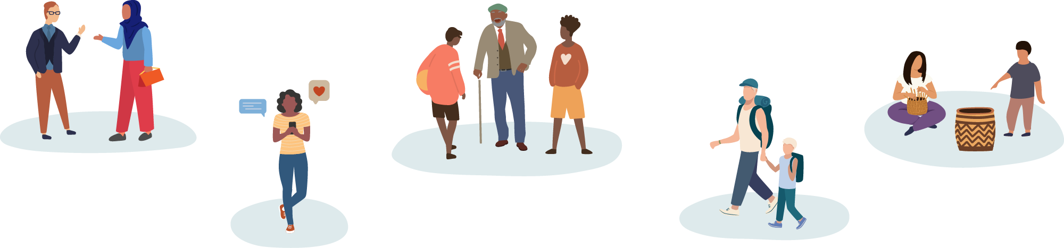
Diversity
Diversity refers to the ways in which people are similar and different. This includes identities, social positions, lived experiences, values, and beliefs.
Notes:
Definition from Garibay, C. & Olson, J. (2020). CCLI National Landscape Study: The state of DEAI practices in museums. Cultural Competence Learning Institute

Slide 17
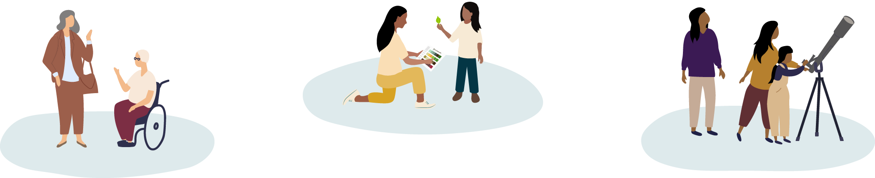
Equity
Equity means providing different people with fair access to resources so they can participate fully in society and meet their own needs.
Notes:
Definition from Garibay, C. & Olson, J. (2020). CCLI National Landscape Study: The state of DEAI practices in museums. Cultural Competence Learning Institute

Slide 18
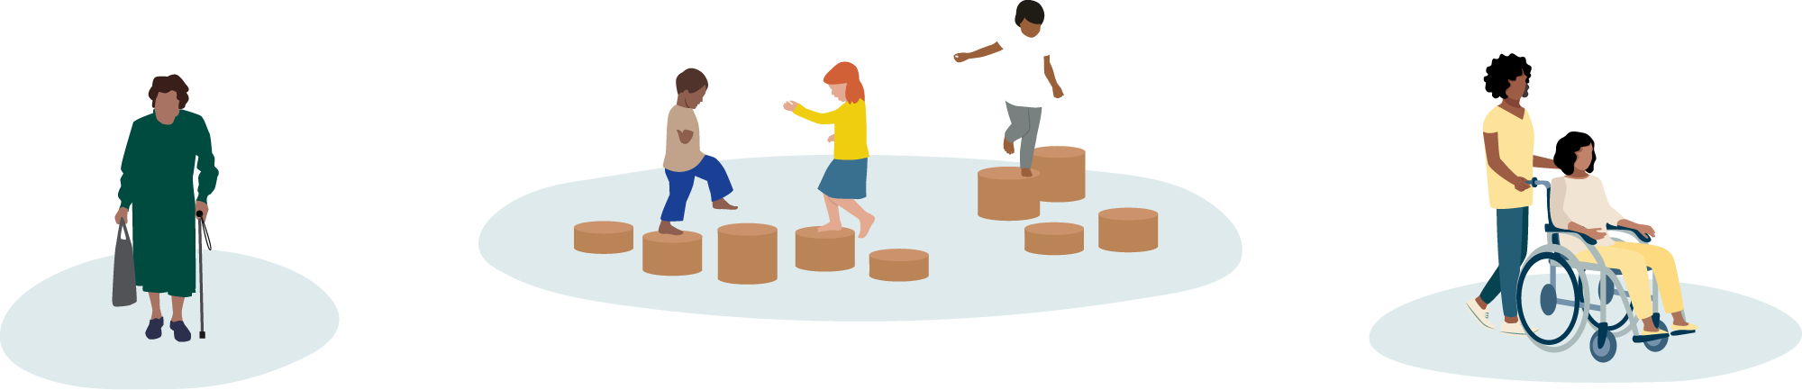
Accessibility
Accessibility means accommodating everyone along the continuum of human ability and experience.
Notes:
Definition from Garibay, C. & Olson, J. (2020). CCLI National Landscape Study: The state of DEAI practices in museums. Cultural Competence Learning Institute

Slide 19
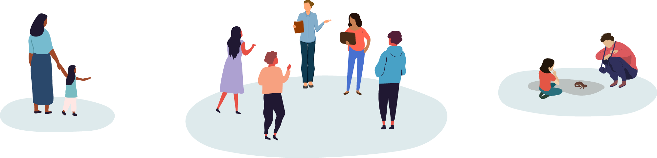
Inclusion
Inclusion is valuing diverse ideas, backgrounds, and perspectives and creating an environment of involvement, respect, and connection.
Notes:
Definition from Garibay, C. & Olson, J. (2020). CCLI National Landscape Study: The state of DEAI practices in museums. Cultural Competence Learning Institute

Slide 20
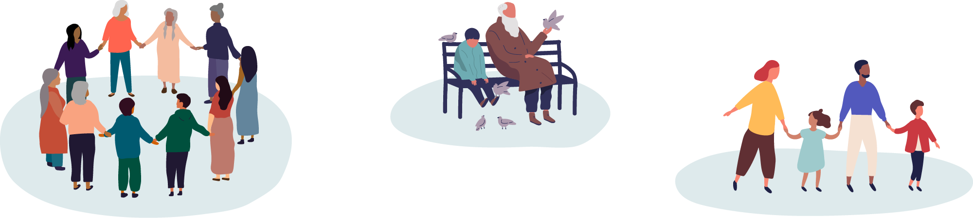
Belonging
Belonging refers to the feeling of being connected to a community, place, or situation, and being supported and welcomed there.
Notes:
Definition developed by the SciAct STEM Ecosystem project

Slide 21
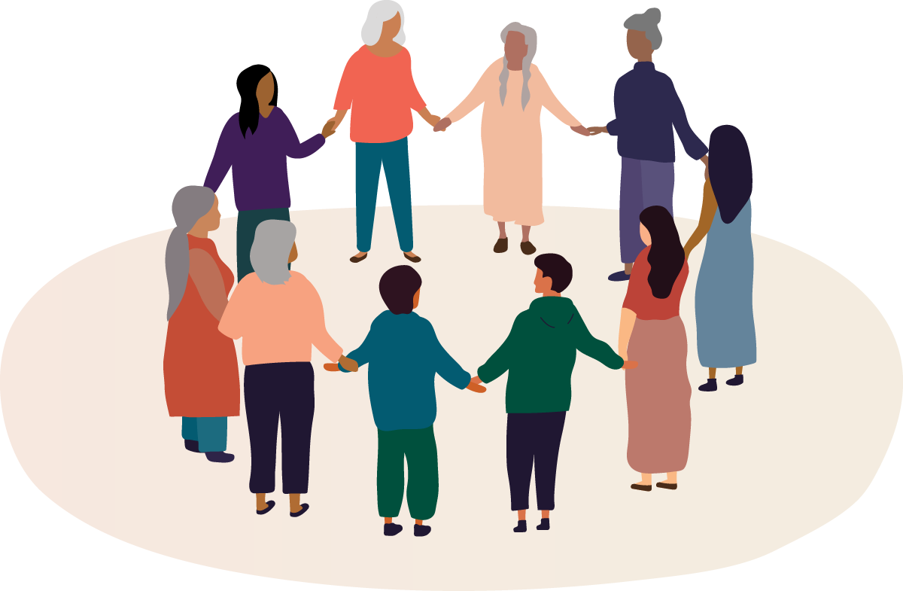
STEM Learning Ecosystems
KEY IDEAS
Belonging
Ecosystems can broaden participation by cultivating genuine relationships among individuals and organizations; creating a flexible and transparent culture; sharing programming and resources; and prioritizing diversity, equity, accessibility, inclusion,
and belonging.
Notes:
So, within the context of STEM learning ecosystems, we saw that the projects designed to broaden STEM participation center diversity, equity, accessibility, and inclusion to create a sense of belonging.
[Read Findings

Slide 22

Structure and design
STEM learning ecosystems support diversity, equity, accessibility, inclusion, and belonging (DEIAB) through their:
Organizational structures and culture
Relationships and communication
Resources and activities
Notes:
ALLISON
WE know that these are not unique to ecosystems, in fact can be applied to any similar partnership; however are very important to the supporting relationships within the context of ecosystems.
So, when thinking about the key idea from the last slide, we see that:
The organizational structures and culture that the main project team cultivates impacts their work with partners and public audiences. And centering DEAIB at an organizational level means prioritizing flexibility and respecting both individuals and organizations.
Healthy relationships are important for any partnership, but when centering DEAIB it is important to commit the time necessary to build genuine relationships and making people feel they belong. Fostering strong relationships means showing up, being actively engaged, and being part of the communities they are working with.
When centering DEAIB in a learning ecosystem, being open and sharing access to people, organizations, information, programming, and other resources is important not only to reaching public audiences, but also to supporting open organizational cultures and building mutually beneficial relationships. Openly sharing resources can support non-transactional relationships, where all groups in and encourage multi-directional learning.
All of our projects do their work through sustained funding and commitment of people to maintain relationships and the work they do, in order to build momentum and continuing to provide opportunities for learners.
[Learning Ecosystem Northeast has embraced an organizational culture that prioritizes flexibility in communication and

Slide 23
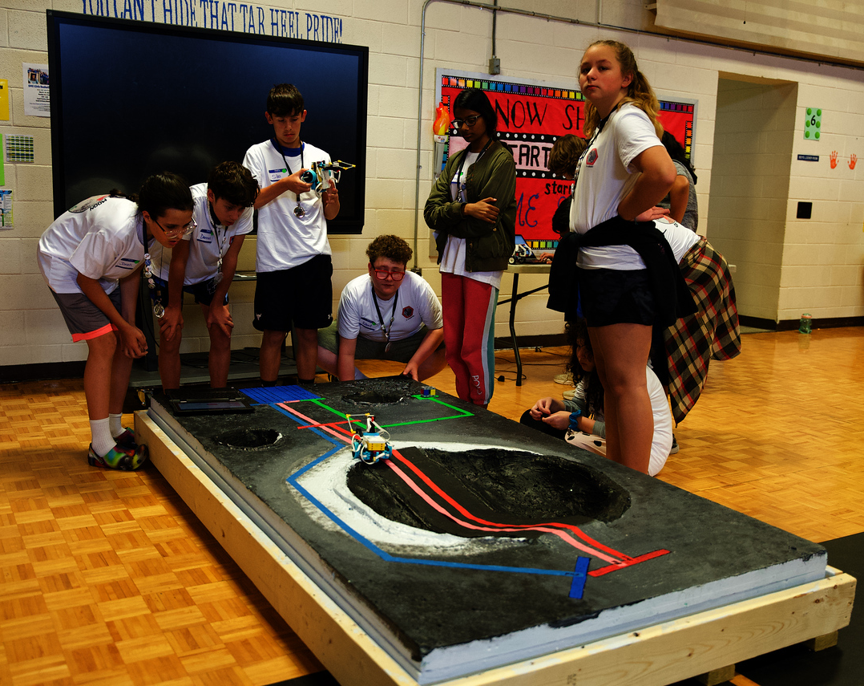
Ecosystem Example
Smoky Mountain STEM Collaborative continually shows up in their community to
build relationship over time
Attend one-off events to build relationships
Continually show up in the community
(e.g. Art Walk, teacher professional development, STEAM Night, etc.)
Drop-in activities at the Boys & Girls Club developed into a relationship that supported a robotics club
Notes:
ALLISON
One example of how building relationships and sharing resources can look in action, example we have is from Smoky Mountains STEM Collaborative, reflecting on how they work to build relationships by continually showing up in the community. This can mean starting through one-off events or programs, and then continually showing up at events in the community and interacting with people. They shared an example about how doing some drop-in activities with Boys & Girls Club, which then developed into a relationship where they helped support a robotics club together.

Slide 24
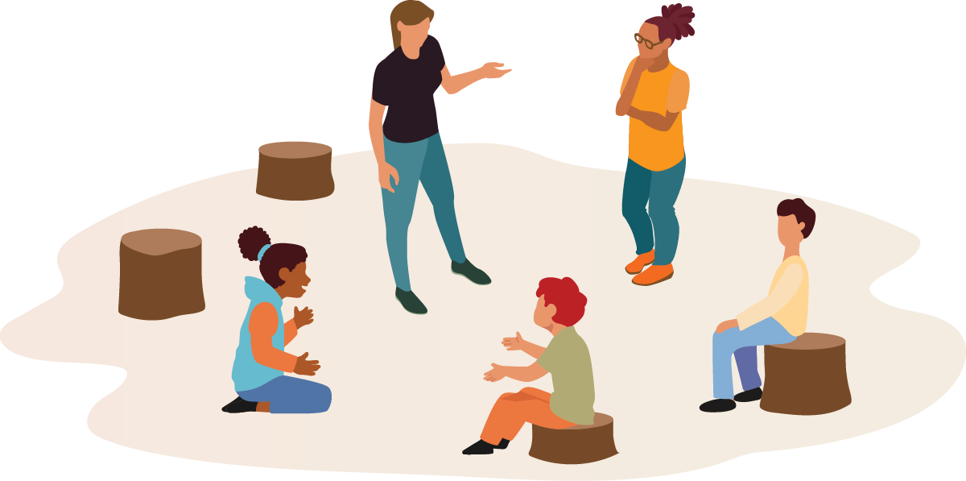
STEM Learning Ecosystems
KEY IDEAS
Engagement
Authentic STEM engagement starts with understanding what is relevant to learners and communities, then creates connections to content through active learning experiences.
Notes:
And the last key idea I want to share is about relevant engagement with their communities.
Providing opportunities for authentic STEM engagement starts with understanding what is relevant to learners and their community, then connecting content and experts through experiences that actively engage those learners.

Slide 25
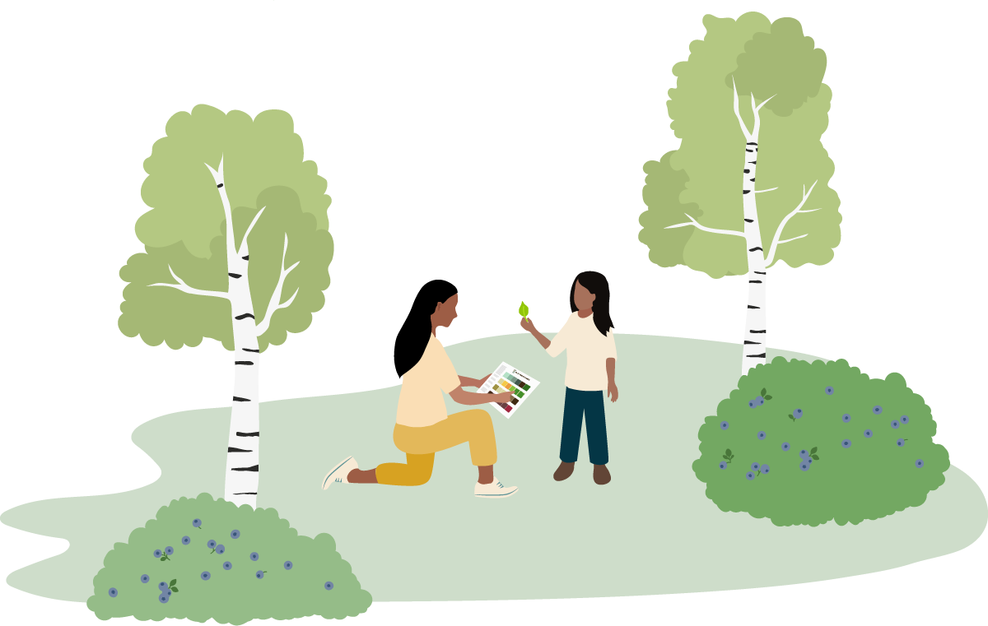
Authentic STEM Engagement
Relevance
Connects to identity and culture, promotes a sense of belonging, and fosters inclusion
Notes:
When we first started to look at authentic STEM learning, we artificially broke that into three areas: what content is included, how that content is shared, and why the content matters. And while we talk about those areas separately, they are really deeply interconnected - so we think of them as perspectives for approaching “authentic” engagement, not separate ways to create an authentic experience.
Starting with Relevance, we consider why the content is being shared. Particularly when the focus is on broadening participation and expanding access to STEM, it is important to connect learners to relevant experiences through consideration of personal identities, community identities, and cultural perspectives. This helps promote a sense of belonging and fostering inclusion.

Slide 26
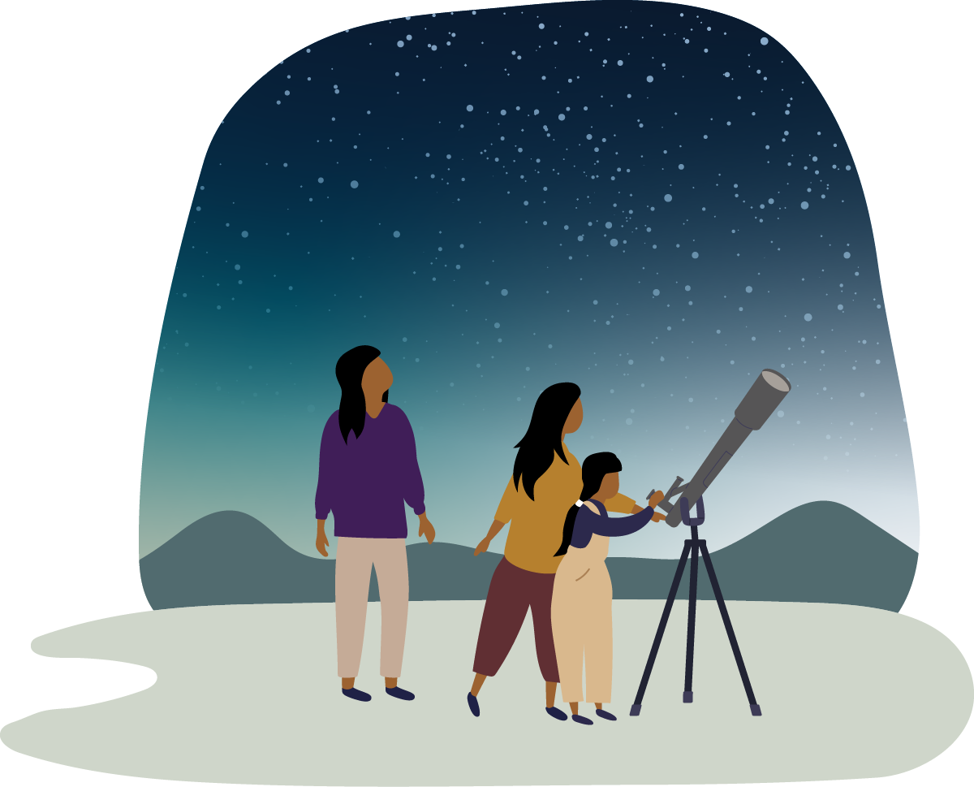
Authentic STEM Engagement
STEM content
Includes community observations, scientific data, assets, and a range of expert perspectives
Notes:
Next, looking at what content is included, STEM content includes community observations, generated by participants through citizen or community science projects or observations over time, scientific data or assets from trusted organizations like NASA or NOAA. Content also include the experts, whether that is someone who is formally recognized as a scientist, or people who have deep expertise in a topic area, like Indigenous Elders, fishermen, and farmers working closely with the land.

Slide 27
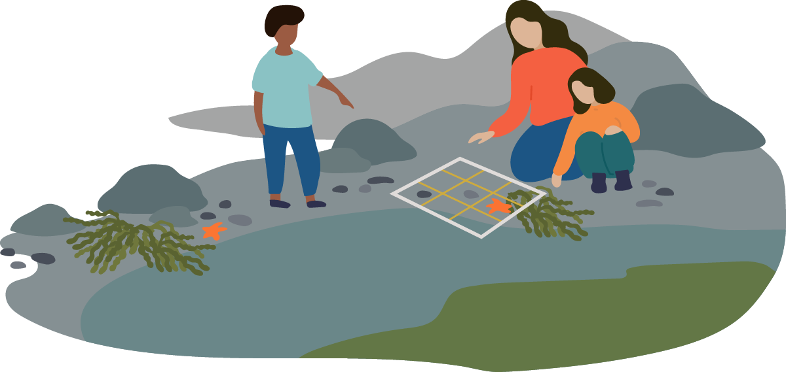
Authentic STEM Engagement
Experience design
Supports active learning, encourages dialogue, and builds on community strengths
Notes:
And lastly, how is that content being shared. People in the ecosystems we worked with emphasized the importance of recognizing what people already bring to the table and constructing learning experiences that build on their knowledge. Experienced should be designed to support active learning, encourage dialogue, and build on community strengths, which often can look like hands-on or applied learning.

Slide 28
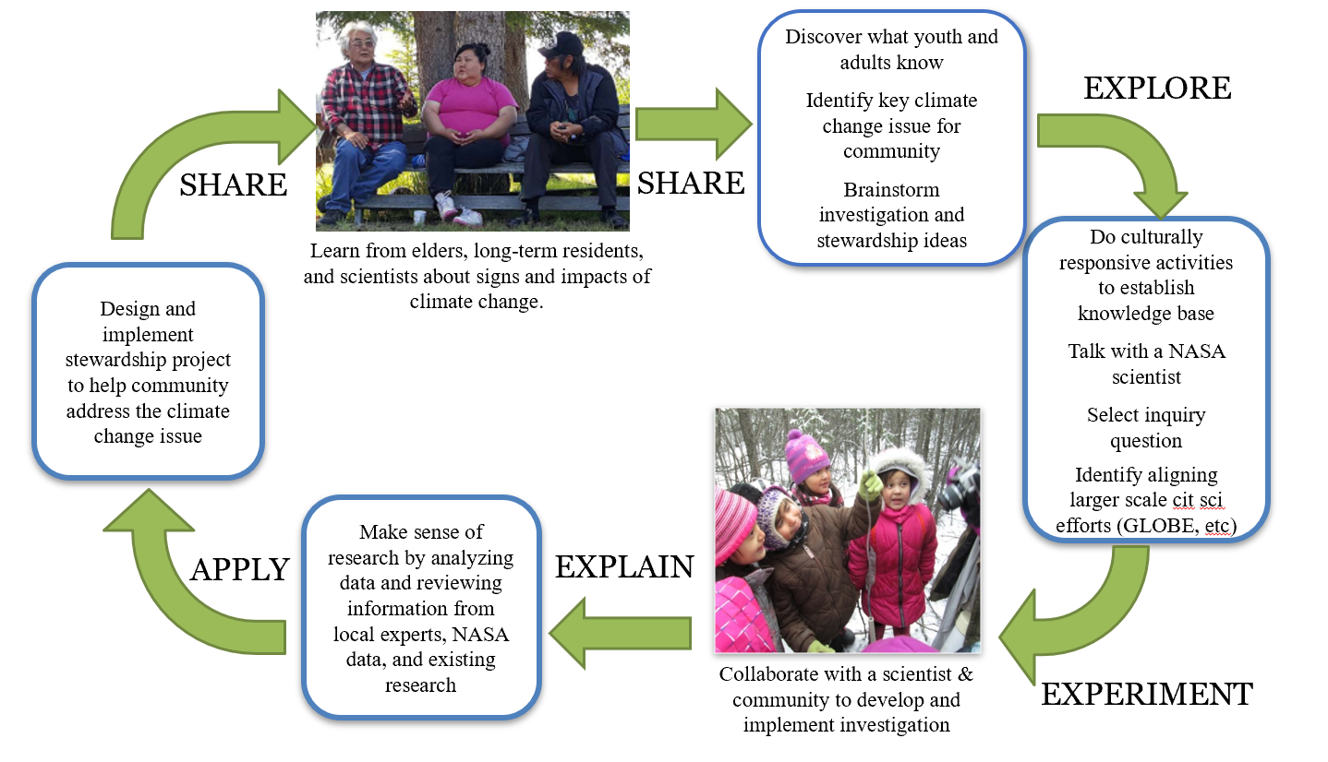
Ecosystem Example
Arctic & Earth STEM Integrating GLOBE & NASA
Designing for generational and cultural diversity: A culturally sustaining learning framework:
Starts with learning from Elders, long-term residents, and scientists
Embraces multiple ways of knowing
Braids together Indigenous knowledge and western science
Figure modified from Stephens 2003 and OLCG 2002; published in Spellman et al. 2018
Notes:
ALLISON
In our second example, the Arctic & Earth SIGNs project intentionally designs for generational and cultural diversity though their framework. Their work embraces multiple ways on knowing, braiding together Indigenous knowledge and western science. In this framework, they start by recognizing and honoring Indigenous knowledge.
I’m going to wrap up here, and pass you to Ali to hear about some STEM learning ecosystems in practice.

Slide 30
Ali Jackson
Sciencenter
Ithaca, NY
ajackson@sciencenter.org

Slide 31





Ithaca’s Connected Learning Ecosystem
Fostering professional relationships around climate education and data literacy

Slide 32
Learning Ecosystems Northeast
LENE is an network of Connected Learning Ecosystems committed to empowering the next generation of climate stewards by:
Connecting in and out of school educators
Building climate and data literacy
Fostering strong science interest, identity, and agency
Centering rural, Indigenous, Immigrant & Refugee communities
Highlighting the relevance of NASA science to local communities

Slide 33
Shared Core Principles
Youth need as many entry points into STEM as possible
Important STEM learning happens both in and outside of the classroom
The adults surrounding youth – their educators and communities – are responsible for connecting learning experiences
Place-based climate change education has particular affordances for teaching data and modeling that can empower learners toward a wide range of careers
The reach of NASA’s robust scientific missions provides global context for local, place-based investigations
Centering knowledge from Indigenous, Immigrant/Refugee and rural communities is critical to youth STEM identity development

Slide 34
Ithaca’s Connected Learning Ecosystem (CLE)
History of collaboration
Discovery Trail & Kids Discover the Trail Field Trips
Ongoing Museum & Community Partnerships
Participants
libraries, our local land trust, state parks, community-based organizations, community science organizations, museums (art, historical, science, natural history), 4H, classroom
teachers (science & social studies)

Slide 35
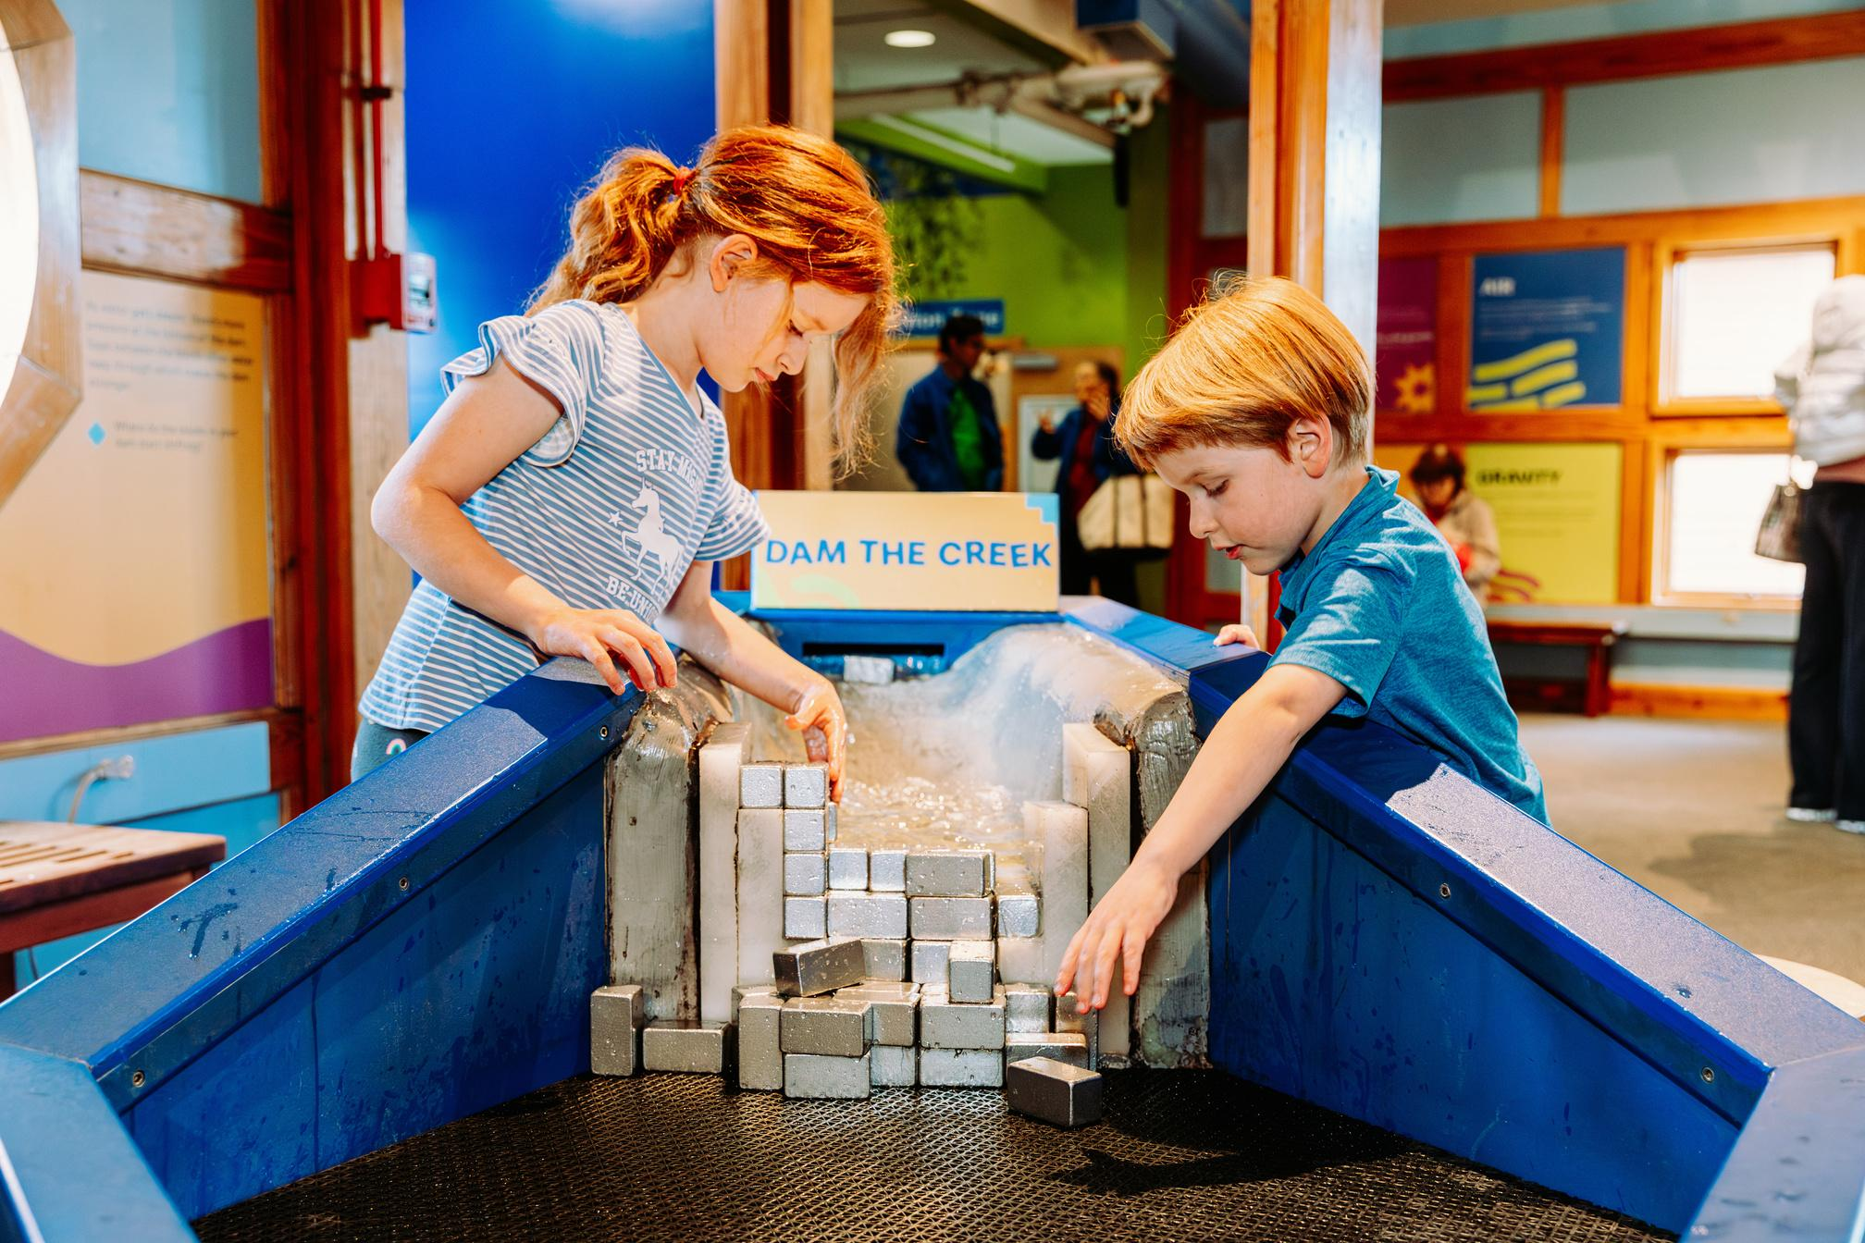
Ithaca’s Connected Learning Ecosystem Priorities
Relationship Building
Mission Aligned & Sustainable Programming
Connected Experiences
“Doing Work Together”

Slide 36
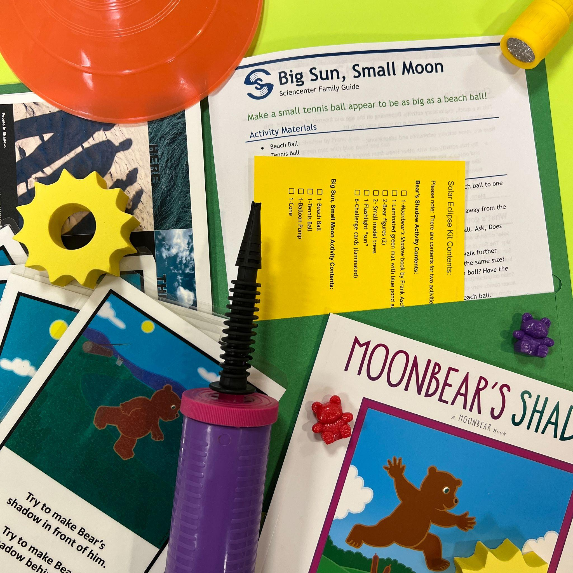
Museum & Library Partnerships
Summer Reading Program
Librarian Solar Eclipse Training
Co-developed Family Science Kits
Family Memberships & Museum Comeback Passes
This project was made possible in part by a grant from NASA’s Universe of Learning
Notes:
Example of doing work together…..

Slide 37
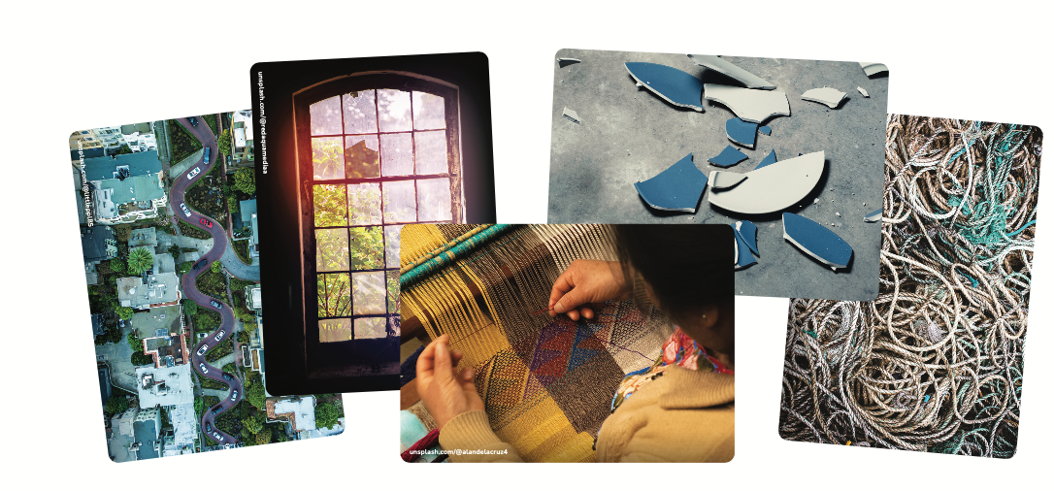
What is Learning?
Conversation Starter
Learning takes many forms and occurs in different settings across a person’s lifetime.
1. First, look through the pictures and choose one that relates to how you think about learning.
2. Now, show your picture to the others in your group and explain why it represents learning to you.
https://www.nisenet.org/learningcards
Notes:
These images provide an opportunity for a group to reflect on and share what they feel best
represents learning. This activity can help professionals recognize that learning takes many
forms and occurs in different settings across a person’s lifetime.
Group size: Activity is ideal for a group of 8-10 people per deck of cards, but can be used with as few as 2 People.
This icebreaker-style activity is intended to help professionals articulate what learning looks like
and where and when it takes place. This can help surface different understandings and goals
that inform how professionals approach their engagement and education work. You can use this
activity in a variety of settings. For example, use the activity at internal project meetings to help
teams achieve a common vision and understanding. Or at events where multiple projects,
organizations, or initiatives are sharing what they do and why.
Introduce the activity by explaining that its purpose is to provide a way to reflect on and share
different perspectives on learning. Participants can choose a printed photo card or pull up an
image of their choosing on their phone. Emphasize there are no right or wrong answers in this
activity. Be sure to allow time for participants to share and discuss their ideas.

Slide 38
Lynnsey Childress-Wimp
Discovery Lab
Tulsa, OK
lchildress@discoverylab.org

Slide 39

Discovery Lab
Tulsa Regional STEM Alliance
Opened in 2013
Fundraising and programming
Building community
Hands-on STEAM experiences mainly for K-6th
One of many partners in the alliance
Opened in 2013
Fundraising and promoting programming
Building community
Creating access to STEAM experiences for all learners
Hub for the work being done
300 Partners
69 school districts

Slide 40
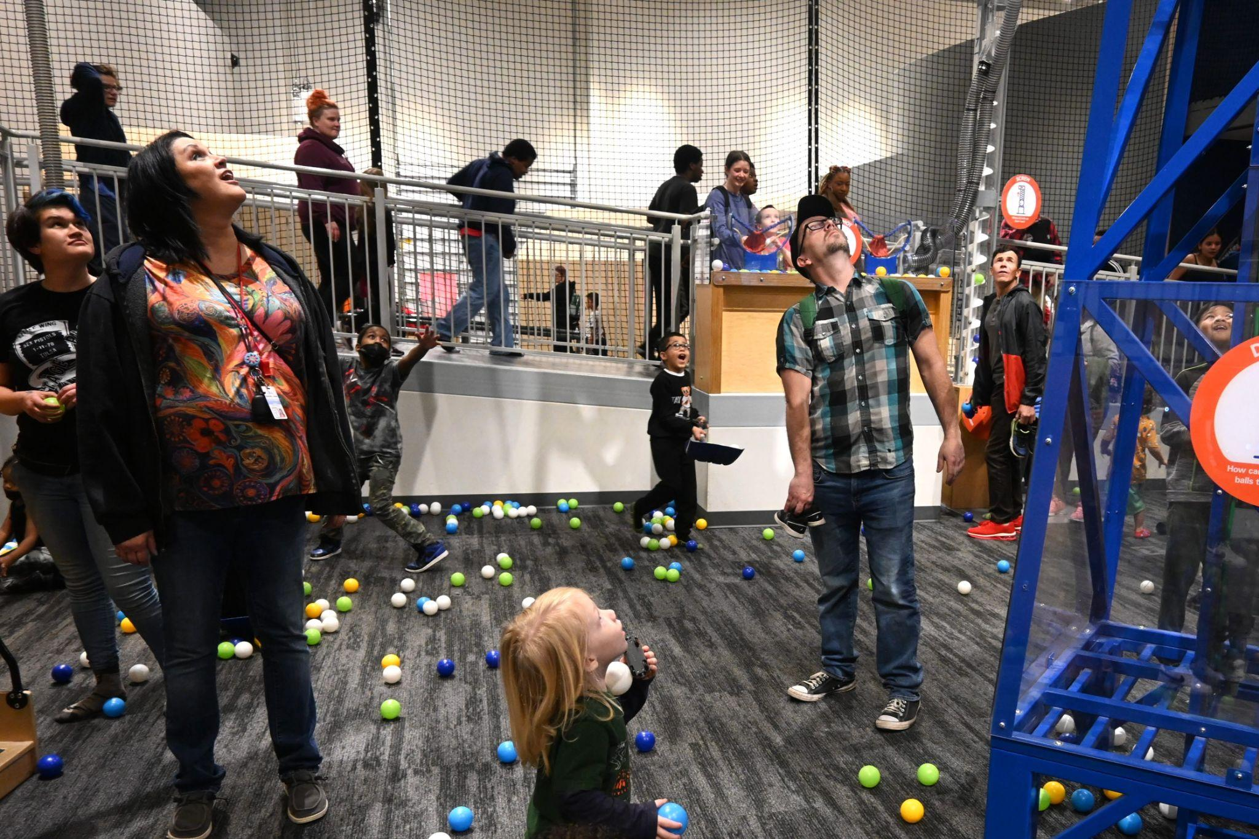
Co-Creating Opportunities
During the pandemic approx. 25,000 kits assembled by Discovery Lab and delivered by TRSA
Professional development opportunities for teachers
Space Week
  Field Trips
  Community Night
  Keynote Speakers
Connection to other community-based events
  Meet people where they are

Slide 41
Leveraging Resources
Grants to schools for Discovery Lab programming
  Family STEAM Nights
  After-school programming
Harvard PEAR Evaluation
Mutual benefit
  TRSA convenes community partners and helps to plan events
  Discovery Lab includes TRSA in planning our events to keep others connected

Slide 42
Debbie Coppula
Children’s Museum of Pittsburgh
Pittsburgh, PA
dcoppula@pittsburghkids.org

Slide 43
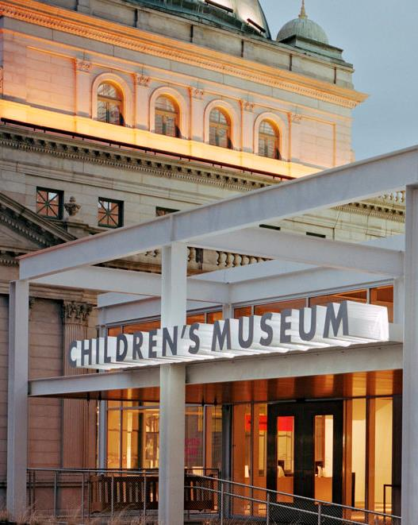

Children’s Museum of Pittsburgh: Advancing the STEM ecosystem through authentic partnerships

Slide 44
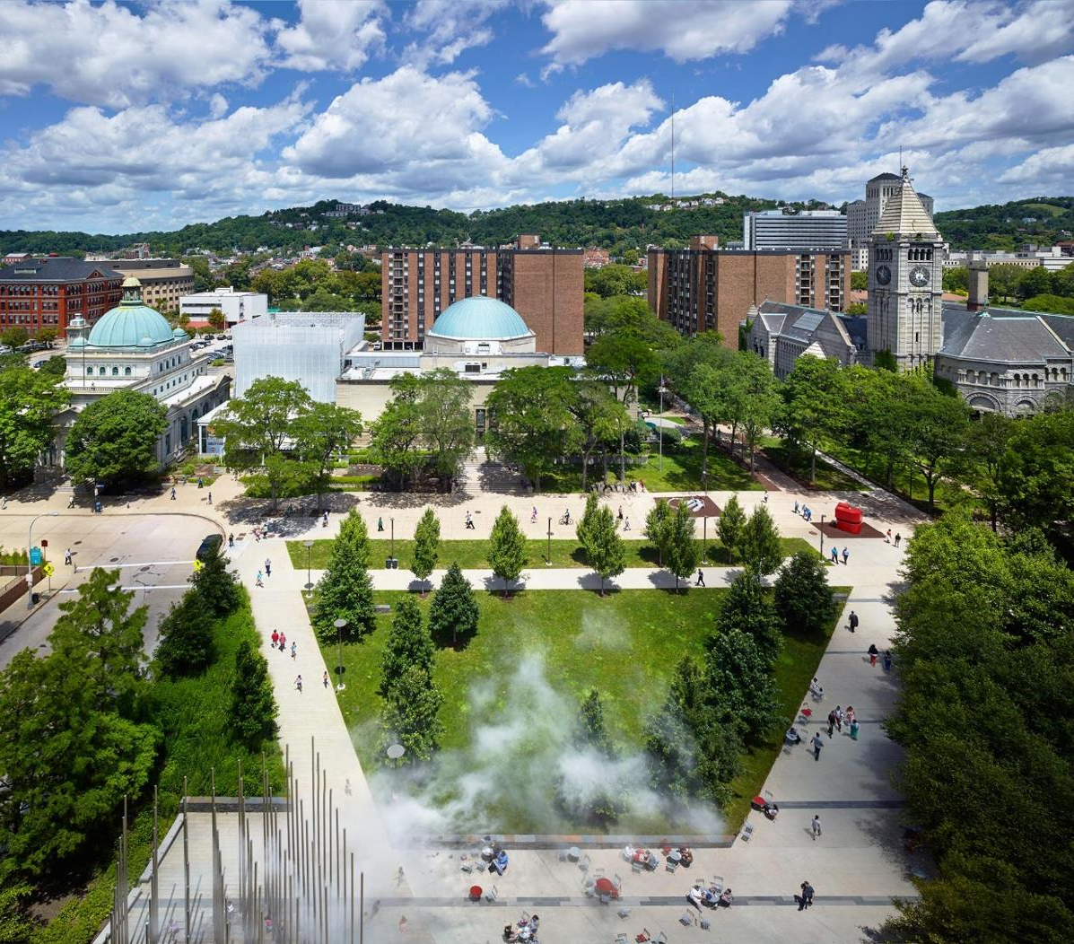
Carnegie Library, 1890.
Opened 2019.
Post Office, 1897.
Opened in 1983.
Lantern, 2004.
Opened in 2004
Buhl Planetarium, 1939. Opened in 2004
The largest cultural campus for children in the U.S.
Buhl Community Park.
Restored 2015.

Slide 45

The mission of Children’s Museum of Pittsburgh is to provide innovative and inclusive museum experiences that inspire kindness, joy, creativity and curiosity for all learners. ​
​
Our vision is to transform education.

Slide 46
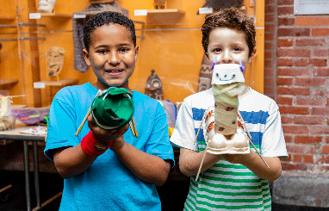
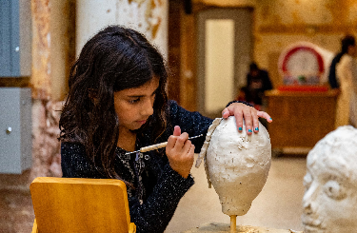
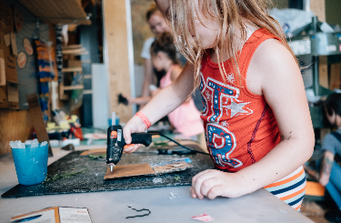
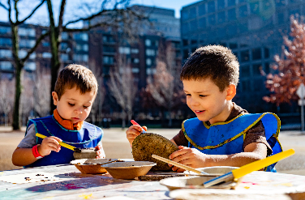
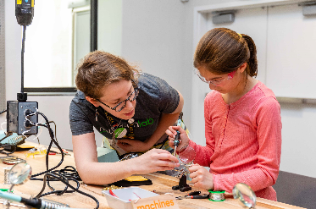
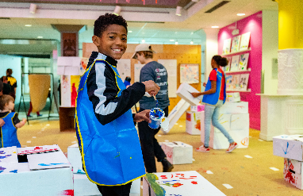
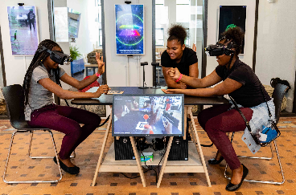
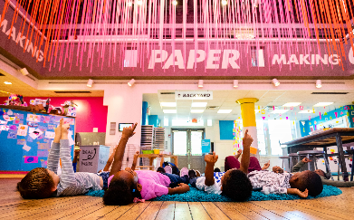
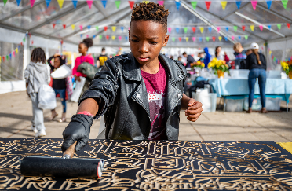
Two STEM Partnerships that apply our approach:
Play with real stuff
Art, artists, and design
Focus on art and making
Learning science research

Slide 47
example 1:
accessible art & making

Slide 48

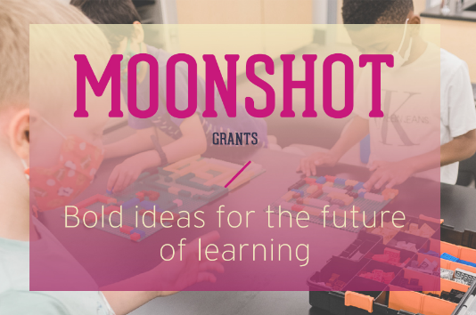
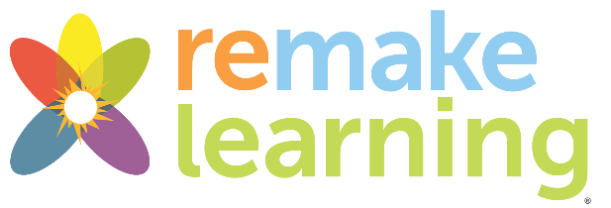

Accessible Art & Making
One-year project combining three focus areas of the Museum’s work:
Art & making education
Universal Design and Universal Design for Learning
Justice, Equity, Diversity, Accessibility & Inclusion – with a special focus on anti-ableism

Slide 49
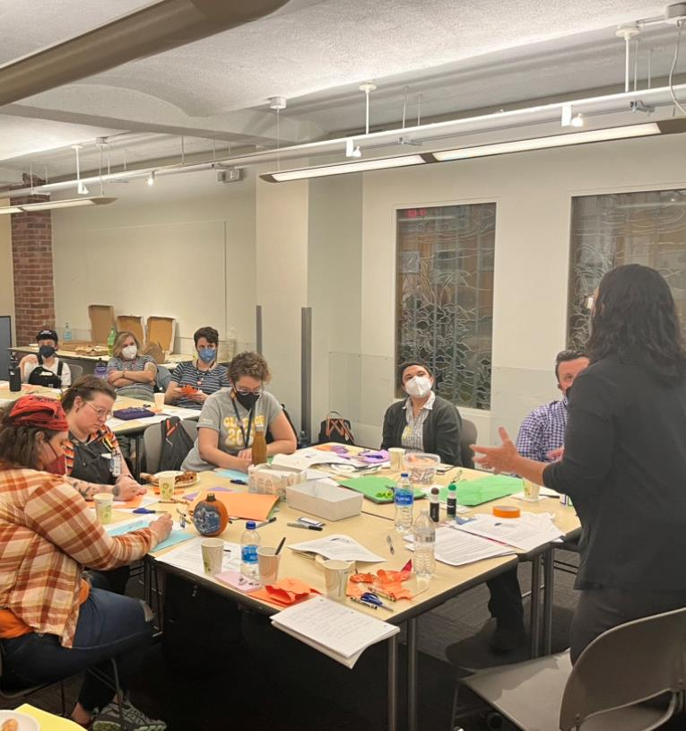
Project Ingredients
Working intensively with local partners
  Mutual professional development --exchanged expertise & co-plan activities
  Outreach – supported by frequent visits to understand routines & interests
  Field trips – designed to meet student needs & interests

Slide 50
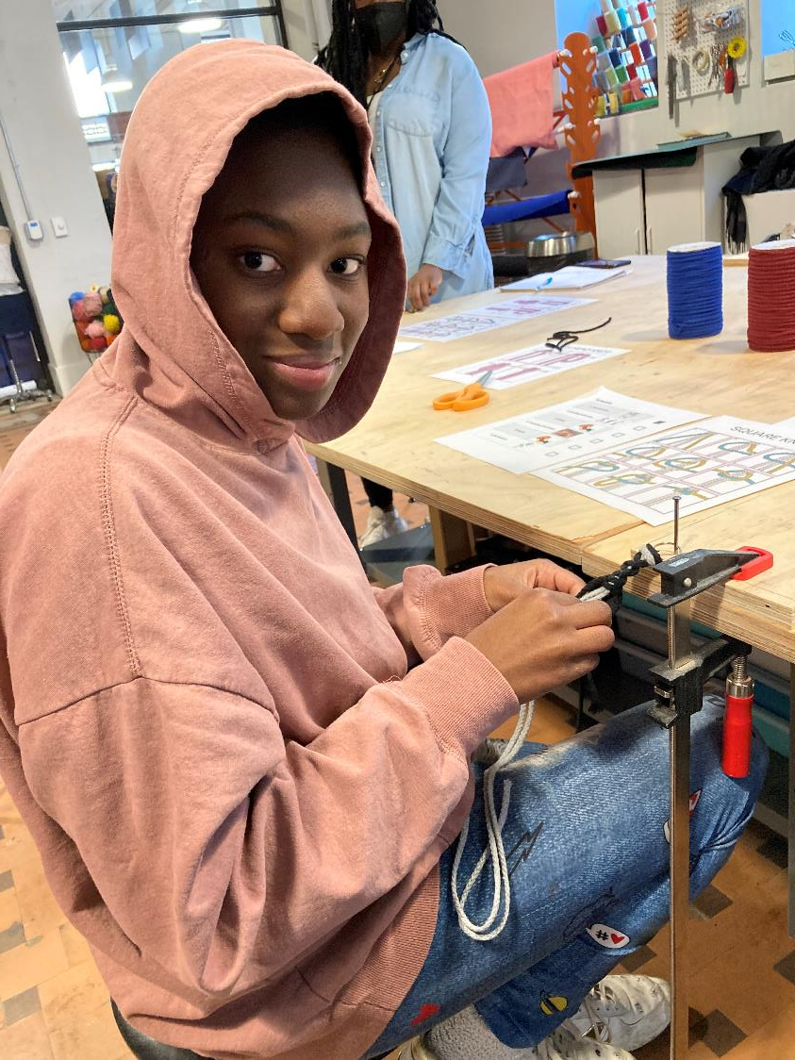
Project Ingredients
Centering the insights, expertise, and agency of disabled youth
Built relationships & trust
Challenged our notions of data collection rigor, allowing youth to guide our approaches.
Committing to continuous assessment and reflective practice
Observed
Reflected
Invited feedback
Iterated
Learned

Slide 51
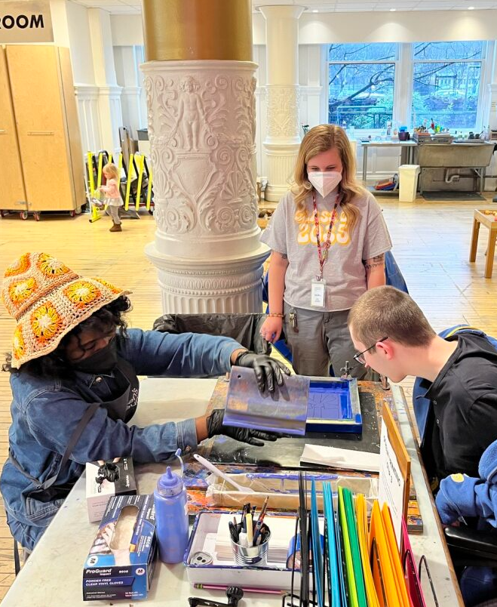
Project Results: Best Practices
New best practices for accessible hands-on art and making
      Developed collaboratively with project stakeholders, including disabled youth.
    Embrace the human diversity in ability as a brilliant asset that sparks innovation.

Slide 52
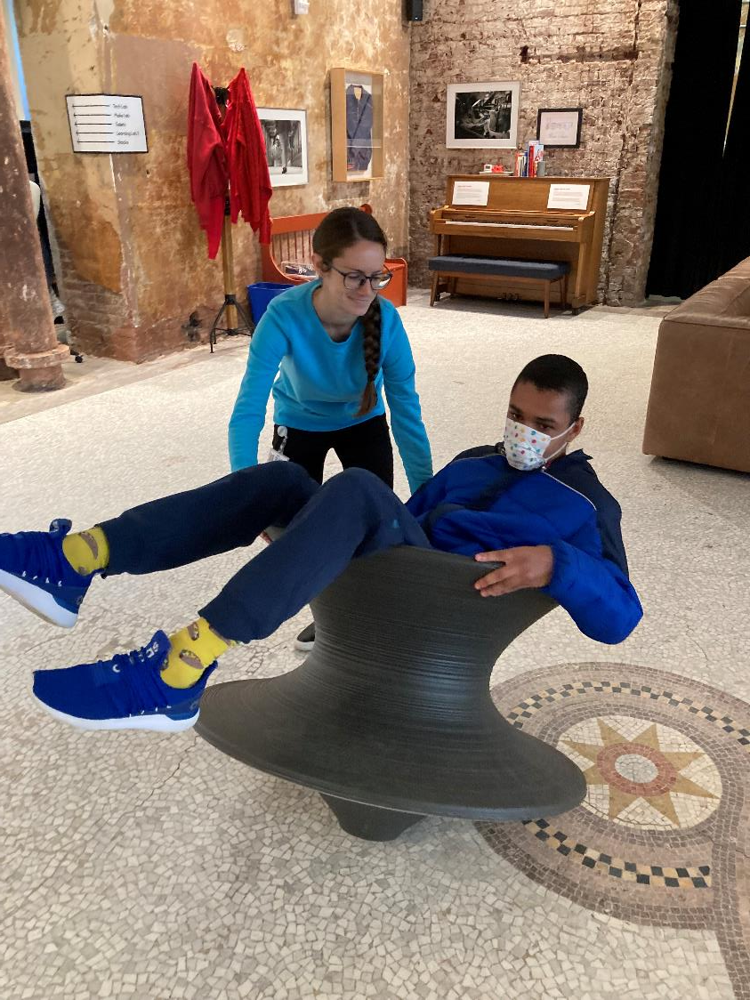
Best Practices
Design for flexibility
Elevate ability
Incorporate interests
Practice disruption
Enact adaptability
Embrace imperfection
Apply accessibility
Care for all – including yourself!

Slide 53
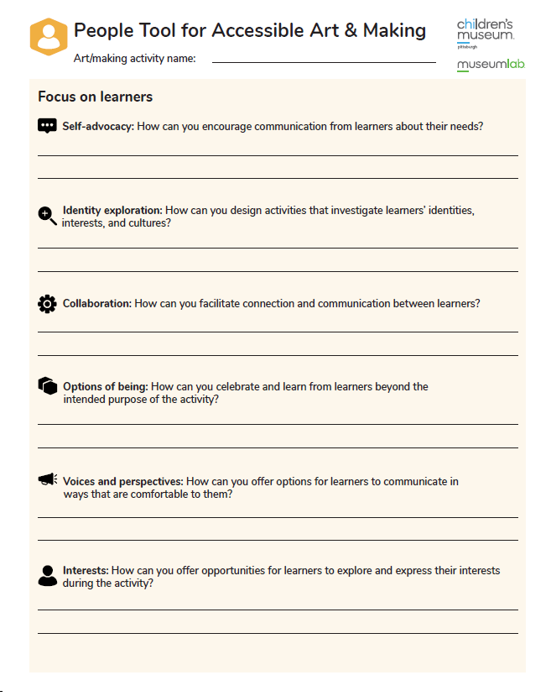
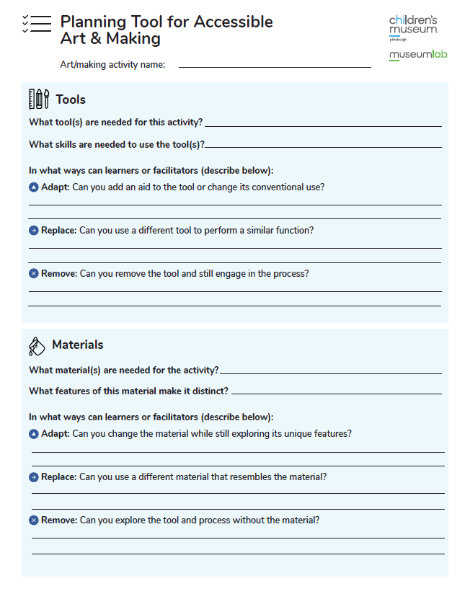
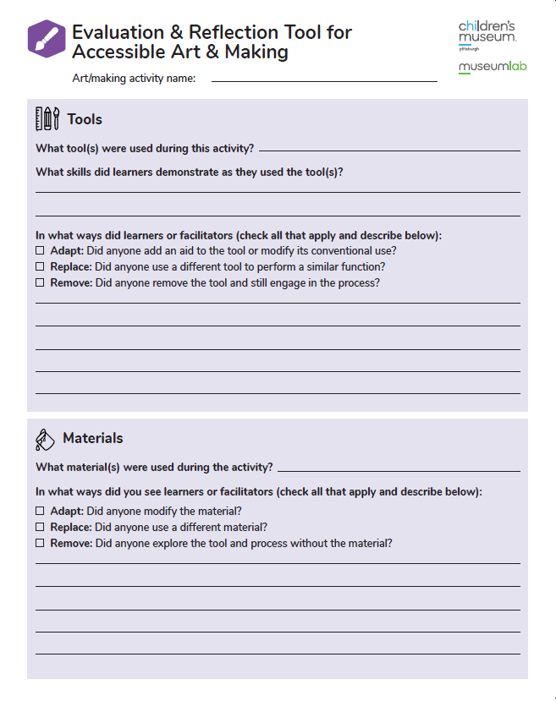
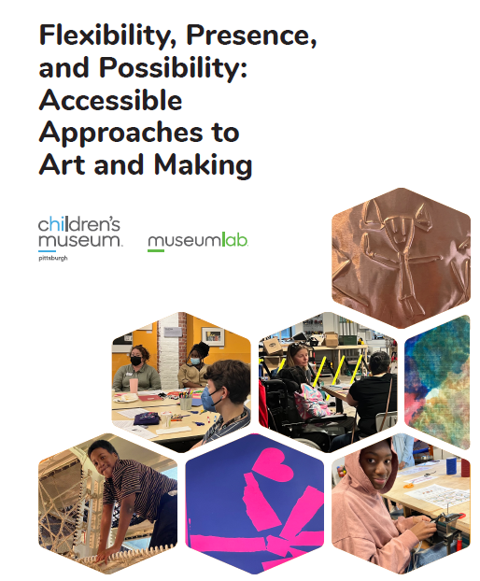
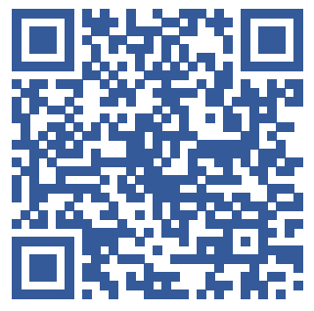
Project Results:
New Tools for Educators
Inspired by the Universal Design for Learning guidelines and the Principles of Disability Justice, these tools can assist educators, teaching artists, and facilitators in:
Designing and enhancing accessible and anti-ableist hands-on activities.
Reflecting on programs and activities.

Slide 54
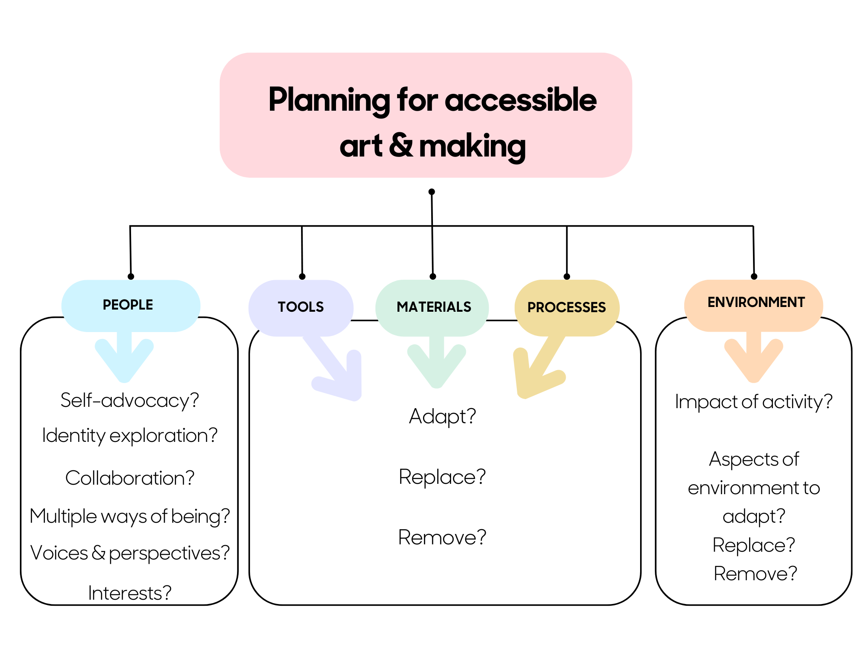

Slide 55
example 2:
keystone year-long pd cohort

Slide 56
Elementary Professional Development Cohort
Two-year project funded by a grant from the McElhattan Foundation
Focus to enhance STEAM education and hands-on learning
Professional development integrates all three parts of the grant
  Field trips
  Outreach
  Workshops
Teachers choose to participate in the program
  Stipend
  Classroom supplies

Slide 57

Opening Convening
We conducted a convening with the entire faculty to introduce the components of the program, focusing on its central component: professional development
“PD Nightmares” and “PD Dreams” activity
Draft plan
Feedback
Final structure
This was an important first step to establishing trust and getting to know the group. We continue to incorporate their ideas and suggestions as we go.

Slide 58


Elementary Cohort Structure
3-4 in-person meetings throughout the year
  One extended
  Faculty meeting times
Teachers complete five projects & reflections
  Try It Out
  Two self-study projects
    Maker Technique, Read & Reflect, Peer Visit
  Two classroom projects
    Outreach-supported or co-planned lesson or field trip

Slide 59


Examples of Classroom Projects
Mini Metric Olympics: 5th Grade
Intro to Volume: Cityscape and Other Building Challenges: 5th Grade
Life Cycles Dance Interpretation: 3rd Grade
Ice & Weather Exploration Stations: Kindergarten
Animal Adaptations: 1st Grade & 3rd Grade

Slide 60

Examples of Classroom Projects
Color Theory: 1st Grade
Animal Research & Habitats: 1st Grade
Nature Journals: 4th Grade
Composting & Environment Science: Kindergarten
Inventing a Better Future: 5th & 6th Grade
Moon Phases: 4th Grade

Slide 61

Examples of Classroom Projects
States of Matter with Candles: 6th Grade
Weather Instruments: 6th Grade
Claymation: 6th Grade
Build Your Own Quiz Game: 5th Grade
Sound theory & Instrument-making: 1st & 4th grade
Force & Motion: 2nd Grade Science & 5th/6th Grade P.E.
Scientific Method with BUBBLES!: 2nd Grade
Art with Technology ~Draw Bots & Finches: 4th Grade

Slide 62


Other work
Supported two school-wide STEM Nights
  Circuitry
  Buoyancy
  Chemical Reactions
  Leap Year
  Magnet Painting
End of year Celebration of Learning for the entire staff

Slide 63

Elementary Cohort Results
Teacher reflections show incredible growth, especially in terms of incorporating more hands-on learning.
Teachers also report feeling more creative and intentional in their practice.
All but three of the 17 participants from Year 1 continued during Year 2.
Year 2 has 23 participants – more than half the school staff.

Slide 64


Common Threads
Although different, these projects share:
Relationship-building & trust
Art & making
  For the classroom
  For its own sake - foster creativity & joy
Integrate professional development, outreach, & field trips
  Educators learn with students
Participant-directed
  Design with instead of for

Slide 65

NISE Network Resources
Videos:
What are STEM learning ecosystems?
Introduction to STEM learning ecosystems
Building and supporting strong partnerships
Using equitable approaches to broaden participation
Creating authentic STEM learning experiences
Activities:
What is learning?
Depict your partnership
Illustrations:
STEM learning ecosystems
Key ideas and definitions
Resources
https://www.nisenet.org/stem-learning-ecosystems

Slide 66

SLECoP Resources
STEM Learning Ecosystems Community of Practice (SLECoP)
https://stemecosystems.org/
Connect with existing STEM Learning Ecosystems
https://stemecosystems.org/ecosystems/

Slide 67
Questions and Discussion
Notes:
Image Credit: NISE Network
Image Description: Large group of professionals attending conference seated at tables listening to speaker and watching slideshow.

Slide 68
Talk at your table
What would you like to take home and share?
What is one thing you excited about?
What do you want to follow up on?

