Slide 1






Welcome!
Focus on Frontline Staff
InterActivity 2024 - Friday, May 17th
Notes:
Illustration Credit: Arizona State University, part of the STEM Learning Ecosystems project.
This material is based upon work supported by NASA under cooperative agreement award number 80NSSC21M0007. Any opinions, findings, and conclusions or recommendations expressed in this material are those of the author(s) and do not necessarily reflect the view of the National Aeronautics and Space Administration (NASA).

Slide 2
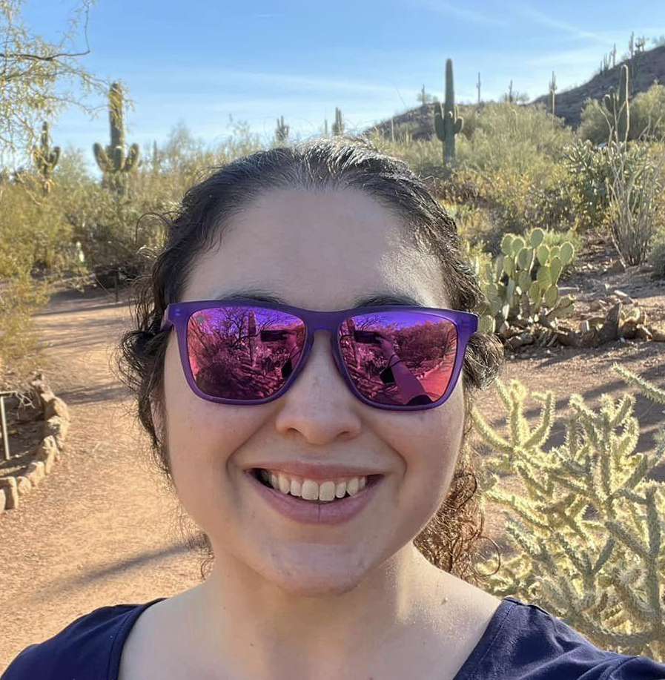
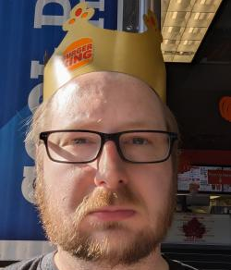

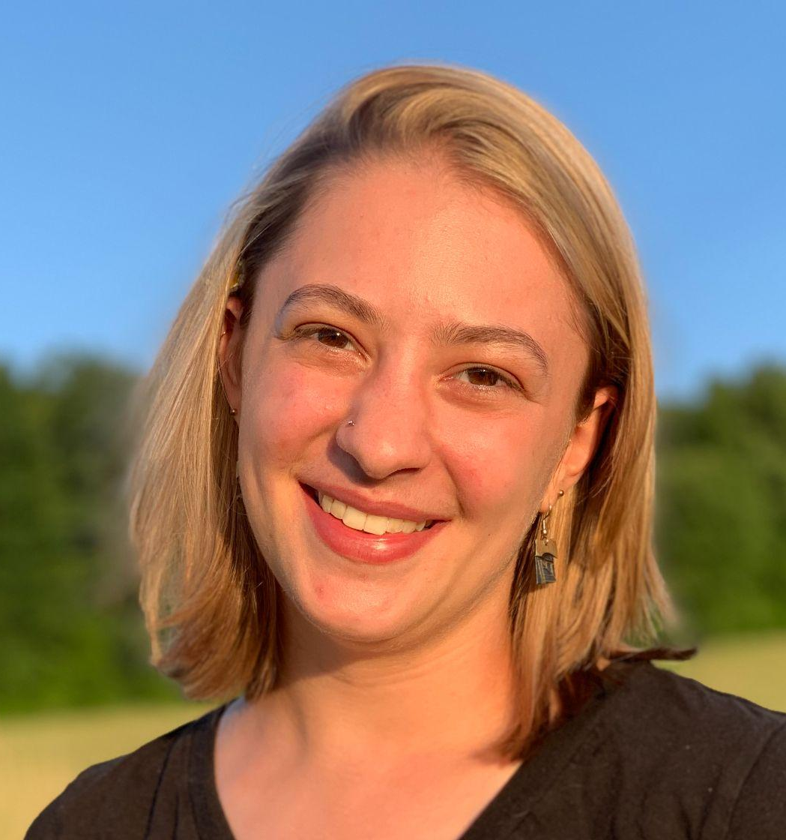
Presenters
Christina Leavell, Project Manager, Arizona State University/NISE Network
Don Riefler, Science Programs Manager, The Children’s Museum of Indianapolis
Bill Pariso, Director Of Education, Betty Brinn Children's Museum
Annie Gordon, Education Program Coordinator, Sciencenter

Slide 3

Overview
We’re excited to share the last session of the conference with you!
Intro (~15 min)
Panel (~30 min)
Small Group Discussions (~20 min)
Wrap Up (~10 min)
Notes:
…we wanted to dedicate part of this session to small group discussions. Now originally we imagined breaking into 4 groups with the 4 of us facilitating, however when we got our estimated group size we decided the best approach would be to float between tables so we could have smaller groups where everyone could share. With that, have provided prompts on tables, we’ll talk more about those in the second part of our session. Another resource you will find on your table is a flyer with a QR code directing you to a Google folder with resources that we will be talking through today. So feel free to take a flyer with you or simply scan and go.
Illustration Credit: Arizona State University, part of the STEM Learning Ecosystems project.
This material is based upon work supported by NASA under cooperative agreement award number 80NSSC21M0007. Any opinions, findings, and conclusions or recommendations expressed in this material are those of the author(s) and do not necessarily reflect the view of the National Aeronautics and Space Administration (NASA).

Slide 4
Rock, Paper, Scissors

Slide 5
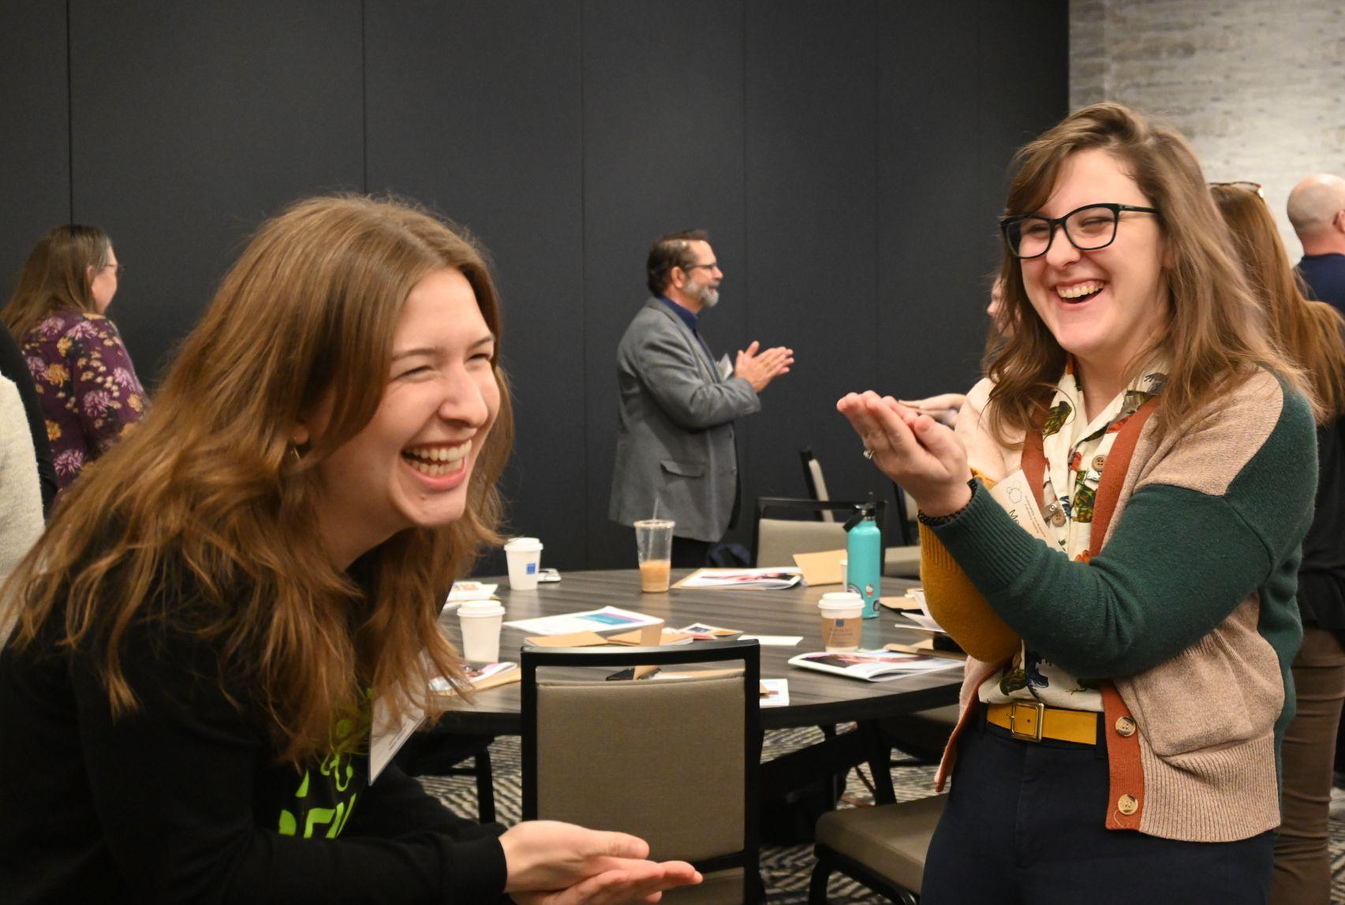
1…2…THROW!
Rock Beats Scissors
Scissors Beats Paper
Paper Beats Rock
Notes:
We’re going to play an old fashioned game of Rock, Paper, Scissors. Now I chose this game with the expected size of our group as well as the fact that this is a game that can be as powerful as it is played. It shouldn’t be too physically demanding, however if for any reason you are not comfortable participating, feel free to observe.
Photo credit: NISE Network

Slide 6
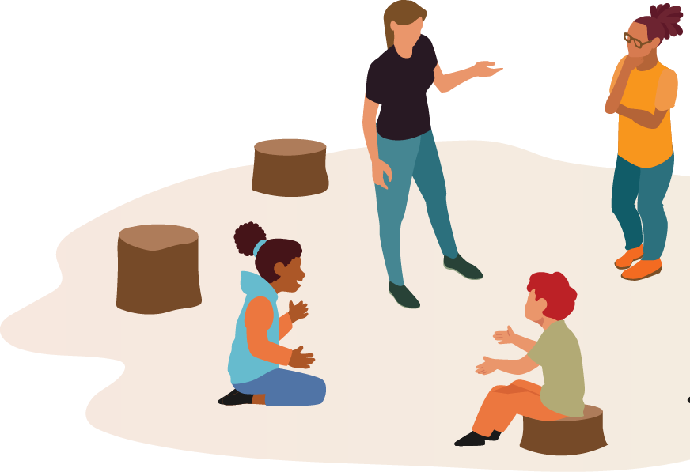
Improv Exercises
Tools to empower staff to facilitate positive learning conversations.
Create a supportive, light-hearted environment for staff to practice and strengthen essential skills.
Develop a more cohesive team while also building staff confidence to engage more deeply with visitors.
Various exercises with guides & tips for how to lead.
nisenet.org/catalog/improv-exercises
Notes:
How many of you are using improvisation as part of staff training…
Improv is not only a great tool to get staff thinking on their feet, but also to build connections between staff, build security in relationships between other staff as well as our audiences, and ultimately enhance communication with our audiences. One of the things this group discussed last time we met was the desire to build teams that could “read a crowd” as well as create sustainability within frontline staff positions.
Illustration Credit: Arizona State University, part of the STEM Learning Ecosystems project.
This material is based upon work supported by NASA under cooperative agreement award number 80NSSC21M0007. Any opinions, findings, and conclusions or recommendations expressed in this material are those of the author(s) and do not necessarily reflect the view of the National Aeronautics and Space Administration (NASA).

Slide 7

“What Is Learning” Conversation Starter
Cards to spark conversations about what learning looks like.
Staff articulate their own thoughts on learning
Group conversations inform approaches to engagement and education work
Staff recognize that learning takes many forms and occurs in different settings across a person’s lifetime
nisenet.org/learningcards
Notes:
I wanted to share this with you today because I feel that we do a lot of logistics and content training with our staff, but how often to we engage these individuals in conversations about what learning looks like to them? How they learn? How they visualize learning happening on our floors, and it’s really quite interesting to think these individuals are the face of our institutions, facilitating learning experiences with our guests, and how much do we know about how they themselves actually think about learning.
Photo Credit: NISE Network

Slide 8
Focus on Frontline Staff
ACM InterActivity 2024
Don Riefler, Science Programs Manager

Slide 9
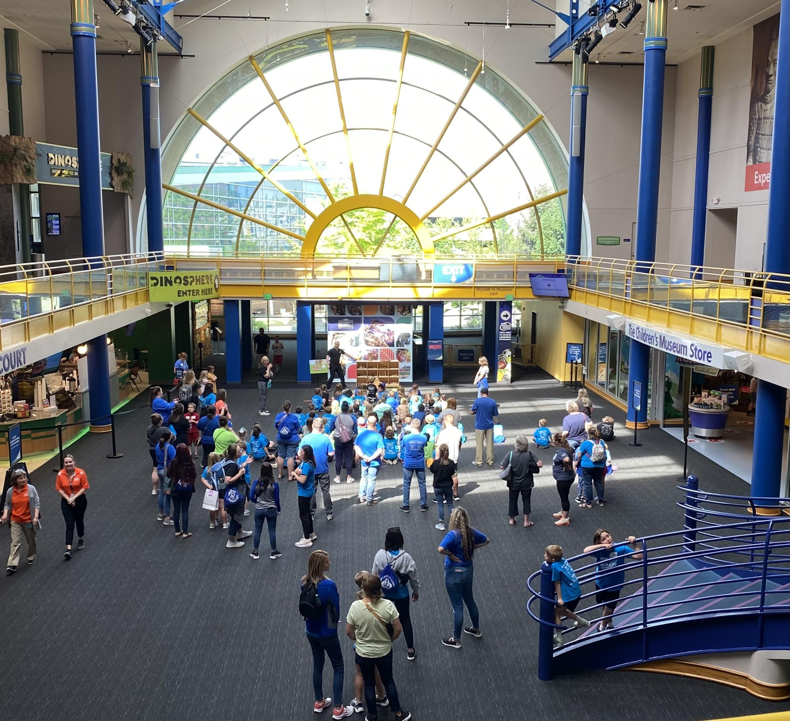
Focus on Frontline Staff
What are the ways we communicate with teachers and chaperones?
How do we provide information to frontline staff and hear their concerns?
What is within our control?
How can our School Programs dept. be a bridge between schools and frontline staff?
Notes:
I’m a former teacher and a life-long educator and advocate; what do I take for granted that I know about schools, students, teachers, that is not ‘second nature’ to other staff. Especially the younger staff on our frontline teams.

Slide 10
Field trip communications
Teacher’s first contact with TCM
Field trip order confirmation
1 week before field trip
Immediately after the field trip
Future & On-going contact
Website & print materials
Booking the field trip
Field trip arrival
During the visit
Notes:
I mapped out our current communications and ‘touch points’ and looked for possibilities to improve communication, provide more information, provide information or engagement in different formats.

Slide 11
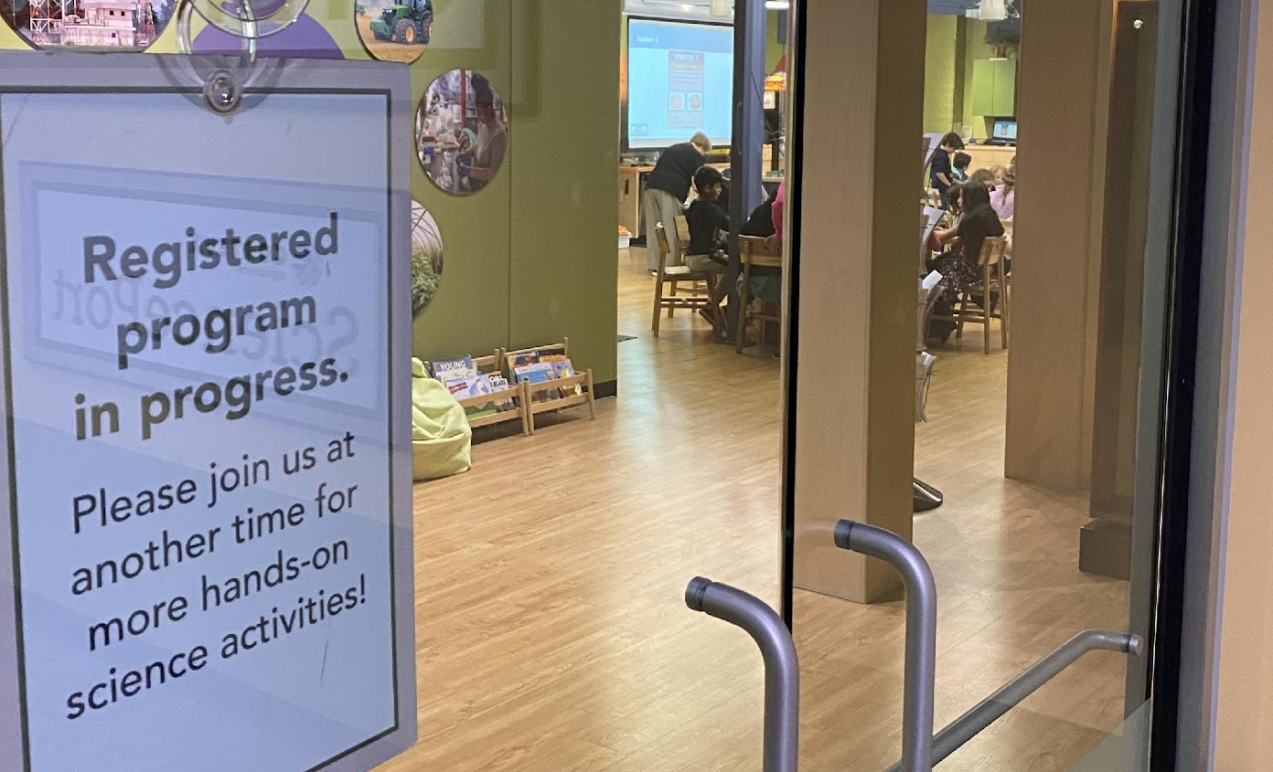
Hearing staff concerns
We make time to listen to each other
  Meetings with Visitor Services, Security, and Interpretation teams
  New lines of communication (email group, Teams group)
Top concerns
  Want more information from our School Programs team about communications with schools
  It’s exhausting to enforce rules repeatedly
    Walk, don’t run
    Where is your chaperone?
    No food and drink in galleries
    Don’t use the materials that way
    Watch where you’re going
  Chaperones are on their phones and not helping redirect students or engaging with them & exhibits
Notes:
We stay open to hearing reports of issues and responding to them, while also maintaining positivity and understanding about school groups

Slide 12
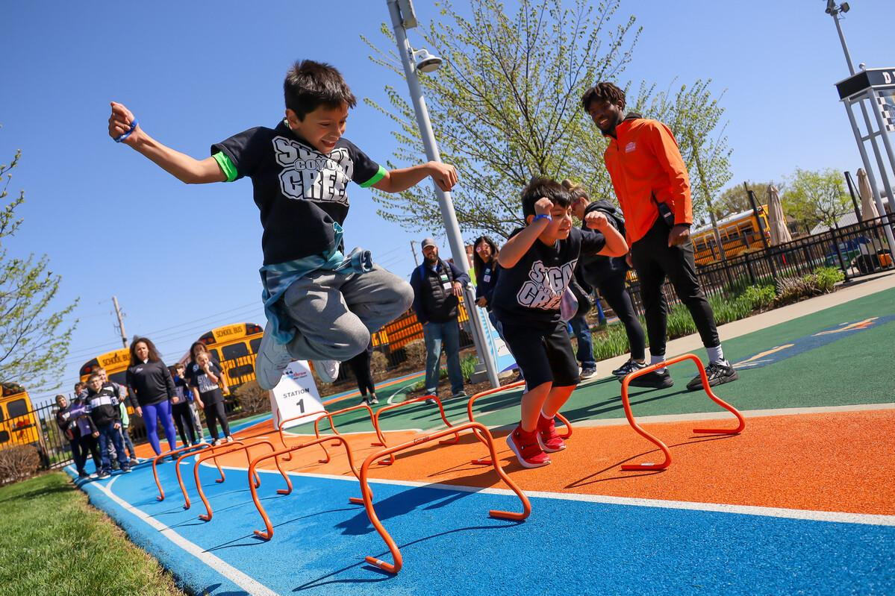
Changes
New CRM & tickets/orders system
  New field trip and group reports
New staff
Increasing field trip attendance
New schools, new teachers & changes to schools
Notes:
Where are the opportunities? | More teachers contacting us to say they’ve never been to the museum before and they have a lot of questions

Slide 13
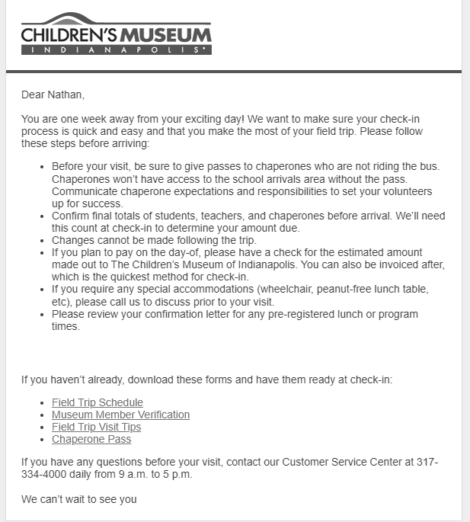
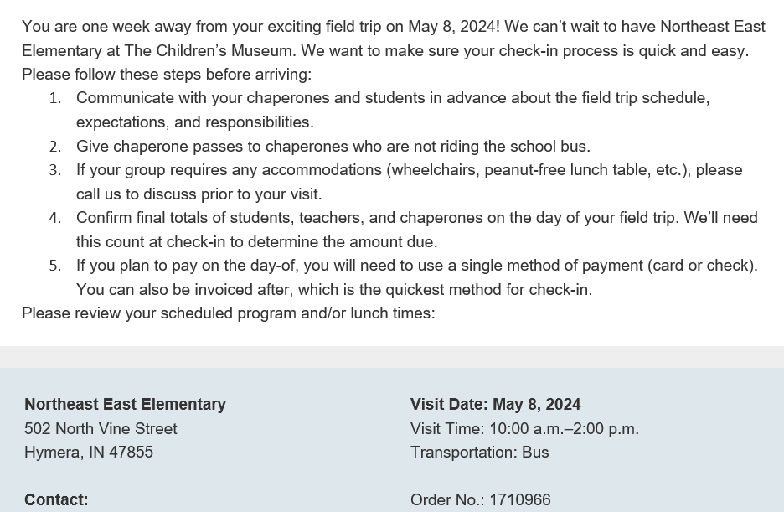
Putting ideas into action
New automated confirmation emails to teachers re: field trip orders & upcoming field trips

Slide 14
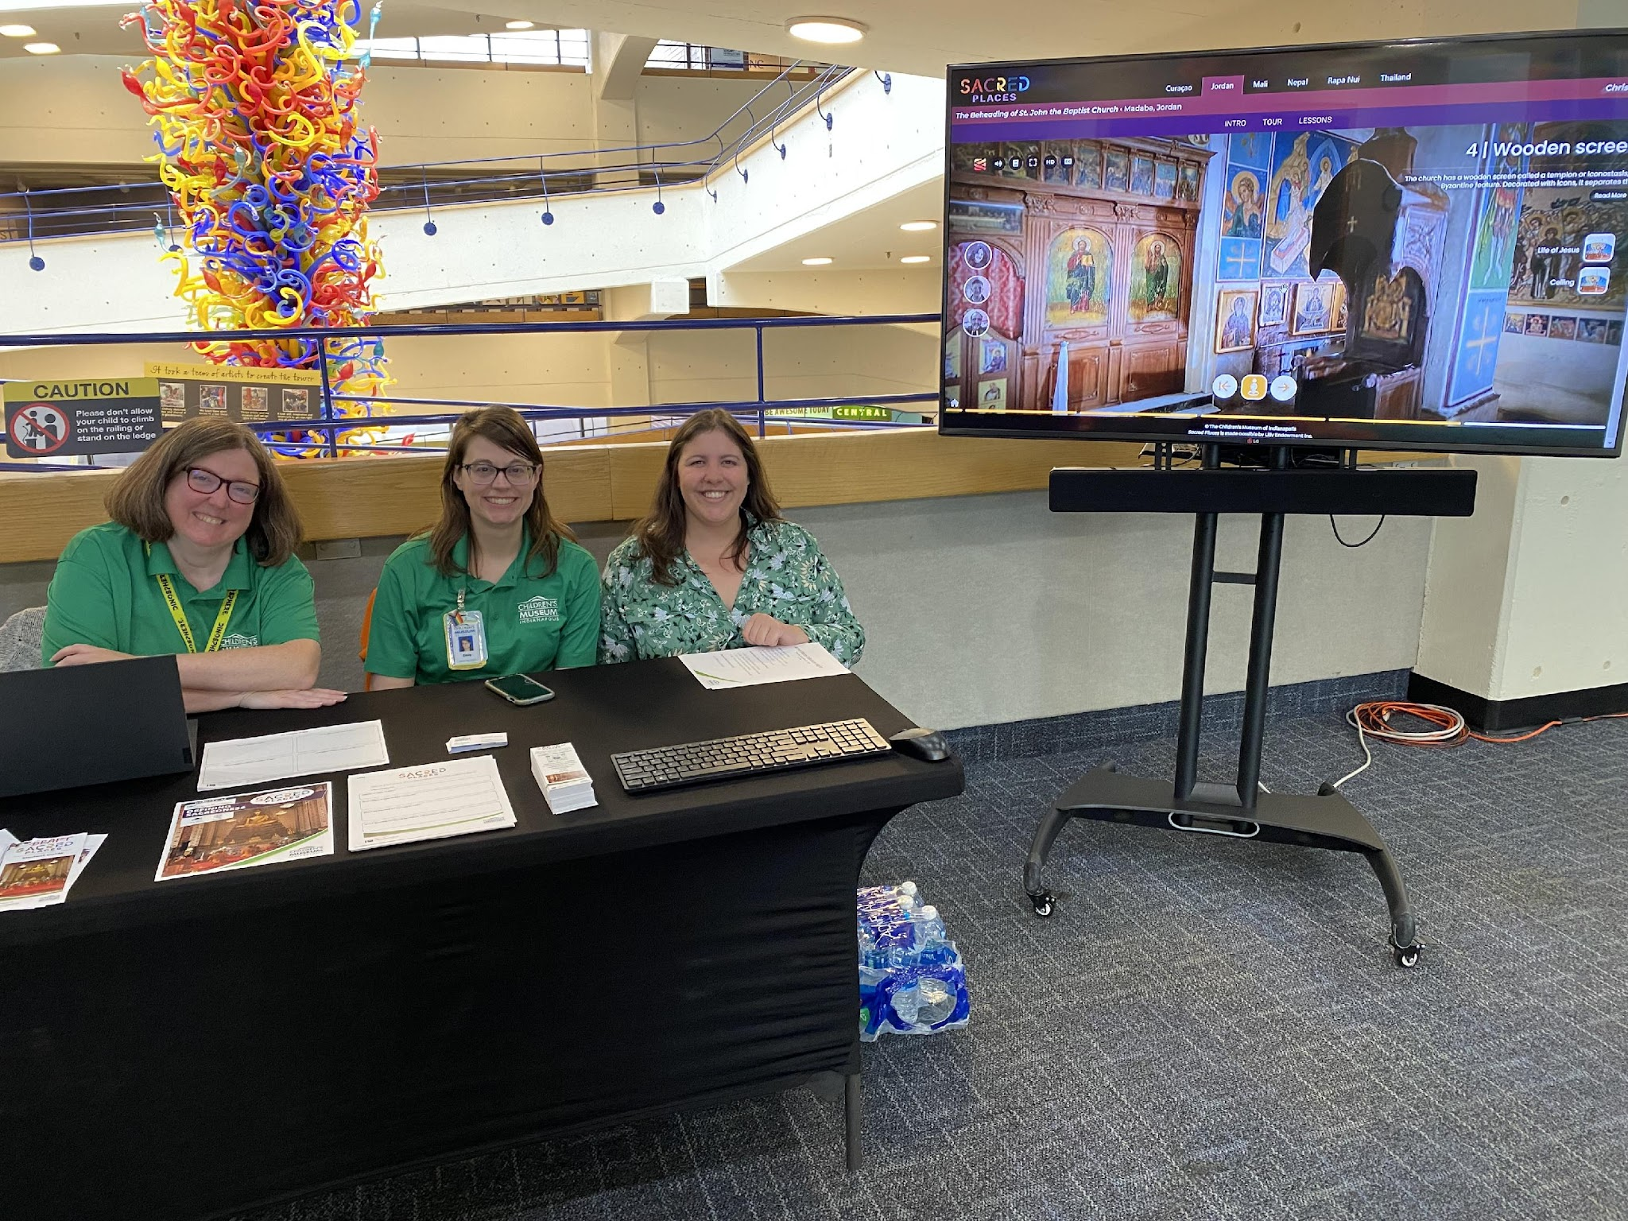
Putting ideas into action
Exhibit Resources
  Comic book
  Chaperone guide
  Student processing activities

Slide 15
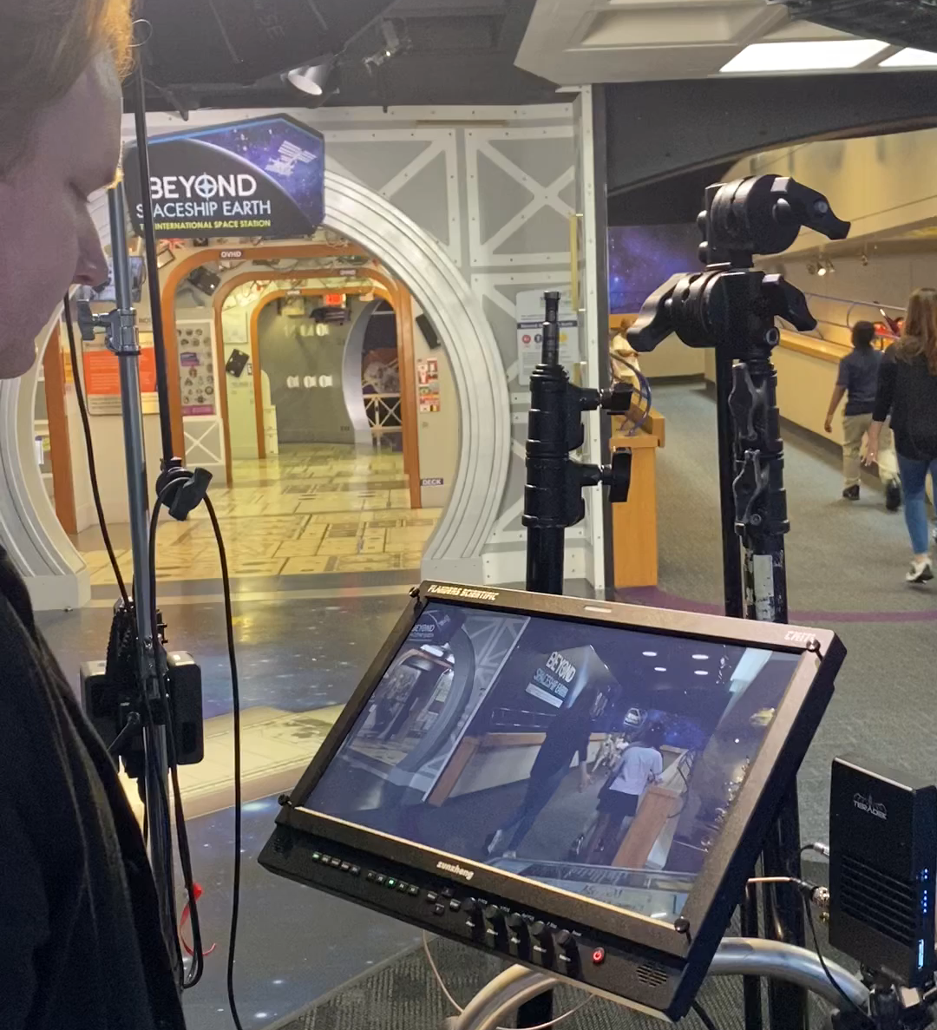
Putting ideas into action
Chaperone Video
  Frontline managers read the script, gave feedback, and we implemented it
  Keep it short & sweet!

Slide 16
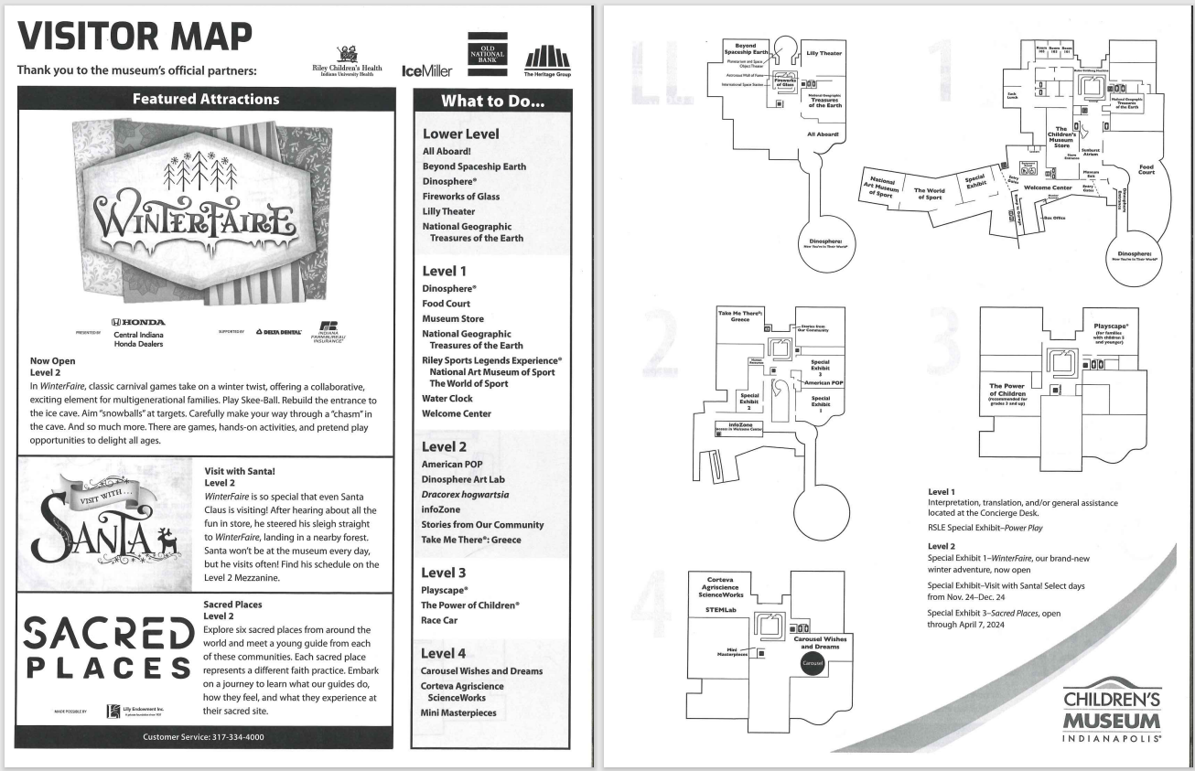
Putting ideas into action
Chaperone Map
  How can we use pre-existing formats better?
  Should we move from paper to digital format?
  Connecting chaperones to sensory & accessibility information
Notes:
Making a version of the Visitor Map that is for chaperones + has field trip information instead of general visitor information

Slide 17

Putting ideas into action
Active presence & relationship building
  I attend teams’ daily ‘stand up’ meetings when we have a special event
  End of School Year Appreciation Party
  Presenting at September All-Staff meeting to generate excitement about field trips returning

Slide 18


Milwaukee, Wisconsin
2023 Attendance 169,104
2023 Field Trip Attendance 12,586

Slide 19


Slide 20
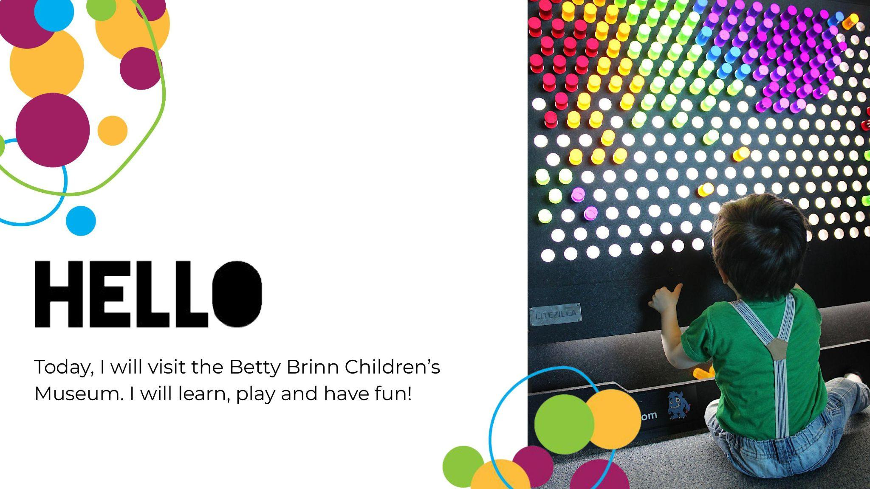

Slide 21
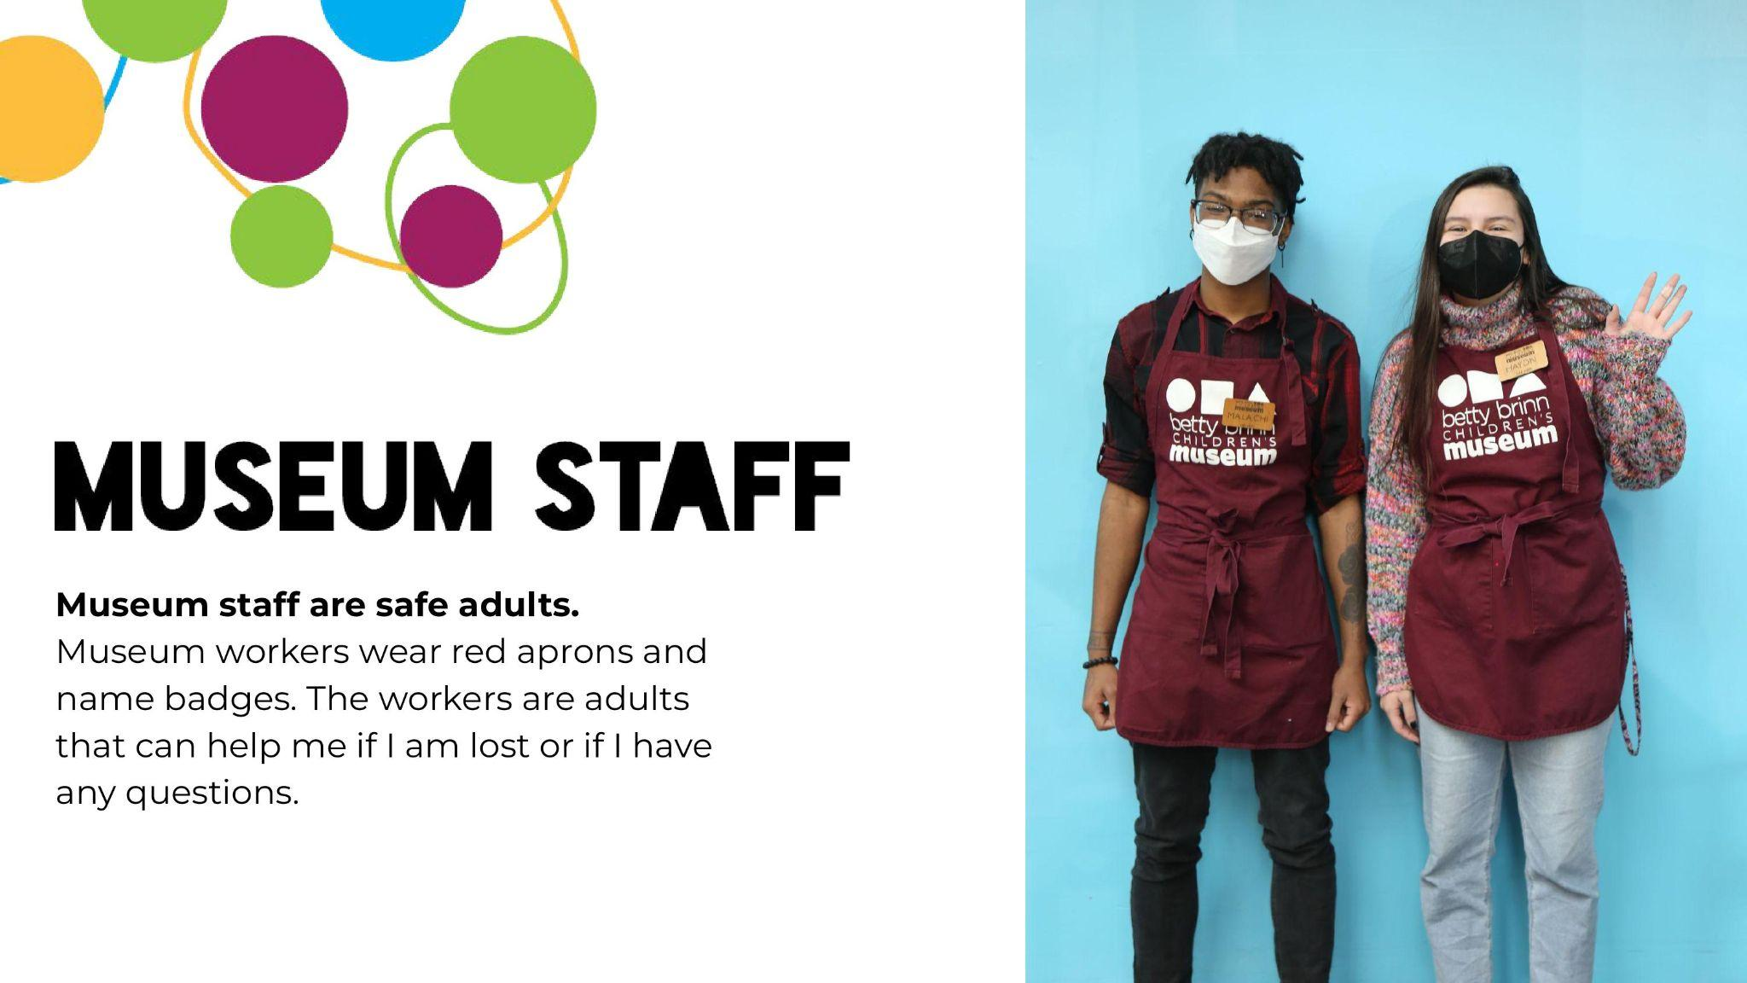

Slide 22
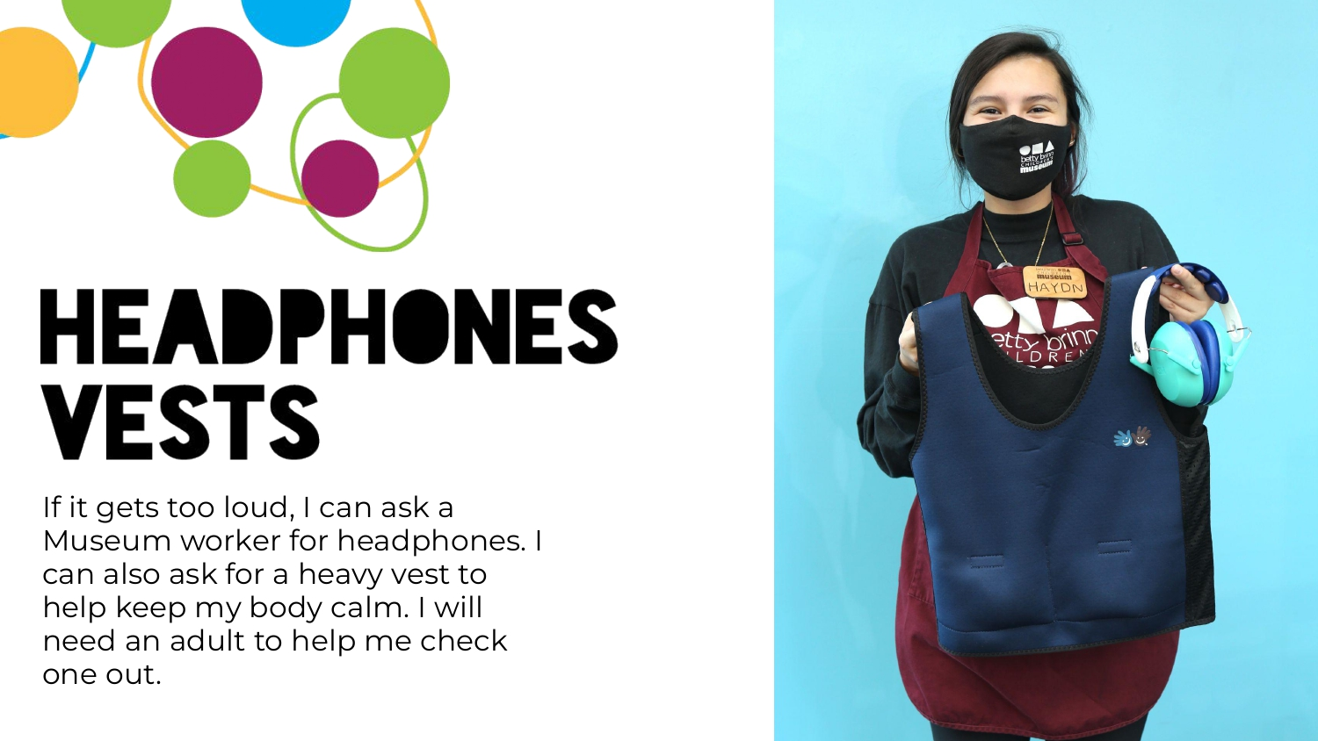

Slide 23
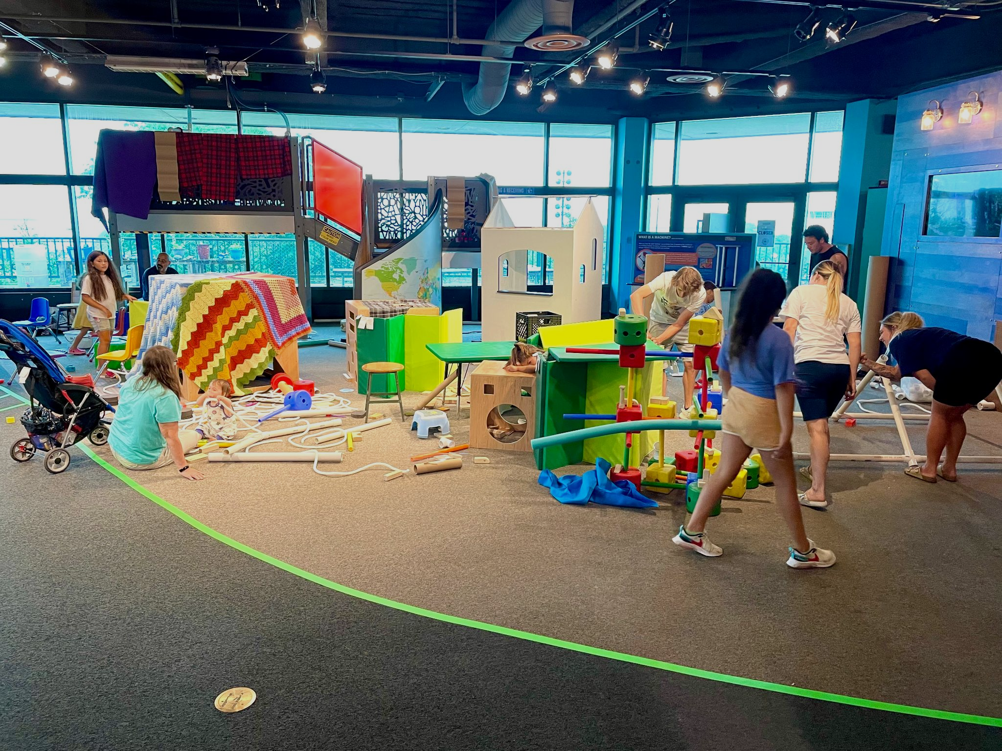
PlayLAB
@
Betty Brinn

Slide 24
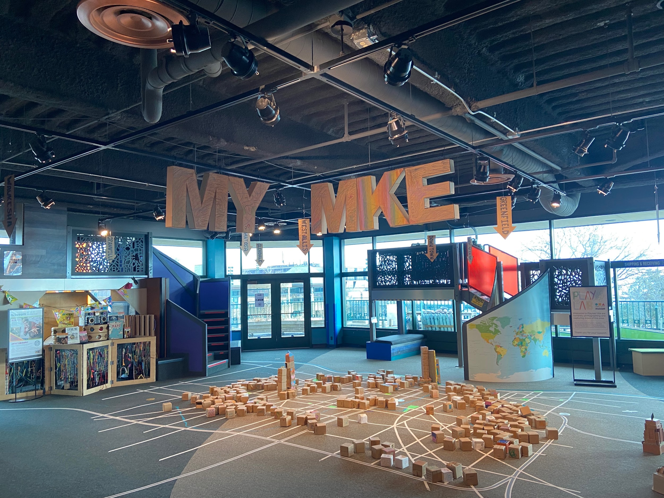
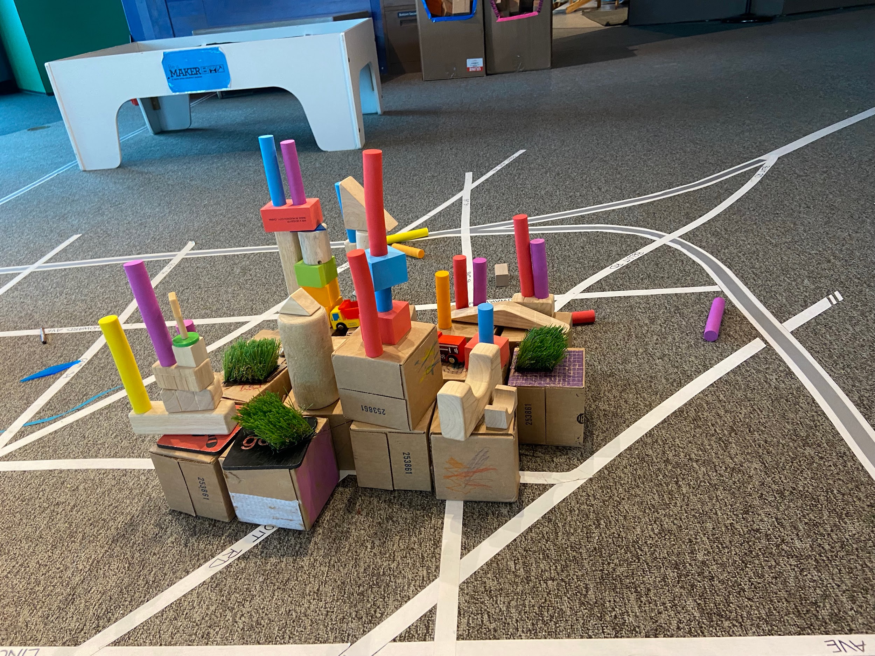
My Milwaukee

Slide 25
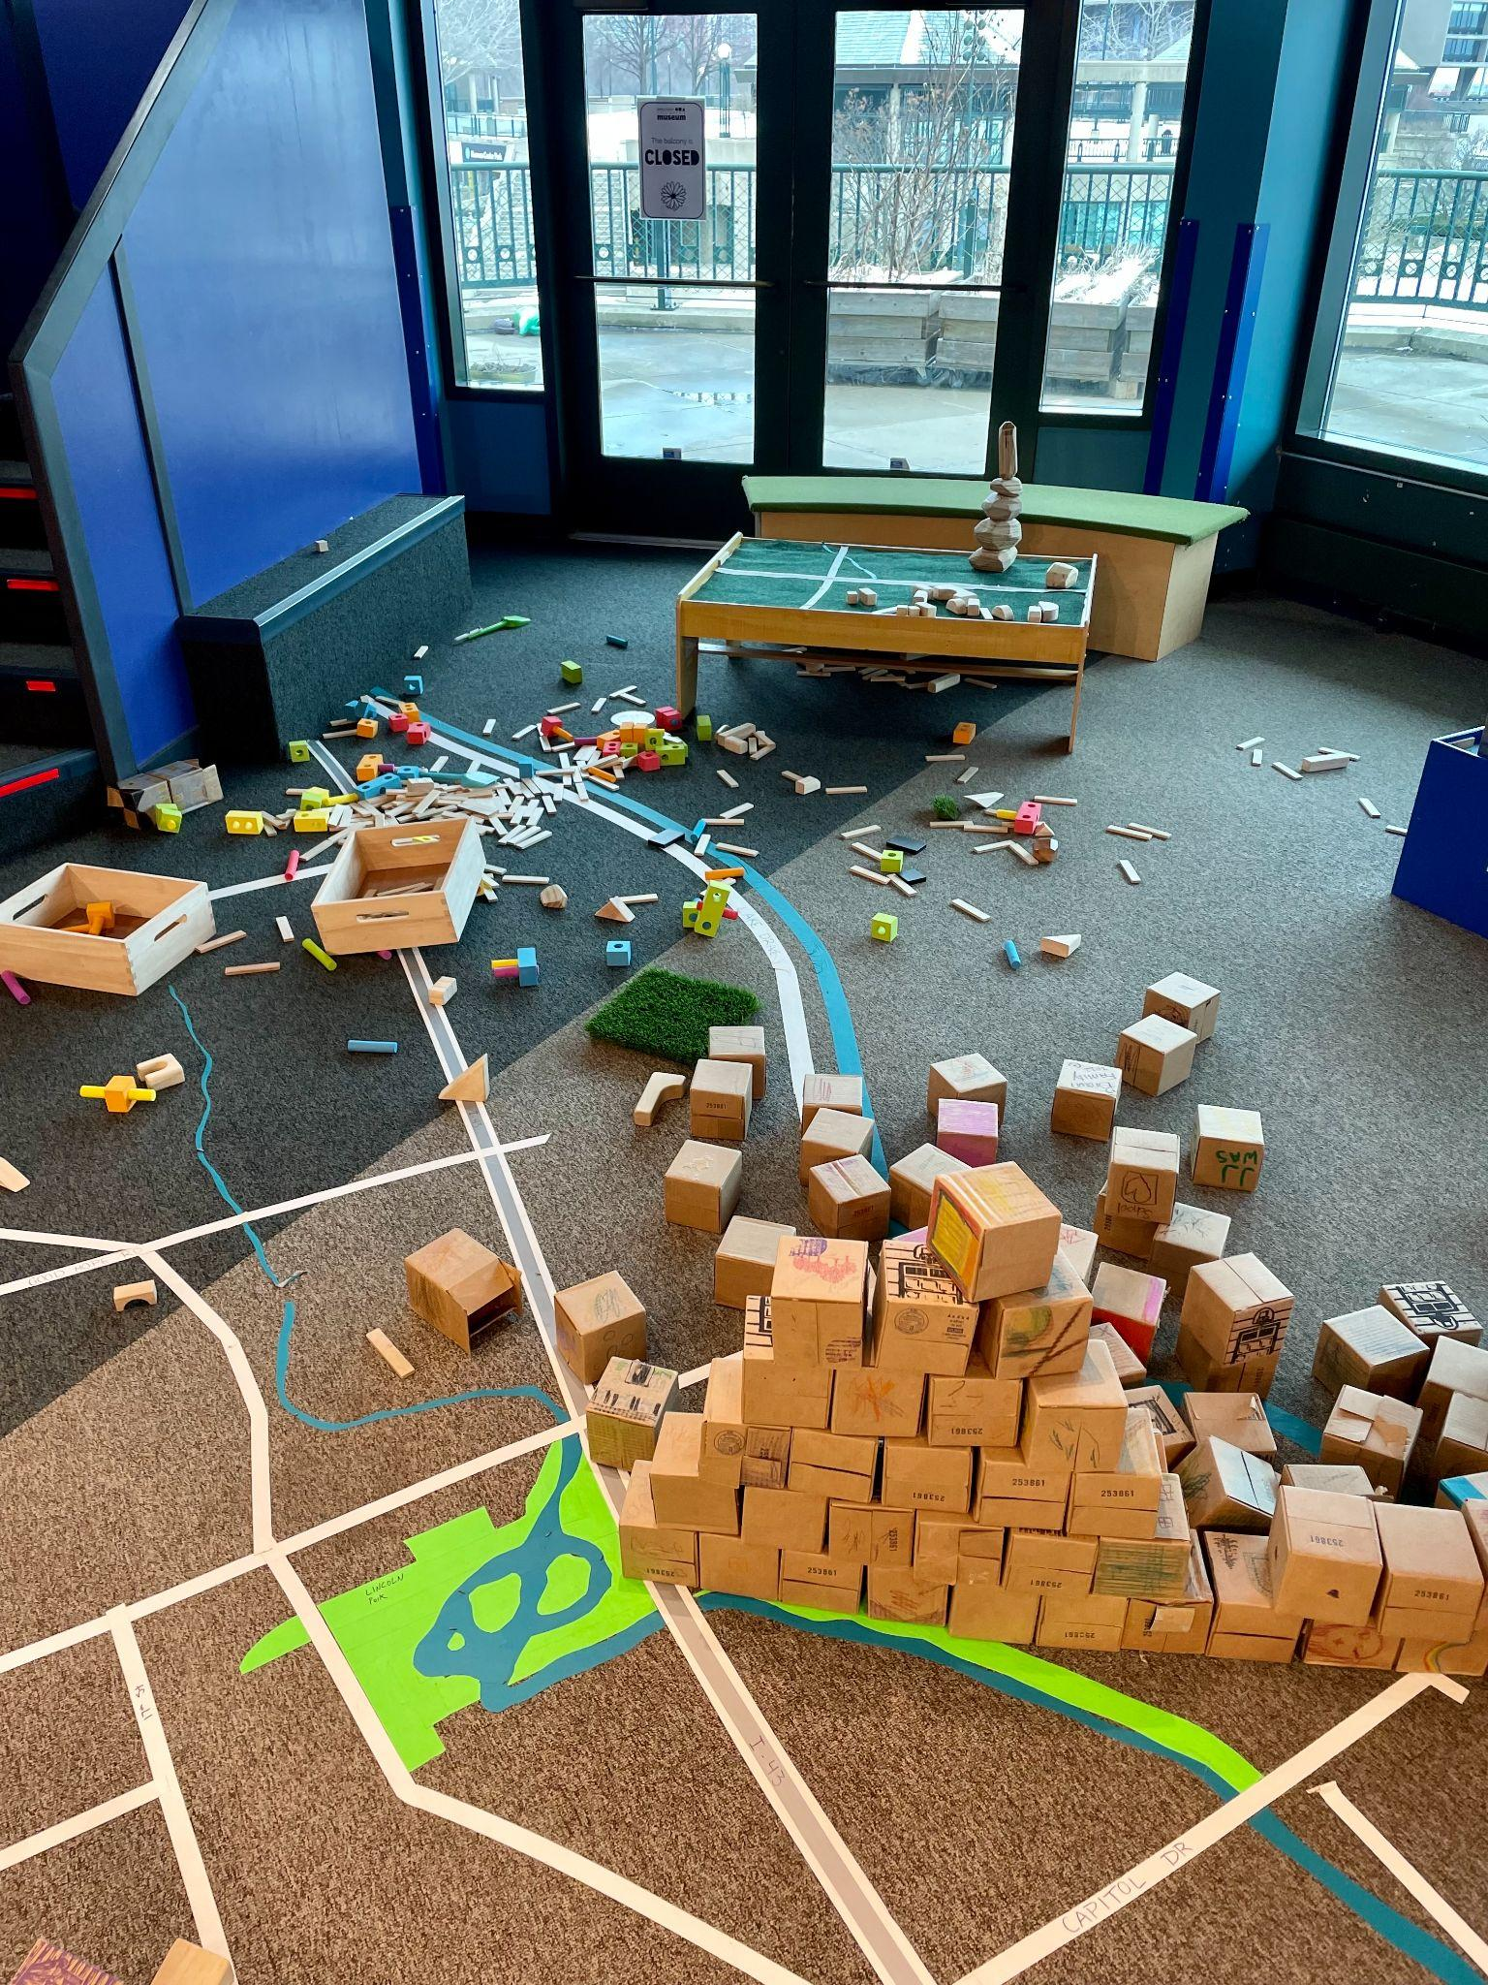
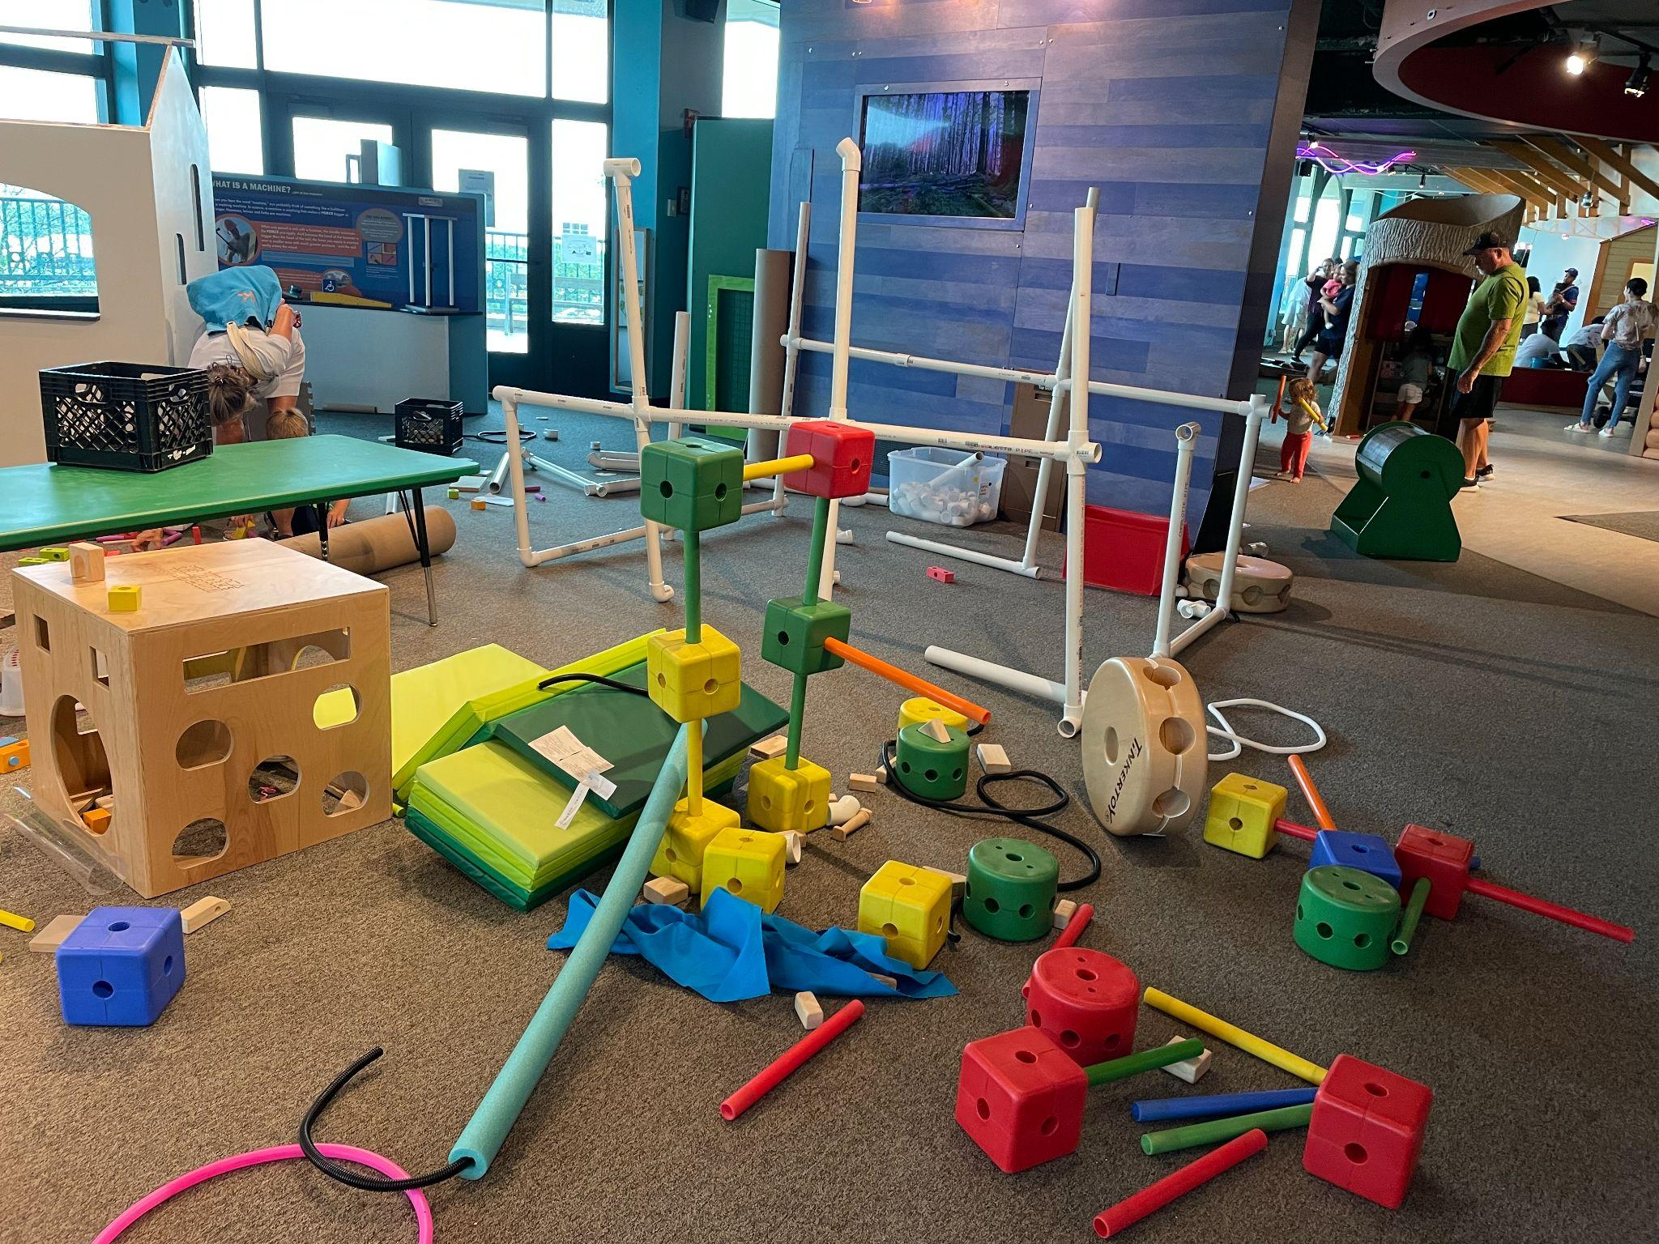
IT’S MESSY!

Slide 26




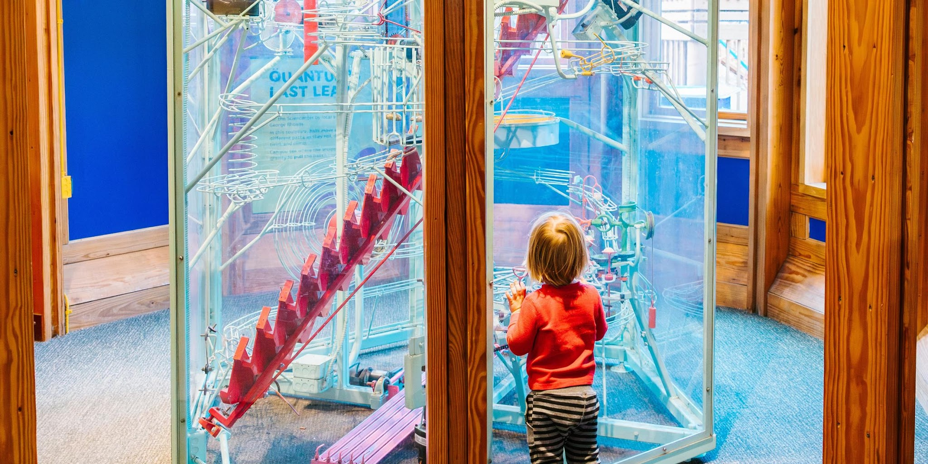

Stats
Mid-size: 100k people a year
Location: Ithaca, NY
Audience: More members than one-time visitors
Programmatic Field trips a year: 60

Slide 27
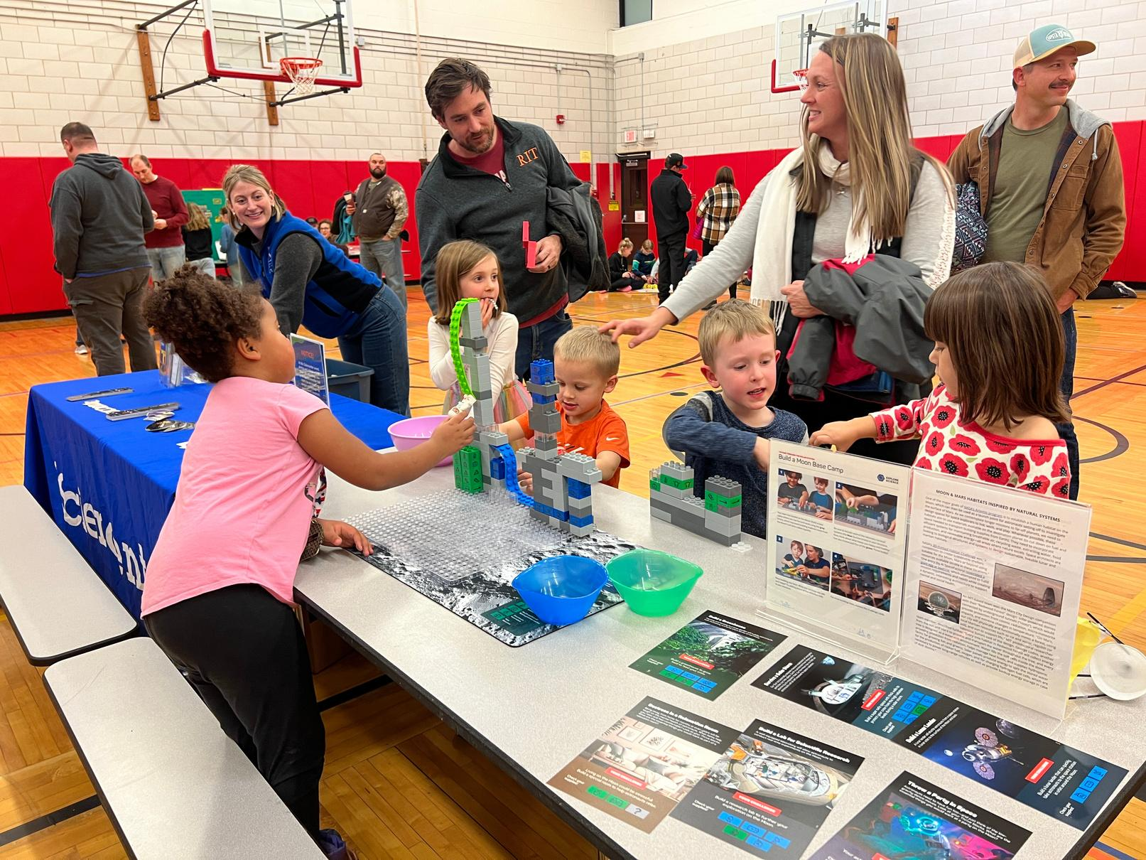
Noticeable Changes
The shift from an educational museum space to an indoor play space
Want for needs to be met more precisely and quicker
More rigidity when it comes to field trips
People want information to be more specific and also broken down into smaller chunks
Notes:
Shift from an educational museum to a safe, indoor play space.
resulted in rowdier behavior, less likely to care for manipulatives, want for needs to be met immediately
how do we continue to support learning and engagement while recognizing this shift?
There is more rigidity when booking and delivering field trips
could be teachers, could be admin, could be transportation
how do we work with teachers to ensure their class needs are being met while still within the EDU staff capacity?
Desire for specific information delivered precisely

Slide 28
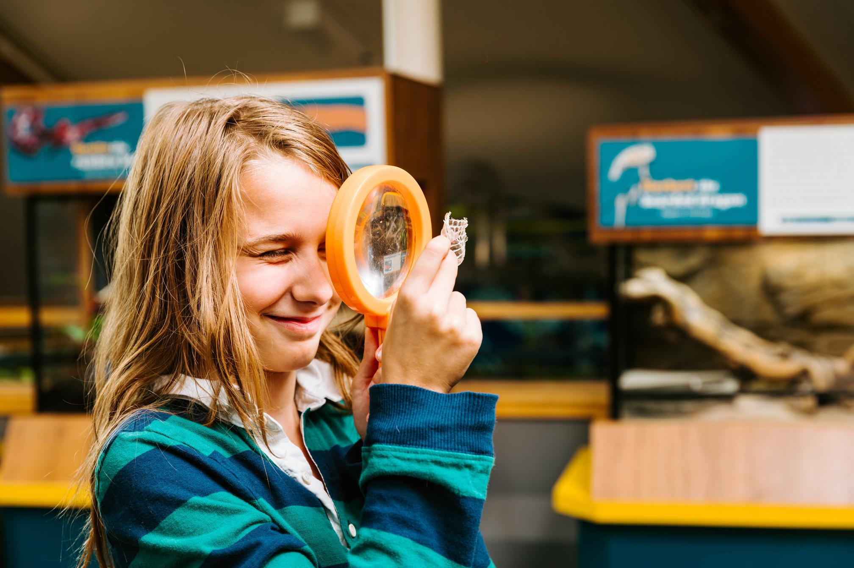
Neighbor Membership program
What to do about unaccompanied children
Development of a special membership for children in the neighborhood next door
Opportunity to clarify visitor expectations
Highlighted how children want to use the museum
Shone a light on how the front desk staff was handling visitor needs
Still in development (fluctuating needs/ growing kids)
Notes:
We are situated in a mixed urban area and are on the other side of the street from a housing development.
Many of the children that live in the neighborhood have the agency to play (in the area) by themselves. They saw us as a safe play space (especially on rainy days) and invited themselves in.
This led to the development of of the neighborhood kid membership. Bourne out of a combo between map memberships/ deai funding
This is offered to children that live and play within a few blocks of the Sciencenter, who are already interested in coming (tend to show up anyway)
we had a lot of trouble getting guardian permission/ sign off/ contact and landed on asking the children to provide a phone number and address.
With the creation of these memberships we are able to create some community connections with our next door neighbors. For those of us on the floor it has made it a lot easier to identify (and recognize by name) the children that seem to be unaccompanied. This has also been an opportunity to set expectations within this space. (running, language use, material use, where to eat, etc.)
We have found that this was an opportunity to clarify visitor expectations: around running, language use, where to eat, material use, etc.)
We were able to respond to a direct community need and as a result have developed working relationships with some of these children’s adults (who ended up being Ithaca community leaders)
We also gained insight into how children wanted to use the museum. How do they see the space, what engagement are they looking for, what materials do they want to see?
Shone a light on frontline staff and how they were handling visitor needs
It’s not perfect, we are still struggling with getting caregiver info, we are working on actually getting the kids to use the membership (check in at the front desk),
still high engagement! we are just working on getting the younger kids signed up

Slide 29
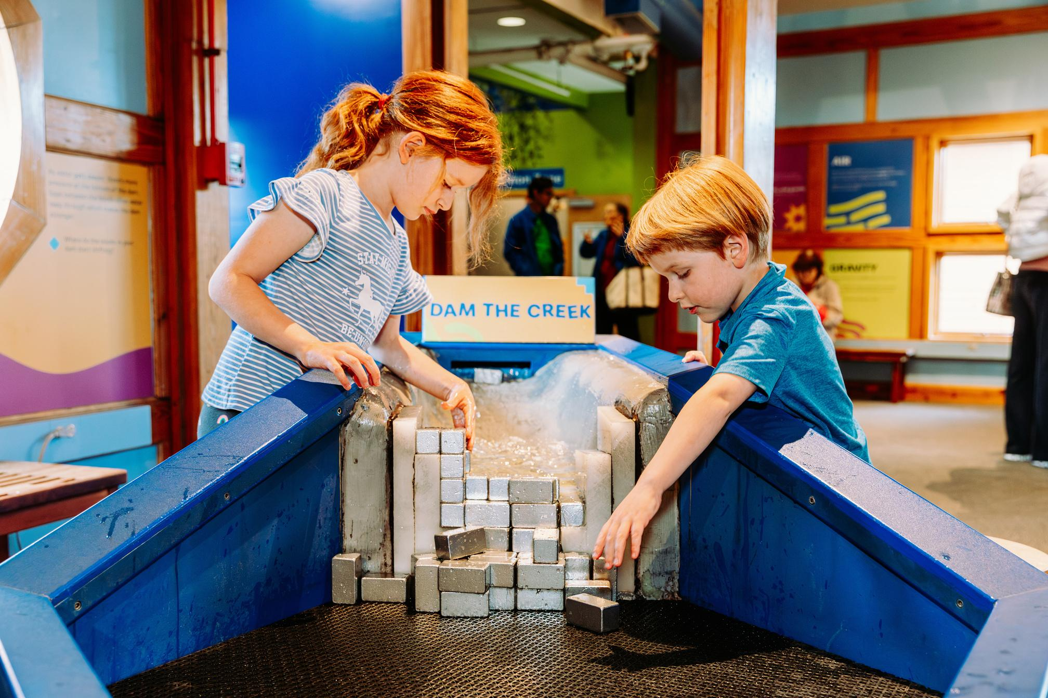
Resiliency in failure
An engineering field trip
Field trip aimed at 2nd and 3rd grade
Post shutdown, children were struggling with regulation when it came to failure
Teachers were interested in supporting the engineering design process
Shift to highlighting
  collaboration as a problem solving technique
  the expectation of failure
Gave chaperones instructions on supporting the test and design portions of the activity
Notes:
This is a long- running field trip that is aimed at 2nd and 3rd graders. We deliver this field trip to all the 2nd graders in the county and it is also available as a paid field trip.
Developed with a ton of emphasis on clean energy and the engineering process was secondary.
We were finding that children had a shorter attention span for this activity and were having difficulty regulating through the redesign that is baked into the engineering design process.
Teachers were also finding that they found an engineering focused (rather than energy focused) field trip was more important to their classrooms.
We did a major shift (without a huge design overall) to highlighting engineering skills like, problem solving, collaboration, creative thinking.
Made sure that chaperones had some tools to help kids do the test and design portions of the trip.

Slide 30
Small Group Discussions
(Prompts on tables to help you get started)

Slide 31

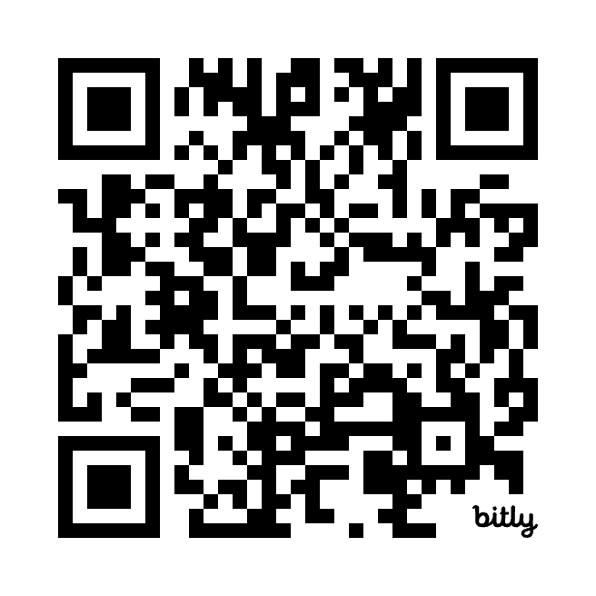
Wrap-up
Thank you for your participation in today’s discussion!
Panel Highlights Small Group Conversations
Final Thoughts
Session Resources
https://bit.ly/4bxsWrb
See Session Handout
Notes:
Illustration Credit: Arizona State University, part of the STEM Learning Ecosystems project.
This material is based upon work supported by NASA under cooperative agreement award number 80NSSC21M0007. Any opinions, findings, and conclusions or recommendations expressed in this material are those of the author(s) and do not necessarily reflect the view of the National Aeronautics and Space Administration (NASA).

Slide 32
Resources
Annie Gordon, Sciencenter:
Neighbor Membership Application
Bill Pariso
Social Story
Don Riefler
Coming Soon!
Christina Leavell, ASU:
What is learning?
Improv Exercises
Notes:
Illustration Credit: Arizona State University, part of the STEM Learning Ecosystems project.
This material is based upon work supported by NASA under cooperative agreement award number 80NSSC21M0007. Any opinions, findings, and conclusions or recommendations expressed in this material are those of the author(s) and do not necessarily reflect the view of the National Aeronautics and Space Administration (NASA).

Slide 33

Thank you!!!
Safe Travels Home
Christina Leavell: Christina.Leavell@asu.edu, nisenet.org/
Don Riefler: donaldr@childrensmuseum.org, childrensmuseum.org/
Bill Pariso: BPariso@bbcmkids.org, bbcmkids.org/
Annie Gordon: AGordon@sciencenter.org, sciencenter.org/
Notes:
Illustration Credit: Arizona State University, part of the STEM Learning Ecosystems project.
This material is based upon work supported by NASA under cooperative agreement award number 80NSSC21M0007. Any opinions, findings, and conclusions or recommendations expressed in this material are those of the author(s) and do not necessarily reflect the view of the National Aeronautics and Space Administration (NASA).

