Slide 1


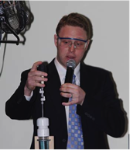
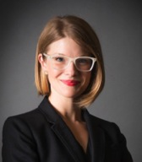
Building with Biology
Larry Bell David Sittenfeld Megan Palmer
Notes:
THURSDAY LUNCH, 12PM
LARRY
Larry makes transition from NISE Net to Building with Biology and introduces David
David describes BwB project and introduces Megan
Megan talks about syn bio

Slide 2

New opportunities
Notes:
LARRY

Slide 3
Building with Biology
Larry Bell David Sittenfeld Megan Palmer
Notes:
THURSDAY LUNCH, 12PM
LARRY
Larry makes transition from NISE Net to Building with Biology and introduces David
David describes BwB project and introduces Megan
Megan talks about syn bio

