Slide 1
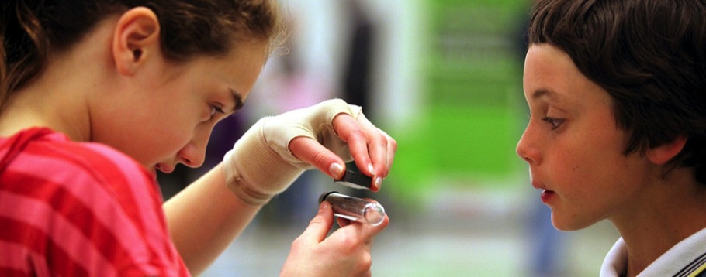
June 2015
Network-Wide Meeting
Thursday wrap-up
www.nisenet.org
Notes:
THURSDAY AFTERNOON, 4:30PM
PAUL: We want to cover a few logistical items before we say a few things to wrap up the meeting

Slide 2
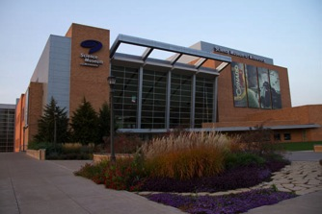
Thursday night
6:00pm – 7:00pm Informal dinner at the museum
7:00pm – 11:00pm Social Science event at the museum
Bring your map (blue top)
Wear your badge
Bring your ID (over 21 years old)
Bring wristband and ticket for Space: An Out of Gravity Experience
Notes:
PAUL

Slide 3
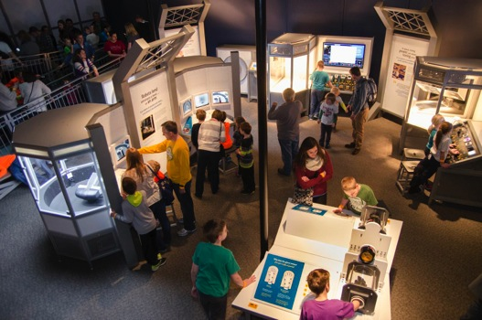
Bike Night: From the nanoscience behind lightweight bike frames to the physics that propels you forward, we'll be digging in deep with the science of cycling.
Evening program for adult audiences
All exhibits will be open
Free tickets for meeting attendees to the special exhibition Space: An Out-of-Gravity Experience
Notes:
PAUL
Experience how nanoscale science content can be integrated into a broader theme, the theme for tonight’s Social Science event is Bike Night.
Bike Night: From the nanoscience behind lightweight bike frames to the physics that propels you forward, we'll be digging in deep with the science of cycling.

Slide 4
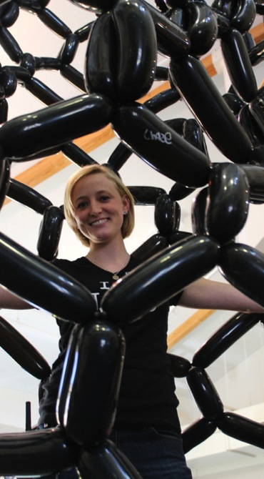
Logistics
Taxis
Taxi shares listing by departure time by the registration area
See page 4 for taxi phone #s
Cleanup of showcase materials and shipping boxes:
Cart for ready-to-ship labeled boxes will be near the registration table Thursday afternoon
We will have packing tape, scissors, and FedEx forms (use your own FedEx shipping account)
Notes:
PAUL
Emphasize: We need to clean everything out of this building tonight before dinner

Slide 5
June 2015
Network-Wide Meeting
Thursday wrap-up
www.nisenet.org
Notes:
THURSDAY AFTERNOON, 4:30PM
PAUL: We want to cover a few logistical items before we say a few things to wrap up the meeting

Slide 6
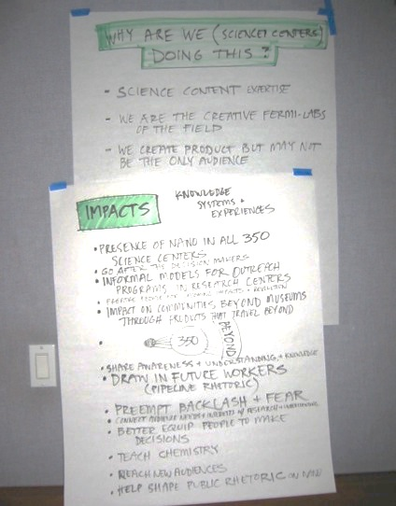
NISE Net reach
Notes from planning meeting a little over 10 years ago in which we talked about our wildest dreams for this project
Notes:
LARRY
A little over ten years ago, Paul, Rob Semper, Carol Lynn Alpert, Bronwyn Bevan, and I met to lay out the ideas for the NSF proposal that eventually got us NISE Net funding. We brainstormed our wildest dreams. Let me zoom in on this section

Slide 7
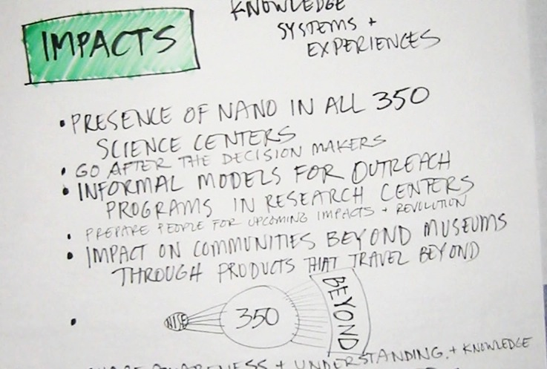
NISE Net reach
Notes:
LARRY
We imagined the presence of Nano in 350 museums and science centers
Informal models for outreach programs in research centers
and impacting the community beyond through the 350 museums

Slide 8
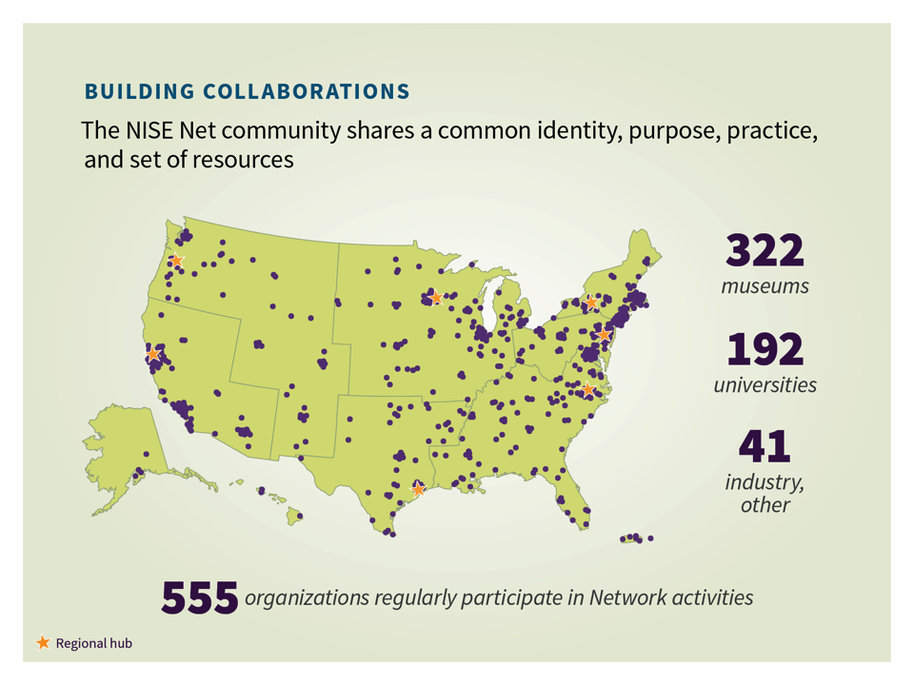
352
203
43
598
Notes:
LARRY
Well, with today’s updated figure, we have actively engaged 352 museums and related ISE organizations, 203 university groups, and 43 others for a total of 598 organizations that have participate actively in NISE Net. I may be wrong, but I don’t think there has ever been a group of this size within our field working together on similar goals and with similar content. And this number will continue to grow through the spin-off project and opportunities we’ve been talking about and through the things that YOU do in the years ahead.

Slide 9
NanoDays kits
Cumulative number of kits distributed
Notes:
LARRY
1650 NanoDays kits have been distributed and the materials from these kits are out there as education resources throughout the country, and everyone yes that they use them for many more things that the annual NanoDays events.

Slide 10
Mini-grants
Cumulative number of mini-grants awarded
Notes:
LARRY
We wanted to make it possible for you to do more with your NISE Net materials and to use them in unique new ways of your own, and so in year 6, we started the Mini-grant program. Mini-grants have support nearly 200 special projects throughout the country where you have made nano informal education your own.

Slide 11
Nano mini-exhibition
Cumulative number of Nano exhibitions distributed
Notes:
LARRY
At the beginning, no one wanted exhibits about nanotechnology. But by the end of our first five years, a strong interest had grown and by the end of this year 93 exhibits will be out there, some rooted in one institution and some being shared among institutions. With all of these resources distribute, the NISE Net is at its peak. Even though our ten years of funding is winding down, we now have extraordinary capacity within our field.

Slide 12
Known Annual Reach
Notes:
LARRY
With the NanoDays kit materials and mini-exhibitions fully deployed we are now reaching over 10 million people each year and that goes on as long as the exhibits are on display and the kit materials are being used.

Slide 13
Known Annual Reach
Notes:
LARRY
With the NanoDays kit materials and mini-exhibitions fully deployed we are now reaching over 10 million people each year and that goes on as long as the exhibits are on display and the kit materials are being used.

Slide 14
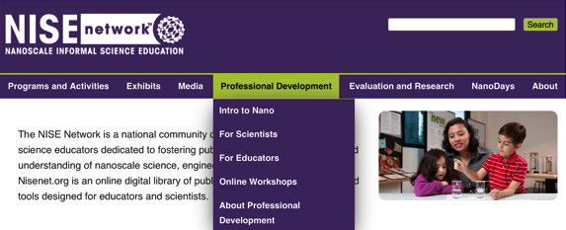
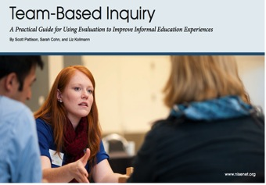
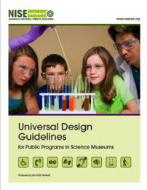
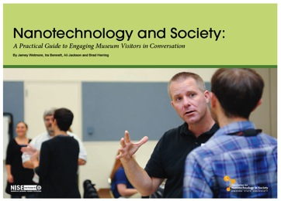

Slide 15
New opportunities
Museum and Community Partnerships
Building with Biology
Sustainability and Science Museums
Small footprint exhibitions
And more
Final grant close is February 2017
Notes:
LARRY

Slide 16
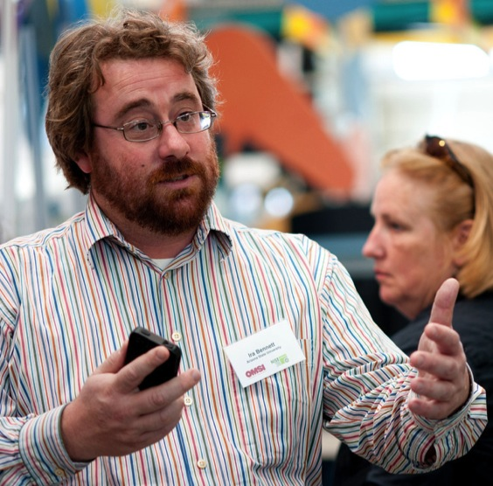
Stay in touch!
Nano Bite Newsletter
www.nisenet.org
kberry@mos.org
Notes:
LARRY

Slide 17
New opportunities
The Network belongs to all of us
Notes:
LARRY (insert photo here from day one plenary of the people in the room

Slide 18
New opportunities
The Network belongs to all of us
picture missing
Notes:
LARRY (insert photo here from day one plenary of the people in the room

Slide 19
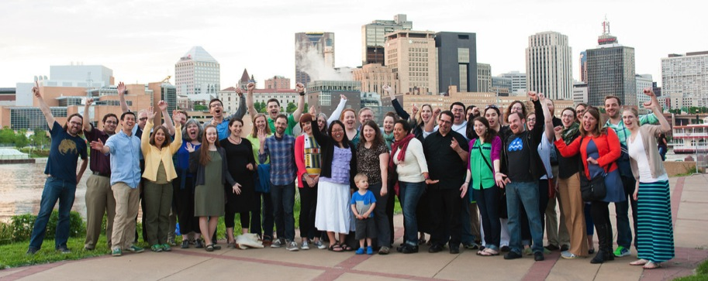
Group photo
Notes:
INSTRUCTIONS TBD

Slide 20
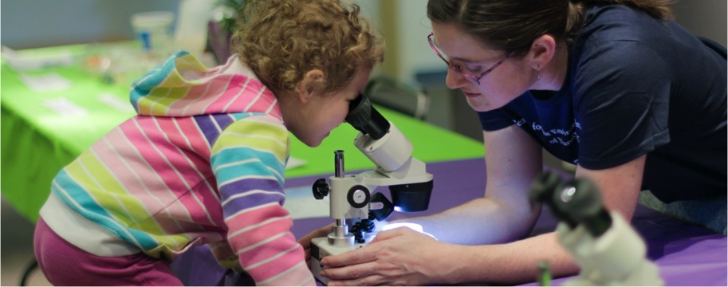
Thank you
Cynthia Needham, ICAN Productions
This presentation is based on work supported by the National Science Foundation under Grant No. 0940143. Any opinions, findings, and conclusions or recommendations expressed in this presentation are those of the authors and do not necessarily reflect the views of the Foundation.

Slide 21
