Slide 1
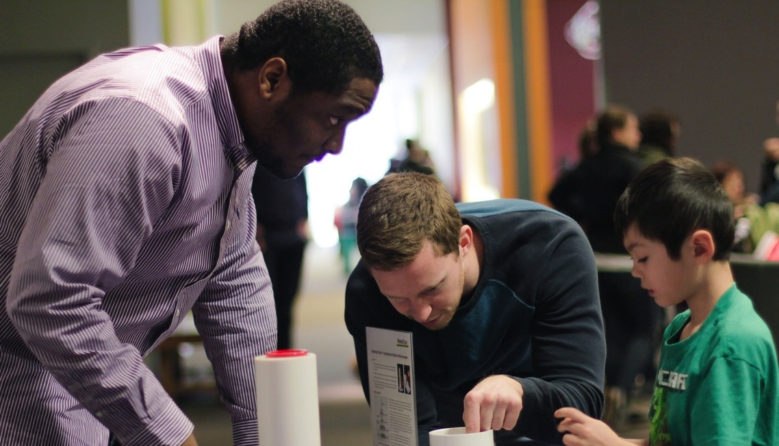
Bringing Science experts into your museum – why, how, and wow!
Association of Children’s Museums Conference May 2018

Slide 2

Presenters
Catherine McCarthy, Science Museum of Minnesota, Saint Paul, MN cmccarthy@smm.org
Michelle Kortenaar, Sciencenter Ithaca, NY mkortenaar@sciencenter.org
Christina Leavell, Science Museum of Minnesota Saint Paul, MN cleavell@smm.org
Becky Wolfe, The Children’s Museum of Indianapolis beckyw@childrensmuseum.org
Celeste Kathleen, Marbles Kids Museum, Raleigh, NC ckathleen@marbleskidsmuseum.org
Notes:
Catherine McCarthy, Project Leader, NISE Network
Science Museum of Minnesota, Saint Paul, MN
cmccarthy@smm.org
Michelle Kortenaar, Senior Director of Engagement and Learning, Sciencenter Ithaca, NY mkortenaar@sciencenter.org
Christina Leavell, Manager, Network Projects,
Science Museum of Minnesota Saint Paul, MN cleavell@smm.org
Becky Wolfe, Manager, Science Education & Resources, The Children’s Museum of Indianapolis beckyw@childrensmuseum.org
Celeste Kathleen, Community Engagement Coordinator, Marbles Kids Museum, Raleigh, NC ckathleen@marbleskidsmuseum.org

Slide 3
Bringing Science experts into your museum – why, how, and wow!
Catherine McCarthy, Science Museum of Minnesota,
Introduction Why, When, Resources
Michelle Kortenaar, Sciencenter Ithaca, NY
Working with and training college students facilitators
Christina Leavell, Science Museum of Minnesota Recruiting volunteers from professional societies and expert networks such as Solar System Ambassadors
Becky Wolfe, The Children’s Museum of Indianapolis Preparing for successful family-friendly large scale events
Celeste Kathleen, Marbles Kids Museum, Raleigh, NC
Forming connections with local scientists and businesses, preparing them for play-based programming
Discussion

Slide 4
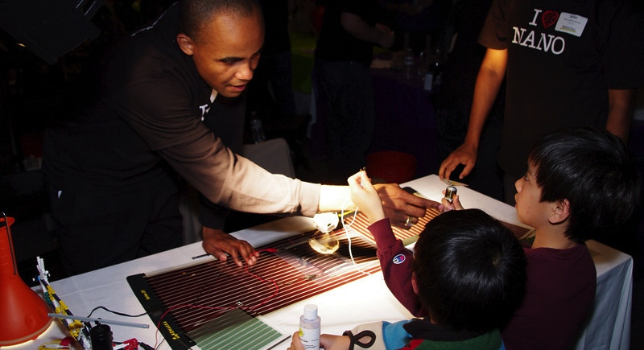


Topic
Catherine McCarthy
cmccarthy@smm.org
Association of Children’s Museums, May 2018
www.nisenet.org

Slide 5
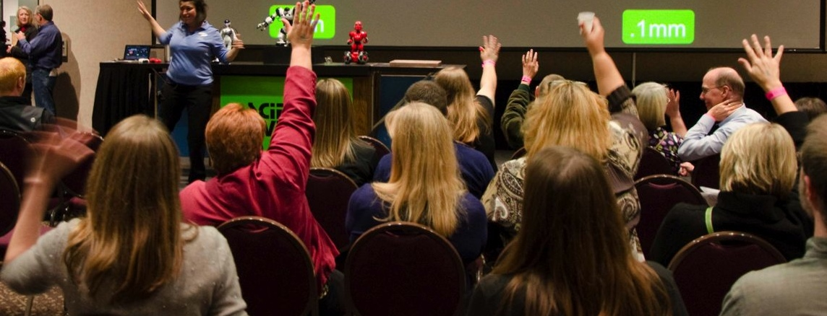
Do you already bring science experts into your museum?
Notes:
Before we start, would you raise your hand if already bring science experts into your museum?

Slide 6
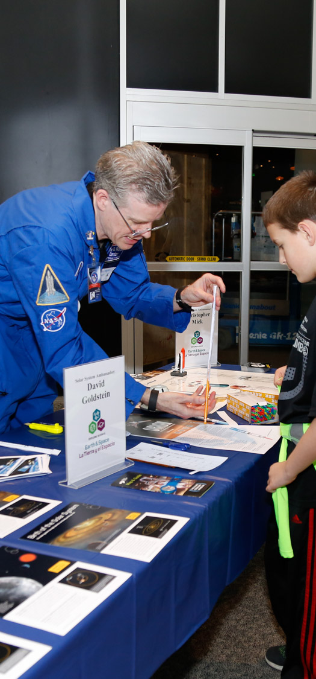
Why?
inspirational
excitement for content
role model for young visitors
opportunity to meet a scientist
chance to have a conversation
Notes:
Why do you want to bring science experts into your museum?

Slide 7
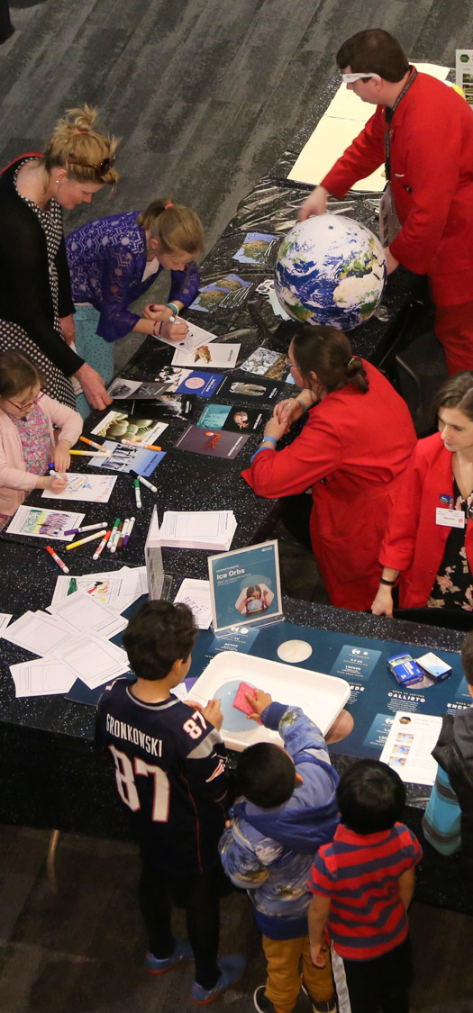
More reasons why
content expertise you don’t have
make connections to members of your local community (businesses, industry, college)
broader impact relationship with local university/ college
science communication opportunity for students /scientists
two-way communication and conversations (public engagement in science)

Slide 8
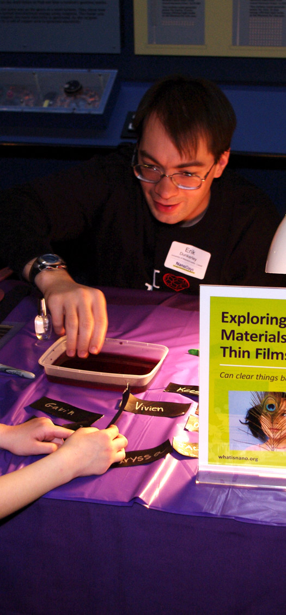
When?
daily
weekly
special events
  Earth Day
  National Chemistry Week
  Astronomical / Celestial events
  NanoDays
  Special STEM days and events

Slide 9
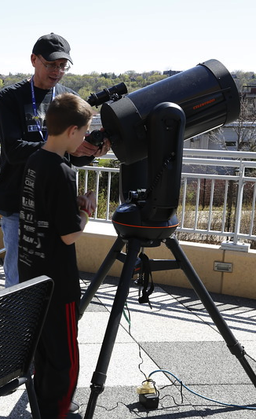
Resources
Handouts
STEM events and holidays
NISE Network training materials and professional development resources
Planning Guest Presentations
Tips for guest speakers
Tips for leading hands-on activities

Slide 10



Thank you to our funders
The Nanoscale Informal Science Education Network is supported by the National Science Foundation under award numbers 0532536 and 0940143. Multi-Site Public Engagement in Science is supported by the National Science Foundation under award number 1421179. Transmedia Museum is supported by the National Science Foundation under award number 1516684. ChemAttitudes is supported by the National Science Foundation under award number 1612482. Collaborative Research: Grounding Institutional Partnerships in Structures for Broader Impacts Design is supported by the National Science Foundation under award number 1610039. Any opinions, findings, and conclusions or recommendations expressed in this presentation are those of the authors and do not necessarily reflect the views of the Foundation.
Sustainability in Science Museums is supported by the Walton Sustainability Solutions Initiatives at Arizona State University (ASU) and is a collaboration with the Center for Engagement and Training in Science and Society at ASU.
Space and Earth Informal STEM Education is supported by NASA under cooperative agreement number NNX16AC67A. Any opinions, findings, and conclusions or recommendations expressed in this material are those of the author(s) and do not necessarily reflect the view of the National Aeronautics and Space Administration (NASA).

Slide 11
Bringing Science experts into your museum – why, how and wow!
Catherine McCarthy, Science Museum of Minnesota,
Introduction Why, When, Resources
Michelle Kortenaar, Sciencenter Ithaca, NY
Working with and training college students facilitators
Christina Leavell, Science Museum of Minnesota Recruiting volunteers from professional societies and expert networks such as Solar System Ambassadors
Becky Wolfe, The Children’s Museum of Indianapolis Preparing for successful family-friendly large scale events
Celeste Kathleen, Marbles Kids Museum, Raleigh, NC
Forming connections with local scientists and businesses, preparing them for play-based programming
Discussion

Slide 12
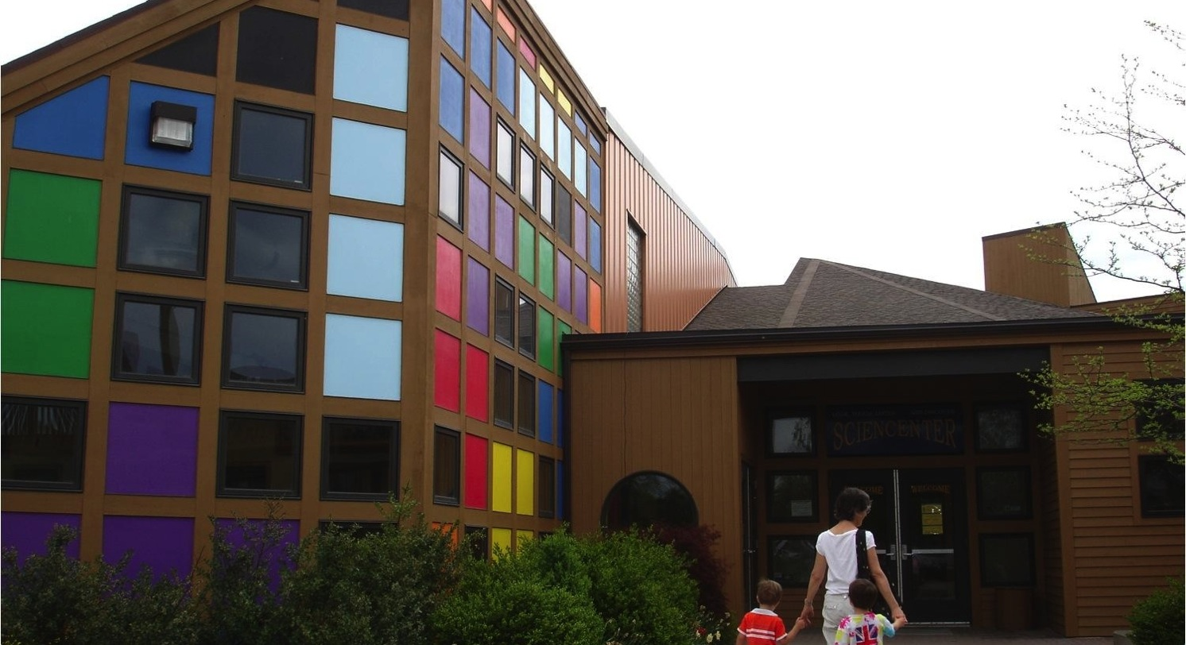

Topic
Michelle Kortenaar
mkortenaar@sciencenter.org
Sciencenter
Ithaca, NY
Notes:
The Sciencenter is a mid-sized museum in upstate New York. We welcome about 109,000 visitors a year, and have 25 staff.

Slide 13
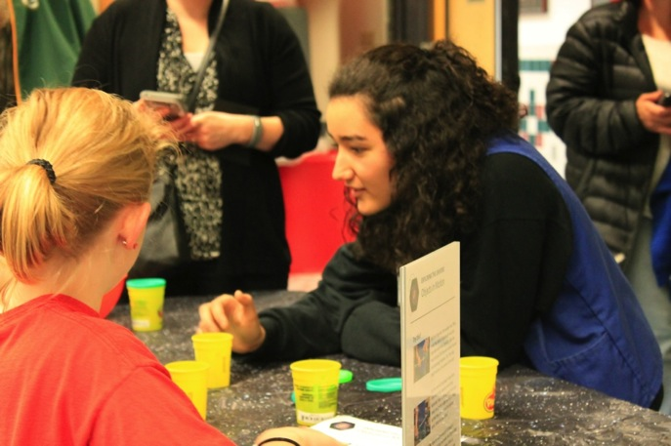
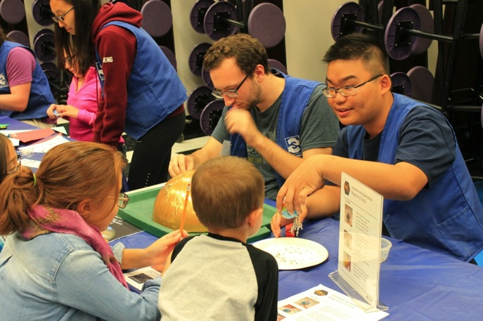
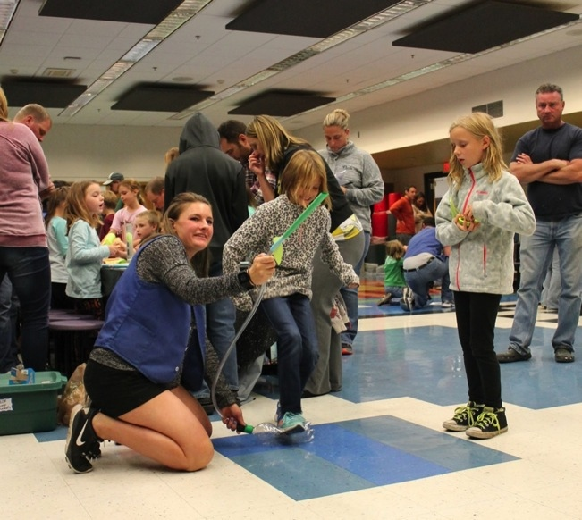
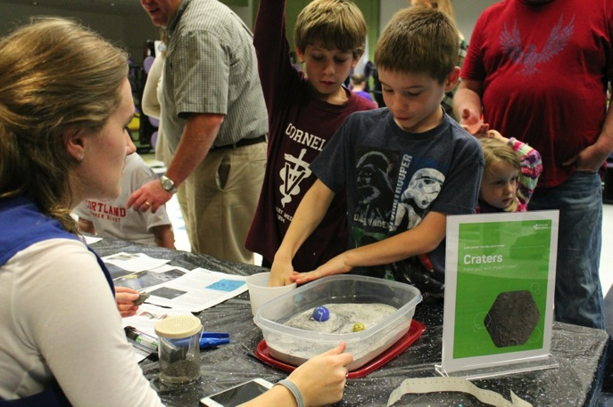
In the Community
Notes:
At the Sciencenter we use volunteers to help us reach a larger audience. These volunteers are often graduate and undergraduate science students. We require that anyone who volunteers for community outreach during the year comes to one training we offer in the fall. We use existing materials, and provide the materials and training needed. That way, we know the activities are good, and we can concentrate on the facilitation. This is an example of a community science night (2 staff, 12 volunteers and 250 guests in 1 hour) with NISE Net Space and Earth Science activities.

Slide 14
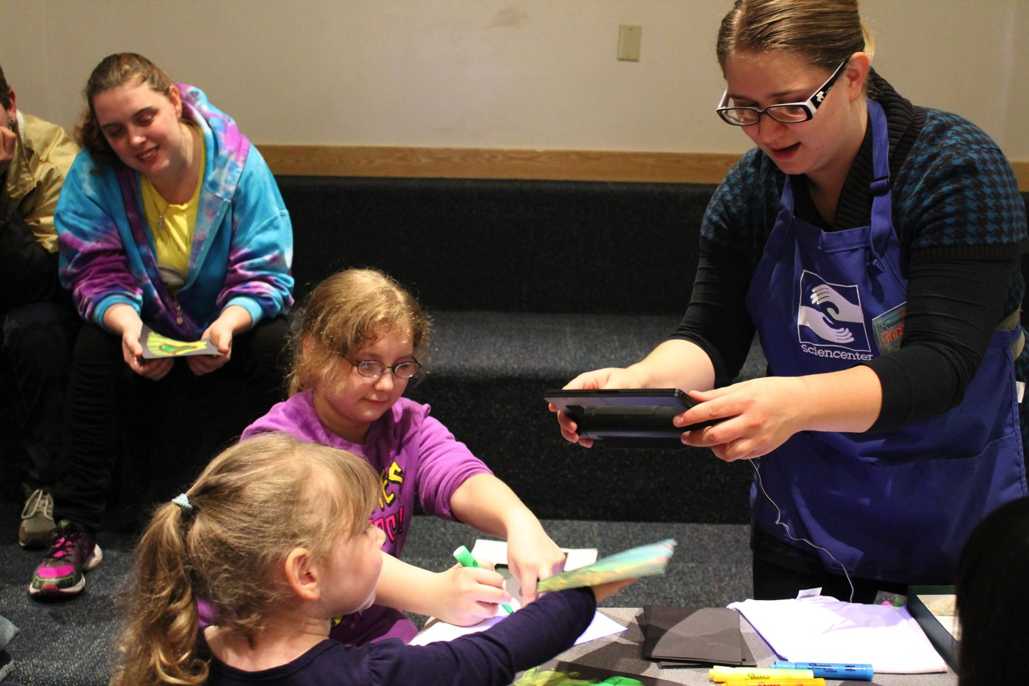
Meet a Scientist
Notes:
At the Sciencenter, we also host “meet a scientist” events where the scientists have created their own activities to share their research. We use PoP Net training to help them develop and facilitate effective activities.

Slide 15
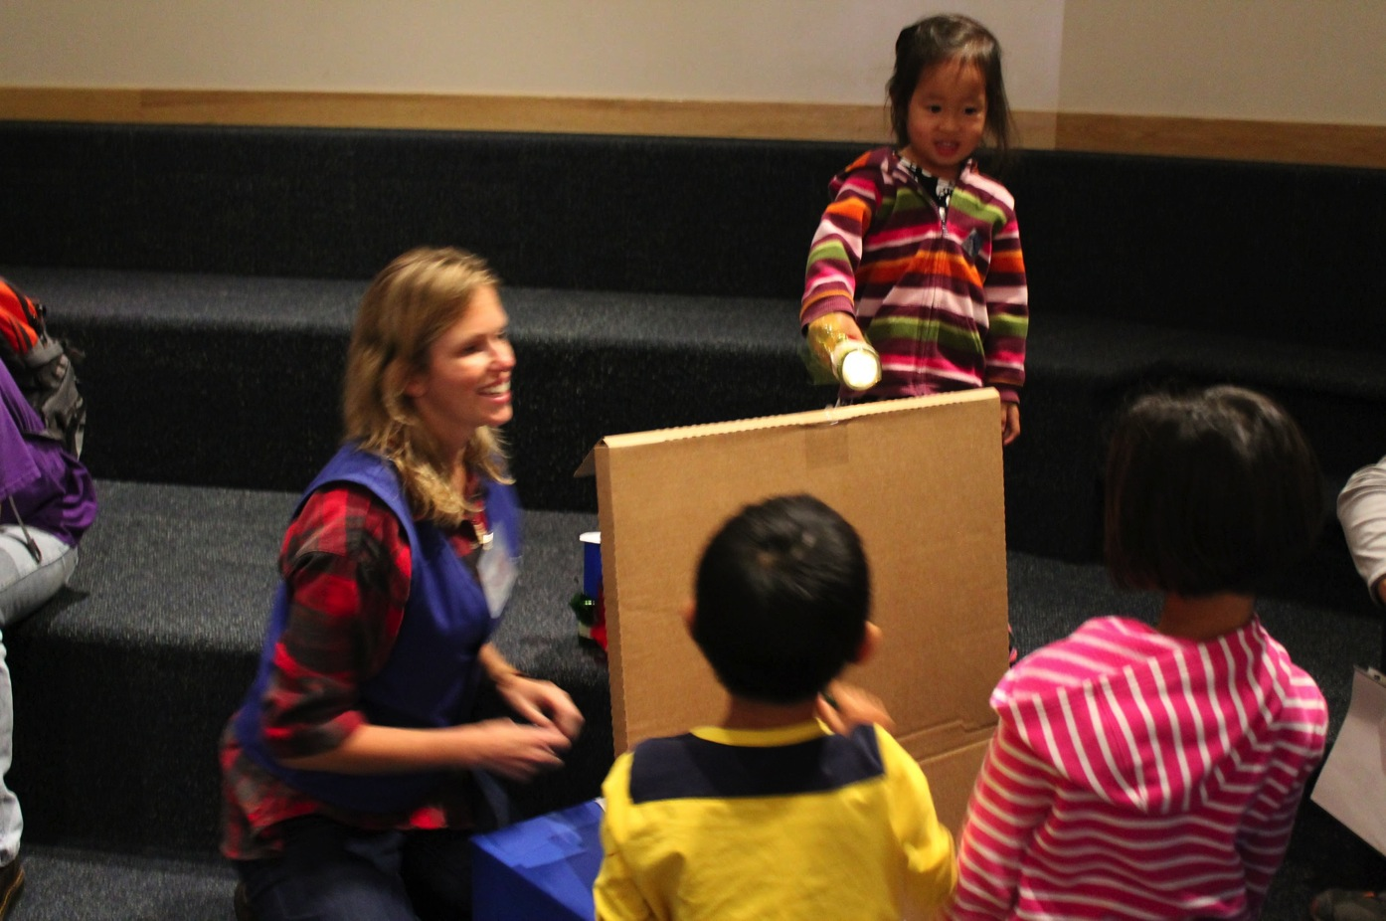
Every Saturday (52+ times/year!)
Notes:
At the Sciencenter, we have to recruit lots of researchers, scientists and enthusiasts and train them, quickly.

Slide 16
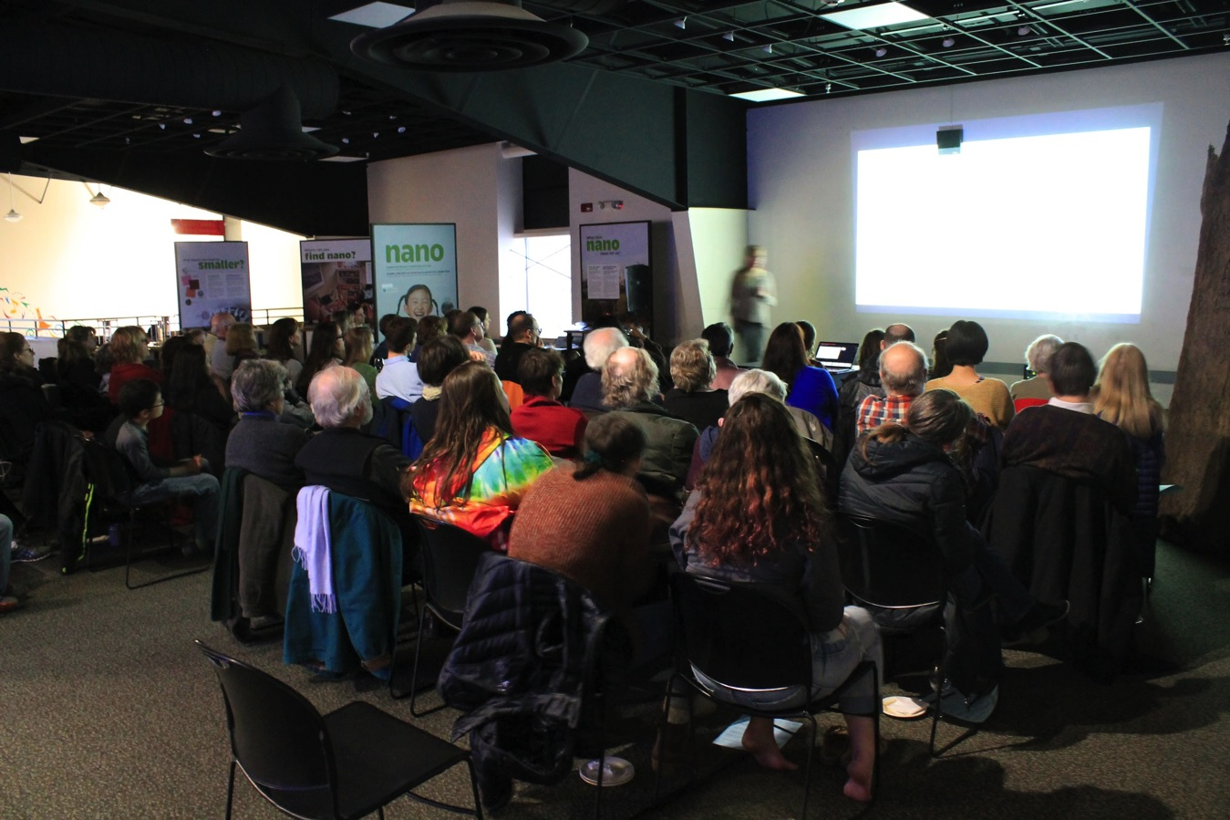
Broader Impact Design
Notes:
With funding from NSF, a group of museums and universities are looking for ways to institutionalize university - ISE partnerships. We are often approached at the last minute to be part of a researcher’s NSF proposal’s Broader Impacts section. We are trying to create tools to help us institutionalize these partnerships - how do researchers find us? how do we decide which partnerships help us to meet our mission? how do we ensure that the outreach meets the needs of our community, and is based on current research into learning?

Slide 17
Bringing Science experts into your museum – why, how and wow!
Catherine McCarthy, Science Museum of Minnesota,
Introduction Why, When, Resources
Michelle Kortenaar, Sciencenter Ithaca, NY
Working with and training college students facilitators
Christina Leavell, Science Museum of Minnesota Recruiting volunteers from professional societies and expert networks such as Solar System Ambassadors
Becky Wolfe, The Children’s Museum of Indianapolis Preparing for successful family-friendly large scale events
Celeste Kathleen, Marbles Kids Museum, Raleigh, NC
Forming connections with local scientists and businesses, preparing them for play-based programming
Discussion

Slide 18
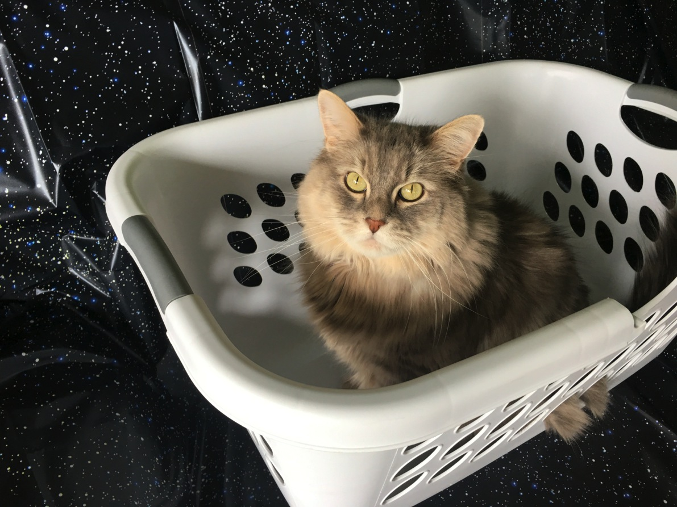
Finding Volunteers – Amateur Astronomers and Beyond
I haz space ship.
Christina Leavell
Manager, Network Projects
and NISE Network Midwest Regional Hub Leader at
The Science Museum of Minnesota

Slide 19
WHAT am I talking about…
Professional societies and expert networks:
  NOT a comprehensive overview!
  Earth and Space Project
  Chemistry Project
Why, When & How to connect
Specific experiences with the Solar System Ambassadors program

Slide 20
WHY
I work with these volunteers

Slide 21
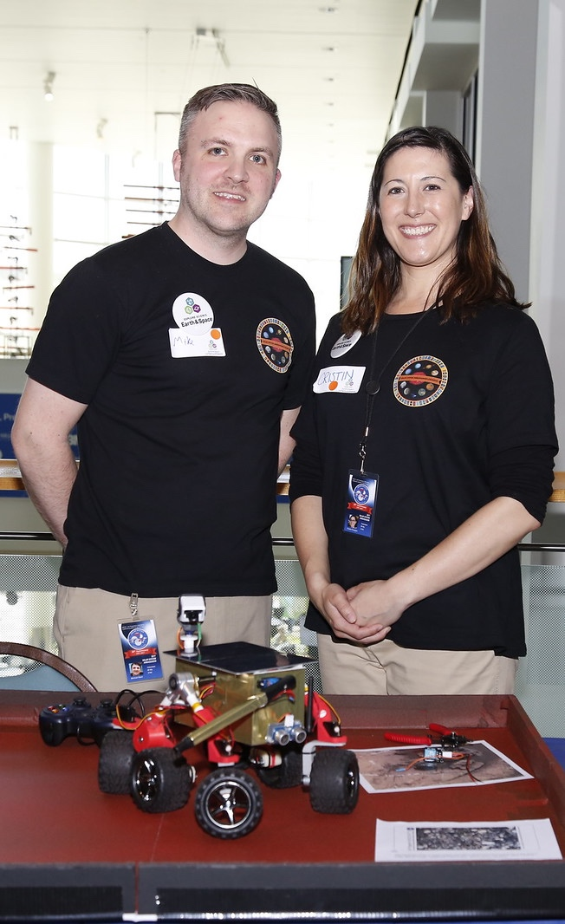
WHY
Incredibly passionate
  Special way of engaging with audiences around this content
Professionally trained and/or experienced working in a museum setting
  Easily oriented to working with your audiences – less staff time training
New and unique resources to share
  Telescopes
  Model Rovers
  Make and takes
Seeking these opportunities!

Slide 22
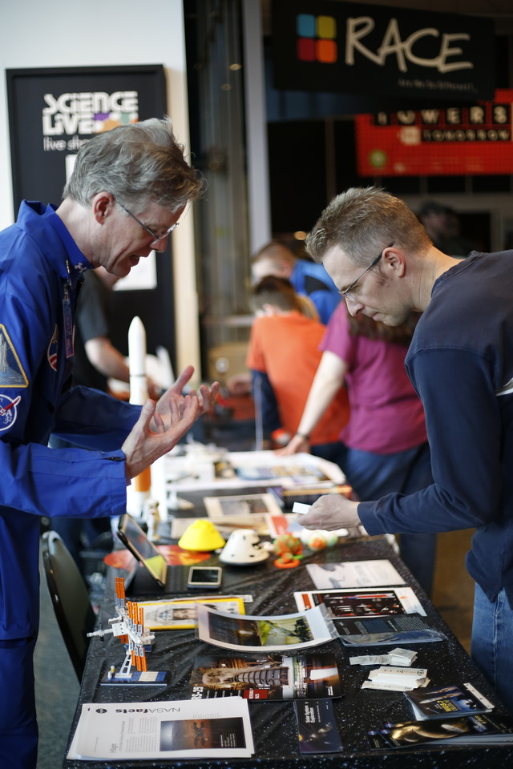
WHEN
National Festivals & Events:
  2017 Total Solar Eclipse
  Earth Day, Yuri’s Night, etc.
  National Chemistry Week
Passionate Speakers:
  Special Events - Sit with an Amateur Astronomer
  Evening Programs - Scientist Speed Dating
  Large group presentations
Hands-on Activities:
  Summer Camps
  Afterschool programs
  Regular floor demos and toolkit activities
More ideas: nisenet.org/seasons

Slide 23
HOW
do I find volunteers?

Slide 24
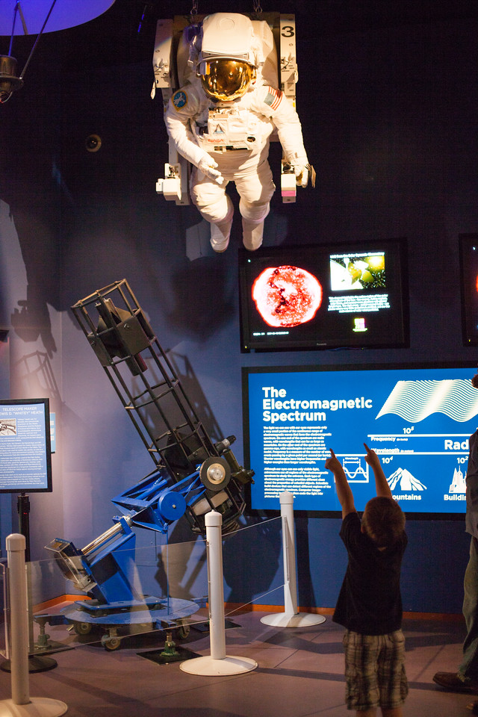
Earth and Space Science
Night Sky Network: amateur astronomy clubs, members share their time and telescopes to provide unique astronomy experiences at science museums, observatories, classrooms, and under the real night sky.
http://nightsky.jpl.nasa.gov/index.cfm
American Astronomical Society: “Astronomy Ambassadors,” program provides mentoring and training experiences for young astronomers http://aas.org/outreach/roster-aas-astronomy-ambassadors
Solar System Ambassadors Program (SSA)
http://solarsystem.nasa.gov/ssa/home.cfm

Slide 25
WOW!
Great Experiences with
Solar System Ambassadors

Slide 26

Solar System Ambassadors Program
Professional Development – Collaboration with the NASA Museum Alliance at JPL
Program over 20 years old
Over 750 space enthusiast volunteers in 2017
Public engagement across all 50 states as well as:
  Puerto Rico, Guam, US Virgin Islands
  US citizens living abroad: Netherlands, Nigeria, Germany, Japan, Republic of Korea, United Kingdom

Slide 27
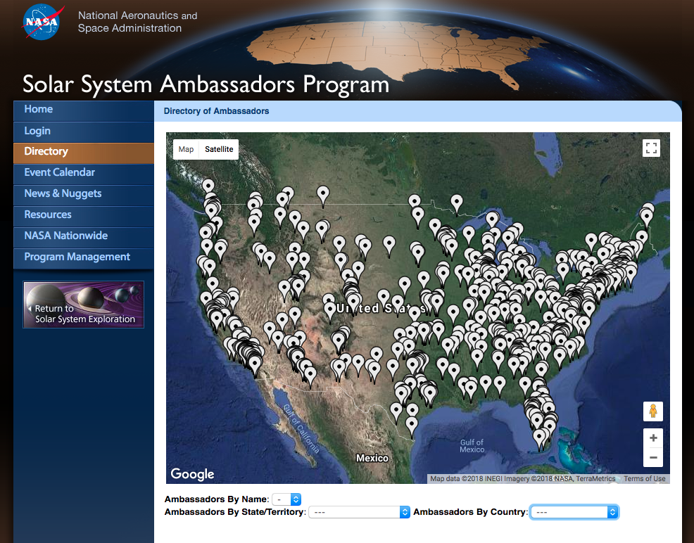
solarsystem.nasa.gov/ssa/home.cfm

Slide 28
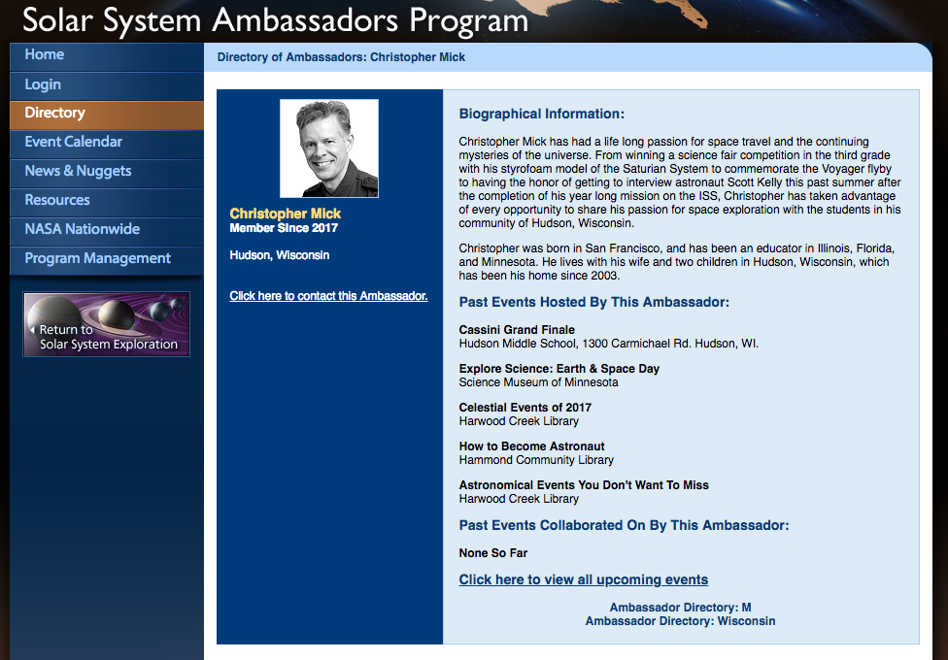

Slide 29
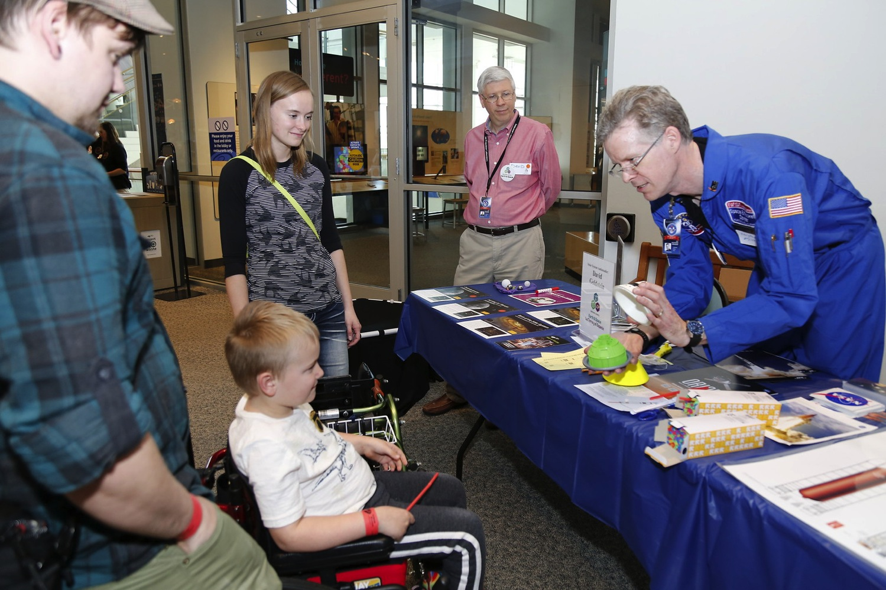

Slide 30
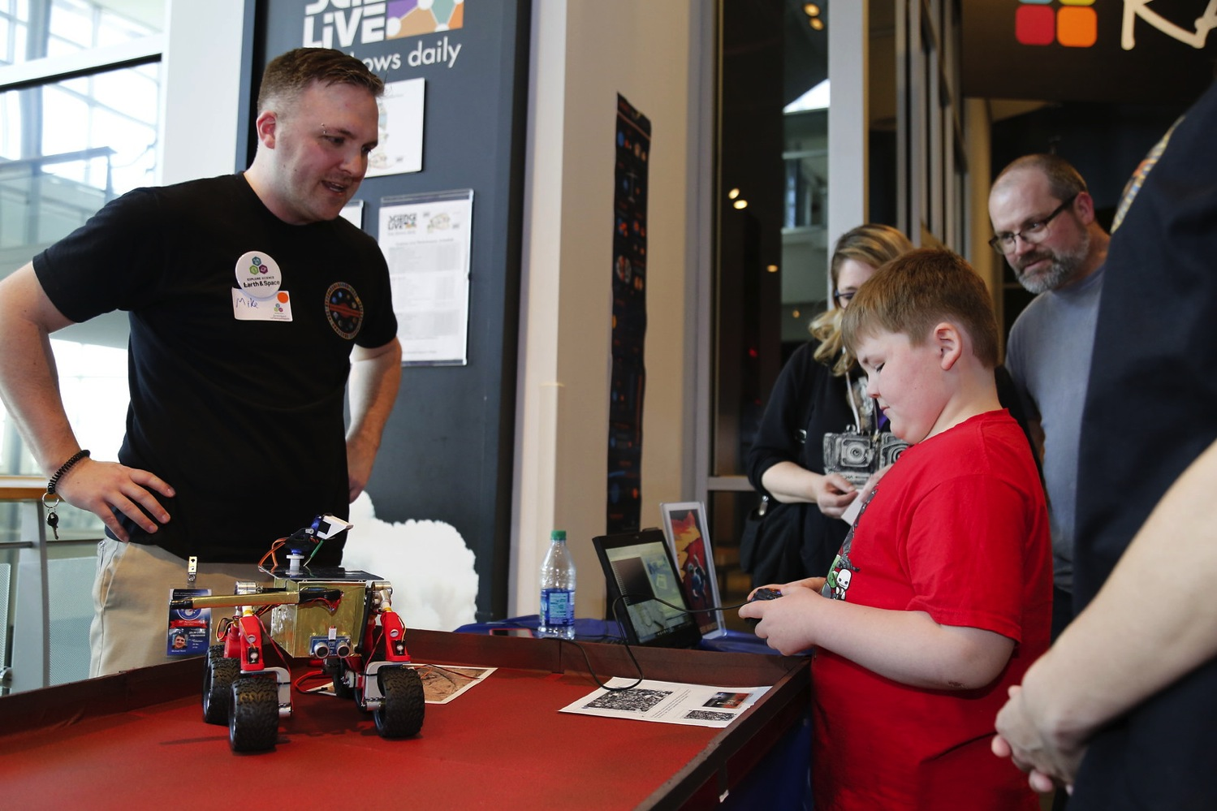

Slide 31
WAIT!
What about Chemistry?

Slide 32

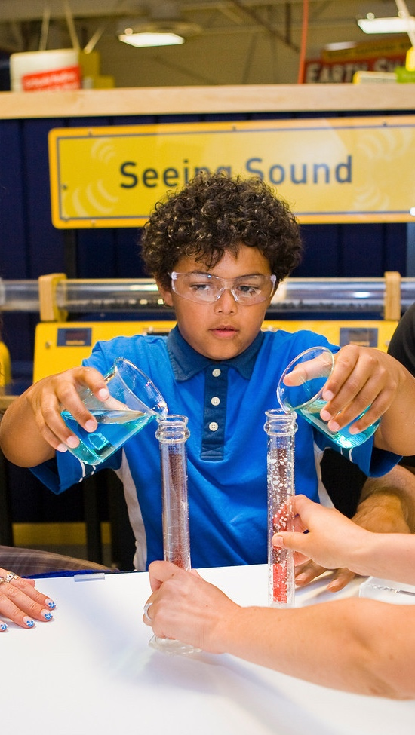

Chemistry
American Chemical Society (ACS) Local Sections: 185 nationwide https://lslookup.acs.org/lslookup/local_search
American Chemical Society (ACS) Student Chapters: located on many college campuses across the country.
https://www.acs.org/content/acs/en/education/students/college/studentaffiliates/find-a-chapter.html

Slide 33

Explore Science: Let’s Do Chemistry!
STILL TIME TO APPLY!!!
Applications due June 1, 2018
Kit Overview document and how to apply:
http://www.nisenet.org/chemistry-apply
In collaboration with the American Chemical Society, the NISE Network has assembled a set of engaging, hands-on experiences designed to stimulate interest, sense of relevance, and feelings of self-efficacy about chemistry among public audiences.
250 free physical kits awarded to successful applicants for public events between October and December 2018.
A great opportunity to use the Explore Science: Let’s Do Chemistry kit is during National Chemistry Week taking place October 21-27!

Slide 34
Conclusion: WHY NOT!?
Working with professional societies and networks…
  Access to current pool of passionate professionals
  Expands upon program offerings at your museum
  No additional training required
  Gives audiences an engaging and unique experience

Slide 35
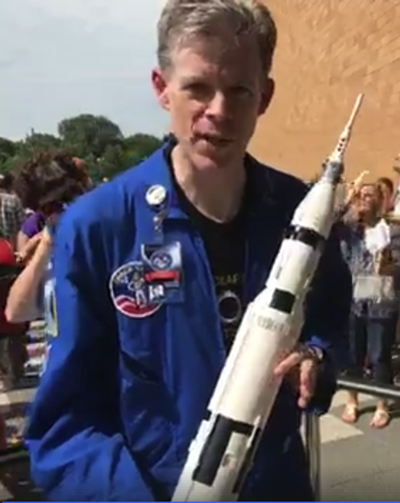
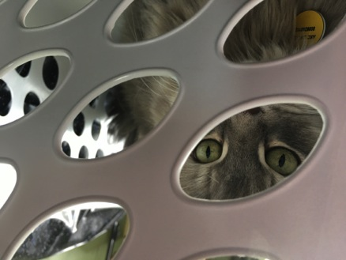

Thank You!
Contact me with questions & find your local societies/networks!
Christina Leavell, Science Museum of Minnesota: cleavell@smm.org
I haz better space ship.
This material is based upon work supported by NASA under cooperative agreement award number NNX16AC67A.
Any opinions, findings, and conclusions or recommendations expressed in this material are those of the author(s) and do not necessarily reflect the view of the National Aeronautics and Space Administration (NASA).

Slide 36
Bringing Science experts into your museum – why, how and wow!
Catherine McCarthy, Science Museum of Minnesota,
Introduction Why, When, Resources
Michelle Kortenaar, Sciencenter Ithaca, NY
Working with and training college students facilitators
Christina Leavell, Science Museum of Minnesota Recruiting volunteers from professional societies and expert networks such as Solar System Ambassadors
Becky Wolfe, The Children’s Museum of Indianapolis Preparing for successful family-friendly large scale events
Celeste Kathleen, Marbles Kids Museum, Raleigh, NC
Forming connections with local scientists and businesses, preparing them for play-based programming
Discussion

Slide 37

Scientists and Large Scale Events
Becky Wolfe

Slide 38
Before You Recruit
Set your goals and objectives
Identify your target audience
Choose your location, venue and time of day
Identify science content for event
Reminder - not everyone will be a good fit
Notes:
Treat this like any other program. Why do you want to bring in a scientist? What is your rationale for this program? What will the ideal visitor experience. It’s important to decide if you are okay with a presentation, if you want Q&A or if you are looking for the speaker to work more informally with visitors?
Speakers will often tell you, I can talk to anyone or will have an idea what their ideal audience will be. Decided prior to making contact who your audience will be. Make sure you know what it appropriate for younger children vs middle school students.
Speakers will want to know this morning. Make sure you can share this information.
This is your event, and if people have a good experience, they will associate positive thoughts with your museum. The same is true. Ultimatley, you are driving this event. It’s okay, and helpful to speakers if you can be specific of the content for the event.

Slide 39
Questions to Ask
Have you ever presented to children or middle school students before?
Will you have any visuals to share?
What is the length of your presentation?
Would it be possible for me to preview?
  Ask about TED talks, other local events

Slide 40
Prepping Your Speaker & Event
Share venue photos
Explain your audience
Provide a tour
Logistics, logistics, logistics
Contracts
Social media
Promotion
Notes:
Sharing photos of where your speaker will be talking, for speakers who may not be able to visit will be able to visit will help them visualize
You are the expert on your audience – if you know young children will be in the audience, make sure that you tell the speaker what to expect. Remind them that visuals go a long way. If there are developmental needs of the specific audience, such as explaing vocabulary share this!
If you speaker is local, offer to have them visit the museum. This will let them see the venue, but also give you a chance to talk inmore detail. You can also offer to preview or review the presentation and provide feedback.
Provide your speaker with all of the information they might need – where to park, where to check in. If this is a new thing, the presenter will be nervous and this makes it worse. Your presenter might tell you that they know the museum well or are their with their kids – give them specifics anyway.
Make sure you have cleared up any contract and payment issues. It’s not easy to talk about these things, but you don’t want to ruin the day! If you are provided a contract, read it closely – there may be information about travel or the like that you need to know.
Always make sure you know what type of social is appropriate – can you tweet, live FB, instastory? A lot of your big name speakers will have these platforms, and are open to getting traction
Let the speaker know how you will be promoting this. Nothing is worse that having a school only presentation, and your speaker has promoted this to their univeristiy. You can also ask if it’s okay to reference them in the recuirtment, and ask if they have a media photo. Part of your promotion discussion should also be about press releases and inviting local media. Make sure they know what you are doing and do allow them to preview. It’s also important to know if they will want to speak to the media.

Slide 41
Presentation Day!
Provide a handler
Green room
Plan extra time for tech issues
Offer lunch (or coffee)
Plan the Q & A
Find a bouncer
Thank yous
Notes:
Make sure you have a dedicated staff member or volunteer to help this person. This is especially important if you are busy with other event logistics. On paper, it might look like you have time to do both, but don’t assume you will!
Always provide a place for the person to stash their coat, purse or just take a breather. Don’t forget water!
Make sure your venue is ready with plenty of time to test technology – all of it! Whenever possible, have the speaker provide you with their media ahead of time. If they do, be diligent and test it!
While you might not be providing lunch for your volunteers, the presentation will be near a meal time, offer. It’s a nice gesture.
If it’s someone really famous, make sure that you have an exit plan – people will try to mob you! Have a staff person who can help manage the crowd.
Ask if the speaker wants help with Q & a
I always provide a little token from the museum and a hand written note. It’s a simple gesture that goes a long way. For other volunteers I work with, especially academia, I ask if there is someone I can contact to share my thanks. This provides the documentation they need for service.

Slide 42
The Good and the Questionable
Astronaut visits
Magnet Man
Paleontologists
Notes:
I have worked with several retired and current astronauts. For current astronauts, there I had to figure out all of the details prior to the application. For a retired astronaut that was an advisor, and also did regular presentations, I prepped him on audience specifics. After I saw his presentation, we made edits to his video, to shorten it for the museum audience. I shared key points that would be appropriate to the students.
This is my disaster story. Someone approached the museum about bringing a scientists from out of state to speak at the museum. We didn’t ask enough questions – it sounded like this guy was a big name, but he was being honored by a high school. He wasn’t expecting to speak to students, and had to change his slides a few days prior to the event. This wasn’t set up as a partnerhsip, but more of a way to appease a donor. We had to comp admission to get school groups to attend, and the content was a lecture. It was way over their heads. As a result, I’ve learned to tell people no and are very upfront with them – this is what my audience expects.
Phil and Victoria – contracted with them to work on our paleo projects. We started doing presentations because I saw how enganging Phil is with visitors. He also has great visuals too share. To develop his school presentation, we talked through what are students learning, what is appropriate language and identifyed key messages

Slide 43
Bringing Science experts into your museum – why, how and wow!
Catherine McCarthy, Science Museum of Minnesota,
Introduction Why, When, Resources
Michelle Kortenaar, Sciencenter Ithaca, NY
Working with and training college students facilitators
Christina Leavell, Science Museum of Minnesota Recruiting volunteers from professional societies and expert networks such as Solar System Ambassadors
Becky Wolfe, The Children’s Museum of Indianapolis Preparing for successful family-friendly large scale events
Celeste Kathleen, Marbles Kids Museum, Raleigh, NC
Forming connections with local scientists and businesses, preparing them for play-based programming
Discussion

Slide 44

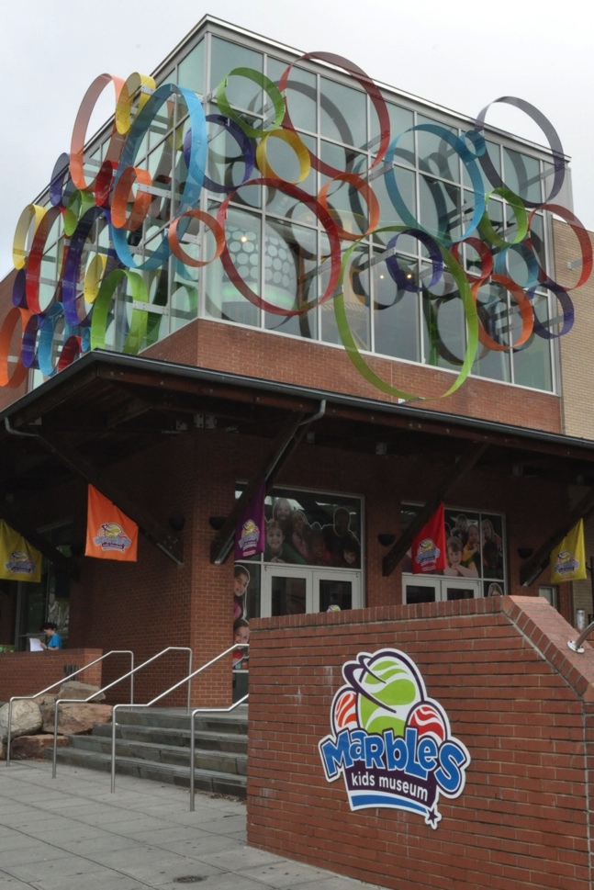
Engaging Scientists at Marbles Kids Museum
Downtown Raleigh, NC
Over 650,000 visitors per year
Over 100,000 SQ FT
Smaller opportunities: monthly
Large Scale Programs: quarterly

Slide 45
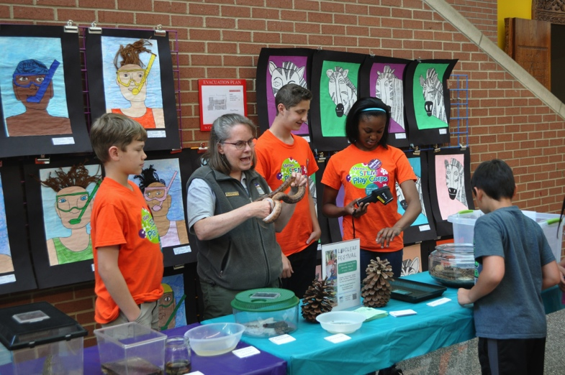
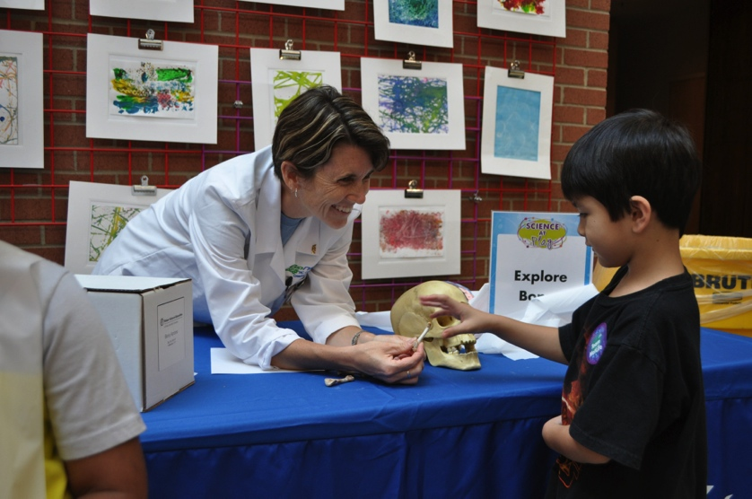
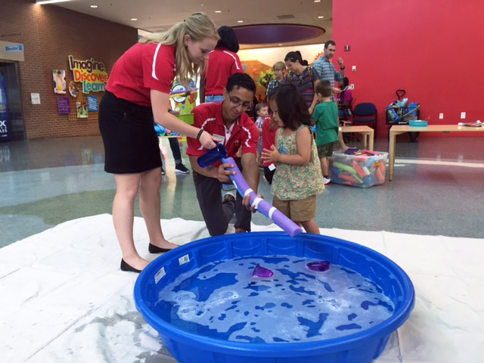
Engaging Scientists at Marbles Kids Museum
SMALL SCALE
1 program per month
2 hours in length
One partner per program focusing on his or her work

Slide 46
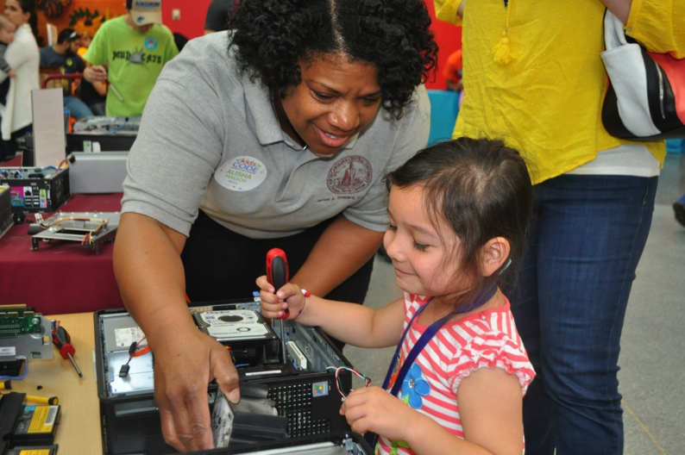
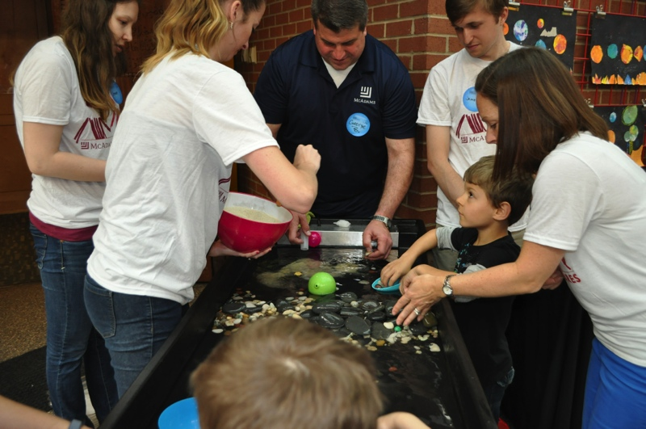
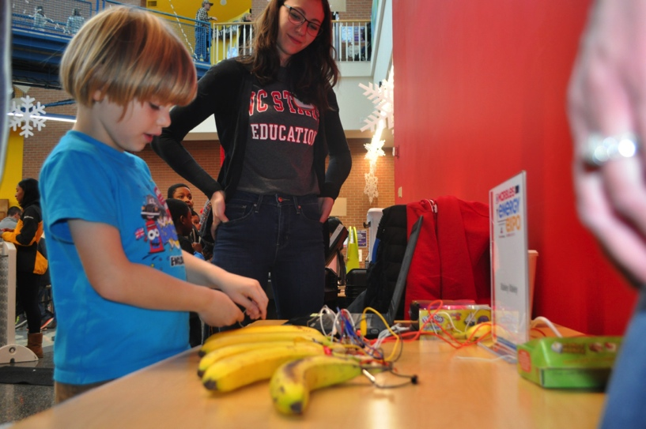
Engaging Scientists at Marbles Kids Museum
LARGE SCALE
1-2 times per year each
3-4 hours in length
Involve ten or more partners
One common theme ( Blast Off, Kids Code, Engineer It)

Slide 47
Engaging Scientists at Marbles Kids Museum
RECRUITMENT:
KEYS TO SUCCESS:
Local STEM Expos
Networking Events
Career Fairs
Neighbors
Personal Connections
Local Universities
Keep your mission at the forefront
Pair the science experts with play experts
Prepare the scientists for the type of audience your museum will be.

Slide 48
Bringing Science experts into your museum – why, how and wow!
Catherine McCarthy, Science Museum of Minnesota,
Introduction Why, When, Resources
Michelle Kortenaar, Sciencenter Ithaca, NY
Working with and training college students facilitators
Christina Leavell, Science Museum of Minnesota Recruiting volunteers from professional societies and expert networks such as Solar System Ambassadors
Becky Wolfe, The Children’s Museum of Indianapolis Preparing for successful family-friendly large scale events
Celeste Kathleen, Marbles Kids Museum, Raleigh, NC
Forming connections with local scientists and businesses, preparing them for play-based programming
Discussion

Slide 49
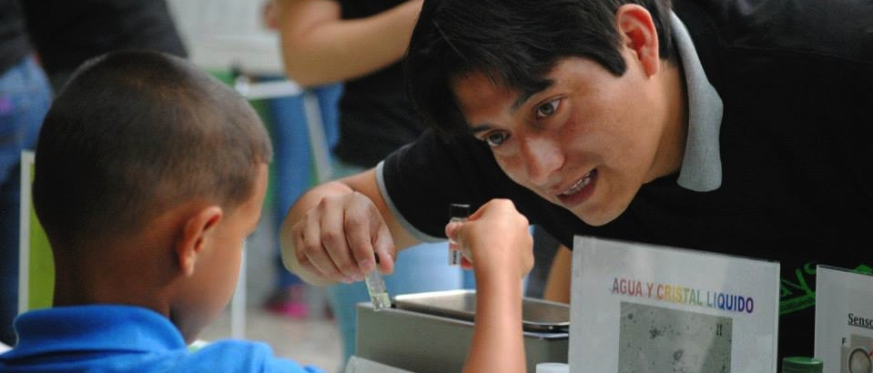
DISCUSSION

Slide 50
Resources
Handouts
STEM events and holidays
NISE Network training materials and professional development resources
Planning Guest Presentations
Tips for guest speakers
Tips for leading hands-on activities

Slide 51
Thank you to our funders
The Nanoscale Informal Science Education Network is supported by the National Science Foundation under award numbers 0532536 and 0940143. Multi-Site Public Engagement in Science is supported by the National Science Foundation under award number 1421179. Transmedia Museum is supported by the National Science Foundation under award number 1516684. ChemAttitudes is supported by the National Science Foundation under award number 1612482. Collaborative Research: Grounding Institutional Partnerships in Structures for Broader Impacts Design is supported by the National Science Foundation under award number 1610039. Any opinions, findings, and conclusions or recommendations expressed in this presentation are those of the authors and do not necessarily reflect the views of the Foundation.
Sustainability in Science Museums is supported by the Walton Sustainability Solutions Initiatives at Arizona State University (ASU) and is a collaboration with the Center for Engagement and Training in Science and Society at ASU.
Space and Earth Informal STEM Education is supported by NASA under cooperative agreement number NNX16AC67A. Any opinions, findings, and conclusions or recommendations expressed in this material are those of the author(s) and do not necessarily reflect the view of the National Aeronautics and Space Administration (NASA).

Slide 52
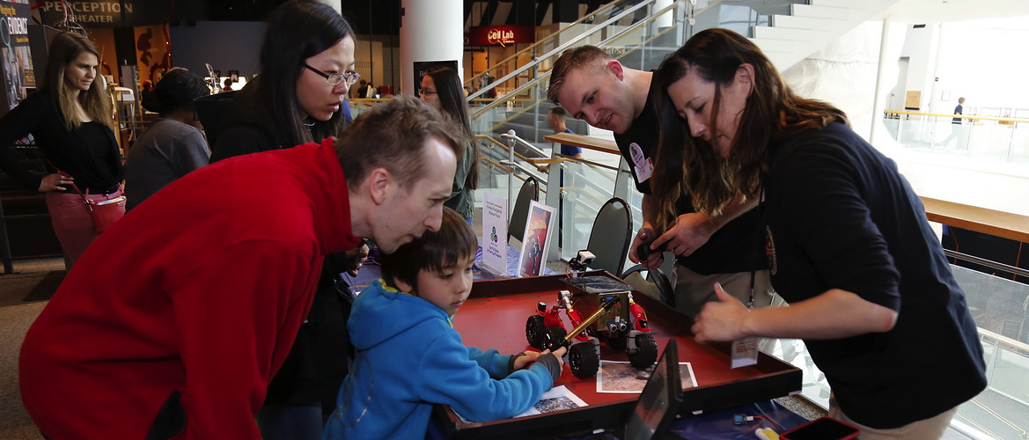
Discussion Questions
How do you select and screen volunteers?

Slide 53
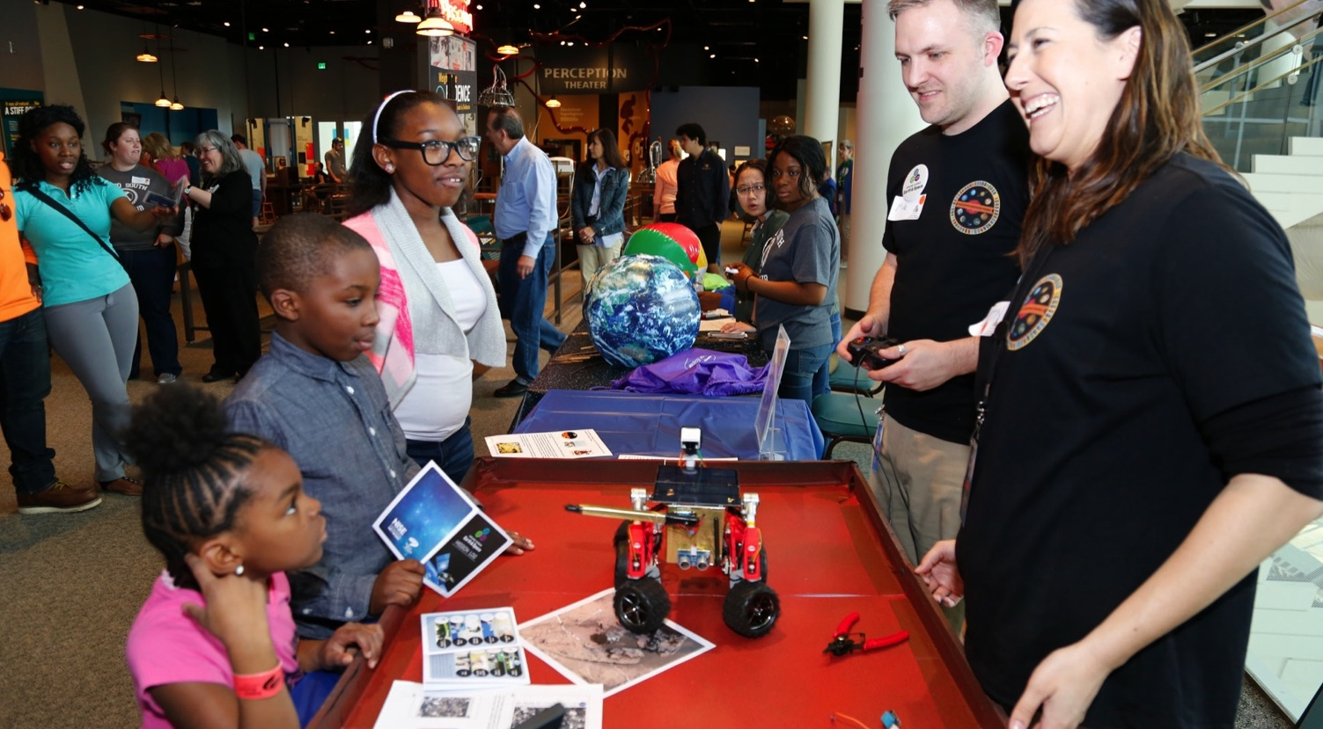
Discussion Questions
Can you tell us about things that didn’t go so well? Any cautionary tales we can learn from

Slide 54
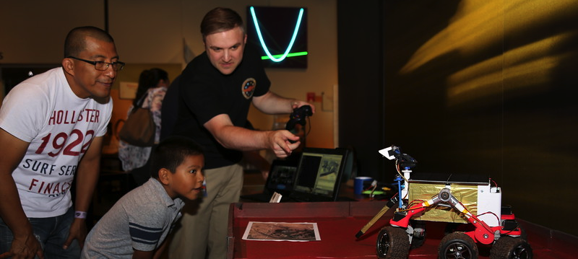
Please fill out an evaluation form

