Slide 1
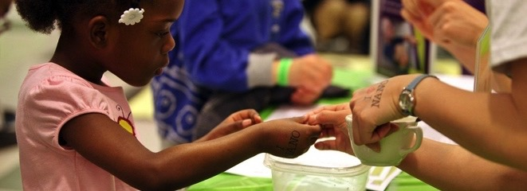

ENGAGING ALL LEARNERS:
Partnerships and programs
to reach diverse audiences
Association of Children’s Museums
Interactivity 2017

Slide 2
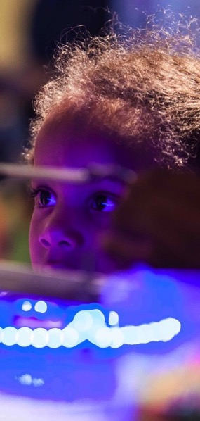
Session overview
MUSEUM & COMMUNITY PARTNERSHIPS
Rae Ostman | raeostman@gmail.com
Catherine McCarthy | cmccarthy@smm.org
PARTNERSHIP PROGRAMS
Keith Ostfeld | KTO@cmhouston.org
Don Riefler | donaldr@childrensmuseum.org
Nora Thompson | nthompson@portdiscovery.org
Kathleen Lawson | klawson@museumofdiscovery.org
Q&A
DISCUSSION

Slide 3
NISE Network

Slide 4
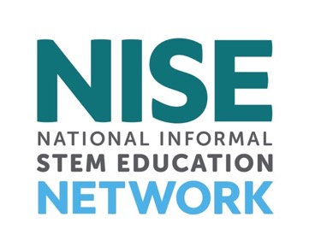
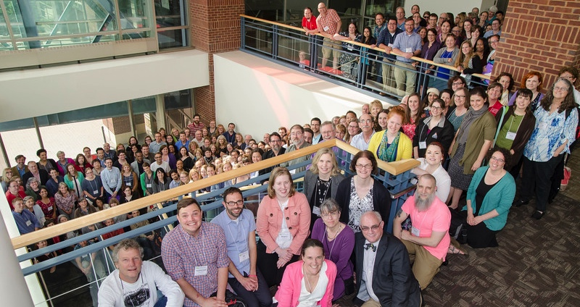

Slide 5
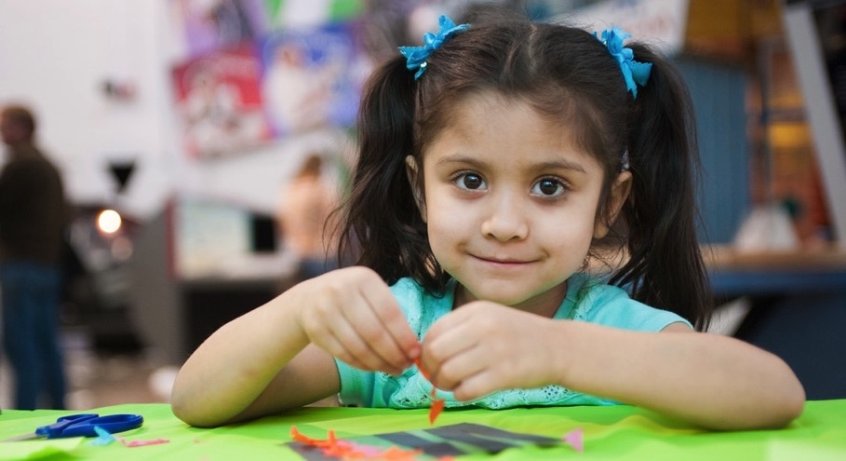
NISE Net supports informal learning about STEM in communities across the United States.

Slide 6
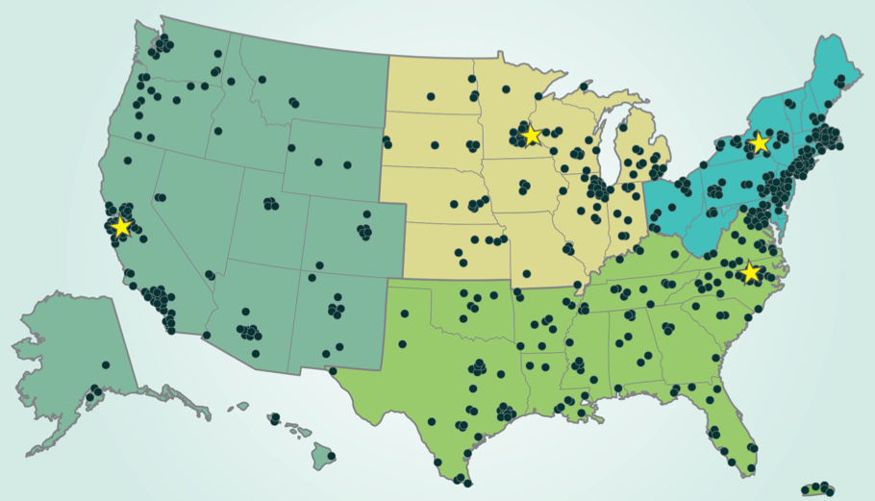
Over 600 organizations regularly participate in Network activities.
Notes:
All 50 states and Puerto Rico
~400 museums
~200 universities

Slide 7
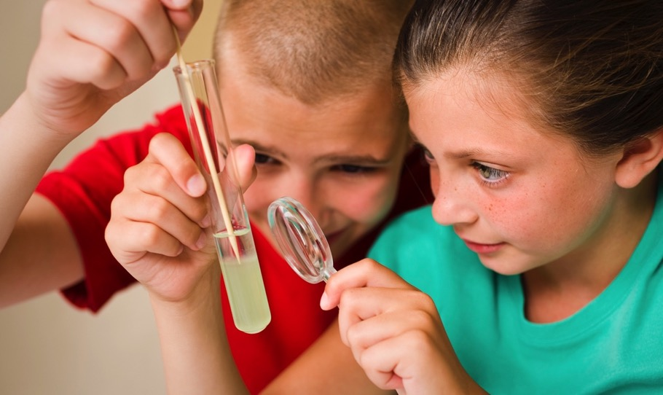
Together, we reach millions of people each year!

Slide 8
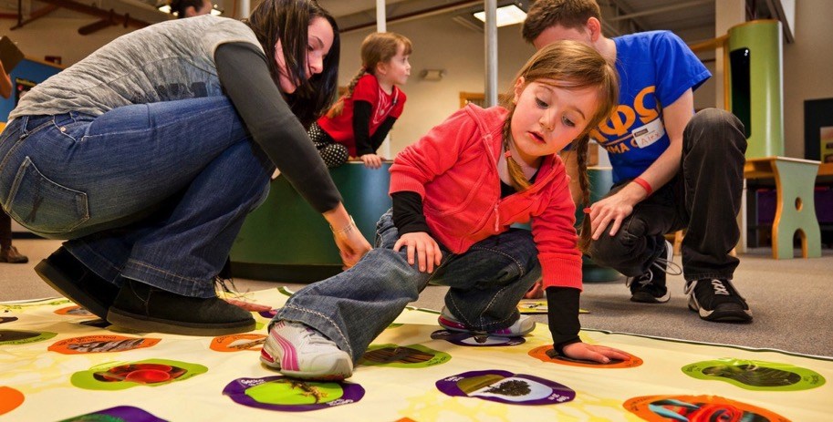
NISE Net engages all audiences in learning about STEM in ways that are fun and easy to understand.

Slide 9
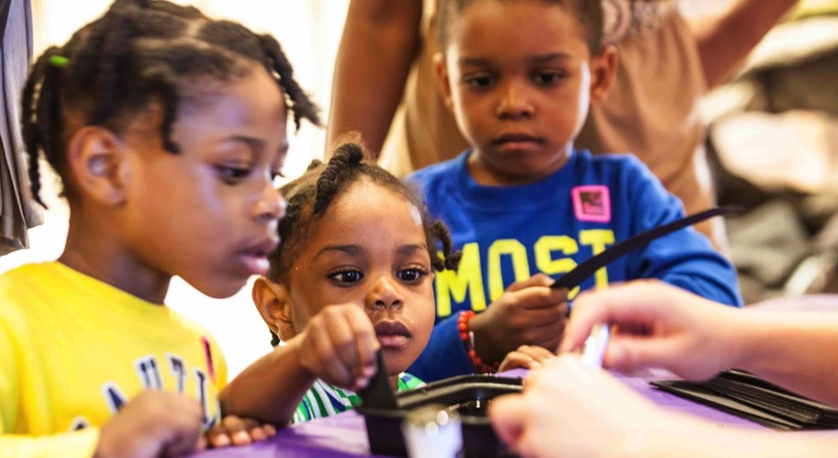
We seek to broaden participation in STEM learning—at school, at home, and in the community.

Slide 10
MUSEUM & COMMUNITY PARTNERSHIPS

Slide 11
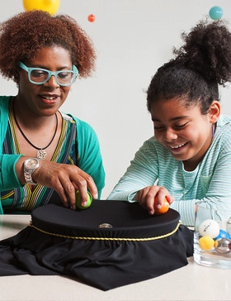
Project strategy – Collaboration!
Museums collaborating with local chapters of national youth-serving organizations and community groups

Slide 12
Why collaborate?
To achieve something you can’t do on your own!
Collaboration occurs when organizations and individuals make a commitment to work together and contribute resources and expertise to achieve a common, long-term goal.
To share resources, expertise, and connections
To build upon existing strengths
To reach new audiences
Notes:
Communities face a variety of challenging and complex problems that can be addressed through collaborative public, private, and nonprofit partnerships. Many of these challenges simply cannot be addressed effectively by one organization acting alone, and require the diverse resources and expertise of government agencies, community-based organizations, state and national organizations, businesses, schools, and individuals. When surveying case studies of local communities who have successfully addressed complex problems, collaborative strategic partnerships are almost always a key ingredient in these success stories. Partnerships can ultimately improve the health and welfare of children, families, and communities.

Slide 13
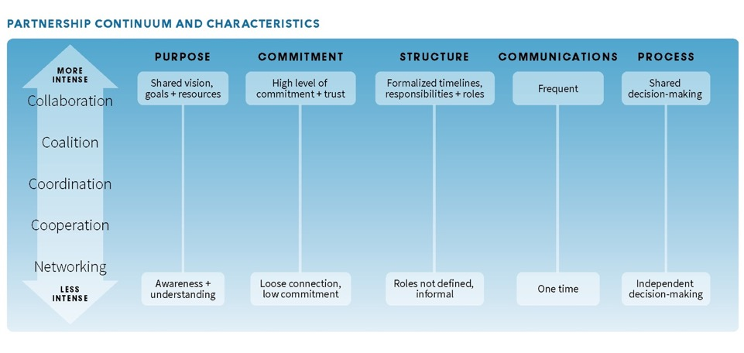
Levels of partnerships
Notes:
There are many ways to think about and categorize organizational partnerships. It is useful to view partnerships as a continuum of possibilities, with increasing levels of partnership ranging from informal networking all the way up to a more intensive collaboration at the top. The intensity of a partnership and interdependence of a relationship between two organizations will typically vary over time and with different projects. It is important to determine what level of partnership works best for your specific situation. Different types of situations are appropriate for various situations with different partners. Take things slowly and let the relationship evolve.

Slide 14

Project goals
Broader reach to multiple and diverse audiences
Mutually-beneficial relationships among NISE Network partners and community organizations
New knowledge and models for reaching new audiences and creating successful collaborations

Slide 15
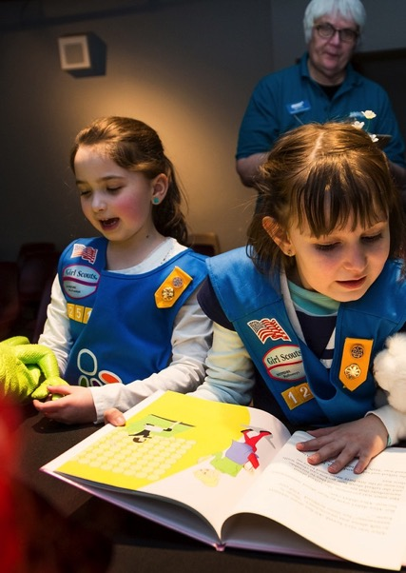
National partners
CORE PARTNERS
Afterschool Alliance
Boys & Girls Clubs of America
Girls Inc.
National Girls Collaborative Project
4-H
ADDITIONAL PARTICIPATION
American Library Association
Arizona State Library
Boy Scouts of America
Girl Scouts
Parent Teacher Association (PTA)
Y (YMCA)
YWCA

Slide 16
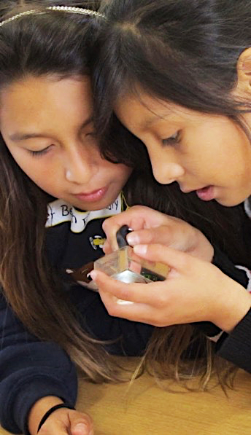
Project overview
Professional audience
Museum educators and professionals
Youth organization educators and professionals
Public audience
Elementary school age children
Traditionally underserved and underrepresented
Process
Existing and new partnerships
NISE Net partners take lead responsibility
Partnership is defined and managed locally
Products
100 Explore Science: Zoom into Nano kits

Slide 17
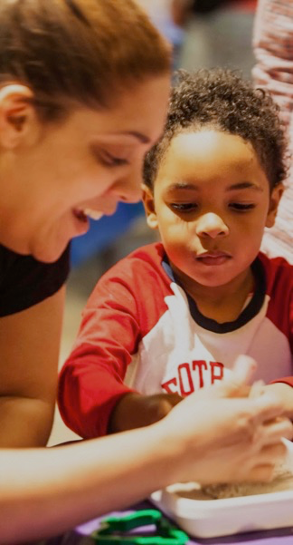
Zoom into Nano kits
EDUCATIONAL PRODUCTS
Over a dozen hands-on activities for “classroom” and “event” use
Training videos and supporting materials
PROFESSIONAL RESOURCES
Planning and promotional materials
Training videos, slides, and guides
Collaboration guide and tools

Slide 18
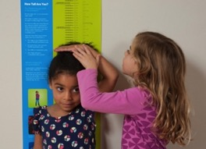
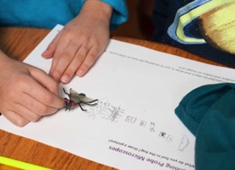
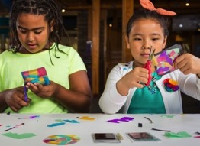

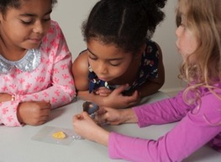
Educational products
Zoom into Nano
Labs and Tools
Nano and Our Lives
Small and Surprising
Tech and Nature

Slide 19
Training resources

Slide 20
Planning resources

Slide 21
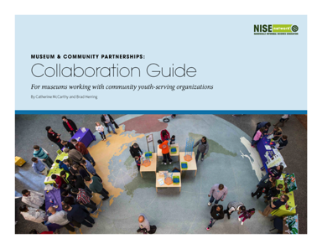
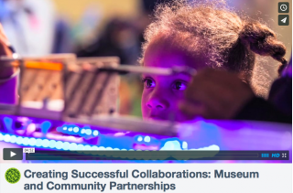
Collaboration resources
  Available at www.nisenet.org/collaboration-guide
Notes:
We created a collaboration guide and video summarizing major collaboration basics as well as templates and MOUs
This guide offers an introduction to collaborations between museums and youth-serving community organizations. While this guide is designed specifically for museums and community organizations, much of the content contained in this document can be applied to all kinds and levels of partnerships. This guide includes an overview of why to collaborate, levels of partnerships, how to start a partnership, and a variety of resources to sustain and deepen your collaborative relationships.

Slide 22
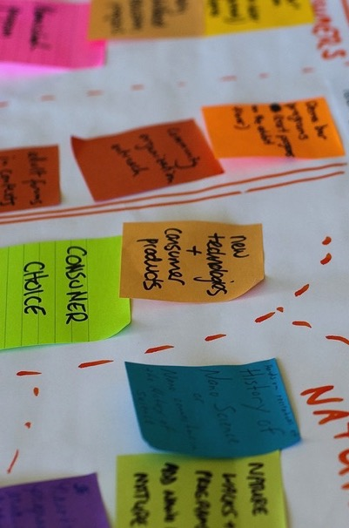
Evaluation
Audiences
Questions
Methods
Findings
Notes:
Evaluation was led by Katie Todd at the Museum of Science in Boston

Slide 23
Methods
Data were gathered in three ways:
Pre- and post-surveys of participating professionals from museums and community organizations (N=254)
Activity surveys about kit materials collected from professionals who facilitated activities (N=119)
Administrative records including project applications (N=84)
Notes:
Pre/post surveys:
Professionals, including the main museum applicants, their named community partners, and any additional professionals who those main contacts said would be involved in the project.
Approx two-thirds museum respondents and one-third community organization respondents.
Not everyone completed both surveys.
Activity Survey:
This was a very brief online survey that activity facilitators would fill out right after they led the activities.

Slide 24
Evaluation Qs for professionals
To what extent does participation impact the value professionals place on local collaborations among NISE Net partners and community organizations?
To what extent does participation impact professionals’ awareness of key concepts in nano?
To what extent does participation impact professionals’ use of professional resources and educational products for creating partnerships and engaging diverse public audiences in nano?
To what extent does participation impact professionals’ awareness of theories, methods, and practices for forming partnerships and engaging diverse public audiences in nano?

Slide 25
Value of partnership

Slide 26
Learning nano concepts

Slide 27
Use of kit materials

Slide 28
Confidence with practices

Slide 29
Evaluation Qs for publics
To what extent does the project reach its target audience of children, youth, and families from demographic groups that are underrepresented in STEM fields?
To what extent do the educational materials facilitate engagement and learning among public participants?

Slide 30
Public reach

Slide 31
Learning, engagement + relevance

Slide 32
PARTNERSHIP
PROGRAMS

Slide 33
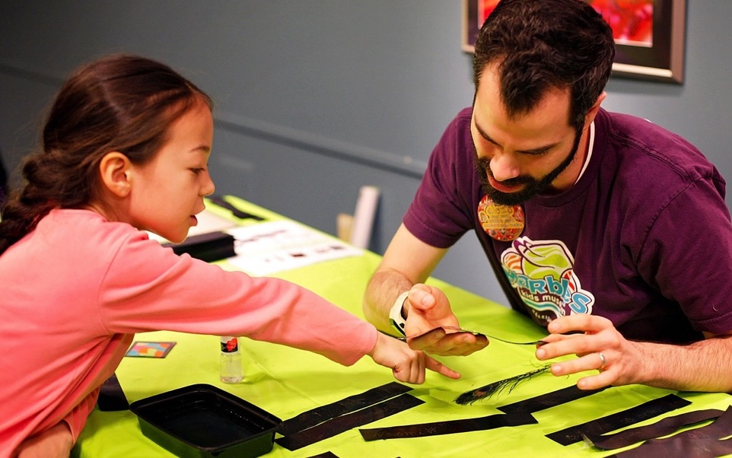
Children’s Museum of Houston

Slide 34
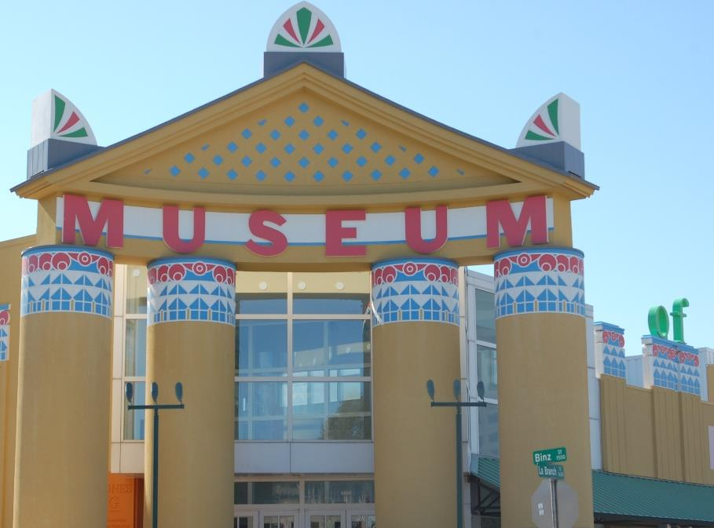

Slide 35
Mission:
To transform communities through innovative, child-centered learning

Slide 36
Serve children age 0-12 years and their parents and caregivers

Slide 37
817,000 annual visitors
+ 329,000 through outreach programming
Notes:
1.15 Million cumulative audience
280+ partners – including schools, community centers, places of worship, afterschool centers, shelters and libraries

Slide 38
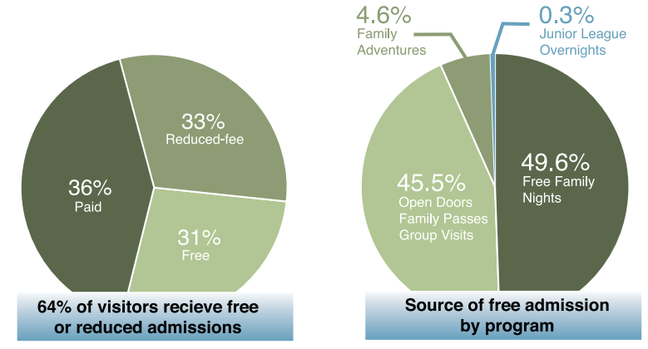
810,000 annual visitors
+344,000 through outreach programming
Notes:
With 45% of children in Harris County living in low-income households and more than 27% of children living below the federal poverty line (Children at Risk, 2014–2016), CMH realizes the importance of reaching those most in need of educational opportunities. CMH engages low-income families by providing free and reduced-fee admissions to 64% of our visitors (through our 870+ Open Doors community partners and our designated free days and times) and free community-based programs to another 329,600 individuals.

Slide 39
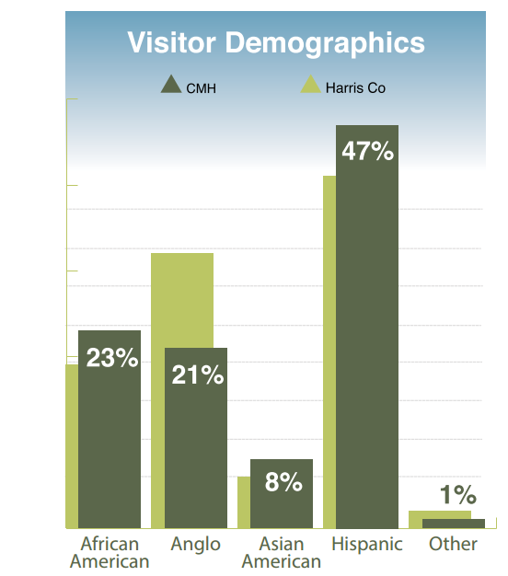
Notes:
Audience Demographics – According to the Kinder Institute for Urban Research, Hobby Center for the Study of Texas, and American Community Survey, the greater Houston area has a greater degree of racial and ethnic diversity than any of the nation’s major metropolitan areas. School districts report that 112 languages are spoken by their students. Minorty majority population and CMH reflects that.
CMH serves one of the most socioeconomically and culturally diverse populations in the county. Our Museum visitorship this past year was 47% Hispanic/Latino, 23% African-American, 21% Anglo, 8% Asian, and 1% other, while our visitors during free times were 55% Hispanic, 26% African-American, 12% Anglo, 6% Asian, and 1% other
100% Museum’s exhibits and programs are offered in English and Spanish
50% Staff are bilingual or multilingual (10 languages represented)
79% Visitors are non-Anglo
94% Outreach participants are non-Anglo.

Slide 40
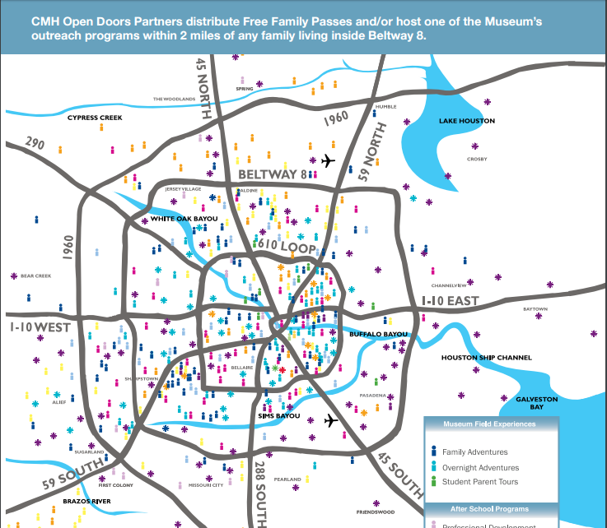
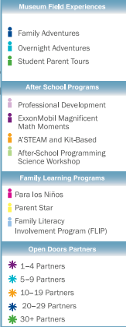
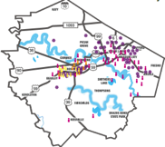
Notes:
Who we work with in the community:
Over three decades
Museum Field Experiences: 567 schools
Open Doors Partners: 870 community organizations
After School Programs and Family Learning: 238 schools, libraries, and community organizations

Slide 41
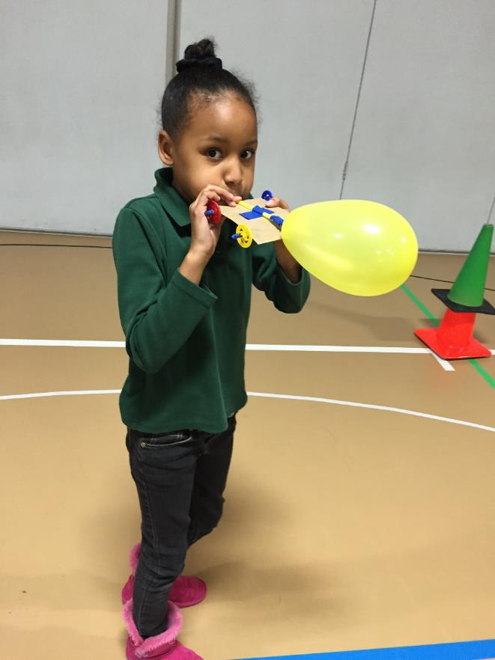
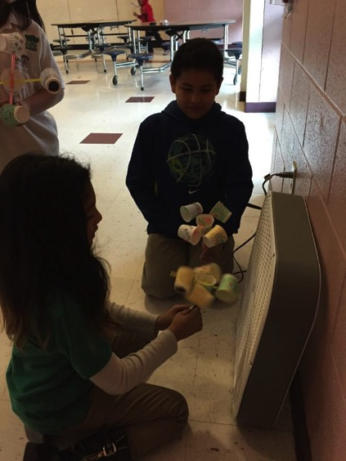
A’STEAM Program
After-school Science, Technology, Engineering, Arts (Design), and Mathematics
Notes:
Partnership with the Greater Houston YMCA and United Way.
Kit-based program with train-the-trainer model of PD.
History – started as Summer Learning Loss prevention program
Started in 28 sites in the first year, 34 sites second year, grew to 41 sites year 3, 54 sites in year 4, and now 111 sites in year 5

Slide 42
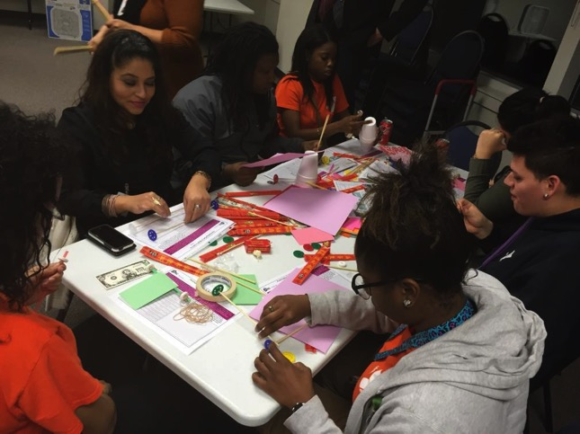
Notes:
Each month, sites gather together in larger groups for train-the trainer sessions on that month’s activities
Training videos for each activity are also online for refresher

Slide 43
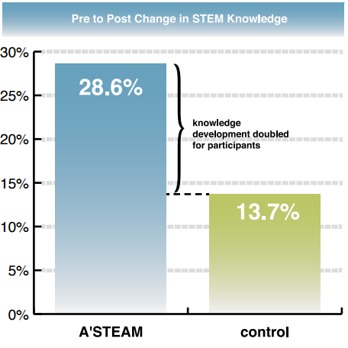
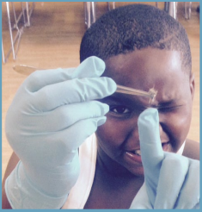
Notes:
Students participating in A’STEAM during the 2015–16 school year made statistically significant gains greater than those of peers within a control group who attended afterschool centers in less impoverished neighborhoods where the A’STEAM program was not offered. These findings are consistent with those since the inception of the program. While the A’STEAM students had lower scores at the beginning of the 2015–16 school year than the control group, they caught up to their more advantaged peers by the end of the school year, achieving an increase in STEM knowledge that was twice that of their control group peers.

Slide 44

Children’s Museum of Indianapolis

Slide 45

STEM Scouts Partnership
Don Riefler
The Children’s Museum of Indianapolis

Slide 46
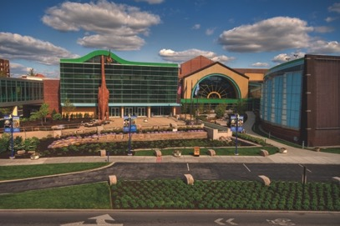
Museum Info
Mission
To create extraordinary learning experiences across the arts, sciences and humanities that have the power to transform the lives of children and families.
Notes:
Largest Children’s Museum in the World
Collection of over 120,000 objects
Immersive exhibits

Slide 47


Partner
STEM Scouts
Notes:
Hosted at schools, community groups or industry partners
Program is supported by modules and community experiences
Unlike regular BSA, is co-ed

Slide 48
Audience
STEM Scouts – upper elementary and middle school aged students
Families – designed event to be a family program for STEM Scouts

Slide 49
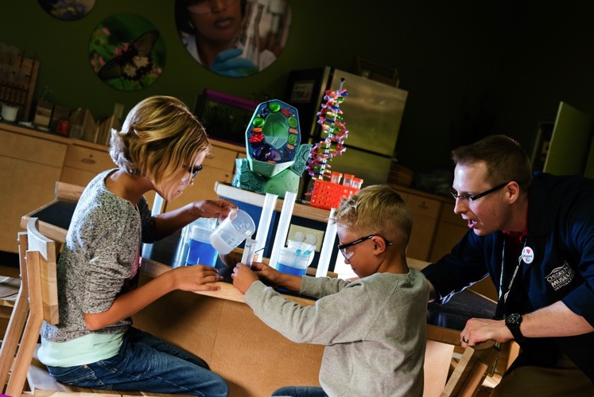
The Project
Notes:
STEM Scouts in Central Indiana hosts regular community and family events
Nano program was paired with nano module for STEM Scouts
Museum hosted family event – families rotated through activities in our science lab.
Included museum exploration time
Major issues were staff turnover at STEM Scouts and registration confusion

Slide 50
Outcomes
New Audience!
Opened two new STEM exhibits, have more capacity to offer programs to new types of groups
Staff experience
Notes:
New Audience!
Opened two new STEM exhibits, have more capacity to offer programs.
Staff experience
Learned from setup and logistical mistakes

Slide 51
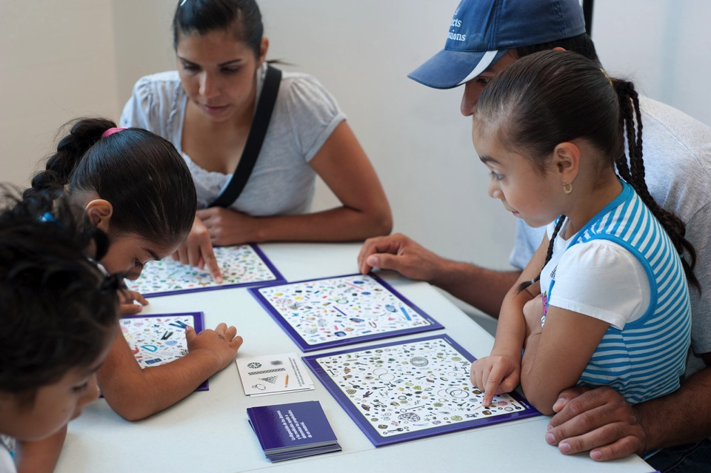
Port Discovery Children’s Museum

Slide 52

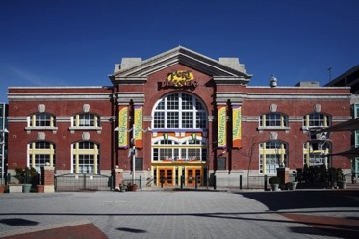
Port Discovery Children’s Museum
Explore Science: Bringing Nano to a New Audience

Slide 53
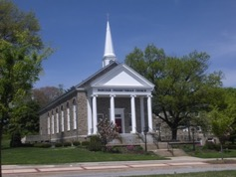
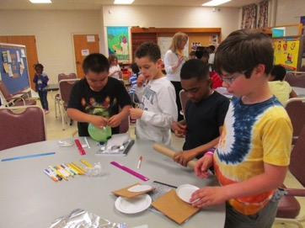
Babcock Presbyterian Church
A+ Care
Located in Towson, Maryland
Before and after care for a low fee
Partnership:
  Began in spring 2015
  Provided NASA’s BEST curriculum through grant with NASA Goddard
  Chosen for this project to further engage the faith based community

Slide 54
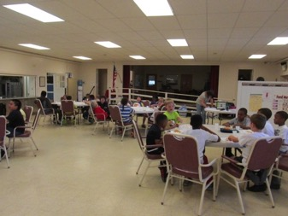
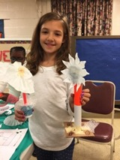
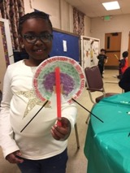
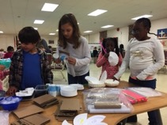
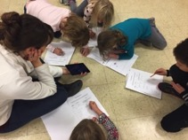
Audience Served
Faith based partner
After school program
28 children Kindergarten through 5th grade
Services students from two local Title I schools
Very diverse group of students!

Slide 55
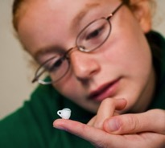
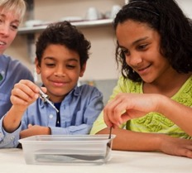
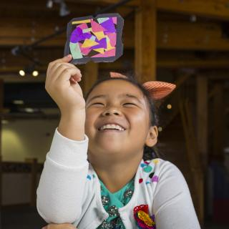
Nanoscience Exposed
Gravity Fail
Rainbow Film
Stained Glass Art
Notes:
Port Discovery’s after school program using NanoDay kits and other NISE Net resources
5 one-hour sessions
Sessions: 1) Nano is very very small 2) Unexpected things can happen 3) Scientists can make and study tiny things 4) Nano is found in nature 5) Nano inspires new technologies
This program includes 6 activities that were included in the Explore Science kit: Gravity Fail, Ready Set Fizz, Smelly Balloons, Rainbow Film, Stained Glass Art, You Decide
Additionally it includes other (NISE Net and others) activities such as: building marshmallow molecules, feel Nano magnets, strawberry DNA extraction, Nano fabric/pants, make a flying car, and more!

Slide 56
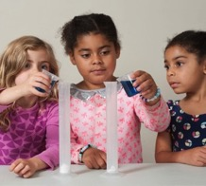
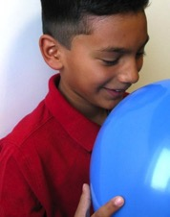
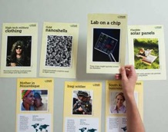
Nanoscience Exposed
Ready, Set, Fizz!
Smelly Balloons
You Decide!
Notes:
Port Discovery’s after school program using NanoDay kits and other NISE Net resources
5 one-hour sessions
Sessions: 1) Nano is very very small 2) Unexpected things can happen 3) Scientists can make and study tiny things 4) Nano is found in nature 5) Nano inspires new technologies
This program includes 6 activities that were included in the Explore Science kit: Gravity Fail, Ready Set Fizz, Smelly Balloons, Rainbow Film, Stained Glass Art, You Decide
Additionally it includes other (NISE Net and others) activities such as: building marshmallow molecules, feel Nano magnets, strawberry DNA extraction, Nano fabric/pants, make a flying car, and more!

Slide 57
Successes and Challenges
Successes
  A+ Care at Babcock Presbyterian was a pleasure to work with.
  Site coordinator and the children were very enthusiastic to have us there. They do not typically receive these types of enrichment programs.
  Staff was plentiful and very hands-on.
  Parents were supportive, said their kids didn’t want to go home! They would pick up their children later on Port Discovery days so their kids could complete the program.
Challenges
  Due to the after school program location, there is a lot of ethnic, economic, and ability diversity within the group of students. Many children have varying learning disabilities.
  All students, Kindergarten through 5th grade were in one group.

Slide 58


Best Outcomes
Continued Partnership
  With NISE Net support of the Explore Science kit, Nanoscience Exposed was provided to A+ Care free of charge.
  In the 2016/2017 school year, two new after school programs were provided free of charge with support from Baltimore County.
New grant from local foundation!
  Provide after school enrichment to 4 Catholic Schools in Baltimore City in 2017

Slide 59

Arkansas Discovery Network

Slide 60




Slide 61
Berryville Public Library
Audience: Rural, North Central Arkansas
Five Towns Served, Ranging in Population from 291 to Just over 5,000
25% of Families are Living in Poverty

Slide 62
“The kit really represents a bit of a paradigm shift in terms of library programming in our two counties. We know in theory that more and more it will be important for libraries to embrace the promotion of invention literacy/STEM topics along with more traditional forms of literacy. But in small towns it is still easy to say that is for big city libraries with more funding, staff, space, etc. This allowed us to see what we really can do with relatively simple supplies even in the small spaces we have for such programming.” – Director, Berryville Public Library
Training, Co-Presenting, Left Kit for Future Use

Slide 63





Slide 64
Q&A
DISCUSSION

Slide 65

Questions for our presenters?

Slide 66
Discussion
What collaboration challenges have you experienced?
Let’s discuss strategies for working through them!
For example:
Identifying the right partnership, right now
Dealing with changes in personnel
Addressing changing organizational priorities (on either side)
Fostering organizational buy-in

Slide 67



Thank you
The Nanoscale Informal Science Education Network is supported by the National Science Foundation under award numbers 0532536 and 0940143. Multi-Site Public Engagement in Science is supported by the National Science Foundation under award number 1421179. Transmedia Museum is supported by the National Science Foundation under award number 1516684. ChemAttitudes is supported by the National Science Foundation under award number 1612482. Any opinions, findings, and conclusions or recommendations expressed in this presentation are those of the authors and do not necessarily reflect the views of the Foundation.
Sustainability in Science Museums is supported by the Walton Sustainability Solutions Initiatives at Arizona State University (ASU) and is a collaboration with the Center for Engagement and Training in Science and Society at ASU.
Space and Earth Informal STEM Education is supported by NASA under cooperative agreement number NNX16AC67A. Any opinions, findings, and conclusions or recommendations expressed in this material are those of the author(s) and do not necessarily reflect the view of the National Aeronautics and Space Administration (NASA).

