Slide 1
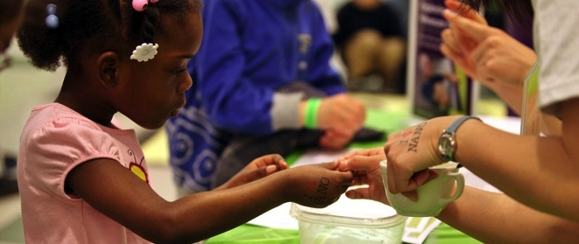

STEM Community Partnerships:
Strategies and Resources
for Developing Collaborations
and Reaching New Audiences
ASTC | 2017

Slide 2
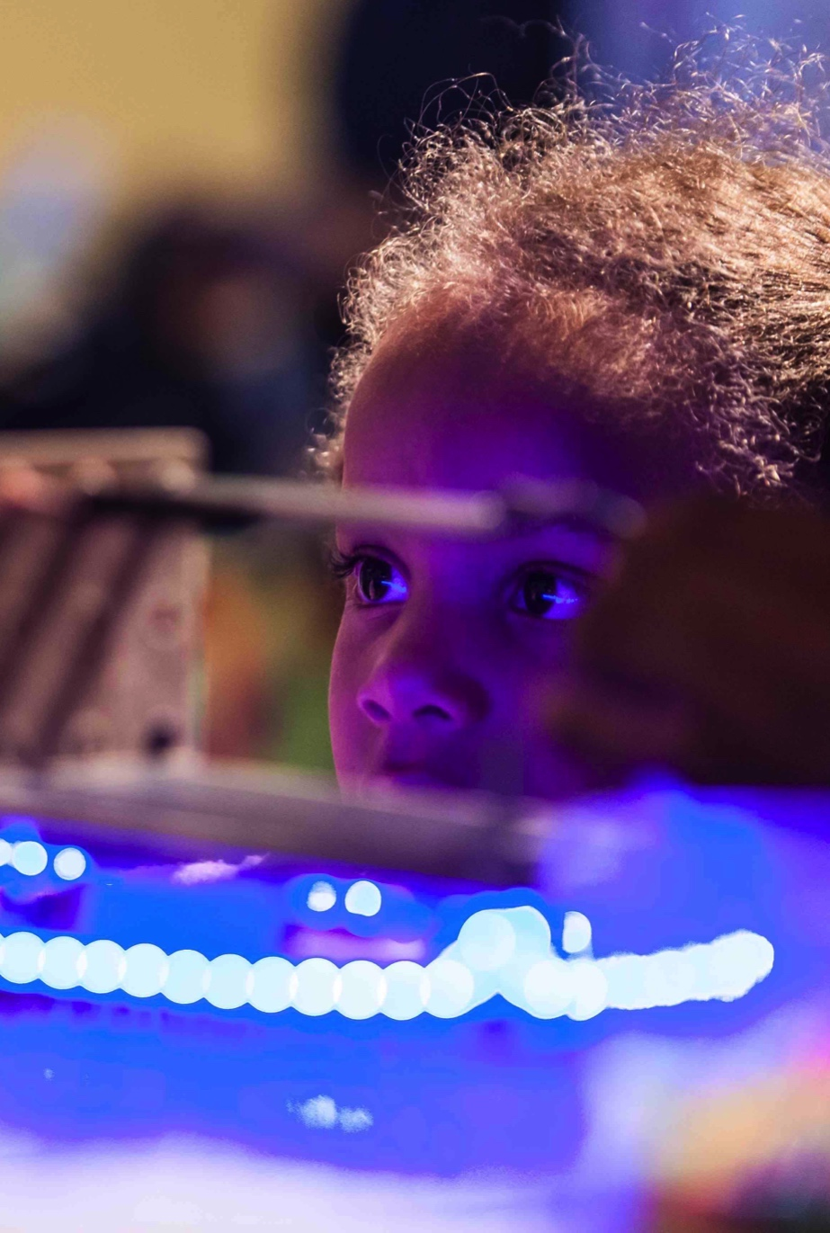
Session overview
MUSEUM & COMMUNITY PARTNERSHIPS
Rae Ostman, Arizona State University
Catherine McCarthy, Science Museum of Minnesota
PARTNERSHIP PROGRAMS
Jason Hammond, Children’s Museum of Houston
Ali Jackson, Sciencenter
EVALUATION
Liz Kollmann, Museum of Science
RESOURCES
Brad Herring, Museum of Life + Science
Q&A
DISCUSSION

Slide 3
MUSEUM & COMMUNITY PARTNERSHIPS

Slide 4
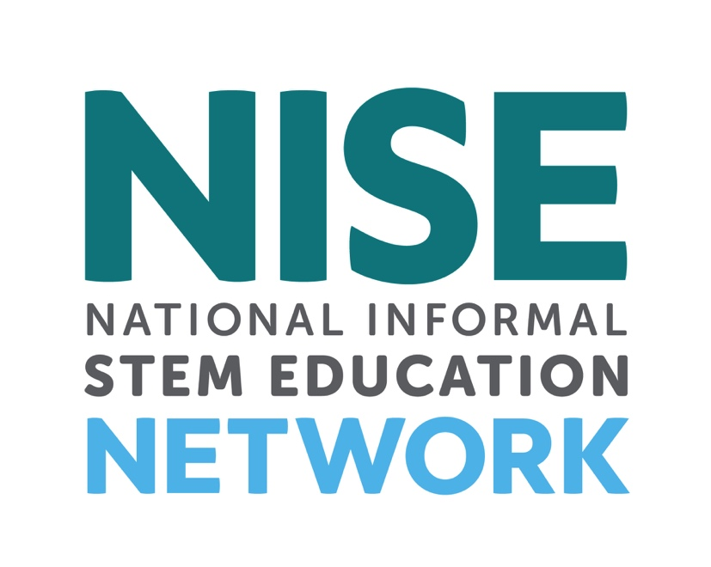
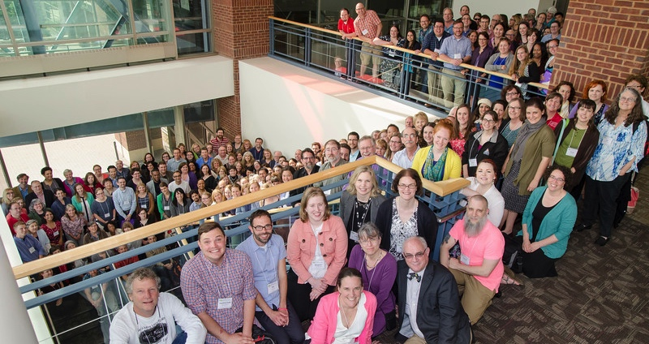
NISE Net supports informal learning about STEM in communities across the United States.

Slide 5
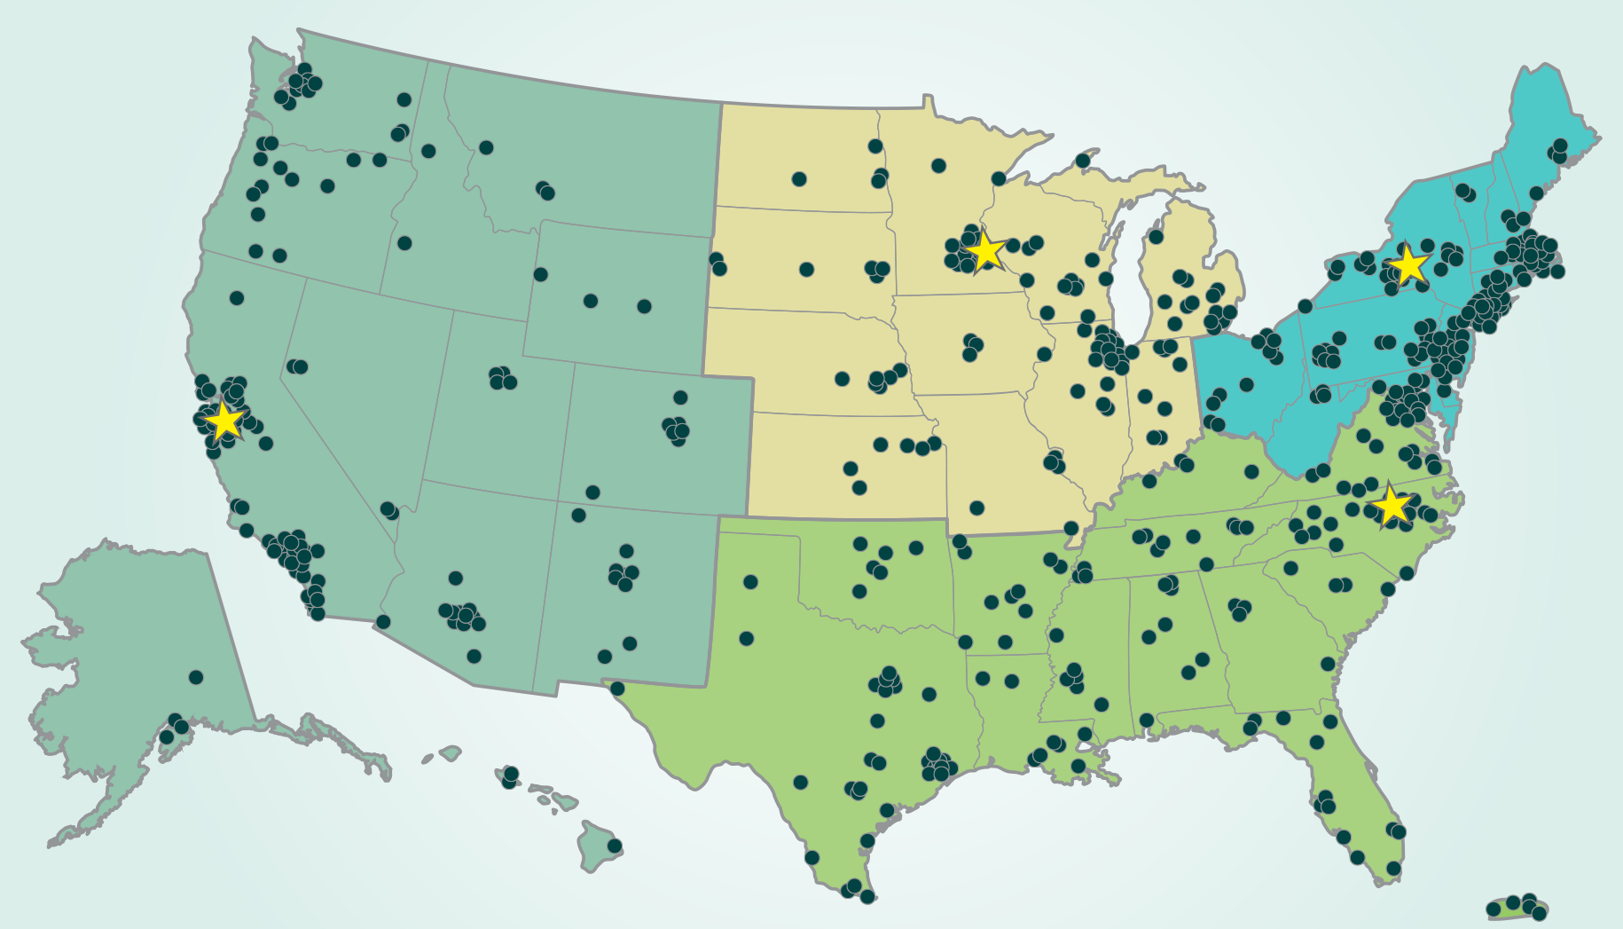
Over 600 organizations regularly participate in Network activities.
Notes:
All 50 states and Puerto Rico
~400 museums
~200 universities

Slide 6
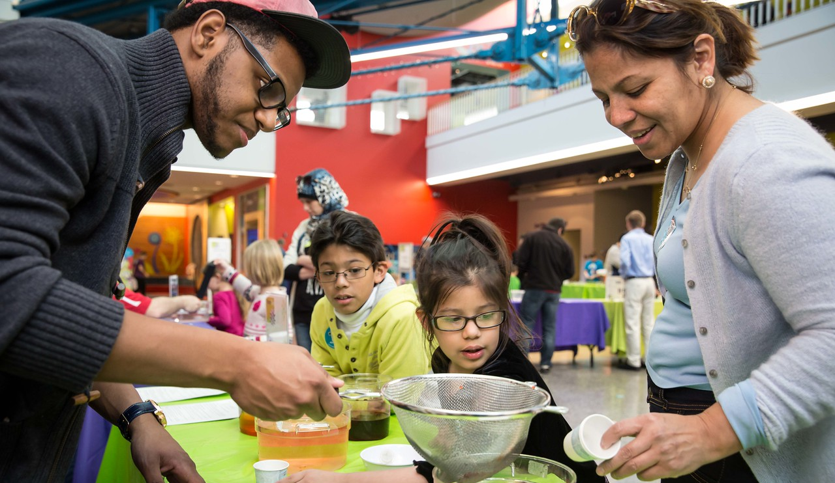
Together we reach millions of people each year!

Slide 7
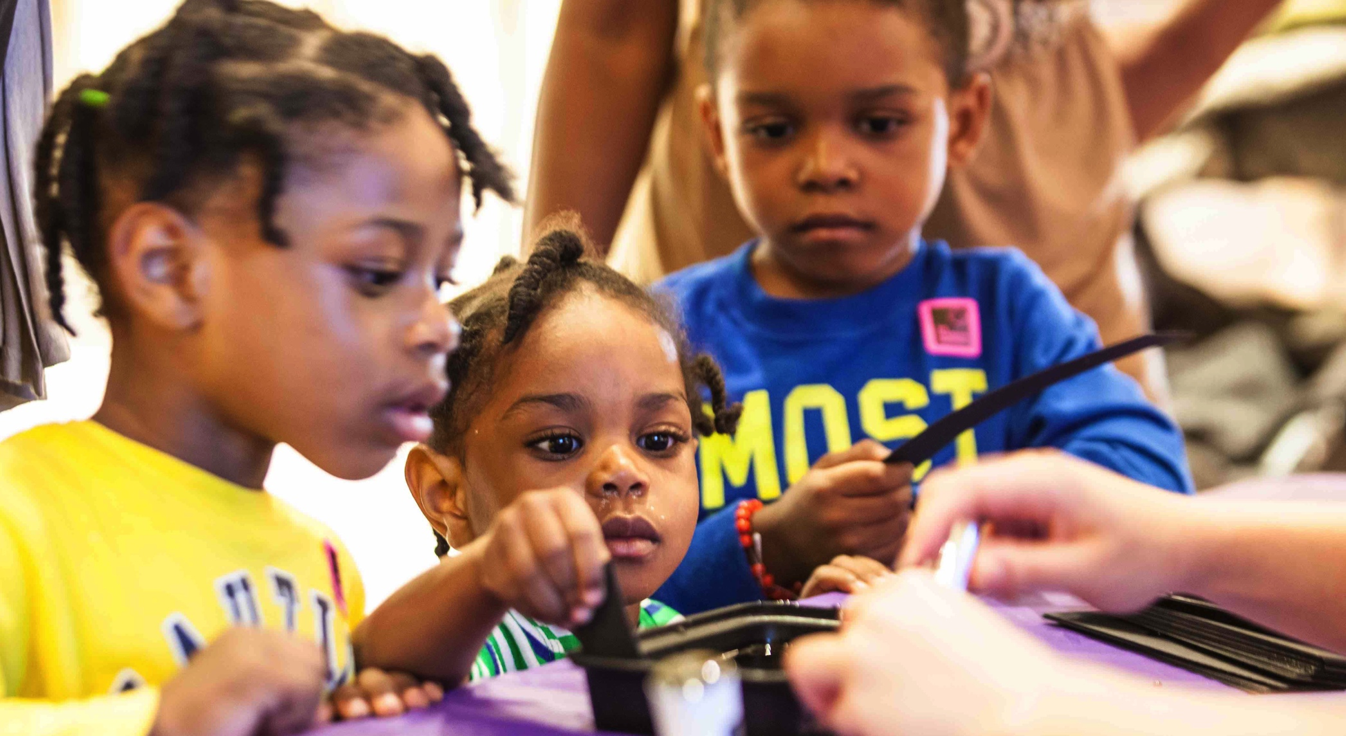
We seek to broaden participation in STEM learning at school, at home, and in the community.

Slide 8
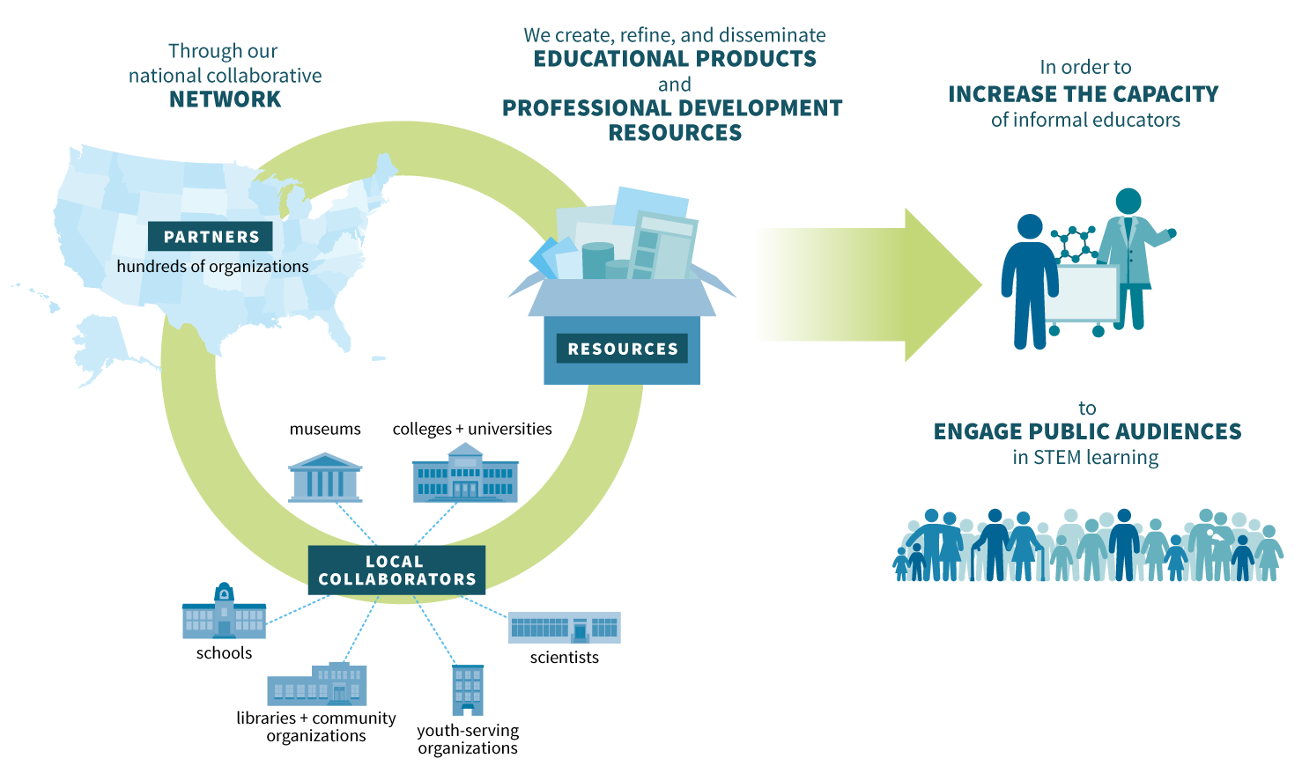
NISE Net partners collaborate to develop and implement resources across the Network.

Slide 9
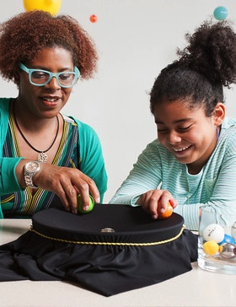
Museum & Community Partnerships
Museums collaborating with local chapters of national youth-serving organizations and community groups

Slide 10
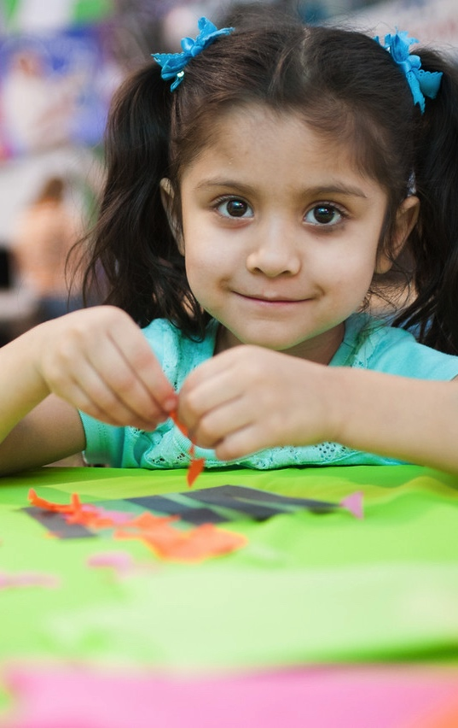
Project goals
Broader reach to multiple and diverse audiences
Mutually-beneficial relationships among NISE Network partners and community organizations
New knowledge and models for reaching new audiences and creating successful collaborations

Slide 11
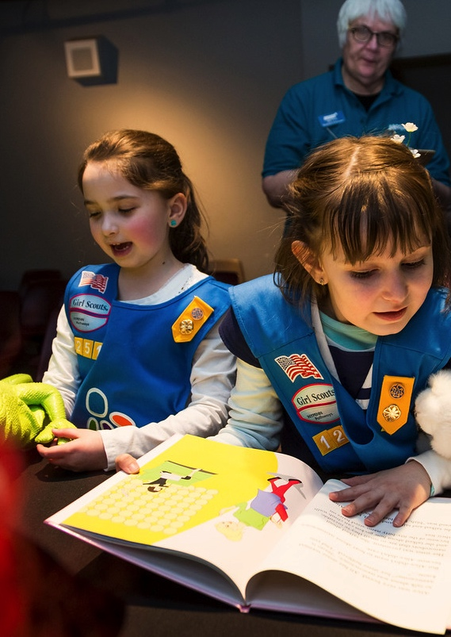
National partners
CORE PARTNERS
Afterschool Alliance
Boys & Girls Clubs of America
Girls Inc.
National Girls Collaborative Project
4-H
ADDITIONAL PARTICIPATION
American Library Association
Arizona State Library
Boy Scouts of America
Girl Scouts
Parent Teacher Association (PTA)
Y (YMCA)
YWCA

Slide 12
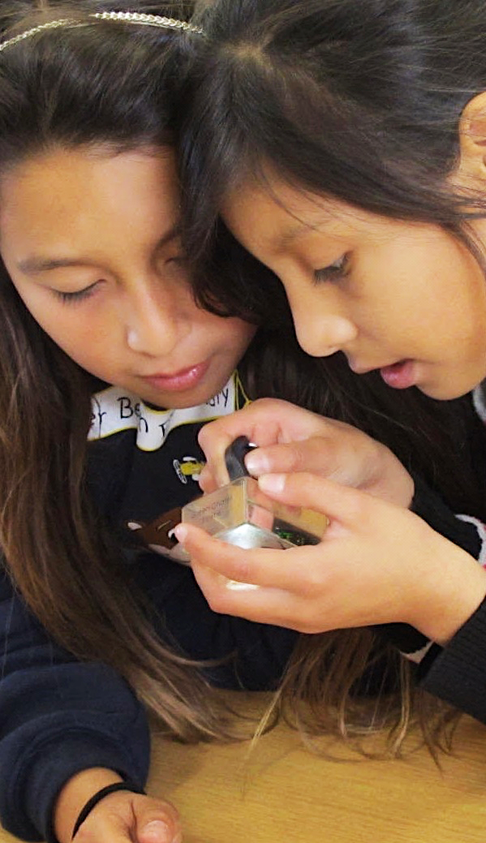
Project overview
Professional audience
Museum educators and professionals
Youth organization educators and professionals
Public audience
Elementary school age children
Traditionally underserved and underrepresented
Process
Existing and new partnerships
NISE Net partners take lead responsibility
Partnership is defined and managed locally
Products
100 Explore Science: Zoom into Nano kits

Slide 13
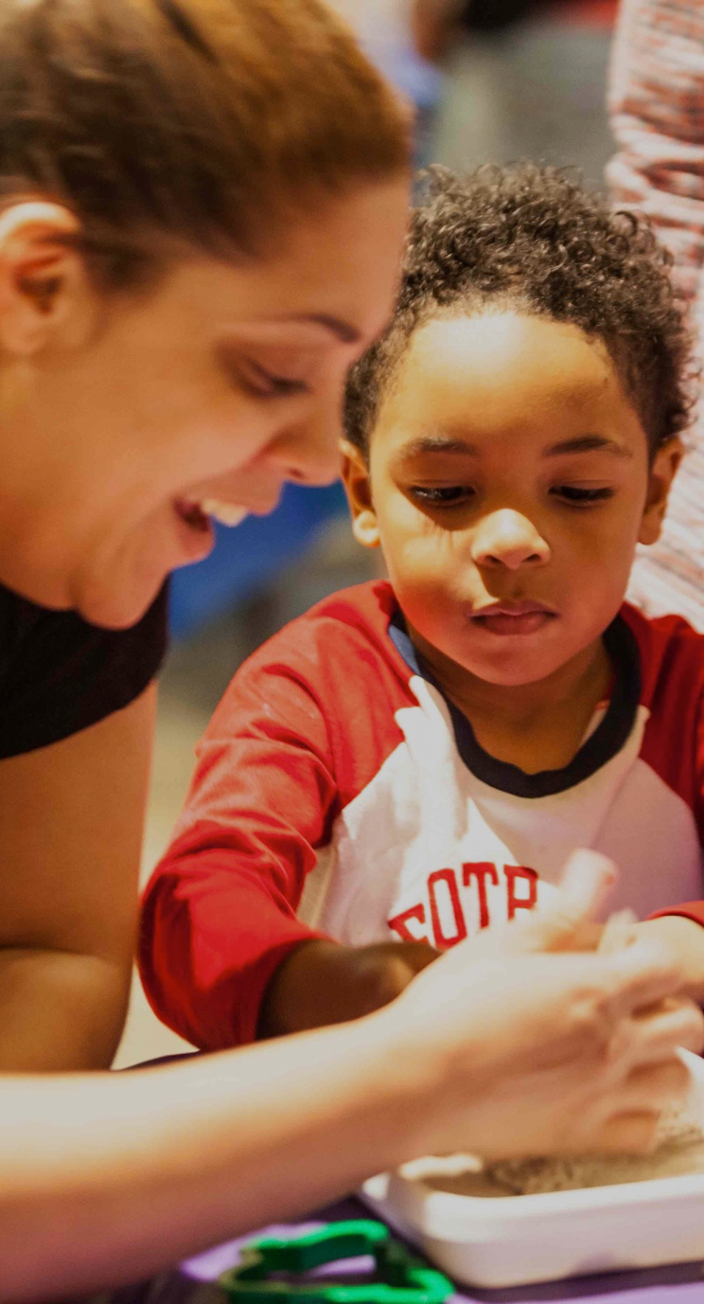
Explore Science kits
EDUCATIONAL PRODUCTS
Over a dozen hands-on activities for “classroom” and “event” use
Training videos and supporting materials
PROFESSIONAL RESOURCES
Planning and promotional materials
Training videos, slides, and guides
Collaboration guide and tools

Slide 14
collaboration

Slide 15
STEM Community Partnerships:
Strategies and Resources for Developing Collaborations and Reaching New Audiences
Why Collaborate?
Catherine McCarthy, PhD
Project Leader
Science Museum of Minnesota
Saint Paul, Minnesota
cmccarthy@smm.org
  651-262-3850
  www.nisenet.org
ASTC Conference
October 2017
San Jose
Notes:
Collaboration takes time and isn’t always easy, but the speakers today will give you some practical advice and examples of making collaborations successful.
I’m going to talk a little bit about the WHY you would want to collaborate

Slide 16
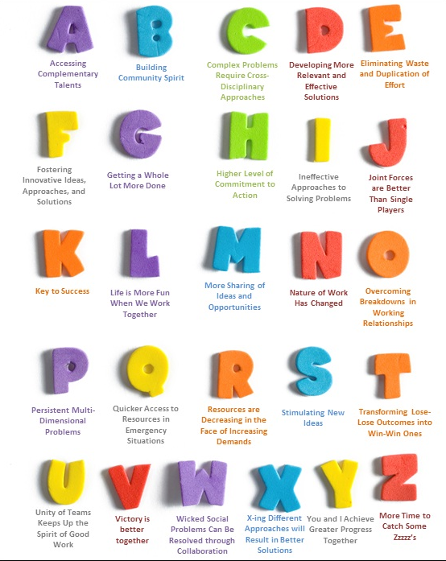
Why Collaborate?
Notes:
There are a lot of great reasons to collaborate (My favorite up here is L: Life is more fun when we work together)
image courtesy of Michael Sampson and Plantronics 2012

Slide 17

Why Collaborate?
To share resources, expertise, and connections
To build upon existing strengths
To reach new audiences
To achieve
something you can’t do on your own!
Notes:
There are a lot of great reasons to collaborate, but basically I think it boils down into a few things.
We collaborate to achieve something you can’t do on your own:
To share resources, expertise, and connections
To build upon existing strengths
To reach new audiences

Slide 18
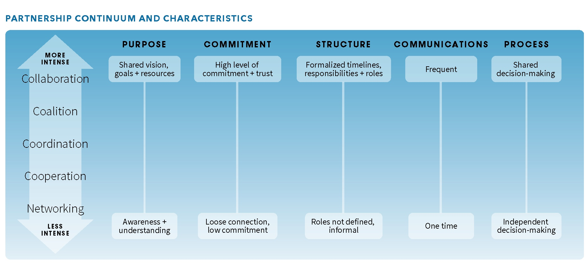
Levels of Partnerships – Continuum
Notes:
There are many ways to think about and categorize organizational partnerships. It is useful to view partnerships as a continuum of possibilities, with increasing levels of partnership ranging from informal networking all the way up to a more intensive collaboration at the top. The intensity of a partnership and interdependence of a relationship between two organizations will typically vary over time and with different projects. It is important to determine what level of partnership works best for your specific situation. Different types of partnership are appropriate for different situations with different partners.
• Collaboration occurs when organizations and individuals make a commitment to work together and contribute resources and expertise to achieve a common, long-term goal.
Page 7 of the guide

Slide 19
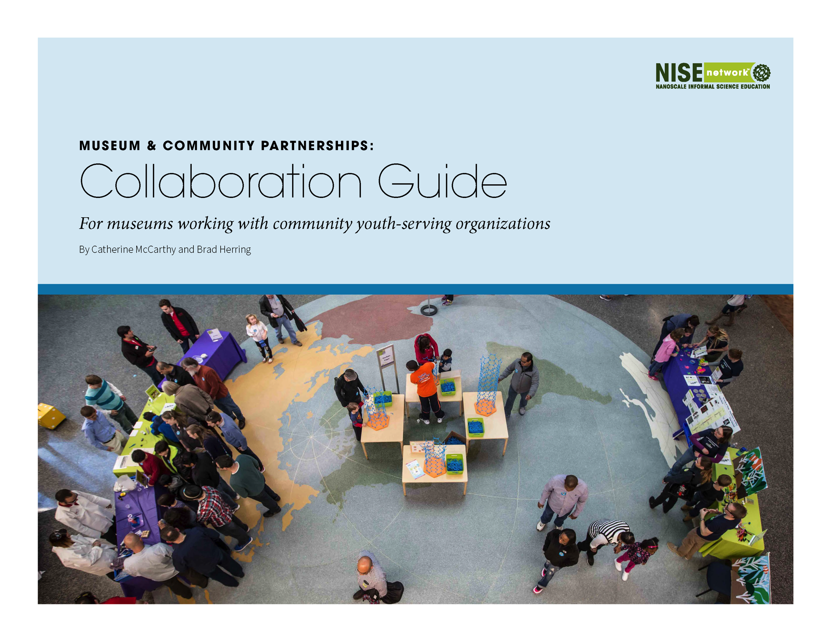
  Available at www.nisenet.org/collaboration-guide
Notes:
When surveying case studies of local communities who have successfully addressed complex problems, collaborative strategic partnerships are almost always a key ingredient in these success stories. Partnerships can ultimately improve the health and welfare of children, families, and communities.
The NISE Network created a collaboration guide. This guide offers an introduction to collaborations between museums and youth-serving community organizations. While this guide is designed specifically for museums and community organizations, much of the content contained in this document can be applied to all kinds and levels of partnerships. This guide includes an overview of why to collaborate, levels of partnerships, how to start a partnership, and a variety of resources to sustain and deepen your collaborative relationships.
Sprinkled throughout the collaboration guide is advice from experienced collaborators as well as examples of different ways museums and community organizations are collaborating to increase access for underserved audiences, improve STEM equity, increase school readiness, support family learning, and engage different audiences.
BRAD WILL DISCUSS THIS MORE

Slide 20
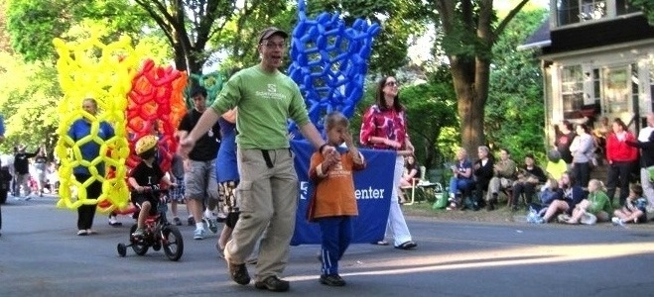

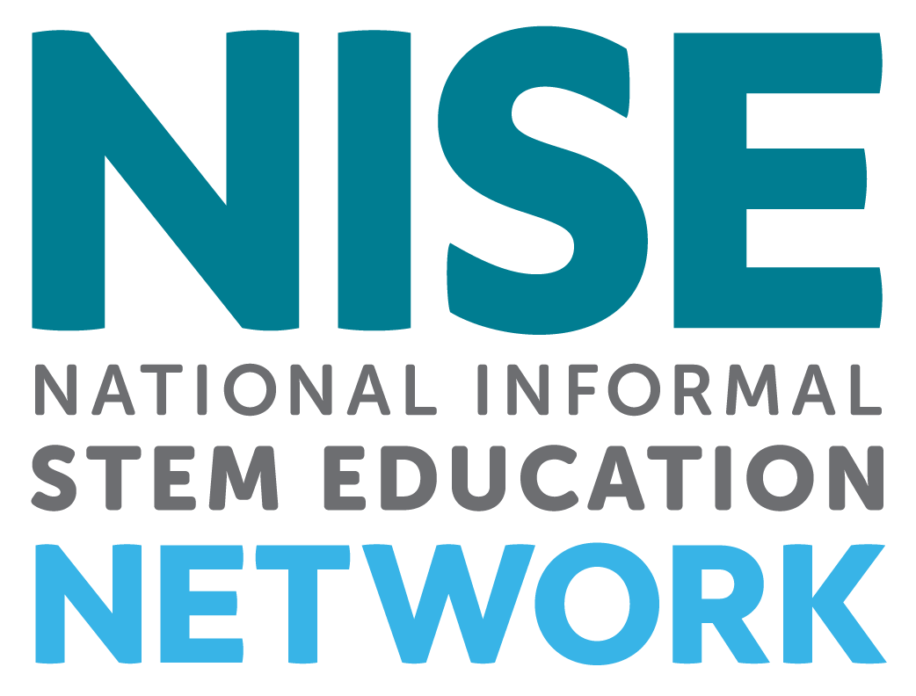

Thank you NSF and partners!
This presentation is based on work supported by the National Science Foundation under Grant No. 0940143. Any opinions, findings, and conclusions or recommendations expressed in this presentation are those of the authors and do not necessarily reflect the views of the Foundation.
Notes:
We would like to thank our funder the National Science Foundation for making the Museums & Community Partnerships project possible.
We would like to thank partners who helped develop the guide and materials and all the partners who are implementing these programs and partnerships in their local communities across the United States.

Slide 21
PARTNERSHIP
PROGRAMS

Slide 22

CHILDREN’S MUSEUM OF HOUSTON
A’STEAM Program

Slide 23
A’STEAM Program Began in 2012 with 30 Schools
Partnership with YMCA of Greater Houston
8 month program
7 units of science
4 activities per unit
CMH staff conduct monthly trainings with YMCA counselors
YMCA counselors deliver weekly programming
CMH staff do daily site checks
5 Year rotating program

Slide 24
Evaluation
Pre-assessment is given at the beginning of the year before the first unit
Post-assessment is given before the start of the final unit
Assessments are administered to experimental and control groups
During the final month of A’STEAM, A’STEAM staff conduct focus groups throughout various sites to gather anecdotal information and student satisfaction assessments
Parents and YMCA staff are interviewed or given online surveys to further understand successes and challenges of A’STEAM program

Slide 25
Curriculum
Seven units of curriculum are written at the beginning of the year
The first and last units are delivered to all of the sites at the same time
Between the first and last units a rotating five unit curriculum is administered
Curriculum topics have included astronomy, adaptation, geology, chemistry, archaeology, science of art, science of cooking, gross science, botany, physics and body systems
CMH staff writes all curriculum, orders all supplies and builds all the kits needed to deliver the program

Slide 26
In 2016, the program completed its first five year cycle. For the year 2017-18, A’STEAM has expanded to 125 YMCA sites, 2 iServe sites and 1 contract site for a total of 128 sites.

Slide 27
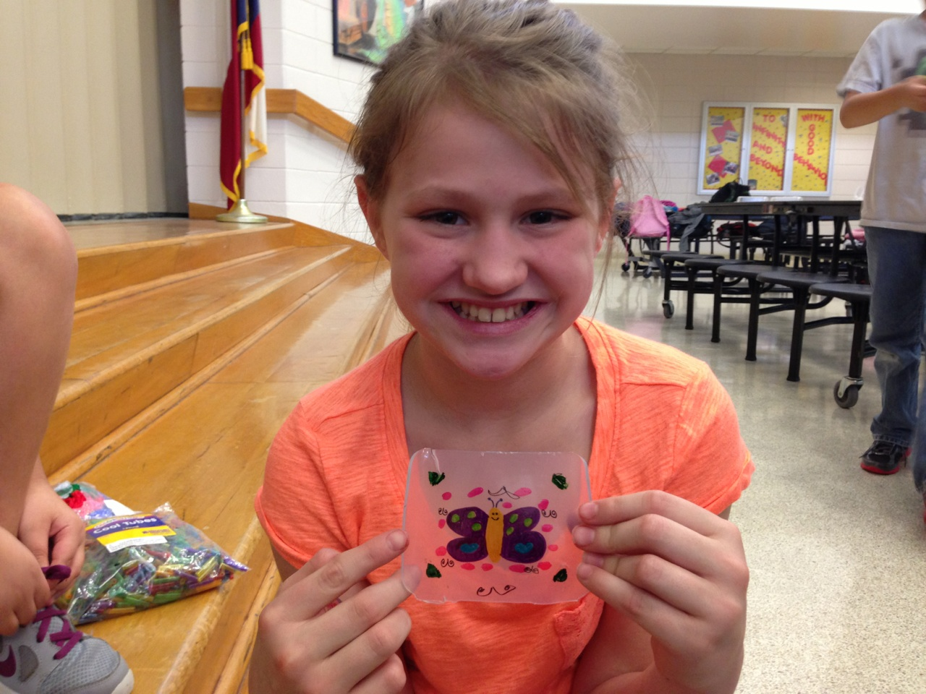
Polymers – DIY Shrinky dinks

Slide 28
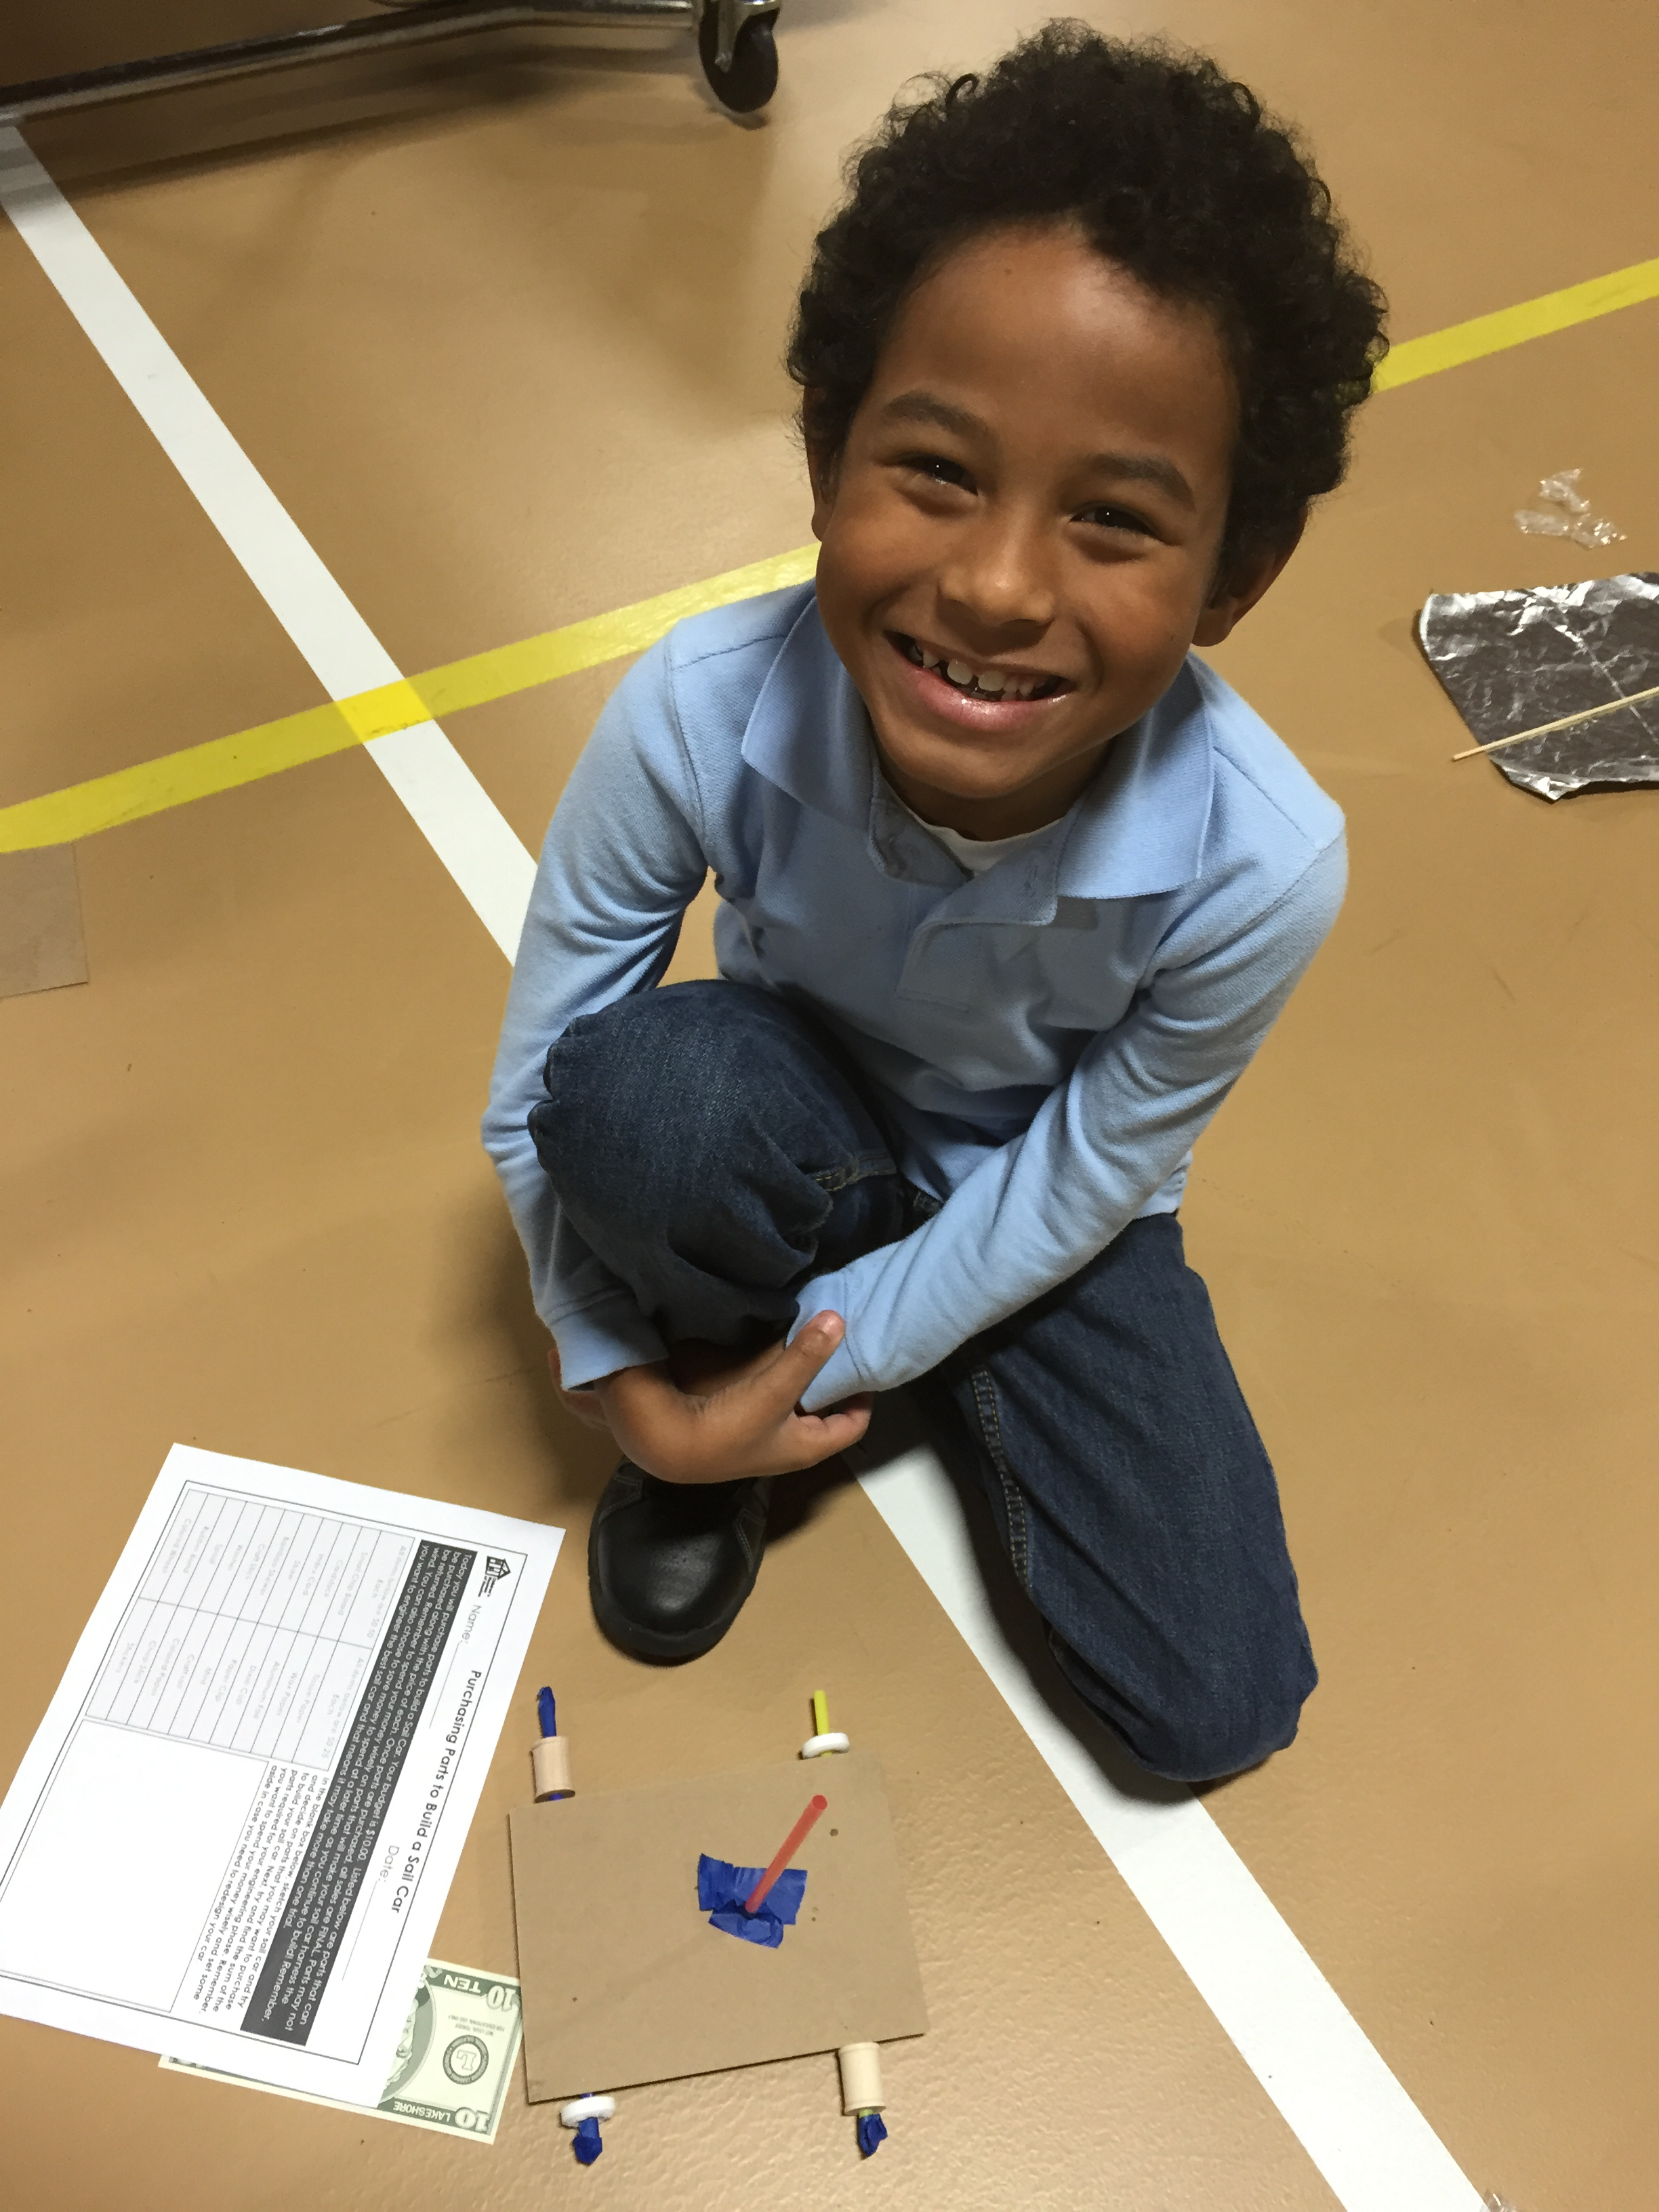
Engineering – Balloon Cars

Slide 29
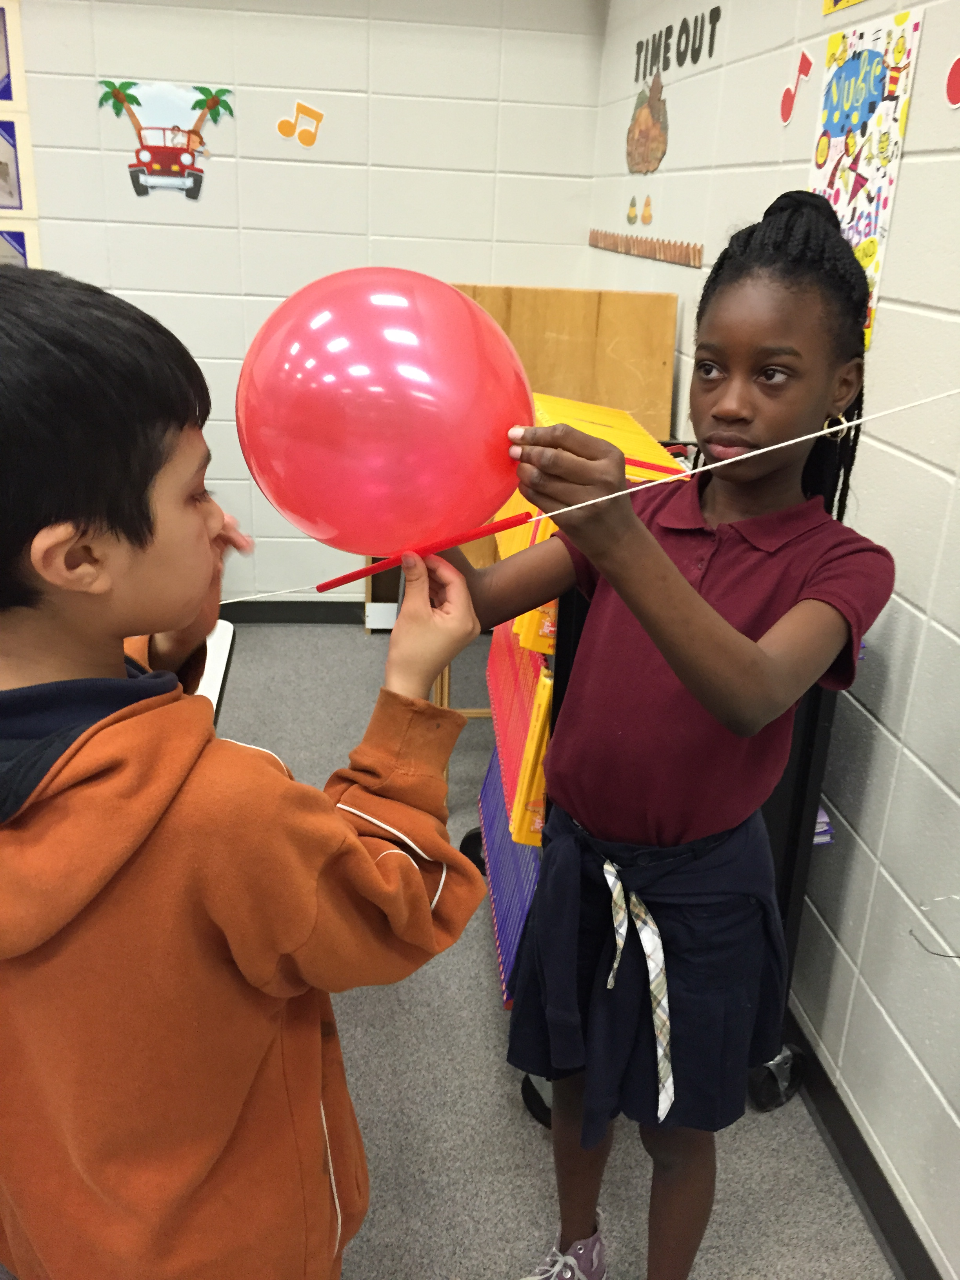
Engineering – Balloon Racers

Slide 30
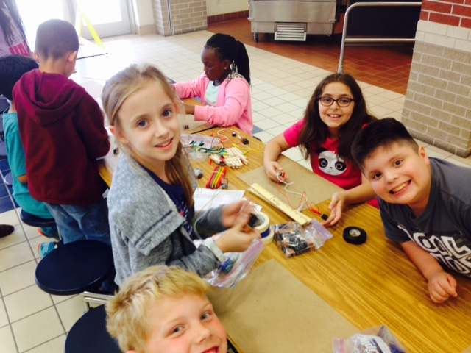
Electricity – Door Alarms

Slide 31
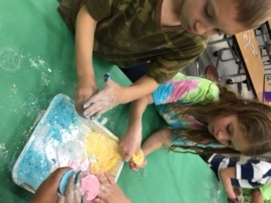
Chemistry – bath bombs

Slide 32
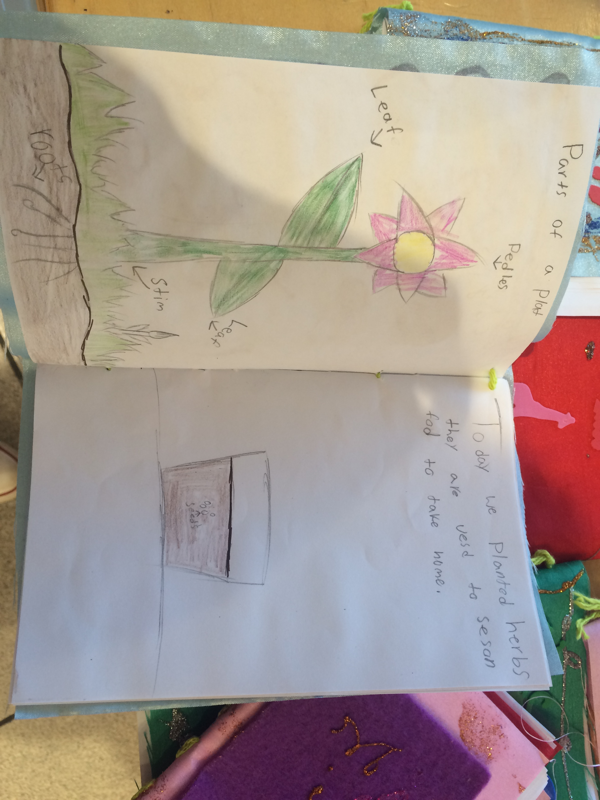
Botany – Herb garden journal

Slide 33
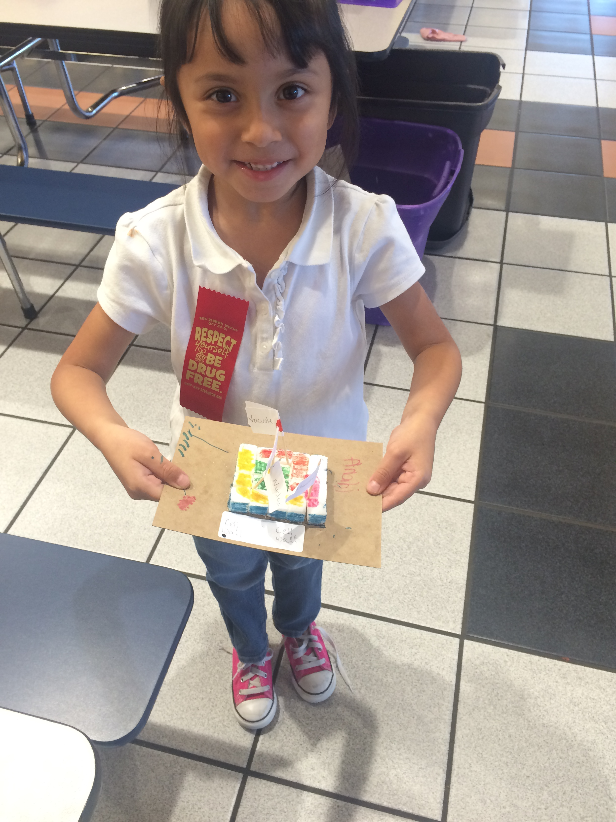
Botany – Sugar Cube Plant Cell

Slide 34
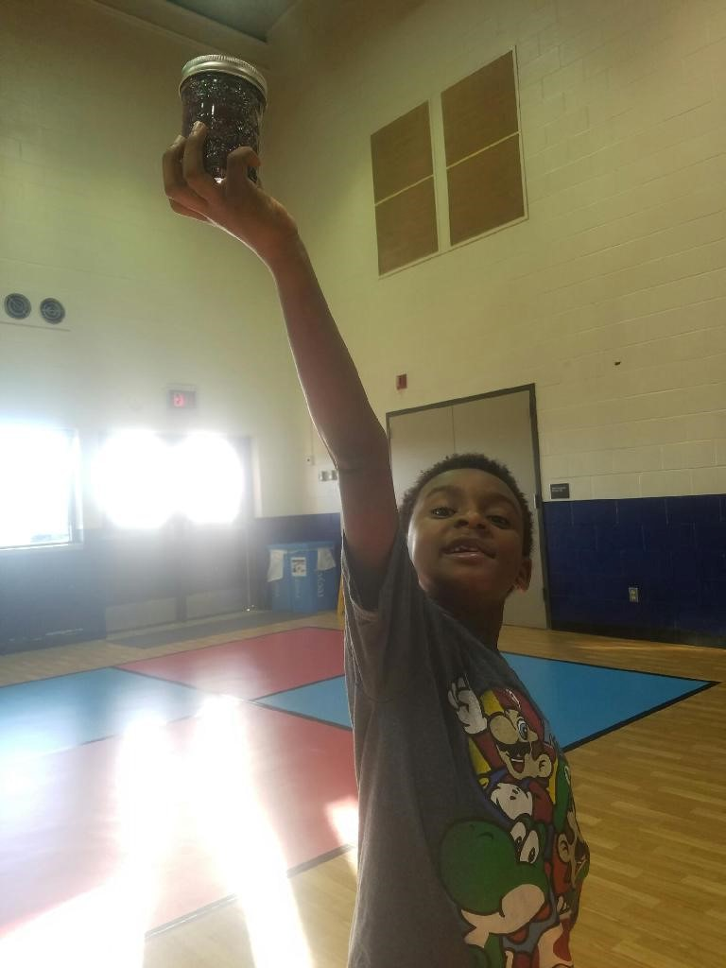
Astronomy – Galaxy in a Jar

Slide 35
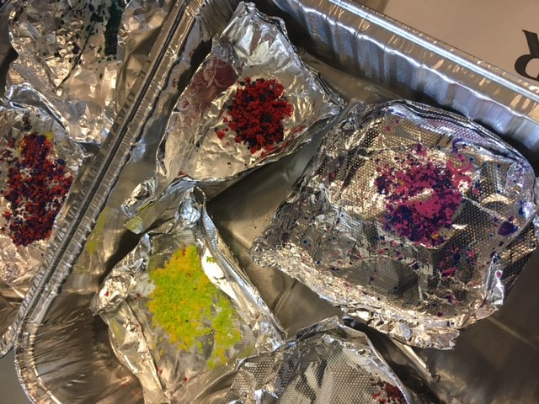
natural gas – crayon rock cycle

Slide 36
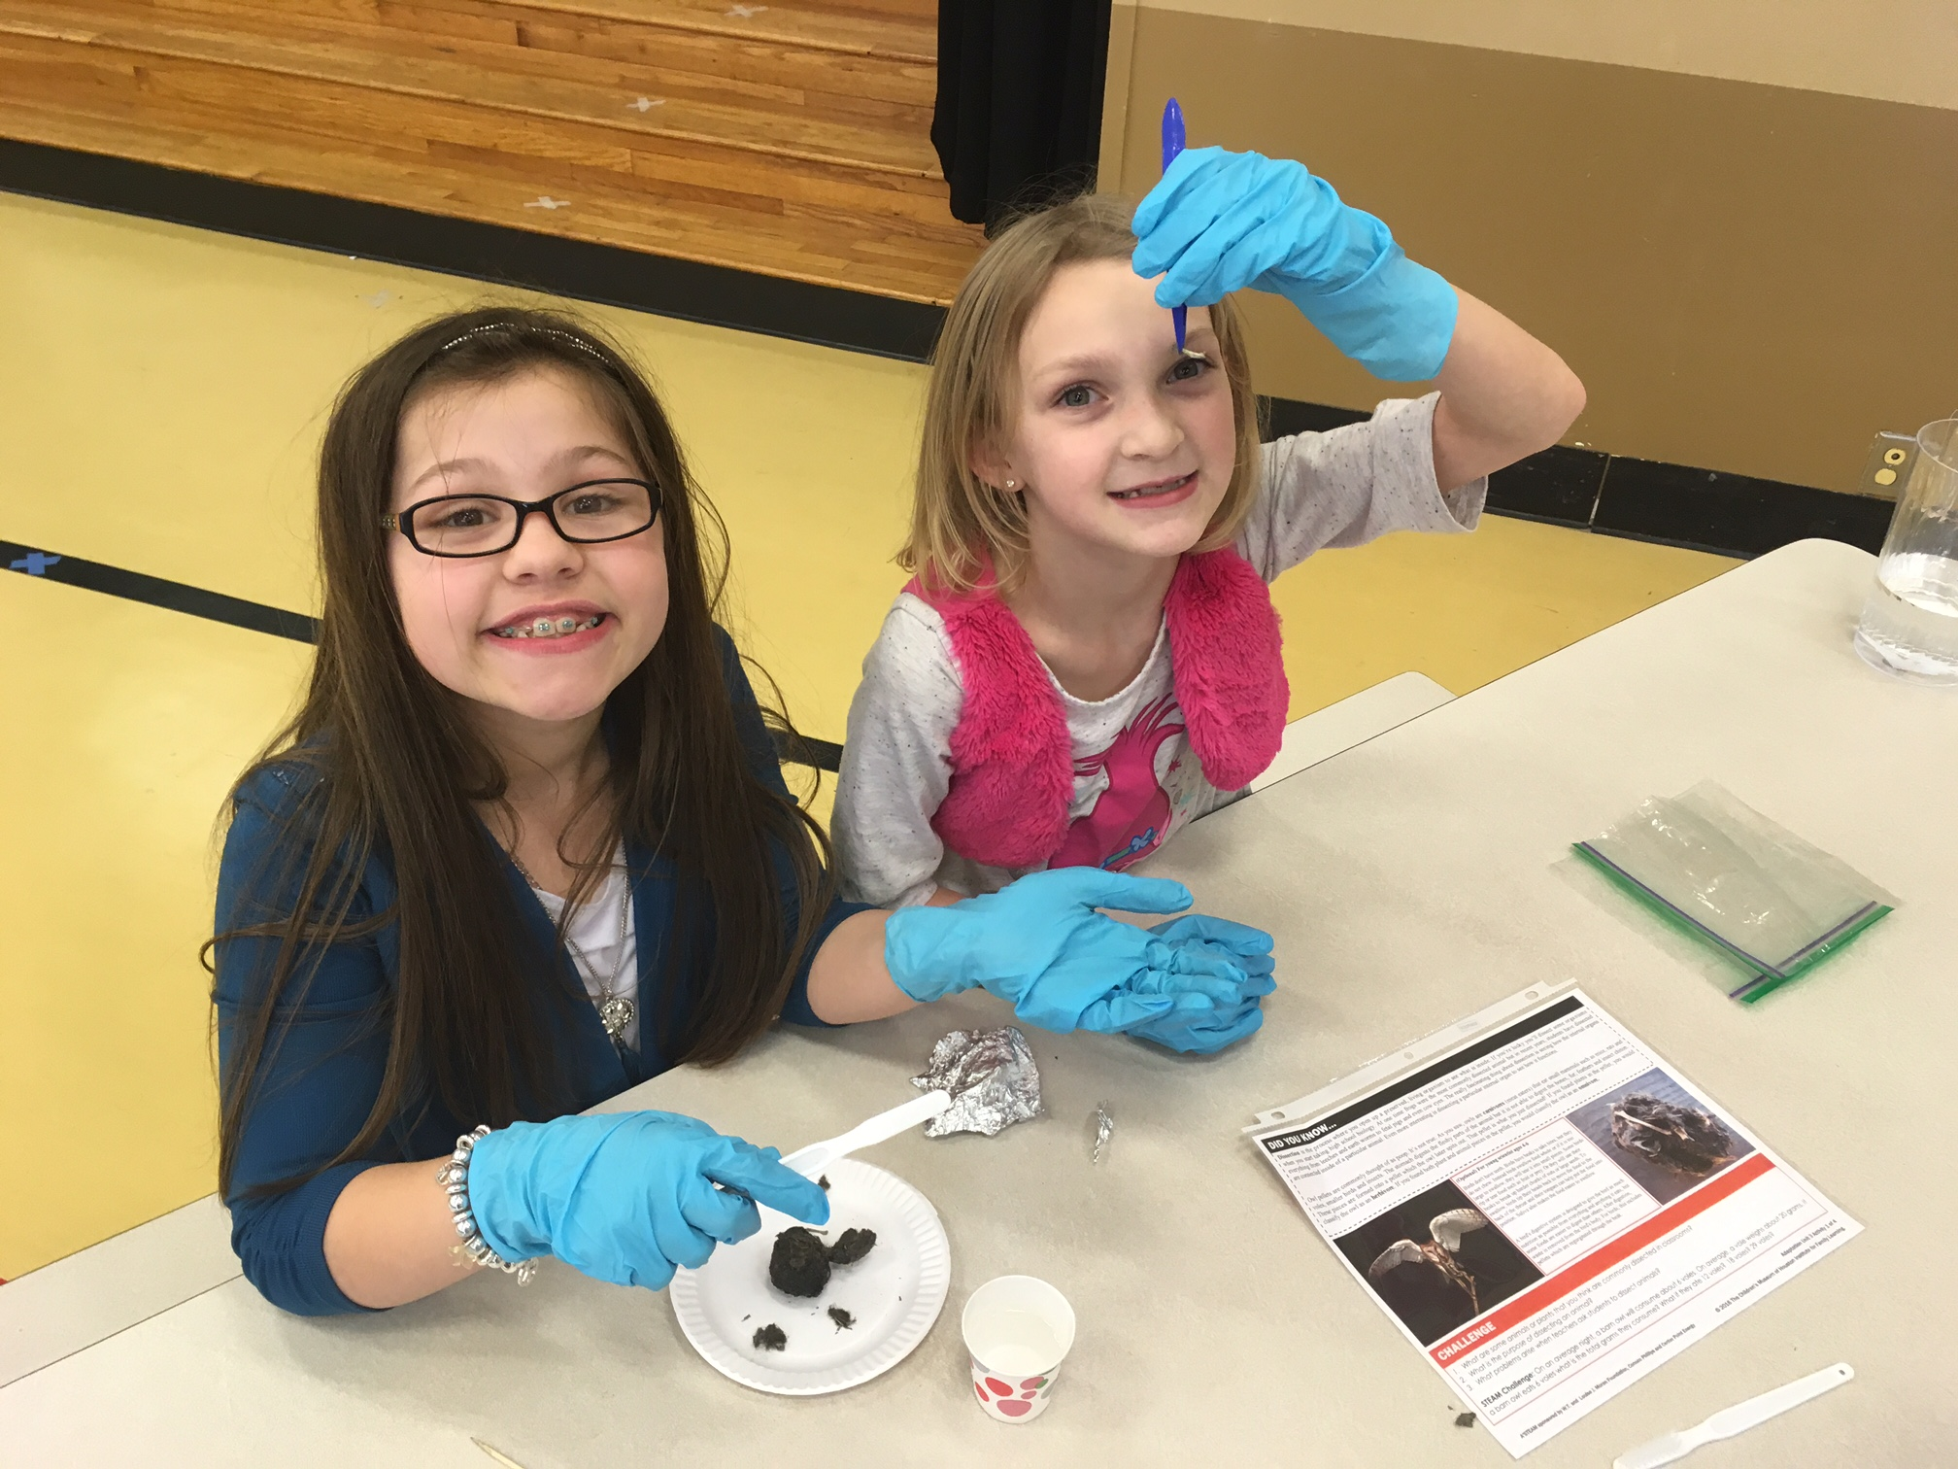
adaptations – Owl Pellets

Slide 37
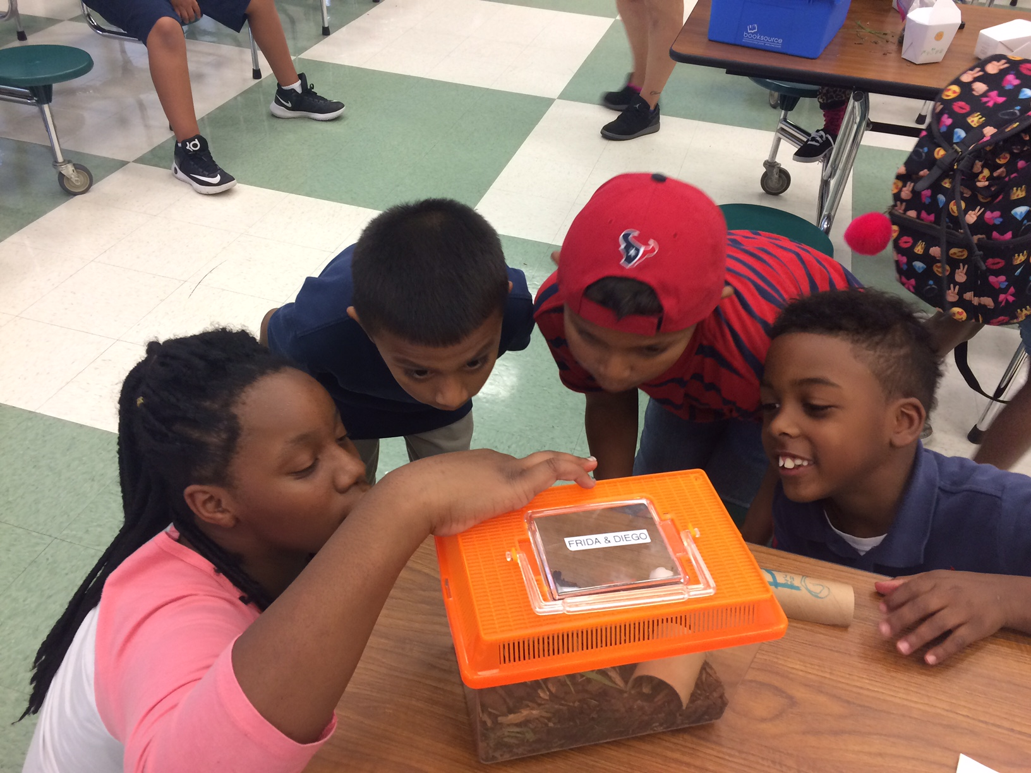
habitats – Roaches

Slide 38
Explore Science—Zoom into Nano

Slide 39
Explore Science kits
Designed for hands-on learning
Adaptable to different settings and learners
Five units, each with several activities
Everything you need is in the kit!
Notes:
The kits focused on hands-on science activities, that were adaptable to different settings and different kinds of learners. The kits include five units. Each unit has several activities that contribute to the overall theme of the unit. Like other NISE Network products, each kit includes everything you need for all the activities, with supplies for about 100 people.
There are five units, which cover these themes:
Introduction to Nano: a nanometer is a billionth of a meter.
Small and Surprising: nano-sized things can behave in surprising ways.
Labs and Tools: nano scientists use special tools and equipment.
Technology and Nature: nano research lets us create new technologies and understand nature.
Nano and Our Lives: nanotechnologies will be part of our lives—now and in the future.

Slide 40
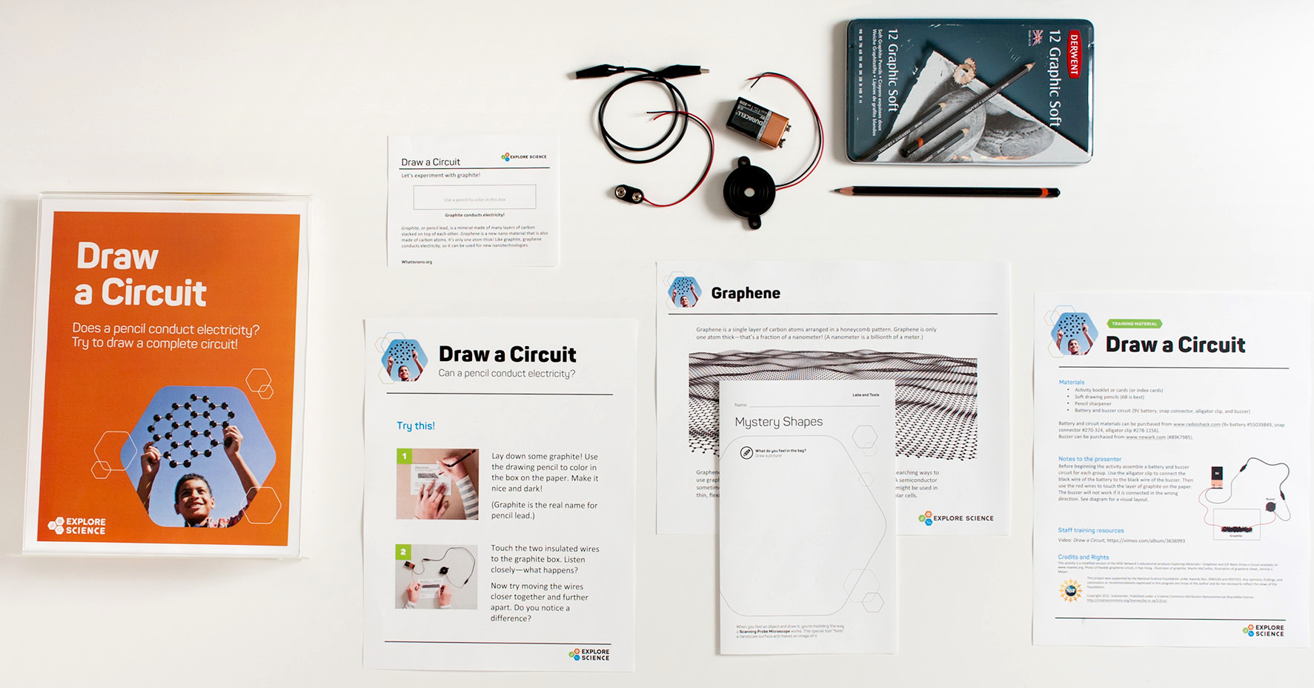
Activity materials
Notes:
There were 16 activities in the Explore Science—Zoom into Nano kit. Here is an example of just one activity, Draw a Circuit. The image shows all the materials needed to do the activity. The physical kits included sets of materials for multiple learner groups.

Slide 41
Planning materials
Notes:
The kit also included some professional development guides and planning materials to support partners using these materials in different settings, in addition to resources specific to establishing and sustaining collaborations which Catherine and Brad will talk more about.
All the materials were created with local adaptation in mind, and designed to be modified for use in other settings, taking advantage of partner knowledge and expertise

Slide 42
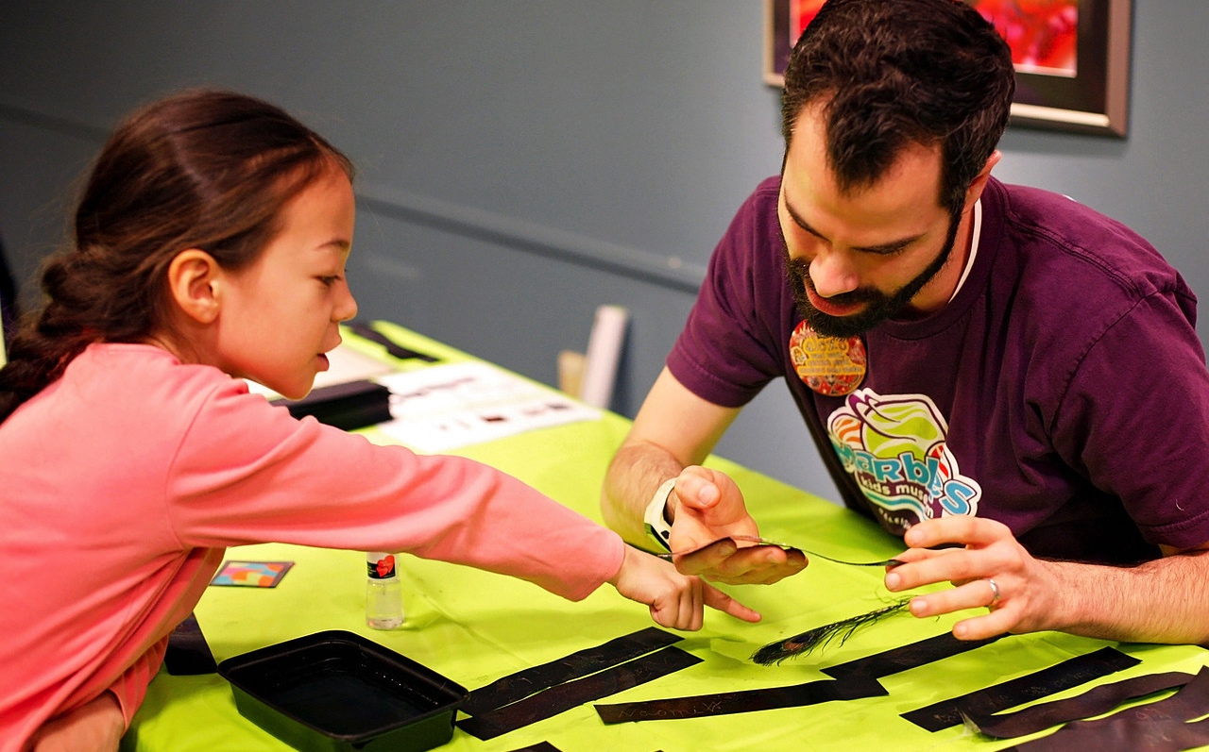
Partner Collaborations
Ali Jackson, ajackson@sciencenter.org
2017 ASTC
Notes:
Example collaboration stories from NISE Network partners around the country to demonstrate how these resources were used and also the incredible creativity and effort of both the network partners and the community organizations.

Slide 43
Arkansas Discovery Network & Berryville Public Library
Museum - Library model
Rural communities
Co-training model
Resources remain at the library
For more information, contact Ginsie Simmons: gsimmons@museumofidscovery.org
Notes:
The Discovery Network is a community of organizations spread through out the state of AK, led by the Museum of Discovery in Little Rock. Their MCP project focused on sharing the museum’s comfort and experience with nano with a regional library in rural, north central Arkansas. Through the collaboration, five towns were served, ranging in population from 291 to just over 5,000. Over 25% of the families in these communities are living in poverty.
For more information, contact Ginsie Simmons at gsimmons@museumofidscovery.org

Slide 44
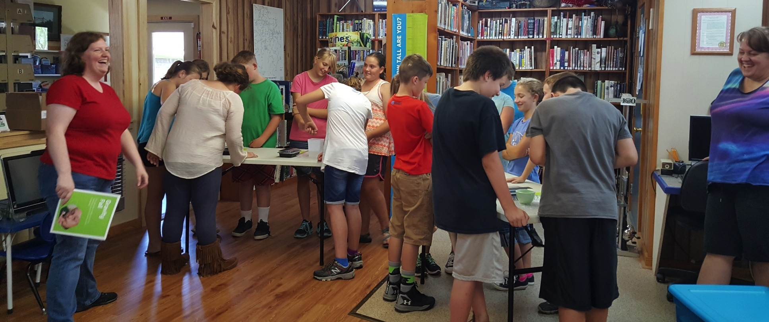

“The kit really represents a bit of a paradigm shift in terms of library programming in our two counties. We know in theory that more and more it will be important for libraries to embrace the promotion of invention literacy/STEM topics along with more traditional forms of literacy. But in small towns it is still easy to say that is for big city libraries with more funding, staff, space, etc. This allowed us to see what we really can do with relatively simple supplies even in the small spaces we have for such programming.” – Director, Berryville Public Library
Notes:
Here’s a quote the director of the Berryville Public Library shared back with the Museum of Discovery about the impact of these resources on their programming. I’ll just read the highlighted portion.

Slide 45
Acton Discovery Museums and Boys & Girls Clubs
Museum – After school model
Bi-weekly museum led programming
Culminating Nano@Night family event at the museum
For more information, contact Elizabeth Leahey: eleahey@discoverymuseums.org
Notes:
Another overall successful and enriching partnership example comes from the Acton Discovery Museums. The MCP project allowed the museum to renew their relationship with two local Boys & Girls Clubs, and serve youth from surrounding communities who might not otherwise be able to experience the museums. Building on previous experience with the Boys & Girls Club of MetroWest and a newer relationship with the Boys & Girls Club of Assabet Valley, Acton delivered nano related programming 2x a week from late April through early June. The series culminated with an invitation to all families from the clubs to attend a nano themed night at he museum as part of the museum's Free Friday Night Fun series.
For questions about The Discovery Museums partnership with these regional Boys & Girls clubs, please contact Elizabeth Leahey: eleahey@discoverymuseums.org

Slide 46
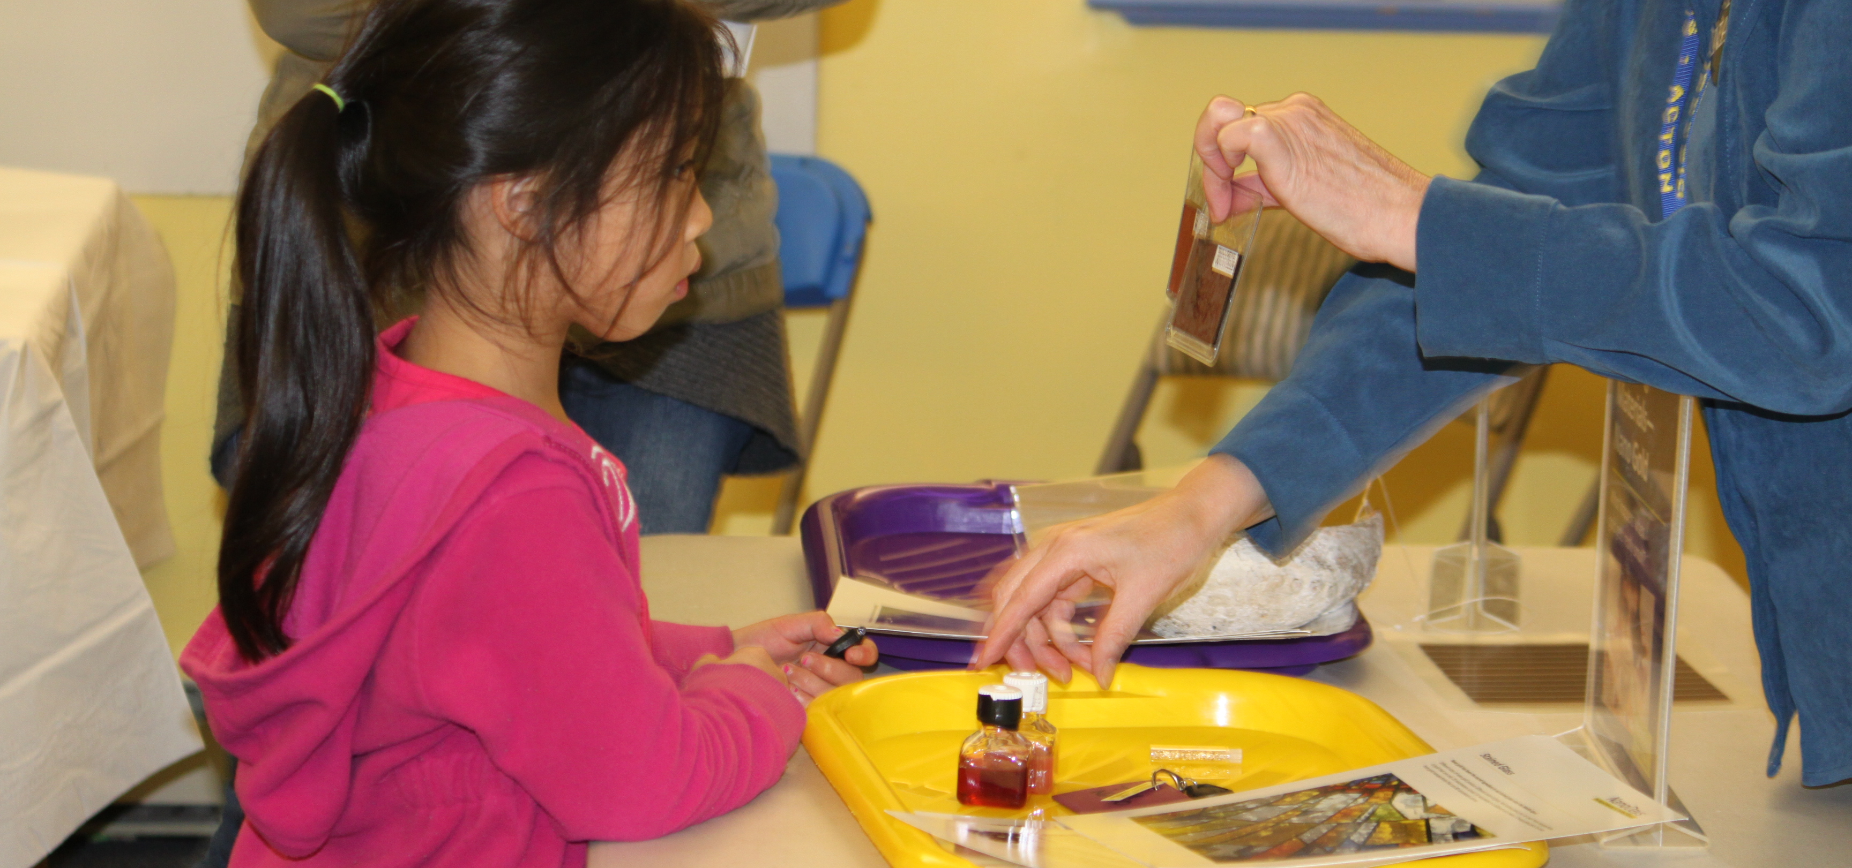
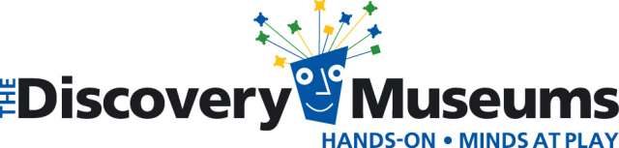
Notes:
Liz shared that overall, having access to this collection of kits made it easier to take nano-based activities outside the museum, which allowed museum staff to serve approximately 150 youth and their families through this initiative.
Liz also shared a nice concrete story of ownership and impact, and how one particular student, a young girl who had attended every session at the Boys & Girls Club of MetroWest, proudly led her family through each of the activities presented that evening, having seen all but one during the afterschool sessions. Before leaving the room, her mother told museum staff that it was the girl’s birthday and that she had eagerly chosen the museum, and the Nano program, as her birthday celebration destination!

Slide 47
Children’s Museum of Indianapolis & STEM Scouts
Museum - Scout model
Co-ed, STEM Club
Events hosted at schools, community groups, or industry partners
STEM career focus
For more information, contact Becky Wolf: beckyw@childrensmuseum.org
Notes:
The Children’s Museum of Indianapolis is the largest children’s museum in the world. For MCP, they partnered with the STEM Scouts in Central Indiana, and relied on the module resources and their partner’s community experience. The Zoom into Nano program was paired with a planned nano module for STEM Scouts that involved multiple departments and staff at the museum. The Museum hosted a family event – families rotated through activities in science lab.
For more information about this partnership, contact Becky Wolf: beckyw@childrensmuseum.org

Slide 48
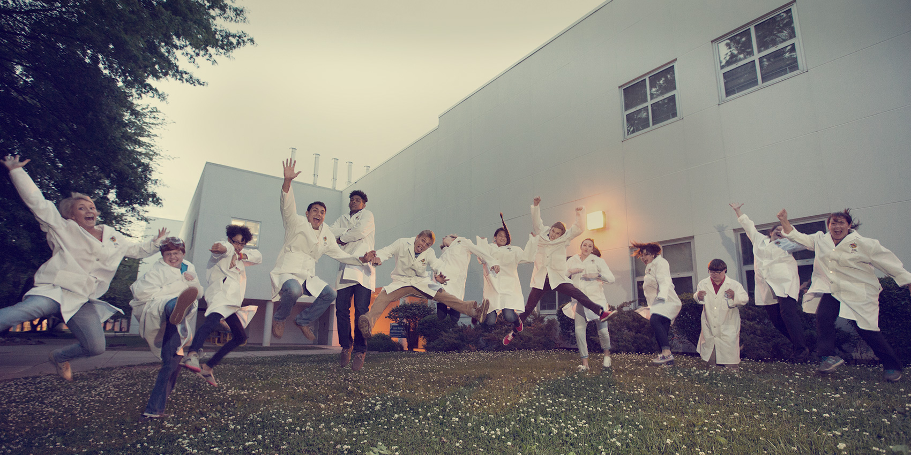


Notes:
Becky has shared some good reminders about possible challenges with community collaborations, including staff changes within partner organizations and the importance of clear communication and set expectations. With this event and partnership, they had to be really open to last minute changes to programming. But they welcomed new families into the museum and strengthen an important partnership with a community STEM organization.

Slide 49
Port Discovery & Babcock Presbyterian Church
Museum – Faith-based partner model
A+ before/ after care
Co-teaching model
For more information, contact Nora Thompson: nthompson@portdiscovery.org
Notes:
The Port Discovery Children’s museum in Baltimore had an established relationship with the Babcock Presbyterian church’s before and after care program, A+, and had previously run NASA’s BEST curriculum through a grant with NASA Goddard. They saw the MCP project as a way to expand that programming. Ran a series call Nano Exposed. The A+ program at the church serves children Kindergarten through 5th grade, students come from two local Title I school. Programs were co-taught by museum staff and afterschool staff.
For more information about this partnership, contact Nora Thompson: nthompson@portdiscovery.org

Slide 50
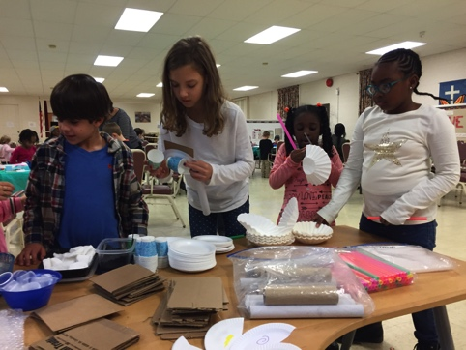
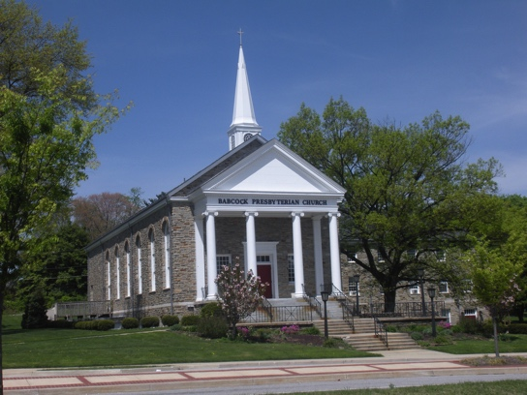
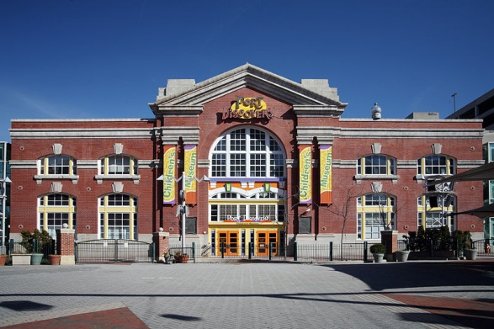
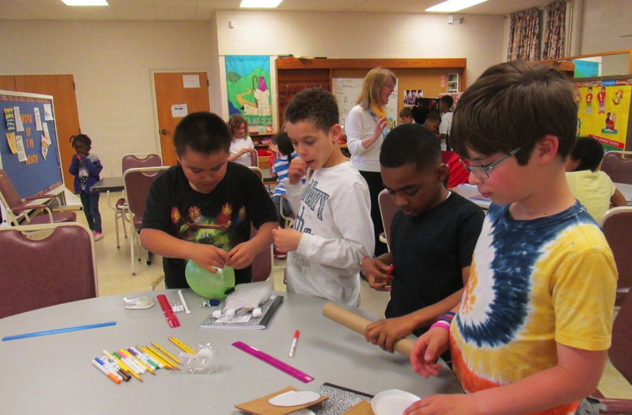
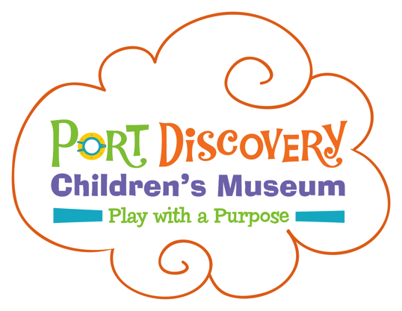
Notes:
One of the things Nora has shared is that the faith-based partners are a real place for growth in our communities. They do not typically receive these types of enrichment programs. Staff was plentiful and very hands-on. And the parents were enthusiastic, supportive, said their kids didn’t want to go home! They would pick up their children later on Port Discovery days so their kids could complete the program. Of course there were challenges, but the museum has learned a lot about working in this community from their partners, and they have taken this experience to successfully develop new grant funded outreach programs with other faith-based organizations and schools. As Nora has shared back with us, this fits her philosophy of community outreach to meet people where they play, pay, and pray.

Slide 51
Sci-Port Discovery Center’s Bars without Barriers
Workforce re-entry facility
Staff led parent class series
Supervised family visits
For more information, contact Alan Brown: abrown@sciport.org
Notes:
Another inspiring example partnership come from the Sci-Port Discovery Center began a joint venture with the Caddo Parish Sheriff's Workforce Re-entry Facility. The re-entry program provides job training and skills, and the museum’s Bars without Barriers program provides training on Informal Science Education techniques and activities both to raise awareness of the importance of STEM education, and to also use the STEM activities and communication skills taught in the classes to help offenders rebuild whatever bonds may have been strained by their years of incarceration.
The partnership involved a series of staff led classes for the offenders, and then the offenders, in turn, lead the hands-on activities for their own children each week during supervised family visits.
For more about Sci-Port Discovery Center's Bars without Barriers program, please contact Alan Brown, Director of Education, at abrown@sciport.org.

Slide 52
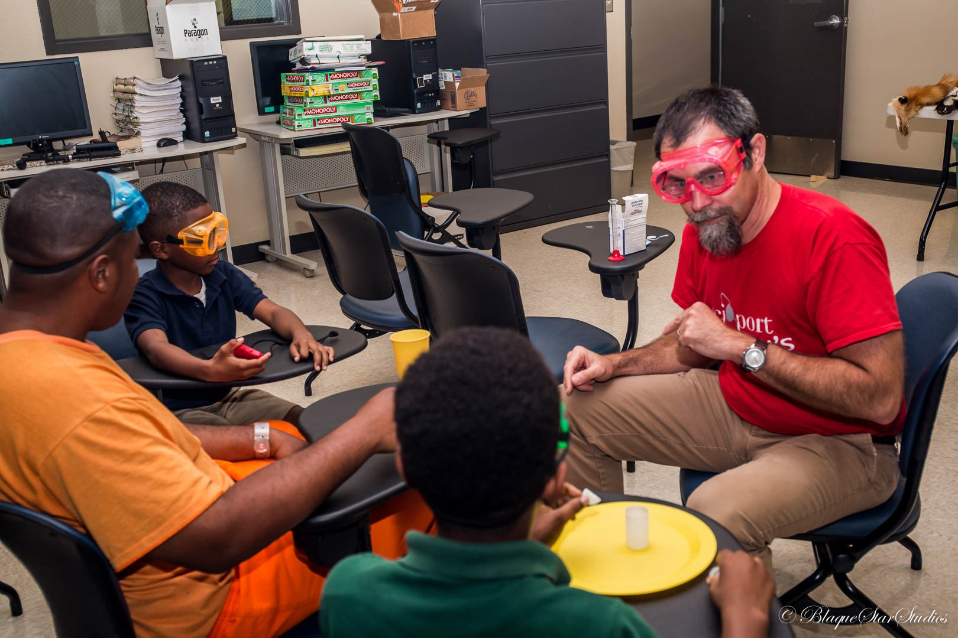
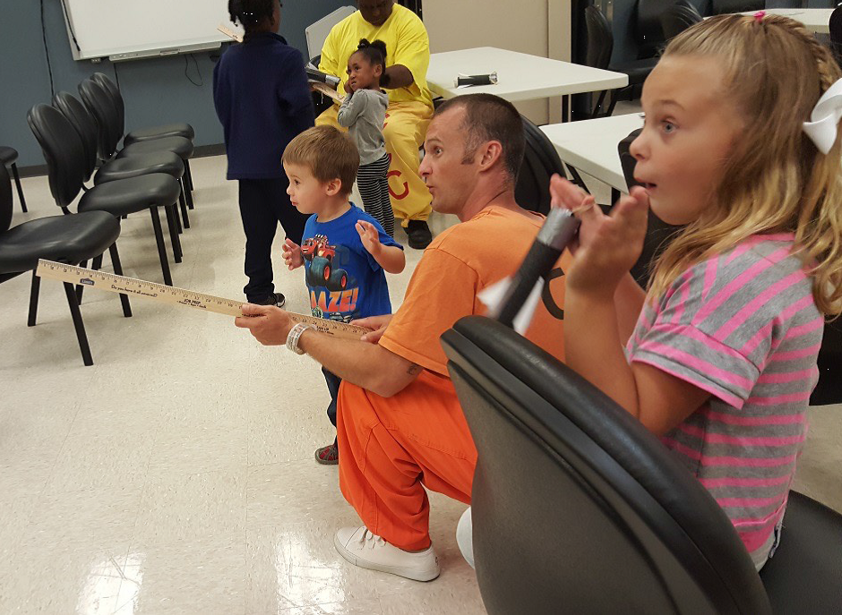

Notes:
Alan shared that that the six week series covers a lot of content. Each week is themed. The Zoom into Nano modules were folded into the theme of Science in the City. While a good time was had by all, observation and a post-visit informal survey revealed that learning did take place. UV Bracelets and Smelly Balloons were, as always, a huge hit, and the two games (I Spy Nano and Power of Tens) both kept the families engaged for extended periods of time.

Slide 53
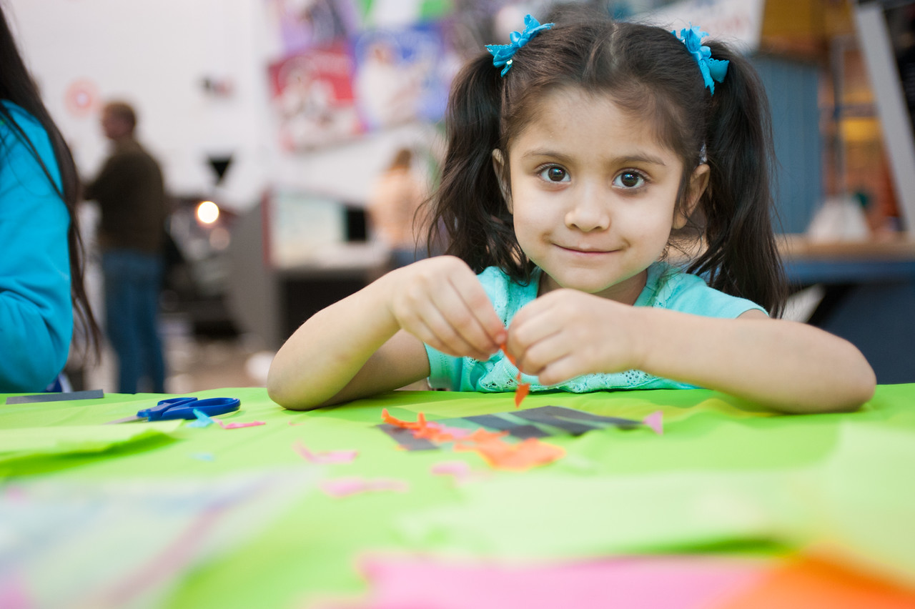
Thank you!

Slide 54
EVALUATION

Slide 55
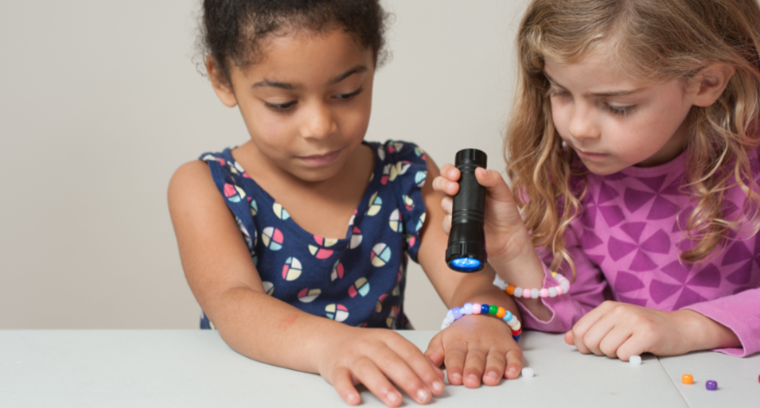

Museum & Community Partnerships Evaluation Findings
2017 ASTC Conference
Elizabeth Kunz Kollmann (ekollmann@mos.org)
Notes:
Hello, my name is Liz Kollmann, and I am the leader of the NISE Net evaluation team.
Today, I want to tell you a bit about the summative evaluation for the Museums and Community Partnership project
Which was led by Katie Todd from the Museum of Science and
Also involved evaluators from the Science Museum of Minnesota and Oregon Museum of Science and Industry
During the presentation, I’ll share some information about
Some of the evaluation questions guiding the evaluation and the methods used to answer them, but
I’ll spend most of my time discussing the results of the evaluation focusing on how the project impacted both professionals and the public participants

Slide 56
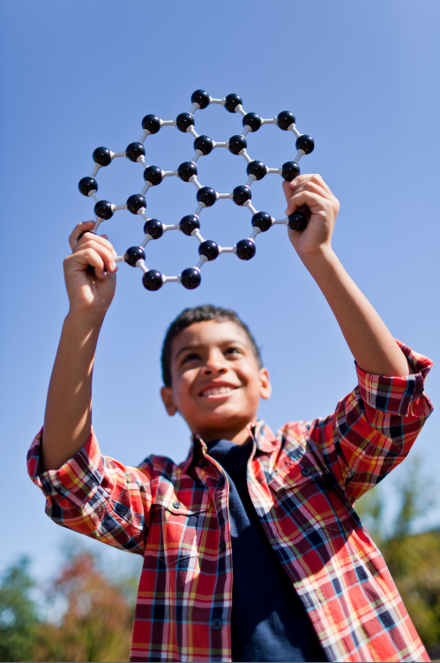
Evaluation questions for professional audiences
To what extent does participation impact the value professionals place on local collaborations among NISE Net partners and community organizations?
To what extent does participation impact professionals’ awareness of theories, methods, and practices for effectively forming partnerships and engaging diverse public audiences in nano?
Notes:
The focus of the evaluation was on understanding the impacts of the project on professionals.
We had a series of evaluation questions focused on the kinds of professional impacts that we were looking for. Among these questions, we were trying to understand:
To what extent does participation impact the value professionals place on local collaborations?
To what extent does participation impact professionals’ awareness of theories, methods, and practices for partnering and engaging diverse audiences?

Slide 57
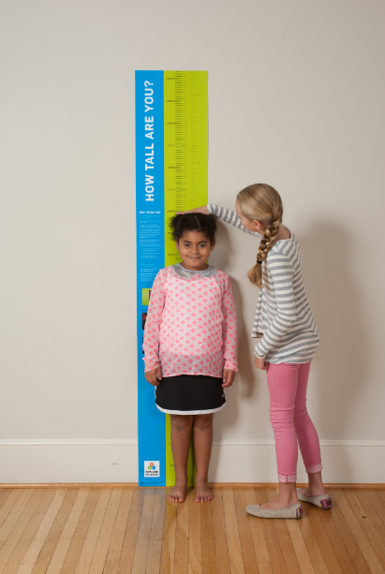
Evaluation questions for public audiences
To what extent does the project reach its target audience of children, youth, and families from demographic groups that are underrepresented in STEM fields?
To what extent do the educational materials facilitate engagement and learning among public participants?
Notes:
We also wanted to gain an understanding of the impacts of the project on public audiences.
However, given the scope and resources of this project, we were not able to gather information directly from the public.
Instead, we asked the professionals to provide insights about the public audiences they were using the kits with
The questions guiding the public side of the evaluation included:
To what extent does the project reach its target audience of underrepresented children, youth, and families?
To what extent do the educational materials facilitate engagement and learning among public participants?

Slide 58
Methods overview
Date | Event
January-February 2016 | Pre-survey coinciding with kit distribution
February-October 2016 | Ongoing data collection from Activity Survey
October 2016 | Post-survey as sites conclude their use of the kit
Notes:
To answer these questions, we:
Sent pre-surveys and post-surveys to the museum applicants, their community partners, and any additional professionals who the main contact said were involved in the project, and
Asked those who facilitated activities to fill out a brief survey right after they led the activities with the public
With these methods, we received 65 matched pre and post surveys and 119 activity surveys
__________________
Pre/post surveys:
Invitations were sent to 170 professionals, including the main museum applicants, their named community partners, and any additional professionals who those main contacts said would be involved in the project.
65 people completed both the pre- and the post-surveys (143 pre-surveys and 111 post-, with not all post-respondents having done the pre-)
67% museum respondents and 33% community organization respondents.
Activity Survey:
This was a very brief online survey that activity facilitators would fill out right after they led the activities.
We got 119 of these surveys.

Slide 59
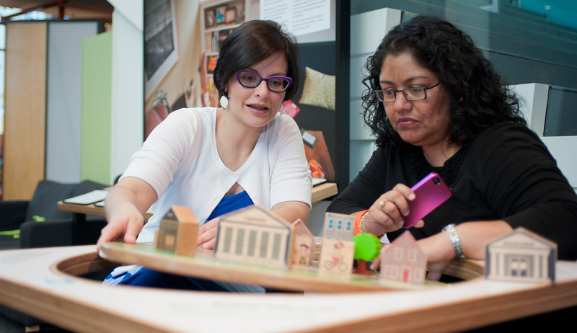
Findings: The value of partnership
Notes:
Responses to the pre and post surveys helped us to understand the impacts of the project on professionals’ feelings about the value of partnering

Slide 60
Professionals benefitted from the project.
Notes:
As shown here, almost all professional respondents felt they benefitted from the project, both as individuals and as representatives of their organizations.
Additionally, almost all participants reported that they were more likely to engage in a museum and community organization collaboration in the future.
________________________
Museum respondents were more likely to mostly or completely agree (100%) they benefitted than community respondents (85%) (𝜒2 (1, n=62) = 6.620, Fischer’s Exact 2-tailed p=0.030)
Other data points not on slide:
94% of post-survey respondents reported they were more likely to engage in future museum/community organization collaboration.
99% of post-survey respondents valued fostering local partnership between museums and community organizations ‘a great deal’ or ‘a lot.’
92% said the project gave them the opportunity to foster local partnership between museums and community organizations.

Slide 61
Professionals valued hands-on activities, reaching underserved audiences, and professional development.
What aspects of the Explore Science—Zoom into Nano project, if any, did you find most valuable? (n=56)
Hands-on activities (54%)
Working with underserved audiences (29%)
The professional development (29%)
“I think being able to reach children that don't normally have the opportunity to explore and experience science in such a hands-on fashion is great for all involved - the children, the community, myself, and even my students!”
“Having access to the provided teaching/training materials allowed me to deepen my understanding of the Science behind the activities.”
“It is extremely valuable for me to have a ready to go tabletop activity that can be used for outreach, camps, professional development, quick demos, etc. It all looks (and is) professional and attractive and comes with not only materials but signage and everything needed to explain it all.”
Notes:
When we asked an open-ended question about what about the project was most valuable, respondents most commonly mentioned:
The hands-on activities, like this person who says having ready-to-go activities is valuable
Working with underserved audiences, like this person who says the materials were valuable because they worked for a diversity of audiences, and
The professional development, like this person who said the materials deepened their understanding of the science.
___________________________________
The hands-on activities, like this person who says having ready-to-go activities is valuable
The second most common theme was the value of working with underserved audiences, like this person who says lots of people benefit from this work
The third most common theme was that professional development was valuable, like this person who said they helped deepen an understanding of the science.
(In a similar close-ended question, 56% said they benefitted from receiving educational materials, 50% said they benefitted from the partnership, and 47% benefitted by learning from the project and reaching a new audience. Museums were more likely to say they benefitted from the materials and reaching a new audience, and community organizations were more likely to say they benefitted by learning from the project.)

Slide 62
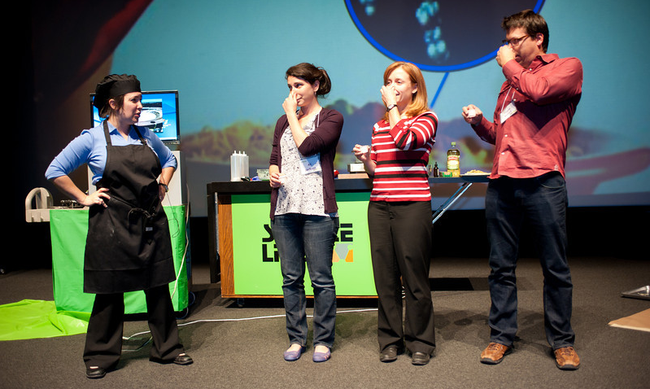
Findings: Awareness of Practices
Notes:
We also asked questions to understand how participation in the project impacted professional participants’ awareness of practices related to forming partnerships and engaging underrepresented audiences

Slide 63
Respondents had high levels of confidence with project practices.
Notes:
This slide shows that there was high confidence in each of the six project practices that we asked about after the project, including engaging girls and underserved audiences, deepening and initiating partnerships, engaging the public in nano, and engaging Spanish-speaking audiences.
While confidence for engaging Spanish-speaking audiences is the lowest at the end of the project, it was the only item for which there was a statistically significant improvement in confidence between pre- and post- surveys.
Indicating that the Museum and Community Partnership project had the greatest impact in this area
Wilcoxon Signed Ranks Test (n=26, Z= -2.804, p=0.005)
__________________________
(More than one-third engaged in each practice (no differences C vs. M):
Engage underrepresented children or families (91%)
Engage girls (86%)
Engage the public in nano (81%)
Deepen an existing partnership (66%)
Initiate a new partnership (47%)
Engage Spanish-speaking audiences (35%)
When doing the practices, people used project materials.
Deepen an existing partnership (98%)
Engage the public in nano (96%)
Engage girls (95%)
Engage underrepresented children or families (93%)
Initiate a new partnership (88%)
Engage Spanish-speaking audiences (88%)
When NOT doing the practices, people knew about project materials.
Engage underrepresented children or families (100%)
Engage girls (100%)
Initiate a new partnership (87%)
Deepen an existing partnership (85%)
Engage the public in nano (83%)
Engage Spanish-speaking audiences (76%) (C’s knew less than Ms)
Some professionals used project materials for non-nano content.
Engage underrepresented children or families (69%)
Deepen an existing partnership (60%)
Initiate a new partnership (47%)
Engage Spanish-speaking audiences (34%) )

Slide 64

Findings: Public reach
Notes:
As I mentioned earlier, we didn’t do any surveys or direct data collection with the participants, but we did ask the professionals involved in the partnerships to tell us about the experiences of the public.

Slide 65
Most community organizations reported reaching low-income, female, minority, and rural participants.
Notes:
We asked the community organization respondents which underserved audiences the kit were used with
These data indicate that the kit was used with a variety of public audiences although most commonly institutions reported that they used the kit with:
Low income audiences,
Female audiences,
Racial or ethnic minority audiences, including individuals who are Hispanic and Latino, and
Rural audiences
___________________________
whether the kits had been used to reach a range of underserved audiences.
21 community partners responded to this question on the post survey. This is NOT how many of their participants fell into this category, but rather, how often at least one person in these demographics was reached by the organization.
Other included three responses (in case people ask): International children, Asian, and “I don’t keep those stats.”
Based on kit recipients’ estimates, we found that the 100 partnerships reached about 36,500 people, with a median of 365 people per kit.

Slide 66
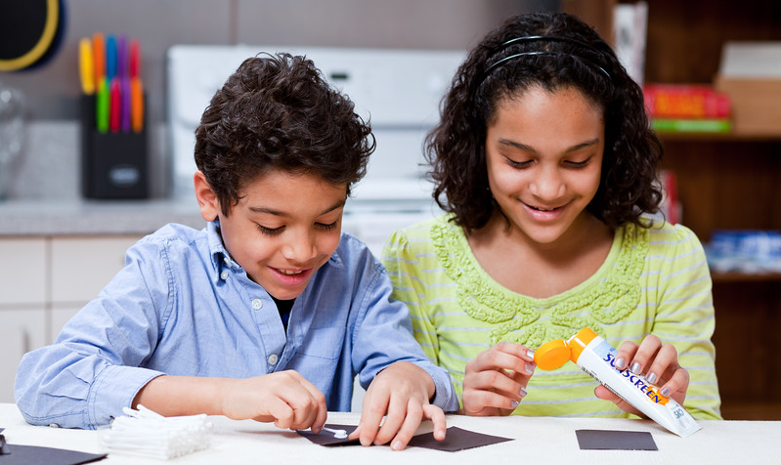
Findings: Public engagement & learning
Notes:
Finally, asked professionals to indicate whether they thought the kit activities were educational and engaging for their public audiences.

Slide 67
Most respondents felt the activities were engaging, educational, and relevant.
Overall, how ENGAGING
do you think today’s
activities were for
participants? (n=118)
Notes:
Professionals reported that overall the activities were engaging, educational, and relevant for their audiences.
However, they were most likely to think the activities were engaging for their audiences with 91% reporting that the activities were engaging or very engaging
Fewer professionals, at 85% felt that their public audiences learned from the activities, and
Even fewer at 68% said that the activities were relevant or very relevant for their audiences.
__________________
…in that order.
Community organization respondents gave higher ratings for engagement and relevance.

Slide 68
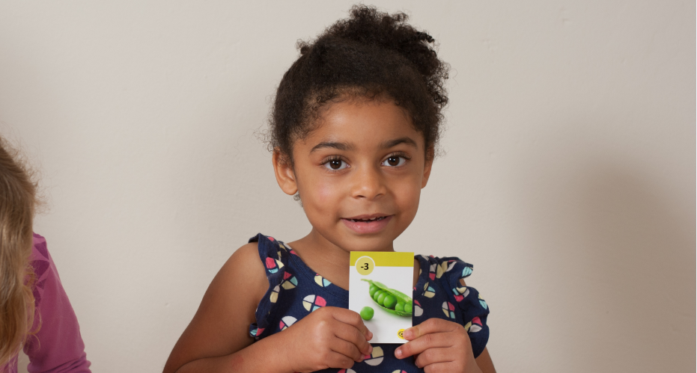

Thank you!
Cynthia Needham, ICAN Productions
This presentation is based on work supported by the National Science Foundation under Grant No. 0940143. Any opinions, findings, and conclusions or recommendations expressed in this presentation are those of the authors and do not necessarily reflect the views of the Foundation.

Slide 69
RESOURCES

Slide 70

Collaboration Tools & Resources

Slide 71
Collaboration Guide

Slide 72

Collaboration Tips
1. Why collaborate? To achieve something you can’t do on your own!
2. Be patient! Collaborations take time.
3. Be clear about your goals and expectations.
4. Get to know each other. Each partner has a lot to offer.
5. Communication is critical.
6. Stay focused on your goals. And don’t forget to celebrate your successes!

Slide 73

Text for contacting potential partners
Friendly invitation to discuss possibilities
Sets the stage to discuss roles and responsibilities

Slide 74

Memorandum of Understanding

Slide 75

Profiles of Youth Serving Organizations
1. 4-H
2. Afterschool Alliance
3. Boys & Girls Clubs of America
4. Boy Scouts of America
5. Girls Inc.
6. Girl Scouts
7. Libraries
8. National Girls Collaborative Project
9. Parent Teacher Association (PTA)
10. Y (YMCA)
11. YWCA
Notes:
Each of these profiles has the following sections: About – Audience and Geographic Reach – Website – finding a local partner – STEM Focus and Resources – Tips for collaborations
The profiles of national youth-serving organizations have been compiled to assist museums and university outreach programs in developing partnerships with a community organization or a local chapter of a national youth-serving organization. These profiles are intended to provide a brief introduction to each organization.

Slide 76

Annotated Bibliography
Notes:
Collaborations – General; Collaborations and Collective Impact; Museum – Community Collaborations; Museum – Museum Collaborations, Libraries, Scientists, Schools, Consultants etc…

Slide 77

Video: Creating Successful Collaborations:
Museum and Community Partnerships
  Available at: https://vimeo.com/139256428

Slide 78
Q&A
DISCUSSION

Slide 79

Questions?

Slide 80
Discussion
What collaboration challenges have you experienced?
What strategies did you use to work through them?
For example:
Identifying the right partnership, right now
Dealing with changes in personnel
Addressing changing organizational priorities (on either side)
Fostering organizational buy-in

Slide 81
More discussion questions
How can you ensure the project aligns with both organizations’ missions?
What can you do to be sure your partnership starts off on the right foot?
How do you design a program together to fit the needs of new audiences?
How can you design your program to grow?
How do you set goals and evaluate your success?
How can you use national resources and organizations to further a local partnership?

Slide 82
Thank you
The Nanoscale Informal Science Education Network was supported by the National Science Foundation under award numbers 0532536 and 0940143. Any opinions, findings, and conclusions or recommendations expressed in this presentation are those of the authors and do not necessarily reflect the views of the Foundation.

